Slide 1
Alternative development approaches
AS 1: APPROACHES TO SYSTEMS DEVELOPMENT · TOPIC
Lessons in this topic
AP10 The waterfall model, iterative and spiral development
AP11 Prototyping, RAD and Agile methods

Slide 2

Topic menu
Tap a button to jump straight there. The ☰ Menu button on every slide brings you back here.
Specification map
AP11 Prototyping, RAD and Agile methods
AP10 The waterfall model, iterative and spiral development

Slide 3
Specification map
Lesson | Specification: students should be able to
AP10 | Describe the main features of the waterfall model of systems development; Describe each stage of the waterfall model and the deliverable it produces; Describe the involvement of users when a system is developed using the waterfall model; Describe iterative development and the spiral model, including the role of risk analysis; Evaluate the waterfall model, including its advantages and disadvantages, and its suitability for different projects
AP11 | Describe prototyping, including throwaway and evolutionary prototyping; Describe the main features and phases of Rapid Application Development (RAD), including user involvement; Describe the main features of the Agile approach, including product and release backlogs, sprints, the Scrum team, daily Scrums and burn down charts; Describe extreme programming (XP) practices such as pair programming and test-driven development; Evaluate the waterfall model, RAD and Agile and recommend an approach for a given project
☰ Menu
Notes:
Each lesson below is its own section in PowerPoint (View → Slide Sorter shows them). To split this deck by specification point, right-click a section → Move Section, or delete the sections you do not need.

Slide 4
The waterfall model, iterative and spiral development
AS 1: APPROACHES TO SYSTEMS DEVELOPMENT · AP10
Learning objectives
Describe the five stages of the waterfall model and the deliverable from each
Explain when users are involved in a waterfall project and why that matters
Evaluate the advantages and disadvantages of the waterfall model
Describe iterative development and the four quadrants of the spiral model
Recommend a suitable development model for a given project and justify the choice
Notes:
Specification: Describe the main features of the waterfall model of systems development | Describe each stage of the waterfall model and the deliverable it produces | Describe the involvement of users when a system is developed using the waterfall model | Describe iterative development and the spiral model, including the role of risk analysis | Evaluate the waterfall model, including its advantages and disadvantages, and its suitability for different projects

Slide 5
In this lesson
Tap a button to jump straight there. The ☰ Menu button on every slide brings you back here.
The big picture
Advantages of the waterfall model
The spiral model (Boehm)
Why there is more than one approach
Disadvantages of the waterfall model
Spiral model: strengths and weaknesses
The waterfall model: main features
Worked example: a missed requirement
Choosing a model
Stages and deliverables
Making the waterfall model work
Exit quiz
Where the user fits in
Iterative development
↑ Topic menu
Notes:
Lesson menu: each button jumps to that part of the lesson in Slide Show. The ☰ Menu button on each slide returns here.

Slide 6
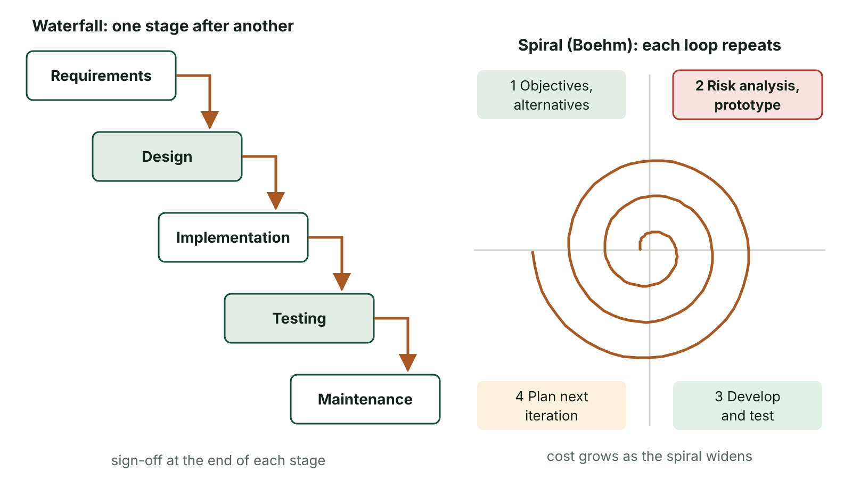
The big picture
The waterfall model as a cascade of sequential stages beside the spiral model with its four quadrants and risk analysis in every loop
☰ Menu
Notes:
Explain the diagram in your own words before you read on.

Slide 7
Why there is more than one approach
A development methodology is a structured way of getting from an identified need to a working, installed system
No single methodology is perfect: each has strengths that suit some projects and weaknesses that rule it out for others
Approaches differ in how strictly stages are ordered, how often users are involved and how easily requirements can change
This lesson: the traditional waterfall model, plus iterative development and the risk-driven spiral model
Next lesson: Rapid Application Development (RAD), prototyping and Agile (Scrum and XP)
☰ Menu

Slide 8
The waterfall model: main features
The classic, traditional model, widely described from the 1970s onwards
A sequence of distinct stages: requirements (analysis), design, implementation, testing, maintenance
Each stage must be completed and verified (signed off) before the next stage begins
Each stage ends with a deliverable that becomes the input to the next stage – work ‘flows down’ like a waterfall
If an error is found later, an earlier stage may have to be revisited, which is slow and expensive
☰ Menu

Slide 9
Stages and deliverables (1 of 2)
Stage | What happens | Deliverable
Requirements (analysis) | Analyst uses fact-finding (interviews, questionnaires, observation, document inspection) to establish complete user requirements | System specification: clear, unambiguous, complete requirements
Design | Processes, inputs and outputs, software units and how they interact, user interfaces and hardware needs are designed | Design document precise enough to code from
Implementation | A team of programmers writes the code, each given specific tasks, working to the design document | Program code (with unit testing as it is written)
Testing (verification) | The whole system is tested against the specification using a test plan | Tested system and test results
☰ Menu

Slide 10
Stages and deliverables (2 of 2)
Stage | What happens | Deliverable
Maintenance | Installation, data migration from any old system, support, then corrections and improvements over time | Working system kept in use and updated
☰ Menu

Slide 11
Where the user fits in
Users are mainly involved at the start, when the analyst gathers their requirements
They return near the end, for acceptance testing to check the system works as they intended
Between these points the users usually see nothing working
So any misunderstanding about what the user wanted may not be noticed until testing – when it is costly to fix
If no current system exists, users’ stated requirements are the analyst’s main source of information
☰ Menu

Slide 12
Advantages of the waterfall model
Distinct stages give clear milestones, so progress is easy to measure and manage
Each deliverable can be formally signed off, and the client can be invoiced stage by stage
Thorough documentation is produced, which helps later maintenance and new staff
Specialist staff can work on the same stage across many projects (e.g. analysts move to the next project’s analysis)
Costs and timescales are easier to estimate when requirements are stable and well understood
☰ Menu

Slide 13
Disadvantages of the waterfall model
Inflexible: changing requirements once a stage is signed off means going back up the waterfall
Each handover between stages is a point where misunderstandings can enter and travel a long way undetected
Errors made in requirements are often found only at testing, when they are most expensive to correct
Users wait a long time to see working software, and receive no benefit until the end
Staff who specialise in one stage have narrower skills and are harder to move between tasks than multi-skilled Agile teams
☰ Menu

Slide 14
Worked example: a missed requirement
Stage | What happens in a Derry leisure centre booking project
Requirements | Analyst records adult and junior prices; nobody mentions the council’s free sessions for over-65s
Design | Price table and payment screens are designed with only two ticket types – signed off
Implementation | Programmers build exactly what the design says; the code is correct to the design
Testing | During acceptance testing, reception staff try to book a free over-65 swim – impossible
Result | Specification, database design, screens, code and test plan must all be revisited: weeks of rework
Lesson | An error introduced at the first handover cost far more to fix because it was found four stages later
☰ Menu

Slide 15
Making the waterfall model work
Consult every group of stakeholders during requirements, not just managers – the people who will use the system daily
Get each deliverable formally signed off before moving on, and do not change it informally afterwards
Use change control: any agreed change is recorded, costed and tracked through all later stages
Carry out quality assurance during implementation, e.g. code reviews and unit testing
Write the test plan from the specification so the system can be verified against what was agreed
☰ Menu

Slide 16
Iterative development
The system is built through repeated cycles (iterations) of planning, analysis, design, coding and testing
Each iteration produces a working version or increment that users can review
User feedback from one iteration shapes the requirements for the next
Misunderstandings surface early, and some useful functionality can be delivered before the whole system is finished
Needs good communication with users and careful control so the scope does not keep growing each cycle
☰ Menu

Slide 17
The spiral model (Boehm)
A risk-driven iterative model proposed by Barry Boehm in the 1980s; each loop of the spiral is one iteration
Quadrant 1: determine the objectives, alternatives and constraints for this loop
Quadrant 2: evaluate alternatives, identify and resolve risks – risk analysis, often by building a prototype
Quadrant 3: develop and test the next level of the product
Quadrant 4: review with the client and plan the next iteration; the spiral widens as cost and detail grow
☰ Menu

Slide 18
Spiral model: strengths and weaknesses
Strengths | Weaknesses
High-risk issues are identified and tackled early, before large sums are spent | Risk analysis needs specialist expertise and adds cost
Requirements can be refined on every loop | Can be hard to manage and to know when to stop looping
Users see prototypes and give regular feedback | Too costly and complex for small, low-risk projects
Suits large, complex, high-risk or novel systems | Success depends heavily on the quality of the risk analysis
☰ Menu

Slide 19
Choosing a model
Project | Suitable model | Why
Software for a medical device that must meet fixed regulations | Waterfall | Stable requirements; full documentation and formal sign-off are required
A new emergency-call dispatch system for a whole region | Spiral | Large, complex and safety-related; risks must be analysed repeatedly
A new customer app for a start-up with unclear needs | Iterative / Agile | Requirements will change; early feedback is essential
Payroll update for a known change in tax rules | Waterfall | Small, well understood, fixed deadline
Online timetabling tool for a group of NI schools | Iterative | Core needs known, but details improve with teacher feedback
☰ Menu

Slide 20
Exit quiz: question 1 of 9
Tap an answer to check it. Presenting? Click to reveal the answer.
Which statement best describes the waterfall model?
A Stages repeat in short cycles with constant user feedback
B A prototype is refined until it becomes the final system
✗
✗
C Distinct stages are completed in sequence, each signed off before the next begins
D The team works in fixed-length sprints from a product backlog
✓
✗
✓ C: Distinct stages are completed in sequence, each signed off before the next begins – Waterfall is sequential: each stage produces a deliverable and is completed before the next starts.
☰ Menu

Slide 21
Exit quiz: question 2 of 9
Tap an answer to check it. Presenting? Click to reveal the answer.
During which two stages are users mainly involved in a waterfall project?
A Requirements and acceptance testing
B Design and implementation
✓
✗
C Implementation and maintenance
D Design and testing
✗
✗
✓ A: Requirements and acceptance testing – Users give their requirements at the start and test the finished system near the end; between these they see little.
☰ Menu

Slide 22
Exit quiz: question 3 of 9
Tap an answer to check it. Presenting? Click to reveal the answer.
What is the deliverable of the design stage?
A The system specification
B The test results
✗
✗
C A design document
D The product backlog
✓
✗
✓ C: A design document – The design document describes processes, data, interfaces and hardware precisely enough to code from.
☰ Menu

Slide 23
Exit quiz: question 4 of 9
Tap an answer to check it. Presenting? Click to reveal the answer.
Why are errors in the requirements stage so costly in the waterfall model?
A Programmers refuse to change code
B They may not be found until testing, after design and code are built on them
✗
✓
C Requirements are never documented
D Testing is skipped in waterfall
✗
✗
✓ B: They may not be found until testing, after design and code are built on them – The error flows down through design and code, so much more work has to be redone.
☰ Menu

Slide 24
Exit quiz: question 5 of 9
Tap an answer to check it. Presenting? Click to reveal the answer.
The distinctive feature of the spiral model is…
A no documentation
B pair programming
✗
✗
C direct changeover
D risk analysis in every loop
✗
✓
✓ D: risk analysis in every loop – Boehm’s model is risk-driven: risks are identified and resolved in each loop.
☰ Menu

Slide 25
Exit quiz: question 6 of 9
Tap an answer to check it. Presenting? Click to reveal the answer.
Which project is best suited to the waterfall model?
A A start-up app with unclear needs
B A payroll change for a known new tax rule
✗
✓
C An experimental game with changing features
D A new product where users want weekly releases
✗
✗
✓ B: A payroll change for a known new tax rule – Small, well-understood projects with stable requirements suit a sequential approach.
☰ Menu

Slide 26
Exit quiz: question 7 of 9
Tap an answer to check it. Presenting? Click to reveal the answer.
Each repeated cycle in iterative development is called…
A a milestone
B a deliverable
✗
✗
C an iteration
D a handover
✓
✗
✓ C: an iteration – Each iteration produces a version that users can review.
☰ Menu

Slide 27
Exit quiz: question 8 of 9
Tap an answer to check it. Presenting? Click to reveal the answer.
Which is an advantage of the waterfall model?
A Clear milestones allow the client to be invoiced stage by stage
B Requirements can change easily at any point
✓
✗
C Users see working software from the first week
D No documentation is needed
✗
✗
✓ A: Clear milestones allow the client to be invoiced stage by stage – Distinct, signed-off stages make progress and payment easy to manage.
☰ Menu

Slide 28
Exit quiz: question 9 of 9
Tap an answer to check it. Presenting? Click to reveal the answer.
A disadvantage of the spiral model is that it…
A cannot handle risk
B has no user involvement
✗
✗
C never uses prototypes
D can be expensive and needs risk-analysis expertise
✗
✓
✓ D: can be expensive and needs risk-analysis expertise – Repeated risk analysis adds cost and requires skilled staff.
☰ Menu

Slide 29
Exit quiz answers
Q | Answer | Why
1 | C Distinct stages are completed in sequence, each signed off before the next begins | Waterfall is sequential: each stage produces a deliverable and is completed before the next starts.
2 | A Requirements and acceptance testing | Users give their requirements at the start and test the finished system near the end; between these they see little.
3 | C A design document | The design document describes processes, data, interfaces and hardware precisely enough to code from.
4 | B They may not be found until testing, after design and code are built on them | The error flows down through design and code, so much more work has to be redone.
5 | D risk analysis in every loop | Boehm’s model is risk-driven: risks are identified and resolved in each loop.
6 | B A payroll change for a known new tax rule | Small, well-understood projects with stable requirements suit a sequential approach.
7 | C an iteration | Each iteration produces a version that users can review.
8 | A Clear milestones allow the client to be invoiced stage by stage | Distinct, signed-off stages make progress and payment easy to manage.
9 | D can be expensive and needs risk-analysis expertise | Repeated risk analysis adds cost and requires skilled staff.
☰ Menu

Slide 30
Prototyping, RAD and Agile methods
AS 1: APPROACHES TO SYSTEMS DEVELOPMENT · AP11
Learning objectives
Compare throwaway and evolutionary prototyping
Describe the four phases of RAD and explain how timeboxing and prioritised requirements work
Describe how an Agile project uses backlogs, sprints, Scrum roles, daily Scrums and burn down charts
Interpret a burn down chart to judge whether a sprint is on schedule
Evaluate waterfall, RAD and Agile for a given scenario and justify a recommendation
Notes:
Specification: Describe prototyping, including throwaway and evolutionary prototyping | Describe the main features and phases of Rapid Application Development (RAD), including user involvement | Describe the main features of the Agile approach, including product and release backlogs, sprints, the Scrum team, daily Scrums and burn down charts | Describe extreme programming (XP) practices such as pair programming and test-driven development | Evaluate the waterfall model, RAD and Agile and recommend an approach for a given project

Slide 31
In this lesson
Tap a button to jump straight there. The ☰ Menu button on every slide brings you back here.
The big picture
Agile: principles
Comparing the three approaches
Prototyping
Backlogs and sprints
Choosing an approach: worked example
Throwaway v. evolutionary
The Scrum team
Exit quiz
Rapid Application Development (RAD)
Worked example: a burn down chart
↑ Topic menu
The four phases of RAD
Extreme programming (XP)
RAD: evaluation
Agile: evaluation
Notes:
Lesson menu: each button jumps to that part of the lesson in Slide Show. The ☰ Menu button on each slide returns here.

Slide 32
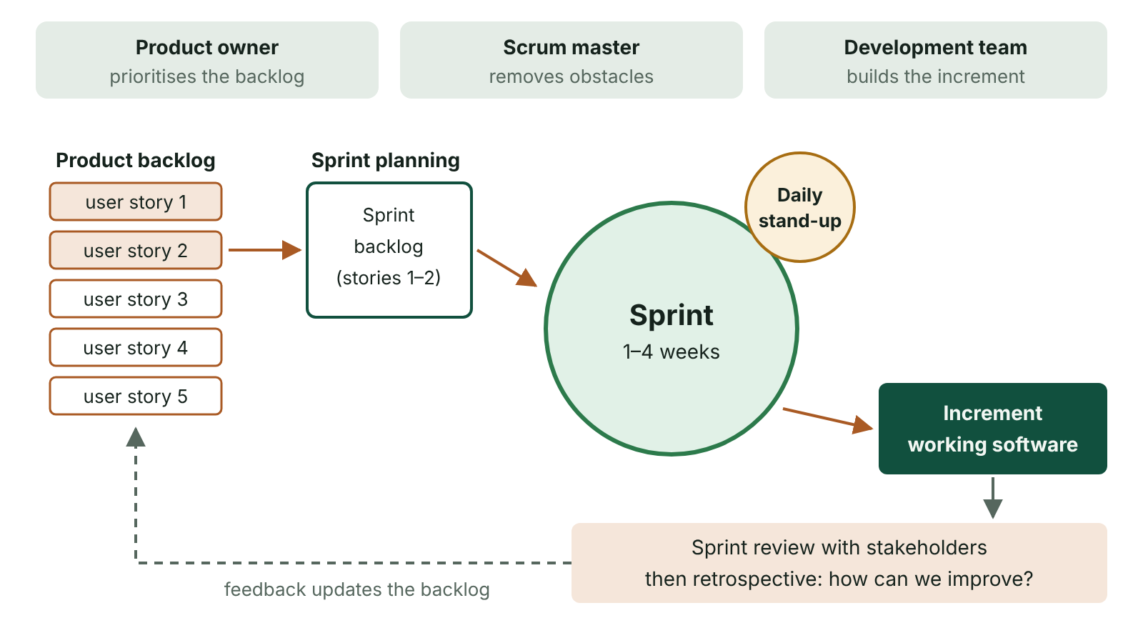
The big picture
The Scrum framework: a product backlog feeds sprint planning, the team works in a 1–4 week sprint with daily stand-ups, producing an increment that is reviewed
☰ Menu
Notes:
Explain the diagram in your own words before you read on.

Slide 33
Prototyping
A prototype is an early model of all or part of a system, built quickly so users can see and try it
Often a mock-up with little real functionality – enough to show screens, menus and reports
Helps users clarify requirements they find hard to describe, especially the user interface
Throwaway prototyping: used to agree requirements, then discarded; the real system is built properly
Evolutionary prototyping: refined repeatedly in response to feedback until it becomes the final system
☰ Menu

Slide 34
Throwaway v. evolutionary
 | Throwaway | Evolutionary
Purpose | Clarify requirements, try out interface ideas | Grow into the final system
Built with | Quick tools: wireframes, mock-ups, simple code | Production tools and coding standards
Advantage | Fast and cheap; requirements agreed before the expensive build | Effort is not wasted; users get a working system sooner
Risk | Effort is discarded; users may think the system is almost finished | Early quick decisions can leave a poorly structured, hard-to-maintain system; scope creep
☰ Menu

Slide 35
Rapid Application Development (RAD)
Developed by James Martin in the late 1980s and set out in his 1991 book; aims to deliver working applications much faster than waterfall
The project is split into a series of builds, each developed and refined with users
A strict, fixed timescale (timeboxing) that cannot be overrun
Requirements are ranked by priority; if time runs out, ‘desirable add-ons’ are dropped, not the deadline
Far more user involvement than waterfall: prototypes are delivered to users frequently for feedback
Reuses components and uses tools such as GUI builders to speed up construction
☰ Menu

Slide 36
The four phases of RAD
Phase | What happens
Requirements planning | Users, managers and developers meet to agree scope and key requirements; more flexible than waterfall because changes are expected
User design | Users and analysts work together on prototypes (mock-ups) to design functions and try alternative interfaces
Construction | Programming, with software continually refined in response to user feedback on real screens and reports; modules integrated and tested
Cutover | Transition from old to new system: final testing, data conversion, changeover and user training
☰ Menu

Slide 37
RAD: evaluation
Advantages | Disadvantages
System is built, delivered and in use much sooner | Needs skilled practitioners trained in the method
Continual user involvement means errors and misunderstandings are found early | Users must commit significant time to workshops and reviews
Final system closely matches what users want | Can be expensive, because it is used when speed is essential
Fixed deadline is protected by dropping low-priority features | Less suitable for large, safety-critical or hard-to-modularise systems
☰ Menu

Slide 38
Agile: principles
Popularised by the Manifesto for Agile Software Development (2001), drawing on several earlier methods
Values individuals and interactions, working software, customer collaboration and responding to change
Early and continuous delivery of working software in short iterations
Close collaboration between the team and the customer throughout the project
Changes to requirements are welcomed, even late in development
Requirements are often written as user stories: ‘As a [user], I want [feature] so that [benefit]’
☰ Menu

Slide 39
Backlogs and sprints
Product backlog: the prioritised ‘wish list’ of everything the product should eventually do
Release planning: features for the next release are moved from the product backlog into a release backlog
Release backlog items are broken into work items, estimated and put in priority order
A sprint is a fixed period of a few weeks that delivers a working increment of the product
Completed tasks are removed from the backlog; the product backlog becomes a ‘to-do’ list of what remains
☰ Menu

Slide 40
The Scrum team (1 of 2)
Role / event | Description
Scrum team | Small, multi-skilled group (developers, testers, customer input) able to analyse, design, build and test; everyone contributes
Scrum master | Makes sure the team works effectively, removes obstacles, arranges meetings, monitors progress (similar to a project manager)
Product owner | Voice of the client: prioritises backlog items, stops unrealistic items being added, accountable for delivering value
Daily Scrum | About 15 minutes, often standing: what did I do yesterday? what will I do today? what obstacles are in my way?
Sprint review | Team shows the completed increment to the product owner and notes unfinished work
☰ Menu

Slide 41
The Scrum team (2 of 2)
Role / event | Description
Sprint retrospective | Team reflects on the process (not the product): what went well and what to improve next sprint
☰ Menu

Slide 42
Worked example: a burn down chart
A Belfast team’s 10-day sprint for a GAA club membership app has 60 story points of work
Ideal line falls evenly: 60 ÷ 10 = 6 points per day, so ideal remaining on day d = 60 − 6d
Day 4: ideal 60 − 24 = 36 remaining; actual 40 → 4 points behind, so the Scrum master investigates
A blocked task is resolved and a tester is moved to help; by day 9 the gap is down to 1 point (ideal 6, actual 7)
Day 10: 0 remaining – the sprint finishes on schedule
☰ Menu

Slide 43
Worked example: a burn down chart – code
C#
int total = 60, days = 10;
int[] actual = { 60, 53, 48, 44, 40, 34, 30, 22, 14, 7, 0 };
for (int day = 0; day <= days; day++)
{
int ideal = total - (total / days) * day;
string status = actual[day] > ideal ? "behind" : "on track";
Console.WriteLine($"Day {day}: ideal {ideal}, actual {actual[day]} ({status})");
}
☰ Menu

Slide 44
Extreme programming (XP)
An Agile method focused on technical practices and code quality
Pair programming: two programmers at one computer – one writes, one reviews, roles swap regularly
Test-driven development: automated tests are written before the code they test
Small, frequent releases; continuous integration; refactoring; collective code ownership
An on-site customer is available to answer questions and write user stories
☰ Menu

Slide 45
Agile: evaluation
Advantages | Disadvantages
Project can start quickly with the most important requirements, then evolve | Hard to estimate accurately how long tasks will take and allocate staff
Working deliverables are produced early | Quality of estimates depends heavily on the experience of the Scrum master
Ongoing contact with the customer reduces misunderstandings | Documentation may be less detailed than in traditional methods
Multi-skilled team members can be moved to tasks that are running late | Needs a customer who can commit time throughout; fixed price and scope are hard to agree
☰ Menu

Slide 46
Comparing the three approaches
Feature | Waterfall | RAD | Agile
Structure | Sequential stages | Four phases with repeated prototypes | Repeated sprints
User involvement | Requirements and testing only | Continual, through prototypes | Continual; customer on the team
Changing requirements | Difficult and costly | Expected and encouraged | Welcomed at any time
Delivery | Whole system at the end | Quickly, within a fixed timebox | Working increments every few weeks
Documentation | Extensive | Lighter | Lighter; may be poorer
Best for | Stable, well-understood, regulated projects | Interface-heavy systems needed fast | Evolving requirements, available customer
☰ Menu

Slide 47
Choosing an approach: worked example
Scenario: a Newry garden centre wants stock, supplier and customer records plus automatic receipts; owner is on site daily
Requirements are fairly clear but the owner has not used such a system and will think of extras once he sees it
Waterfall: workable but risky – the owner sees nothing until testing, and late ideas are costly
RAD: good fit – prototypes of stock and receipt screens, fixed deadline before the spring season, extras dropped if needed
Agile: also suitable if the owner can act as product owner; core stock features in sprint 1, mail-order list later
A full-marks answer chooses one and justifies it from the scenario, not from general features
☰ Menu

Slide 48
Exit quiz: question 1 of 10
Tap an answer to check it. Presenting? Click to reveal the answer.
In RAD, what happens if time is running out before the deadline?
A The deadline is moved back
B Lower-priority ‘desirable’ requirements are dropped
✗
✓
C The project returns to the requirements phase
D More prototypes are built
✗
✗
✓ B: Lower-priority ‘desirable’ requirements are dropped – RAD timeboxes the project; requirements are ranked so add-ons are sacrificed, not the deadline.
☰ Menu

Slide 49
Exit quiz: question 2 of 10
Tap an answer to check it. Presenting? Click to reveal the answer.
In an Agile project, who is responsible for removing obstacles that slow the team down?
A The product owner
B The customer
✗
✗
C The Scrum master
D The tester
✓
✗
✓ C: The Scrum master – The Scrum master facilitates the team, arranges meetings, monitors progress and removes obstacles.
☰ Menu

Slide 50
Exit quiz: question 3 of 10
Tap an answer to check it. Presenting? Click to reveal the answer.
Which is the correct order of the four RAD phases?
A User design, requirements, cutover, construction
B Requirements, construction, user design, cutover
✗
✗
C Requirements, user design, construction, cutover
D Construction, user design, requirements, cutover
✓
✗
✓ C: Requirements, user design, construction, cutover – Requirements planning, then user design with prototypes, then construction, then cutover to the new system.
☰ Menu

Slide 51
Exit quiz: question 4 of 10
Tap an answer to check it. Presenting? Click to reveal the answer.
A prototype that is refined until it becomes the final system is…
A evolutionary
B throwaway
✓
✗
C a burn down chart
D a release backlog
✗
✗
✓ A: evolutionary – It evolves through repeated refinement in response to feedback.
☰ Menu

Slide 52
Exit quiz: question 5 of 10
Tap an answer to check it. Presenting? Click to reveal the answer.
What does a burn down chart show?
A The critical path through a project
B Work remaining in a sprint plotted against time
✗
✓
C Who made each change to the code
D The cost of each feature
✗
✗
✓ B: Work remaining in a sprint plotted against time – It compares actual work remaining with the ideal straight-line burn down.
☰ Menu

Slide 53
Exit quiz: question 6 of 10
Tap an answer to check it. Presenting? Click to reveal the answer.
Who acts as the voice of the client and sets priorities in the backlog?
A Scrum master
B Tester
✗
✗
C Systems analyst
D Product owner
✗
✓
✓ D: Product owner – The product owner represents the client and is accountable for the team delivering value.
☰ Menu

Slide 54
Exit quiz: question 7 of 10
Tap an answer to check it. Presenting? Click to reveal the answer.
A short daily meeting where members say what they did, what they will do and any obstacles is the…
A sprint retrospective
B sprint review
✗
✗
C release planning meeting
D daily Scrum
✗
✓
✓ D: daily Scrum – The daily Scrum lasts about 15 minutes and is often held standing.
☰ Menu

Slide 55
Exit quiz: question 8 of 10
Tap an answer to check it. Presenting? Click to reveal the answer.
Which is an extreme programming practice?
A Pair programming
B Parallel running
✓
✗
C Feasibility study
D Direct changeover
✗
✗
✓ A: Pair programming – XP focuses on engineering practices such as pair programming and test-driven development.
☰ Menu

Slide 56
Exit quiz: question 9 of 10
Tap an answer to check it. Presenting? Click to reveal the answer.
Which is a recognised disadvantage of Agile?
A Users see nothing until the end
B Requirements can never change
✗
✗
C Task times can be hard to estimate accurately
D There is no customer involvement
✓
✗
✓ C: Task times can be hard to estimate accurately – Estimates are difficult and depend on the Scrum master’s experience.
☰ Menu

Slide 57
Exit quiz: question 10 of 10
Tap an answer to check it. Presenting? Click to reveal the answer.
‘As a member, I want to book a class online so that I don’t have to phone’ is a…
A test plan
B user story
✗
✓
C Gantt chart
D data flow
✗
✗
✓ B: user story – User stories capture requirements from the user’s point of view in Agile.
☰ Menu

Slide 58
Exit quiz answers
Q | Answer | Why
1 | B Lower-priority ‘desirable’ requirements are dropped | RAD timeboxes the project; requirements are ranked so add-ons are sacrificed, not the deadline.
2 | C The Scrum master | The Scrum master facilitates the team, arranges meetings, monitors progress and removes obstacles.
3 | C Requirements, user design, construction, cutover | Requirements planning, then user design with prototypes, then construction, then cutover to the new system.
4 | A evolutionary | It evolves through repeated refinement in response to feedback.
5 | B Work remaining in a sprint plotted against time | It compares actual work remaining with the ideal straight-line burn down.
6 | D Product owner | The product owner represents the client and is accountable for the team delivering value.
7 | D daily Scrum | The daily Scrum lasts about 15 minutes and is often held standing.
8 | A Pair programming | XP focuses on engineering practices such as pair programming and test-driven development.
9 | C Task times can be hard to estimate accurately | Estimates are difficult and depend on the Scrum master’s experience.
10 | B user story | User stories capture requirements from the user’s point of view in Agile.
☰ Menu

