Slide 1
Software projects
AS 1: APPROACHES TO SYSTEMS DEVELOPMENT · TOPIC
Lessons in this topic
AP12 Organising and managing a software project
AP13 Version management and tools for software projects

Slide 2
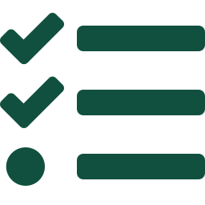
Topic menu
Tap a button to jump straight there. The ☰ Menu button on every slide brings you back here.
Specification map
AP13 Version management and tools for software projects
AP12 Organising and managing a software project

Slide 3
Specification map
Lesson | Specification: students should be able to
AP12 | Describe the main elements in the organisation of a software project: resources, constraints and risks; Explain the main features of project management for a software project, including the role of the project manager and SMART objectives; Describe the roles of members of a software project team; Construct and interpret Gantt charts and critical path analysis, identifying the critical path, earliest start times, latest finish times and float; Evaluate the use of project management tools: Gantt charts and critical path analysis
AP13 | Describe the importance of version management during systems development; Describe how a version management system records changes and how versions are branched, merged and rolled back, including version management graphs; Describe the conditions needed for version management to work successfully; Describe the use of computer-aided software engineering (CASE) tools and collaboration tools; Describe code reviews, quality assurance and the use of standards in software projects
☰ Menu
Notes:
Each lesson below is its own section in PowerPoint (View → Slide Sorter shows them). To split this deck by specification point, right-click a section → Move Section, or delete the sections you do not need.

Slide 4
Organising and managing a software project
AS 1: APPROACHES TO SYSTEMS DEVELOPMENT · AP12
Learning objectives
Classify the resources of a software project and explain the constraints and risks that affect it
Explain why managing a software project differs from other projects and describe the project manager’s role
Write SMART objectives for a software project
Draw a Gantt chart and carry out critical path analysis to find the critical path, project duration and float
Evaluate how Gantt charts and critical path analysis help a project manager
Notes:
Specification: Describe the main elements in the organisation of a software project: resources, constraints and risks | Explain the main features of project management for a software project, including the role of the project manager and SMART objectives | Describe the roles of members of a software project team | Construct and interpret Gantt charts and critical path analysis, identifying the critical path, earliest start times, latest finish times and float | Evaluate the use of project management tools: Gantt charts and critical path analysis

Slide 5
In this lesson
Tap a button to jump straight there. The ☰ Menu button on every slide brings you back here.
The big picture
A risk register
Critical path analysis: the method
What a software project must balance
Why software projects are harder to manage
Worked example: finding the critical path
Resources and how they are classified
The project manager
Evaluating Gantt charts and CPA
Managing resources
Team roles
Exit quiz
Constraints
Clear objectives: SMART
↑ Topic menu
Risks and how to manage them
Worked example: a Gantt chart
Notes:
Lesson menu: each button jumps to that part of the lesson in Slide Show. The ☰ Menu button on each slide returns here.

Slide 6
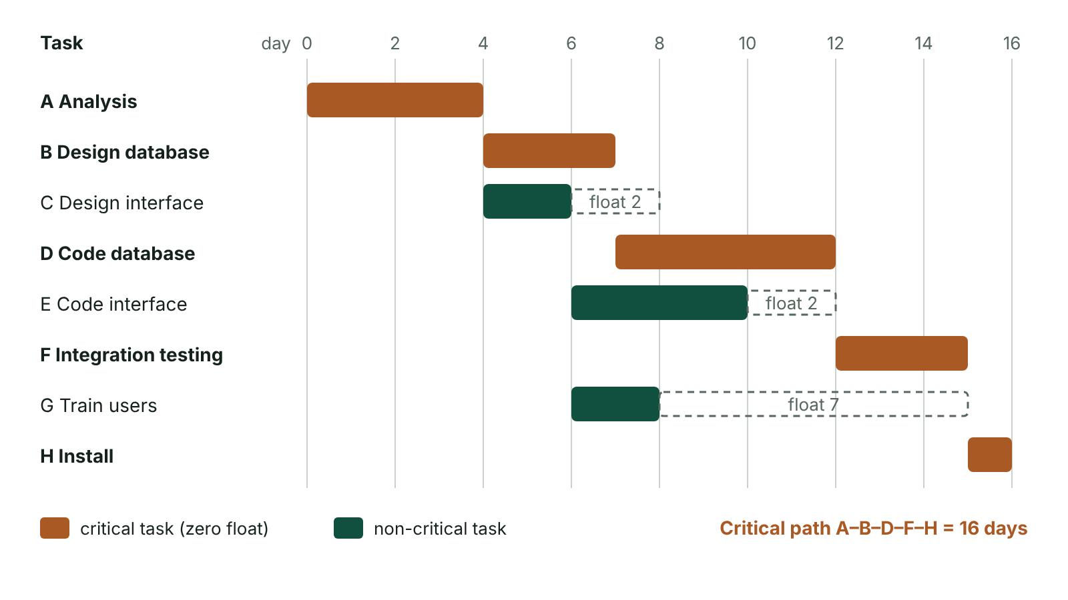
The big picture
Gantt chart for an eight-task project showing the critical path A, B, D, F, H of 16 days and the float on tasks C, E and G
☰ Menu
Notes:
Explain the diagram in your own words before you read on.

Slide 7
What a software project must balance
Whatever the methodology (waterfall, RAD or Agile), the central task is the same
Meet the project objectives…
…by deploying resources (people, technology, money, premises)…
…within constraints (scope, time, resource limits)…
…while managing risks that could delay or wreck the project
☰ Menu

Slide 8
Resources and how they are classified
Type / property | Meaning | Example
Human, technical, financial, physical | The four kinds of resource a project can draw on | Programmers; server processing power; the budget; office space
Availability: recurring v. depleting | Recurring resources do not run down as they are used; depleting ones are used up | Recurring: staff on the project. Depleting: time and money
Location: fixed v. movable | Whether the resource can easily be moved to where it is needed | Fixed: a data centre. Movable: a developer
Elasticity: elastic v. inelastic | Whether the amount can be increased or decreased | Elastic: budget, staff numbers. Inelastic: time before a hard deadline
Ownership: dedicated v. shared | Whether the resource works only on this project or on several | Dedicated: lead programmer. Shared: graphic designer
☰ Menu

Slide 9
Managing resources
Planning (before work starts): estimate how much of each resource is needed, request it and schedule when it is needed
Deployment (during the project): allocate resources to tasks, monitor each stage and reallocate if a stage falls behind
Release (after each stage): compare resources actually used with the plan and record differences
Recording over- and under-use means estimates for future projects improve
Goal: the right resource in the right place at the right time, so the project stays on schedule and within budget
☰ Menu

Slide 10
Constraints
Constraints are restrictions placed on the project that the developer cannot change
Scope: features the client has fixed, e.g. 500 simultaneous users, 2-second response, must work on all major browsers and mobiles
Time: a fixed delivery deadline; the agreed scope must be achievable within it
Resources: limits on budget, staff and equipment – even ‘elastic’ resources have a ceiling in practice
Constraints must be explicit: ‘deliver by 30 June, maximum budget £80,000’, not ‘as soon and as cheaply as possible’
☰ Menu

Slide 11
Risks and how to manage them (1 of 2)
Risk | Why it matters | How the project manager reduces it
Time (missed deadline) | Client may lose business; developer may pay for overruns on a fixed-price contract; reputations suffer | Realistic schedule, regular monitoring, contingency time
Requirements shift | Unclear or changing requirements lead to rework, delay and extra cost | Involve users fully in analysis; agreed specification; change control
Staff turnover | A leaving developer takes vital knowledge with them | Collaboration, documentation, code reviews, pair programming
Productivity | Teams start slowly on long tasks, assuming they can catch up later | Split long tasks into smaller sections with their own deadlines
☰ Menu

Slide 12
Risks and how to manage them (2 of 2)
Risk | Why it matters | How the project manager reduces it
Technology / suppliers | New technology may fail; hardware or services arrive late | Prototype risky ideas early; order early; have a fallback
☰ Menu

Slide 13
A risk register
Risk | Likelihood (1–5) | Impact (1–5) | Score | Mitigation and owner
Client keeps adding features | 4 | 4 | 16 | Change-control procedure; agreed scope – project manager
Lead programmer leaves | 2 | 5 | 10 | Pair programming, documented code – team leader
Cloud hosting contract delayed | 3 | 3 | 9 | Sign contract early; test on local server – technical lead
Team underestimates database work | 3 | 4 | 12 | Split into weekly milestones; review progress – project manager
☰ Menu

Slide 14
Why software projects are harder to manage
Software is intangible: you can see a half-built house, but not half-built software, so progress is hard to judge
Software is usually bespoke: one-off systems mean past experience and solutions transfer less well
Technology changes rapidly: new tools may appear mid-project, offering benefits but forcing changes to the plan
Software project management became a distinct role in the 1970s, after a series of high-profile project failures
☰ Menu

Slide 15
The project manager
Controls all aspects of analysis, development and deployment
Produces a realistic plan: what will be built, acceptance criteria and how the system will be maintained
Schedules tasks, allocates (delegates) staff and resources, and monitors progress against milestones
Communicates with the client and stakeholders, reports progress and controls changes to scope
Identifies and manages risks, and is accountable for delivery on time, within budget and to quality
☰ Menu

Slide 16
Team roles
Role | Main responsibilities
Systems analyst | Investigates the current system, gathers and documents requirements
Designer / architect | Designs interfaces, data structures and the overall system structure
Programmer / developer | Writes, documents and unit-tests the code
Tester | Plans and carries out testing, records and reports defects
Technical author | Writes user and technical documentation
Client / end-user representative | Provides requirements, reviews deliverables, carries out acceptance testing
☰ Menu

Slide 17
Clear objectives: SMART
Each objective needs: a clear statement, performance indicators (metrics) and the value of each that counts as success
Specific – clearly defined, with no room for misinterpretation
Measurable – a quantifiable metric such as time, cost, size or error rate
Agreed – signed off by client and developer before development starts
Realistic – achievable with the resources available; Timed – has a target date
e.g. ‘Online booking for an Omagh dental practice, handling 200 bookings a day, live by 1 March, cutting missed appointments by 25% in six months’
☰ Menu

Slide 18
Worked example: a Gantt chart
Task | Depends on | Days | Scheduled (earliest)
A Analyse requirements | – | 3 | Days 1–3
B Design database | A | 4 | Days 4–7
C Design interface | A | 2 | Days 4–5
D Code database | B | 5 | Days 8–12
E Code interface | C | 6 | Days 6–11
F Integration testing | D, E | 3 | Days 13–15
G User guide / H Install and train | G: C / H: F, G | 2 / 1 | G: days 6–7 / H: day 16
☰ Menu

Slide 19
Critical path analysis: the method
Draw the network: nodes (circles) are events such as the start or end of tasks; arrows are tasks labelled with durations
Forward pass (left to right): EST of each node = earliest the next tasks can start; where arrows meet, take the highest value
Backward pass (right to left): LFT of the final node = project duration; subtract durations, and where paths meet take the lowest value
Critical nodes have EST = LFT; the tasks joining them form the critical path
Float of a task = latest finish − earliest start − duration; critical tasks have zero float
☰ Menu

Slide 20
Worked example: finding the critical path
Paths: A-B-D-F-H = 3+4+5+3+1 = 16; A-C-E-F-H = 3+2+6+3+1 = 15; A-C-G-H = 3+2+2+1 = 8
F waits for D (ends day 12) and E (ends day 11): EST of F = max(12, 11) = 12
C must finish by min(12 − 6, 15 − 2) = 6 but can finish at 5, so C and E each have 1 day of float
Critical path A, B, D, F, H; minimum duration 16 days. G has 8 days’ float (finish by 15, earliest finish 7)
☰ Menu

Slide 21
Worked example: finding the critical path – code
C#
string[] task = { "A", "B", "C", "D", "E", "F", "G", "H" };
int[] dur = { 3, 4, 2, 5, 6, 3, 2, 1 };
int[][] pre = { new int[0], new[] { 0 }, new[] { 0 }, new[] { 1 },
new[] { 2 }, new[] { 3, 4 }, new[] { 2 }, new[] { 5, 6 } };
int[] est = new int[8];
for (int i = 0; i < 8; i++) // forward pass
foreach (int p in pre[i])
est[i] = Math.Max(est[i], est[p] + dur[p]);
int end = est[7] + dur[7]; // 16 days
int[] lft = new int[8];
for (int i = 7; i >= 0; i--) // backward pass
{
lft[i] = end;
for (int j = i + 1; j < 8; j++)
if (Array.IndexOf(pre[j], i) >= 0)
lft[i] = Math.Min(lft[i], lft[j] - dur[j]);
Console.WriteLine($"{task[i]}: EST {est[i]}, float {lft[i] - dur[i] - est[i]}");
}
☰ Menu

Slide 22
Evaluating Gantt charts and CPA
Tool | Benefits | Limitations
Gantt chart | Easy to read; shows each task’s start, end, duration, overlaps and milestones; good for reporting progress to the client | Dependencies and the critical path are not always clear, especially on large charts
Critical path analysis | Identifies critical tasks and float; shows bottlenecks; shows the effect of a delay | Harder to draw and read; only as good as the duration estimates
Both | Show which tasks can run in parallel, minimising project duration | Must be updated as the project changes
Both | Help schedule resources to arrive at a task’s EST and be released at its LFT | Do not by themselves manage quality or risk
☰ Menu

Slide 23
Exit quiz: question 1 of 9
Tap an answer to check it. Presenting? Click to reveal the answer.
What is the critical path in a project?
A The shortest chain of tasks
B The longest chain of dependent tasks, which sets the minimum project duration
✗
✓
C The tasks with the most float
D The tasks that use the most staff
✗
✗
✓ B: The longest chain of dependent tasks, which sets the minimum project duration – Because these tasks follow one another, the project cannot finish sooner than their total duration.
☰ Menu

Slide 24
Exit quiz: question 2 of 9
Tap an answer to check it. Presenting? Click to reveal the answer.
Which of these is a depleting resource for a software project?
A A dedicated programmer
B A fixed server room
✗
✗
C The project budget
D A shared graphic designer
✓
✗
✓ C: The project budget – Money is used up as the project proceeds; staff on the project are recurring resources.
☰ Menu

Slide 25
Exit quiz: question 3 of 9
Tap an answer to check it. Presenting? Click to reveal the answer.
In SMART objectives, what does the ‘M’ stand for?
A Manageable
B Monitored
✗
✗
C Minimal
D Measurable
✗
✓
✓ D: Measurable – Each objective needs a quantifiable metric, such as time, cost or error rate.
☰ Menu

Slide 26
Exit quiz: question 4 of 9
Tap an answer to check it. Presenting? Click to reveal the answer.
A developer leaving mid-project and taking vital knowledge with them is which risk?
A Staff turnover
B Requirements shift
✓
✗
C Productivity
D Scope
✗
✗
✓ A: Staff turnover – Collaboration and documentation reduce the impact of staff turnover.
☰ Menu

Slide 27
Exit quiz: question 5 of 9
Tap an answer to check it. Presenting? Click to reveal the answer.
In the backward pass of CPA, where two paths meet at a node, which latest finish time is used?
A The highest
B The average
✗
✗
C The lowest
D The first one calculated
✓
✗
✓ C: The lowest – The lowest value is taken so that no following task is delayed.
☰ Menu

Slide 28
Exit quiz: question 6 of 9
Tap an answer to check it. Presenting? Click to reveal the answer.
Task D has latest finish 12, earliest start 7 and duration 5. Its float is…
A 0 days
B 5 days
✓
✗
C 7 days
D 12 days
✗
✗
✓ A: 0 days – Float = 12 − 7 − 5 = 0, so D is critical.
☰ Menu

Slide 29
Exit quiz: question 7 of 9
Tap an answer to check it. Presenting? Click to reveal the answer.
Which is a limitation of a Gantt chart?
A It cannot show task durations
B It cannot show overlapping tasks
✗
✗
C It cannot be shown to a client
D Dependencies and the critical path may be unclear on large projects
✗
✓
✓ D: Dependencies and the critical path may be unclear on large projects – CPA is used to identify the critical path clearly.
☰ Menu

Slide 30
Exit quiz: question 8 of 9
Tap an answer to check it. Presenting? Click to reveal the answer.
Why is software project management different from managing a building project?
A Software has no deadlines
B Software is intangible, so progress is hard to see
✗
✓
C Software projects never use teams
D Software projects have no budget
✗
✗
✓ B: Software is intangible, so progress is hard to see – Other differences: software is often bespoke and technology changes rapidly.
☰ Menu

Slide 31
Exit quiz: question 9 of 9
Tap an answer to check it. Presenting? Click to reveal the answer.
Which is a scope constraint?
A The system must support 500 simultaneous users
B The lead programmer may leave
✓
✗
C The budget is £80,000
D Coding starts after design
✗
✗
✓ A: The system must support 500 simultaneous users – Scope constraints are characteristics of the final product fixed by the client.
☰ Menu

Slide 32
Exit quiz answers
Q | Answer | Why
1 | B The longest chain of dependent tasks, which sets the minimum project duration | Because these tasks follow one another, the project cannot finish sooner than their total duration.
2 | C The project budget | Money is used up as the project proceeds; staff on the project are recurring resources.
3 | D Measurable | Each objective needs a quantifiable metric, such as time, cost or error rate.
4 | A Staff turnover | Collaboration and documentation reduce the impact of staff turnover.
5 | C The lowest | The lowest value is taken so that no following task is delayed.
6 | A 0 days | Float = 12 − 7 − 5 = 0, so D is critical.
7 | D Dependencies and the critical path may be unclear on large projects | CPA is used to identify the critical path clearly.
8 | B Software is intangible, so progress is hard to see | Other differences: software is often bespoke and technology changes rapidly.
9 | A The system must support 500 simultaneous users | Scope constraints are characteristics of the final product fixed by the client.
☰ Menu

Slide 33
Version management and tools for software projects
AS 1: APPROACHES TO SYSTEMS DEVELOPMENT · AP13
Learning objectives
Explain why version management is essential when a team works on shared code
Draw and interpret a version management graph showing parallel versions, merges and rollbacks
Describe what a version management system records and the conditions for it to work
Describe upper and lower CASE tools and collaboration tools and their benefits
Explain how code reviews, quality assurance and standards improve software quality
Notes:
Specification: Describe the importance of version management during systems development | Describe how a version management system records changes and how versions are branched, merged and rolled back, including version management graphs | Describe the conditions needed for version management to work successfully | Describe the use of computer-aided software engineering (CASE) tools and collaboration tools | Describe code reviews, quality assurance and the use of standards in software projects

Slide 34
In this lesson
Tap a button to jump straight there. The ☰ Menu button on every slide brings you back here.
The big picture
Worked example: rollback (part 2)
Code reviews
Why version management matters
The same ideas in Git
Quality assurance and standards
What is recorded for each change
Making version management work
Exit quiz
Key operations
Benefits of version management
↑ Topic menu
Version management graphs
CASE tools
Worked example: Ciara and Tomás (part 1)
Collaboration tools
Notes:
Lesson menu: each button jumps to that part of the lesson in Slide Show. The ☰ Menu button on each slide returns here.

Slide 35
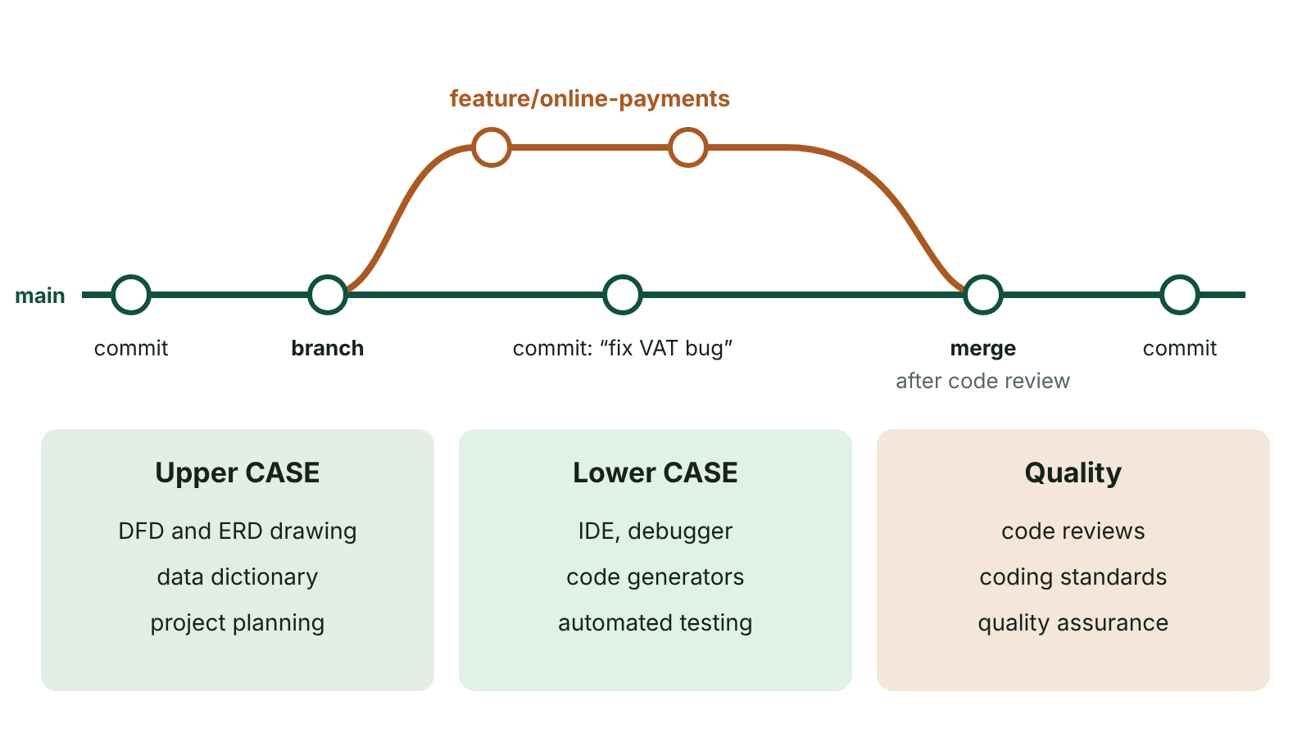
The big picture
Version control: commits on the main branch, a feature branch that is merged back, and the CASE tools and quality techniques used in software projects
☰ Menu
Notes:
Explain the diagram in your own words before you read on.

Slide 36
Why version management matters
Version management keeps track of every change made to a project’s code files over time
Allows the team to return to a previous working version if an error is discovered
Essential when many programmers share the same files: unrestricted editing by anyone would quickly cause chaos
All code is kept in a repository where access is controlled and every change is tracked
Also called version control or source control; Git is the most widely used system today
☰ Menu

Slide 37
What is recorded for each change
The author: who made the change
The date and time of the change
A note (commit message) describing the change and any knock-on effects others must act on
A new version number, so every revision can be identified and retrieved
Together these form a full audit trail of how the system was developed
☰ Menu

Slide 38
Key operations
Term | Meaning
Repository | Central store of all files and their complete history
Commit (check in) | Save a new version to the repository with a message describing the change
Branch | A separate line of development, e.g. for a new feature, that does not affect the main version
Merge | Combine two lines of development into a single version containing both sets of changes
Conflict | Two people changed the same lines; the software flags it and a developer resolves it
Rollback (revert) | Return to an earlier version and continue developing from there
☰ Menu

Slide 39
Version management graphs
A project’s history can be drawn as a graph: each node is a version of a file, each arrow shows which version it came from
A straight chain v1 → v2 → v3 means one change after another
Two arrows leaving one node: two developers worked on the same version in parallel (branching)
Two arrows entering one node: two versions were merged into one
An arrow from an old node to a new one, skipping later versions: the team rolled back and continued from the earlier version
☰ Menu

Slide 40
Worked example: Ciara and Tomás (part 1)
Version | Created from | What happened
v1 | – | Original code for a Dungannon bakery’s ordering system
v2 | v1 | Ciara adds a delivery-slot feature
v3 | v2 | Ciara rewrites the price calculation
v4 | v2 | At the same time, Tomás adds allergen labels to v2
v5 | v3 + v4 | The software merges the two parallel versions into one
☰ Menu

Slide 41
Worked example: rollback (part 2)
Testing shows Ciara’s price rewrite (v3) introduced a serious error, so v5 is also faulty
The team decides v4 is the last stable version and rolls back to it
Tomás develops on from v4 to create v6
v6 contains the work of v1, v2 and v4, but none of the faulty changes from v3; v3 and v5 are discarded
Graph: v1 → v2; v2 → v3 and v2 → v4; v3 + v4 → v5; v4 → v6
☰ Menu

Slide 42
The same ideas in Git
Each commit records author, date and message; branches let features be developed in parallel
Merge combines branches; revert creates a new commit that undoes a faulty one, keeping history intact
☰ Menu

Slide 43
The same ideas in Git – code
PSEUDOCODE
git checkout -b allergen-labels # new branch from current version
git add Labels.cs
git commit -m "Add allergen labels to order screen"
git checkout main
git merge allergen-labels # combine the branch into main
git log # show history: author, date, message
git revert a1b2c3d # undo the faulty commit a1b2c3d
☰ Menu

Slide 44
Making version management work
Condition | Why it matters
A consistent method of tracking changes and recording all version numbers | Every version can be identified, compared and retrieved
It must be possible to reverse changes | Faulty work can be undone by returning to a stable version
All developers work from the same (latest) version of each file | Prevents people building on out-of-date code and losing each other’s work
Developers commit regularly with clear messages | History is useful and conflicts stay small
Commitment from the whole team | One person bypassing the system undermines it for everyone
☰ Menu

Slide 45
Benefits of version management
Problem without it | How version management helps
Changes overwrite each other | Merging and conflict detection
A change breaks the program | Roll back to the last working version
Nobody knows who changed what | Full history with author, date and message
Experiments risk the live code | Branches keep work separate until it is ready
Work is lost if a laptop fails | A remote repository acts as a backup
☰ Menu

Slide 46
CASE tools
Computer-aided software engineering tools are software that support or automate parts of development
Upper CASE: analysis and design – drawing DFDs and ERDs, data dictionaries, project planning
Lower CASE: implementation and testing – IDEs, code generators, debuggers, automated testing tools
Integrated CASE combines both, keeping diagrams, data dictionary and code consistent
Benefits: standard notation, consistency, automatic documentation, faster development; drawbacks: cost and training
☰ Menu

Slide 47
Collaboration tools
Shared repositories with issue trackers to log bugs and tasks
Communication: messaging channels, video meetings, shared documents and wikis
Kanban or Scrum boards show who is working on what
Continuous integration servers automatically build and test the code after each commit
Support remote and distributed teams, but need clear rules on how they are used
☰ Menu

Slide 48
Code reviews
Other developers examine code before it is merged, often through a pull request
They check for errors, security weaknesses, readability and adherence to coding standards
Defects are found early, when they are cheaper to fix than after release
Knowledge is spread across the team, reducing the risk from staff turnover
Can be formal (an inspection meeting) or informal (peer review, pair programming)
☰ Menu

Slide 49
Quality assurance and standards
Quality assurance (QA): planned activities that build quality in at every stage, not just testing at the end
Includes reviews, walkthroughs, inspections, testing and audits of documentation
Coding standards: naming conventions, indentation, comments, error handling – consistent, maintainable code
Process and product standards, e.g. ISO 9001 quality management, ISO/IEC 25010 software quality model, WCAG accessibility
☰ Menu

Slide 50
Quality assurance and standards – code
C#
// Coding standard example: meaningful names, a constant, a comment
// Returns the price including VAT, rounded to 2 decimal places
static decimal AddVat(decimal netPrice)
{
const decimal VatRate = 0.20m;
return Math.Round(netPrice * (1 + VatRate), 2);
}
Console.WriteLine(AddVat(12.50m)); // 15.00
☰ Menu

Slide 51
Exit quiz: question 1 of 9
Tap an answer to check it. Presenting? Click to reveal the answer.
What is the main purpose of version management?
A To compress code files so they take less storage
B To track every change to code files so the team can collaborate and return to earlier versions
✗
✓
C To design the user interface
D To schedule tasks on a Gantt chart
✗
✗
✓ B: To track every change to code files so the team can collaborate and return to earlier versions – It records each change with author, date and note, supports parallel work and allows rollback.
☰ Menu

Slide 52
Exit quiz: question 2 of 9
Tap an answer to check it. Presenting? Click to reveal the answer.
Two developers both start work from v2 at the same time. On a version management graph this appears as…
A two arrows entering v2
B a straight chain from v2
✗
✗
C v2 being deleted
D two arrows leaving v2
✗
✓
✓ D: two arrows leaving v2 – Parallel versions branch from the same parent node.
☰ Menu

Slide 53
Exit quiz: question 3 of 9
Tap an answer to check it. Presenting? Click to reveal the answer.
Which of these is NOT normally recorded when a change is committed?
A Who made the change
B When it was made
✗
✗
C The developer’s salary
D A note describing the change
✓
✗
✓ C: The developer’s salary – Author, time and a descriptive message are recorded for every change.
☰ Menu

Slide 54
Exit quiz: question 4 of 9
Tap an answer to check it. Presenting? Click to reveal the answer.
Combining two parallel versions into a single version is called…
A merging
B branching
✓
✗
C committing
D refactoring
✗
✗
✓ A: merging – A merge brings both sets of changes into one new version.
☰ Menu

Slide 55
Exit quiz: question 5 of 9
Tap an answer to check it. Presenting? Click to reveal the answer.
v3 contains a serious error, so the team returns to v4 and creates v6 from it. Which statement is true?
A v6 includes the work from v3
B v6 includes v4’s work but not v3’s faulty changes
✗
✓
C v6 must be created from v5
D v4 is deleted
✗
✗
✓ B: v6 includes v4’s work but not v3’s faulty changes – Rolling back to v4 means v6 builds on v4 and leaves out the problematic changes.
☰ Menu

Slide 56
Exit quiz: question 6 of 9
Tap an answer to check it. Presenting? Click to reveal the answer.
Which is a lower CASE tool?
A A DFD drawing tool
B A data dictionary
✗
✗
C A project planning tool
D A debugger
✗
✓
✓ D: A debugger – Lower CASE tools support implementation and testing.
☰ Menu

Slide 57
Exit quiz: question 7 of 9
Tap an answer to check it. Presenting? Click to reveal the answer.
Which condition is needed for version management to work successfully?
A All developers work from the same version of each file
B Only one developer may use the system
✓
✗
C Changes can never be reversed
D Version numbers are optional
✗
✗
✓ A: All developers work from the same version of each file – Working from different versions causes clashes and lost work.
☰ Menu

Slide 58
Exit quiz: question 8 of 9
Tap an answer to check it. Presenting? Click to reveal the answer.
What is the main benefit of a code review?
A It removes the need for testing
B It replaces version management
✗
✗
C Defects are found early, before code is accepted
D It speeds up compilation
✓
✗
✓ C: Defects are found early, before code is accepted – Reviewers find errors, security weaknesses and standards breaches early, when they are cheap to fix.
☰ Menu

Slide 59
Exit quiz: question 9 of 9
Tap an answer to check it. Presenting? Click to reveal the answer.
Quality assurance is best described as…
A testing only at the end of the project
B planned activities that build quality into every stage
✗
✓
C a type of version control
D a programming language standard
✗
✗
✓ B: planned activities that build quality into every stage – QA includes reviews, inspections, testing and audits throughout the project.
☰ Menu

Slide 60
Exit quiz answers
Q | Answer | Why
1 | B To track every change to code files so the team can collaborate and return to earlier versions | It records each change with author, date and note, supports parallel work and allows rollback.
2 | D two arrows leaving v2 | Parallel versions branch from the same parent node.
3 | C The developer’s salary | Author, time and a descriptive message are recorded for every change.
4 | A merging | A merge brings both sets of changes into one new version.
5 | B v6 includes v4’s work but not v3’s faulty changes | Rolling back to v4 means v6 builds on v4 and leaves out the problematic changes.
6 | D A debugger | Lower CASE tools support implementation and testing.
7 | A All developers work from the same version of each file | Working from different versions causes clashes and lost work.
8 | C Defects are found early, before code is accepted | Reviewers find errors, security weaknesses and standards breaches early, when they are cheap to fix.
9 | B planned activities that build quality into every stage | QA includes reviews, inspections, testing and audits throughout the project.
☰ Menu

