Slide 1
Security issues
AS 1: APPROACHES TO SYSTEMS DEVELOPMENT · TOPIC
Lessons in this topic
AP14 Threats to data, archiving and the need for backup
AP15 Protecting systems: security measures, backup methods and disaster recovery

Slide 2

Topic menu
Tap a button to jump straight there. The ☰ Menu button on every slide brings you back here.
Specification map
AP15 Protecting systems: security measures, backup methods and disaster recovery
AP14 Threats to data, archiving and the need for backup

Slide 3
Specification map
Lesson | Specification: students should be able to
AP14 | Describe the main deliberate threats to data: malware (viruses, worms, Trojans, ransomware and spyware), hacking, social engineering and denial of service; Describe internal and accidental threats, including insider misuse, human error, hardware failure and natural disasters, and their consequences for organisations; Explain why data is archived, including the advantages and disadvantages of archiving; Explain the difference between archiving data and backing up data; Explain the need for backup and recovery, including the use of restore points
AP15 | Describe the purpose and content of a security policy; Describe access control and authentication methods, encryption and firewalls; Evaluate methods of backup: full backup, differential backup and incremental backup; Describe how a system is restored using each method of backup; Explain the purpose of a disaster recovery plan; Describe the contents of a typical disaster recovery plan, including recovery point and recovery time objectives, and how plans are tested
☰ Menu
Notes:
Each lesson below is its own section in PowerPoint (View → Slide Sorter shows them). To split this deck by specification point, right-click a section → Move Section, or delete the sections you do not need.

Slide 4
Threats to data, archiving and the need for backup
AS 1: APPROACHES TO SYSTEMS DEVELOPMENT · AP14
Learning objectives
Distinguish between types of malware by how they spread and what they do
Explain how hacking, social engineering and denial of service attacks work and the harm they cause
Describe internal and accidental threats and apply their consequences to a given organisation
Explain why inactive data is archived and weigh up the advantages and disadvantages
Explain why current data must be backed up and how a restore point is used to recover a system
Notes:
Specification: Describe the main deliberate threats to data: malware (viruses, worms, Trojans, ransomware and spyware), hacking, social engineering and denial of service | Describe internal and accidental threats, including insider misuse, human error, hardware failure and natural disasters, and their consequences for organisations | Explain why data is archived, including the advantages and disadvantages of archiving | Explain the difference between archiving data and backing up data | Explain the need for backup and recovery, including the use of restore points

Slide 5
In this lesson
Tap a button to jump straight there. The ☰ Menu button on every slide brings you back here.
The big picture
Insider and accidental threats
The need for backup and recovery
Why data needs protecting
Active and inactive data
Restore points and transaction logs
Types of malware
What archiving involves
Worked example: how much work could be lost?
Hacking
Archiving: advantages and disadvantages
Exit quiz
Phishing and social engineering
Worked example: a GAA club in County Tyrone
↑ Topic menu
Denial of service
Archiving is not backing up
Notes:
Lesson menu: each button jumps to that part of the lesson in Slide Show. The ☰ Menu button on each slide returns here.

Slide 6
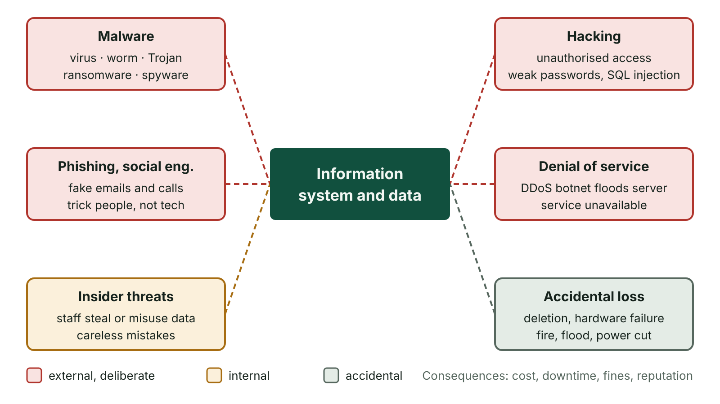
The big picture
Threats to an information system grouped as external deliberate attacks, insider threats and accidental loss
☰ Menu
Notes:
Explain the diagram in your own words before you read on.

Slide 7
Why data needs protecting
Data is often the most valuable asset an organisation owns: customer records, payment details, designs, medical histories
Deliberate threats: malware, hacking, social engineering, denial of service and malicious insiders
Accidental threats: human error, hardware failure, power cuts, fire and flood
Consequences: lost revenue, downtime, fines and enforcement under the UK GDPR and Data Protection Act 2018, damaged reputation
Protection has two sides: reduce the chance of loss, and make sure data can be recovered when loss happens anyway
☰ Menu

Slide 8
Types of malware
Type | How it spreads | What it does
Virus | Attaches to a host file or program; spreads when a user runs or shares the host | Replicates and may corrupt, delete or encrypt data
Worm | Self-replicates across networks without user action, exploiting unpatched vulnerabilities | Uses up bandwidth; often carries a damaging payload
Trojan | Disguised as useful software that the user chooses to install | Opens a back door or steals data; does not self-replicate
Ransomware | Often arrives through phishing attachments or unpatched systems | Encrypts files and demands payment for the decryption key
Spyware / keylogger | Bundled with free downloads or installed by a Trojan | Secretly records activity such as keystrokes and passwords
☰ Menu

Slide 9
Hacking
Hacking is gaining unauthorised access to a computer system or its data
It is an offence under the Computer Misuse Act 1990 (as amended in 2006 and 2015), whether or not damage is done
Methods: exploiting unpatched software, brute-force or dictionary attacks on weak passwords, SQL injection through poorly validated web forms
Aims: steal, alter or delete data, plant malware, or use the system to attack others
Ethical (white-hat) hackers carry out penetration testing with the owner’s written permission
☰ Menu

Slide 10
Phishing and social engineering
Social engineering manipulates people, not machines, into handing over information or access
Phishing: bulk fake emails or websites copying a trusted brand to harvest log-ins or card details
Spear phishing targets a named person using researched details; smishing uses SMS; vishing uses phone calls
Pretexting invents a believable story; shoulder surfing means watching someone type a PIN or password
Relies on urgency, fear and trust, so staff training matters as much as any software
☰ Menu

Slide 11
Denial of service
A denial of service (DoS) attack floods a server or network with requests until genuine users cannot get through
A distributed attack (DDoS) uses a botnet of thousands of compromised devices, so blocking one address does not stop it
Effects: website or online service unavailable, lost sales, frustrated customers, damaged reputation
Usually no data is stolen, but a DDoS can be used to distract staff while another attack takes place
☰ Menu

Slide 12
Insider and accidental threats
Threat | Example | Consequence
Malicious insider | A departing sales rep copies the customer database to a USB stick | Data breach, regulator investigation, customers lost to a rival
Careless insider | A receptionist emails a list of patients to the wrong address | Personal data breach that may need reporting to the Information Commission (formerly the ICO) within 72 hours
Human error | A file is overwritten with an older version or deleted by mistake | Lost work unless a recent backup exists
Hardware failure | A server hard disk or power supply fails | Data loss and downtime until repaired
Natural disaster | The River Erne floods a ground-floor server room | Systems unavailable for days without off-site backups and a recovery plan
☰ Menu

Slide 13
Active and inactive data
Active (current) data is needed for day-to-day work and must be available immediately
Inactive data is no longer used routinely but may be needed later for reference, legal or audit reasons
Example: a school needs current pupils’ records daily, but only occasionally looks up pupils who left years ago
Keeping everything in the live system slows searches, reports and backups and uses expensive fast storage
So inactive data is moved out of the live system and archived
☰ Menu

Slide 14
What archiving involves
Data archiving moves inactive data from the live system to separate, secure, long-term storage
The archive is indexed so that records can be found again quickly when needed
Archived data must be complete and well structured so it still makes sense years later
Archive storage is usually cheaper and slower: tape, high-capacity disks or a low-cost cloud storage tier
UK GDPR still applies: personal data may only be kept as long as necessary, then must be securely deleted
☰ Menu

Slide 15
Archiving: advantages and disadvantages
Advantages | Disadvantages
Live system holds fewer records, so searches, reports and processing run faster | Archived data is not immediately available; time is spent finding it
Backups of the live system are smaller and quicker | Access to archived data can be slow once located
Older data is kept for reference, audit or legal compliance | Archive must be maintained, indexed and kept secure
Cheaper storage media can be used for rarely accessed data | If the index is poor, records may be hard or impossible to find
Historical data can be analysed for long-term trends | Retention periods must be managed to stay within data protection law
☰ Menu

Slide 16
Worked example: a GAA club in County Tyrone
The club database holds about 5,000 people who have ever been members, but only around 400 are current
Every mailing, fee reminder and fixture text has to work through the whole table, which is slow
Records of people inactive for three seasons are moved to an archive file, indexed by surname and year joined
Day-to-day jobs now process about 400 records; the nightly backup shrinks too
When a former player rejoins, the secretary searches the archive index and restores the record to the live table
☰ Menu

Slide 17
Archiving is not backing up
 | Archiving | Backing up
What | Inactive data | Current (live) data
Purpose | Long-term retention for reference or compliance | Recovery if live data is lost or corrupted
Original | Removed from the live system | Stays in the live system; a copy is made
How often | Periodically, e.g. end of year | Frequently, e.g. nightly or hourly
Storage | Cheap, slower media; indexed for retrieval | Separate media, ideally off-site, ready for fast restore
☰ Menu

Slide 18
The need for backup and recovery
A backup is a copy of current data kept separately so it can be used if the original is lost or corrupted
Data recovery means using backed-up data to return the system to a previously correct state
Losing live data has an immediate effect: orders, bookings or patient notes simply disappear
The more often backups are taken, the less work is lost when something goes wrong
Backups are usually automated (e.g. overnight) so they do not rely on someone remembering
☰ Menu

Slide 19
Restore points and transaction logs
A restore point records the exact state of a system at the moment a backup was taken
Recovery returns the system to the most recent good restore point
Changes made since then are lost unless they were also recorded, e.g. in a transaction log
Re-applying the logged transactions in order brings the system fully up to date (roll forward)
Windows System Restore creates restore points for system files and settings, but it does not back up personal files
☰ Menu

Slide 20
Worked example: how much work could be lost?
A Derry pharmacy backs up its dispensing system every night at 23:00
The server fails at 16:00 the next day: 23:00 to 16:00 is 17 hours of changes since the last restore point
Without a transaction log, every prescription recorded in those 17 hours must be re-entered from paper or memory
With hourly backups, at most 1 hour of changes could be lost
With a transaction log stored on a separate device, the logged changes can be replayed, so little or nothing is lost
☰ Menu

Slide 21
Exit quiz: question 1 of 9
Tap an answer to check it. Presenting? Click to reveal the answer.
A sports club moves the records of members who left more than five years ago from its live database into separate, indexed storage. What is this process called?
A Backing up
B Data archiving
✗
✓
C Data recovery
D Encryption
✗
✗
✓ B: Data archiving – Archiving moves inactive data out of the live system into long-term storage from which it can still be retrieved.
☰ Menu

Slide 22
Exit quiz: question 2 of 9
Tap an answer to check it. Presenting? Click to reveal the answer.
Which type of malware spreads across a network on its own by exploiting unpatched vulnerabilities?
A Trojan
B Spyware
✗
✗
C Worm
D Adware
✓
✗
✓ C: Worm – A worm is self-replicating and does not need a host file or user action.
☰ Menu

Slide 23
Exit quiz: question 3 of 9
Tap an answer to check it. Presenting? Click to reveal the answer.
Which malware encrypts a victim’s files and demands payment for the key?
A Ransomware
B Keylogger
✓
✗
C Worm
D Rootkit
✗
✗
✓ A: Ransomware – Ransomware holds data to ransom; recent offline backups are the main defence.
☰ Menu

Slide 24
Exit quiz: question 4 of 9
Tap an answer to check it. Presenting? Click to reveal the answer.
A phone call claiming to be from the bank’s fraud team asks for your PIN. This is…
A a worm
B a DDoS attack
✗
✗
C a brute-force attack
D vishing (social engineering)
✗
✓
✓ D: vishing (social engineering) – Vishing is voice phishing: it manipulates the person rather than the technology.
☰ Menu

Slide 25
Exit quiz: question 5 of 9
Tap an answer to check it. Presenting? Click to reveal the answer.
Which UK law makes unauthorised access to computer material an offence?
A Copyright, Designs and Patents Act 1988
B Freedom of Information Act 2000
✗
✗
C Computer Misuse Act 1990
D Equality Act 2010
✓
✗
✓ C: Computer Misuse Act 1990 – Section 1 of the Computer Misuse Act 1990 covers unauthorised access.
☰ Menu

Slide 26
Exit quiz: question 6 of 9
Tap an answer to check it. Presenting? Click to reveal the answer.
Which is a disadvantage of archiving data?
A Archived data is not immediately available and can be slow to access
B The live system becomes slower
✓
✗
C Backups of the live system take longer
D Older data cannot be kept for legal reasons
✗
✗
✓ A: Archived data is not immediately available and can be slow to access – Archived data must be searched for and retrieved, and access to it may be slow.
☰ Menu

Slide 27
Exit quiz: question 7 of 9
Tap an answer to check it. Presenting? Click to reveal the answer.
What does a restore point record?
A The list of users allowed to restore files
B The state of the system at the moment it was backed up
✗
✓
C The time limit for recovering each system
D Which files are inactive
✗
✗
✓ B: The state of the system at the moment it was backed up – Recovery returns the system exactly to that recorded state.
☰ Menu

Slide 28
Exit quiz: question 8 of 9
Tap an answer to check it. Presenting? Click to reveal the answer.
A shop backs up at 22:00 each night. The server fails at 14:00 the next day and there is no transaction log. How many hours of changes are lost?
A 8
B 10
✗
✗
C 14
D 16
✗
✓
✓ D: 16 – From 22:00 to 14:00 is 16 hours, all of it after the last restore point.
☰ Menu

Slide 29
Exit quiz: question 9 of 9
Tap an answer to check it. Presenting? Click to reveal the answer.
What is the key difference between backing up and archiving?
A Backups are only made once a year
B Archiving copies current data and leaves it in place
✗
✗
C Backing up copies current data so it can be restored; archiving moves inactive data out for long-term storage
D Archives are always stored on the same server as the live data
✓
✗
✓ C: Backing up copies current data so it can be restored; archiving moves inactive data out for long-term storage – A backup is a recovery copy of live data; an archive is long-term storage of data no longer in active use.
☰ Menu

Slide 30
Exit quiz answers
Q | Answer | Why
1 | B Data archiving | Archiving moves inactive data out of the live system into long-term storage from which it can still be retrieved.
2 | C Worm | A worm is self-replicating and does not need a host file or user action.
3 | A Ransomware | Ransomware holds data to ransom; recent offline backups are the main defence.
4 | D vishing (social engineering) | Vishing is voice phishing: it manipulates the person rather than the technology.
5 | C Computer Misuse Act 1990 | Section 1 of the Computer Misuse Act 1990 covers unauthorised access.
6 | A Archived data is not immediately available and can be slow to access | Archived data must be searched for and retrieved, and access to it may be slow.
7 | B The state of the system at the moment it was backed up | Recovery returns the system exactly to that recorded state.
8 | D 16 | From 22:00 to 14:00 is 16 hours, all of it after the last restore point.
9 | C Backing up copies current data so it can be restored; archiving moves inactive data out for long-term storage | A backup is a recovery copy of live data; an archive is long-term storage of data no longer in active use.
☰ Menu

Slide 31
Protecting systems: security measures, backup methods and disaster recovery
AS 1: APPROACHES TO SYSTEMS DEVELOPMENT · AP15
Learning objectives
Explain how a security policy, authentication, access rights, encryption and firewalls protect data
Describe how full, differential and incremental backups work and evaluate each one
Describe the steps needed to restore a system from each type of backup
Explain why an organisation needs a disaster recovery plan and describe its contents
Explain recovery point and recovery time objectives and how a plan is tested
Notes:
Specification: Describe the purpose and content of a security policy | Describe access control and authentication methods, encryption and firewalls | Evaluate methods of backup: full backup, differential backup and incremental backup | Describe how a system is restored using each method of backup | Explain the purpose of a disaster recovery plan | Describe the contents of a typical disaster recovery plan, including recovery point and recovery time objectives, and how plans are tested

Slide 32
In this lesson
Tap a button to jump straight there. The ☰ Menu button on every slide brings you back here.
The big picture
Worked example: backup sizes over a week
Disaster recovery and the DR plan
Security policy
Which files does each method copy?
Recovery objectives for a Belfast online retailer
Access control and authentication
Evaluating the backup methods
Achieving the objectives and testing the plan
Encryption
Restoring a system
Exit quiz
Firewalls and other technical measures
Worked example: a Coleraine garden centre
↑ Topic menu
Three methods of backup
Good backup practice
Notes:
Lesson menu: each button jumps to that part of the lesson in Slide Show. The ☰ Menu button on each slide returns here.

Slide 33
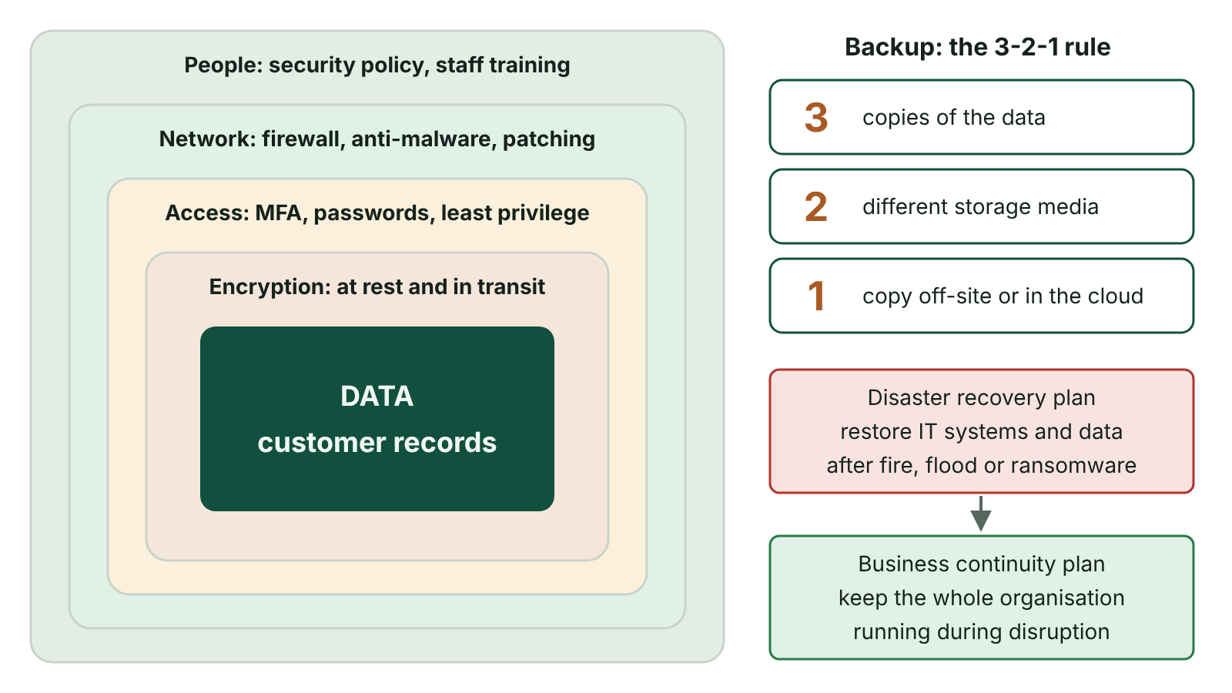
The big picture
Layers of protection around data – policy and training, network defences, authentication and access rights, encryption – alongside the 3-2-1 backup rule and disaster recovery
☰ Menu
Notes:
Explain the diagram in your own words before you read on.

Slide 34
Security policy
A formal document setting out how an organisation protects its systems and data and what staff must do
Typical contents: acceptable use, password rules, access levels, personal devices and removable media, remote working
Also: how to report incidents, backup procedures, staff training and the disciplinary action for breaches
Helps the organisation meet its duties under the UK GDPR and Data Protection Act 2018
Only works if it is communicated to staff, enforced and reviewed regularly
☰ Menu

Slide 35
Access control and authentication
Identification (a user ID) says who you claim to be; authentication proves it
Factors: something you know (password, PIN), something you have (phone, smart card), something you are (fingerprint, face)
Multi-factor authentication (MFA) combines two or more factor types, so a stolen password alone is not enough
Access rights give each user only what their job needs (least privilege), e.g. read-only rather than read/write
Audit logs record who accessed what and when, deterring and detecting misuse
☰ Menu

Slide 36
Encryption
Encryption uses an algorithm and a key to turn plaintext into ciphertext; only the correct key decrypts it
Symmetric: the same key encrypts and decrypts; fast, but the key must be shared securely
Asymmetric: a public key encrypts and only the matching private key decrypts; used to set up HTTPS (TLS) connections
Protects data in transit (HTTPS, VPNs) and at rest (encrypted laptops, USB drives, backups)
Stolen encrypted data is unreadable, but encryption does not stop it being copied or deleted
☰ Menu

Slide 37
Firewalls and other technical measures
A firewall checks network traffic against rules (IP address, port, protocol) and blocks anything not permitted
Hardware firewalls protect the network boundary; software firewalls protect individual devices
Anti-malware software detects and removes known malware and suspicious behaviour
Patching software promptly closes the vulnerabilities that worms and hackers exploit
Physical security: locked server rooms, swipe-card entry and CCTV
☰ Menu

Slide 38
Three methods of backup
Method | What is copied each time | Restore needs
Full | Every file on the system | Only the latest full backup
Differential | All files changed since the last full backup | Last full backup + the most recent differential
Incremental | Only files altered since the most recent backup, whether that was full or incremental | Last full backup + every incremental since, in order
☰ Menu

Slide 39
Worked example: backup sizes over a week
A Newry accountancy firm holds 200 GB of data; about 10 GB of different files changes each day
Full backup every day for 7 days: 7 × 200 = 1,400 GB stored
Full on day 0, then 6 differentials: 200 + (10 + 20 + 30 + 40 + 50 + 60) = 200 + 210 = 410 GB
Full on day 0, then 6 incrementals: 200 + (6 × 10) = 260 GB
Each differential grows because it holds every change since the full; each incremental stays at about one day’s changes
☰ Menu

Slide 40
Which files does each method copy?
Backup software compares each file’s last-modified time with the time of an earlier backup
Incremental compares with the last backup of any kind; differential compares with the last full backup
☰ Menu

Slide 41
Which files does each method copy? – code
PSEUDOCODE
FOR EACH file IN system
IF backupType = "FULL" THEN
COPY file
ELSE IF backupType = "DIFFERENTIAL" AND file.modified > lastFullTime THEN
COPY file
ELSE IF backupType = "INCREMENTAL" AND file.modified > lastBackupTime THEN
COPY file
END IF
END FOR
IF backupType = "FULL" THEN
lastFullTime ← now
END IF
lastBackupTime ← now
☰ Menu

Slide 42
Evaluating the backup methods
Method | Advantages | Disadvantages
Full | Everything copied at once; whole system restored from one backup; simplest, fastest restore | Slowest to create; most storage; recopies unchanged files
Differential | Quicker to create than full; restore needs only two backups, so faster than incremental | Grows larger each day; slower restore than full as the newest copy of each file must be picked out
Incremental | Fastest to create; least storage of the three | Slowest, most complex restore; one corrupt incremental breaks the chain
☰ Menu

Slide 43
Restoring a system
Restores must be planned so that downtime (time the system cannot be used) is as short as possible
Full: replace the files with the latest full backup; the simplest and usually quickest restore
Differential: restore the last full backup, then the latest differential, which holds the newest copy of every changed file
Incremental: restore the last full backup, then every incremental in date order, so later copies overwrite earlier ones
Finally re-apply transactions logged since the last backup to bring data fully up to date
☰ Menu

Slide 44
Worked example: a Coleraine garden centre
Full backup every Saturday at 20:00; incremental backup at 20:00 on each of the other six nights
The server fails on Wednesday at 10:30
Restore Saturday’s full backup, then Sunday’s, Monday’s and Tuesday’s incrementals, in that order
The system is now as it was at 20:00 on Tuesday; 14½ hours of changes remain
Replay the transactions logged since 20:00 on Tuesday to bring stock and sales up to date
If they used differentials instead: restore Saturday’s full backup, then only Tuesday’s differential
☰ Menu

Slide 45
Good backup practice
Store at least one copy off-site or in the cloud, so a fire or flood cannot destroy the data and its backups together
A common rule: 3 copies of the data, on 2 different types of media, 1 of them off-site
Keep at least one copy offline or unchangeable so ransomware cannot encrypt the backups too
Encrypt backups, because a lost backup tape or drive is a data breach
Automate backups, check that they completed, and regularly test that data can actually be restored
☰ Menu

Slide 46
Disaster recovery and the DR plan
Disaster recovery is how an organisation recovers its systems after a catastrophic incident, more serious than one lost file
Causes: accidents (fire, major corruption), natural events (flood, storm), deliberate acts (hacking, terrorism)
Disasters cannot be avoided; the plan aims to minimise their effects and resume work quickly
Core contents of a DR plan: the critical data, the key people and their roles, how backup and recovery are done, and a fallback site
It is written when a system is set up and kept up to date as the system changes
☰ Menu

Slide 47
Recovery objectives for a Belfast online retailer
System to recover (RPO list) | Recovery time objective (RTO) | Why
Online shop and payments | 12 hours | Every hour offline is lost sales
Order dispatch system | 24 hours | Customers expect next-day delivery
Stock control | 48 hours | Short gaps can be covered manually
Payroll | 5 days | Staff are paid monthly
Management reports | 7 days | Useful but not urgent
☰ Menu

Slide 48
Achieving the objectives and testing the plan
Techniques: regular off-site backups; private online storage for fast restores; cloud-hosted servers that can be started on demand; standby staff
An alternative site: hot (ready to run at once), warm (equipment but needs data) or cold (premises only)
Walk-through test: staff talk through the plan step by step so everyone knows their role
Simulation test: systems are deliberately switched off and actually recovered, exposing weaknesses
A business continuity plan is wider: keeping the whole organisation running, including staff, premises, suppliers and communication
☰ Menu

Slide 49
Exit quiz: question 1 of 10
Tap an answer to check it. Presenting? Click to reveal the answer.
A business takes a full backup on Sunday and backs up only the files changed since the previous night’s backup on each other night. Which backup method is used on those other nights?
A Full
B Differential
✗
✗
C Mirror
D Incremental
✗
✓
✓ D: Incremental – Copying only changes since the last backup of any type is incremental.
☰ Menu

Slide 50
Exit quiz: question 2 of 10
Tap an answer to check it. Presenting? Click to reveal the answer.
Which of these should a disaster recovery plan identify?
A The colour scheme of the company website
B A fallback location where staff can keep working
✗
✓
C The marketing budget for next year
D Each customer’s favourite products
✗
✗
✓ B: A fallback location where staff can keep working – The core contents are the critical data, the key staff and their roles, how backups are taken and restored, and a fallback site.
☰ Menu

Slide 51
Exit quiz: question 3 of 10
Tap an answer to check it. Presenting? Click to reveal the answer.
A password plus a code sent to your phone is an example of…
A multi-factor authentication
B biometrics
✓
✗
C encryption
D a firewall
✗
✗
✓ A: multi-factor authentication – It combines something you know with something you have.
☰ Menu

Slide 52
Exit quiz: question 4 of 10
Tap an answer to check it. Presenting? Click to reveal the answer.
Which backup method needs only the last full backup and one other backup to restore?
A Incremental
B Differential
✗
✓
C Transaction log
D Partial
✗
✗
✓ B: Differential – The latest differential holds every change since the last full backup.
☰ Menu

Slide 53
Exit quiz: question 5 of 10
Tap an answer to check it. Presenting? Click to reveal the answer.
Which backup method is fastest to create and uses the least storage?
A Full
B Differential
✗
✗
C Incremental
D All are the same
✓
✗
✓ C: Incremental – Each incremental copies only one period’s changes, but restoring is slowest.
☰ Menu

Slide 54
Exit quiz: question 6 of 10
Tap an answer to check it. Presenting? Click to reveal the answer.
A full backup is taken on day 0 of 100 GB. 5 GB of different files changes each day. How large is the differential backup on day 4?
A 5 GB
B 10 GB
✗
✗
C 20 GB
D 105 GB
✓
✗
✓ C: 20 GB – A differential holds all changes since the full backup: 4 days × 5 GB = 20 GB.
☰ Menu

Slide 55
Exit quiz: question 7 of 10
Tap an answer to check it. Presenting? Click to reveal the answer.
In disaster recovery planning, the recovery time objective is…
A the time limit for recovering a part of the system
B the time a backup takes to run
✓
✗
C the date the plan was written
D the time a firewall takes to block a packet
✗
✗
✓ A: the time limit for recovering a part of the system – Each system to be recovered is given a time limit based on how critical it is.
☰ Menu

Slide 56
Exit quiz: question 8 of 10
Tap an answer to check it. Presenting? Click to reveal the answer.
Which device or software filters traffic using rules on ports and IP addresses?
A Backup server
B Anti-malware
✗
✗
C Router table
D Firewall
✗
✓
✓ D: Firewall – A firewall enforces rules on what traffic may pass.
☰ Menu

Slide 57
Exit quiz: question 9 of 10
Tap an answer to check it. Presenting? Click to reveal the answer.
Why should at least one backup be kept off-site?
A It makes the backup run faster
B So that a fire or flood at the main site does not destroy the backups too
✗
✓
C Because off-site backups cannot be encrypted
D So that the backup does not need testing
✗
✗
✓ B: So that a fire or flood at the main site does not destroy the backups too – Backups stored with the live system share the same physical risks.
☰ Menu

Slide 58
Exit quiz: question 10 of 10
Tap an answer to check it. Presenting? Click to reveal the answer.
Staff talk through each step of the disaster recovery plan in a meeting without switching any systems off. This is a…
A simulation test
B penetration test
✗
✗
C walk-through (theoretical) test
D load test
✓
✗
✓ C: walk-through (theoretical) test – A walk-through checks that people know their roles; a simulation actually disables systems.
☰ Menu

Slide 59
Exit quiz answers
Q | Answer | Why
1 | D Incremental | Copying only changes since the last backup of any type is incremental.
2 | B A fallback location where staff can keep working | The core contents are the critical data, the key staff and their roles, how backups are taken and restored, and a fallback site.
3 | A multi-factor authentication | It combines something you know with something you have.
4 | B Differential | The latest differential holds every change since the last full backup.
5 | C Incremental | Each incremental copies only one period’s changes, but restoring is slowest.
6 | C 20 GB | A differential holds all changes since the full backup: 4 days × 5 GB = 20 GB.
7 | A the time limit for recovering a part of the system | Each system to be recovered is given a time limit based on how critical it is.
8 | D Firewall | A firewall enforces rules on what traffic may pass.
9 | B So that a fire or flood at the main site does not destroy the backups too | Backups stored with the live system share the same physical risks.
10 | C walk-through (theoretical) test | A walk-through checks that people know their roles; a simulation actually disables systems.
☰ Menu

