Slide 1
Algorithms
AS 1: APPROACHES TO SYSTEMS DEVELOPMENT · TOPIC
Lessons in this topic
AP16 Programs, algorithms and their design
AP17 Searching algorithms
AP18 Sorting algorithms

Slide 2

Topic menu
Tap a button to jump straight there. The ☰ Menu button on every slide brings you back here.
Specification map
AP17 Searching algorithms
AP16 Programs, algorithms and their design
AP18 Sorting algorithms

Slide 3
Specification map
Lesson | Specification: students should be able to
AP16 | Describe the purpose of a computer program; Explain the term algorithm and the properties a good algorithm must have; Explain decomposition and abstraction as techniques for solving problems; Describe how algorithms can be represented using pseudocode and flowcharts; Use trace tables and dry runs to test an algorithm and find logic errors
AP17 | Describe how a linear search and a binary search work, using pseudocode, flowcharts and trace tables; Implement linear search and binary search in C#; Compare the efficiency of searching algorithms in terms of the number of comparisons in the best, average and worst cases; Explain the conditions under which each search is appropriate
AP18 | Describe, trace and implement bubble sort and insertion sort using pseudocode and C#; Describe the principles of merge sort and quick sort as divide-and-conquer algorithms; Compare sorting algorithms in terms of time efficiency, memory use and suitability for a given data set; Explain how design features such as a swapped flag improve the efficiency of an algorithm
☰ Menu
Notes:
Each lesson below is its own section in PowerPoint (View → Slide Sorter shows them). To split this deck by specification point, right-click a section → Move Section, or delete the sections you do not need.

Slide 4
Programs, algorithms and their design
AS 1: APPROACHES TO SYSTEMS DEVELOPMENT · AP16
Learning objectives
Describe what a program is for and explain what makes a set of instructions an algorithm
Break a problem down and remove unnecessary detail before designing a solution
Express the same algorithm as pseudocode, a flowchart and C# using sequence, selection and iteration
Dry run an algorithm with a trace table to predict its output and locate logic errors
Notes:
Specification: Describe the purpose of a computer program | Explain the term algorithm and the properties a good algorithm must have | Explain decomposition and abstraction as techniques for solving problems | Describe how algorithms can be represented using pseudocode and flowcharts | Use trace tables and dry runs to test an algorithm and find logic errors

Slide 5
In this lesson
Tap a button to jump straight there. The ☰ Menu button on every slide brings you back here.
The big picture
Input – process – output
Trace table: inputs 12, 4, 15, 0
What is a computer program for?
Pseudocode and structured English
Unknown number of inputs: a sentinel value
What is an algorithm?
Flowchart symbols
Debug the design: a dry run finds the error
Properties of a good algorithm
Worked example: Lough Erne rainfall
Exit quiz
Making instructions precise
The rainfall algorithm as a flowchart
↑ Topic menu
Decomposition and abstraction
The rainfall algorithm in C#
Notes:
Lesson menu: each button jumps to that part of the lesson in Slide Show. The ☰ Menu button on each slide returns here.

Slide 6
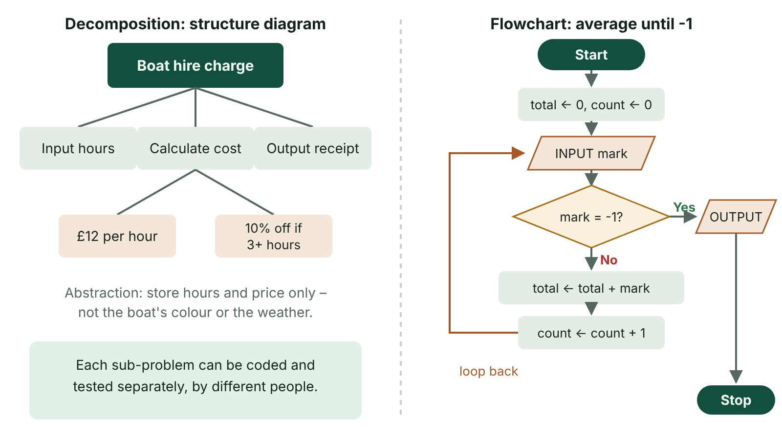
The big picture
Decomposition of a boat-hire problem into a structure diagram, beside a flowchart of a sentinel-controlled averaging loop
☰ Menu
Notes:
Explain the diagram in your own words before you read on.

Slide 7
What is a computer program for?
A computer program is a set of instructions that a computer carries out to perform a task – from a simple calculator to a hospital booking system
Programs are software: they are kept separate from the physical hardware they run on
System software (such as the operating system) lets us use and control the computer; application programs do a specific job for the user
Word processors, spreadsheets, school MIS packages and a club's membership app are all application programs
Every program starts life as an algorithm: the programmer works out the steps first, then writes the code
☰ Menu

Slide 8
What is an algorithm?
An algorithm is a finite, ordered set of precise, unambiguous steps that solves a problem or completes a task
Everyday algorithms: a recipe, directions to Enniskillen bus station, instructions for assembling flat-pack furniture
An algorithm is language-independent – once designed, it can be coded in C#, Python, Java or any other language
Every algorithm is built from three constructs: sequence, selection (decisions) and iteration (loops)
Think of the algorithm being followed by a robot with no common sense: it does exactly what is written, nothing more
☰ Menu

Slide 9
Properties of a good algorithm (1 of 2)
Property | What it means | Everyday illustration
Ordered | Steps are followed in a set sequence | Toast the bread before buttering it, not after
Precise | Each step states exactly what to do | 'Toast for 2 minutes', not 'toast for a while'
Unambiguous | Each step has only one possible meaning | 'Turn left at the second roundabout', not just 'the roundabout' when there are several
Finite | It always stops after a limited number of steps | 'Stir until smooth' could go on forever if it never becomes smooth
Inputs and outputs | Zero or more inputs; at least one output related to them | Ingredients in, a finished sandwich out
☰ Menu

Slide 10
Properties of a good algorithm (2 of 2)
Property | What it means | Everyday illustration
Correct and efficient | Works for all valid cases, handles errors sensibly and has no wasted steps | Checks the bread is not mouldy; does not walk to the shop twice
☰ Menu

Slide 11
Making instructions precise
Vague instruction | Problem | Precise version
Add some sugar | Imprecise quantity | Add 2 level teaspoons of sugar
Wait a bit, then check | Imprecise time | Wait 5 minutes, then check
Go left after the church | Ambiguous if two churches | Turn left at the junction immediately after St Michael's Church
Keep going until it looks right | May never terminate | Repeat up to 10 times or until the total reaches 100
Get the number | Unclear source | Input a whole number from the keyboard
☰ Menu

Slide 12
Decomposition and abstraction
 | Decomposition | Abstraction
Meaning | Breaking a complex problem into smaller sub-problems that can be solved separately | Removing unnecessary detail to focus on what matters for the problem
Example | A Translink ticket app split into: login, journey planner, payment, ticket display | A route map shows stops and connections, not the exact road shapes
Benefit | Sub-problems can be given to different programmers and tested separately | Simpler model, less data to store, faster to design and process
Shown with | A structure (top-down) diagram | A model, data dictionary or simplified diagram
☰ Menu

Slide 13
Input – process – output
Most algorithms take inputs, process them and produce outputs
Example: a cinema in Omagh charges £8.50 per adult and £6.00 per child
Inputs: number of adults and children; process: calculate the cost; output: the total
Trace with 2 adults and 3 children: 2 × 8.50 + 3 × 6.00 = 17.00 + 18.00 = £35.00
This algorithm is pure sequence: every step runs once, in order
PSEUDOCODE
INPUT adults
INPUT children
cost ← adults * 8.50 + children * 6.00
OUTPUT "Total cost: £", cost
☰ Menu

Slide 14
Pseudocode and structured English
Algorithms can first be written in plain English so non-programmers (such as the client) can check that they are correct
Structured English and pseudocode are closer to program code: more useful to the programmer, slightly harder for a non-expert
Pseudocode has no fixed syntax, but it must be consistent and unambiguous
In this course: INPUT, OUTPUT, ← for assignment, IF…THEN…ELSE…ENDIF, FOR…NEXT, WHILE…ENDWHILE, REPEAT…UNTIL
Keywords such as GET, PRINT and SET are also acceptable if used consistently
Indentation shows which statements belong inside a selection or a loop
☰ Menu

Slide 15
Flowchart symbols
Symbol | Shape | Use
Terminator | Rounded rectangle (oval) | START and END – one of each
Process | Rectangle | A calculation or assignment, e.g. total ← total + rain
Input/output | Parallelogram | INPUT rain, OUTPUT total
Decision | Diamond | A yes/no question, e.g. rain > 10? – two exits, each labelled
Flow line | Arrow | Shows the order steps are followed; a loop is an arrow back to an earlier point
☰ Menu

Slide 16
Worked example: Lough Erne rainfall
A weather volunteer records rainfall (mm) for 4 days and wants the total and the number of wet days (more than 10 mm)
Decomposition: input each reading; add it to a running total; count it if wet; output the results
A count-controlled loop (FOR) is used because the number of readings is known in advance
Totals and counters must be set to 0 before the loop starts (initialised)
PSEUDOCODE
total ← 0
wetDays ← 0
FOR day ← 1 TO 4
INPUT rain
total ← total + rain
IF rain > 10 THEN
wetDays ← wetDays + 1
ENDIF
NEXT day
OUTPUT total
OUTPUT wetDays
☰ Menu

Slide 17
The rainfall algorithm as a flowchart
Order | Symbol | Contents
1 | Terminator | START
2 | Process | total ← 0, wetDays ← 0, day ← 1
3 | Decision | day <= 4? No → go to step 7; Yes → step 4
4 | Input | INPUT rain
5 | Process, then decision | total ← total + rain; then rain > 10? Yes → wetDays ← wetDays + 1
6 | Process | day ← day + 1, then flow line back to the decision at step 3
7 | Output, then terminator | OUTPUT total and wetDays, then END
☰ Menu

Slide 18
The rainfall algorithm in C#
The for loop keeps the counter, the test (day <= 4) and the increment together on one line
int.Parse converts the text typed at the keyboard into a whole number
☰ Menu

Slide 19
The rainfall algorithm in C# – code
C#
int total = 0, wetDays = 0;
for (int day = 1; day <= 4; day++)
{
Console.Write($"Rainfall for day {day} (mm): ");
int rain = int.Parse(Console.ReadLine());
total += rain;
if (rain > 10)
{
wetDays++;
}
}
Console.WriteLine($"Total rainfall: {total} mm");
Console.WriteLine($"Wet days: {wetDays}");
☰ Menu

Slide 20
Trace table: inputs 12, 4, 15, 0
day | rain | total | rain > 10? | wetDays | Output
– | – | 0 | – | 0
1 | 12 | 12 | True | 1
2 | 4 | 16 | False | 1
3 | 15 | 31 | True | 2
4 | 0 | 31 | False | 2
5 (loop ends) | 0 | 31 | – | 2 | 31, then 2
☰ Menu

Slide 21
Unknown number of inputs: a sentinel value
When the amount of data is not known in advance, use a condition-controlled loop that stops at a sentinel (rogue) value such as -1
Read the first value before the loop and the next value at the end of the loop body
Dry run with marks 60, 70, -1: total 0 → 60 → 130, count 0 → 1 → 2, output 65
The count > 0 check avoids dividing by zero; casting to double avoids integer division
☰ Menu

Slide 22
Unknown number of inputs: a sentinel value – code
C#
int total = 0, count = 0;
Console.Write("Mark (-1 to end): ");
int mark = int.Parse(Console.ReadLine());
while (mark != -1)
{
total += mark;
count++;
Console.Write("Mark (-1 to end): ");
mark = int.Parse(Console.ReadLine());
}
if (count > 0)
Console.WriteLine("Average: " + (double)total / count);
else
Console.WriteLine("No marks entered");
☰ Menu

Slide 23
Debug the design: a dry run finds the error
A pupil moved 'wetDays ← 0' inside the loop, just before INPUT rain
Dry run with 12, 4, 15, 0: wetDays is reset to 0 on every pass, so it ends each pass as 1, 0, 1, 0
Output is 0 wet days instead of 2 – the program runs, so this is a logic error, not a syntax error
Other errors a trace exposes: an uninitialised total, < instead of <=, a loop that runs one time too many, or forgetting to input the next value
Choose test data that includes normal, boundary (exactly 10 mm) and erroneous values
☰ Menu

Slide 24
Exit quiz: question 1 of 9
Tap an answer to check it. Presenting? Click to reveal the answer.
Which property of an algorithm is broken by the instruction 'keep stirring until the sauce looks right'?
A Inputs
B Finiteness
✗
✓
C Sequence
D Abstraction
✗
✗
✓ B: Finiteness – The instruction may never end, so the algorithm may not terminate, and 'looks right' is also imprecise.
☰ Menu

Slide 25
Exit quiz: question 2 of 9
Tap an answer to check it. Presenting? Click to reveal the answer.
A bus map shows only stops and routes, not the exact shape of each road. This is an example of…
A abstraction
B decomposition
✓
✗
C iteration
D validation
✗
✗
✓ A: abstraction – Unnecessary detail has been removed to leave a simpler model.
☰ Menu

Slide 26
Exit quiz: question 3 of 9
Tap an answer to check it. Presenting? Click to reveal the answer.
Which construct repeats a set of instructions?
A Sequence
B Selection
✗
✗
C Iteration
D Decomposition
✓
✗
✓ C: Iteration – Iteration means looping.
☰ Menu

Slide 27
Exit quiz: question 4 of 9
Tap an answer to check it. Presenting? Click to reveal the answer.
Which flowchart symbol is used for 'total ← total + price'?
A Diamond
B Parallelogram
✗
✗
C Rounded rectangle
D Rectangle
✗
✓
✓ D: Rectangle – Processes, such as calculations and assignments, use a rectangle.
☰ Menu

Slide 28
Exit quiz: question 5 of 9
Tap an answer to check it. Presenting? Click to reveal the answer.
What is a sentinel value?
A The first value in an array
B A special input value that signals the end of the data
✗
✓
C A constant used for VAT
D An error message
✗
✗
✓ B: A special input value that signals the end of the data – For example, -1 entered to stop the input of marks.
☰ Menu

Slide 29
Exit quiz: question 6 of 9
Tap an answer to check it. Presenting? Click to reveal the answer.
Which tool records variable values step by step during a dry run?
A Structure diagram
B Data dictionary
✗
✗
C Trace table
D Gantt chart
✓
✗
✓ C: Trace table – A trace table has a column for each variable and for output.
☰ Menu

Slide 30
Exit quiz: question 7 of 9
Tap an answer to check it. Presenting? Click to reveal the answer.
Inputs 12, 4, 15, 0 are processed by the rainfall algorithm (count days with rain > 10). What is output for wetDays?
A 1
B 2
✗
✓
C 3
D 4
✗
✗
✓ B: 2 – Only 12 and 15 are greater than 10.
☰ Menu

Slide 31
Exit quiz: question 8 of 9
Tap an answer to check it. Presenting? Click to reveal the answer.
Why might an algorithm be written in plain English first?
A It runs faster
B It is shorter than code
✗
✗
C A client with no programming knowledge can check it is correct
D It cannot contain errors
✓
✗
✓ C: A client with no programming knowledge can check it is correct – Plain English lets non-programmers confirm the design solves the right problem.
☰ Menu

Slide 32
Exit quiz: question 9 of 9
Tap an answer to check it. Presenting? Click to reveal the answer.
A loop totals 5 numbers but outputs only the last number entered. What is the most likely cause?
A total is reset to 0 inside the loop
B The loop is a FOR loop
✓
✗
C total is output after the loop
D The numbers are integers
✗
✗
✓ A: total is reset to 0 inside the loop – Resetting the total inside the loop throws away earlier values – a logic error.
☰ Menu

Slide 33
Exit quiz answers
Q | Answer | Why
1 | B Finiteness | The instruction may never end, so the algorithm may not terminate, and 'looks right' is also imprecise.
2 | A abstraction | Unnecessary detail has been removed to leave a simpler model.
3 | C Iteration | Iteration means looping.
4 | D Rectangle | Processes, such as calculations and assignments, use a rectangle.
5 | B A special input value that signals the end of the data | For example, -1 entered to stop the input of marks.
6 | C Trace table | A trace table has a column for each variable and for output.
7 | B 2 | Only 12 and 15 are greater than 10.
8 | C A client with no programming knowledge can check it is correct | Plain English lets non-programmers confirm the design solves the right problem.
9 | A total is reset to 0 inside the loop | Resetting the total inside the loop throws away earlier values – a logic error.
☰ Menu

Slide 34
Searching algorithms
AS 1: APPROACHES TO SYSTEMS DEVELOPMENT · AP17
Learning objectives
Describe and code a linear search and a binary search in C#
Trace a binary search, recording low, high and mid and the items compared
Calculate the maximum number of comparisons each search needs for a list of a given size
Justify which search to use for a given scenario
Notes:
Specification: Describe how a linear search and a binary search work, using pseudocode, flowcharts and trace tables | Implement linear search and binary search in C# | Compare the efficiency of searching algorithms in terms of the number of comparisons in the best, average and worst cases | Explain the conditions under which each search is appropriate

Slide 35
In this lesson
Tap a button to jump straight there. The ☰ Menu button on every slide brings you back here.
The big picture
Binary search in pseudocode
Big-O at a glance
Why searching matters
Binary search in C#
Which search should be used?
Linear search
Trace: find 46 in 2 5 9 14 21 27 33 40 46 52
Exit quiz
Linear search in C#
Trace: search for 10 (not present)
↑ Topic menu
Linear search trace: find Enniskillen
Counting comparisons
Binary search
Comparing efficiency
Notes:
Lesson menu: each button jumps to that part of the lesson in Slide Show. The ☰ Menu button on each slide returns here.

Slide 36
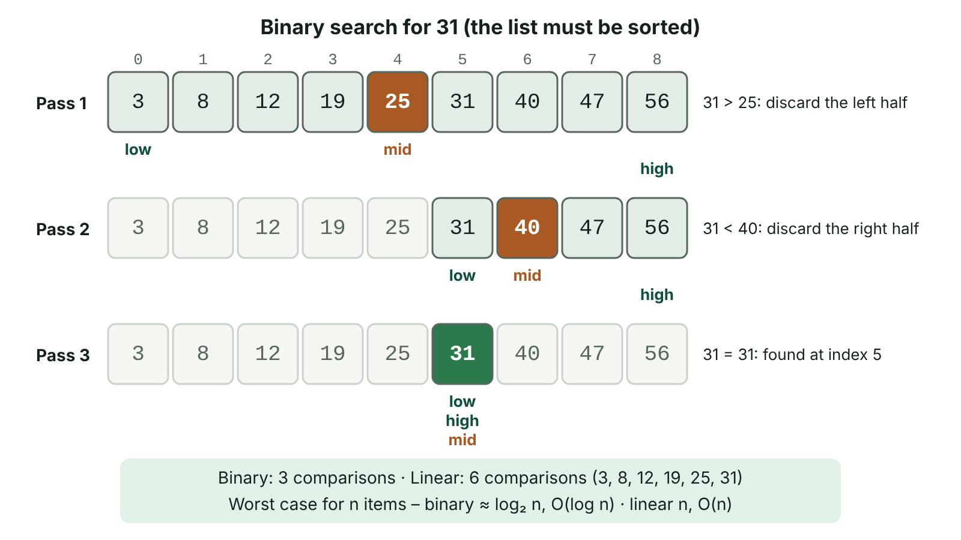
The big picture
Binary search for 31 in a sorted array of nine items: each pass compares the middle item and discards half, finding it in 3 comparisons compared with 6 for a linear search
☰ Menu
Notes:
Explain the diagram in your own words before you read on.

Slide 37
Why searching matters
Searching means finding whether a target value is in a collection of data and, if so, where it is
Examples: finding a pupil in the school register, a product code at a Newry supermarket till, a patient record in a hospital system
The two standard algorithms are linear search and binary search
Both are judged by how many comparisons they make – fewer comparisons means a faster search on large data sets
A search returns the position (index) of the target, or a signal such as -1 if it is not there
☰ Menu

Slide 38
Linear search
Check each item in turn, from the first, until the target is found or the end of the list is reached
Works on unsorted or sorted data, and on structures that can only be read in order, such as a file read line by line
Best case: 1 comparison (first item); worst case: n comparisons (last item or not present)
Average about n/2 comparisons when the item is present
PSEUDOCODE
found ← False
i ← 0
WHILE i < LENGTH(list) AND found = False
IF list[i] = target THEN
found ← True
ELSE
i ← i + 1
ENDIF
ENDWHILE
IF found THEN
OUTPUT "Found at position ", i
ELSE
OUTPUT "Not found"
ENDIF
☰ Menu

Slide 39
Linear search in C#
The method returns the index of the target, or -1 if it is not found
Returning as soon as the item is found avoids needless comparisons
☰ Menu

Slide 40
Linear search in C# – code
C#
static int LinearSearch(string[] list, string target)
{
for (int i = 0; i < list.Length; i++)
{
if (list[i] == target) return i;
}
return -1;
}
string[] towns = { "Omagh", "Derry", "Belfast", "Enniskillen", "Newry" };
Console.WriteLine(LinearSearch(towns, "Enniskillen")); // 3
Console.WriteLine(LinearSearch(towns, "Armagh")); // -1
☰ Menu

Slide 41
Linear search trace: find Enniskillen
i | towns[i] | towns[i] = target? | Action
0 | Omagh | False | i ← 1
1 | Derry | False | i ← 2
2 | Belfast | False | i ← 3
3 | Enniskillen | True | Return 3 – found after 4 comparisons
0 to 4 (target Armagh) | every town | False each time | Return -1 – 5 comparisons (worst case)
☰ Menu

Slide 42
Binary search
The list MUST be sorted (numerically or alphabetically)
Find the middle item: mid = (low + high) DIV 2, rounding down
If the middle item is the target, stop – it has been found
If the target is smaller, discard the upper half (high ← mid − 1); if larger, discard the lower half (low ← mid + 1)
Repeat on the remaining half until found, or until low > high, meaning no items remain and the target is not present
Each comparison halves the search space – a 'divide and conquer' approach
☰ Menu

Slide 43
Binary search in pseudocode
low and high mark the part of the list still being searched
The loop stops when the target is found or the range is empty
PSEUDOCODE
low ← 0
high ← LENGTH(list) - 1
found ← False
WHILE low <= high AND found = False
mid ← (low + high) DIV 2
IF list[mid] = target THEN
found ← True
ELSE IF list[mid] < target THEN
low ← mid + 1
ELSE
high ← mid - 1
ENDIF
ENDWHILE
☰ Menu

Slide 44
Binary search in C#
In C#, dividing one int by another gives an int, so (low + high) / 2 rounds down automatically
The array holds sorted membership numbers for a Lisburn swimming club
☰ Menu

Slide 45
Binary search in C# – code
C#
static int BinarySearch(int[] a, int target)
{
int low = 0, high = a.Length - 1;
while (low <= high)
{
int mid = (low + high) / 2;
if (a[mid] == target) return mid;
else if (a[mid] < target) low = mid + 1;
else high = mid - 1;
}
return -1;
}
int[] members = { 2, 5, 9, 14, 21, 27, 33, 40, 46, 52 };
Console.WriteLine(BinarySearch(members, 46)); // 8
Console.WriteLine(BinarySearch(members, 10)); // -1
☰ Menu

Slide 46
Trace: find 46 in 2 5 9 14 21 27 33 40 46 52
Pass | low | high | mid | a[mid] | Action
1 | 0 | 9 | 4 | 21 | 46 > 21 so low ← 5
2 | 5 | 9 | 7 | 40 | 46 > 40 so low ← 8
3 | 8 | 9 | 8 | 46 | Found at index 8 – 3 comparisons
☰ Menu

Slide 47
Trace: search for 10 (not present)
Pass | low | high | mid | a[mid] | Action
1 | 0 | 9 | 4 | 21 | 10 < 21 so high ← 3
2 | 0 | 3 | 1 | 5 | 10 > 5 so low ← 2
3 | 2 | 3 | 2 | 9 | 10 > 9 so low ← 3
4 | 3 | 3 | 3 | 14 | 10 < 14 so high ← 2
End | 3 | 2 | – | – | low > high: not found, return -1 after 4 comparisons
☰ Menu

Slide 48
Counting comparisons
Binary search worst case = the number of times n can be halved before nothing is left = ⌊log₂ n⌋ + 1
n = 10: 10 → 5 → 2 → 1, so at most 4 comparisons (matches the trace above)
n = 1 024 = 2¹⁰: at most 11 comparisons; a linear search could need 1 024
n = 1 000 000: 2¹⁹ = 524 288 ≤ n < 2²⁰, so at most 20 comparisons
Quick estimate: each doubling of the data adds just one comparison to a binary search but doubles the work of a linear search
☰ Menu

Slide 49
Comparing efficiency
Items (n) | Linear: best | Linear: worst | Binary: best | Binary: worst
10 | 1 | 10 | 1 | 4
1 000 | 1 | 1 000 | 1 | 10
1 000 000 | 1 | 1 000 000 | 1 | 20
Big-O (worst) | – | O(n) linear | – | O(log n) logarithmic
☰ Menu

Slide 50
Big-O at a glance
Big-O notation describes how the time taken (number of steps) grows as the size of the input, n, grows
It usually describes the worst case and ignores constants: 3n + 2 steps is still O(n)
O(1) constant, O(log n) logarithmic, O(n) linear, O(n log n), O(n²) quadratic – from most to least efficient for large n
O(n): doubling the data doubles the comparisons; O(log n): doubling the data adds one comparison
Efficiency can also mean memory used (space complexity); both searches need very little extra memory
☰ Menu

Slide 51
Which search should be used?
 | Linear search | Binary search
Data must be sorted? | No | Yes
Speed on large lists | Slow – O(n) | Very fast – O(log n)
Small or rarely searched lists | Ideal – simple | Sorting first may cost more than it saves
Data read in order only (e.g. a file) | Works | Needs direct access to the middle item
Implementation | Very simple | More complex; easy to make off-by-one errors
☰ Menu

Slide 52
Exit quiz: question 1 of 9
Tap an answer to check it. Presenting? Click to reveal the answer.
A sorted list holds 1 000 items. What is the maximum number of comparisons a binary search needs?
A 10
B 500
✓
✗
C 100
D 1 000
✗
✗
✓ A: 10 – Halving 1 000 repeatedly reaches one item after about 10 comparisons; ⌊log₂ 1000⌋ + 1 = 10.
☰ Menu

Slide 53
Exit quiz: question 2 of 9
Tap an answer to check it. Presenting? Click to reveal the answer.
Why must the list be sorted before a binary search?
A So the middle item can be calculated
B So the program uses less memory
✗
✗
C So the half that cannot contain the target can be safely discarded
D So that every item is checked
✓
✗
✓ C: So the half that cannot contain the target can be safely discarded – Only in a sorted list do you know the target cannot be in the discarded half.
☰ Menu

Slide 54
Exit quiz: question 3 of 9
Tap an answer to check it. Presenting? Click to reveal the answer.
What is the worst-case number of comparisons for a linear search of 500 items?
A 9
B 250
✗
✗
C 500
D 1 000
✓
✗
✓ C: 500 – Every item may have to be checked.
☰ Menu

Slide 55
Exit quiz: question 4 of 9
Tap an answer to check it. Presenting? Click to reveal the answer.
What is the big-O time complexity of binary search?
A O(1)
B O(log n)
✗
✓
C O(n)
D O(n²)
✗
✗
✓ B: O(log n) – The search space is halved with each comparison.
☰ Menu

Slide 56
Exit quiz: question 5 of 9
Tap an answer to check it. Presenting? Click to reveal the answer.
In a binary search, low = 4 and high = 9. What is mid?
A 5
B 7
✗
✗
C 6.5
D 6
✗
✓
✓ D: 6 – (4 + 9) DIV 2 = 13 DIV 2 = 6, as integer division rounds down.
☰ Menu

Slide 57
Exit quiz: question 6 of 9
Tap an answer to check it. Presenting? Click to reveal the answer.
When does a binary search stop if the target is not present?
A When mid = 0
B When low > high
✗
✓
C After n comparisons
D When high = mid
✗
✗
✓ B: When low > high – No items remain in the range being searched.
☰ Menu

Slide 58
Exit quiz: question 7 of 9
Tap an answer to check it. Presenting? Click to reveal the answer.
Which is a good reason to choose a linear search?
A The list is huge and sorted
B The list is sorted and searched constantly
✗
✗
C It is O(log n)
D The list is short and unsorted
✗
✓
✓ D: The list is short and unsorted – Sorting first would not be worth the effort for a short list.
☰ Menu

Slide 59
Exit quiz: question 8 of 9
Tap an answer to check it. Presenting? Click to reveal the answer.
The list 3 8 12 19 25 31 40 47 56 is searched for 31. Which items are compared?
A 25, 40, 31
B 25, 31
✓
✗
C 3, 8, 12, 19, 25, 31
D 40, 31
✗
✗
✓ A: 25, 40, 31 – mid 4 → 25, then low 5, mid 6 → 40, then high 5, mid 5 → 31.
☰ Menu

Slide 60
Exit quiz: question 9 of 9
Tap an answer to check it. Presenting? Click to reveal the answer.
A data set grows from 1 000 to 2 000 items. Roughly what happens to the worst-case comparisons of a linear search?
A Stays the same
B Increases by one
✗
✗
C Halves
D Doubles
✗
✓
✓ D: Doubles – Linear search is O(n), so work grows in proportion to n.
☰ Menu

Slide 61
Exit quiz answers
Q | Answer | Why
1 | A 10 | Halving 1 000 repeatedly reaches one item after about 10 comparisons; ⌊log₂ 1000⌋ + 1 = 10.
2 | C So the half that cannot contain the target can be safely discarded | Only in a sorted list do you know the target cannot be in the discarded half.
3 | C 500 | Every item may have to be checked.
4 | B O(log n) | The search space is halved with each comparison.
5 | D 6 | (4 + 9) DIV 2 = 13 DIV 2 = 6, as integer division rounds down.
6 | B When low > high | No items remain in the range being searched.
7 | D The list is short and unsorted | Sorting first would not be worth the effort for a short list.
8 | A 25, 40, 31 | mid 4 → 25, then low 5, mid 6 → 40, then high 5, mid 5 → 31.
9 | D Doubles | Linear search is O(n), so work grows in proportion to n.
☰ Menu

Slide 62
Sorting algorithms
AS 1: APPROACHES TO SYSTEMS DEVELOPMENT · AP18
Learning objectives
Trace bubble sort and insertion sort pass by pass, showing every comparison and swap
Write both sorts in C# using arrays, nested loops and a temporary variable
Describe how merge sort and quick sort divide and recombine a list
Choose and justify a sorting algorithm for a scenario using big-O and practical factors
Notes:
Specification: Describe, trace and implement bubble sort and insertion sort using pseudocode and C# | Describe the principles of merge sort and quick sort as divide-and-conquer algorithms | Compare sorting algorithms in terms of time efficiency, memory use and suitability for a given data set | Explain how design features such as a swapped flag improve the efficiency of an algorithm

Slide 63
In this lesson
Tap a button to jump straight there. The ☰ Menu button on every slide brings you back here.
The big picture
Insertion sort
Comparing sorting algorithms
Why sort data?
Insertion sort trace: 14 9 22 5 17 11
Choosing a sort
Bubble sort
Insertion sort in C#
Exit quiz
Bubble sort in pseudocode
Merge sort (divide and conquer)
↑ Topic menu
Worked example: netball league points
Quick sort
Bubble sort in C#
How the work grows
Notes:
Lesson menu: each button jumps to that part of the lesson in Slide Show. The ☰ Menu button on each slide returns here.

Slide 64
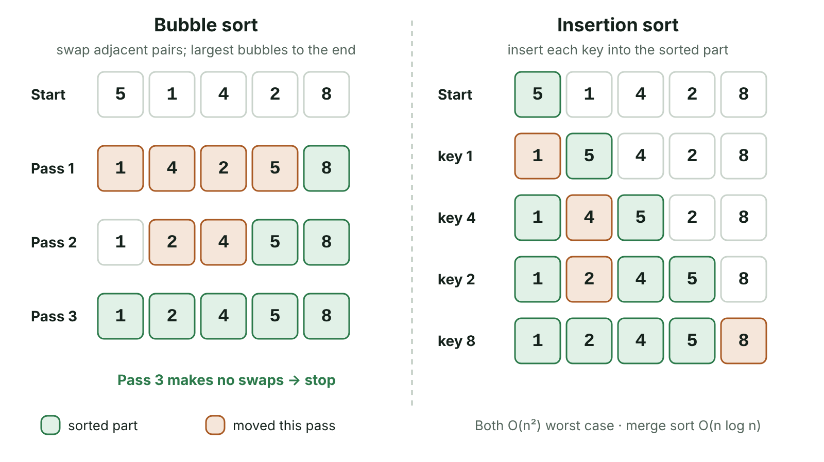
The big picture
Bubble sort and insertion sort of 5 1 4 2 8 shown pass by pass side by side
☰ Menu
Notes:
Explain the diagram in your own words before you read on.

Slide 65
Why sort data?
Sorting puts data into ascending or descending order, numerically or alphabetically
Sorted data is easier for people to read: league tables, class lists, price lists
Sorted data allows a fast binary search, and makes finding duplicates, maximums and medians simple
Simple sorts: bubble sort and insertion sort – easy to code but slow on large lists
Divide-and-conquer sorts: merge sort and quick sort – more complex but far faster on large lists
☰ Menu

Slide 66
Bubble sort
Compare each pair of adjacent items and swap them if they are in the wrong order
One complete run through the list is a pass; after pass 1 the largest item has 'bubbled' to the end
Each later pass can therefore check one fewer item
Repeat passes until a pass makes no swaps – a swapped flag lets the algorithm stop early
Swapping needs a temporary variable, or one value is overwritten and lost
☰ Menu

Slide 67
Bubble sort in pseudocode
The outer REPEAT loop runs passes; the inner FOR loop compares neighbours
end shrinks by one each pass because the last item is already in place
PSEUDOCODE
end ← LENGTH(list) - 1
REPEAT
swapped ← False
FOR i ← 0 TO end - 1
IF list[i] > list[i + 1] THEN
temp ← list[i]
list[i] ← list[i + 1]
list[i + 1] ← temp
swapped ← True
ENDIF
NEXT i
end ← end - 1
UNTIL swapped = False
☰ Menu

Slide 68
Worked example: netball league points
Six Fermanagh netball teams have points 14, 9, 22, 5, 17, 11 – sort them into ascending order with a bubble sort
Pass 1: 14↔9 swap, 14 and 22 no swap, 22↔5, 22↔17, 22↔11 → 9 14 5 17 11 22
Pass 2: 9 and 14 no swap, 14↔5, 14 and 17 no swap, 17↔11 → 9 5 14 11 17 22
Pass 3: 9↔5, 9 and 14 no swap, 14↔11 → 5 9 11 14 17 22
Pass 4: 5 and 9, 9 and 11 – no swaps, so swapped stays False and the sort stops
Total: 5 + 4 + 3 + 2 = 14 comparisons and 8 swaps
☰ Menu

Slide 69
Bubble sort in C#
do…while matches REPEAT…UNTIL: the body runs at least once
Without the flag the sort would always make n − 1 passes, even on a list that is already sorted
☰ Menu

Slide 70
Bubble sort in C# – code
C#
int[] points = { 14, 9, 22, 5, 17, 11 };
bool swapped;
int end = points.Length - 1;
do
{
swapped = false;
for (int i = 0; i < end; i++)
{
if (points[i] > points[i + 1])
{
int temp = points[i];
points[i] = points[i + 1];
points[i + 1] = temp;
swapped = true;
}
}
end--;
} while (swapped);
Console.WriteLine(string.Join(" ", points)); // 5 9 11 14 17 22
☰ Menu

Slide 71
Insertion sort
Treat the first item as a sorted sub-list of one
Take the next item (the key) and compare it with the items in the sorted part, working from right to left
Shift each larger item one place right to open a gap
Insert the key into the gap, so the sorted part grows by one item each pass
A list of n items needs n − 1 passes
☰ Menu

Slide 72
Insertion sort trace: 14 9 22 5 17 11
Pass | Key | Shifts | List after the pass (sorted part in brackets)
1 | 9 | 14 shifted right (1) | [9 14] 22 5 17 11
2 | 22 | None – 22 > 14 | [9 14 22] 5 17 11
3 | 5 | 22, 14, 9 shifted (3) | [5 9 14 22] 17 11
4 | 17 | 22 shifted (1) | [5 9 14 17 22] 11
5 | 11 | 22, 17, 14 shifted (3) | [5 9 11 14 17 22]
☰ Menu

Slide 73
Insertion sort in C#
The while loop stops at the start of the array (j >= 0) or when a smaller item is reached
Values are shifted, not swapped, so only one assignment is needed per move
☰ Menu

Slide 74
Insertion sort in C# – code
C#
int[] points = { 14, 9, 22, 5, 17, 11 };
for (int i = 1; i < points.Length; i++)
{
int key = points[i];
int j = i - 1;
while (j >= 0 && points[j] > key)
{
points[j + 1] = points[j]; // shift right
j--;
}
points[j + 1] = key; // insert key
}
Console.WriteLine(string.Join(" ", points)); // 5 9 11 14 17 22
☰ Menu

Slide 75
Merge sort (divide and conquer)
Divide: split the list in half repeatedly until every sub-list has one item (one item is already sorted)
Conquer: merge pairs of sub-lists by repeatedly taking the smaller front item, producing larger sorted lists
6 2 9 4 7 1 8 3 → [6 2 9 4] [7 1 8 3] → [6 2] [9 4] [7 1] [8 3] → eight single items
Merge: [2 6] [4 9] [1 7] [3 8] → [2 4 6 9] [1 3 7 8] → 1 2 3 4 6 7 8 9
Always O(n log n), but needs extra memory for the sub-lists and is usually written recursively
☰ Menu

Slide 76
Quick sort
Choose a pivot item (here, the first item of each sub-list)
Partition: items smaller than the pivot go to its left, larger items to its right – the pivot is now in its final place
6 2 9 4 7 1 8 3: pivot 6 → [2 4 1 3] 6 [9 7 8]
Left: pivot 2 → [1] 2 [4 3], then pivot 4 → [3] 4. Right: pivot 9 → [7 8] 9, then pivot 7 → 7 [8]
Result 1 2 3 4 6 7 8 9; average O(n log n) and sorts in place, but O(n²) worst case, e.g. a first-item pivot on already sorted data
☰ Menu

Slide 77
How the work grows
n | n² (bubble/insertion, worst) | n log₂ n (merge/quick, typical)
10 | 100 | about 33
1 000 | 1 000 000 | about 10 000
1 000 000 | 1 000 000 000 000 | about 20 000 000
Effect of doubling n | About 4 times the work | A little over twice the work
☰ Menu

Slide 78
Comparing sorting algorithms
Algorithm | Best | Average / worst | Extra memory | Good for
Bubble | O(n) with flag, if already sorted | O(n²) | None (in place) | Teaching; tiny or nearly sorted lists
Insertion | O(n), if already sorted | O(n²) | None (in place) | Small or nearly sorted lists; adding items to a sorted list
Merge | O(n log n) | O(n log n) | Extra space for sub-lists | Large lists; guaranteed performance
Quick | O(n log n) | O(n log n) / O(n²) | Little (in place) | Large lists in memory; usually fastest in practice
☰ Menu

Slide 79
Choosing a sort
For a dozen items any algorithm is fast – simplicity and ease of maintenance matter more
For 1 000 000 items, n² is a trillion steps but n log n is about 20 million, so merge or quick sort is essential
Insertion sort is efficient when a few new items are added to an already sorted list
Memory limits favour in-place sorts (bubble, insertion, quick) over merge sort
Merge sort gives guaranteed O(n log n), so it suits cases where a slow worst case is unacceptable
☰ Menu

Slide 80
Exit quiz: question 1 of 9
Tap an answer to check it. Presenting? Click to reveal the answer.
What is the list 4 2 7 1 after ONE pass of a bubble sort into ascending order?
A 2 4 1 7
B 1 2 4 7
✓
✗
C 2 1 4 7
D 2 4 7 1
✗
✗
✓ A: 2 4 1 7 – 4↔2 swap, 4 and 7 no swap, 7↔1 swap, giving 2 4 1 7.
☰ Menu

Slide 81
Exit quiz: question 2 of 9
Tap an answer to check it. Presenting? Click to reveal the answer.
Which sorting algorithm repeatedly splits a list in half and then merges sorted sub-lists?
A Bubble sort
B Insertion sort
✗
✗
C Merge sort
D Quick sort
✓
✗
✓ C: Merge sort – Merge sort divides into single items, then merges them back in order.
☰ Menu

Slide 82
Exit quiz: question 3 of 9
Tap an answer to check it. Presenting? Click to reveal the answer.
Which sort places each item into the correct position in a growing sorted section?
A Bubble sort
B Merge sort
✗
✗
C Quick sort
D Insertion sort
✗
✓
✓ D: Insertion sort – It inserts the key into the sorted part of the list.
☰ Menu

Slide 83
Exit quiz: question 4 of 9
Tap an answer to check it. Presenting? Click to reveal the answer.
What is the average time complexity of merge sort?
A O(n)
B O(n²)
✗
✗
C O(n log n)
D O(log n)
✓
✗
✓ C: O(n log n) – About log n levels of splitting, with n items handled when merging at each level.
☰ Menu

Slide 84
Exit quiz: question 5 of 9
Tap an answer to check it. Presenting? Click to reveal the answer.
What does quick sort use to partition the list?
A A pivot
B A flag
✓
✗
C A sentinel
D A temporary list of single items
✗
✗
✓ A: A pivot – Smaller items go left of the pivot, larger items right.
☰ Menu

Slide 85
Exit quiz: question 6 of 9
Tap an answer to check it. Presenting? Click to reveal the answer.
Which is a disadvantage of merge sort?
A It is O(n²)
B It needs extra memory
✗
✓
C It only works on sorted lists
D It cannot sort strings
✗
✗
✓ B: It needs extra memory – Sub-lists are stored while merging.
☰ Menu

Slide 86
Exit quiz: question 7 of 9
Tap an answer to check it. Presenting? Click to reveal the answer.
In an insertion sort of 14 9 22 5 17 11, what is the list after the third pass?
A 9 14 22 5 17 11
B 5 9 14 22 17 11
✗
✓
C 5 9 11 14 17 22
D 9 14 5 22 17 11
✗
✗
✓ B: 5 9 14 22 17 11 – Passes insert 9, then 22, then 5 at the front.
☰ Menu

Slide 87
Exit quiz: question 8 of 9
Tap an answer to check it. Presenting? Click to reveal the answer.
A bubble sort with a swapped flag is given a list that is already sorted. How many passes does it make?
A 1
B 0
✓
✗
C n − 1
D n
✗
✗
✓ A: 1 – The first pass makes no swaps, so the flag stays false and the sort stops.
☰ Menu

Slide 88
Exit quiz: question 9 of 9
Tap an answer to check it. Presenting? Click to reveal the answer.
Why is quick sort's worst case O(n²)?
A It always needs extra memory
B It cannot handle duplicates
✗
✗
C A poor pivot can leave one partition almost as large as the list
D It compares only adjacent items
✓
✗
✓ C: A poor pivot can leave one partition almost as large as the list – If each partition removes just one item, about n levels of partitioning are needed.
☰ Menu

Slide 89
Exit quiz answers
Q | Answer | Why
1 | A 2 4 1 7 | 4↔2 swap, 4 and 7 no swap, 7↔1 swap, giving 2 4 1 7.
2 | C Merge sort | Merge sort divides into single items, then merges them back in order.
3 | D Insertion sort | It inserts the key into the sorted part of the list.
4 | C O(n log n) | About log n levels of splitting, with n items handled when merging at each level.
5 | A A pivot | Smaller items go left of the pivot, larger items right.
6 | B It needs extra memory | Sub-lists are stored while merging.
7 | B 5 9 14 22 17 11 | Passes insert 9, then 22, then 5 at the front.
8 | A 1 | The first pass makes no swaps, so the flag stays false and the sort stops.
9 | C A poor pivot can leave one partition almost as large as the list | If each partition removes just one item, about n levels of partitioning are needed.
☰ Menu

