Slide 1
Fundamentals of programming
AS 1: APPROACHES TO SYSTEMS DEVELOPMENT · TOPIC
Lessons in this topic
AP19 IDEs, translators, data types, variables and operators
AP20 Program control: sequence, selection and iteration
AP21 Subroutines: procedures, functions, parameters and scope
AP22 Data structures: arrays, lists, records and files
AP23 Robust programs: validation, exceptions, errors, testing and debugging

Slide 2

Topic menu
Tap a button to jump straight there. The ☰ Menu button on every slide brings you back here.
Specification map
AP21 Subroutines: procedures, functions, parameters and scope
AP19 IDEs, translators, data types, variables and operators
AP22 Data structures: arrays, lists, records and files
AP20 Program control: sequence, selection and iteration
AP23 Robust programs: validation, exceptions, errors, testing and debugging

Slide 3
Specification map (1 of 3)
Lesson | Specification: students should be able to
AP19 | Describe the main features of an integrated development environment (IDE), including the editor, preferences, compiler and debugging tools; Explain the process of translation and the differences between assemblers, compilers and interpreters; Explain the terms syntax, data type and variable, and use the data types integer, real, character, string and Boolean appropriately; Explain the use of variables and constants, and declare, initialise and assign them in a high-level language; Use arithmetic, relational and Boolean (logical) operators, including integer division and modulus, and evaluate conditions; Write programs that take input from the user, convert it to a suitable type and produce formatted output
AP20 | Describe the fundamental programming concepts of sequence, selection and iteration; Use if, if…else, else if, nested if and switch statements for selection, with conditions built from relational and Boolean operators; Describe count-controlled iteration and use for loops, including loops that count up, down and in steps; Describe condition-controlled iteration and use while (pre-condition) and do…while (post-condition) loops, including sentinel values; Use nested loops and nested selection, and trace programs that combine all three constructs
☰ Menu

Slide 4
Specification map (2 of 3)
Lesson | Specification: students should be able to
AP21 | Explain what is meant by a subroutine and describe the difference between a procedure and a function; Write and call procedures and functions in a high-level language, using parameters, arguments and return values; Explain passing parameters by value and by reference, and predict the effect of each; Explain the scope of local and global variables and the advantages of using local variables; Explain the benefits of modular programming and decomposing a problem into subroutines
AP22 | Describe the purpose of data structures and distinguish between static and dynamic structures; Use one-dimensional and two-dimensional arrays, including traversing them with loops; Use lists as dynamic data structures and justify the choice of a list or an array; Describe and use records to group related fields of different data types; Write to, append to and read from text files, splitting delimited lines into fields; Explain why files are needed for persistent storage and how file errors can be avoided
☰ Menu

Slide 5
Specification map (3 of 3)
Lesson | Specification: students should be able to
AP23 | Describe and use validation checks, and distinguish validation from verification; Use exception handling to deal with run-time errors; Explain the differences between syntax, semantic, run-time and logic errors; Select valid, extreme, invalid and null test data and use a test plan to find errors; Use the debugging tools of an integrated development environment (IDE), such as breakpoints, stepping and watches, to locate errors (IDE features are introduced in AP19); Explain how the choice of translator (compiler or interpreter, covered in AP19) affects when syntax, semantic and run-time errors are detected
☰ Menu
Notes:
Each lesson below is its own section in PowerPoint (View → Slide Sorter shows them). To split this deck by specification point, right-click a section → Move Section, or delete the sections you do not need.

Slide 6
IDEs, translators, data types, variables and operators
AS 1: APPROACHES TO SYSTEMS DEVELOPMENT · AP19
Learning objectives
Describe how the tools in an IDE help a programmer write, translate and debug code
Compare assemblers, compilers and interpreters and say when each is useful
Choose the most suitable C# data type for a value and justify the choice
Declare, initialise and assign variables and constants using rules and conventions for identifiers
Evaluate expressions and conditions using arithmetic, relational and Boolean operators
Notes:
Specification: Describe the main features of an integrated development environment (IDE), including the editor, preferences, compiler and debugging tools | Explain the process of translation and the differences between assemblers, compilers and interpreters | Explain the terms syntax, data type and variable, and use the data types integer, real, character, string and Boolean appropriately | Explain the use of variables and constants, and declare, initialise and assign them in a high-level language | Use arithmetic, relational and Boolean (logical) operators, including integer division and modulus, and evaluate conditions | Write programs that take input from the user, convert it to a suitable type and produce formatted output

Slide 7
In this lesson
Tap a button to jump straight there. The ☰ Menu button on every slide brings you back here.
The big picture
Variables and identifiers
Boolean operators and truth table
From algorithm to running program
Data types in C#
Combining conditions
Features of an IDE
Worked example: choosing data types for a GAA club
Worked example: Belfast car park charge
Why translation is needed
Declaring, assigning and constants
Exit quiz
Assembler, compiler and interpreter
Arithmetic operators
↑ Topic menu
Compilers and interpreters in practice
Relational operators and conditions
Notes:
Lesson menu: each button jumps to that part of the lesson in Slide Show. The ☰ Menu button on each slide returns here.

Slide 8
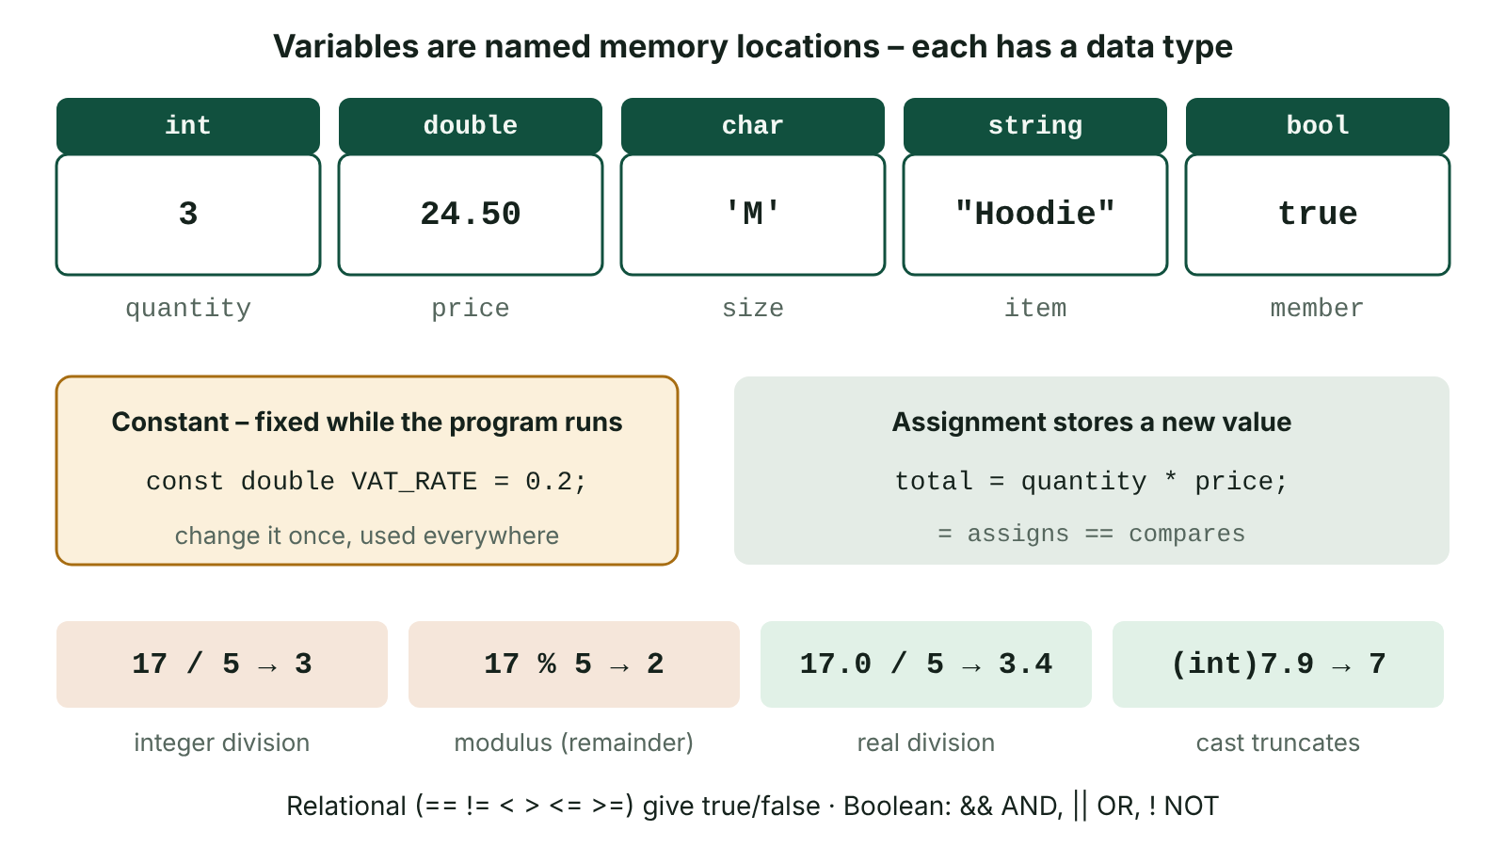
The big picture
Variables as labelled memory boxes with their C# data types, a locked constant, and examples of integer division and modulus
☰ Menu
Notes:
Explain the diagram in your own words before you read on.

Slide 9
From algorithm to running program
An algorithm written correctly in a programming language such as C# is called source code: it is readable by people but not by the processor
Programmers write source code inside an integrated development environment (IDE), a single application bringing together all the tools they need
Source code must be translated into binary machine code (object code) before the processor can execute it
Every program stores data in variables, each with a data type, and manipulates that data with operators
This lesson covers the tools (IDE, translators) and the building blocks (data types, variables, constants, operators, input and output)
☰ Menu

Slide 10
Features of an IDE (1 of 2)
Feature | What it does | How it helps the programmer
Editor | Write, edit and save source code with line numbers and code folding | Code is organised in one place and easy to navigate
Syntax highlighting and auto-indent | Colours keywords, strings and comments; indents blocks automatically | Structure and flow of the program are easier to see
Syntax checking | Underlines invalid code (e.g. a missing semicolon) as it is typed | Errors are fixed before compiling, saving time
Code completion (IntelliSense) | Suggests keywords, variable and method names after a few letters | Faster typing and fewer spelling mistakes in identifiers
Preferences / formatting | Stores agreed layout rules, e.g. where braces go, and can reformat code | A team's code is laid out consistently and is easier to read
☰ Menu

Slide 11
Features of an IDE (2 of 2)
Feature | What it does | How it helps the programmer
Compiler and run | Builds the program, lists errors, then runs it in one click | Quick edit-compile-test cycle
Debugging tools | Breakpoints, stepping line by line, watching variable values | Errors can be located and fixed more easily (see AP23)
☰ Menu

Slide 12
Why translation is needed
The processor only executes machine code: binary op-codes and operands specific to that processor
Early programmers entered binary directly, which was slow and very error-prone
Assembly language replaced binary with mnemonics such as LDA (load) and ADD; an assembler converts each one to a single machine code instruction (one-to-one)
High-level languages (C#, Python, Java) use English-like keywords; one statement may become many machine code instructions (one-to-many)
Translation converts source code into a form the computer can execute; it is done by an assembler, a compiler or an interpreter
☰ Menu

Slide 13
Assembler, compiler and interpreter (1 of 2)
 | Assembler | Compiler | Interpreter
Translates | Assembly language | Whole high-level program before it runs | One high-level statement at a time, then runs it
Errors | Reported after assembly | Error report for the whole program; it will not run until all are fixed | Stops at the first error found, possibly after part of the program has run
Output | Machine code | Object code / executable file | No object code is kept
Speed of running | Fast | Fast: code optimised once, no translation at run time | Slower: statements are translated every time they run
To run later | Machine code only | Executable only; source code need not be shared | Source code and interpreter needed every time
☰ Menu

Slide 14
Assembler, compiler and interpreter (2 of 2)
 | Assembler | Compiler | Interpreter
Typical use | Device drivers, embedded systems | Distributing finished software | Development, scripting, web languages such as JavaScript and PHP
☰ Menu

Slide 15
Compilers and interpreters in practice
Compile once, run many times: users get a fast program and cannot easily read or alter the source code
But every change, however small, means recompiling the whole program before it can be tested
An interpreter lets a developer run and test code straight away, so it is handy while developing and debugging
Risk with an interpreter: a file or database may already have been updated before a later error crashes the program
C# uses both ideas: the compiler turns source code into Common Intermediate Language (CIL); the .NET runtime then just-in-time compiles CIL to machine code
☰ Menu

Slide 16
Variables and identifiers
A variable is a named location in memory that holds a single value which can change while the program runs
The name is the identifier; declaring a variable gives its identifier and data type so the right amount of memory can be reserved
C# rules (must obey): start with a letter or underscore; letters, digits and _ only; no spaces; not a keyword such as int; case-sensitive
Conventions (should follow): meaningful names; camelCase for variables (ticketPrice); PascalCase for methods; many teams use UPPER_CASE for constants
Syntax is the set of rules defining how valid statements are written in a language; breaking them gives a syntax error
☰ Menu

Slide 17
Data types in C#
Data type | C# keyword | Example value | Memory / notes
Integer | int | 350, -7, 0 | 32 bits; whole numbers up to about ±2.1 billion
Real (floating point) | double | 14.5, -0.25 | 64 bits; about 15-16 significant digits
Real (exact decimal) | decimal | 4.99m | 128 bits; preferred for money as it avoids binary rounding
Character | char | 'B' | 16 bits; one Unicode character in single quotes
String | string | "BT74 6AB" | Variable length; text in double quotes
Boolean | bool | true / false | Only two possible values
☰ Menu

Slide 18
Worked example: choosing data types for a GAA club
Data to store | Identifier | Data type | Reason
Number of players in the squad | squadSize | int | Whole number that may be counted or added to
Annual fee | annualFee | decimal | Money with pence; exact decimal arithmetic
Membership category (J, A or S) | category | char | Always exactly one character
Postcode | postcode | string | Mix of letters, digits and a space
Parent's mobile number | mobile | string | Leading zero must be kept; never used in arithmetic
Whether the fee has been paid | feePaid | bool | Only two states: paid or not paid
☰ Menu

Slide 19
Declaring, assigning and constants
Declaration gives a type and identifier; initialisation gives a first value; assignment (=) stores a new value, replacing the old one
A constant (const) is a named value that cannot change while the program runs; trying to assign to it is a compile-time error
Constants improve readability and maintenance: change the VAT rate once at the top instead of in every calculation
☰ Menu

Slide 20
Declaring, assigning and constants – code
C#
const double VAT_RATE = 0.2;
string item = "Hoodie";
int quantity = 3;
double price = 24.50;
bool member = true;
char size = 'M';
double total = quantity * price; // 73.5
if (member) total = total * 0.9; // 10% member discount
total = total + total * VAT_RATE;
Console.WriteLine($"{quantity} x {item} ({size}): £{total:F2}");
// Output: 3 x Hoodie (M): £79.38
☰ Menu

Slide 21
Arithmetic operators
Operator | Meaning | Example | Result
+ - * | Add, subtract, multiply (BIDMAS applies) | 4 + 3 * 2 | 10
/ on two ints | Integer division (DIV): remainder discarded | 17 / 5 | 3
/ with a real | Real division | 17.0 / 5 | 3.4
% | Modulus (MOD): the remainder | 17 % 5 | 2
Math.Pow | Exponent (returns a double) | Math.Pow(2, 3) | 8
++ += -= | Increment, add to, subtract from | x = 5; x += 3; | x is 8
☰ Menu

Slide 22
Relational operators and conditions
A condition compares two values with a relational operator: == != < <= > >=; the result is always true or false
Method: substitute the values, work out any brackets, then apply the operator
Given score = 45, target = 50, price = 12.5, rate = 0.2:
score >= target → 45 >= 50 → false; score != 45 → 45 != 45 → false
(price * rate) < 3 → (12.5 * 0.2) < 3 → 2.5 < 3 → true
Do not confuse = (assignment) with == (comparison)
☰ Menu

Slide 23
Boolean operators and truth table
A | B | A && B (AND) | A || B (OR) | !A (NOT)
false | false | false | false | true
false | true | false | true | true
true | false | false | true | false
true | true | true | true | false
☰ Menu

Slide 24
Combining conditions
AND: true only if both parts are true, e.g. a range check mark >= 0 && mark <= 100
OR: true if either or both parts are true, e.g. an out-of-range check mark < 0 || mark > 100
Precedence: ! first, then arithmetic, then relational, then &&, then || – use brackets to make the meaning clear
☰ Menu

Slide 25
Combining conditions – code
C#
int a = 17, b = 5;
Console.WriteLine(a / b); // 3
Console.WriteLine(a % b); // 2
Console.WriteLine((double)a / b); // 3.4
bool inRange = a >= 10 && a <= 20;
Console.WriteLine(inRange); // True
Console.WriteLine(a > b && b != 5); // False
Console.WriteLine(!(a < b) || b == 0); // True
☰ Menu

Slide 26
Worked example: Belfast car park charge
Console.ReadLine() always returns a string, so convert it with int.Parse, double.Parse or Convert.ToInt32
DIV and MOD split 200 minutes into 200 / 60 = 3 hours and 200 % 60 = 20 minutes
Any part hour is charged as a full hour, so 4 hours × £1.80 = £7.20
Casting: (int)7.9 gives 7 (truncates); (double)total / count forces real division
Output with + (concatenation) or $"…{value}…" (interpolation); :F2 shows two decimal places
☰ Menu

Slide 27
Worked example: Belfast car park charge – code
C#
const decimal RATE_PER_HOUR = 1.80m;
Console.Write("Minutes parked: ");
int minutes = int.Parse(Console.ReadLine());
int hours = minutes / 60; // DIV
int extra = minutes % 60; // MOD
int charged = hours;
if (extra > 0) charged = hours + 1; // part hour = full hour
decimal charge = charged * RATE_PER_HOUR;
Console.WriteLine($"{hours} h {extra} min: £{charge:F2}");
// Input 200 -> Output: 3 h 20 min: £7.20
☰ Menu

Slide 28
Exit quiz: question 1 of 10
Tap an answer to check it. Presenting? Click to reveal the answer.
Which translator converts the whole of a high-level program into object code before any of it is run?
A Interpreter
B Assembler
✗
✗
C Compiler
D Editor
✓
✗
✓ C: Compiler – A compiler translates the complete program first, reports all errors, and produces an executable that runs without retranslation.
☰ Menu

Slide 29
Exit quiz: question 2 of 10
Tap an answer to check it. Presenting? Click to reveal the answer.
A program stores a customer's mobile number, such as 07700 900123. Which data type is most suitable?
A int
B double
✗
✗
C string
D bool
✓
✗
✓ C: string – It has a leading zero and a space and is never used in calculations, so a string keeps it exactly as entered.
☰ Menu

Slide 30
Exit quiz: question 3 of 10
Tap an answer to check it. Presenting? Click to reveal the answer.
What is the value of 29 % 6?
A 4
B 5
✗
✓
C 4.83
D 0
✗
✗
✓ B: 5 – 29 = 4 × 6 + 5, so the remainder is 5.
☰ Menu

Slide 31
Exit quiz: question 4 of 10
Tap an answer to check it. Presenting? Click to reveal the answer.
Which data type is most suitable for a single grade letter such as 'B'?
A string
B int
✗
✗
C bool
D char
✗
✓
✓ D: char – char holds exactly one character, written in single quotes.
☰ Menu

Slide 32
Exit quiz: question 5 of 10
Tap an answer to check it. Presenting? Click to reveal the answer.
What does (int)8.9 evaluate to in C#?
A 9
B 8.9
✗
✗
C 8
D An error
✓
✗
✓ C: 8 – Casting a double to int truncates: the fractional part is discarded, not rounded.
☰ Menu

Slide 33
Exit quiz: question 6 of 10
Tap an answer to check it. Presenting? Click to reveal the answer.
Which expression is true when x is outside the range 1 to 10?
A x < 1 || x > 10
B x < 1 && x > 10
✓
✗
C x >= 1 && x <= 10
D !(x < 1)
✗
✗
✓ A: x < 1 || x > 10 – Outside means below the bottom OR above the top; no number can be both, so && would always be false.
☰ Menu

Slide 34
Exit quiz: question 7 of 10
Tap an answer to check it. Presenting? Click to reveal the answer.
Which keyword declares a constant in C#?
A static
B const
✗
✓
C final
D fixed
✗
✗
✓ B: const – For example: const double VAT_RATE = 0.2;
☰ Menu

Slide 35
Exit quiz: question 8 of 10
Tap an answer to check it. Presenting? Click to reveal the answer.
What is output by Console.WriteLine("Total: " + 3 + 4);?
A Total: 7
B Total: 34
✗
✓
C An error
D Total: 3 + 4
✗
✗
✓ B: Total: 34 – + works left to right: "Total: " + 3 is a string, so 4 is then joined on as text.
☰ Menu

Slide 36
Exit quiz: question 9 of 10
Tap an answer to check it. Presenting? Click to reveal the answer.
Which IDE feature suggests variable and method names after the programmer types a few letters?
A Code completion
B Breakpoint
✓
✗
C Compiler
D Error report
✗
✗
✓ A: Code completion – Code completion (IntelliSense) speeds up typing and avoids misspelt identifiers.
☰ Menu

Slide 37
Exit quiz: question 10 of 10
Tap an answer to check it. Presenting? Click to reveal the answer.
Which statement about an interpreter is correct?
A It produces a standalone executable file
B It reports every syntax error before running
✗
✗
C It normally runs a program faster than compiled code
D It translates and executes one statement at a time
✗
✓
✓ D: It translates and executes one statement at a time – Translation and execution are interleaved, so it is slower and stops at the first error it reaches.
☰ Menu

Slide 38
Exit quiz answers
Q | Answer | Why
1 | C Compiler | A compiler translates the complete program first, reports all errors, and produces an executable that runs without retranslation.
2 | C string | It has a leading zero and a space and is never used in calculations, so a string keeps it exactly as entered.
3 | B 5 | 29 = 4 × 6 + 5, so the remainder is 5.
4 | D char | char holds exactly one character, written in single quotes.
5 | C 8 | Casting a double to int truncates: the fractional part is discarded, not rounded.
6 | A x < 1 || x > 10 | Outside means below the bottom OR above the top; no number can be both, so && would always be false.
7 | B const | For example: const double VAT_RATE = 0.2;
8 | B Total: 34 | + works left to right: "Total: " + 3 is a string, so 4 is then joined on as text.
9 | A Code completion | Code completion (IntelliSense) speeds up typing and avoids misspelt identifiers.
10 | D It translates and executes one statement at a time | Translation and execution are interleaved, so it is slower and stops at the first error it reaches.
☰ Menu

Slide 39
Program control: sequence, selection and iteration
AS 1: APPROACHES TO SYSTEMS DEVELOPMENT · AP20
Learning objectives
Explain sequence, selection and iteration with reference to a given algorithm
Choose between if…else if and switch for a selection problem and write the C#
Select the right type of loop for a task and justify the choice
Write and trace programs that use nested loops, sentinel values and nested selection
Notes:
Specification: Describe the fundamental programming concepts of sequence, selection and iteration | Use if, if…else, else if, nested if and switch statements for selection, with conditions built from relational and Boolean operators | Describe count-controlled iteration and use for loops, including loops that count up, down and in steps | Describe condition-controlled iteration and use while (pre-condition) and do…while (post-condition) loops, including sentinel values | Use nested loops and nested selection, and trace programs that combine all three constructs

Slide 40
In this lesson
Tap a button to jump straight there. The ☰ Menu button on every slide brings you back here.
The big picture
Selection with switch
Nested loops
Three control structures
Count-controlled iteration: for
Combining constructs: zoo group tickets
Sequence: order matters
Condition-controlled iteration
Choosing a construct
Selection: if and if…else
while loop with a sentinel value
Exit quiz
Worked example: bus fare with else if
Trace table: inputs 12, 30, 8, -1
↑ Topic menu
Nested selection
Worked example: running challenge with do…while
Notes:
Lesson menu: each button jumps to that part of the lesson in Slide Show. The ☰ Menu button on each slide returns here.

Slide 41
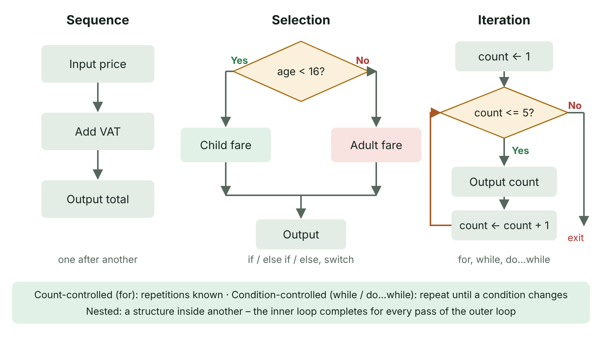
The big picture
The three control structures as flowcharts: sequence, selection with two branches, and iteration with a loop back
☰ Menu
Notes:
Explain the diagram in your own words before you read on.

Slide 42
Three control structures
Sequence: statements are executed one after another, in the order they are written
Selection: a condition (true or false) decides which path through the program is followed
Iteration: a block of statements (the body of the loop) is repeated, either a set number of times or while/until a condition is met
Every algorithm can be built from these three structures, combined and nested inside each other
A C# console program starts at its first statement (or the Main method) and follows these structures to the end
☰ Menu

Slide 43
Sequence: order matters
Each statement runs once, top to bottom; changing the order can change the result
Here the total must be calculated after both inputs are read, and before it is output
Swapping the last two lines would be a logic error: the output would appear before the discount is applied
☰ Menu

Slide 44
Sequence: order matters – code
C#
Console.Write("Adult tickets: ");
int adults = int.Parse(Console.ReadLine());
Console.Write("Child tickets: ");
int children = int.Parse(Console.ReadLine());
double total = adults * 9.50 + children * 6.00;
total = total * 0.9; // 10% online discount
Console.WriteLine($"Total: £{total:F2}");
// Input 2 and 3 -> Total: £33.30
☰ Menu

Slide 45
Selection: if and if…else
if: the block runs only when the condition is true; otherwise it is skipped and the program carries on
if…else: exactly one of two blocks runs – never both, never neither
Pseudocode uses IF … ELSE … ENDIF; C# uses braces { } to mark each block
PSEUDOCODE
INPUT weight
IF weight <= 23 THEN
bagFee ← 0
ELSE
bagFee ← 40
ENDIF
IF hasPriorityPass = TRUE THEN
queue ← "Fast Track"
ENDIF
OUTPUT bagFee
☰ Menu

Slide 46
Worked example: bus fare with else if
Conditions are tested in order and only the first true branch runs, so order matters
Test the lowest ages first so each later test needs only one bound
The final else catches every case not matched above
Test data: 3 → £0.00, 10 → £1.10, 17 student → £1.65, 40 → £2.20, 65 → £0.00
☰ Menu

Slide 47
Worked example: bus fare with else if – code
C#
Console.Write("Age: ");
int age = int.Parse(Console.ReadLine());
Console.Write("Student (y/n)? ");
bool student = Console.ReadLine() == "y";
double fare;
if (age < 5) fare = 0;
else if (age < 16) fare = 1.10;
else if (age >= 60) fare = 0; // concessionary pass
else if (student) fare = 1.65;
else fare = 2.20;
Console.WriteLine($"Fare: £{fare:F2}");
☰ Menu

Slide 48
Nested selection
Nested selection places one if inside another: the inner test only happens when the outer condition is true (or false)
Useful when a second decision only makes sense after the first, e.g. a hospital fridge reading: OK, or else too cold / too warm
Deep nesting is hard to read; an else if chain or combined conditions (&&, ||) are often clearer
☰ Menu

Slide 49
Nested selection – code
C#
Console.Write("Fridge temperature (°C): ");
double temp = double.Parse(Console.ReadLine());
if (temp >= 2 && temp <= 8)
{
Console.WriteLine("OK");
}
else
{
if (temp < 2)
Console.WriteLine("Alert: too cold");
else
Console.WriteLine("Alert: too warm");
}
☰ Menu

Slide 50
Selection with switch
switch compares one variable with a list of exact values (case labels)
Each case ends with break; stacked cases share code; default handles any other value
Clearer than a long else if chain for menus and fixed codes, but the classic form cannot test ranges
C#
Console.Write("Day number (1-7): ");
int day = int.Parse(Console.ReadLine());
switch (day)
{
case 6:
case 7:
Console.WriteLine("Weekend");
break;
case 1: case 2: case 3: case 4: case 5:
Console.WriteLine("School day");
break;
default:
Console.WriteLine("Invalid day");
break;
}
☰ Menu

Slide 51
Count-controlled iteration: for
Used when the number of repetitions is known before the loop starts (a fixed number, or a value entered first)
for (initialise counter; condition; update) – the condition is checked before each pass and the counter is updated after it
The counter can count up, down or in steps; foreach visits every item of an array or list
☰ Menu

Slide 52
Count-controlled iteration: for – code
C#
int total = 0;
for (int i = 1; i <= 5; i++)
{
total += i * i;
}
Console.WriteLine("Sum of squares: " + total); // 55
for (int n = 10; n >= 0; n -= 5)
{
Console.Write(n + " "); // 10 5 0
}
Console.WriteLine();
for (int k = 2; k < 10; k += 3) Console.Write(k); // 258
☰ Menu

Slide 53
Condition-controlled iteration
 | while | do…while
Condition tested | At the start of each pass (pre-condition) | At the end of each pass (post-condition)
Minimum number of runs | Zero – the body may never run | One – the body always runs at least once
Typical use | Process data until a sentinel; the loop may not be needed at all | Menus and validation: get input first, then check it
Pseudocode | WHILE condition … ENDWHILE | REPEAT … UNTIL condition (UNTIL stops when its condition becomes true)
Risk | Infinite loop if nothing in the body changes the condition | Same – the control variable must change inside the loop
☰ Menu

Slide 54
while loop with a sentinel value
A sentinel is a dummy value (here -1) that marks the end of the data; it is not processed as data
Read the first value before the loop, then read the next value as the last statement inside the loop
If -1 is entered first, the body never runs – so test count before dividing to avoid dividing by zero
☰ Menu

Slide 55
while loop with a sentinel value – code
C#
int total = 0, count = 0;
Console.Write("Score (-1 to finish): ");
int score = int.Parse(Console.ReadLine());
while (score != -1)
{
total += score;
count++;
Console.Write("Score (-1 to finish): ");
score = int.Parse(Console.ReadLine());
}
if (count > 0)
Console.WriteLine($"Average: {(double)total / count:F2}");
else
Console.WriteLine("No scores entered");
☰ Menu

Slide 56
Trace table: inputs 12, 30, 8, -1
Step | score | score != -1? | total | count
Before loop | 12 | true | 0 | 0
End of pass 1 | 30 | true | 12 | 1
End of pass 2 | 8 | true | 42 | 2
End of pass 3 | -1 | false – exit | 50 | 3
Output |  |  | Average: 16.67
☰ Menu

Slide 57
Worked example: running challenge with do…while
A member of an Omagh running club logs runs until a 20 km weekly goal is reached
At least one run must be entered, so the test belongs at the end of the loop
Runs of 5 km, 8 km, 3 km and 6 km → total 22 km after 4 runs
☰ Menu

Slide 58
Worked example: running challenge with do…while – code
C#
const int GOAL_KM = 20;
int totalKm = 0, runs = 0;
do
{
Console.Write("Distance of run (km): ");
int km = int.Parse(Console.ReadLine());
totalKm += km;
runs++;
} while (totalKm < GOAL_KM);
Console.WriteLine($"Goal reached: {totalKm} km in {runs} runs");
☰ Menu

Slide 59
Nested loops
A nested loop is a loop inside another; the inner loop completes all its passes for every single pass of the outer loop
Total inner repetitions = outer passes × inner passes, e.g. 3 rows × 4 columns = 12
Ideal for two-dimensional data such as seating plans, timetables and grids
C#
for (int row = 1; row <= 3; row++)
{
for (int col = 1; col <= 4; col++)
{
Console.Write(row * col + "\t");
}
Console.WriteLine();
}
// 1 2 3 4
// 2 4 6 8
// 3 6 9 12
☰ Menu

Slide 60
Combining constructs: zoo group tickets
Sequence: read the group size, then each age, then output the total
Iteration: do…while validates the group size (1-8); a for loop runs once per visitor
Selection: else if places each person in a price band
C#
int people;
do
{
Console.Write("Group size (1-8): ");
people = int.Parse(Console.ReadLine());
} while (people < 1 || people > 8);
double total = 0;
for (int p = 1; p <= people; p++)
{
Console.Write($"Age of person {p}: ");
int age = int.Parse(Console.ReadLine());
if (age < 3) total += 0;
else if (age < 16) total += 8;
else total += 12;
}
Console.WriteLine($"Total: £{total:F2}");
☰ Menu

Slide 61
Choosing a construct
Situation | Best construct | Reason
Process all 28 pupils in a class | for / foreach | Number of repetitions is known
Read scores until -1 is entered | while | Unknown repetitions; there might be none
Show a menu until 'Quit' is chosen | do…while | The menu must be shown at least once
Choose an action from menu options 1-4 | switch | One variable matched against exact values
Charge by age band | if…else if…else | Ranges of values; first true branch wins
Print a seating plan of rows and seats | Nested for | Two dimensions
☰ Menu

Slide 62
Exit quiz: question 1 of 9
Tap an answer to check it. Presenting? Click to reveal the answer.
A program must show a menu and keep showing it until the user chooses Quit. Which loop is most suitable?
A for
B do…while
✗
✓
C foreach
D None – use switch
✗
✗
✓ B: do…while – The menu must appear at least once, so a post-condition do…while loop fits; the number of repetitions is not known in advance.
☰ Menu

Slide 63
Exit quiz: question 2 of 9
Tap an answer to check it. Presenting? Click to reveal the answer.
What is the key difference between a count-controlled and a condition-controlled loop?
A Only condition-controlled loops use a counter
B Count-controlled loops can never be nested
✗
✗
C A count-controlled loop repeats a number of times known before it starts
D A condition-controlled loop always runs at least once
✓
✗
✓ C: A count-controlled loop repeats a number of times known before it starts – A for loop repeats a known number of times; while and do…while repeat until a condition changes, so the number of passes need not be known.
☰ Menu

Slide 64
Exit quiz: question 3 of 9
Tap an answer to check it. Presenting? Click to reveal the answer.
What is printed by for (int i = 2; i < 10; i += 3) Console.Write(i);?
A 258
B 2581
✓
✗
C 25811
D 36912
✗
✗
✓ A: 258 – i takes 2, 5 and 8; 11 fails the condition i < 10.
☰ Menu

Slide 65
Exit quiz: question 4 of 9
Tap an answer to check it. Presenting? Click to reveal the answer.
What happens if a while loop's condition never becomes false?
A A syntax error
B It runs once
✗
✗
C An infinite loop
D The program skips it
✓
✗
✓ C: An infinite loop – Nothing in the body changes the condition, so the loop never ends – a logic error.
☰ Menu

Slide 66
Exit quiz: question 5 of 9
Tap an answer to check it. Presenting? Click to reveal the answer.
Which statement is most suitable for choosing between menu options 1, 2, 3 and 4?
A while
B for
✗
✗
C do…while
D switch
✗
✓
✓ D: switch – A switch matches one variable against exact values and has a default for anything else.
☰ Menu

Slide 67
Exit quiz: question 6 of 9
Tap an answer to check it. Presenting? Click to reveal the answer.
In REPEAT … UNTIL x > 10, when does the loop stop?
A When x > 10 becomes true
B When x > 10 is false
✓
✗
C Before the first pass
D Never
✗
✗
✓ A: When x > 10 becomes true – UNTIL loops stop when their condition becomes true, and they always run at least once.
☰ Menu

Slide 68
Exit quiz: question 7 of 9
Tap an answer to check it. Presenting? Click to reveal the answer.
Scores are entered until -1 is typed. If the user types -1 first, what does a correctly written while loop do?
A Adds -1 to the total
B Runs the body once
✗
✗
C Crashes
D Does not run the body at all
✗
✓
✓ D: Does not run the body at all – The pre-condition is false at the start, so the body is skipped – but a later average must check for a count of zero.
☰ Menu

Slide 69
Exit quiz: question 8 of 9
Tap an answer to check it. Presenting? Click to reveal the answer.
Given if (age < 5) … else if (age < 16) … else if (age >= 60) … else …, which branch runs when age is 3?
A The first only
B The first and second
✓
✗
C All three if branches
D The else
✗
✗
✓ A: The first only – Only the first true branch in an else if chain runs; later tests are not checked.
☰ Menu

Slide 70
Exit quiz: question 9 of 9
Tap an answer to check it. Presenting? Click to reveal the answer.
An outer loop runs 3 times and its inner loop runs 4 times per pass. How many times does the inner body run?
A 7
B 12
✗
✓
C 4
D 3
✗
✗
✓ B: 12 – The inner loop completes fully for each outer pass: 3 × 4 = 12.
☰ Menu

Slide 71
Exit quiz answers
Q | Answer | Why
1 | B do…while | The menu must appear at least once, so a post-condition do…while loop fits; the number of repetitions is not known in advance.
2 | C A count-controlled loop repeats a number of times known before it starts | A for loop repeats a known number of times; while and do…while repeat until a condition changes, so the number of passes need not be known.
3 | A 258 | i takes 2, 5 and 8; 11 fails the condition i < 10.
4 | C An infinite loop | Nothing in the body changes the condition, so the loop never ends – a logic error.
5 | D switch | A switch matches one variable against exact values and has a default for anything else.
6 | A When x > 10 becomes true | UNTIL loops stop when their condition becomes true, and they always run at least once.
7 | D Does not run the body at all | The pre-condition is false at the start, so the body is skipped – but a later average must check for a count of zero.
8 | A The first only | Only the first true branch in an else if chain runs; later tests are not checked.
9 | B 12 | The inner loop completes fully for each outer pass: 3 × 4 = 12.
☰ Menu

Slide 72
Subroutines: procedures, functions, parameters and scope
AS 1: APPROACHES TO SYSTEMS DEVELOPMENT · AP21
Learning objectives
Write C# procedures and functions that take parameters and return values
Distinguish between parameters and arguments and match them in number, order and type
Predict the effect of passing an argument by value and by reference (ref)
Explain local and global scope and the advantages of a modular design
Notes:
Specification: Explain what is meant by a subroutine and describe the difference between a procedure and a function | Write and call procedures and functions in a high-level language, using parameters, arguments and return values | Explain passing parameters by value and by reference, and predict the effect of each | Explain the scope of local and global variables and the advantages of using local variables | Explain the benefits of modular programming and decomposing a problem into subroutines

Slide 73
In this lesson
Tap a button to jump straight there. The ☰ Menu button on every slide brings you back here.
The big picture
Passing by value and by reference
Worked example: decomposing a café till
What is a subroutine?
Using ref: swapping two values
Designing good subroutines
Procedures and functions
By value or by reference?
Exit quiz
Parameters and arguments
Scope: local and global variables
↑ Topic menu
Worked example: leisure centre membership
Why prefer local variables?
Tracing a function call
Benefits of modular programming
Notes:
Lesson menu: each button jumps to that part of the lesson in Slide Show. The ☰ Menu button on each slide returns here.

Slide 74
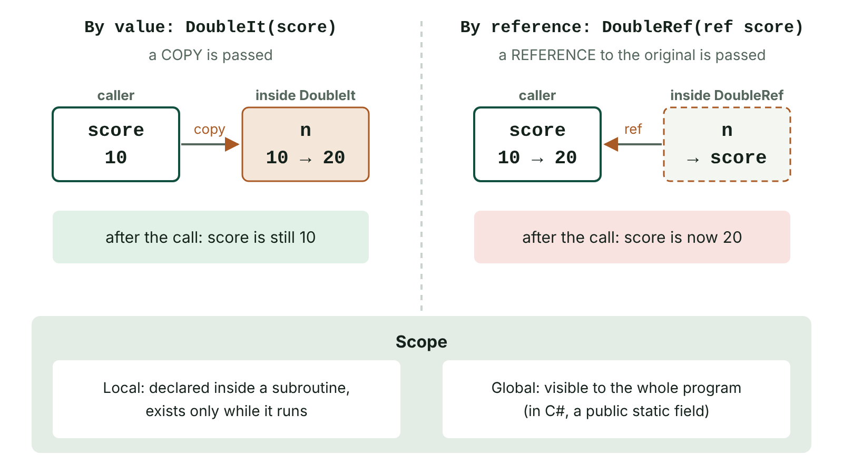
The big picture
Passing by value copies the argument into the parameter so the original is unchanged; passing by reference makes the parameter refer to the original variable, so it changes
☰ Menu
Notes:
Explain the diagram in your own words before you read on.

Slide 75
What is a subroutine?
A subroutine is a named, self-contained block of code that performs a specific task and can be called from elsewhere in the program
When it is called, control jumps to the subroutine; when it finishes, control returns to the statement after the call
It can be called many times, each time with different data passed in through parameters
C# calls subroutines methods; built-in ones such as Console.WriteLine, Math.Round and int.Parse are library routines
Breaking a problem into subroutines follows the top-down decomposition used when designing algorithms
☰ Menu

Slide 76
Procedures and functions
 | Procedure | Function
Purpose | Carries out a task | Carries out a task and returns a single value
C# return type | void | A data type, e.g. int, double, bool, string
How it is called | As a statement on its own: ShowMenu(); | Within an expression: double t = AddVat(40);
Uses return? | Not needed (return; may exit early) | Must return a value of the declared type on every path
Example | PrintReceipt(order); | if (IsValidPin(pin)) …
☰ Menu

Slide 77
Parameters and arguments
A parameter is a variable named in the subroutine header that receives a value when it is called
An argument is the actual value or variable supplied in the call
Arguments must match the parameters in number, order and data type
return sends a value back to the calling code and ends the function immediately
☰ Menu

Slide 78
Parameters and arguments – code
C#
static void ShowLine(char symbol, int length) // parameters
{
for (int i = 0; i < length; i++) Console.Write(symbol);
Console.WriteLine();
}
static double AddVat(double price, double rate)
{
return price + price * rate;
}
ShowLine('=', 20); // arguments
Console.WriteLine("Total: " + AddVat(40, 0.2)); // Total: 48
ShowLine('=', 20);
☰ Menu

Slide 79
Worked example: leisure centre membership
A Lisburn leisure centre charges £18 a month for juniors (under 16) and £32 for adults; off-peak members get 25% off
The function takes the age and an off-peak flag and returns the monthly cost
Checks: age 14, peak → £18.00; age 40, off-peak → £24.00; age 14, off-peak → £13.50
☰ Menu

Slide 80
Worked example: leisure centre membership – code
C#
static double MonthlyCost(int age, bool offPeak)
{
double cost;
if (age < 16) cost = 18.00;
else cost = 32.00;
if (offPeak) cost = cost * 0.75;
return cost;
}
static void PrintCost(string name, double cost)
{
Console.WriteLine($"{name}: £{cost:F2} per month");
}
PrintCost("Aoife", MonthlyCost(14, false)); // Aoife: £18.00 per month
PrintCost("Ciaran", MonthlyCost(40, true)); // Ciaran: £24.00 per month
☰ Menu

Slide 81
Tracing a function call
Each call gets fresh copies of its parameters and local variables
Trace Divide(17, 5): a = 17 → 12 → 7 → 2 while count = 0 → 1 → 2 → 3; 2 >= 5 is false, so 3 is returned
Divide(3, 7) returns 0 because the loop body never runs
The function performs integer division (DIV) by repeated subtraction
C#
static int Divide(int a, int b)
{
int count = 0;
while (a >= b)
{
a = a - b;
count++;
}
return count;
}
Console.WriteLine(Divide(17, 5)); // 3
Console.WriteLine(Divide(3, 7)); // 0
☰ Menu

Slide 82
Passing by value and by reference
By value (the C# default): a copy of the argument is passed, so changes inside the subroutine do not affect the original
By reference (ref): a reference to the original variable (its memory address) is passed, so changes inside the subroutine change the original
ref must be written in both the header and the call
☰ Menu

Slide 83
Passing by value and by reference – code
C#
static void DoubleByValue(int n)
{
n = n * 2;
}
static void DoubleByRef(ref int n)
{
n = n * 2;
}
int score = 10;
DoubleByValue(score);
Console.WriteLine(score); // 10 - only the copy changed
DoubleByRef(ref score);
Console.WriteLine(score); // 20 - the original changed
☰ Menu

Slide 84
Using ref: swapping two values
A function can return only one value; ref lets a subroutine change several of the caller's variables
A classic use is a Swap procedure, used in sorting algorithms such as bubble sort
out is similar but the subroutine must assign it, as in int.TryParse(text, out int value)
Overusing ref makes code harder to follow, because a call can change variables unexpectedly (side effects)
☰ Menu

Slide 85
Using ref: swapping two values – code
C#
static void Swap(ref int a, ref int b)
{
int temp = a;
a = b;
b = temp;
}
int x = 3, y = 8;
Swap(ref x, ref y);
Console.WriteLine($"x = {x}, y = {y}"); // x = 8, y = 3
☰ Menu

Slide 86
By value or by reference?
 | By value | By reference
What is passed | A copy of the value | A reference (address) to the original variable
Effect on original | Unchanged, whatever the subroutine does | Changed if the subroutine changes the parameter
Memory | Extra memory for the copy | No copy made – efficient for large data
Safety | Original is protected from accidental change | Risk of unintended side effects
Use when | The subroutine only needs to read the data | The subroutine must update the caller's data or give back several results
☰ Menu

Slide 87
Scope: local and global variables
Scope is the region of a program in which a variable can be accessed
A local variable is declared inside a subroutine (or block) and exists only while it runs; parameters are local too
A global variable is accessible throughout the program and exists for the whole run
C# has no true globals: a static field of a class plays this role (Game.highScore below)
☰ Menu

Slide 88
Scope: local and global variables – code
C#
static void Record(int points)
{
int bonus = 5; // local to Record
Game.highScore = Math.Max(Game.highScore, points + bonus);
}
Record(40);
Record(25);
Console.WriteLine(Game.highScore); // 45
// Console.WriteLine(bonus); would not compile: out of scope
class Game
{
public static int highScore = 0; // acts as a global
}
☰ Menu

Slide 89
Why prefer local variables?
Each subroutine is self-contained, so it can be tested and reused without depending on the rest of the program
The same identifier (e.g. count) can be used safely in different subroutines without clashing
Memory is released when the subroutine ends
Globals can be changed from anywhere, so a wrong value is hard to trace and one change can break other modules
Use globals (or constants) only for values that genuinely belong to the whole program, e.g. a VAT rate
☰ Menu

Slide 90
Benefits of modular programming
Each subroutine can be written and tested separately (unit testing), so errors are easier to locate
Code is written once and called many times, making programs shorter and reducing duplication
Maintenance is easier: a change or fix is made in one place
Work can be split across a team, each programmer developing different modules in parallel
Tested modules can be stored in libraries and reused in other programs
Well-named subroutines make the main program read like an outline of the solution
☰ Menu

Slide 91
Worked example: decomposing a café till
The main program reads like the top level of a structure diagram
Each function has one job and passes data in through parameters and out through return values
GetQuantity could be reused for any item; changing the VAT rule only affects one function
☰ Menu

Slide 92
Worked example: decomposing a café till – code
C#
int coffees = GetQuantity("Coffees");
int scones = GetQuantity("Scones");
double subtotal = coffees * 2.80 + scones * 2.20;
PrintReceipt(subtotal, AddVat(subtotal));
static int GetQuantity(string item)
{
Console.Write(item + ": ");
return int.Parse(Console.ReadLine());
}
static double AddVat(double amount) => amount * 1.2;
static void PrintReceipt(double net, double gross)
{
Console.WriteLine($"Net £{net:F2} Total £{gross:F2}");
}
☰ Menu

Slide 93
Designing good subroutines
Each subroutine should do one clearly defined job and have a meaningful verb-based name, e.g. CalculateFare
Pass data in through parameters and out through return values rather than relying on globals
Keep subroutines short; if one grows long, decompose it further
Comment the purpose, parameters and return value so other programmers can use it without reading the body
Prefer functions that do not change anything outside themselves: they are easier to test and reuse
☰ Menu

Slide 94
Exit quiz: question 1 of 9
Tap an answer to check it. Presenting? Click to reveal the answer.
What is the main difference between a function and a procedure?
A A function always has parameters
B A function returns a value to the calling code
✗
✓
C A procedure can only be called once
D A procedure must use global variables
✗
✗
✓ B: A function returns a value to the calling code – A function returns a single value and is used in an expression; a procedure (void in C#) just carries out a task.
☰ Menu

Slide 95
Exit quiz: question 2 of 9
Tap an answer to check it. Presenting? Click to reveal the answer.
What does passing a parameter by value mean?
A The subroutine receives a reference to the original
B The subroutine can only read global variables
✗
✗
C The subroutine receives a copy, so the original cannot be changed
D The value is returned to the caller
✓
✗
✓ C: The subroutine receives a copy, so the original cannot be changed – Changes to the copy are lost when the subroutine ends, so the caller's variable is protected.
☰ Menu

Slide 96
Exit quiz: question 3 of 9
Tap an answer to check it. Presenting? Click to reveal the answer.
What does the C# keyword ref do in a parameter list?
A Makes the parameter read-only
B Passes the argument by reference
✗
✓
C Returns a value
D Declares a global
✗
✗
✓ B: Passes the argument by reference – The subroutine works on the caller's variable, so changes affect the original.
☰ Menu

Slide 97
Exit quiz: question 4 of 9
Tap an answer to check it. Presenting? Click to reveal the answer.
Which is a valid call of static double Area(double w, double h)?
A Area(3.5);
B double a = Area(3.5, "2");
✗
✗
C double a = Area(3.5, 2);
D Area = (3.5, 2);
✓
✗
✓ C: double a = Area(3.5, 2); – Two numeric arguments in the right order; the returned value is used in an assignment (2 converts implicitly to double).
☰ Menu

Slide 98
Exit quiz: question 5 of 9
Tap an answer to check it. Presenting? Click to reveal the answer.
Where can a local variable be used?
A Only inside the subroutine or block where it is declared
B Anywhere in the program
✓
✗
C Only in the main program
D In any class
✗
✗
✓ A: Only inside the subroutine or block where it is declared – That region is its scope; it is destroyed when the subroutine ends.
☰ Menu

Slide 99
Exit quiz: question 6 of 9
Tap an answer to check it. Presenting? Click to reveal the answer.
Which is NOT a benefit of modular programming?
A Code reuse
B Easier testing
✗
✗
C Team working
D Programs always run faster
✗
✓
✓ D: Programs always run faster – Calls add a small overhead; the benefits are about development and maintenance.
☰ Menu

Slide 100
Exit quiz: question 7 of 9
Tap an answer to check it. Presenting? Click to reveal the answer.
What is printed? static void Add(int x) { x = x + 1; } int n = 4; Add(n); Console.WriteLine(n);
A 5
B 1
✗
✗
C An error
D 4
✗
✓
✓ D: 4 – n was passed by value, so only the copy x changed.
☰ Menu

Slide 101
Exit quiz: question 8 of 9
Tap an answer to check it. Presenting? Click to reveal the answer.
In static int Max(int a, int b), what are a and b?
A Arguments
B Global variables
✗
✗
C Return values
D Parameters
✗
✓
✓ D: Parameters – They are named in the header and receive the arguments supplied in each call.
☰ Menu

Slide 102
Exit quiz: question 9 of 9
Tap an answer to check it. Presenting? Click to reveal the answer.
Why might a programmer choose to pass a variable by reference?
A So the subroutine can update the caller's variable
B To protect the original from change
✓
✗
C To make the variable global
D Because functions cannot have parameters
✗
✗
✓ A: So the subroutine can update the caller's variable – For example, a Swap procedure must change both of the caller's variables.
☰ Menu

Slide 103
Exit quiz answers
Q | Answer | Why
1 | B A function returns a value to the calling code | A function returns a single value and is used in an expression; a procedure (void in C#) just carries out a task.
2 | C The subroutine receives a copy, so the original cannot be changed | Changes to the copy are lost when the subroutine ends, so the caller's variable is protected.
3 | B Passes the argument by reference | The subroutine works on the caller's variable, so changes affect the original.
4 | C double a = Area(3.5, 2); | Two numeric arguments in the right order; the returned value is used in an assignment (2 converts implicitly to double).
5 | A Only inside the subroutine or block where it is declared | That region is its scope; it is destroyed when the subroutine ends.
6 | D Programs always run faster | Calls add a small overhead; the benefits are about development and maintenance.
7 | D 4 | n was passed by value, so only the copy x changed.
8 | D Parameters | They are named in the header and receive the arguments supplied in each call.
9 | A So the subroutine can update the caller's variable | For example, a Swap procedure must change both of the caller's variables.
☰ Menu

Slide 104
Data structures: arrays, lists, records and files
AS 1: APPROACHES TO SYSTEMS DEVELOPMENT · AP22
Learning objectives
Declare, populate, traverse and search 1D and 2D arrays in C#
Choose between an array and a list for a scenario and justify the choice
Define a record structure and process a collection of records
Save records to a comma-separated text file and load them back into a list
Notes:
Specification: Describe the purpose of data structures and distinguish between static and dynamic structures | Use one-dimensional and two-dimensional arrays, including traversing them with loops | Use lists as dynamic data structures and justify the choice of a list or an array | Describe and use records to group related fields of different data types | Write to, append to and read from text files, splitting delimited lines into fields | Explain why files are needed for persistent storage and how file errors can be avoided

Slide 105
In this lesson
Tap a button to jump straight there. The ☰ Menu button on every slide brings you back here.
The big picture
Worked example: theatre ticket sales
Writing and appending
Why use data structures?
Lists: a dynamic structure
Reading a file into a list of records
Declaring a one-dimensional array
Array or list?
Common pitfalls
Worked example: a week of rainfall
Records
Exit quiz
Searching an array
Worked example: a list of club members
↑ Topic menu
Two-dimensional arrays
Text files and persistent storage
Notes:
Lesson menu: each button jumps to that part of the lesson in Slide Show. The ☰ Menu button on each slide returns here.

Slide 106
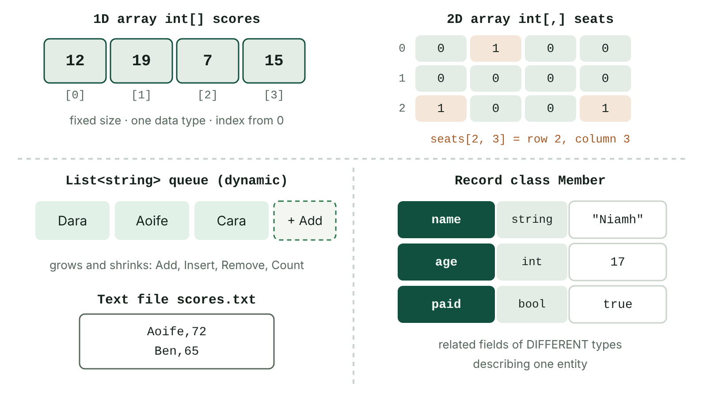
The big picture
Four data structures: a one-dimensional array with indexes, a two-dimensional array addressed by row and column, a growing list, and a record with fields of different types
☰ Menu
Notes:
Explain the diagram in your own words before you read on.

Slide 107
Why use data structures?
A data structure groups many related data items under one identifier so they can be stored and processed together
Thirty separate variables for thirty pupils' marks is unworkable; one array of thirty elements can be processed with a single loop
Static structures (arrays) have a size fixed when they are created; dynamic structures (lists) grow and shrink while the program runs
Arrays and lists are homogeneous (one data type); a record groups fields of different data types
Data in memory is lost when the program ends, so text files are used to keep data between runs
☰ Menu

Slide 108
Declaring a one-dimensional array
An array holds a fixed number of elements of the same type; each element is identified by an index starting at 0
The last valid index is always Length - 1
new int[5] creates five elements set to the default value 0; an initialiser list sets the size and values at once
☰ Menu

Slide 109
Declaring a one-dimensional array – code
C#
int[] goals = new int[5]; // five ints, all 0
string[] counties = { "Antrim", "Armagh", "Down",
"Fermanagh", "Londonderry", "Tyrone" };
double[] prices = new double[] { 2.50, 3.75, 1.20 };
goals[0] = 3;
goals[4] = goals[0] + 1;
Console.WriteLine(counties[3]); // Fermanagh
Console.WriteLine(counties.Length); // 6
Console.WriteLine(goals[4]); // 4
Console.WriteLine(prices[prices.Length - 1]); // 1.2
☰ Menu

Slide 110
Worked example: a week of rainfall
Daily rainfall (mm) at a Fermanagh weather station is stored in one array, Monday at index 0
One for loop traverses every element to total the values, find the index of the largest and count dry days
Casting total to double before dividing avoids integer division when calculating the mean
☰ Menu

Slide 111
Worked example: a week of rainfall – code
C#
int[] rain = { 4, 0, 12, 7, 0, 3, 9 }; // Mon to Sun
int total = 0, wettest = 0, dryDays = 0;
for (int i = 0; i < rain.Length; i++)
{
total += rain[i];
if (rain[i] > rain[wettest]) wettest = i;
if (rain[i] == 0) dryDays++;
}
Console.WriteLine($"Total {total} mm, mean {(double)total / rain.Length} mm");
Console.WriteLine($"Wettest day index {wettest}, dry days {dryDays}");
// Total 35 mm, mean 5 mm
// Wettest day index 2, dry days 2
☰ Menu

Slide 112
Searching an array
A linear search checks each element in turn until the target is found or the end of the array is reached
position starts at -1, a rogue value meaning 'not found'; the loop stops early once the item is found
Input Tomas outputs 'Tomas found at index 3'; input Sean outputs 'Sean is not in the squad'
☰ Menu

Slide 113
Searching an array – code
C#
string[] squad = { "Ciara", "Oisin", "Megan", "Tomas", "Erin" };
Console.Write("Player to find: ");
string target = Console.ReadLine();
int position = -1;
int i = 0;
while (i < squad.Length && position == -1)
{
if (squad[i] == target) position = i;
i++;
}
if (position == -1) Console.WriteLine(target + " is not in the squad");
else Console.WriteLine(target + " found at index " + position);
☰ Menu

Slide 114
Two-dimensional arrays
A 2D array is a table of elements of one data type, accessed with two indexes written [row, column]
GetLength(0) gives the number of rows, GetLength(1) the number of columns and Length the total number of elements
Suits grid-shaped data: seating plans, marks per pupil per test, sales per product per day
☰ Menu

Slide 115
Two-dimensional arrays – code
C#
int[,] marks = new int[3, 4]; // 3 pupils x 4 tests, all 0
int[,] grid = { { 1, 2, 3 },
{ 4, 5, 6 } }; // 2 rows, 3 columns
marks[2, 3] = 85; // pupil 2, test 3
Console.WriteLine(grid[1, 0]); // 4
Console.WriteLine(grid.GetLength(0)); // 2 (rows)
Console.WriteLine(grid.GetLength(1)); // 3 (columns)
Console.WriteLine(grid.Length); // 6 (elements)
☰ Menu

Slide 116
Worked example: theatre ticket sales
A theatre in Enniskillen records tickets sold for 3 shows (rows) over 4 nights (columns)
Nested loops: the outer loop visits each row (show), the inner loop each column (night); showTotal is reset for every row
Output: Show 0: 585, Show 1: 425, Show 2: 830, then All shows: 1840
☰ Menu

Slide 117
Worked example: theatre ticket sales – code
C#
int[,] sales = {
{ 120, 135, 150, 180 }, // show 0, Wed to Sat
{ 90, 85, 110, 140 }, // show 1
{ 200, 210, 190, 230 } // show 2
};
int grand = 0;
for (int show = 0; show < sales.GetLength(0); show++)
{
int showTotal = 0;
for (int night = 0; night < sales.GetLength(1); night++)
{
showTotal += sales[show, night];
}
Console.WriteLine($"Show {show}: {showTotal} tickets");
grand += showTotal;
}
Console.WriteLine($"All shows: {grand}");
☰ Menu

Slide 118
Lists: a dynamic structure
List<T> stores items of type T and grows or shrinks as items are added and removed, so memory is used only for items actually stored
Add, Insert, Remove, RemoveAt, Contains, IndexOf and Sort do work that would need extra code with an array
Count gives the number of items (an array uses Length); items are still accessed by index from 0
☰ Menu

Slide 119
Lists: a dynamic structure – code
C#
using System.Collections.Generic;
List<string> waiting = new List<string>();
waiting.Add("Aoife");
waiting.Add("Ben");
waiting.Add("Cara");
waiting.Remove("Ben");
waiting.Insert(0, "Dara");
Console.WriteLine(waiting.Count); // 3
Console.WriteLine(string.Join(", ", waiting)); // Dara, Aoife, Cara
Console.WriteLine(waiting.IndexOf("Cara")); // 2
waiting.RemoveAt(0);
Console.WriteLine(waiting[0]); // Aoife
Console.WriteLine(waiting.Contains("Ben")); // False
☰ Menu

Slide 120
Array or list?
Feature | Array | List<T>
Size | Fixed when created (static) | Changes at run time (dynamic)
Data types | One type for every element | One type for every item
Number of items | Length property | Count property
Adding or removing | Not possible; must copy into a new array | Add, Insert, Remove, RemoveAt
Memory | Reserved for every element, even unused ones | Grows as needed
Good for | 12 monthly totals; a 10 x 10 game board | Online orders arriving through the day
☰ Menu

Slide 121
Records
A record groups a fixed set of related fields describing one item; unlike an array, the fields can have different data types
In C# a record structure can be defined with struct (or a class with public fields); each field is reached with dot notation
An array or list of records works like a table in a database: each record is a row, each field a column
☰ Menu

Slide 122
Records – code
C#
Player p = new Player();
p.name = "Cian Doherty";
p.squadNumber = 9;
p.heightM = 1.82;
p.injured = false;
Player[] team = new Player[15]; // an array of records
team[0] = p;
Console.WriteLine($"{team[0].name} wears {team[0].squadNumber}");
// Cian Doherty wears 9
struct Player
{
public string name;
public int squadNumber;
public double heightM;
public bool injured;
}
☰ Menu

Slide 123
Worked example: a list of club members
A youth club keeps one record per member in a list, because members join and leave during the year
foreach visits each record; the paid field selects members who still owe fees
Output: Ross owes fees, Shauna owes fees, 2 of 3 members owe fees
☰ Menu

Slide 124
Worked example: a list of club members – code
C#
using System.Collections.Generic;
List<Member> club = new List<Member>
{
new Member { name = "Niamh", age = 17, paid = true },
new Member { name = "Ross", age = 16, paid = false },
new Member { name = "Shauna", age = 15, paid = false }
};
int owing = 0;
foreach (Member m in club)
{
if (!m.paid)
{
Console.WriteLine(m.name + " owes fees");
owing++;
}
}
Console.WriteLine($"{owing} of {club.Count} members owe fees");
class Member { public string name = ""; public int age; public bool paid; }
☰ Menu

Slide 125
Text files and persistent storage
Variables and arrays are held in RAM and lost when the program closes; a file on secondary storage keeps the data (persistent storage)
A file is opened in a mode: read, write (creates a new file or overwrites an existing one) or append (adds to the end)
A text file is processed a line at a time, usually one record per line
Fields are separated by a delimiter, often a comma (a CSV file): Niamh,17,true
Everything read from a text file is a string, so numbers must be converted (int.Parse) before calculations
The file must be closed so buffered data is written and other programs can use it
☰ Menu

Slide 126
Writing and appending
StreamWriter(name, false) creates or overwrites the file; StreamWriter(name, true) appends to it
A using block closes the file automatically, even if an error occurs; otherwise call Close()
File.AppendAllText and File.ReadAllLines are one-line shortcuts for simple tasks
☰ Menu

Slide 127
Writing and appending – code
C#
using System.IO;
// false = overwrite (or create); true would append
using (StreamWriter sw = new StreamWriter("members.csv", false))
{
sw.WriteLine("Niamh,17,true");
sw.WriteLine("Ross,16,false");
}
File.AppendAllText("members.csv", "Shauna,15,false\n");
string[] lines = File.ReadAllLines("members.csv");
Console.WriteLine(lines.Length + " records saved"); // 3 records saved
☰ Menu

Slide 128
Reading a file into a list of records
File.Exists prevents a run-time error if the file is missing
ReadLine reads one line; Split(',') breaks it into an array of fields; Parse converts each field to the right type
EndOfStream becomes true after the last line, ending the condition-controlled loop
☰ Menu

Slide 129
Reading a file into a list of records – code
C#
using System.Collections.Generic;
using System.IO;
List<Member> club = new List<Member>();
if (!File.Exists("members.csv")) Console.WriteLine("File not found");
else
{
using (StreamReader sr = new StreamReader("members.csv"))
{
while (!sr.EndOfStream)
{
string[] f = sr.ReadLine().Split(',');
club.Add(new Member { name = f[0], age = int.Parse(f[1]),
paid = bool.Parse(f[2]) });
}
}
Console.WriteLine(club.Count + " members loaded"); // 3 members loaded
}
class Member { public string name = ""; public int age; public bool paid; }
☰ Menu

Slide 130
Common pitfalls
Index out of range: scores[4] in an array of 4 elements throws an IndexOutOfRangeException at run time
Off-by-one errors: loop with i < Length, not i <= Length, and start at index 0, not 1
Mixing up [row, column] order or GetLength(0) and GetLength(1) in a 2D array
Forgetting to reset a running total inside the outer loop when totalling each row
Opening a missing file throws a FileNotFoundException; opening for write when you meant append wipes the existing data
Doing arithmetic on fields read from a file without converting them from strings
☰ Menu

Slide 131
Exit quiz: question 1 of 9
Tap an answer to check it. Presenting? Click to reveal the answer.
An array is declared as int[] a = new int[10]. What is the index of its last element?
A 10
B 9
✗
✓
C 1
D 11
✗
✗
✓ B: 9 – Indexes run from 0 to Length - 1, so ten elements have indexes 0 to 9.
☰ Menu

Slide 132
Exit quiz: question 2 of 9
Tap an answer to check it. Presenting? Click to reveal the answer.
A café takes a varying number of online orders each day. Which structure best stores the orders while the program runs?
A A list, because it can grow as orders arrive
B A 1D array of fixed size
✓
✗
C A constant
D A 2D array
✗
✗
✓ A: A list, because it can grow as orders arrive – The number of orders is unknown, so a dynamic list that grows as items are added is most suitable.
☰ Menu

Slide 133
Exit quiz: question 3 of 9
Tap an answer to check it. Presenting? Click to reveal the answer.
What does grid.GetLength(1) return for int[,] grid = new int[5, 8]?
A 5
B 40
✗
✗
C 8
D 13
✓
✗
✓ C: 8 – Dimension 1 is the number of columns, which is 8; GetLength(0) gives the 5 rows and Length gives 40.
☰ Menu

Slide 134
Exit quiz: question 4 of 9
Tap an answer to check it. Presenting? Click to reveal the answer.
What is the value of "Ben,65".Split(',')[1]?
A "Ben"
B 65 as an int
✗
✗
C ","
D "65" as a string
✗
✓
✓ D: "65" as a string – Split returns an array of strings; index 1 is "65", which must be converted with int.Parse before arithmetic.
☰ Menu

Slide 135
Exit quiz: question 5 of 9
Tap an answer to check it. Presenting? Click to reveal the answer.
Why must a file be closed after writing to it?
A To delete the temporary copy
B So buffered data is written to disk and the file is released
✗
✓
C To convert it to binary
D It does not need to be closed
✗
✗
✓ B: So buffered data is written to disk and the file is released – Closing flushes any data still in the buffer and frees the file for other programs.
☰ Menu

Slide 136
Exit quiz: question 6 of 9
Tap an answer to check it. Presenting? Click to reveal the answer.
Which statement best describes a record?
A A fixed set of related fields that may have different data types
B A list of values that must all be the same type
✓
✗
C A file stored on secondary storage
D A loop that processes every element
✗
✗
✓ A: A fixed set of related fields that may have different data types – A record describes one item using several named fields, which can be of different types.
☰ Menu

Slide 137
Exit quiz: question 7 of 9
Tap an answer to check it. Presenting? Click to reveal the answer.
A program needs to add a new line to an existing log file without losing earlier entries. Which should it use?
A new StreamReader("log.txt")
B new StreamWriter("log.txt", false)
✗
✗
C File.ReadAllLines("log.txt")
D new StreamWriter("log.txt", true)
✗
✓
✓ D: new StreamWriter("log.txt", true) – true opens the file in append mode, adding to the end; false would overwrite it.
☰ Menu

Slide 138
Exit quiz: question 8 of 9
Tap an answer to check it. Presenting? Click to reveal the answer.
int[] r = { 4, 0, 12, 7 }; What is the value of r[r.Length - 1] - r[1]?
A 4
B 12
✗
✗
C 7
D -4
✓
✗
✓ C: 7 – r[3] is 7 and r[1] is 0, so the result is 7.
☰ Menu

Slide 139
Exit quiz: question 9 of 9
Tap an answer to check it. Presenting? Click to reveal the answer.
Which loop header correctly visits every element of an array called data?
A for (int i = 1; i <= data.Length; i++)
B for (int i = 0; i < data.Length; i++)
✗
✓
C for (int i = 0; i <= data.Length; i++)
D for (int i = 1; i < data.Length; i++)
✗
✗
✓ B: for (int i = 0; i < data.Length; i++) – Indexes start at 0 and stop at Length - 1, so the condition must be i < Length.
☰ Menu

Slide 140
Exit quiz answers
Q | Answer | Why
1 | B 9 | Indexes run from 0 to Length - 1, so ten elements have indexes 0 to 9.
2 | A A list, because it can grow as orders arrive | The number of orders is unknown, so a dynamic list that grows as items are added is most suitable.
3 | C 8 | Dimension 1 is the number of columns, which is 8; GetLength(0) gives the 5 rows and Length gives 40.
4 | D "65" as a string | Split returns an array of strings; index 1 is "65", which must be converted with int.Parse before arithmetic.
5 | B So buffered data is written to disk and the file is released | Closing flushes any data still in the buffer and frees the file for other programs.
6 | A A fixed set of related fields that may have different data types | A record describes one item using several named fields, which can be of different types.
7 | D new StreamWriter("log.txt", true) | true opens the file in append mode, adding to the end; false would overwrite it.
8 | C 7 | r[3] is 7 and r[1] is 0, so the result is 7.
9 | B for (int i = 0; i < data.Length; i++) | Indexes start at 0 and stop at Length - 1, so the condition must be i < Length.
☰ Menu

Slide 141
Robust programs: validation, exceptions, errors, testing and debugging
AS 1: APPROACHES TO SYSTEMS DEVELOPMENT · AP23
Learning objectives
Write validation loops in C# using presence, length, range, type, format and lookup checks
Use try...catch...finally to handle exceptions so a program does not crash
Classify programming errors and design a test plan with suitable test data
Use IDE tools such as breakpoints, stepping and watches to locate logic errors
Explain when each kind of error is detected when a program is compiled or interpreted
Notes:
Specification: Describe and use validation checks, and distinguish validation from verification | Use exception handling to deal with run-time errors | Explain the differences between syntax, semantic, run-time and logic errors | Select valid, extreme, invalid and null test data and use a test plan to find errors | Use the debugging tools of an integrated development environment (IDE), such as breakpoints, stepping and watches, to locate errors (IDE features are introduced in AP19) | Explain how the choice of translator (compiler or interpreter, covered in AP19) affects when syntax, semantic and run-time errors are detected

Slide 142
In this lesson
Tap a button to jump straight there. The ☰ Menu button on every slide brings you back here.
The big picture
Four kinds of programming error
Debugging techniques
What makes a program robust?
Choosing test data
Translators: a quick recap (see AP19)
Validation checks
Worked example: leisure centre prices
When is each error detected?
A validation loop
Worked example: the test plan
Exit quiz
Validation or verification?
The IDE: a recap from AP19
↑ Topic menu
Exception handling
Debugging tools
Notes:
Lesson menu: each button jumps to that part of the lesson in Slide Show. The ☰ Menu button on each slide returns here.

Slide 143
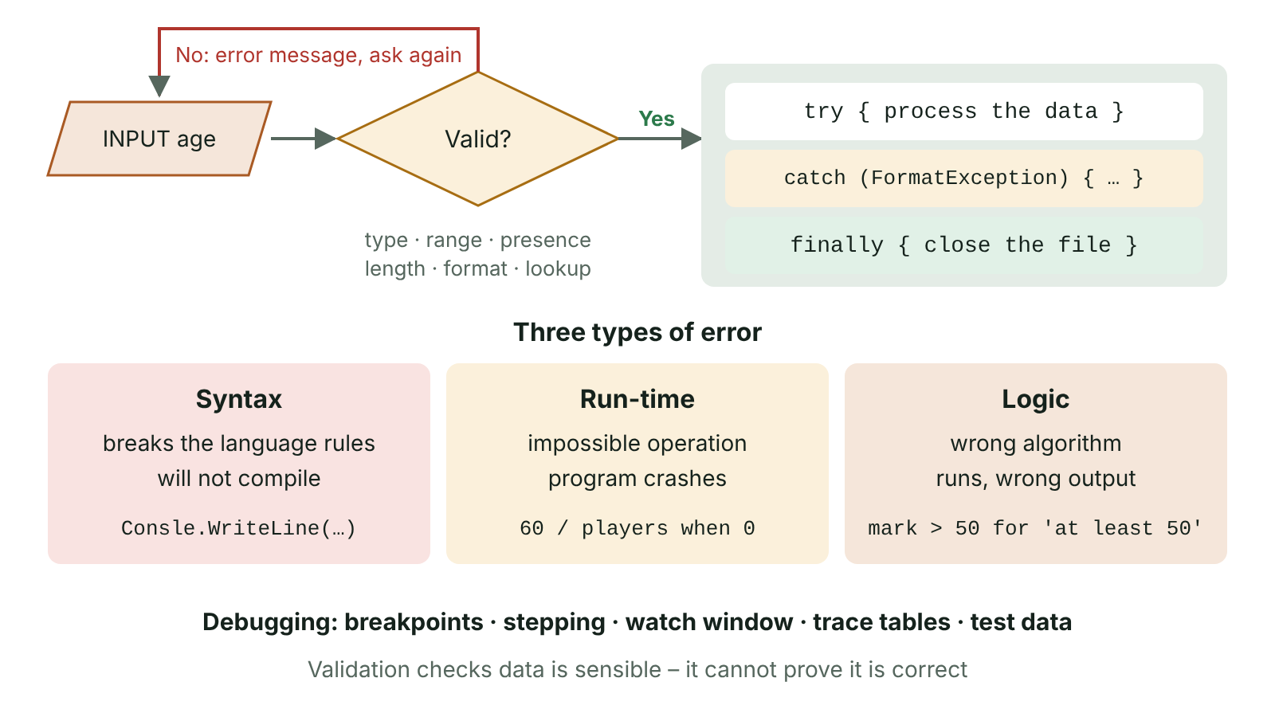
The big picture
A robust input process: validation loop rejects bad data, try and catch handle run-time errors, with the three error types summarised
☰ Menu
Notes:
Explain the diagram in your own words before you read on.

Slide 144
What makes a program robust?
A robust program copes with invalid input and unexpected events without crashing or producing wrong results
Validation: automatic checks that input is reasonable and follows rules before it is used
Exception handling: catches run-time errors and responds sensibly instead of crashing
Testing: running the program with planned test data and comparing expected with actual results
Debugging: finding and correcting the causes of errors, helped by the tools in an IDE
☰ Menu

Slide 145
Validation checks
Check | What it ensures | C# condition (true = valid)
Presence | Something has been entered | name != ""
Length | Number of characters is within limits | password.Length >= 8
Range | Value lies between a lower and upper limit | mark >= 0 && mark <= 100
Type | Data is of the expected data type | int.TryParse(input, out age)
Format | Data matches a set pattern | postcode.StartsWith("BT")
Lookup | Value is one of a list of allowed values | houses.Contains(house)
☰ Menu

Slide 146
A validation loop
int.TryParse returns false instead of crashing when the input is not a whole number (type check)
The range check only runs if TryParse succeeds, because && short-circuits
do...while asks at least once and repeats with a helpful message until the input is valid
☰ Menu

Slide 147
A validation loop – code
C#
int tickets;
bool valid;
do
{
Console.Write("Tickets (1-6): ");
string input = Console.ReadLine() ?? "";
valid = int.TryParse(input, out tickets) && tickets >= 1 && tickets <= 6;
if (!valid) Console.WriteLine("Please enter a whole number from 1 to 6.");
} while (!valid);
Console.WriteLine("Accepted: " + tickets);
☰ Menu

Slide 148
Validation or verification?
Validation checks that data is reasonable; it cannot prove it is correct: an age of 34 passes a range check even if the person is 43
Verification checks that data has been entered or copied accurately, matching the original source
Double entry: type the data twice (e.g. a new password or email) and compare the two copies
Visual check: the user reads the data back on screen, or against the source document, before confirming
Using both improves data integrity: validation rejects impossible values and verification catches typing mistakes
☰ Menu

Slide 149
Exception handling
An exception is an object created when a run-time error occurs, such as dividing by zero or a missing file
Risky code goes in try; a catch block handles a specific exception type; finally always runs, e.g. to close a file
Order catch blocks from the most specific to the general Exception, which must come last
☰ Menu

Slide 150
Exception handling – code
C#
try
{
Console.Write("Players: ");
int players = int.Parse(Console.ReadLine() ?? "");
int each = 60 / players;
Console.WriteLine("Minutes each: " + each);
}
catch (FormatException)
{
Console.WriteLine("That is not a whole number.");
}
catch (DivideByZeroException)
{
Console.WriteLine("There must be at least one player.");
}
finally
{
Console.WriteLine("Done.");
}
☰ Menu

Slide 151
Four kinds of programming error
Error | What it is | When detected | C# example
Syntax | Breaks the grammar rules of the language | By the compiler; the program will not run | Missing ; or bracket; Consle.WriteLine
Semantic | Grammatically correct but meaningless or invalid | Often by the compiler, sometimes only at run time | int n = "five"; using a variable before it has a value
Run-time | An impossible operation while the program runs | During execution: the program crashes | Divide by zero; index out of range; int.Parse("4.5")
Logic | A flaw in the algorithm | Only by testing: it runs but the output is wrong | cost = price + qty instead of price * qty; > instead of >=
☰ Menu

Slide 152
Choosing test data
Type of test data | Purpose | Example: age accepted if 0 to 120
Valid (normal) | Typical data that should be accepted and processed correctly | 30, 72
Extreme (boundary) | Values at the edges of the valid range, and at each band boundary | 0, 120 (also 15/16 and 64/65 if prices change there)
Invalid (erroneous) | Data that should be rejected: out of range or the wrong type | -1, 121, ten, 4.5
Null (absent) | Nothing entered, to test presence checks | Pressing Enter with no input
☰ Menu

Slide 153
Worked example: leisure centre prices
A leisure centre in Omagh charges under 16s £3.00, adults £5.00 and those aged 65 and over £2.50
The age is validated with a type check and a range check of 0 to 120
The code compiles and runs, but it contains a logic error that only careful boundary testing will reveal
☰ Menu

Slide 154
Worked example: leisure centre prices – code
C#
Console.Write("Age: ");
int age;
while (!int.TryParse(Console.ReadLine(), out age) || age < 0 || age > 120)
{
Console.Write("Enter a whole number from 0 to 120: ");
}
double price;
if (age < 16) price = 3.00;
else if (age > 65) price = 2.50; // logic error: should be >= 65
else price = 5.00;
Console.WriteLine($"Price: £{price:F2}");
☰ Menu

Slide 155
Worked example: the test plan
Test | Data | Type | Expected | Actual | Result
1 | 30 | Valid | £5.00 | £5.00 | Pass
2 | 15 | Extreme | £3.00 | £3.00 | Pass
3 | 16 | Extreme | £5.00 | £5.00 | Pass
4 | 65 | Extreme | £2.50 | £5.00 | Fail
5 | 121 | Invalid | Rejected, asked again | Asked again | Pass
6 | ten | Invalid | Rejected, asked again | Asked again | Pass
7 | (nothing) | Null | Rejected, asked again | Asked again | Pass
☰ Menu

Slide 156
The IDE: a recap from AP19
Editor: write, edit and save code, with line numbers and code folding
Syntax highlighting and auto-indent; syntax checking underlines errors such as a missing ; as you type
Code completion (IntelliSense) suggests keywords and identifiers, reducing spelling mistakes
Preferences / formatting keep a team's layout consistent; compile and run builds the program and lists errors with line numbers
Debugging tools – breakpoints, stepping, watches and the call stack – are the focus of this lesson
☰ Menu

Slide 157
Debugging tools
Breakpoint: pauses execution at a chosen line so the program's state can be examined
Step into / step over: execute one line at a time, entering or skipping over subroutine calls, to follow the flow of control
Watch and Locals windows: show variable values as they change, so the first wrong value can be spotted
Call stack: shows which subroutines were called to reach the current line
Leisure centre bug: a breakpoint on the if, input 65, then step: the >65 branch is skipped, so the fault is in that condition
☰ Menu

Slide 158
Debugging techniques
Dry run the code with a trace table, comparing expected and actual values at each step
Insert temporary output statements to display variable values at key points, then remove them
Test with valid, extreme, invalid and null data to narrow down where the logic fails
Isolate the problem: test each subroutine separately or comment out sections of code
Read error messages carefully: the exception type and line number usually point to the cause
After fixing, re-run all the earlier tests to check that nothing else has been broken
☰ Menu

Slide 159
Translators: a quick recap (see AP19)
Source code must be translated into machine code before the processor can run it
Assembler: assembly language to machine code, one mnemonic to one instruction
Compiler: translates the whole program first, lists every error, and produces an executable
Interpreter: translates and runs one statement at a time; no object code is kept
C# is compiled to Common Intermediate Language, which the .NET runtime JIT-compiles to machine code
For the full comparison of the three translators, use AP19 slides 2–4
☰ Menu

Slide 160
When is each error detected?
Error type | Compiled (e.g. C#) | Interpreted
Syntax | Listed by the compiler before anything runs | Found only when that line is reached; earlier lines have already run
Semantic (e.g. text into an int) | Usually rejected at compile time by type checking | Often appears only at run time, when the line executes
Run-time (e.g. divide by zero) | During execution, unless handled with try…catch | During execution, unless handled
Logic (wrong formula or operator) | Not detected: program runs with wrong output | Not detected: found only by testing
Consequence | No executable until every syntax error is fixed | A late error may strike after files or data have been changed
☰ Menu

Slide 161
Exit quiz: question 1 of 10
Tap an answer to check it. Presenting? Click to reveal the answer.
An online form rejects a mark of 120 when marks must be out of 100. Which validation check has been applied?
A Presence check
B Format check
✗
✗
C Range check
D Length check
✓
✗
✓ C: Range check – The value lies outside the allowed lower and upper limits, so a range check rejects it.
☰ Menu

Slide 162
Exit quiz: question 2 of 10
Tap an answer to check it. Presenting? Click to reveal the answer.
A program outputs the wrong total but never crashes. What type of error does it contain?
A Logic error
B Syntax error
✓
✗
C Run-time error
D Compilation error
✗
✗
✓ A: Logic error – It compiles and runs, so the fault is in the algorithm: a logic error, found only by testing.
☰ Menu

Slide 163
Exit quiz: question 3 of 10
Tap an answer to check it. Presenting? Click to reveal the answer.
Which exception does int.Parse("ten") throw?
A DivideByZeroException
B FormatException
✗
✓
C IndexOutOfRangeException
D FileNotFoundException
✗
✗
✓ B: FormatException – The text is not in a valid numeric format, so a FormatException is thrown.
☰ Menu

Slide 164
Exit quiz: question 4 of 10
Tap an answer to check it. Presenting? Click to reveal the answer.
Which IDE feature shows how the values of variables change as a program runs?
A Syntax highlighting
B Error list
✗
✗
C Code completion
D Watch window
✗
✓
✓ D: Watch window – A watch (or locals) window displays chosen variables' current values while the program is paused or stepped.
☰ Menu

Slide 165
Exit quiz: question 5 of 10
Tap an answer to check it. Presenting? Click to reveal the answer.
Why is a do...while loop often used for input validation?
A It runs faster than a for loop
B It may run zero times
✗
✗
C The input must be requested at least once before it is checked
D It catches exceptions
✓
✗
✓ C: The input must be requested at least once before it is checked – The condition is tested after the body, so the prompt is always shown at least once.
☰ Menu

Slide 166
Exit quiz: question 6 of 10
Tap an answer to check it. Presenting? Click to reveal the answer.
Valid ages are 0 to 120. Which value is extreme (boundary) test data?
A 120
B 45
✓
✗
C -5
D abc
✗
✗
✓ A: 120 – Boundary data lies exactly at the limits of the valid range; 120 is the upper limit.
☰ Menu

Slide 167
Exit quiz: question 7 of 10
Tap an answer to check it. Presenting? Click to reveal the answer.
A program is run by an interpreter and line 30 contains a syntax error. What happens?
A Nothing runs until the error is fixed
B The interpreter skips line 30 and carries on
✗
✗
C The error is reported as a logic error
D Lines 1 to 29 run, then execution stops at line 30
✗
✓
✓ D: Lines 1 to 29 run, then execution stops at line 30 – An interpreter translates and runs one statement at a time, so the error is only found when line 30 is reached.
☰ Menu

Slide 168
Exit quiz: question 8 of 10
Tap an answer to check it. Presenting? Click to reveal the answer.
A programmer writes int total = "twelve"; Which type of error is this?
A Logic error
B Semantic (type) error
✗
✓
C Run-time error
D Boundary error
✗
✗
✓ B: Semantic (type) error – The statement follows the grammar but assigning a string to an int has no valid meaning; the C# compiler rejects it.
☰ Menu

Slide 169
Exit quiz: question 9 of 10
Tap an answer to check it. Presenting? Click to reveal the answer.
Which describes verification by double entry?
A Checking a value is in a list
B Entering data twice and comparing the two copies
✗
✓
C Checking data has the right number of characters
D Running the program twice
✗
✗
✓ B: Entering data twice and comparing the two copies – Double entry checks the data was typed accurately by comparing two independent entries.
☰ Menu

Slide 170
Exit quiz: question 10 of 10
Tap an answer to check it. Presenting? Click to reveal the answer.
What does the C# compiler produce from source code?
A Common Intermediate Language, later compiled to machine code by the JIT compiler
B Assembly language mnemonics
✓
✗
C Python bytecode
D Nothing; C# is interpreted line by line
✗
✗
✓ A: Common Intermediate Language, later compiled to machine code by the JIT compiler – C# compiles to CIL in an .exe or .dll; the .NET runtime's JIT compiler turns it into native machine code.
☰ Menu

Slide 171
Exit quiz answers
Q | Answer | Why
1 | C Range check | The value lies outside the allowed lower and upper limits, so a range check rejects it.
2 | A Logic error | It compiles and runs, so the fault is in the algorithm: a logic error, found only by testing.
3 | B FormatException | The text is not in a valid numeric format, so a FormatException is thrown.
4 | D Watch window | A watch (or locals) window displays chosen variables' current values while the program is paused or stepped.
5 | C The input must be requested at least once before it is checked | The condition is tested after the body, so the prompt is always shown at least once.
6 | A 120 | Boundary data lies exactly at the limits of the valid range; 120 is the upper limit.
7 | D Lines 1 to 29 run, then execution stops at line 30 | An interpreter translates and runs one statement at a time, so the error is only found when line 30 is reached.
8 | B Semantic (type) error | The statement follows the grammar but assigning a string to an int has no valid meaning; the C# compiler rejects it.
9 | B Entering data twice and comparing the two copies | Double entry checks the data was typed accurately by comparing two independent entries.
10 | A Common Intermediate Language, later compiled to machine code by the JIT compiler | C# compiles to CIL in an .exe or .dll; the .NET runtime's JIT compiler turns it into native machine code.
☰ Menu

