Slide 1
Digital data
UNIT 1: DIGITAL TECHNOLOGY · TOPIC
Lessons in this topic
L01 Data, information and units of storage
L02 Data types
L03 Representing images: pixels, resolution, bitmap and vector
L04 Representing sound; buffering and streaming
L05 Data portability, file formats and compression

Slide 2

Topic menu
Tap a button to jump straight there. The ☰ Menu button on every slide brings you back here.
Specification map
L03 Representing images: pixels, resolution, bitmap and vector
L01 Data, information and units of storage
L04 Representing sound; buffering and streaming
L02 Data types
L05 Data portability, file formats and compression

Slide 3
Specification map (1 of 2)
Lesson | Specification: students should be able to
L01 | Describe the difference between information and data; Describe how data is stored in bit, nibble, byte, kilobyte, megabyte, gigabyte and terabyte; Explain how characters are represented in binary using a character set such as ASCII; Calculate conversions between units of storage
L02 | Identify the following data types: numeric (integer and real), date/time, character and string; Explain why data must be defined as a particular data type before it is processed; Select and justify the most appropriate data type for a given item of data
L03 | Demonstrate understanding of how pixels are used in image representation; Demonstrate understanding of how image resolution affects file size; Describe how vector-based graphics and bitmap graphics are stored; Describe the difference between vector-based and bitmap graphics; Calculate the file size of a bitmap image from its resolution and colour depth
☰ Menu

Slide 4
Specification map (2 of 2)
Lesson | Specification: students should be able to
L04 | Explain the need for analogue-to-digital conversion in sound recording; Describe factors that affect sound quality when recording sound, including sample rate, bit depth and bit rate; Calculate the bit rate and file size of a sound recording; Demonstrate understanding of how buffering and streaming are used to support the transfer of moving image files
L05 | Demonstrate understanding of data portability and the following file formats that support it: jpeg, tiff, png, pict, gif, txt, csv, rtf, mp3, mp4, midi, mpeg, avi, pdf, wav and wma; Choose and justify a suitable file format for a given purpose; Demonstrate understanding of the need for data compression; Describe lossy and lossless compression and give examples of each
☰ Menu
Notes:
Each lesson below is its own section in PowerPoint (View → Slide Sorter shows them). To split this deck by specification point, right-click a section → Move Section, or delete the sections you do not need.

Slide 5
Data, information and units of storage
UNIT 1: DIGITAL TECHNOLOGY · L01
Learning objectives
Define data and information and explain how processing turns one into the other
Explain why computers store everything in binary and how ASCII represents characters
Order the units of storage from bit to terabyte
Convert between units of storage and work out how many files will fit on a device
Notes:
Specification: Describe the difference between information and data | Describe how data is stored in bit, nibble, byte, kilobyte, megabyte, gigabyte and terabyte | Explain how characters are represented in binary using a character set such as ASCII | Calculate conversions between units of storage

Slide 6
In this lesson
Tap a button to jump straight there. The ☰ Menu button on every slide brings you back here.
The big picture
Worked example: conversions
Data or information?
Worked example: will it fit?
From data to information
1000 or 1024?
Why computers use binary
Exam tips
Characters and ASCII
Exit quiz
Units of storage
↑ Topic menu
Converting between units
Notes:
Lesson menu: each button jumps to that part of the lesson in Slide Show. The ☰ Menu button on each slide returns here.

Slide 7
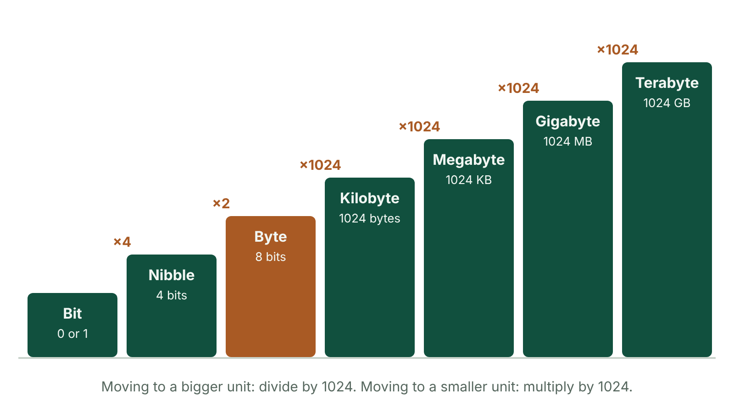
The big picture
Units of storage as a staircase from bit to terabyte, with the multiplier between each step
☰ Menu
Notes:
Explain the diagram in your own words before you read on.

Slide 8
Data or information?
Data: raw facts and figures with no meaning or context, e.g. 18, 22, 19
Information: data that has been processed and given context, so it has meaning
Example: 'Belfast maximum temperatures on Mon, Tue and Wed this week: 18°C, 22°C, 19°C'
Information = data + context (processing adds the meaning)
The same data can give different information in different contexts: 140526 could be a date (14/05/26) or a product code
☰ Menu

Slide 9
From data to information
An information system is hardware and software working together
It takes data as input, processes it, and outputs information
Example: a school canteen till records each item sold (data)
At the end of the week the system produces 'Most popular lunch: chicken wrap, 312 sold' (information)
Input → Process → Output
☰ Menu

Slide 10
Why computers use binary
Inside a computer are billions of tiny switches (transistors) that are either on or off
On = 1 and off = 0, so data is stored using the binary number system
One binary digit (0 or 1) is called a bit – the smallest unit of storage
Text, numbers, images, sound and video are all stored as patterns of bits
☰ Menu

Slide 11
Characters and ASCII
A character is a letter, digit, punctuation mark or symbol
Each character is stored as one byte (8 bits)
A character set gives every character its own unique binary code
ASCII is a commonly used character set: 'A' = 01000001, 'B' = 01000010, 'a' = 01100001
Upper and lower case letters have different codes
So 'Belfast' has 7 characters = 7 bytes = 56 bits
☰ Menu

Slide 12
Units of storage
Unit | Size | Roughly enough for…
Bit | A single 0 or 1 | Yes or no, on or off
Nibble | 4 bits (half a byte) | One hexadecimal digit
Byte | 8 bits | One character, e.g. 'K'
Kilobyte (KB) | 1024 bytes | A short plain-text file
Megabyte (MB) | 1024 KB | About 1 minute of MP3 music
Gigabyte (GB) | 1024 MB | About 20 minutes of HD video
Terabyte (TB) | 1024 GB | A typical laptop or external hard drive
☰ Menu

Slide 13
Converting between units
Bits → bytes: divide by 8. Bytes → bits: multiply by 8
Going UP to a bigger unit (e.g. KB → MB): divide by 1024
Going DOWN to a smaller unit (e.g. GB → MB): multiply by 1024
Skip two units? Use 1024 twice, e.g. 1 GB = 1024 × 1024 = 1 048 576 KB
Always show your working and write the unit with your answer
☰ Menu

Slide 14
Worked example: conversions
Convert 3 GB to MB: 3 × 1024 = 3072 MB
Convert 6144 KB to MB: 6144 ÷ 1024 = 6 MB
A file is 6400 bits. In bytes: 6400 ÷ 8 = 800 bytes
How many bits in 5 KB? 5 × 1024 = 5120 bytes, then 5120 × 8 = 40 960 bits
How many nibbles in 4096 bits? 4096 ÷ 4 = 1024 nibbles
☰ Menu

Slide 15
Worked example: will it fit?
Orla has a 64 GB phone with all its space free. Each photo she takes is about 4 MB
Step 1 – same units: 64 GB × 1024 = 65 536 MB
Step 2 – divide: 65 536 ÷ 4 = 16 384 photos
A 32 GB USB stick and 512 MB video clips: 32 × 1024 = 32 768 MB; 32 768 ÷ 512 = 64 clips
Key rule: change both sizes into the SAME unit before dividing
☰ Menu

Slide 16
1000 or 1024?
Computers work in binary, so units go up in powers of 2: 2¹⁰ = 1024
CCEA questions use 1024 – use it in the exam
Some manufacturers advertise storage using 1000, which is why a new '1 TB' drive can show slightly less free space than expected
☰ Menu

Slide 17
Exam tips
'Describe the difference' between data and information: define BOTH and give an example of each
Your example of information must show the context, not just the numbers
Learn the order: bit, nibble, byte, KB, MB, GB, TB
Calculations: show each step, and check your answer is sensible (a bigger unit gives a smaller number)
☰ Menu

Slide 18
Exit quiz: question 1 of 9
Tap an answer to check it. Presenting? Click to reveal the answer.
Which of these is information rather than data?
A 14, 17, 21
B Q7X
✗
✗
C Sam scored 17 out of 20 in the maths test
D 01101
✓
✗
✓ C: Sam scored 17 out of 20 in the maths test – It has context – we know whose score it is and what it is out of – so it has meaning.
☰ Menu

Slide 19
Exit quiz: question 2 of 9
Tap an answer to check it. Presenting? Click to reveal the answer.
A phone has 64 GB of free space. Each photo is 4 MB. About how many photos will fit?
A 16
B 256
✗
✗
C 16 384
D 65 536
✓
✗
✓ C: 16 384 – 64 × 1024 = 65 536 MB, then 65 536 ÷ 4 = 16 384 photos.
☰ Menu

Slide 20
Exit quiz: question 3 of 9
Tap an answer to check it. Presenting? Click to reveal the answer.
How many bits make one byte?
A 4
B 8
✗
✓
C 16
D 1024
✗
✗
✓ B: 8 – A byte is 8 bits. Four bits is a nibble.
☰ Menu

Slide 21
Exit quiz: question 4 of 9
Tap an answer to check it. Presenting? Click to reveal the answer.
Which unit is the largest?
A Gigabyte
B Megabyte
✗
✗
C Kilobyte
D Terabyte
✗
✓
✓ D: Terabyte – A terabyte is 1024 GB.
☰ Menu

Slide 22
Exit quiz: question 5 of 9
Tap an answer to check it. Presenting? Click to reveal the answer.
What is 2 MB in KB?
A 2048 KB
B 1024 KB
✓
✗
C 16 KB
D 2000 KB
✗
✗
✓ A: 2048 KB – Going to a smaller unit, multiply: 2 × 1024 = 2048 KB.
☰ Menu

Slide 23
Exit quiz: question 6 of 9
Tap an answer to check it. Presenting? Click to reveal the answer.
A file is 6400 bits. How many bytes is that?
A 51 200
B 6.25
✗
✗
C 800
D 1600
✓
✗
✓ C: 800 – Divide bits by 8 to get bytes: 6400 ÷ 8 = 800.
☰ Menu

Slide 24
Exit quiz: question 7 of 9
Tap an answer to check it. Presenting? Click to reveal the answer.
Why does a computer use a character set such as ASCII?
A To compress text files
B To give each character a unique binary code
✗
✓
C To check spelling
D To translate between languages
✗
✗
✓ B: To give each character a unique binary code – Computers can only store binary, so each character needs its own agreed binary code.
☰ Menu

Slide 25
Exit quiz: question 8 of 9
Tap an answer to check it. Presenting? Click to reveal the answer.
Roughly how much video would 1 GB hold?
A About 20 minutes of HD video
B About 1 second of HD video
✓
✗
C About 20 hours of HD video
D About 1 minute of audio
✗
✗
✓ A: About 20 minutes of HD video – A gigabyte (1024 MB) is around 20 minutes of HD video; 1 MB is roughly a minute of MP3 music.
☰ Menu

Slide 26
Exit quiz: question 9 of 9
Tap an answer to check it. Presenting? Click to reveal the answer.
How many bytes are needed to store the word 'Strabane'?
A 8
B 7
✓
✗
C 64
D 16
✗
✗
✓ A: 8 – S-t-r-a-b-a-n-e is 8 characters, and each character takes 1 byte, so 8 bytes (64 bits).
☰ Menu

Slide 27
Exit quiz answers
Q | Answer | Why
1 | C Sam scored 17 out of 20 in the maths test | It has context – we know whose score it is and what it is out of – so it has meaning.
2 | C 16 384 | 64 × 1024 = 65 536 MB, then 65 536 ÷ 4 = 16 384 photos.
3 | B 8 | A byte is 8 bits. Four bits is a nibble.
4 | D Terabyte | A terabyte is 1024 GB.
5 | A 2048 KB | Going to a smaller unit, multiply: 2 × 1024 = 2048 KB.
6 | C 800 | Divide bits by 8 to get bytes: 6400 ÷ 8 = 800.
7 | B To give each character a unique binary code | Computers can only store binary, so each character needs its own agreed binary code.
8 | A About 20 minutes of HD video | A gigabyte (1024 MB) is around 20 minutes of HD video; 1 MB is roughly a minute of MP3 music.
9 | A 8 | S-t-r-a-b-a-n-e is 8 characters, and each character takes 1 byte, so 8 bytes (64 bits).
☰ Menu

Slide 28
In the exam
Paper | Question | Marks | What it tested
Unit 1 2019 | Q2(a) | 4 | Data and information with examples
Unit 1 2019 | Q2(b) | 2 | Bits in a nibble; KB in an MB
Unit 1 2021 | Q4 | 6 | Bits, nibble, byte; data types matching
Unit 1 2023 | Q1 | 5 | Bit and byte, data types, data in context
Unit 1 2025 | Q4 | 7 | Boot process, OS roles, storage conversion
Papers and mark schemes: ccea.org.uk → GCSE Digital Technology → Past Papers & Mark Schemes.
☰ Menu

Slide 29
Data types
UNIT 1: DIGITAL TECHNOLOGY · L02
Learning objectives
Name and describe the five data types in the specification and give an example of each
Explain why choosing the correct data type matters for storage, processing and validation
Choose the most suitable data type for an item of data and justify the choice
Recognise common date and time formats
Notes:
Specification: Identify the following data types: numeric (integer and real), date/time, character and string | Explain why data must be defined as a particular data type before it is processed | Select and justify the most appropriate data type for a given item of data

Slide 30
In this lesson
Tap a button to jump straight there. The ☰ Menu button on every slide brings you back here.
The big picture
Choosing a data type – method
Why data types matter
Worked example: leisure centre membership
The five data types
Data types in programs and databases
Numeric: integer and real
Exam tips
Date/time formats
Exit quiz
Character and string
↑ Topic menu
Trick items
Notes:
Lesson menu: each button jumps to that part of the lesson in Slide Show. The ☰ Menu button on each slide returns here.

Slide 31
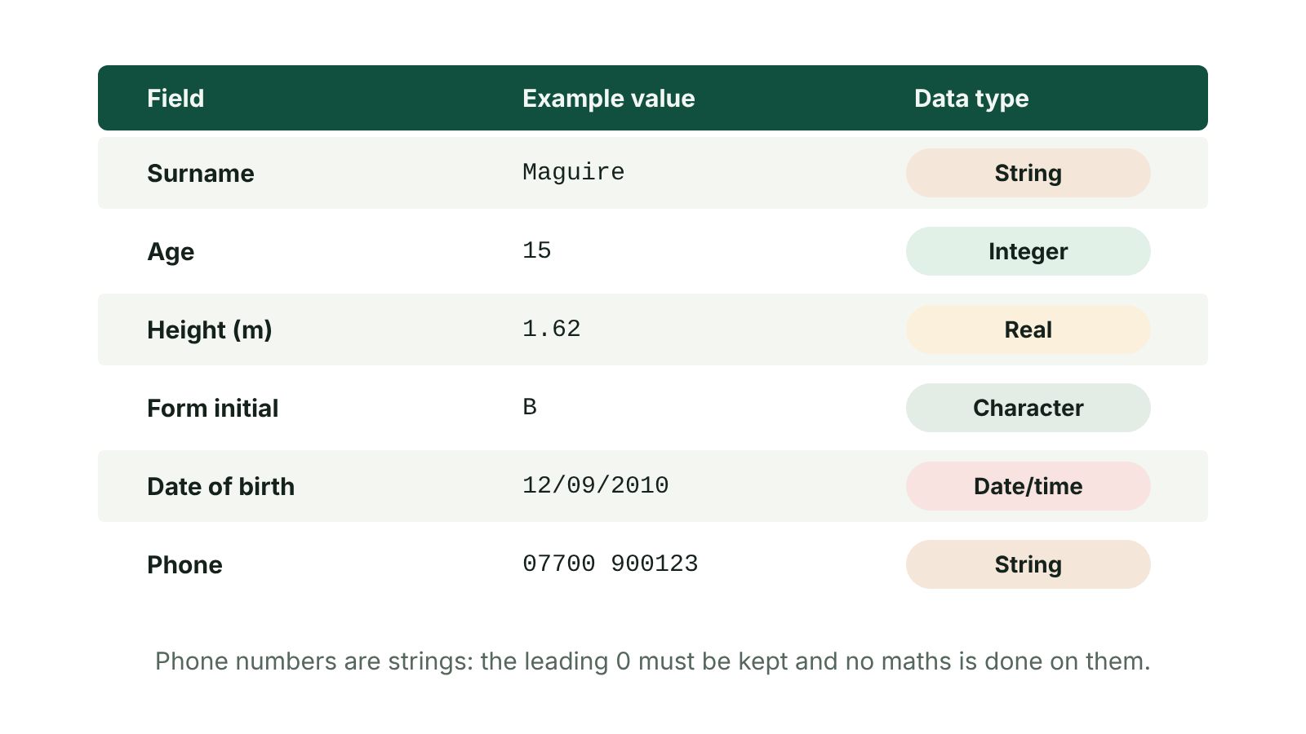
The big picture
A pupil record with each field matched to its data type
☰ Menu
Notes:
Explain the diagram in your own words before you read on.

Slide 32
Why data types matter
A data type tells the computer what kind of data an item is, e.g. a whole number or text
Data must be given a type BEFORE it is processed
It controls what you can do with the data: add numbers, sort dates into order, join text
It helps the computer store the data efficiently, using the right amount of space
It allows validation: a type check rejects data of the wrong kind, e.g. 'ten' in a number field
☰ Menu

Slide 33
The five data types
Data type | Description | Example
Integer (numeric) | Whole number, positive or negative, no decimal part | 15, -3, 2026
Real (numeric) | Number that can have a decimal or fractional part, positive or negative | 1.62, -4.6, 3.99
Date/time | A date and/or a time, stored so it can be sorted and calculated with | 12/09/2026, 15:45
Character | A single letter, digit or symbol from the character set | F, Y, 7, #
String | A sequence of characters; the length can vary | Enniskillen, BT74 6AA, 07700 900123
☰ Menu

Slide 34
Numeric: integer and real
Integer: whole numbers only, e.g. number of pupils in a class (28) or a team's goal difference (-1)
Real: can include decimal parts, e.g. a height of 1.75 m or a temperature of -2.5 °C
Real numbers also include whole numbers: 7 is real as well as integer
Which are integers? 7.25, -3, -61, 4.8, 512 → -3, -61 and 512
In C#, int stores integers and double stores real numbers
☰ Menu

Slide 35
Date/time formats
Format | Example (Saturday 12 September 2026, 3:45:30 pm)
Long date | Saturday, 12 September 2026
Medium date | 12-Sep-2026
Short date | 12/09/2026
Long time | 15:45:30
Medium time | 03:45 PM
Short time | 15:45
☰ Menu

Slide 36
Character and string
Character: exactly ONE letter, digit or symbol, e.g. a grade 'A' or a shirt size 'M'
Each character is stored using its code from the character set, e.g. ASCII
String: a sequence of characters, such as a word, name or address
A string has a variable length: 'Ann' is 3 characters, 'Londonderry' is 11
Digits inside a string are treated as text, not as numbers to calculate with
☰ Menu

Slide 37
Trick items
Phone numbers → string: the leading zero would be lost as an integer, they can contain spaces, and you never do maths on them
Postcodes → string: they mix letters, digits and a space (BT74 6AA)
Prices → real (or currency in a database): £3.99 needs a decimal part
Age in years → integer; date of birth → date/time
Yes/No answers: character (Y/N) in the Unit 1 list; databases also offer a Yes/No (Boolean) field
☰ Menu

Slide 38
Choosing a data type – method
1. Will I do calculations with it? If yes → numeric
2. Does it need a decimal point? Yes → real; no → integer
3. Is it a date or a time? → date/time
4. Is it always exactly one character? → character
5. Otherwise → string (this includes 'numbers' like phone numbers and IDs with leading zeros)
☰ Menu

Slide 39
Worked example: leisure centre membership
Field | Sample data | Data type | Reason
Member name | Aoife McCann | String | Several letters and a space
Mobile | 07700 900456 | String | Leading zero, no calculations
Date joined | 03/03/2026 | Date/time | Sorted and used to find renewal date
Visits this month | 12 | Integer | Whole number, will be totalled
Monthly fee | 24.50 | Real | Money needs a decimal part
Junior member? | Y | Character | Always one letter, Y or N
☰ Menu

Slide 40
Data types in programs and databases
Programs declare a type for each variable, as in the pseudocode below
Databases use similar field types, sometimes with different names
Access names: Short Text (string), Number, Currency, Date/Time, Yes/No
CCEA mark schemes credit currency and Yes/No in database questions
PSEUDOCODE
DECLARE pupils AS INTEGER
DECLARE lunchPrice AS REAL
DECLARE dateOfBirth AS DATE
DECLARE grade AS CHARACTER
DECLARE surname AS STRING
pupils ← 28
lunchPrice ← 2.85
grade ← 'A'
surname ← "O'Neill"
☰ Menu

Slide 41
Exam tips
Give the exact name: 'integer' or 'real', not just 'number', unless the question says numeric
Justify with a reason linked to the data: 'it has a decimal part', 'it starts with 0'
'Describe' a data type: say what it stores AND give a suitable example
Do not say a phone number is an integer – this is the most common mistake
☰ Menu

Slide 42
Exit quiz: question 1 of 8
Tap an answer to check it. Presenting? Click to reveal the answer.
Which data type is best for a postcode such as BT74 6AA?
A Integer
B Real
✗
✗
C String
D Character
✓
✗
✓ C: String – A postcode mixes letters, digits and a space, so it is a string.
☰ Menu

Slide 43
Exit quiz: question 2 of 8
Tap an answer to check it. Presenting? Click to reveal the answer.
Why is a mobile phone number not stored as an integer?
A It is too long to store
B Integers cannot be sorted
✗
✗
C It uses less storage
D The leading zero would be lost
✗
✓
✓ D: The leading zero would be lost – Integers drop leading zeros, so 07700 900123 would become 7700900123. Phone numbers are also never used in calculations.
☰ Menu

Slide 44
Exit quiz: question 3 of 8
Tap an answer to check it. Presenting? Click to reveal the answer.
Which data type should store a height of 1.75 m?
A Real
B Integer
✓
✗
C Character
D Date/time
✗
✗
✓ A: Real – It has a decimal part, so it must be real.
☰ Menu

Slide 45
Exit quiz: question 4 of 8
Tap an answer to check it. Presenting? Click to reveal the answer.
A field stores a single letter for shirt size (S, M or L). Which data type?
A String
B Character
✗
✓
C Integer
D Real
✗
✗
✓ B: Character – It is always exactly one character.
☰ Menu

Slide 46
Exit quiz: question 5 of 8
Tap an answer to check it. Presenting? Click to reveal the answer.
Which item should be stored as an integer?
A Price of a ticket
B Number of goals scored
✗
✓
C Phone number
D Team name
✗
✗
✓ B: Number of goals scored – Goals are counted in whole numbers and may be added up.
☰ Menu

Slide 47
Exit quiz: question 6 of 8
Tap an answer to check it. Presenting? Click to reveal the answer.
'int' and 'double' are both examples of which kind of data type?
A Text
B Date/time
✗
✗
C Numeric
D Boolean
✓
✗
✓ C: Numeric – Both store numbers: int for whole numbers and double for real numbers.
☰ Menu

Slide 48
Exit quiz: question 7 of 8
Tap an answer to check it. Presenting? Click to reveal the answer.
Which of these is a short date format?
A Saturday, 12 September 2026
B 12-Sep-2026
✗
✗
C 15:45:30
D 12/09/2026
✗
✓
✓ D: 12/09/2026 – dd/mm/yyyy is the short date format; 12-Sep-2026 is a medium date.
☰ Menu

Slide 49
Exit quiz: question 8 of 8
Tap an answer to check it. Presenting? Click to reveal the answer.
Which is NOT a reason for defining a data type before processing?
A It makes the data more interesting to read
B It decides what processing can be done
✓
✗
C It allows a type check
D It helps the data be stored efficiently
✗
✗
✓ A: It makes the data more interesting to read – Data types control processing, storage and validation – not how interesting the data is.
☰ Menu

Slide 50
Exit quiz answers
Q | Answer | Why
1 | C String | A postcode mixes letters, digits and a space, so it is a string.
2 | D The leading zero would be lost | Integers drop leading zeros, so 07700 900123 would become 7700900123. Phone numbers are also never used in calculations.
3 | A Real | It has a decimal part, so it must be real.
4 | B Character | It is always exactly one character.
5 | B Number of goals scored | Goals are counted in whole numbers and may be added up.
6 | C Numeric | Both store numbers: int for whole numbers and double for real numbers.
7 | D 12/09/2026 | dd/mm/yyyy is the short date format; 12-Sep-2026 is a medium date.
8 | A It makes the data more interesting to read | Data types control processing, storage and validation – not how interesting the data is.
☰ Menu

Slide 51
In the exam
Paper | Question | Marks | What it tested
Unit 1 2021 | Q2(a)–(c) | 8 | Relational database terms, relationships, data types, key field
Unit 1 2021 | Q4 | 6 | Bits, nibble, byte; data types matching
Unit 1 2023 | Q1 | 5 | Bit and byte, data types, data in context
Unit 1 2024 | Q3 | 11 | Field names and data types, database terms, key field, query design
Unit 1 2024 | Q10 | 8 | Key term matching
Unit 1 2025 | Q5 | 11 | Data types, validation checks, data processing
1 more past questions on the website. Papers and mark schemes: ccea.org.uk → GCSE Digital Technology → Past Papers & Mark Schemes.
☰ Menu

Slide 52
Representing images: pixels, resolution, bitmap and vector
UNIT 1: DIGITAL TECHNOLOGY · L03
Learning objectives
Explain how a bitmap image is made of pixels, each stored as a binary colour code
Explain how resolution and colour depth affect image quality and file size
Calculate the file size of a simple bitmap image
Compare bitmap and vector graphics, giving a suitable use for each
Notes:
Specification: Demonstrate understanding of how pixels are used in image representation | Demonstrate understanding of how image resolution affects file size | Describe how vector-based graphics and bitmap graphics are stored | Describe the difference between vector-based and bitmap graphics | Calculate the file size of a bitmap image from its resolution and colour depth

Slide 53
In this lesson
Tap a button to jump straight there. The ☰ Menu button on every slide brings you back here.
The big picture
Calculating file size
Bitmap vs vector
What is a pixel?
Worked example: two images
Worked example: choosing a type
Colour depth: bits per pixel
How a bitmap is stored
Exam tips
How many bits do I need?
Pixelation
Exit quiz
Resolution
Vector graphics
↑ Topic menu
Notes:
Lesson menu: each button jumps to that part of the lesson in Slide Show. The ☰ Menu button on each slide returns here.

Slide 54
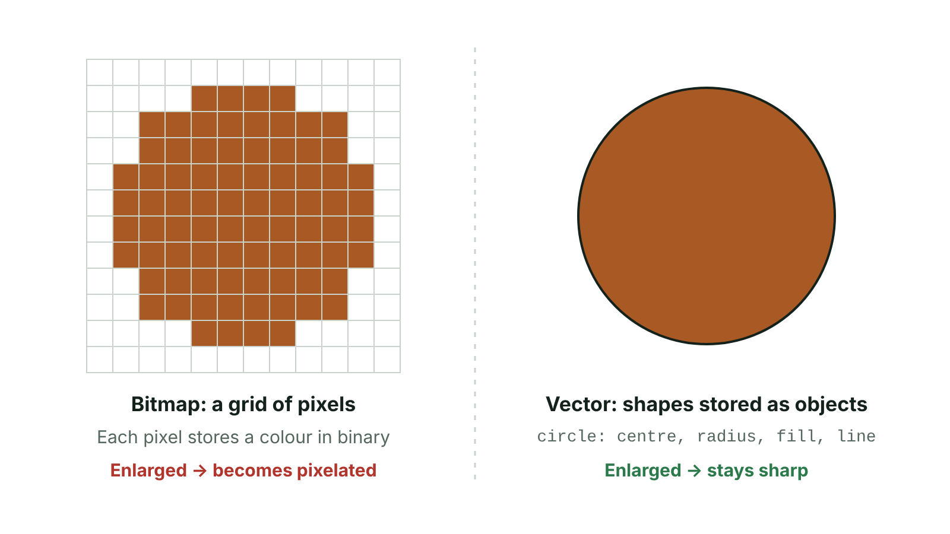
The big picture
Bitmap image as a grid of pixels compared with a vector circle stored as an object
☰ Menu
Notes:
Explain the diagram in your own words before you read on.

Slide 55
What is a pixel?
Pixel = picture element: the smallest single point of a digital image that a screen can show and an editor can change
A bitmap image is a grid of pixels; together they make the complete picture
Each pixel has its own colour, stored as a binary code
A pixel's position is given like (x, y) coordinates: across first, then down
The number of pixels on a screen depends on the screen size and the graphics card
☰ Menu

Slide 56
Colour depth: bits per pixel
Bits per pixel | Number of colours | Example use
1 | 2¹ = 2 | Black and white icon
2 | 2² = 4 | Simple pixel-art emoji
4 | 2⁴ = 16 | Early computer games
8 | 2⁸ = 256 | GIF images
24 | 2²⁴ = 16 777 216 (about 16.7 million) | Photos (8 bits each for red, green, blue)
☰ Menu

Slide 57
How many bits do I need?
Each extra bit DOUBLES the number of colours available
To find the bits needed: find the smallest power of 2 that is at least the number of colours
4 colours → 2 bits (00, 01, 10, 11)
5 colours → 3 bits (2 bits only gives 4 codes; 3 bits gives 8)
256 colours → 8 bits
☰ Menu

Slide 58
Resolution
Resolution = how many pixels an image has, written width × height, e.g. 1280 × 720
First number = pixels across (horizontal); second = pixels down (vertical)
Higher resolution → more pixels → more detail and a sharper image
More pixels → more data to store → larger file size
Print and screen resolution can also be given as pixels per inch (ppi) or dots per inch (dpi)
☰ Menu

Slide 59
Calculating file size
File size (bits) = width × height × colour depth
Then ÷ 8 for bytes, ÷ 1024 for KB, ÷ 1024 again for MB
Doubling the width AND the height gives 4 times as many pixels, so 4 times the file size
Doubling the colour depth doubles the file size
This is the image data only; a real file also stores metadata and may be compressed
☰ Menu

Slide 60
Worked example: two images
Pixel emoji: 10 × 10 pixels, 4 colours → 2 bits per pixel
10 × 10 × 2 = 200 bits; 200 ÷ 8 = 25 bytes
School website banner: 1280 × 720 pixels, 24-bit colour
1280 × 720 = 921 600 pixels; × 24 = 22 118 400 bits
÷ 8 = 2 764 800 bytes; ÷ 1024 = 2700 KB; ÷ 1024 ≈ 2.64 MB
☰ Menu

Slide 61
How a bitmap is stored
The colour code of EVERY pixel is stored, row by row
Metadata (data about the data) is also stored: width, height and colour depth
Without the width, the computer would not know where each row ends
Photos from a phone camera or a scanner are bitmaps
Bitmap files are often large and can be slow to load, so they are often compressed
☰ Menu

Slide 62
Pixelation
When you zoom in or enlarge a bitmap, each pixel is simply made bigger
The pixels become visible as small square blocks – this is pixelation
No new detail is added, so the image looks blocky and jagged
This is why a small, low-resolution photo looks poor printed on a large poster
☰ Menu

Slide 63
Vector graphics
NOT a grid of pixels: stores a list of objects such as lines, curves, circles and shapes
Each object is stored with its properties: position (coordinates), size, line colour, line thickness, fill colour
The shapes are mathematical, so they are redrawn (recalculated) at any size
Can be enlarged without losing quality – no pixelation
Each object can be edited separately: move it, resize it or recolour it
Usually smaller files. Suits logos, diagrams, maps and fonts; not photographs. Example format: SVG
☰ Menu

Slide 64
Bitmap vs vector
 | Bitmap | Vector
Stored as | Grid of pixels, each with a colour code | Objects with properties
Enlarging | Pixelates, loses quality | Stays sharp
File size | Larger; grows with resolution | Usually smaller
Editing | Edit individual pixels | Edit whole objects
Best for | Photographs, scanned images | Logos, diagrams, maps
File formats | JPEG, PNG, GIF, TIFF, BMP | SVG
☰ Menu

Slide 65
Worked example: choosing a type
Fermanagh GAA club needs a new crest for shirts, a website and a pitch-side banner
Choose vector: the crest can be scaled from a tiny website icon to a large banner without pixelating
The file stays small and colours can be changed easily for an away kit
The club's team photo from the final must be a bitmap – it is a photograph with millions of colour variations
☰ Menu

Slide 66
Exam tips
'Describe two differences' needs BOTH sides of each difference: bitmap does X, whereas vector does Y
Link resolution to BOTH quality and file size
In calculations, write the formula, show each step and label the units
Vector stores objects AND their properties – name at least two properties
☰ Menu

Slide 67
Exit quiz: question 1 of 9
Tap an answer to check it. Presenting? Click to reveal the answer.
What happens when a bitmap image is enlarged a lot?
A It stays sharp
B It becomes a vector
✗
✗
C It becomes pixelated
D The file size halves
✓
✗
✓ C: It becomes pixelated – Each pixel is made bigger, so the pixels show as visible blocks.
☰ Menu

Slide 68
Exit quiz: question 2 of 9
Tap an answer to check it. Presenting? Click to reveal the answer.
Which image is best stored as a vector graphic?
A A school logo
B A holiday photograph
✓
✗
C A scanned X-ray
D A webcam image
✗
✗
✓ A: A school logo – A logo is built from shapes and must scale to any size without losing quality.
☰ Menu

Slide 69
Exit quiz: question 3 of 9
Tap an answer to check it. Presenting? Click to reveal the answer.
What does a bitmap image store for each pixel?
A A shape
B A colour value in binary
✗
✓
C A line thickness
D A list of coordinates for curves
✗
✗
✓ B: A colour value in binary – Every pixel has its own binary colour code.
☰ Menu

Slide 70
Exit quiz: question 4 of 9
Tap an answer to check it. Presenting? Click to reveal the answer.
Increasing the resolution of an image will…
A reduce the file size
B not change the file size
✗
✗
C turn it into a vector
D increase the file size
✗
✓
✓ D: increase the file size – More pixels means more colour codes to store.
☰ Menu

Slide 71
Exit quiz: question 5 of 9
Tap an answer to check it. Presenting? Click to reveal the answer.
How many colours can a 2-bit colour image use?
A 2
B 4
✗
✓
C 8
D 16
✗
✗
✓ B: 4 – 2 bits give 4 combinations: 00, 01, 10, 11.
☰ Menu

Slide 72
Exit quiz: question 6 of 9
Tap an answer to check it. Presenting? Click to reveal the answer.
A 10 × 10 image uses 4 colours. What is the size of the image data?
A 25 bytes
B 100 bytes
✓
✗
C 200 bytes
D 40 bytes
✗
✗
✓ A: 25 bytes – 4 colours need 2 bits: 10 × 10 × 2 = 200 bits, and 200 ÷ 8 = 25 bytes.
☰ Menu

Slide 73
Exit quiz: question 7 of 9
Tap an answer to check it. Presenting? Click to reveal the answer.
Which of these is metadata stored with a bitmap image?
A The colour of pixel 1
B The image's width and height
✗
✓
C The fill colour of a circle
D The printer used
✗
✗
✓ B: The image's width and height – Metadata describes the image, e.g. its dimensions, so it can be rebuilt correctly.
☰ Menu

Slide 74
Exit quiz: question 8 of 9
Tap an answer to check it. Presenting? Click to reveal the answer.
Which is a property stored in a vector graphic?
A Fill colour of a shape
B Pixel colour depth
✓
✗
C Number of pixels per inch
D Compression ratio
✗
✗
✓ A: Fill colour of a shape – Vectors store object properties such as position, size, line colour and fill colour.
☰ Menu

Slide 75
Exit quiz: question 9 of 9
Tap an answer to check it. Presenting? Click to reveal the answer.
Which file type is a vector graphic?
A JPEG
B PNG
✗
✗
C GIF
D SVG
✗
✓
✓ D: SVG – SVG (Scalable Vector Graphics) stores lines, curves and shapes.
☰ Menu

Slide 76
Exit quiz answers
Q | Answer | Why
1 | C It becomes pixelated | Each pixel is made bigger, so the pixels show as visible blocks.
2 | A A school logo | A logo is built from shapes and must scale to any size without losing quality.
3 | B A colour value in binary | Every pixel has its own binary colour code.
4 | D increase the file size | More pixels means more colour codes to store.
5 | B 4 | 2 bits give 4 combinations: 00, 01, 10, 11.
6 | A 25 bytes | 4 colours need 2 bits: 10 × 10 × 2 = 200 bits, and 200 ÷ 8 = 25 bytes.
7 | B The image's width and height | Metadata describes the image, e.g. its dimensions, so it can be rebuilt correctly.
8 | A Fill colour of a shape | Vectors store object properties such as position, size, line colour and fill colour.
9 | D SVG | SVG (Scalable Vector Graphics) stores lines, curves and shapes.
☰ Menu

Slide 77
In the exam
Paper | Question | Marks | What it tested
Unit 1 2019 | Q4(a) | 6 | Image file type, compression, resolution, ppi/dpi
Unit 1 2023 | Q2 | 10 | Bitmap vs vector, resolution, buffering, sample rate, ADC, compression
Unit 1 2025 | Q2 | 6 | Bitmap vs vector; sound file size calculation
Papers and mark schemes: ccea.org.uk → GCSE Digital Technology → Past Papers & Mark Schemes.
☰ Menu

Slide 78
Representing sound; buffering and streaming
UNIT 1: DIGITAL TECHNOLOGY · L04
Learning objectives
Explain why sound must be converted from analogue to digital and describe what an ADC does
Describe how sample rate, bit depth and bit rate affect quality and file size
Calculate the bit rate and the file size of a simple sound recording
Explain how streaming and buffering let a video play while it downloads
Notes:
Specification: Explain the need for analogue-to-digital conversion in sound recording | Describe factors that affect sound quality when recording sound, including sample rate, bit depth and bit rate | Calculate the bit rate and file size of a sound recording | Demonstrate understanding of how buffering and streaming are used to support the transfer of moving image files

Slide 79
In this lesson
Tap a button to jump straight there. The ☰ Menu button on every slide brings you back here.
The big picture
Worked example: bit rate
Sound is analogue
Worked example: file size
From microphone to binary
Streaming
Sampling and sample rate
Buffering
Bit depth
Streaming vs downloading
Comparing sample rate and bit depth
Exit quiz
Bit rate
↑ Topic menu
Notes:
Lesson menu: each button jumps to that part of the lesson in Slide Show. The ☰ Menu button on each slide returns here.

Slide 80
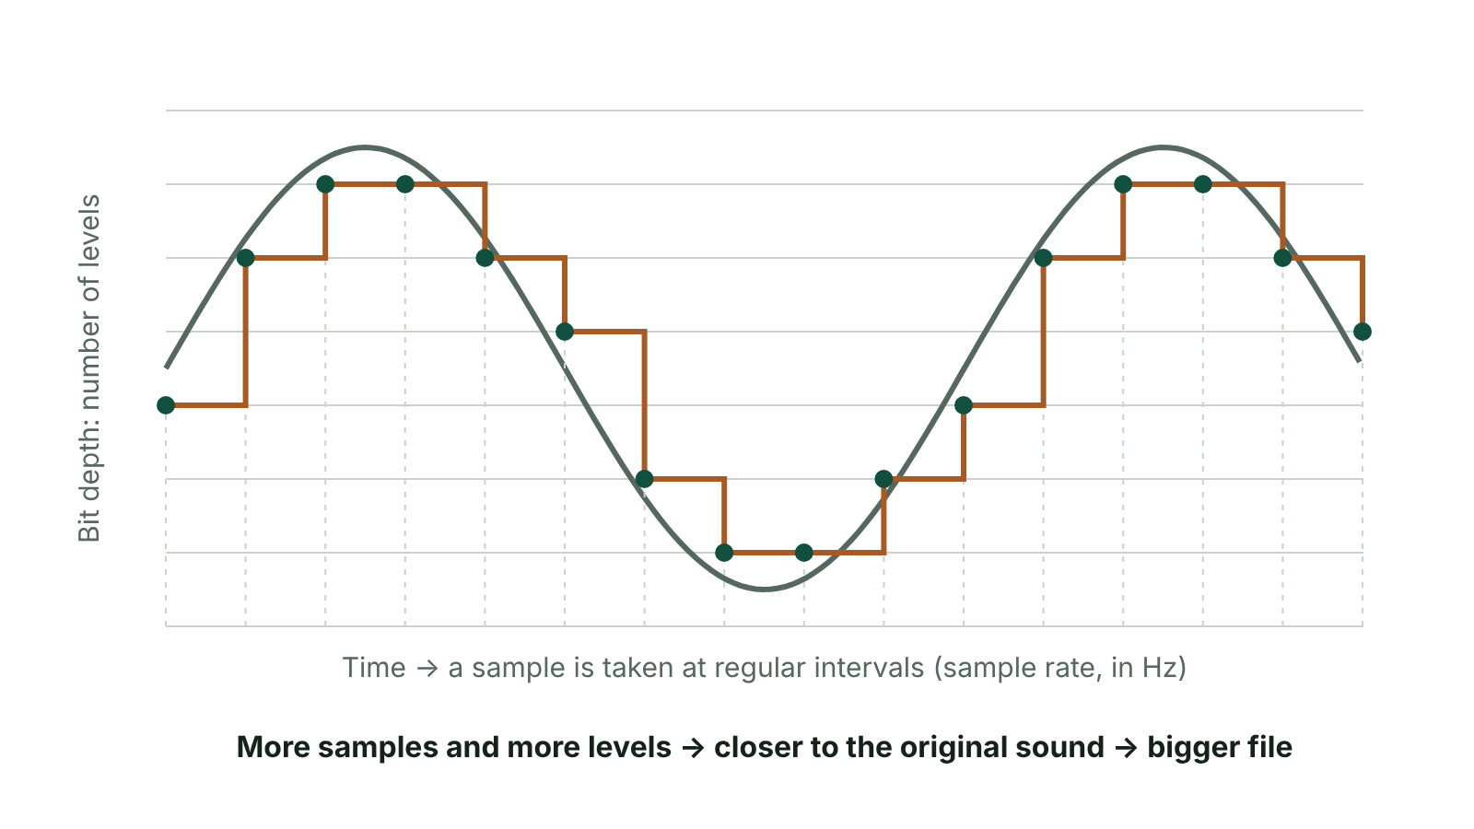
The big picture
A sound wave sampled at regular intervals, with sample rate on the time axis and bit depth as the number of levels
☰ Menu
Notes:
Explain the diagram in your own words before you read on.

Slide 81
Sound is analogue
Sound travels as a wave of vibrations in the air
An analogue signal changes smoothly and continuously, with no gaps or steps
Computers can only store and process digital data: binary 0s and 1s
So sound must be converted from analogue to digital before a computer can store, edit or play it
☰ Menu

Slide 82
From microphone to binary
1. A microphone (input device) picks up the sound wave
2. It turns the vibrations into an analogue electrical signal
3. An analogue-to-digital converter (ADC) measures the signal at regular time intervals
4. Each measurement (a sample) is rounded to the nearest whole-number level
5. Each level is stored as a binary number, so the sound is now digital
To play it back, a digital-to-analogue converter turns the numbers back into a signal for the speakers
☰ Menu

Slide 83
Sampling and sample rate
A sample is one measurement of the height (amplitude) of the sound wave at one instant
Sample rate = the number of samples taken every second, measured in hertz (Hz)
CD-quality audio uses 44 100 samples per second (44.1 kHz)
Low sample rate: changes in the wave between samples are missed, so the sound is less like the original
Higher sample rate: the wave's shape is captured more accurately, but there are more numbers to store, so the file is bigger
☰ Menu

Slide 84
Bit depth
Bit depth = how many bits are given to each sample
n bits give 2ⁿ possible levels: 8 bits = 256 levels, 16 bits = 65 536 levels
CDs use 16-bit samples; DVD and studio audio often use 24 bits (16 777 216 levels)
More levels means each sample is rounded less, so it is recorded more accurately
Higher bit depth: better quality and a larger file
☰ Menu

Slide 85
Comparing sample rate and bit depth
 | Sample rate | Bit depth
What it measures | How often the wave is measured | How precisely each measurement is stored
Unit | Hertz (samples per second) | Bits per sample
Typical CD value | 44 100 Hz (44.1 kHz) | 16 bits
If increased | Better quality, bigger file | Better quality, bigger file
If too low | Sound loses detail between samples | Samples rounded roughly, adds hiss and noise
☰ Menu

Slide 86
Bit rate
Bit rate = the amount of data (in bits) processed for each second of sound
For one channel: bit rate = sample rate × bit depth
Stereo has 2 channels (left and right), so multiply by 2
Measured in bits per second (bps) or kilobits per second (kbps)
Compressed music is often 128–320 kbps: a higher bit rate usually means better quality and a bigger file
☰ Menu

Slide 87
Worked example: bit rate
A voice memo on a phone: sample rate 8 000 Hz, bit depth 8 bits, mono (1 channel)
Bit rate = 8 000 × 8 = 64 000 bits per second = 64 kbps
CD audio: 44 100 × 16 = 705 600 bps for one channel
CD stereo: 705 600 × 2 = 1 411 200 bps, about 1 411 kbps
That is about 11 times the bit rate of a 128 kbps MP3 (1 411 200 ÷ 128 000 ≈ 11)
☰ Menu

Slide 88
Worked example: file size
File size (bits) = sample rate × bit depth × channels × length in seconds
Ciara records a 1-minute mono voice note for her Irish oral: 8 000 Hz, 8-bit
8 000 × 8 × 1 × 60 = 3 840 000 bits
÷ 8 = 480 000 bytes; ÷ 1024 = 468.75 KB
A 10-second CD-quality stereo clip: 44 100 × 16 × 2 × 10 = 14 112 000 bits = 1 764 000 bytes ≈ 1.68 MB
☰ Menu

Slide 89
Streaming
Downloading: the whole file is copied and saved on the device before you watch or listen
Streaming: the video or audio plays while it is still being received from the internet
You can start watching almost straight away without waiting for the full file
The file is not normally kept permanently, so it uses little storage space
Needs a working internet connection all the time; quality depends on its speed
Examples: BBC iPlayer, YouTube, Netflix, Spotify, watching an Ulster Rugby match online
☰ Menu

Slide 90
Buffering
A buffer is a part of memory set aside to hold data temporarily
While you watch one part of a video, the next part is downloaded into the buffer
If the connection slows or drops for a moment, playback carries on using the data already in the buffer
If the buffer runs empty, playback pauses while more data arrives: the spinning 'buffering' icon
Many services lower the picture quality on slow connections to keep the buffer topped up
☰ Menu

Slide 91
Streaming vs downloading
 | Streaming | Downloading
Start time | Plays almost immediately | Must wait for the whole file
Storage used | Little: only the buffer | The whole file is saved
Internet needed? | Yes, all the time | Only to download; can then play offline
Interruptions | Can pause if the buffer empties | None once the file is saved
Data use | Uses data every time it is watched | Downloaded once, watched many times
☰ Menu

Slide 92
Exit quiz: question 1 of 8
Tap an answer to check it. Presenting? Click to reveal the answer.
What does an analogue-to-digital converter (ADC) do when sound is recorded?
A Converts digital data into sound for the speakers
B Compresses the sound file to make it smaller
✗
✗
C Samples the analogue signal and turns each sample into a binary number
D Stores the next part of a song in memory
✓
✗
✓ C: Samples the analogue signal and turns each sample into a binary number – An ADC measures the analogue signal at regular intervals and stores each measurement in binary. Converting back for speakers is done by a DAC.
☰ Menu

Slide 93
Exit quiz: question 2 of 8
Tap an answer to check it. Presenting? Click to reveal the answer.
What is the bit rate of a mono sound sampled at 8 000 Hz with an 8-bit depth?
A 16 000 bps
B 64 000 bps
✗
✓
C 8 008 bps
D 1 000 bps
✗
✗
✓ B: 64 000 bps – Bit rate = sample rate × bit depth = 8 000 × 8 = 64 000 bits per second.
☰ Menu

Slide 94
Exit quiz: question 3 of 8
Tap an answer to check it. Presenting? Click to reveal the answer.
What is the unit of sample rate?
A Hertz (Hz)
B Bits
✓
✗
C Bytes
D Pixels
✗
✗
✓ A: Hertz (Hz) – Sample rate is samples per second, which is measured in hertz.
☰ Menu

Slide 95
Exit quiz: question 4 of 8
Tap an answer to check it. Presenting? Click to reveal the answer.
Which change makes each sample more accurate?
A Lower sample rate
B Fewer channels
✗
✗
C Lower bit rate
D Higher bit depth
✗
✓
✓ D: Higher bit depth – More bits per sample give more possible levels, so each sample is rounded less.
☰ Menu

Slide 96
Exit quiz: question 5 of 8
Tap an answer to check it. Presenting? Click to reveal the answer.
Why is some detail lost when sound is sampled?
A The microphone is digital
B What the wave does between samples is not recorded
✗
✓
C Binary cannot store numbers
D The buffer is too small
✗
✗
✓ B: What the wave does between samples is not recorded – Only the readings at each sample point are kept; changes between them are lost.
☰ Menu

Slide 97
Exit quiz: question 6 of 8
Tap an answer to check it. Presenting? Click to reveal the answer.
A 10-second stereo clip is recorded at 44 100 Hz with 16-bit samples. How many bits is it?
A 705 600
B 1 411 200
✗
✗
C 7 056 000
D 14 112 000
✗
✓
✓ D: 14 112 000 – 44 100 × 16 × 2 channels × 10 s = 14 112 000 bits.
☰ Menu

Slide 98
Exit quiz: question 7 of 8
Tap an answer to check it. Presenting? Click to reveal the answer.
What is a buffer?
A A cable that speeds up downloads
B A compressed video format
✗
✗
C Memory that temporarily holds data before it is used
D A type of microphone
✓
✗
✓ C: Memory that temporarily holds data before it is used – When streaming, the buffer stores the next section of the video ahead of playback.
☰ Menu

Slide 99
Exit quiz: question 8 of 8
Tap an answer to check it. Presenting? Click to reveal the answer.
What happens when a streamed video stops and shows a loading icon?
A The buffer has run out of data
B The file has finished downloading
✓
✗
C The bit depth is too high
D The ADC has stopped working
✗
✗
✓ A: The buffer has run out of data – Playback pauses when the buffer empties, until enough new data arrives.
☰ Menu

Slide 100
Exit quiz answers
Q | Answer | Why
1 | C Samples the analogue signal and turns each sample into a binary number | An ADC measures the analogue signal at regular intervals and stores each measurement in binary. Converting back for speakers is done by a DAC.
2 | B 64 000 bps | Bit rate = sample rate × bit depth = 8 000 × 8 = 64 000 bits per second.
3 | A Hertz (Hz) | Sample rate is samples per second, which is measured in hertz.
4 | D Higher bit depth | More bits per sample give more possible levels, so each sample is rounded less.
5 | B What the wave does between samples is not recorded | Only the readings at each sample point are kept; changes between them are lost.
6 | D 14 112 000 | 44 100 × 16 × 2 channels × 10 s = 14 112 000 bits.
7 | C Memory that temporarily holds data before it is used | When streaming, the buffer stores the next section of the video ahead of playback.
8 | A The buffer has run out of data | Playback pauses when the buffer empties, until enough new data arrives.
☰ Menu

Slide 101
In the exam
Paper | Question | Marks | What it tested
Unit 1 2019 | Q4(b)–(c) | 4 | Streaming and buffering; capturing sound
Unit 1 2021 | Q11 | 8 | Key term matching
Unit 1 2022 | Q1 | 9 | MCQ: storage, bit rate, real-time, compression, buffering, ADC, big data, backup
Unit 1 2023 | Q2 | 10 | Bitmap vs vector, resolution, buffering, sample rate, ADC, compression
Unit 1 2024 | Q7 | 5 | Compression, video formats, bit depth
Unit 1 2025 | Q2 | 6 | Bitmap vs vector; sound file size calculation
1 more past questions on the website. Papers and mark schemes: ccea.org.uk → GCSE Digital Technology → Past Papers & Mark Schemes.
☰ Menu

Slide 102
Data portability, file formats and compression
UNIT 1: DIGITAL TECHNOLOGY · L05
Learning objectives
Define data portability and explain why standard file formats support it
Describe the purpose and typical use of each of the 16 file formats in the specification
Choose a suitable file format for a task and justify the choice
Explain why data is compressed and compare lossy and lossless compression
Notes:
Specification: Demonstrate understanding of data portability and the following file formats that support it: jpeg, tiff, png, pict, gif, txt, csv, rtf, mp3, mp4, midi, mpeg, avi, pdf, wav and wma | Choose and justify a suitable file format for a given purpose | Demonstrate understanding of the need for data compression | Describe lossy and lossless compression and give examples of each

Slide 103
In this lesson
Tap a button to jump straight there. The ☰ Menu button on every slide brings you back here.
The big picture
Choosing a format
Data portability
Why compress data?
Why portability matters
Lossy compression
Image formats
Lossless compression
Text and document formats
Worked example: how much smaller?
Audio formats
Exit quiz
Video formats
↑ Topic menu
Notes:
Lesson menu: each button jumps to that part of the lesson in Slide Show. The ☰ Menu button on each slide returns here.

Slide 104
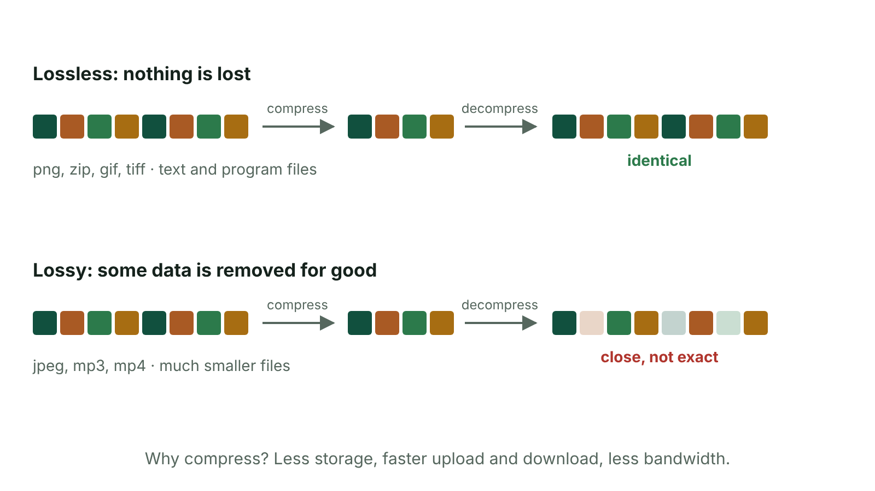
The big picture
Lossless compression restores every block of data; lossy compression permanently removes some
☰ Menu
Notes:
Explain the diagram in your own words before you read on.

Slide 105
Data portability
Data portability: being able to move data from one computer or application to another without having to type it in again
Also credited as interoperability or compatibility
Works because the data is saved in a standard file format that many programs can open
Example: a club exports its member list from a database as csv, then opens it in a spreadsheet
The file extension (e.g. .csv, .pdf) tells the computer which format a file uses
☰ Menu

Slide 106
Why portability matters
People use different devices and operating systems: Windows, macOS, Android, iOS
Organisations share data with others, e.g. a school sending results to a council or exam board
Saves time and avoids typing errors because data is not re-entered
Users can change software without losing old work
Choosing the wrong format can lose formatting, quality or the data itself
☰ Menu

Slide 107
Image formats
Format | Key facts | Typical use
jpeg | Lossy compression; user can choose the level; millions of colours; small files | Photographs, web pages, social media
png | Lossless compression; keeps quality; supports transparency | Logos, web graphics, screenshots
gif | Limited to 256 colours; lossless; can hold a series of images to animate | Simple animations, icons, simple graphics
tiff | Bitmap; keeps high quality; large files; moves between Windows and Apple | Printing, publishing, scanned images
pict | Apple's standard graphics format; can hold bitmap and vector graphics | Older Apple Mac graphics
☰ Menu

Slide 108
Text and document formats
Format | Key facts | Typical use
txt | Plain text only, no formatting; opens in any text editor or word processor | Notes, program code, simple data
csv | Comma-separated values: one record per line, fields separated by commas | Moving tables between spreadsheets and databases
rtf | Rich Text Format: text with basic formatting (fonts, bold, italics) | Sharing documents between different word processors and operating systems
pdf | Portable Document Format (Adobe): fonts, images and layout look the same on any device; usually read-only | Forms, leaflets, letters, documents to print
☰ Menu

Slide 109
Audio formats
Format | Key facts | Typical use
mp3 | Lossy compressed audio; much smaller than wav; quality close to the original | Music, podcasts
wav | Uncompressed audio; high quality; large files | Recording and editing sound, sound effects
wma | Windows Media Audio: Microsoft's compressed audio format | Audio on Windows Media Player
midi | Stores instructions (notes, instrument, timing), not recorded sound; very small | Electronic keyboards, composing music
☰ Menu

Slide 110
Video formats
Format | Key facts | Typical use
mp4 | Compresses video and sound; can also hold still images and subtitles; supports streaming | Online video, phones, social media
mpeg | Named after the Moving Picture Experts Group, who set standards for compressing video | DVDs, digital broadcasting
avi | Audio Video Interleave: Microsoft format with audio and video kept in sync; often large | Video on Windows PCs, editing
☰ Menu

Slide 111
Choosing a format
Holiday photo for Instagram → jpeg (small file, millions of colours)
School crest with a see-through background → png (lossless, transparency)
Poster sent to a printer in Belfast → tiff or pdf (high quality / fixed layout)
Exam results sent from a database to a spreadsheet → csv
Song for a phone → mp3; raw recording to edit → wav
Always justify: say what the format does that suits the task
☰ Menu

Slide 112
Why compress data?
Compression: making a file smaller by encoding its data more efficiently or removing some of it
Smaller files take up less storage space
Smaller files upload and download faster, so web pages load quicker
Less bandwidth is needed, so streaming is smoother
Email and websites often limit attachment or upload sizes
☰ Menu

Slide 113
Lossy compression
Removes some data permanently, e.g. detail or colours the eye or ear is unlikely to notice
Gives much smaller files
Quality is reduced, and the original can never be fully rebuilt
Higher compression = smaller file but worse quality (e.g. blocky jpegs)
Examples: jpeg, mp3, mp4
Suits photos, music and video, where a small loss is acceptable
☰ Menu

Slide 114
Lossless compression
Makes the file smaller without losing any data
The file can be decompressed back to exactly the original
Files are not reduced as much as with lossy compression
Examples: zip files (e.g. WinZip), png, gif
Must be used for text, spreadsheets and program files: losing even one bit could change a mark or stop a program working
☰ Menu

Slide 115
Worked example: how much smaller?
A 3-minute song as CD-quality wav: 44 100 × 16 × 2 × 180 = 254 016 000 bits
÷ 8 = 31 752 000 bytes ≈ 30.3 MB
The same song as a 128 kbps mp3: 128 000 × 180 = 23 040 000 bits
÷ 8 = 2 880 000 bytes ≈ 2.75 MB
The mp3 is about 11 times smaller (254 016 000 ÷ 23 040 000 ≈ 11), so it is quicker to download and many more songs fit on a phone
☰ Menu

Slide 116
Exit quiz: question 1 of 9
Tap an answer to check it. Presenting? Click to reveal the answer.
What is meant by data portability?
A Carrying a laptop between rooms
B Moving data between computers or applications without re-entering it
✗
✓
C Making a file as small as possible
D Storing data in the cloud
✗
✗
✓ B: Moving data between computers or applications without re-entering it – Portability means data can be transferred and opened elsewhere without being typed in again.
☰ Menu

Slide 117
Exit quiz: question 2 of 9
Tap an answer to check it. Presenting? Click to reveal the answer.
Which audio format stores musical instructions rather than recorded sound?
A wav
B mp3
✗
✗
C wma
D midi
✗
✓
✓ D: midi – midi stores which notes to play, on which instrument and for how long.
☰ Menu

Slide 118
Exit quiz: question 3 of 9
Tap an answer to check it. Presenting? Click to reveal the answer.
Which format stores data with each field separated by a comma?
A rtf
B csv
✗
✓
C tiff
D wma
✗
✗
✓ B: csv – csv means comma-separated values.
☰ Menu

Slide 119
Exit quiz: question 4 of 9
Tap an answer to check it. Presenting? Click to reveal the answer.
Which image format supports simple animation?
A gif
B tiff
✓
✗
C jpeg
D pict
✗
✗
✓ A: gif – gif can store a series of images that play one after another.
☰ Menu

Slide 120
Exit quiz: question 5 of 9
Tap an answer to check it. Presenting? Click to reveal the answer.
Lossy compression…
A keeps every bit of the original
B always increases file size
✗
✗
C permanently removes some data
D is used for program files
✓
✗
✓ C: permanently removes some data – Removed data cannot be restored, so quality is reduced.
☰ Menu

Slide 121
Exit quiz: question 6 of 9
Tap an answer to check it. Presenting? Click to reveal the answer.
Which format keeps a document's layout the same on any device?
A txt
B csv
✗
✗
C midi
D pdf
✗
✓
✓ D: pdf – Portable Document Format keeps fonts, images and layout fixed.
☰ Menu

Slide 122
Exit quiz: question 7 of 9
Tap an answer to check it. Presenting? Click to reveal the answer.
Which format contains no formatting and can be opened by any word processor?
A txt
B rtf
✓
✗
C pdf
D pict
✗
✗
✓ A: txt – Plain text (txt) has no formatting at all.
☰ Menu

Slide 123
Exit quiz: question 8 of 9
Tap an answer to check it. Presenting? Click to reveal the answer.
Which format is best for a logo that needs a transparent background and no loss of quality?
A jpeg
B mp4
✗
✗
C png
D csv
✓
✗
✓ C: png – png uses lossless compression and supports transparency.
☰ Menu

Slide 124
Exit quiz: question 9 of 9
Tap an answer to check it. Presenting? Click to reveal the answer.
Which format was created by Microsoft to play audio and video in sync?
A mp3
B avi
✗
✓
C midi
D wav
✗
✗
✓ B: avi – avi (Audio Video Interleave) was created by Microsoft for Windows.
☰ Menu

Slide 125
Exit quiz answers
Q | Answer | Why
1 | B Moving data between computers or applications without re-entering it | Portability means data can be transferred and opened elsewhere without being typed in again.
2 | D midi | midi stores which notes to play, on which instrument and for how long.
3 | B csv | csv means comma-separated values.
4 | A gif | gif can store a series of images that play one after another.
5 | C permanently removes some data | Removed data cannot be restored, so quality is reduced.
6 | D pdf | Portable Document Format keeps fonts, images and layout fixed.
7 | A txt | Plain text (txt) has no formatting at all.
8 | C png | png uses lossless compression and supports transparency.
9 | B avi | avi (Audio Video Interleave) was created by Microsoft for Windows.
☰ Menu

Slide 126
In the exam
Paper | Question | Marks | What it tested
Unit 1 2021 | Q10(a) | 5 | File formats; lossy and lossless
Unit 1 2022 | Q1 | 9 | MCQ: storage, bit rate, real-time, compression, buffering, ADC, big data, backup
Unit 1 2022 | Q11 | 4 | Data portability; JPEG and TIFF
Unit 1 2023 | Q2 | 10 | Bitmap vs vector, resolution, buffering, sample rate, ADC, compression
Unit 1 2024 | Q7 | 5 | Compression, video formats, bit depth
Unit 1 2025 | Q3 | 5 | Data portability and file formats
3 more past questions on the website. Papers and mark schemes: ccea.org.uk → GCSE Digital Technology → Past Papers & Mark Schemes.
☰ Menu

