Slide 1
Digital applications
UNIT 1: DIGITAL TECHNOLOGY · TOPIC
Lessons in this topic
L24 Digital applications and extended-answer technique

Slide 2

Topic menu
Tap a button to jump straight there. The ☰ Menu button on every slide brings you back here.
Specification map
L24 Digital applications and extended-answer technique

Slide 3
Specification map
Lesson | Specification: students should be able to
L24 | Describe the main features of gaming applications, simulations and mobile phone applications; Describe how gaming applications, simulations and mobile phone applications can be used to support education and training, social interactions and work practices; Describe how virtual reality is used to create realistic simulations for training; Evaluate the impact of online banking on customers and on banks; Evaluate the impact of online training on employees and employers; Evaluate the impact of e-commerce on customers and on businesses
☰ Menu
Notes:
Each lesson below is its own section in PowerPoint (View → Slide Sorter shows them). To split this deck by specification point, right-click a section → Move Section, or delete the sections you do not need.

Slide 4
Digital applications and extended-answer technique
UNIT 1: DIGITAL TECHNOLOGY · L24
Learning objectives
Describe the features of gaming applications, simulations and mobile apps
Explain how these applications support education and training, social interaction and work
Weigh up the advantages and disadvantages of online banking, online training and e-commerce for both the user and the organisation
Plan and write a well-organised extended (QWC) answer that reaches a justified conclusion
Notes:
Specification: Describe the main features of gaming applications, simulations and mobile phone applications | Describe how gaming applications, simulations and mobile phone applications can be used to support education and training, social interactions and work practices | Describe how virtual reality is used to create realistic simulations for training | Evaluate the impact of online banking on customers and on banks | Evaluate the impact of online training on employees and employers | Evaluate the impact of e-commerce on customers and on businesses

Slide 5
In this lesson
Tap a button to jump straight there. The ☰ Menu button on every slide brings you back here.
The big picture
Worked example: simulators for training
Evaluating e-commerce
Digital applications: the big picture
Mobile phone applications
Writing an extended (QWC) answer
Gaming applications: key features
Online banking: what it is
Worked example: planning a 6-mark answer
How games support learning, social life and work
Evaluating online banking
Exit quiz
Simulations and virtual reality
Evaluating online training
↑ Topic menu
Notes:
Lesson menu: each button jumps to that part of the lesson in Slide Show. The ☰ Menu button on each slide returns here.

Slide 6
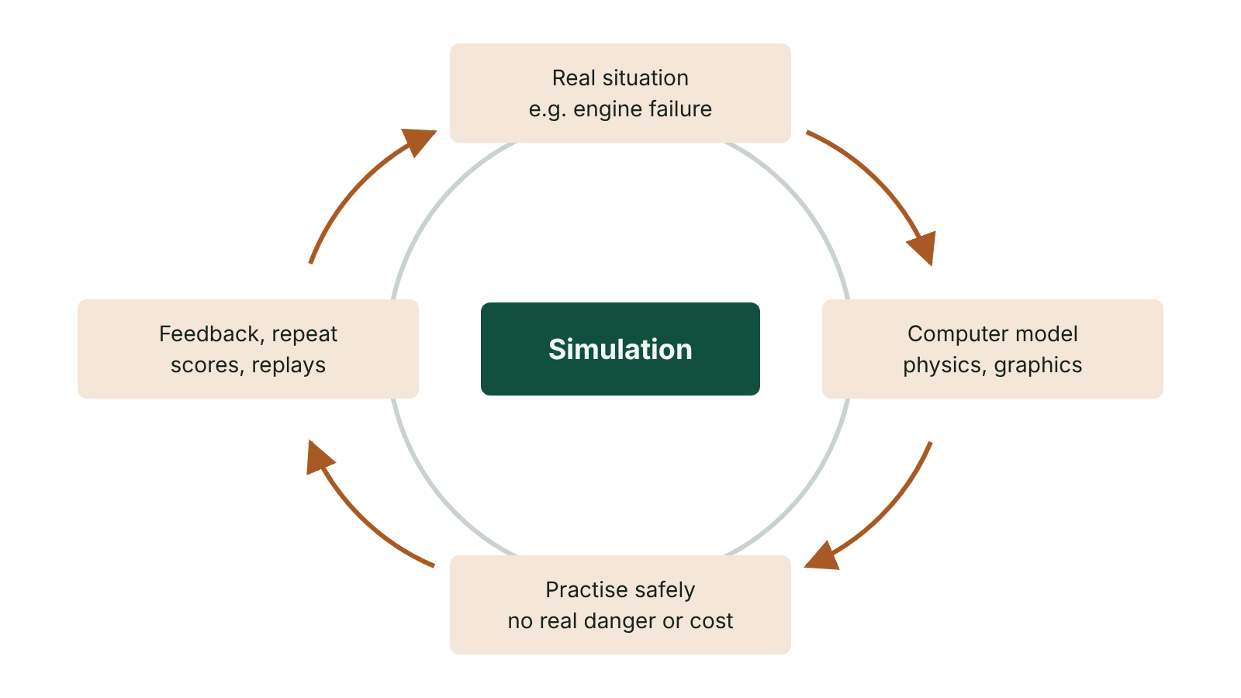
The big picture
How a simulation supports training: model, practise safely, get feedback, repeat
☰ Menu
Notes:
Explain the diagram in your own words before you read on.

Slide 7
Digital applications: the big picture
A digital application is software that does a useful job for people: entertaining, teaching, connecting or trading
This lesson covers six: gaming, simulation and mobile apps, then online banking, online training and e-commerce
For the first three you must describe features and how they support education/training, social interaction and work
For the last three you must evaluate: weigh up positives and negatives for the user AND the organisation
These topics are usually tested by 6-mark extended (QWC) questions, so writing technique matters as much as facts
☰ Menu

Slide 8
Gaming applications: key features
Played on consoles, PCs, tablets and phones; games have moved from discs played alone to downloads, cloud gaming and online multiplayer
Rules and levels: each level gets harder and you cannot move on until you complete the one before
Rewards: points, badges and leaderboards motivate players to improve their score
Immediate feedback: the player sees at once how well they did and decides what to try next
Rich multimedia (graphics, sound, video, animation) and avatars let players take on roles
Real-time communication: headsets with microphones, text chat and online groups or clans
☰ Menu

Slide 9
How games support learning, social life and work
Area | How gaming helps | Example
Education | Learners apply knowledge in a virtual world; leaderboards and instant feedback keep them motivated | A Year 9 class competing in a Kahoot quiz on networks
Training | Levels give step-by-step challenges; role play lets trainees reflect on decisions safely | Shop staff playing a customer-service scenario game
Social interaction | Online multiplayer lets friends compete or co-operate worldwide and talk in real time | A squad from Omagh and Newry playing together after school
Work practices | Gamification of tasks (targets, badges, team leaderboards) can raise staff motivation | Call-centre staff earning badges for resolving queries
Risks to mention | Addiction and lost sleep, contact with strangers, in-game spending, cyberbullying | Use privacy settings and spending limits
☰ Menu

Slide 10
Simulations and virtual reality
A simulation uses a computer model (data plus mathematical rules) to copy how a real object or system behaves
Users can change conditions, repeat scenarios and see the results without real-world risk or cost
Engineering: car makers crash-test virtual cars; architects test how a building copes with storms, floods or earthquakes
Virtual reality (VR) puts the user inside a 3D simulated world using a headset, and sometimes data gloves or motion controllers
VR feeds the senses (sight, sound, sometimes touch) so training feels like the real situation
☰ Menu

Slide 11
Worked example: simulators for training (1 of 2)
 | Trainee pilot (flight simulator) | Trainee surgeon (virtual patient)
What is modelled | Aircraft controls, instruments, weather and flight physics | A 3D model of the patient built from body-scan data
Situations practised | Turbulence, storms, engine failure, emergency landings | Planning and rehearsing a specific operation before doing it
Safety | No passengers or aircraft at risk if the pilot makes a mistake | No real patient is harmed during practice
Cost | No fuel used; no aircraft taken out of paid service | Fewer real training materials needed; mistakes are free
Feedback | Every action is recorded and replayed for the trainee and instructor | Steps can be repeated until the surgeon is confident
☰ Menu

Slide 12
Worked example: simulators for training (2 of 2)
 | Trainee pilot (flight simulator) | Trainee surgeon (virtual patient)
Limitation | Expensive to buy; cannot copy every real feeling or pressure | A model may not match every detail of the real body
☰ Menu

Slide 13
Mobile phone applications
Apps are downloaded from an app store; organisations now build apps first rather than only a mobile version of a website
Features: touch interface, notifications, GPS, camera, offline use with cloud sync, personalised settings and layout, quick search and filtering
Education: revision and language apps; teachers share video, audio and e-books; pupils use cloud storage to work at home and school
Social interaction: messaging, video calls, group chats and social media keep people in touch anywhere
Work practices: group messaging, announcements to staff, calendars, logging jobs on site; schools message parents about events
For apps to succeed: fast loading, secure personal data, and regular updates and support from the developer
☰ Menu

Slide 14
Online banking: what it is
Customers use the bank's secure website or app to manage their account instead of visiting a branch
Register once, then log in with a username/password or PIN, often plus a code or fingerprint (two-factor authentication)
Tasks: view balance, transactions and statements; pay bills; transfer money; set up standing orders and direct debits; search past payments
Faster Payments moves money between UK accounts almost instantly, usually within seconds
Security: encrypted connection (HTTPS), automatic log-out, alerts for unusual spending, and the bank will never ask for your full password by text or email
☰ Menu

Slide 15
Evaluating online banking (1 of 2)
 | Positive impacts | Negative impacts
Customer | Available 24/7 from home or abroad; no travel or queues | Needs a device, internet access and digital skills, so some older people are excluded
Customer | Instant transfers and spending alerts help budgeting | Risk of phishing and fraud: money or personal details stolen
Customer | Easy to search transactions and download statements | No face-to-face help; some people do not trust a system with no person involved
Bank | Fewer branches and staff, so lower wage and building costs | Must build and maintain complex security for large amounts of personal data
Bank | E-statements save paper and postage; customers can live anywhere | Must employ specialist technical staff and keep updating security
☰ Menu

Slide 16
Evaluating online banking (2 of 2)
 | Positive impacts | Negative impacts
Community | Saves travel time and fuel | Branch closures in towns and villages; loss of local jobs
☰ Menu

Slide 17
Evaluating online training (1 of 2)
Advantages | Disadvantages
Learn at a convenient time and at your own pace | Help is often limited to FAQs or email, so learners can feel isolated and wait for replies
No travel to a venue, saving staff time and money | Needs self-motivation; easy to put off
Staff in different branches can train at the same time | Does not suit every learning style
Automatic tracking records modules completed and test scores | Hard to set deadlines when everyone works at a different pace
Multimedia (video, animation, sound) makes content engaging | Depends on technology: a poor connection or out-of-date browser stops learning
☰ Menu

Slide 18
Evaluating online training (2 of 2)
Advantages | Disadvantages
Works on mobile phones; VR simulations give realistic practice | Practical skills are hard to learn fully online; employer may feel less in control
☰ Menu

Slide 19
Evaluating e-commerce (1 of 2)
 | Advantages | Disadvantages
Customer | Shop 24/7 from home: helps people with disabilities, parents of young children and rural customers | Cannot see or try goods; pictures or descriptions may mislead, so items are returned
Customer | Wider choice; reviews and price-comparison sites help decisions | Fake websites can steal card details; secure payment services such as PayPal reduce this risk
Customer | Pre-order popular items such as games before release | Wait for delivery; delivery charges add to the price; Christmas delays
Business | No expensive high-street shop or checkout staff; savings passed on as lower prices | Needs a secure website and payment system, plus warehousing and delivery
Business | Global customer base, so more potential sales | Strong competition; returns cost money
☰ Menu

Slide 20
Evaluating e-commerce (2 of 2)
 | Advantages | Disadvantages
Legal note | Consumer Contracts Regulations 2013: online buyers can usually cancel within 14 days of receiving goods | The customer may have to pay to post goods back
☰ Menu

Slide 21
Writing an extended (QWC) answer
Read the question twice: WHO is it about (customer, bank, employer?) and WHAT is the command word (describe, explain, evaluate, discuss)?
Only answer the side asked: a question on disadvantages to the customer earns nothing for advantages to the bank
Plan three or four points; develop each with 'because', 'which means' or 'for example'
Avoid vague words on their own ('faster', 'easier', 'cheaper'); say faster than what, and why it matters
Evaluate = both sides plus a justified conclusion; write in paragraphs with correct technical terms and spelling
Marked in levels: Level 3 (5-6 marks) is detailed, accurate, well organised and uses specialist terms
☰ Menu

Slide 22
Worked example: planning a 6-mark answer
Question: 'Discuss the disadvantages of online banking to the customer.' (6 marks, QWC)
Point 1: needs a device, internet and skills, so some older customers in rural Fermanagh may be unable to use it and are left out
Point 2: phishing emails or fake texts can trick users into giving login details, so money can be stolen from the account
Point 3: no face-to-face help; if a payment goes wrong the customer may wait on a helpline instead of speaking to staff in a branch
Point 4: a website outage or poor signal means they cannot reach their money when they need it
Finish with a short linking sentence: these risks can be reduced (e.g. two-factor authentication) but not removed
☰ Menu

Slide 23
Exit quiz: question 1 of 9
Tap an answer to check it. Presenting? Click to reveal the answer.
Why is a flight simulator useful for training pilots?
A It is more dangerous than flying a real plane
B Emergencies such as engine failure can be practised with no risk to life
✗
✓
C It needs a real aircraft to be taken out of service
D It removes the need for any instructors
✗
✗
✓ B: Emergencies such as engine failure can be practised with no risk to life – A simulator lets pilots practise rare and dangerous situations safely and cheaply, with their actions recorded for feedback from an instructor.
☰ Menu

Slide 24
Exit quiz: question 2 of 9
Tap an answer to check it. Presenting? Click to reveal the answer.
What is the name for buying and selling goods and services over the internet?
A E-commerce
B E-safety
✓
✗
C Batch processing
D Cloud gaming
✗
✗
✓ A: E-commerce – E-commerce is short for electronic commerce: trading online.
☰ Menu

Slide 25
Exit quiz: question 3 of 9
Tap an answer to check it. Presenting? Click to reveal the answer.
Which of these is a disadvantage of online banking to the customer?
A 24/7 access to the account
B Instant transfers using Faster Payments
✗
✗
C Risk of phishing attacks stealing login details
D Spending alerts sent to their phone
✓
✗
✓ C: Risk of phishing attacks stealing login details – The other three are advantages. Phishing can lead to money or personal details being stolen.
☰ Menu

Slide 26
Exit quiz: question 4 of 9
Tap an answer to check it. Presenting? Click to reveal the answer.
Points, badges and leaderboards added to a revision app are an example of…
A simulation
B encryption
✗
✗
C streaming
D gamification
✗
✓
✓ D: gamification – Gamification uses game features in a non-game activity to increase motivation.
☰ Menu

Slide 27
Exit quiz: question 5 of 9
Tap an answer to check it. Presenting? Click to reveal the answer.
What does an 'evaluate' question require?
A Only the advantages
B A list of key words
✗
✗
C Both sides and a justified conclusion
D A labelled diagram
✓
✗
✓ C: Both sides and a justified conclusion – Evaluate means weigh up positives and negatives and reach a judgement you can support.
☰ Menu

Slide 28
Exit quiz: question 6 of 9
Tap an answer to check it. Presenting? Click to reveal the answer.
Which is a benefit of online banking for the BANK rather than the customer?
A Fewer branches and staff are needed, cutting costs
B The customer can bank while abroad
✓
✗
C The customer avoids queues
D The customer gets spending alerts
✗
✗
✓ A: Fewer branches and staff are needed, cutting costs – Lower wage and building costs benefit the bank; the other options benefit the customer.
☰ Menu

Slide 29
Exit quiz: question 7 of 9
Tap an answer to check it. Presenting? Click to reveal the answer.
How is a 3D virtual patient for surgical training usually created?
A From photographs on social media
B From data collected by body scanners
✗
✓
C By drawing it by hand in a paint program
D From the patient's GP letter
✗
✗
✓ B: From data collected by body scanners – Scanners collect detailed data about the inside of the body, which a computer turns into a 3D model.
☰ Menu

Slide 30
Exit quiz: question 8 of 9
Tap an answer to check it. Presenting? Click to reveal the answer.
Which is a disadvantage of online training for employees?
A They can learn at their own pace
B They do not need to travel to a venue
✗
✗
C Help may be limited to FAQs or email, so they feel unsupported
D Multimedia makes the content more engaging
✓
✗
✓ C: Help may be limited to FAQs or email, so they feel unsupported – Without face-to-face support, learners may wait for answers and feel isolated.
☰ Menu

Slide 31
Exit quiz: question 9 of 9
Tap an answer to check it. Presenting? Click to reveal the answer.
Under the Consumer Contracts Regulations 2013, online shoppers can usually cancel an order for goods within…
A 24 hours
B 7 days
✗
✗
C 30 days
D 14 days of receiving the goods
✗
✓
✓ D: 14 days of receiving the goods – The regulations give a 14-day cancellation period for most goods bought online, starting when the goods are received.
☰ Menu

Slide 32
Exit quiz answers
Q | Answer | Why
1 | B Emergencies such as engine failure can be practised with no risk to life | A simulator lets pilots practise rare and dangerous situations safely and cheaply, with their actions recorded for feedback from an instructor.
2 | A E-commerce | E-commerce is short for electronic commerce: trading online.
3 | C Risk of phishing attacks stealing login details | The other three are advantages. Phishing can lead to money or personal details being stolen.
4 | D gamification | Gamification uses game features in a non-game activity to increase motivation.
5 | C Both sides and a justified conclusion | Evaluate means weigh up positives and negatives and reach a judgement you can support.
6 | A Fewer branches and staff are needed, cutting costs | Lower wage and building costs benefit the bank; the other options benefit the customer.
7 | B From data collected by body scanners | Scanners collect detailed data about the inside of the body, which a computer turns into a 3D model.
8 | C Help may be limited to FAQs or email, so they feel unsupported | Without face-to-face support, learners may wait for answers and feel isolated.
9 | D 14 days of receiving the goods | The regulations give a 14-day cancellation period for most goods bought online, starting when the goods are received.
☰ Menu

Slide 33
In the exam
Paper | Question | Marks | What it tested
Unit 1 2019 | Q9 | 6 | Advantages of online training (QWC)
Unit 1 2021 | Q11 | 8 | Key term matching
Unit 1 2022 | Q6 | 6 | Disadvantages of online shopping for customers (QWC)
Unit 1 2023 | Q11(b) | 2 | Drawbacks of online learning
Unit 1 2024 | Q9 | 7 | Input devices, health risks, gaming and internet risks
Unit 1 2025 | Q12 | 6 | Disadvantages of online banking to the customer (QWC)
Papers and mark schemes: ccea.org.uk → GCSE Digital Technology → Past Papers & Mark Schemes.
☰ Menu

