Slide 1
Software
UNIT 1: DIGITAL TECHNOLOGY · TOPIC
Lessons in this topic
L06 System software and modes of processing
L07 Utility applications and antivirus software

Slide 2

Topic menu
Tap a button to jump straight there. The ☰ Menu button on every slide brings you back here.
Specification map
L07 Utility applications and antivirus software
L06 System software and modes of processing

Slide 3
Specification map
Lesson | Specification: students should be able to
L06 | Distinguish between system software and application software; Describe the functions of system software, referring to allocating memory, storage and processing time; Describe the boot-up sequence; Describe the following modes of processing: real-time, batch and multi-user; Choose and justify a mode of processing for a given application
L07 | Describe the following tasks carried out by the utility applications: disk defragmenting, task scheduling, backup and restoring data; Explain why file fragmentation happens and how defragmentation improves performance; Describe full and incremental backups and a suitable backup procedure; Describe the role of antivirus software and the importance of regular updates
☰ Menu
Notes:
Each lesson below is its own section in PowerPoint (View → Slide Sorter shows them). To split this deck by specification point, right-click a section → Move Section, or delete the sections you do not need.

Slide 4
System software and modes of processing
UNIT 1: DIGITAL TECHNOLOGY · L06
Learning objectives
Distinguish between system software and application software, and between packaged and tailored software
Describe how the operating system allocates memory, storage and processing time
Describe real-time, batch and multi-user processing with examples
Describe how batch processing uses a master file and a transaction file to produce bills
Notes:
Specification: Distinguish between system software and application software | Describe the functions of system software, referring to allocating memory, storage and processing time | Describe the boot-up sequence | Describe the following modes of processing: real-time, batch and multi-user | Choose and justify a mode of processing for a given application

Slide 5
In this lesson
Tap a button to jump straight there. The ☰ Menu button on every slide brings you back here.
The big picture
Allocating processing time
Multi-user systems
System software vs application software
The boot-up sequence
Comparing modes of processing
Packaged and tailored software
Real-time processing
Choosing a mode
Allocating memory
Batch processing
Exit quiz
Allocating storage
Worked example: electricity bills
↑ Topic menu
Notes:
Lesson menu: each button jumps to that part of the lesson in Slide Show. The ☰ Menu button on each slide returns here.

Slide 6
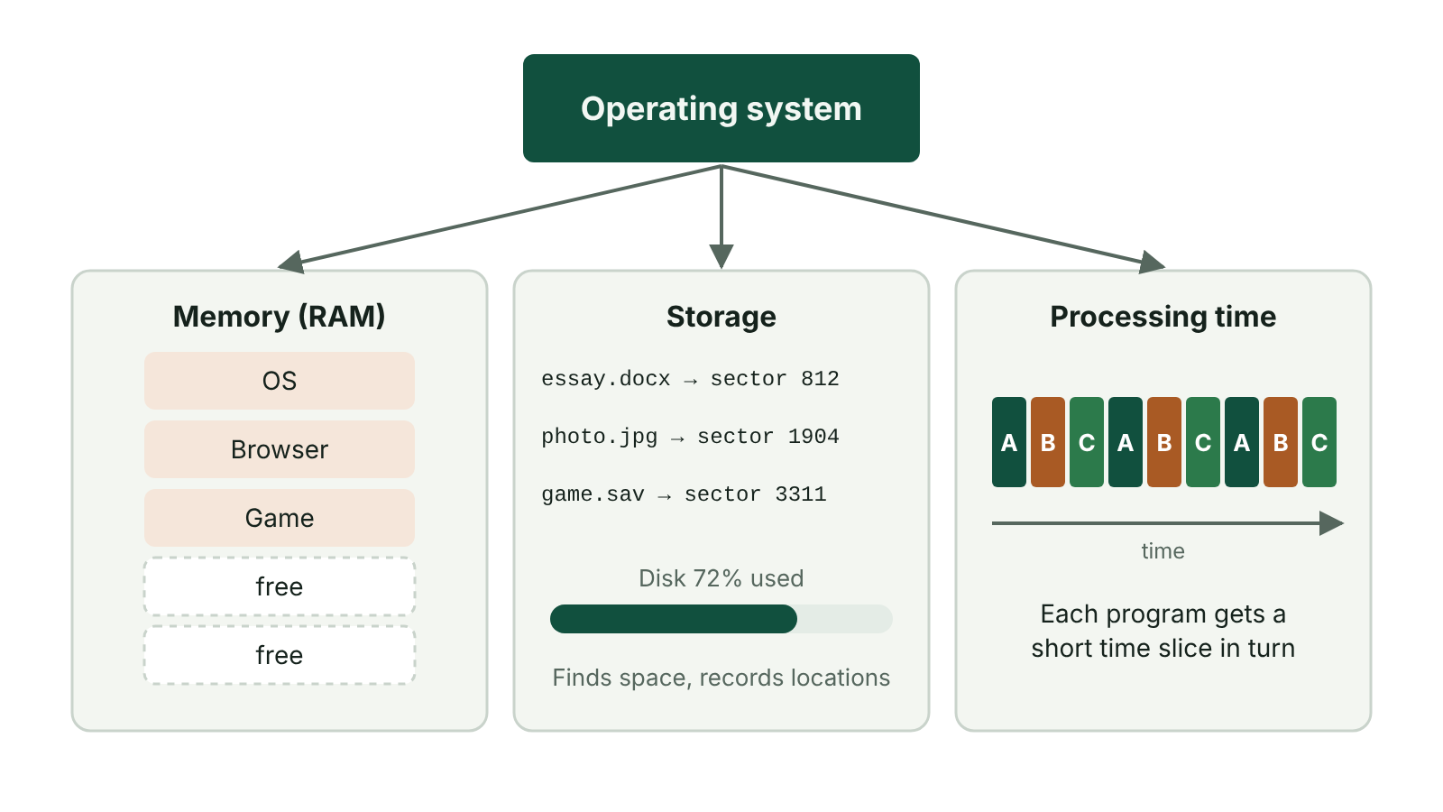
The big picture
The operating system allocating memory, storage and processing time
☰ Menu
Notes:
Explain the diagram in your own words before you read on.

Slide 7
System software vs application software
Software: the instructions (programs) that control the hardware
System software runs the computer itself; it sits between the hardware and the user's applications
Examples of system software: the operating system (Windows, macOS, Android, iOS, Linux), utilities, device drivers
Application software lets the user do a particular task, e.g. word processing, spreadsheets, web browsing, games
Applications cannot run without system software underneath them
☰ Menu

Slide 8
Packaged and tailored software
 | Packaged (off-the-shelf) | Tailored (bespoke)
Made for | Many users with common needs | One organisation's exact needs
Cost | Low; cost shared by many buyers | High; one organisation pays for all of it
Availability | Ready to use straight away | Takes time to design, write and test
Support | Lots of guides, tutorials and users | Help only from the developer
Examples | Microsoft Word, Excel, Photoshop | A hospital's patient booking system
☰ Menu

Slide 9
Allocating memory
Programs and files must be loaded from storage into main memory (RAM) before the CPU can use them
The operating system finds free space in RAM and gives it to the program or file
It keeps each program's memory separate so one cannot overwrite another
When a program closes, its memory is freed for something else
If RAM is full, the OS can use part of the storage drive as virtual memory (slower)
☰ Menu

Slide 10
Allocating storage
The OS manages files and folders on storage devices such as hard drives and USB drives
It decides where each file is saved and keeps a record of its location
It frees the space when files are deleted
It controls who can read or change each file (permissions)
☰ Menu

Slide 11
Allocating processing time
Each CPU core can only carry out one instruction at a time
The OS divides processor time into small time slices
Each running task gets slices in turn; more important (higher-priority) tasks get more slices
Switching is so fast that programs seem to run at the same time (multitasking)
The OS also monitors performance, such as response time and how busy the processor is
☰ Menu

Slide 12
The boot-up sequence
1. The computer is switched on and the CPU runs start-up instructions stored in ROM
2. These instructions test the hardware is working (e.g. memory, keyboard, drives)
3. They find the operating system on the storage drive
4. The OS is loaded from storage into RAM
5. The OS takes control and the user can log in
ROM is used because it is non-volatile: the instructions are not lost when the power is off
☰ Menu

Slide 13
Real-time processing
Each item of data is processed the instant it is entered
The output is produced quickly enough to affect the next input
Examples: concert or flight booking, online stock control, air traffic control, traffic lights
Booking: when one seat is sold, it is marked as taken at once, so it cannot be sold twice
Air traffic control: each plane's position on screen must be updated straight away to prevent accidents
☰ Menu

Slide 14
Batch processing
Similar data is collected into groups (batches) over a period of time
The whole batch is processed together later, with no human involvement
Usually run when the computer is least busy, e.g. overnight or at weekends
Suits large volumes of data that do not need an instant result
Examples: electricity, gas and phone bills; weekly or monthly payroll; monthly bank statements
While the batch runs, the computer is not available for other work
☰ Menu

Slide 15
Worked example: electricity bills
Master file: permanent customer details (account number, name, address, past readings)
Meter readings are collected and stored with account numbers in a temporary transaction file
Each transaction record is matched to the master file record with the same account number
Bill = units used × price per unit, e.g. readings 45 210 → 46 060 = 850 units; 850 × £0.285 = £242.25
Bills are printed or emailed as one batch
The master file is updated from the transaction file, ready for the next quarter
☰ Menu

Slide 16
Multi-user systems
Many users at different computers share the processor of one powerful computer
Also called a time-sharing system
The OS gives each user a small time slice in turn: the round robin method
After the last user, it starts again with the first
The processor is so fast that every user seems to have the computer to themselves
Example: four terminals with 20 ms slices: each user gets a turn every 80 ms, 12.5 times per second
☰ Menu

Slide 17
Comparing modes of processing
Mode | How it works | Example
Real-time | Each input processed at once; output affects next input | Booking seats for a gig at the SSE Arena
Batch | Data collected, then processed together later without people | Monthly payroll for a council
Multi-user | Many users share one processor using time slices in turn | Pupils using a shared school server
☰ Menu

Slide 18
Choosing a mode
Does the result have to be instant, or could a delay cause a problem? → real-time
Is there a large amount of similar data that can wait? → batch
Do many people need to use one system at the same time? → multi-user
Always justify your choice with a reason linked to the scenario
☰ Menu

Slide 19
Exit quiz: question 1 of 9
Tap an answer to check it. Presenting? Click to reveal the answer.
An airline booking system must mark a seat as sold the moment it is booked. Which mode of processing is this?
A Batch processing
B Real-time processing
✗
✓
C Lossy processing
D Offline processing
✗
✗
✓ B: Real-time processing – Real-time processing updates the data immediately, preventing the same seat being sold twice.
☰ Menu

Slide 20
Exit quiz: question 2 of 9
Tap an answer to check it. Presenting? Click to reveal the answer.
Which task is best suited to batch processing?
A Booking a concert seat
B Controlling traffic lights
✗
✗
C Producing monthly electricity bills
D Playing an online game
✓
✗
✓ C: Producing monthly electricity bills – Bills involve lots of similar data that can be collected and processed together later.
☰ Menu

Slide 21
Exit quiz: question 3 of 9
Tap an answer to check it. Presenting? Click to reveal the answer.
Which of these is system software?
A A spreadsheet
B A web browser
✗
✗
C A photo editor
D An operating system
✗
✓
✓ D: An operating system – The operating system manages the hardware and other software.
☰ Menu

Slide 22
Exit quiz: question 4 of 9
Tap an answer to check it. Presenting? Click to reveal the answer.
What does the OS do when allocating processing time?
A Gives each task a time slice of the processor
B Defragments the disk
✓
✗
C Encrypts files
D Backs up data
✗
✗
✓ A: Gives each task a time slice of the processor – Processor time is divided into slices shared between tasks.
☰ Menu

Slide 23
Exit quiz: question 5 of 9
Tap an answer to check it. Presenting? Click to reveal the answer.
Where are the first instructions run at boot-up stored?
A RAM
B Cache
✗
✗
C The cloud
D ROM
✗
✓
✓ D: ROM – ROM is non-volatile, so the instructions are there when the computer is switched on.
☰ Menu

Slide 24
Exit quiz: question 6 of 9
Tap an answer to check it. Presenting? Click to reveal the answer.
In batch processing, which file is permanent or semi-permanent?
A Master file
B Transaction file
✓
✗
C Buffer
D Temporary file
✗
✗
✓ A: Master file – The master file holds customer details and is updated using the transaction file.
☰ Menu

Slide 25
Exit quiz: question 7 of 9
Tap an answer to check it. Presenting? Click to reveal the answer.
A school's pupil-records database written just for it is…
A packaged software
B tailored software
✗
✓
C utility software
D freeware
✗
✗
✓ B: tailored software – Software developed for one specific organisation is tailored (bespoke).
☰ Menu

Slide 26
Exit quiz: question 8 of 9
Tap an answer to check it. Presenting? Click to reveal the answer.
In a multi-user system, how is the processor shared?
A Users queue until the first user logs off
B Each user gets a time slice in turn (round robin)
✗
✓
C Each user gets their own processor
D Jobs are saved and run overnight
✗
✗
✓ B: Each user gets a time slice in turn (round robin) – The OS cycles through the users quickly, giving each a slice so all appear to have constant access.
☰ Menu

Slide 27
Exit quiz: question 9 of 9
Tap an answer to check it. Presenting? Click to reveal the answer.
What does CPU stand for?
A Computer Personal Unit
B Central Program Utility
✗
✗
C Central Processing Unit
D Control Processing Unit
✓
✗
✓ C: Central Processing Unit – Central Processing Unit.
☰ Menu

Slide 28
Exit quiz answers
Q | Answer | Why
1 | B Real-time processing | Real-time processing updates the data immediately, preventing the same seat being sold twice.
2 | C Producing monthly electricity bills | Bills involve lots of similar data that can be collected and processed together later.
3 | D An operating system | The operating system manages the hardware and other software.
4 | A Gives each task a time slice of the processor | Processor time is divided into slices shared between tasks.
5 | D ROM | ROM is non-volatile, so the instructions are there when the computer is switched on.
6 | A Master file | The master file holds customer details and is updated using the transaction file.
7 | B tailored software | Software developed for one specific organisation is tailored (bespoke).
8 | B Each user gets a time slice in turn (round robin) | The OS cycles through the users quickly, giving each a slice so all appear to have constant access.
9 | C Central Processing Unit | Central Processing Unit.
☰ Menu

Slide 29
In the exam
Paper | Question | Marks | What it tested
Unit 1 2022 | Q1 | 9 | MCQ: storage, bit rate, real-time, compression, buffering, ADC, big data, backup
Unit 1 2023 | Q5 | 10 | CPU, system software resources, real-time vs multi-user, utilities, I/O devices
Unit 1 2023 | Q12 | 4 | Batch processing, backups, freeing disk space
Unit 1 2024 | Q10 | 8 | Key term matching
Unit 1 2025 | Q4 | 7 | Boot process, OS roles, storage conversion
Papers and mark schemes: ccea.org.uk → GCSE Digital Technology → Past Papers & Mark Schemes.
☰ Menu

Slide 30
Utility applications and antivirus software
UNIT 1: DIGITAL TECHNOLOGY · L07
Learning objectives
Explain why files become fragmented and how a defragmenter speeds up file access
Describe what a task scheduler does, including round robin sharing of processor time
Describe full and incremental backups, how data is restored and why backups are needed
Explain how antivirus software works and why it must be updated regularly
Notes:
Specification: Describe the following tasks carried out by the utility applications: disk defragmenting, task scheduling, backup and restoring data | Explain why file fragmentation happens and how defragmentation improves performance | Describe full and incremental backups and a suitable backup procedure | Describe the role of antivirus software and the importance of regular updates

Slide 31
In this lesson
Tap a button to jump straight there. The ☰ Menu button on every slide brings you back here.
The big picture
Task scheduling: running jobs automatically
Viruses
What is a utility?
Why back up data?
How antivirus software works
Why files become fragmented
Full and incremental backups
Why update antivirus regularly?
Defragmentation
Worked example: a school backup plan
Exit quiz
Task scheduling: sharing the processor
Restoring data
↑ Topic menu
Notes:
Lesson menu: each button jumps to that part of the lesson in Slide Show. The ☰ Menu button on each slide returns here.

Slide 32
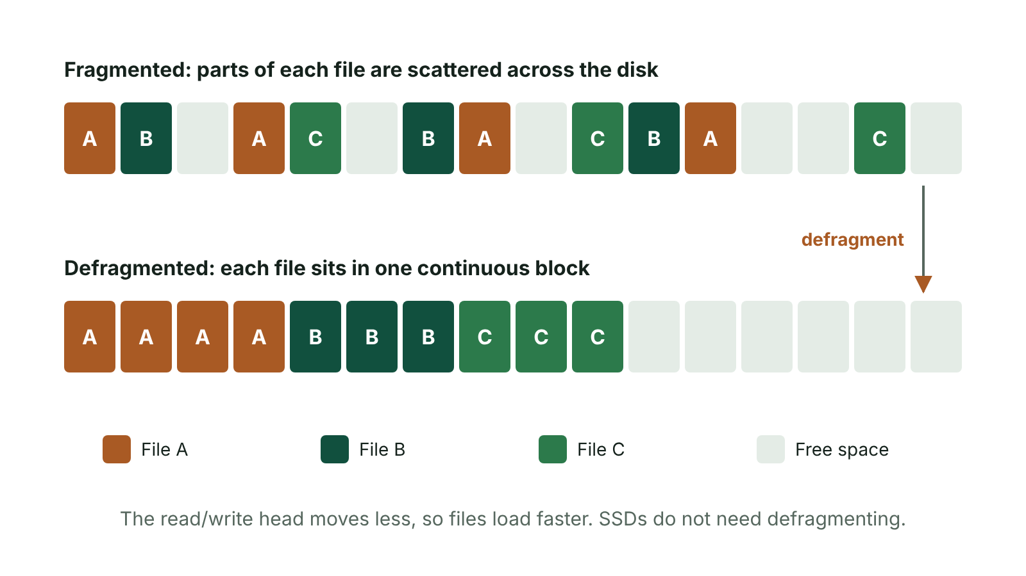
The big picture
Disk blocks before and after defragmentation
☰ Menu
Notes:
Explain the diagram in your own words before you read on.

Slide 33
What is a utility?
A utility is a small program that carries out one specific task to help the operating system
Utilities maintain, protect or speed up the computer
Specification utilities: disk defragmenter, task scheduler, backup and restore
Antivirus software is also a utility; WinZip (file compression) is another example
Utilities are system software, not application software
☰ Menu

Slide 34
Why files become fragmented
The OS splits each file into equal-sized data blocks before saving it
Each block is stored in any free block space on the disk
Over time, files are saved and deleted, leaving small gaps of free space all over the disk
A new large file may not fit in one place, so its blocks are scattered: file fragmentation
On a hard disk drive, the read/write head has to move all over the disk to read one file, which is slow
☰ Menu

Slide 35
Defragmentation
A disk defragmenter rearranges the blocks on the disk
The blocks of each file are moved together so they are stored next to each other
All the free space is gathered into one area of the disk
The head moves less, so files open and save faster
Example: A1 B3 A2 A4 B2 A3 B1 B4 becomes A1 A2 A3 A4 B1 B2 B3 B4, then free space
Solid-state drives (SSDs) should not be defragmented: they have no moving parts, and extra writing wears them out
☰ Menu

Slide 36
Task scheduling: sharing the processor
Task scheduling divides processor time between a number of tasks
Aim: keep the processor busy and make the system as efficient as possible
Round robin: the processor gives computer 1 a short turn, then computer 2, then computer 3, in a fixed order
When every computer has had a turn, the cycle repeats from computer 1
The processor is so fast that every user seems to have uninterrupted access
☰ Menu

Slide 37
Task scheduling: running jobs automatically
A task scheduler also runs jobs at a set time or when an event happens
Examples: a full virus scan every Friday, a backup at 2 a.m., updates when the computer shuts down
Jobs run when the computer is not busy, so users are not disrupted
Important jobs are never forgotten
It can warn the user before a job starts
☰ Menu

Slide 38
Why back up data?
A backup is a copy of data kept separately in case the original is damaged or lost
The hard disk could fail
A virus or ransomware could destroy or lock the data
Someone could delete a file by accident
A fire, flood or theft could destroy the building and its computers
Losing data could be disastrous, e.g. a hospital losing patient records
☰ Menu

Slide 39
Full and incremental backups
 | Full backup | Incremental backup
What is copied | All the data | Only data changed since the last backup
Time taken | Long | Short
Storage needed | A lot | Much less
Restoring | Simple: one backup | Needs the last full backup plus every incremental since
Typical use | Weekly, e.g. Sunday night | Daily, e.g. Monday to Saturday nights
☰ Menu

Slide 40
Worked example: a school backup plan
A school server holds 200 GB of data; about 5 GB changes each day
Full backup every night: 7 × 200 GB = 1 400 GB stored each week
Full backup on Sunday + incremental Monday to Saturday: 200 + (6 × 5) = 230 GB a week
That saves 1 170 GB a week, and the nightly backups finish much faster
Copies kept off-site or in the cloud, scheduled overnight when the network is quiet
☰ Menu

Slide 41
Restoring data
Restore: copying data back from a backup to return it to an earlier state
Used after data is lost, corrupted, deleted or encrypted by ransomware
The most recent backup is used so as little work as possible is lost
How often to back up depends on how often the data changes: daily, or after every transaction for real-time systems
Backups must be tested regularly to make sure they can actually be restored
☰ Menu

Slide 42
Viruses
A virus is a program that attaches itself to a file
When the file is opened, the virus runs and copies itself to other files and other computers
It can delete or damage data, stop a computer starting up or slow it down
Viruses spread through email attachments, downloads, USB drives and networks
☰ Menu

Slide 43
How antivirus software works
Scans files on all connected storage, plus emails and downloads coming into the computer
Compares them with a database of known virus signatures (patterns of code)
Can also spot suspicious behaviour that looks like a new virus (heuristic checking)
Infected files are deleted, repaired or moved to quarantine so they cannot run
Real-time protection scans files as they are opened; full scans can be scheduled
☰ Menu

Slide 44
Why update antivirus regularly?
New viruses are created all the time
Antivirus can only recognise viruses whose signatures are in its database
Without updates, the newest viruses will not be detected
Updates also fix weaknesses in the antivirus program itself
Best practice: set updates to download automatically, at least daily
☰ Menu

Slide 45
Exit quiz: question 1 of 8
Tap an answer to check it. Presenting? Click to reveal the answer.
Why does a disk defragmenter make a hard disk drive faster?
A It deletes unwanted files
B It stores each file's blocks together so the read/write head moves less
✗
✓
C It compresses every file
D It scans for viruses
✗
✗
✓ B: It stores each file's blocks together so the read/write head moves less – With each file in one continuous area, the head does not have to jump around the disk.
☰ Menu

Slide 46
Exit quiz: question 2 of 8
Tap an answer to check it. Presenting? Click to reveal the answer.
Why must antivirus software be updated regularly?
A To make the computer start faster
B To free up disk space
✗
✗
C So it can recognise the signatures of newly created viruses
D So it can defragment the disk
✓
✗
✓ C: So it can recognise the signatures of newly created viruses – It can only detect viruses whose signatures are in its database, and new viruses appear all the time.
☰ Menu

Slide 47
Exit quiz: question 3 of 8
Tap an answer to check it. Presenting? Click to reveal the answer.
An incremental backup copies…
A only files changed since the last backup
B everything on the drive
✓
✗
C only the operating system
D only photos
✗
✗
✓ A: only files changed since the last backup – It saves time and storage space compared with a full backup.
☰ Menu

Slide 48
Exit quiz: question 4 of 8
Tap an answer to check it. Presenting? Click to reveal the answer.
Which utility would run a backup automatically every night?
A Defragmenter
B Firewall
✗
✗
C Compiler
D Task scheduler
✗
✓
✓ D: Task scheduler – A task scheduler runs jobs at set times.
☰ Menu

Slide 49
Exit quiz: question 5 of 8
Tap an answer to check it. Presenting? Click to reveal the answer.
After defragmenting, the blocks A1 B3 A2 A4 B2 A3 B1 B4 become…
A A1 B1 A2 B2 A3 B3 A4 B4
B B1 B2 B3 B4 A1 A2 A3 A4
✗
✗
C A1 A2 A3 A4 B1 B2 B3 B4
D Unchanged
✓
✗
✓ C: A1 A2 A3 A4 B1 B2 B3 B4 – Each file's blocks are stored together in order, with free space gathered at the end.
☰ Menu

Slide 50
Exit quiz: question 6 of 8
Tap an answer to check it. Presenting? Click to reveal the answer.
Which is NOT a reason to back up data?
A The hard drive may fail
B A virus may destroy the data
✗
✗
C A fire may destroy the building
D It makes the processor faster
✗
✓
✓ D: It makes the processor faster – Backups protect against data loss; they do not change processor speed.
☰ Menu

Slide 51
Exit quiz: question 7 of 8
Tap an answer to check it. Presenting? Click to reveal the answer.
In round robin scheduling, what happens after the processor serves the last computer?
A It switches off
B It starts again with the first computer
✗
✓
C It waits for the user to log off
D It serves the busiest computer only
✗
✗
✓ B: It starts again with the first computer – The processor cycles through each computer in turn, over and over.
☰ Menu

Slide 52
Exit quiz: question 8 of 8
Tap an answer to check it. Presenting? Click to reveal the answer.
What is a virus signature?
A A pattern of code that identifies a particular virus
B The name of the person who wrote the virus
✓
✗
C A password to unlock infected files
D A digital certificate on a website
✗
✗
✓ A: A pattern of code that identifies a particular virus – Antivirus software compares files with these known patterns.
☰ Menu

Slide 53
Exit quiz answers
Q | Answer | Why
1 | B It stores each file's blocks together so the read/write head moves less | With each file in one continuous area, the head does not have to jump around the disk.
2 | C So it can recognise the signatures of newly created viruses | It can only detect viruses whose signatures are in its database, and new viruses appear all the time.
3 | A only files changed since the last backup | It saves time and storage space compared with a full backup.
4 | D Task scheduler | A task scheduler runs jobs at set times.
5 | C A1 A2 A3 A4 B1 B2 B3 B4 | Each file's blocks are stored together in order, with free space gathered at the end.
6 | D It makes the processor faster | Backups protect against data loss; they do not change processor speed.
7 | B It starts again with the first computer | The processor cycles through each computer in turn, over and over.
8 | A A pattern of code that identifies a particular virus | Antivirus software compares files with these known patterns.
☰ Menu

Slide 54
In the exam
Paper | Question | Marks | What it tested
Unit 1 2019 | Q5(b) | 4 | Defragmenting and task scheduling
Unit 1 2022 | Q1 | 9 | MCQ: storage, bit rate, real-time, compression, buffering, ADC, big data, backup
Unit 1 2022 | Q5 | 6 | 3D printing, utilities and security, graphics digitiser
Unit 1 2023 | Q5 | 10 | CPU, system software resources, real-time vs multi-user, utilities, I/O devices
Unit 1 2023 | Q12 | 4 | Batch processing, backups, freeing disk space
Unit 1 2024 | Q10 | 8 | Key term matching
Papers and mark schemes: ccea.org.uk → GCSE Digital Technology → Past Papers & Mark Schemes.
☰ Menu

