Slide 1
Database applications
UNIT 1: DIGITAL TECHNOLOGY · TOPIC
Lessons in this topic
L08 Database concepts
L09 Database data types and validation
L10 Queries, logical operators and big data

Slide 2

Topic menu
Tap a button to jump straight there. The ☰ Menu button on every slide brings you back here.
Specification map
L09 Database data types and validation
L08 Database concepts
L10 Queries, logical operators and big data

Slide 3
Specification map (1 of 2)
Lesson | Specification: students should be able to
L08 | Demonstrate understanding of and explain basic database concepts such as table, record, field, key field, query, form, report, macro, relationship and importing data; Explain the difference between a flat file and a relational database; Explain how a primary key and a foreign key are used to create a relationship between tables; Describe one-to-one, one-to-many and many-to-many relationships and the purpose of referential integrity; Describe the purpose of queries, forms, reports and macros in a database application
L09 | Identify and use appropriate data types when creating a database structure; Justify the choice of data type for a field; Demonstrate understanding of the need for data validation; Describe the following types of validation checks: presence, length, type, format and range; Write simple validation rules for database fields
☰ Menu

Slide 4
Specification map (2 of 2)
Lesson | Specification: students should be able to
L10 | Extract data from a database structure using simple query structures and using the following logical operators: <, >, =, <=, >=, AND, OR and BETWEEN; Predict the records returned by a query with given criteria; Demonstrate understanding of big data, referring to volume, velocity and variety; Describe the difference between structured and unstructured data; Demonstrate understanding of the need for data analytics to interpret big data
☰ Menu
Notes:
Each lesson below is its own section in PowerPoint (View → Slide Sorter shows them). To split this deck by specification point, right-click a section → Move Section, or delete the sections you do not need.

Slide 5
Database concepts
UNIT 1: DIGITAL TECHNOLOGY · L08
Learning objectives
Define table, record, field and key field and identify them in a given table
Explain why a key field must be unique and choose a suitable key field
Explain how tables are linked by a relationship using a primary key and a foreign key
Describe what queries, forms, reports and macros are used for
Explain what importing data means and why it is useful
Notes:
Specification: Demonstrate understanding of and explain basic database concepts such as table, record, field, key field, query, form, report, macro, relationship and importing data | Explain the difference between a flat file and a relational database | Explain how a primary key and a foreign key are used to create a relationship between tables | Describe one-to-one, one-to-many and many-to-many relationships and the purpose of referential integrity | Describe the purpose of queries, forms, reports and macros in a database application

Slide 6
In this lesson
Tap a button to jump straight there. The ☰ Menu button on every slide brings you back here.
The big picture
Key fields
Database tools: query, form, report
What is a database?
Flat file or relational database?
Macros
Tables, records and fields
Relationships and foreign keys
Importing data
Worked example: Erne Valley Swimming Club
Types of relationship
Exit quiz
Reading the example
Referential integrity
↑ Topic menu
Notes:
Lesson menu: each button jumps to that part of the lesson in Slide Show. The ☰ Menu button on each slide returns here.

Slide 7
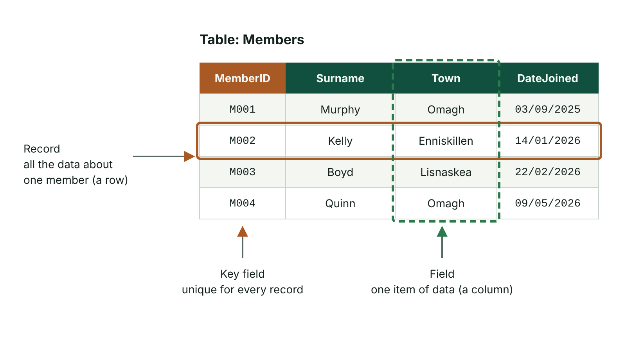
The big picture
A database table showing a record, a field and the key field
☰ Menu
Notes:
Explain the diagram in your own words before you read on.

Slide 8
What is a database?
A database is an organised, structured collection of related data
Data can be stored, searched, sorted and printed quickly and accurately
Examples: a school MIS holding pupil records, a GP surgery's patient records, a sports club's members list
Database software: Microsoft Access, LibreOffice Base, MySQL
A database is more than a store – it has tools (queries, forms, reports, macros) to work with the data
☰ Menu

Slide 9
Tables, records and fields
Table: holds data about one type of thing (an entity), e.g. Members – arranged in rows and columns
Record: all the data about one person or item – one row of the table
Field: one item of data stored for every record – one column, e.g. Surname
Field name: the column heading that identifies the field
Each field is given a data type (text, number, date/time and so on)
☰ Menu

Slide 10
Worked example: Erne Valley Swimming Club
MemberID | Surname | FirstName | DateOfBirth | Squad | Phone
SW001 | Maguire | Orla | 14/03/2011 | Junior | 07700 900123
SW002 | Gallagher | Conor | 02/11/2009 | Senior | 07700 900456
SW003 | Maguire | Ciara | 21/06/2012 | Junior | 07700 900123
SW004 | Thompson | Ben | 30/01/2010 | Senior | 07700 900789
☰ Menu

Slide 11
Reading the example
The table is called Members; it has 4 records and 6 fields
One record: SW002, Gallagher, Conor, 02/11/2009, Senior, 07700 900456
One field: Squad (Junior or Senior for every member)
Key field: MemberID – no two members share it
Surname, Phone and Squad cannot be key fields: two sisters share 'Maguire' and the same phone number
☰ Menu

Slide 12
Key fields
Key field (primary key): a field that uniquely identifies each record in a table
Its value must be unique and must never be left empty
Good key fields: PupilID, MemberID, health and care number, order number
Poor key fields: names, dates of birth, towns – these can be repeated
Composite key: a primary key made from two or more fields together, e.g. MemberID + SessionDate
☰ Menu

Slide 13
Flat file or relational database?
Flat file: all the data is held in one two-dimensional table
Problem: the same details are typed again and again (data redundancy), e.g. a member's phone number on every booking
Repeated data wastes storage and leads to inconsistency when one copy is updated and another is not
Relational database: data is split into several linked tables, each about one entity
Each fact is stored once, so it is easier to keep data accurate and up to date
☰ Menu

Slide 14
Relationships and foreign keys
A relationship links two tables using a field they have in common
The primary key of one table is stored in the other table, where it is called a foreign key
Members (MemberID primary key) → Lessons (MemberID foreign key)
In words: one member can book many lessons, but each lesson booking is for one member
A foreign key does not have to be unique – the same MemberID can appear on many bookings
☰ Menu

Slide 15
Types of relationship
Type | Meaning | Example
One-to-one | One record links to exactly one record in the other table | One pupil has one locker
One-to-many | One record links to many records in the other table | One doctor has many patients
Many-to-many | Many records link to many records | Many pupils take many subjects
Diagram | The 'many' end is shown with ∞ (Access) or a crow's foot | ∞ at the Patient end
☰ Menu

Slide 16
Referential integrity
Referential integrity is a rule set on a relationship to keep the linked tables consistent
A foreign key value must match a primary key that already exists, e.g. no booking for member SW099 if SW099 is not in Members
It also stops a member being deleted while their bookings still exist
Optional extra: cascade delete removes the linked bookings when the member is deleted
Result: no 'orphan' records that point to nothing
☰ Menu

Slide 17
Database tools: query, form, report
Tool | What it does | Club example
Query | Searches the tables and extracts only the records that match criteria | All Junior squad members
Form | On-screen layout for entering, editing and viewing records, often one at a time | New member sign-up screen with a drop-down for Squad
Report | Presents data from a table or query in a formatted, printable layout, with grouping, sorting and totals | Printed register of members grouped by squad
☰ Menu

Slide 18
Macros
A macro is a small stored program that carries out a series of database actions automatically
Usually run by clicking a button on a form, e.g. 'Add new member', 'Print register'
Can open forms, run queries, print reports, add, update or delete records
Benefits: saves time on repetitive tasks, fewer mistakes, easier for users with little database skill
☰ Menu

Slide 19
Importing data
Importing: bringing data into the database from another file instead of typing it in again
Common sources: csv (comma-separated values) files and spreadsheet worksheets
Example: the club imports a csv of new members exported from its online sign-up form
Benefits: much faster than retyping and avoids transcription errors
Check first: column headings must match the fields and data must suit each field's data type
☰ Menu

Slide 20
Exit quiz: question 1 of 8
Tap an answer to check it. Presenting? Click to reveal the answer.
In a database table, what is one row called?
A A field
B A record
✗
✓
C A query
D A macro
✗
✗
✓ B: A record – A row holds all the data about one person or item, which is a record. A column is a field.
☰ Menu

Slide 21
Exit quiz: question 2 of 8
Tap an answer to check it. Presenting? Click to reveal the answer.
A swimming club stores Surname, Squad, DateOfBirth and MemberID. Which is the best key field?
A MemberID
B Surname
✓
✗
C Squad
D DateOfBirth
✗
✗
✓ A: MemberID – MemberID is created to be unique for every member. Names, squads and dates can be shared.
☰ Menu

Slide 22
Exit quiz: question 3 of 8
Tap an answer to check it. Presenting? Click to reveal the answer.
What is a query used for?
A Entering data one record at a time
B Printing a formatted summary
✗
✗
C Searching for records that match criteria
D Recording keystrokes
✓
✗
✓ C: Searching for records that match criteria – A query checks each record and returns only those that meet the criteria.
☰ Menu

Slide 23
Exit quiz: question 4 of 8
Tap an answer to check it. Presenting? Click to reveal the answer.
A set of stored instructions that runs a database task automatically when a button is clicked is a…
A form
B relationship
✗
✗
C field
D macro
✗
✓
✓ D: macro – Macros automate repetitive tasks such as adding a record or printing a report.
☰ Menu

Slide 24
Exit quiz: question 5 of 8
Tap an answer to check it. Presenting? Click to reveal the answer.
When the primary key of one table appears as a field in a second table, it is called a…
A composite key
B foreign key
✗
✓
C lookup
D macro
✗
✗
✓ B: foreign key – It is a foreign key in the second table, and it creates the link between the tables.
☰ Menu

Slide 25
Exit quiz: question 6 of 8
Tap an answer to check it. Presenting? Click to reveal the answer.
One doctor has many patients; each patient has one doctor. Where does the ∞ or crow's foot go?
A At the Doctor end
B At both ends
✗
✗
C At the Patient end
D Nowhere – it is one-to-one
✓
✗
✓ C: At the Patient end – The symbol goes at the 'many' end, which is the Patient table.
☰ Menu

Slide 26
Exit quiz: question 7 of 8
Tap an answer to check it. Presenting? Click to reveal the answer.
What is the main problem with storing everything in a flat file?
A Data is repeated, wasting space and causing inconsistencies
B It cannot be printed
✓
✗
C It cannot be sorted
D It cannot have a key field
✗
✗
✓ A: Data is repeated, wasting space and causing inconsistencies – Data redundancy means the same details are stored many times, and copies can get out of step.
☰ Menu

Slide 27
Exit quiz: question 8 of 8
Tap an answer to check it. Presenting? Click to reveal the answer.
Which tool would present club members grouped by squad, ready to print?
A Form
B Macro
✗
✗
C Relationship
D Report
✗
✓
✓ D: Report – A report formats data from a table or query, and can group, sort and total it.
☰ Menu

Slide 28
Exit quiz answers
Q | Answer | Why
1 | B A record | A row holds all the data about one person or item, which is a record. A column is a field.
2 | A MemberID | MemberID is created to be unique for every member. Names, squads and dates can be shared.
3 | C Searching for records that match criteria | A query checks each record and returns only those that meet the criteria.
4 | D macro | Macros automate repetitive tasks such as adding a record or printing a report.
5 | B foreign key | It is a foreign key in the second table, and it creates the link between the tables.
6 | C At the Patient end | The symbol goes at the 'many' end, which is the Patient table.
7 | A Data is repeated, wasting space and causing inconsistencies | Data redundancy means the same details are stored many times, and copies can get out of step.
8 | D Report | A report formats data from a table or query, and can group, sort and total it.
☰ Menu

Slide 29
In the exam
Paper | Question | Marks | What it tested
Unit 1 2021 | Q2(a)–(c) | 8 | Relational database terms, relationships, data types, key field
Unit 1 2022 | Q10 | 11 | Database tools, field types, importing csv, validation
Unit 1 2023 | Q3 | 9 | Database concepts; validation rules
Unit 1 2024 | Q3 | 11 | Field names and data types, database terms, key field, query design
Unit 1 2024 | Q10 | 8 | Key term matching
Unit 1 2025 | Q5 | 11 | Data types, validation checks, data processing
2 more past questions on the website. Papers and mark schemes: ccea.org.uk → GCSE Digital Technology → Past Papers & Mark Schemes.
☰ Menu

Slide 30
Database data types and validation
UNIT 1: DIGITAL TECHNOLOGY · L09
Learning objectives
Choose and justify a suitable data type for each field in a table
Explain why validation is needed and what it cannot do
Describe presence, length, type, format and range checks with examples
Write validation rules and input masks for database fields
Explain the difference between validation and verification
Notes:
Specification: Identify and use appropriate data types when creating a database structure | Justify the choice of data type for a field | Demonstrate understanding of the need for data validation | Describe the following types of validation checks: presence, length, type, format and range | Write simple validation rules for database fields

Slide 31
In this lesson
Tap a button to jump straight there. The ☰ Menu button on every slide brings you back here.
The big picture
Setting up checks in Access
Why data types matter
Worked example: writing validation rules
Common data types (1)
Input masks for format checks
Common data types (2)
Validation vs verification
Worked example: Bangor summer sailing camp
Exit quiz
What is validation?
↑ Topic menu
Five validation checks
Notes:
Lesson menu: each button jumps to that part of the lesson in Slide Show. The ☰ Menu button on each slide returns here.

Slide 32
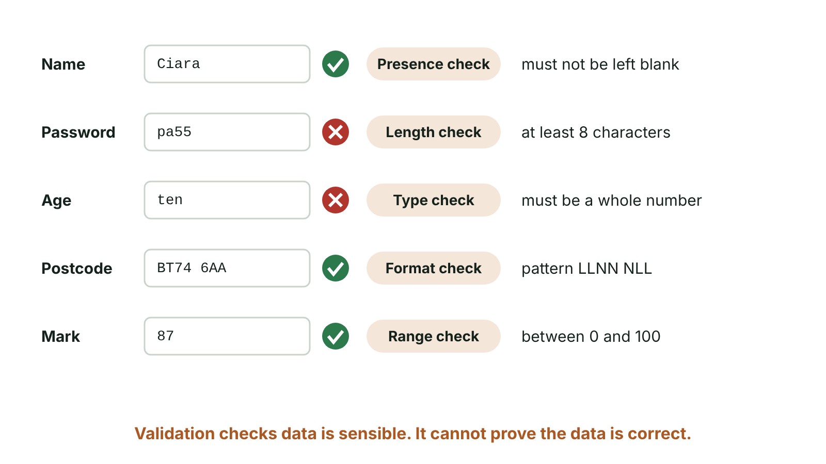
The big picture
Five validation checks applied to form fields, with passes and failures
☰ Menu
Notes:
Explain the diagram in your own words before you read on.

Slide 33
Why data types matter
When a table is designed, every field is given a name and a data type
The data type says what kind of data the field can hold, e.g. text, number or date
It controls what can be entered, how much storage is used and what can be done with the data
Dates stored as Date/Time can be sorted in date order and used in date calculations
Numbers stored as Number or Currency can be added, averaged and totalled
☰ Menu

Slide 34
Common data types (1) (1 of 2)
Data type | Use | Example field
Short Text | Letters, or a mix of letters and numbers, up to 255 characters; numbers not used in calculations | Surname, Postcode, PhoneNumber
Long Text | Large amounts of text | ProductDescription, Notes
Number | Numeric data used in calculations | DaysBooked, GoalsScored
Currency | Money values, shown with two decimal places | TicketPrice, MonthlyFee
Date/Time | Dates and times, often picked from a pop-up calendar | DateOfBirth, BookingDate
☰ Menu

Slide 35
Common data types (1) (2 of 2)
Data type | Use | Example field
AutoNumber | A number created automatically for each new record, usually the key field | BookingID
☰ Menu

Slide 36
Common data types (2)
Data type | Use | Example field
Yes/No | One of two values (Boolean): Yes/No, True/False | FeesPaid, PhotoConsent
OLE Object | Object Linking and Embedding: a file made in other software, e.g. a spreadsheet | MedicalForm
Hyperlink | A web address (URL) or email address | Website, Email
Attachment | Files attached to a record, e.g. a digital photo | MemberPhoto
Calculated | The result of a calculation using other fields in the record | TotalCost = [Quantity]*[Price]
Lookup Wizard | A list of values chosen from a drop-down list | Squad: Junior, Senior, Masters
☰ Menu

Slide 37
Worked example: Bangor summer sailing camp
Field | Data type | Justification
CamperID | AutoNumber | Unique number created automatically – the key field
ParentPhone | Short Text | Starts with 0, has spaces and is never used in a calculation
StartDate | Date/Time | Can be sorted and checked against today's date
DaysBooked | Number (integer) | Whole number used to work out the cost
DailyFee | Currency | Money with two decimal places
PhotoConsent | Yes/No | Only two possible answers
☰ Menu

Slide 38
What is validation?
Validation: an automatic check by the computer, at the input stage, that data is sensible, reasonable and within acceptable limits
Data that breaks the rule is rejected and an error message explains why
It reduces input errors, so the database is more accurate and reliable
Validation cannot prove data is correct – a valid but wrong date of birth is still accepted
Many candidates in 2025 were unsure that validation cannot tell if data is correct
☰ Menu

Slide 39
Five validation checks
Check | What it does | Example
Presence | Makes sure a field is not left blank | Surname must be entered for every camper
Length | Checks the number of characters is within limits or exact | CamperCode must be exactly 7 characters
Type | Checks the data is the correct data type | DaysBooked must be a number, not text
Format | Checks the data matches a set pattern | Postcode like BT74 7AB; email contains @
Range | Checks a value is between a lower and an upper limit | DaysBooked from 1 to 5
☰ Menu

Slide 40
Setting up checks in Access
Presence: set Required to Yes, or use the validation rule Is Not Null
Length: set Field Size, or use a rule such as Len([CamperCode])=7
Type: chosen automatically by the data type – a Number field rejects letters
Format: an input mask controls the pattern of characters, e.g. for a postcode
Range: a rule such as >=1 And <=5, or Between 1 And 5
Validation text: the error message shown, e.g. 'Campers can book from 1 to 5 days'
☰ Menu

Slide 41
Worked example: writing validation rules
Rules are typed into the Validation Rule property of the field
Read each one aloud: 'DaysBooked must be at least 1 and at most 5'
☰ Menu

Slide 42
Worked example: writing validation rules – code
PSEUDOCODE
// Range check: book 1 to 5 days
>=1 And <=5
// Same range check written with BETWEEN
Between 1 And 5
// Range check: exam mark 0 to 100
>=0 And <=100
// Length check: password at least 8 characters
Len([Password])>=8
// Length check: exactly 7 characters
Len([CamperCode])=7
// Presence check
Is Not Null
// Format check: email must contain @
Like "*@*"
☰ Menu

Slide 43
Input masks for format checks
An input mask is a pattern that each character typed must fit
In Access: L = a letter is required, 0 = a digit is required, 9 = a digit is optional
NI postcode mask: "BT"09 0LL accepts BT74 7AB; the optional 9 also allows one-digit districts such as BT1
Student code mask: LL0000 accepts EN2041 but rejects E20411
Input masks stop wrong patterns being typed, but cannot check the postcode really exists
☰ Menu

Slide 44
Validation vs verification
 | Validation | Verification
Purpose | Checks data is sensible and follows rules | Checks data has been entered or copied accurately
Done by | The computer, automatically | The user or the computer comparing two entries
Methods | Presence, length, type, format, range checks | Double entry (type the email twice); visual check against the source
Limit | Valid data can still be wrong | Both entries can contain the same mistake
☰ Menu

Slide 45
Exit quiz: question 1 of 8
Tap an answer to check it. Presenting? Click to reveal the answer.
Which validation check makes sure a field is not left empty?
A Range check
B Presence check
✗
✓
C Format check
D Type check
✗
✗
✓ B: Presence check – A presence check rejects a blank field. In Access set Required to Yes or use Is Not Null.
☰ Menu

Slide 46
Exit quiz: question 2 of 8
Tap an answer to check it. Presenting? Click to reveal the answer.
Which data type is best for a monthly club fee of £24.99?
A Currency
B Number (integer)
✓
✗
C Short Text
D Date/Time
✗
✗
✓ A: Currency – Currency is for money and stores two decimal places. An integer would lose the pence.
☰ Menu

Slide 47
Exit quiz: question 3 of 8
Tap an answer to check it. Presenting? Click to reveal the answer.
Checking that an email address contains an @ symbol is a…
A type check
B range check
✗
✗
C format check
D presence check
✓
✗
✓ C: format check – It checks that the data follows a pattern.
☰ Menu

Slide 48
Exit quiz: question 4 of 8
Tap an answer to check it. Presenting? Click to reveal the answer.
Which statement about validation is true?
A It guarantees data is correct
B It is carried out by a person reading the data
✗
✗
C It encrypts the data
D It cannot tell if data is correct, only if it is sensible
✗
✓
✓ D: It cannot tell if data is correct, only if it is sensible – Valid data can still be wrong, for example a mistyped but possible date of birth.
☰ Menu

Slide 49
Exit quiz: question 5 of 8
Tap an answer to check it. Presenting? Click to reveal the answer.
Which validation rule accepts a group of 5 to 20 people, including 5 and 20?
A >5 And <20
B <5 Or >20
✗
✗
C >=5 And <=20
D Len([GroupSize])>4
✓
✗
✓ C: >=5 And <=20 – >= and <= include the boundary values. Between 5 And 20 would also work.
☰ Menu

Slide 50
Exit quiz: question 6 of 8
Tap an answer to check it. Presenting? Click to reveal the answer.
Which data type stores a file made in other software, such as a spreadsheet, using object linking and embedding?
A Hyperlink
B Calculated
✗
✗
C Lookup Wizard
D OLE Object
✗
✓
✓ D: OLE Object – OLE stands for Object Linking and Embedding.
☰ Menu

Slide 51
Exit quiz: question 7 of 8
Tap an answer to check it. Presenting? Click to reveal the answer.
Which data type automatically creates a new sequential number for each record?
A AutoNumber
B Number
✓
✗
C Yes/No
D Short Text
✗
✗
✓ A: AutoNumber – AutoNumber is often used for the key field.
☰ Menu

Slide 52
Exit quiz: question 8 of 8
Tap an answer to check it. Presenting? Click to reveal the answer.
In an Access input mask, what does the character L mean?
A A digit is required
B A letter is required
✗
✓
C A lower-case letter is optional
D Any character is allowed
✗
✗
✓ B: A letter is required – L = letter required, 0 = digit required, 9 = digit optional.
☰ Menu

Slide 53
Exit quiz answers
Q | Answer | Why
1 | B Presence check | A presence check rejects a blank field. In Access set Required to Yes or use Is Not Null.
2 | A Currency | Currency is for money and stores two decimal places. An integer would lose the pence.
3 | C format check | It checks that the data follows a pattern.
4 | D It cannot tell if data is correct, only if it is sensible | Valid data can still be wrong, for example a mistyped but possible date of birth.
5 | C >=5 And <=20 | >= and <= include the boundary values. Between 5 And 20 would also work.
6 | D OLE Object | OLE stands for Object Linking and Embedding.
7 | A AutoNumber | AutoNumber is often used for the key field.
8 | B A letter is required | L = letter required, 0 = digit required, 9 = digit optional.
☰ Menu

Slide 54
In the exam
Paper | Question | Marks | What it tested
Unit 1 2021 | Q2(g) | 3 | Presence and range checks
Unit 1 2022 | Q10 | 11 | Database tools, field types, importing csv, validation
Unit 1 2023 | Q3 | 9 | Database concepts; validation rules
Unit 1 2025 | Q5 | 11 | Data types, validation checks, data processing
Papers and mark schemes: ccea.org.uk → GCSE Digital Technology → Past Papers & Mark Schemes.
☰ Menu

Slide 55
Queries, logical operators and big data
UNIT 1: DIGITAL TECHNOLOGY · L10
Learning objectives
Write query criteria using comparison operators and AND, OR and BETWEEN
Set up a query in a query design grid and predict which records it returns
Explain big data using volume, velocity and variety
Tell structured and unstructured data apart
Explain why data analytics is needed to make use of big data
Notes:
Specification: Extract data from a database structure using simple query structures and using the following logical operators: <, >, =, <=, >=, AND, OR and BETWEEN | Predict the records returned by a query with given criteria | Demonstrate understanding of big data, referring to volume, velocity and variety | Describe the difference between structured and unstructured data | Demonstrate understanding of the need for data analytics to interpret big data

Slide 56
In this lesson
Tap a button to jump straight there. The ☰ Menu button on every slide brings you back here.
The big picture
Big data
Queries and criteria
The three Vs
Comparison operators
Structured and unstructured data
Logical (Boolean) operators
Data analytics
Worked example: Fermanagh Junior Football League
Exit quiz
Predicting the results
↑ Topic menu
The query design grid
Notes:
Lesson menu: each button jumps to that part of the lesson in Slide Show. The ☰ Menu button on each slide returns here.

Slide 57
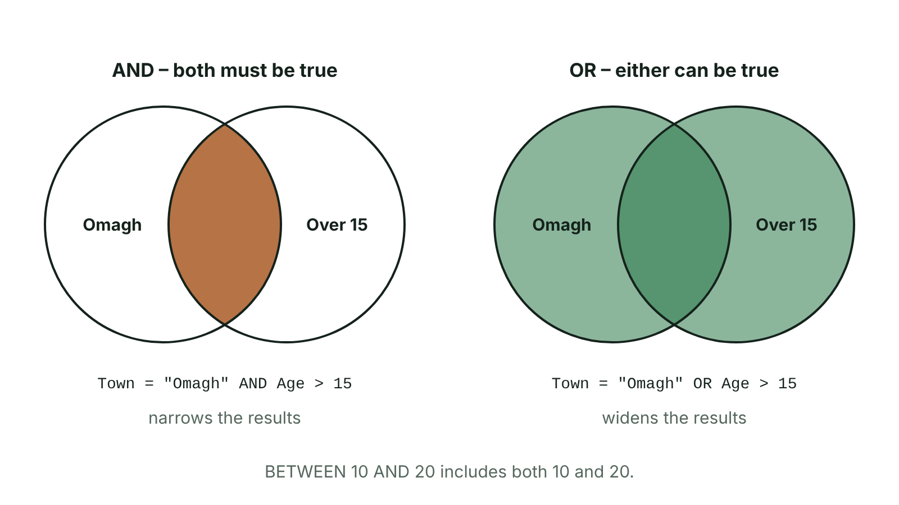
The big picture
Venn diagrams: AND returns records in both sets, OR returns records in either
☰ Menu
Notes:
Explain the diagram in your own words before you read on.

Slide 58
Queries and criteria
A query searches a database and extracts only the records that meet the criteria
Criteria are the conditions the data must meet, e.g. Town = "Omagh"
Each record is tested: if the condition is true the record is included
Text values go in quotation marks; numbers do not; Access puts dates between # signs
Use the exact values stored in the table – "Cat" will not find "Cats"
☰ Menu

Slide 59
Comparison operators
Operator | Meaning | Example criteria | Matches
= | Equal to | Town = "Enniskillen" | Enniskillen only
< | Less than | Price < 10 | 9.99, but not 10
> | Greater than | Goals > 5 | 6 or more
<= | Less than or equal to | Age <= 16 | 16 and under
>= | Greater than or equal to | Score >= 50 | 50 and over
<> | Not equal to | Squad <> "Senior" | Everyone except Senior
☰ Menu

Slide 60
Logical (Boolean) operators
Logical operators combine conditions; each condition gives a Boolean result: true or false
AND: both conditions must be true – the results list usually gets smaller
OR: at least one condition must be true – the results list usually gets bigger
BETWEEN: the value lies within a range, including both end values
Price BETWEEN 5 AND 10 gives the same records as Price >= 5 AND Price <= 10
☰ Menu

Slide 61
Worked example: Fermanagh Junior Football League
PlayerID | Surname | Club | Age | Goals
P01 | Murphy | Lisnaskea | 14 | 12
P02 | Wilson | Enniskillen | 15 | 4
P03 | Reilly | Lisnaskea | 13 | 7
P04 | Corrigan | Irvinestown | 15 | 9
P05 | Hamilton | Enniskillen | 14 | 15
☰ Menu

Slide 62
Predicting the results
Use the Players table on the previous slide
Each line shows the criteria, then the PlayerIDs it returns
☰ Menu

Slide 63
Predicting the results – code
PSEUDOCODE
Goals > 8 -> P01, P04, P05
Age = 15 -> P02, P04
Club = "Lisnaskea" AND Goals > 10 -> P01
Club = "Lisnaskea" OR Club = "Irvinestown" -> P01, P03, P04
Age BETWEEN 13 AND 14 -> P01, P03, P05
Goals >= 12 -> P01, P05
Club <> "Enniskillen" -> P01, P03, P04
☰ Menu

Slide 64
The query design grid
Field row: choose the fields to use; Table row: shows which table each comes from
Sort row: Ascending or Descending; Show tick box: whether the field appears in the results
Criteria row: type the condition under the field it applies to
Criteria on the same row = AND; criteria on different rows (Criteria and Or) = OR
Dates: Between #01/03/2026# And #31/03/2026# finds all of March 2026
Fields from linked tables can be used in one query
☰ Menu

Slide 65
Big data
Big data: data sets so large, fast-changing and mixed that normal database software cannot store or process them in a reasonable time
Collected by supermarkets, social media, banks, phone networks, hospitals and smart devices
Described by the three Vs: volume, velocity and variety
Big data has little value until it is analysed
☰ Menu

Slide 66
The three Vs
V | Meaning | Example
Volume | The huge amount of data – terabytes and petabytes | Every loyalty-card purchase in every UK supermarket, every day
Velocity | The speed at which data is created and must be processed, often in real time | Card payments checked for fraud in under a second; live traffic sensor readings
Variety | The many different types and formats of data | Text, photos, video, GPS locations, sensor readings, tables of sales
☰ Menu

Slide 67
Structured and unstructured data
Structured data: organised in a fixed format such as tables of rows and columns, so it is easy to search and analyse
Examples: names, dates of birth, addresses, card numbers, exam results
Unstructured data: no fixed format, so normal database tools cannot easily process it
Examples: social media posts, emails, essays, photos, videos, voice recordings
Most big data is unstructured, which adds to the variety
☰ Menu

Slide 68
Data analytics
Data analytics: using algorithms, programs or artificial intelligence to find patterns, trends and relationships in data
Data mining: searching large data sets to discover patterns that were not known before
Needs specialist software, powerful computers (often in the cloud) and skilled data analysts
Uses: shop offers, streaming recommendations, spotting bank fraud, planning hospital staffing, managing traffic
Lets organisations make better decisions based on evidence
☰ Menu

Slide 69
Exit quiz: question 1 of 8
Tap an answer to check it. Presenting? Click to reveal the answer.
Which operator finds values from 10 to 20, including 10 and 20?
A OR
B <
✗
✗
C BETWEEN
D <>
✓
✗
✓ C: BETWEEN – BETWEEN includes both end values: BETWEEN 10 AND 20.
☰ Menu

Slide 70
Exit quiz: question 2 of 8
Tap an answer to check it. Presenting? Click to reveal the answer.
Which of the three Vs of big data describes the speed at which data is created and processed?
A Velocity
B Volume
✓
✗
C Variety
D Validation
✗
✗
✓ A: Velocity – Velocity is speed. Volume is the amount and variety is the different types.
☰ Menu

Slide 71
Exit quiz: question 3 of 8
Tap an answer to check it. Presenting? Click to reveal the answer.
Town = "Omagh" AND Age > 15 returns records where…
A either condition is true
B neither condition is true
✗
✗
C only Town is checked
D both conditions are true
✗
✓
✓ D: both conditions are true – AND needs both conditions to be true.
☰ Menu

Slide 72
Exit quiz: question 4 of 8
Tap an answer to check it. Presenting? Click to reveal the answer.
Social media posts, videos and GPS data collected together are an example of…
A volume
B variety
✗
✓
C velocity
D validation
✗
✗
✓ B: variety – They are many different types and formats of data.
☰ Menu

Slide 73
Exit quiz: question 5 of 8
Tap an answer to check it. Presenting? Click to reveal the answer.
Does Score >= 50 return a record with a score of exactly 50?
A Yes
B No
✓
✗
C Only with OR
D Only with BETWEEN
✗
✗
✓ A: Yes – >= means greater than or equal to, so 50 is included.
☰ Menu

Slide 74
Exit quiz: question 6 of 8
Tap an answer to check it. Presenting? Click to reveal the answer.
Which criteria finds every player except those in the Senior squad?
A Squad = "Senior"
B Squad > "Senior"
✗
✗
C Squad <> "Senior"
D Squad BETWEEN "Senior"
✓
✗
✓ C: Squad <> "Senior" – <> means not equal to.
☰ Menu

Slide 75
Exit quiz: question 7 of 8
Tap an answer to check it. Presenting? Click to reveal the answer.
Which of these is unstructured data?
A A table of dates of birth
B Customer addresses in a database
✗
✗
C A list of exam marks
D Video clips and social media posts
✗
✓
✓ D: Video clips and social media posts – Unstructured data has no fixed format of fields and records.
☰ Menu

Slide 76
Exit quiz: question 8 of 8
Tap an answer to check it. Presenting? Click to reveal the answer.
What is data analytics?
A Typing data into a form
B Backing up a database
✗
✗
C Using software to find patterns, trends and relationships in data
D Checking data as it is entered
✓
✗
✓ C: Using software to find patterns, trends and relationships in data – Analytics turns large amounts of raw data into useful information for decisions.
☰ Menu

Slide 77
Exit quiz answers
Q | Answer | Why
1 | C BETWEEN | BETWEEN includes both end values: BETWEEN 10 AND 20.
2 | A Velocity | Velocity is speed. Volume is the amount and variety is the different types.
3 | D both conditions are true | AND needs both conditions to be true.
4 | B variety | They are many different types and formats of data.
5 | A Yes | >= means greater than or equal to, so 50 is included.
6 | C Squad <> "Senior" | <> means not equal to.
7 | D Video clips and social media posts | Unstructured data has no fixed format of fields and records.
8 | C Using software to find patterns, trends and relationships in data | Analytics turns large amounts of raw data into useful information for decisions.
☰ Menu

Slide 78
In the exam
Paper | Question | Marks | What it tested
Unit 1 2019 | Q3(d)–(f) | 5 | Query criteria, reports, sorting, relationship type
Unit 1 2021 | Q2(d)–(f) | 5 | Export to csv, queries, grouping
Unit 1 2021 | Q8(b) | 3 | Big data: volume, velocity, variety
Unit 1 2022 | Q1 | 9 | MCQ: storage, bit rate, real-time, compression, buffering, ADC, big data, backup
Unit 1 2024 | Q3 | 11 | Field names and data types, database terms, key field, query design
Papers and mark schemes: ccea.org.uk → GCSE Digital Technology → Past Papers & Mark Schemes.
☰ Menu

