Slide 1
Spreadsheet applications
UNIT 1: DIGITAL TECHNOLOGY · TOPIC
Lessons in this topic
L11 Spreadsheets 1: structure, formatting, formulae and cell referencing
L12 Spreadsheets 2: IF, VLOOKUP, validation, templates, modelling, charts and macros

Slide 2

Topic menu
Tap a button to jump straight there. The ☰ Menu button on every slide brings you back here.
Specification map
L12 Spreadsheets 2: IF, VLOOKUP, validation, templates, modelling, charts and macros
L11 Spreadsheets 1: structure, formatting, formulae and cell referencing

Slide 3
Specification map
Lesson | Specification: students should be able to
L11 | Describe the basic structures of spreadsheet software: workbooks, worksheets, cells, rows, columns and ranges; Describe and use data types; enter text, numbers and formulae; format cells, rows and columns; Create and replicate formulae using arithmetic operators; Use simple functions (SUM, AVERAGE, MAX, MIN, COUNT, COUNTIF) and relative and absolute cell referencing; Improve worksheet presentation with headers and footers, and select areas of a spreadsheet for printing
L12 | Describe and use conditional formatting and data validation; Describe and use templates, headers and footers, and importing data; create a simple template for others to use; Use IF statements (including nested IF) and VLOOKUPs; Use a spreadsheet for data modelling and what-if analysis; Create, label and format charts; Create simple macros
☰ Menu
Notes:
Each lesson below is its own section in PowerPoint (View → Slide Sorter shows them). To split this deck by specification point, right-click a section → Move Section, or delete the sections you do not need.

Slide 4
Spreadsheets 1: structure, formatting, formulae and cell referencing
UNIT 1: DIGITAL TECHNOLOGY · L11
Learning objectives
Identify cells, rows, columns, ranges and worksheets, and give a cell reference correctly
Choose a suitable data format for a column and describe formatting that improves presentation
Write formulae and simple functions using the correct symbols and range syntax
Explain and use relative and absolute cell references when replicating formulae
Notes:
Specification: Describe the basic structures of spreadsheet software: workbooks, worksheets, cells, rows, columns and ranges | Describe and use data types; enter text, numbers and formulae; format cells, rows and columns | Create and replicate formulae using arithmetic operators | Use simple functions (SUM, AVERAGE, MAX, MIN, COUNT, COUNTIF) and relative and absolute cell referencing | Improve worksheet presentation with headers and footers, and select areas of a spreadsheet for printing

Slide 5
In this lesson
Tap a button to jump straight there. The ☰ Menu button on every slide brings you back here.
The big picture
Worked example: school tuck shop
What is a spreadsheet?
Tuck shop: using the functions
What can a cell hold?
Replicating formulae: relative references
Data formats
Absolute references
Formatting and presentation
Relative or absolute?
Writing formulae
Exit quiz
Simple functions
↑ Topic menu
Notes:
Lesson menu: each button jumps to that part of the lesson in Slide Show. The ☰ Menu button on each slide returns here.

Slide 6
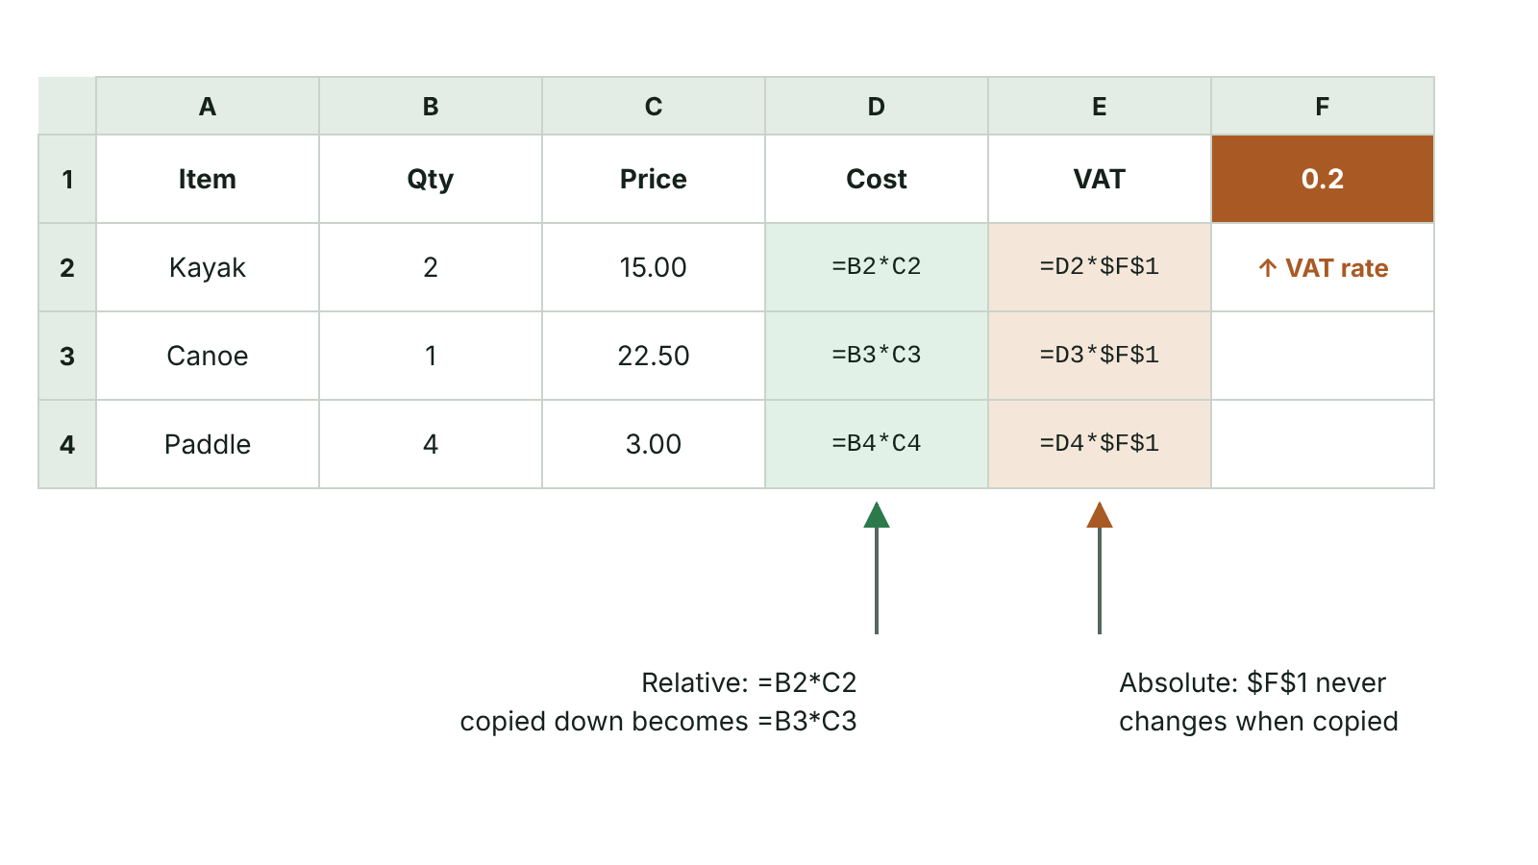
The big picture
Spreadsheet formulas copied down: relative references change, the absolute reference stays fixed
☰ Menu
Notes:
Explain the diagram in your own words before you read on.

Slide 7
What is a spreadsheet?
A spreadsheet file (a workbook) holds one or more worksheets; each worksheet is a separate tab
A worksheet is a grid of columns (lettered A, B, C…) and rows (numbered 1, 2, 3…)
A cell is where a column meets a row; its cell reference gives the column letter first, then the row number, e.g. H8
A range is a block of cells written first cell:last cell, e.g. B2:B10 or G4:G12
Main purpose: carry out calculations and recalculate automatically when data changes
☰ Menu

Slide 8
What can a cell hold?
Content | Example | Notes
Label (text) | Surname, Item | Identifies what a row or column contains
Value (number) | 45, 2.20 | Can be used in calculations
Date or time | 05/09/2026, 15:30 | Stored as numbers, so they can be sorted and subtracted
Formula | =B2*C2 | Starts with =; the cell shows the result
Reference to another cell | =Sheet2!B4 | Shows whatever is in that cell
☰ Menu

Slide 9
Data formats
Format | Displays | Good for
General / Number | 24.06 or 24 | Quantities, scores (choose decimal places)
Currency | £24.06 | Prices, costs, totals
Percentage | 20% (stored as 0.2) | Discounts, VAT rate, attendance
Date | 29/10/2026 | Booking date, date of birth
Time | 15:30 | Start times, lap times
Text | BT74 6DN, 07700 900123 | Postcodes, phone numbers (keeps the leading 0)
☰ Menu

Slide 10
Formatting and presentation
Cell formatting: font, size, bold, alignment, borders, fill colour, number format
Merge and centre: combine several cells into one and centre a title across them
Wrap text: long text continues on extra lines inside the cell
Rows and columns: change width and height, insert or delete, freeze panes so headings stay visible
Headers and footers: text at the top or bottom of each printed page, e.g. title, date, file name, page number
Print area: print only a selected range; Show Formulas prints the formulae as evidence
☰ Menu

Slide 11
Writing formulae
Golden rule: every formula starts with an equals sign =
Operators: + add, - subtract, * multiply, / divide, ^ power; brackets are worked out first
=B2*C2 multiplies; =C5-B5 subtracts B5 from C5; =A3/A4 divides A3 by A4
Use cell references, not typed numbers, so the result updates when the data changes
Common error: writing x for multiply or ÷ for divide – examiners do not credit these
PSEUDOCODE
=B2*C2 Price × Quantity
=D7-D8 Budget minus spent
=(B2+C2)/2 Mean of two cells
=B2*(1-$F$1) Price after a discount in F1
☰ Menu

Slide 12
Simple functions
Function | What it does | Example
SUM | Adds all the numbers in a range | =SUM(D2:D6)
AVERAGE | Finds the mean of a range | =AVERAGE(D2:D6)
MAX | Returns the largest value | =MAX(D2:D6)
MIN | Returns the smallest value | =MIN(D2:D6)
COUNT | Counts the cells that contain numbers | =COUNT(C2:C6)
COUNTIF | Counts the cells that meet a condition | =COUNTIF(D2:D6,">20")
☰ Menu

Slide 13
Worked example: school tuck shop
 | A Item | B Price | C Qty | D Takings
2 | Crisps | £0.60 | 45 | =B2*C2 → £27.00
3 | Water | £0.80 | 30 | =B3*C3 → £24.00
4 | Cereal bar | £0.75 | 22 | =B4*C4 → £16.50
5 | Toastie | £2.20 | 18 | =B5*C5 → £39.60
6 | Fruit cup | £1.10 | 12 | =B6*C6 → £13.20
7 | Total |  |  | =SUM(D2:D6) → £120.30
☰ Menu

Slide 14
Tuck shop: using the functions
=AVERAGE(D2:D6) gives £24.06 – the mean takings per item
=MAX(D2:D6) gives £39.60 (toasties); =MIN(D2:D6) gives £13.20 (fruit cups)
=COUNT(C2:C6) gives 5 – five cells hold numbers
=COUNTIF(D2:D6,">20") gives 3 – crisps, water and toasties took more than £20
Change C5 from 18 to 25 and D5, D7 and the AVERAGE all update instantly
☰ Menu

Slide 15
Replicating formulae: relative references
Replicate = copy one formula into the cells below it or beside it, by dragging the fill handle or using Fill Down
The fill handle is the small square at the bottom right of the selected cell
Relative references change to match the new row or column: =B2*C2 becomes =B3*C3, =B4*C4…
Saves time and avoids typing errors – one correct formula gives a whole column of correct results
☰ Menu

Slide 16
Absolute references
An absolute reference stays the same when a formula is replicated; it is written with $ signs, e.g. $F$1
Use it when every formula must use one fixed cell, e.g. a VAT rate, discount rate or exchange rate
Shop sheet: F1 holds the VAT rate 20%; H2 has =G2*(1+$F$1); filled down, H3 has =G3*(1+$F$1)
Without the $ signs H3 would contain =G3*(1+F2); F2 is empty, so no VAT is added – a wrong answer
Press F4 while editing a reference to add the $ signs
☰ Menu

Slide 17
Relative or absolute?
Formula in row 2 | Copied to row 3 | Why
=B2*C2 | =B3*C3 | Both relative – each row uses its own price and quantity
=G2*(1+$F$1) | =G3*(1+$F$1) | $F$1 is absolute – one VAT rate for every row
=D2*(1-$H$1) | =D3*(1-$H$1) | $H$1 holds one discount rate
=IF(G2<100,$H$1,$H$2) | =IF(G3<100,$H$1,$H$2) | G changes each row; the two fixed rates in H1 and H2 stay locked
☰ Menu

Slide 18
Exit quiz: question 1 of 9
Tap an answer to check it. Presenting? Click to reveal the answer.
Which cell reference identifies column D, row 7?
A 7D
B D7
✗
✓
C D:7
D $7$D
✗
✗
✓ B: D7 – The column letter is always given first, then the row number.
☰ Menu

Slide 19
Exit quiz: question 2 of 9
Tap an answer to check it. Presenting? Click to reveal the answer.
In a tuck shop sheet, which function finds the smallest value in D2 to D6?
A =SMALL(D2:D6)
B =MIN(D2:D6)
✗
✓
C =LOW(D2:D6)
D =MIN(D2,D6)
✗
✗
✓ B: =MIN(D2:D6) – MIN returns the lowest value; a colon (not a comma) shows the whole range D2 to D6.
☰ Menu

Slide 20
Exit quiz: question 3 of 9
Tap an answer to check it. Presenting? Click to reveal the answer.
Every formula must start with…
A +
B #
✗
✗
C =
D $
✓
✗
✓ C: = – A formula always begins with an equals sign.
☰ Menu

Slide 21
Exit quiz: question 4 of 9
Tap an answer to check it. Presenting? Click to reveal the answer.
Which is an absolute reference?
A B2
B B$
✗
✗
C #B2
D $B$2
✗
✓
✓ D: $B$2 – The $ signs fix both the column and the row.
☰ Menu

Slide 22
Exit quiz: question 5 of 9
Tap an answer to check it. Presenting? Click to reveal the answer.
=B4/C4 replicated to row 5 becomes…
A =B5/C5
B =B4/C4
✓
✗
C =C4/D4
D =$B$5/$C$5
✗
✗
✓ A: =B5/C5 – Relative references change by one row when copied down one row.
☰ Menu

Slide 23
Exit quiz: question 6 of 9
Tap an answer to check it. Presenting? Click to reveal the answer.
A cell formatted as Percentage holds 0.2. What does it show?
A 0.2
B 0.2%
✗
✗
C £0.20
D 20%
✗
✓
✓ D: 20% – Percentage format multiplies the stored value by 100 for display.
☰ Menu

Slide 24
Exit quiz: question 7 of 9
Tap an answer to check it. Presenting? Click to reveal the answer.
=D1-C1 does what?
A Subtracts D1 from C1
B Adds C1 and D1
✗
✗
C Subtracts C1 from D1
D Finds the difference between columns C and D
✓
✗
✓ C: Subtracts C1 from D1 – It takes the contents of C1 away from D1.
☰ Menu

Slide 25
Exit quiz: question 8 of 9
Tap an answer to check it. Presenting? Click to reveal the answer.
E2 contains =D2*(1-H1) and is filled down. What is in E3?
A =D3*(1-$H$1)
B =D2*(1-H2)
✗
✗
C =D3*(1-H1)
D =D3*(1-H2)
✗
✓
✓ D: =D3*(1-H2) – Both references are relative, so H1 becomes H2 – a blank cell, so no discount is applied.
☰ Menu

Slide 26
Exit quiz: question 9 of 9
Tap an answer to check it. Presenting? Click to reveal the answer.
Cells D2:D6 hold 27, 24, 16.5, 39.6 and 13.2. What does =COUNTIF(D2:D6,">20") return?
A 3
B 2
✓
✗
C 5
D 90.6
✗
✗
✓ A: 3 – Three values (27, 24 and 39.6) are greater than 20.
☰ Menu

Slide 27
Exit quiz answers
Q | Answer | Why
1 | B D7 | The column letter is always given first, then the row number.
2 | B =MIN(D2:D6) | MIN returns the lowest value; a colon (not a comma) shows the whole range D2 to D6.
3 | C = | A formula always begins with an equals sign.
4 | D $B$2 | The $ signs fix both the column and the row.
5 | A =B5/C5 | Relative references change by one row when copied down one row.
6 | D 20% | Percentage format multiplies the stored value by 100 for display.
7 | C Subtracts C1 from D1 | It takes the contents of C1 away from D1.
8 | D =D3*(1-H2) | Both references are relative, so H1 becomes H2 – a blank cell, so no discount is applied.
9 | A 3 | Three values (27, 24 and 39.6) are greater than 20.
☰ Menu

Slide 28
In the exam
Paper | Question | Marks | What it tested
Unit 1 2019 | Q8(a)–(e) | 8 | Formatting, formulae, absolute references, chart ranges and type
Unit 1 2021 | Q3(a)–(i) | 12 | Formatting, AVERAGE, replication, referencing, templates, validation, nested IF, MAX, ranges, macros
Unit 1 2022 | Q3 | 12 | Currency, merge and centre, formulae, ranges, nested IF, VLOOKUP
Unit 1 2023 | Q4 | 11 | Merge and centre, SUM, formulae, absolute references, IF, charts, template
Unit 1 2024 | Q4 | 13 | SUM, subtraction, wrap text, absolute references, chart ranges and type
Unit 1 2025 | Q6 | 10 | Spreadsheet features, ranges, SUM, IF with absolute reference, lookup functions
Papers and mark schemes: ccea.org.uk → GCSE Digital Technology → Past Papers & Mark Schemes.
☰ Menu

Slide 29
Spreadsheets 2: IF, VLOOKUP, validation, templates, modelling, charts and macros
UNIT 1: DIGITAL TECHNOLOGY · L12
Learning objectives
Write IF, nested IF and VLOOKUP functions and explain what each part does
Use conditional formatting, data validation and templates, and explain why they help users
Use a spreadsheet model to answer what-if questions
Choose, create and label a suitable chart, and describe what a macro is and why it is useful
Notes:
Specification: Describe and use conditional formatting and data validation | Describe and use templates, headers and footers, and importing data; create a simple template for others to use | Use IF statements (including nested IF) and VLOOKUPs | Use a spreadsheet for data modelling and what-if analysis | Create, label and format charts | Create simple macros

Slide 30
In this lesson
Tap a button to jump straight there. The ☰ Menu button on every slide brings you back here.
The big picture
Worked example: leisure centre prices
Model: Saturday sports camp
The IF function
Conditional formatting
Charts
IF that calculates
Data validation
Macros
Nested IF
Templates and importing
Exit quiz
VLOOKUP
Data modelling and what-if
↑ Topic menu
Notes:
Lesson menu: each button jumps to that part of the lesson in Slide Show. The ☰ Menu button on each slide returns here.

Slide 31
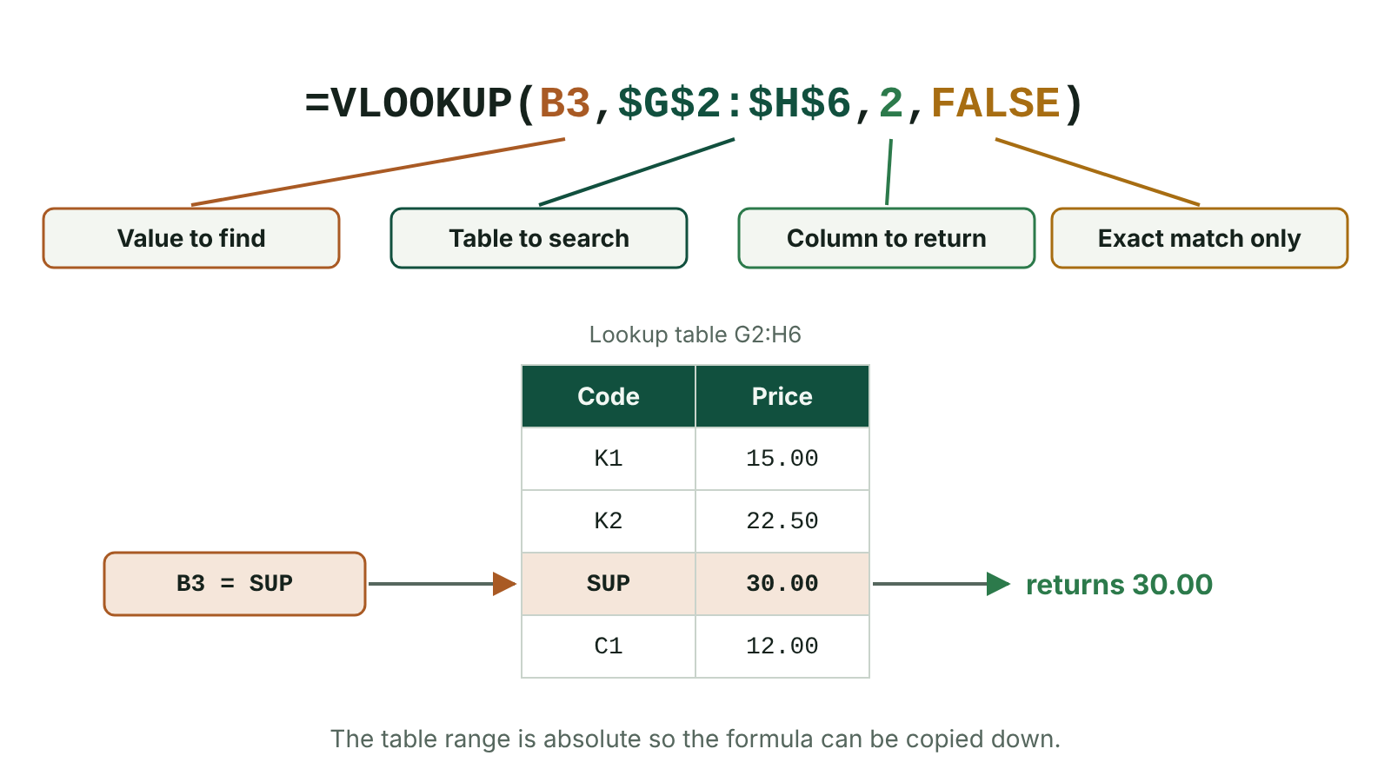
The big picture
The four parts of a VLOOKUP formula and the row it matches in a lookup table
☰ Menu
Notes:
Explain the diagram in your own words before you read on.

Slide 32
The IF function
IF tests a condition and gives one result if it is TRUE and a different result if it is FALSE
=IF(condition, value_if_true, value_if_false)
=IF(C2>=50,"Pass","Fail") – text results go in double quotes; numbers and formulae do not
Comparison operators: = <> > < >= <=
Watch the boundary: =IF(B2>10,"Yes","No") gives No when B2 is 10, because 10 is not greater than 10
PSEUDOCODE
IF mark >= 50 THEN
show "Pass"
ELSE
show "Fail"
ENDIF
=IF(C2>=50,"Pass","Fail")
☰ Menu

Slide 33
IF that calculates
The true or false part can be a number, a cell reference or a calculation
Online shop: free delivery on orders of £50 or more, otherwise the charge in K1: =IF(J2>=50,0,$K$1)
J2 = £62.00 → 0; J2 = £35.50 → £4.95; J2 = £50.00 → 0 (>= includes 50)
Exchange rates: =IF(H5<100,$H$1,$H$2) picks the base rate (H1) or the bonus rate (H2)
Use $ on fixed cells so the IF can be replicated down the column
☰ Menu

Slide 34
Nested IF
A nested IF puts one IF inside another to choose between three or more results
=IF(B2>=80,"Distinction",IF(B2>=65,"Merit","Fail"))
80 → Distinction; 79 → Merit; 65 → Merit; 64 → Fail
Test the highest boundary first; each IF needs its own closing bracket
Common error: putting the inner IF in the wrong part, or missing quotation marks around text
☰ Menu

Slide 35
VLOOKUP
Vertical lookup: searches the FIRST column of a lookup table for a value, then returns a value from a chosen column in the same row
=VLOOKUP(lookup_value, table_range, column_number, FALSE)
lookup_value: what to find, e.g. B2; table_range: the lookup table, e.g. $G$20:$I$24
column_number: which column of the table to return (1 = the first column of the table)
FALSE: exact match only – if the value is not found the result is #N/A
Absolute references on the table so the formula can be replicated
☰ Menu

Slide 36
Worked example: leisure centre prices
 | G Code | H Activity | I Price
20 | SW | Swimming | £4.20
21 | GY | Gym | £6.50
22 | BD | Badminton | £8.00
23 | SQ | Squash | £7.50
24 | CL | Climbing wall | £9.00
Booking | B20 = BD | =VLOOKUP(B20,$G$20:$I$24,3,FALSE) | → £8.00
☰ Menu

Slide 37
Conditional formatting
Changes a cell's appearance automatically (fill colour, font colour, bold, icons) when a condition is met
Example: a bus booking sheet shows any group bigger than 8 in red so staff know a second minibus is needed; other cells keep their normal format
Stock sheet: red fill when stock is below 5 so the manager sees what to reorder
Better than colouring cells by hand: it updates itself when the data changes and nothing is missed
☰ Menu

Slide 38
Data validation
Controls what can be entered in a cell, so data is sensible and within acceptable limits
Range check: a whole number from 1 to 16 for the number of seats booked on a minibus
Type check (whole number, decimal, date), length check, and drop-down lists of allowed choices
Input message guides the user; error alert pops up if invalid data is entered, asking them to try again
Limitation: validation cannot check that data is correct – 7 may be allowed when the true value is 8
☰ Menu

Slide 39
Templates and importing
A template is a ready-made spreadsheet with layout, formatting, formulae and labels set up; users add only their data
Benefits: saves time, every copy looks the same, fewer errors; protect the formula cells so they cannot be overwritten
Excel saves templates as .xltx; a new file is opened from it so the template stays unchanged
Importing: bringing data in from another source (database table, text file, web) using a wizard of step-by-step dialogue boxes
Files often need to be CSV (comma-separated values) first; importing avoids retyping and typing errors
☰ Menu

Slide 40
Data modelling and what-if
A model represents a real situation using values (inputs) and formulae (rules) that calculate the outputs
What-if analysis: change an input and see how the outputs change, e.g. 'What if we raise ticket prices?'
Changing the formulae changes the rules of the model
Benefits: quick, cheap and safe to test many options before deciding; helps predict and plan
Limitation: the model is only as good as its data and rules – people may not behave as predicted
☰ Menu

Slide 41
Model: Saturday sports camp
 | Plan A | Plan B: what if £38?
Price per child | £35 | £38
Children booked | 120 | 105
Income =Price*Children | £4,200 | £3,990
Fixed costs (hall, coaches) | £1,500 | £1,500
Cost per child £18: total =Fixed+18*Children | £3,660 | £3,390
Profit =Income-Costs | £540 | £600
☰ Menu

Slide 42
Charts
Chart | Best for | Example
Column / bar | Comparing categories | Sales of each tuck shop item
Line | Trends over time | Monthly attendance at a youth club
Pie | Parts of a whole (percentages) | How a club's budget is spent
Scatter | Relationship between two variables | Hours revised against test mark
Must have | Title, axis titles with units, legend if more than one series | Data labels and colour to help reading
☰ Menu

Slide 43
Macros
A macro is a small program that stores a sequence of actions so they can be replayed with one click or a shortcut
Created by recording the steps (Developer tab > Record Macro) or written in a script editor (VBA)
Examples: clear the order form for the next customer; sort the data and print the report; add today's date
Assign the macro to a button so less experienced users can run it
Benefits: saves time on repeated tasks, fewer mistakes, steps done the same way every time
Save the workbook as macro-enabled (.xlsm), or the macro is lost
☰ Menu

Slide 44
Exit quiz: question 1 of 9
Tap an answer to check it. Presenting? Click to reveal the answer.
=IF(B2>10,"Yes","No") shows what if B2 is 10?
A Yes
B No
✗
✓
C 10
D Error
✗
✗
✓ B: No – 10 is not greater than 10, so the condition is false and the third part, No, is shown.
☰ Menu

Slide 45
Exit quiz: question 2 of 9
Tap an answer to check it. Presenting? Click to reveal the answer.
In =VLOOKUP(B2,$G$2:$H$6,2,FALSE), what does the 2 tell the spreadsheet?
A Which column of the table to search
B How many rows to check
✗
✗
C Which column of the table to return a value from
D Where to put the answer
✓
✗
✓ C: Which column of the table to return a value from – VLOOKUP always searches the first column; the column number says which column the answer comes from.
☰ Menu

Slide 46
Exit quiz: question 3 of 9
Tap an answer to check it. Presenting? Click to reveal the answer.
Turning a cell red when stock is below 5 is…
A conditional formatting
B a macro
✓
✗
C a VLOOKUP
D a template
✗
✗
✓ A: conditional formatting – The format depends on a condition and updates automatically.
☰ Menu

Slide 47
Exit quiz: question 4 of 9
Tap an answer to check it. Presenting? Click to reveal the answer.
Best chart to show temperature changes over a month?
A Pie chart
B Scatter graph
✗
✗
C Line graph
D No chart
✓
✗
✓ C: Line graph – Line graphs show trends over time.
☰ Menu

Slide 48
Exit quiz: question 5 of 9
Tap an answer to check it. Presenting? Click to reveal the answer.
Peter scores 70. What does =IF(B2>=80,"Distinction",IF(B2>=65,"Merit","Fail")) show?
A Distinction
B Merit
✗
✓
C Fail
D 70
✗
✗
✓ B: Merit – 70 is not >= 80, so the inner IF is used; 70 is >= 65, so Merit.
☰ Menu

Slide 49
Exit quiz: question 6 of 9
Tap an answer to check it. Presenting? Click to reveal the answer.
Which Data Validation tab sets the message shown when invalid data is entered?
A Settings
B Input Message
✗
✗
C Conditional Formatting
D Error Alert
✗
✓
✓ D: Error Alert – The Error Alert asks the user to retry with valid data.
☰ Menu

Slide 50
Exit quiz: question 7 of 9
Tap an answer to check it. Presenting? Click to reveal the answer.
Which file type must you use to save a workbook containing a macro?
A .xlsm
B .xlsx
✓
✗
C .csv
D .xltx
✗
✗
✓ A: .xlsm – A macro-enabled workbook (.xlsm); saving as .xlsx discards the macro.
☰ Menu

Slide 51
Exit quiz: question 8 of 9
Tap an answer to check it. Presenting? Click to reveal the answer.
Changing the price in a model to see the effect on profit is called…
A validation
B importing
✗
✗
C conditional formatting
D what-if analysis
✗
✓
✓ D: what-if analysis – Testing changes to inputs is what-if analysis.
☰ Menu

Slide 52
Exit quiz: question 9 of 9
Tap an answer to check it. Presenting? Click to reveal the answer.
J2 holds £50.00. What does =IF(J2>=50,0,4.95) return?
A 4.95
B 0
✗
✓
C 50
D FALSE
✗
✗
✓ B: 0 – >= includes 50, so the condition is true and 0 (free delivery) is returned.
☰ Menu

Slide 53
Exit quiz answers
Q | Answer | Why
1 | B No | 10 is not greater than 10, so the condition is false and the third part, No, is shown.
2 | C Which column of the table to return a value from | VLOOKUP always searches the first column; the column number says which column the answer comes from.
3 | A conditional formatting | The format depends on a condition and updates automatically.
4 | C Line graph | Line graphs show trends over time.
5 | B Merit | 70 is not >= 80, so the inner IF is used; 70 is >= 65, so Merit.
6 | D Error Alert | The Error Alert asks the user to retry with valid data.
7 | A .xlsm | A macro-enabled workbook (.xlsm); saving as .xlsx discards the macro.
8 | D what-if analysis | Testing changes to inputs is what-if analysis.
9 | B 0 | >= includes 50, so the condition is true and 0 (free delivery) is returned.
☰ Menu

Slide 54
In the exam
Paper | Question | Marks | What it tested
Unit 1 2021 | Q3(a)–(i) | 12 | Formatting, AVERAGE, replication, referencing, templates, validation, nested IF, MAX, ranges, macros
Unit 1 2022 | Q3 | 12 | Currency, merge and centre, formulae, ranges, nested IF, VLOOKUP
Unit 1 2023 | Q4 | 11 | Merge and centre, SUM, formulae, absolute references, IF, charts, template
Unit 1 2024 | Q4 | 13 | SUM, subtraction, wrap text, absolute references, chart ranges and type
Unit 1 2024 | Q5 | 10 | Spreadsheet functions, CPU purpose and components, immediate-access store
Unit 1 2025 | Q6 | 10 | Spreadsheet features, ranges, SUM, IF with absolute reference, lookup functions
3 more past questions on the website. Papers and mark schemes: ccea.org.uk → GCSE Digital Technology → Past Papers & Mark Schemes.
☰ Menu

