Slide 1
Contemporary trends in software development
UNIT 4: DIGITAL DEVELOPMENT CONCEPTS · TOPIC
Lessons in this topic
D01 Programming paradigms: procedural and object-oriented
D02 Development environments, editing features and translators

Slide 2

Topic menu
Tap a button to jump straight there. The ☰ Menu button on every slide brings you back here.
Specification map
D02 Development environments, editing features and translators
D01 Programming paradigms: procedural and object-oriented

Slide 3
Specification map
Lesson | Specification: students should be able to
D01 | Describe the following programming paradigms: procedural programming and object-oriented programming
D02 | Explain the significance of the following aspects of software development environments: editing features; high-level code translation and execution
☰ Menu
Notes:
Each lesson below is its own section in PowerPoint (View → Slide Sorter shows them). To split this deck by specification point, right-click a section → Move Section, or delete the sections you do not need.

Slide 4
Programming paradigms: procedural and object-oriented
UNIT 4: DIGITAL DEVELOPMENT CONCEPTS · D01
Learning objectives
Describe procedural programming as imperative, sequential step-by-step instructions
Describe object-oriented programming using objects, classes, properties and methods
Compare the two paradigms in an extended answer
Notes:
Specification: Describe the following programming paradigms: procedural programming and object-oriented programming

Slide 5
In this lesson
Tap a button to jump straight there. The ☰ Menu button on every slide brings you back here.
The big picture
Key OOP features
What is a programming paradigm?
Comparing the paradigms
Procedural programming
Exam technique (QWC)
Object-oriented programming (OOP)
Exit quiz
OOP example
↑ Topic menu
Notes:
Lesson menu: each button jumps to that part of the lesson in Slide Show. The ☰ Menu button on each slide returns here.

Slide 6
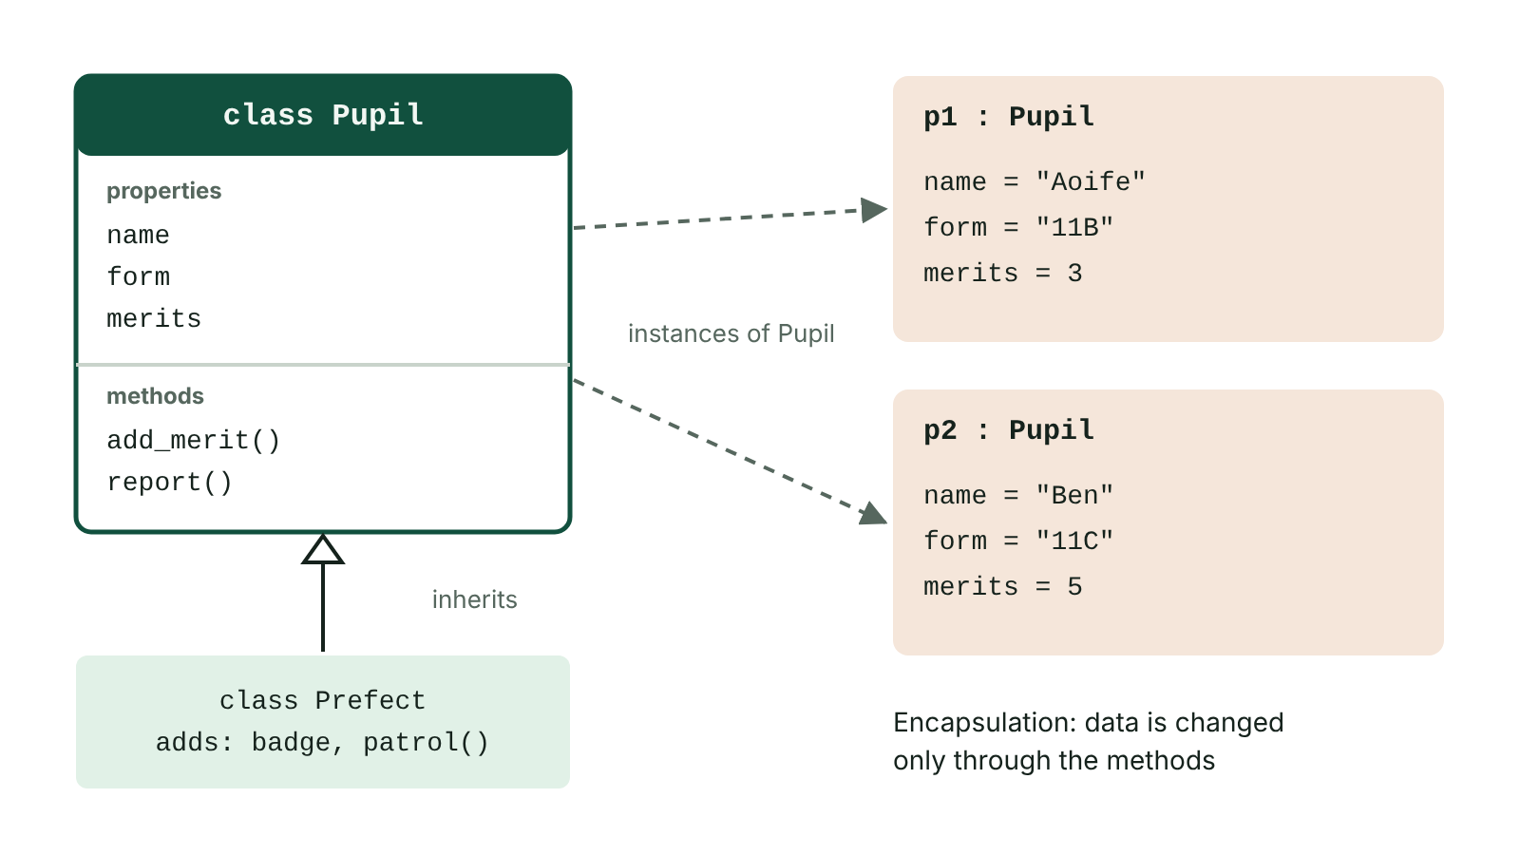
The big picture
A Pupil class, two objects created from it, and a Prefect class that inherits from it
☰ Menu
Notes:
Explain the diagram in your own words before you read on.

Slide 7
What is a programming paradigm?
A paradigm is an approach or style of programming
It decides how a programmer structures a solution
CCEA Unit 4 asks you to describe two: procedural and object-oriented
Most modern languages (Python, Java, C#) support both
☰ Menu

Slide 8
Procedural programming
The programmer writes step-by-step instructions telling the computer exactly what to do
Imperative: the program is a series of commands
Sequential: instructions run one after another – the order is the program flow
Code is grouped into procedures and functions that can be called when needed
Usually designed top-down: the main task is broken into smaller sub-tasks
☰ Menu

Slide 9
Procedural programming – code
C#
static double Area(double width, double height)
{
return width * height;
}
Console.Write("Width: ");
double w = Convert.ToDouble(Console.ReadLine());
Console.Write("Height: ");
double h = Convert.ToDouble(Console.ReadLine());
Console.WriteLine("Area is " + Area(w, h));
☰ Menu

Slide 10
Object-oriented programming (OOP)
A program is built from self-contained objects that hold both data and the code that works on it
A class is a blueprint (template); an object is an instance made from a class
Properties (attributes) are the data an object holds, e.g. a Pupil's name and form
Methods are the actions an object can carry out, e.g. AddMerit()
Objects interact by sending messages (calling each other's methods)
Design starts with the objects, then the application is built from them
☰ Menu

Slide 11
OOP example
Class: Pupil – properties: Name, Form, merits; methods: AddMerit(), Report()
Two objects made from the class: p1 and p2, each with its own data
The constructor Pupil(...) runs when each object is created with new
☰ Menu

Slide 12
OOP example – code
C#
Pupil p1 = new Pupil("Aoife", "11B");
Pupil p2 = new Pupil("Conor", "11C");
p1.AddMerit();
p1.AddMerit();
Console.WriteLine(p1.Report());
Console.WriteLine(p2.Report());
class Pupil
{
public string Name;
public string Form;
private int merits; // encapsulated: changed only by methods
public Pupil(string name, string form)
{
Name = name;
Form = form;
merits = 0;
}
public void AddMerit()
{
merits = merits + 1;
}
public string Report()
{
return Name + " (" + Form + ") has " + merits + " merits";
}
}
☰ Menu

Slide 13
Key OOP features
Encapsulation: an object's data is kept inside it and changed only through its methods – protects data
Inheritance: a new class takes on the properties and methods of an existing class, e.g. Prefect inherits from Pupil
Reusability: classes can be reused in other programs, making programs quicker to build and more reliable
Self-contained objects are simpler to write and test
☰ Menu

Slide 14
Comparing the paradigms
 | Procedural | Object-oriented
Built from | Sequences of instructions grouped into procedures/functions | Objects made from classes
Data and code | Kept separate; data passed to procedures | Combined inside each object
Design starts with | The steps/tasks (top-down) | The objects in the problem
Reuse | Functions can be reused | Classes reused and extended by inheritance
Suits | Smaller, linear tasks | Large, complex systems; GUIs; games
☰ Menu

Slide 15
Exam technique (QWC)
2025 Q7 asked candidates to describe both approaches (6 marks, QWC)
Examiners: OOP was described well; procedural answers were often too thin
For procedural, go beyond 'step-by-step' – mention imperative, sequence, procedures/functions, top-down design
Use the terms class, object, property, method, inheritance, encapsulation for OOP
☰ Menu

Slide 16
Exit quiz: question 1 of 5
Tap an answer to check it. Presenting? Click to reveal the answer.
Which describes procedural programming?
A Programs built from interacting objects
B Step-by-step instructions executed in sequence
✗
✓
C Programs that only use a GUI
D Code that translates itself
✗
✗
✓ B: Step-by-step instructions executed in sequence – Procedural = imperative, sequential.
☰ Menu

Slide 17
Exit quiz: question 2 of 5
Tap an answer to check it. Presenting? Click to reveal the answer.
A class is…
A an instance of an object
B a blueprint for creating objects
✗
✓
C a type of loop
D a syntax error
✗
✗
✓ B: a blueprint for creating objects – Objects are created from classes.
☰ Menu

Slide 18
Exit quiz: question 3 of 5
Tap an answer to check it. Presenting? Click to reveal the answer.
The actions an object can perform are its…
A properties
B methods
✗
✓
C parameters
D indexes
✗
✗
✓ B: methods – Methods are an object's procedures.
☰ Menu

Slide 19
Exit quiz: question 4 of 5
Tap an answer to check it. Presenting? Click to reveal the answer.
Which OOP feature lets a new class reuse an existing class's code?
A Encapsulation
B Inheritance
✗
✓
C Iteration
D Concatenation
✗
✗
✓ B: Inheritance – Inheritance.
☰ Menu

Slide 20
Exit quiz: question 5 of 5
Tap an answer to check it. Presenting? Click to reveal the answer.
Hiding an object's data so it can only be changed through its methods is…
A encapsulation
B decomposition
✓
✗
C abstraction
D compilation
✗
✗
✓ A: encapsulation – Encapsulation protects data.
☰ Menu

Slide 21
Exit quiz answers
Q | Answer | Why
1 | B Step-by-step instructions executed in sequence | Procedural = imperative, sequential.
2 | B a blueprint for creating objects | Objects are created from classes.
3 | B methods | Methods are an object's procedures.
4 | B Inheritance | Inheritance.
5 | A encapsulation | Encapsulation protects data.
☰ Menu

Slide 22
In the exam
Paper | Question | Marks | What it tested
Unit 4 2024 | Q5 | 9 | Paradigms fill-in; compilers and interpreters true/false
Unit 4 2025 | Q7 | 6 | Procedural vs object-oriented programming (QWC)
Papers and mark schemes: ccea.org.uk → GCSE Digital Technology → Past Papers & Mark Schemes.
☰ Menu

Slide 23
Development environments, editing features and translators
UNIT 4: DIGITAL DEVELOPMENT CONCEPTS · D02
Learning objectives
Describe the features of an IDE and the editing features of a code editor
Explain why high-level code must be translated into machine code
Compare compilers and interpreters
Notes:
Specification: Explain the significance of the following aspects of software development environments: editing features; high-level code translation and execution

Slide 24
In this lesson
Tap a button to jump straight there. The ☰ Menu button on every slide brings you back here.
The big picture
Interpreter
Source code and machine code
Compiler vs interpreter
Integrated development environment (IDE)
In the exam
Editing features
Exit quiz
Compiler
↑ Topic menu
Notes:
Lesson menu: each button jumps to that part of the lesson in Slide Show. The ☰ Menu button on each slide returns here.

Slide 25
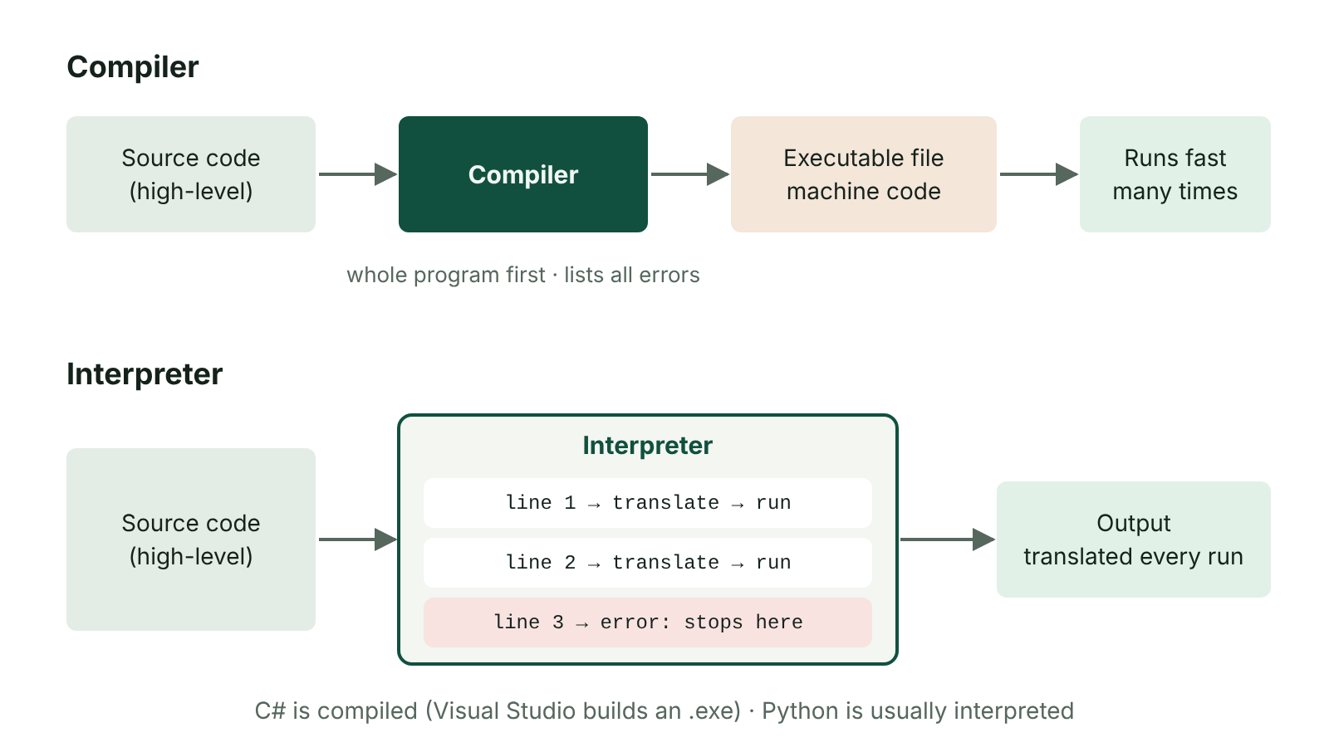
The big picture
A compiler translates the whole program into an executable; an interpreter translates and runs one line at a time
☰ Menu
Notes:
Explain the diagram in your own words before you read on.

Slide 26
Source code and machine code
Programmers write source code in a high-level language (Python, Java, C#) – close to English, easy to read
The CPU can only execute machine code: binary instructions
So high-level code must be translated before it can run
A translator does this – either a compiler or an interpreter
☰ Menu

Slide 27
Integrated development environment (IDE)
An IDE provides everything needed to develop a program in one application
Code editor – for writing source code
Translator – compiler/interpreter to run the code
Debugger – breakpoints, stepping through code line by line, watching variable values
GUI builder/designer with a toolbox of controls (e.g. Visual Studio)
Solution/project explorer – manages the files in a project
Run-time environment and error diagnostics
☰ Menu

Slide 28
Editing features
Feature | How it helps
IntelliSense / auto-complete | Suggests keywords, variables and functions and shows a function's parameters as you type – fewer typing and syntax errors
Syntax highlighting / colour coding | Keywords, strings and comments in different colours – code is easier to read and mistakes stand out
Syntax error highlighting | Wavy underline under incorrect code as you type – errors found immediately
Line numbering | Find a line quickly, e.g. when an error message gives a line number
Code outlining | Collapse/expand blocks of code so long programs are easier to navigate
Clipboard / auto-indent | Copy and paste several items; keeps indentation consistent
☰ Menu

Slide 29
Compiler
Translates the whole program into machine code before it runs
Reports all errors after compiling; the program will not compile until syntax errors are removed
Creates an executable file kept separately from the source code
Compiling takes time, but the compiled program runs quickly and can be distributed without the source code
Examples: C# (compiled by Visual Studio into an executable), C++; Java compiles to bytecode
☰ Menu

Slide 30
Interpreter
Translates and executes the source code one line at a time
Stops as soon as it reaches an error, showing where it is – easier to debug while developing
No separate executable file – the program is translated every time it runs
Runs more slowly than compiled code; the user needs the interpreter
Examples: Python, JavaScript, PHP
☰ Menu

Slide 31
Compiler vs interpreter
 | Compiler | Interpreter
Translates | Whole program at once | One line at a time
Errors reported | After compiling, as a list | When the line is reached; stops
Output | Executable machine code file | No file – translated each run
Execution speed | Fast | Slower
Best for | Distributing finished programs | Developing and testing
☰ Menu

Slide 32
In the exam
2022 Q3: fill-in on translating code; 2024 Q5(b): compiler/interpreter true/false; 2025 Q3(c)(i): two IDE editor aids
2023 Q8 was a QWC on editing features, translation and execution – explain why each feature matters, not just name it
'IntelliSense' and 'auto-complete' are credited by name in mark schemes
☰ Menu

Slide 33
Exit quiz: question 1 of 5
Tap an answer to check it. Presenting? Click to reveal the answer.
Which translator converts a whole program into machine code before it runs?
A Interpreter
B Compiler
✗
✓
C Debugger
D Editor
✗
✗
✓ B: Compiler – Compiler.
☰ Menu

Slide 34
Exit quiz: question 2 of 5
Tap an answer to check it. Presenting? Click to reveal the answer.
Which IDE feature suggests code and shows parameters while you type?
A Line numbering
B IntelliSense/auto-complete
✗
✓
C Code outlining
D Breakpoint
✗
✗
✓ B: IntelliSense/auto-complete – IntelliSense.
☰ Menu

Slide 35
Exit quiz: question 3 of 5
Tap an answer to check it. Presenting? Click to reveal the answer.
An interpreter…
A translates one line at a time
B creates an .exe file
✓
✗
C only works on binary
D removes logic errors
✗
✗
✓ A: translates one line at a time – Line by line.
☰ Menu

Slide 36
Exit quiz: question 4 of 5
Tap an answer to check it. Presenting? Click to reveal the answer.
The CPU can only execute…
A pseudocode
B machine code
✗
✓
C Python
D flowcharts
✗
✗
✓ B: machine code – Binary machine code.
☰ Menu

Slide 37
Exit quiz: question 5 of 5
Tap an answer to check it. Presenting? Click to reveal the answer.
Collapsing and expanding blocks of code is called…
A code outlining
B syntax highlighting
✓
✗
C compiling
D decomposition
✗
✗
✓ A: code outlining – Code outlining.
☰ Menu

Slide 38
Exit quiz answers
Q | Answer | Why
1 | B Compiler | Compiler.
2 | B IntelliSense/auto-complete | IntelliSense.
3 | A translates one line at a time | Line by line.
4 | B machine code | Binary machine code.
5 | A code outlining | Code outlining.
☰ Menu

Slide 39
In the exam
Paper | Question | Marks | What it tested
Unit 4 2019 | Q1 | 18 | Data types, range and presence checks, extending a program, IDE features, translation
Unit 4 2022 | Q3 | 6 | Translating code; IDE features
Unit 4 2023 | Q8 | 6 | Editing features, translation and execution (QWC)
Unit 4 2024 | Q5 | 9 | Paradigms fill-in; compilers and interpreters true/false
Unit 4 2025 | Q3 | 15 | Musician hire algorithm; variables and data types; IDE aids; syntax vs logic
Papers and mark schemes: ccea.org.uk → GCSE Digital Technology → Past Papers & Mark Schemes.
☰ Menu

