Slide 1
Digital data
UNIT 4: DIGITAL DEVELOPMENT CONCEPTS · TOPIC
Lessons in this topic
D03 Binary, units of data and denary–binary conversion
D04 Hexadecimal
D05 Binary addition and overflow
D06 Character sets: ASCII and Unicode
D07 Data types
D08 Boolean operators and truth tables

Slide 2

Topic menu
Tap a button to jump straight there. The ☰ Menu button on every slide brings you back here.
Specification map
D06 Character sets: ASCII and Unicode
D03 Binary, units of data and denary–binary conversion
D07 Data types
D04 Hexadecimal
D08 Boolean operators and truth tables
D05 Binary addition and overflow

Slide 3
Specification map
Lesson | Specification: students should be able to
D03 | Describe how a number is converted to a binary pattern for storage in a computer; Demonstrate understanding of the following units of data: bit, nibble, byte, kilobyte, megabyte, gigabyte and terabyte; Demonstrate understanding of and use number representation and convert between denary, binary and hexadecimal (denary–binary)
D04 | Demonstrate understanding of and use number representation and convert between denary, binary and hexadecimal
D05 | Perform the addition of two bytes and explain the meaning of overflow
D06 | Demonstrate understanding of the following types of character representation: ASCII (7-bit and 8-bit) and Unicode
D07 | Describe and use appropriately the following data types: numeric (integer and real), date/time, character and string
D08 | Demonstrate understanding of and use Boolean operators (AND, OR and NOT) and truth tables
☰ Menu
Notes:
Each lesson below is its own section in PowerPoint (View → Slide Sorter shows them). To split this deck by specification point, right-click a section → Move Section, or delete the sections you do not need.

Slide 4
Binary, units of data and denary–binary conversion
UNIT 4: DIGITAL DEVELOPMENT CONCEPTS · D03
Learning objectives
Explain why computers store data in binary
Convert denary numbers to 8-bit binary and binary to denary
Use units of data and calculate storage capacities
Notes:
Specification: Describe how a number is converted to a binary pattern for storage in a computer | Demonstrate understanding of the following units of data: bit, nibble, byte, kilobyte, megabyte, gigabyte and terabyte | Demonstrate understanding of and use number representation and convert between denary, binary and hexadecimal (denary–binary)

Slide 5
In this lesson
Tap a button to jump straight there. The ☰ Menu button on every slide brings you back here.
The big picture
Binary to denary
Why binary?
Units of data
8-bit place values
Storage calculations
Denary to binary: subtraction method
Exit quiz
Denary to binary: division method
↑ Topic menu
Notes:
Lesson menu: each button jumps to that part of the lesson in Slide Show. The ☰ Menu button on each slide returns here.

Slide 6
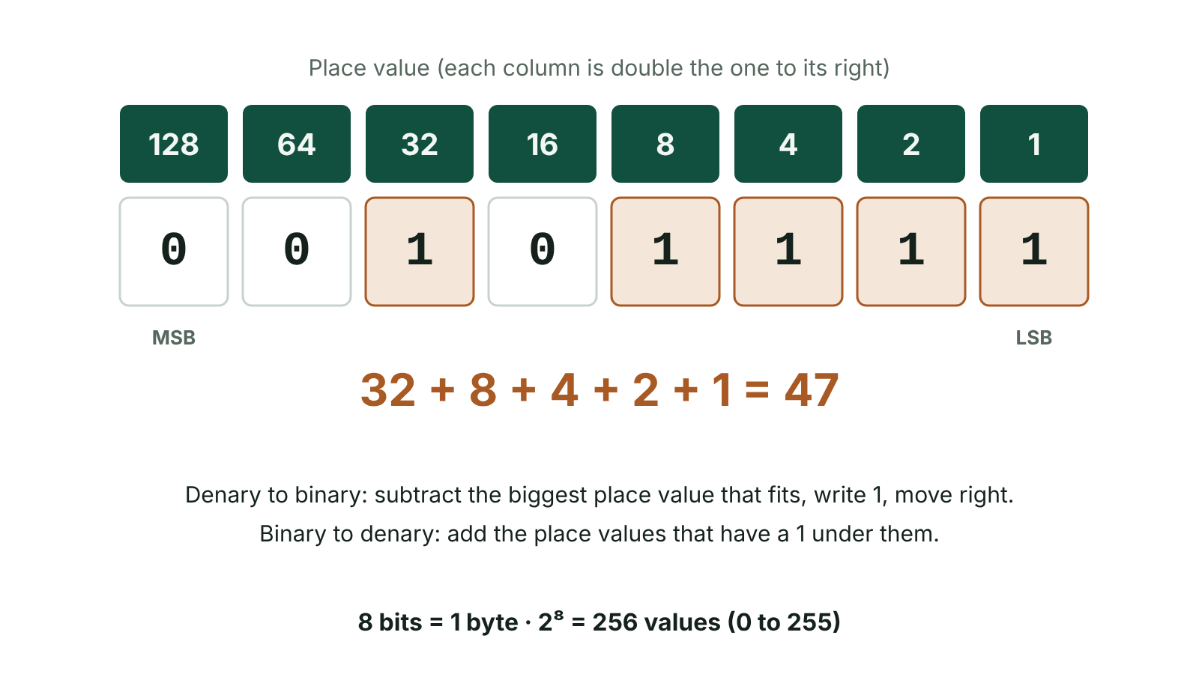
The big picture
Place values of an 8-bit byte showing 47 as 00101111
☰ Menu
Notes:
Explain the diagram in your own words before you read on.

Slide 7
Why binary?
Computers are built from switches (transistors) that are either on or off
On = 1, off = 0: each binary digit is a bit
Every number, character, image and sound is stored as a pattern of bits
Denary is base 10 (columns ×10); binary is base 2 (columns ×2)
☰ Menu

Slide 8
8-bit place values
128 | 64 | 32 | 16 | 8 | 4 | 2 | 1
0 | 1 | 0 | 1 | 0 | 0 | 0 | 0
☰ Menu

Slide 9
Denary to binary: subtraction method
Write the column headings 128 64 32 16 8 4 2 1
Work left to right: if the column fits into what is left, write 1 and subtract; otherwise write 0
Example 47: 32 fits (15 left), 16 no, 8 fits (7), 4 (3), 2 (1), 1 (0)
47 = 00101111 – always write all 8 bits
Check: add the columns with a 1 back up
☰ Menu

Slide 10
Denary to binary: division method
Divide by 2 repeatedly and write down each remainder
Read the remainders from the bottom up
25 ÷ 2 = 12 r1, 12 ÷ 2 = 6 r0, 6 ÷ 2 = 3 r0, 3 ÷ 2 = 1 r1, 1 ÷ 2 = 0 r1
Reading upwards: 11001 → 00011001 as a byte
Both methods earn full marks if working is shown
☰ Menu

Slide 11
Binary to denary
Write the place values above each bit
Add up the values where there is a 1
10101010 = 128 + 32 + 8 + 2 = 170
00011111 = 16 + 8 + 4 + 2 + 1 = 31
The largest 8-bit number is 11111111 = 255; a byte has 256 patterns (0–255)
☰ Menu

Slide 12
Units of data
Unit | Size
Bit | A single binary digit, 0 or 1
Nibble | 4 bits (one hexadecimal digit)
Byte | 8 bits – usually one character
Kilobyte (KB) | 1024 bytes
Megabyte (MB) | 1024 KB
Gigabyte (GB) | 1024 MB
Terabyte (TB) | 1024 GB
☰ Menu

Slide 13
Storage calculations
Bigger unit: ÷ 1024. Smaller unit: × 1024
2022 Q6(d): will a 50 GB app fit on a 2 TB disk that already holds data? Convert to the same unit first
2 TB = 2 × 1024 = 2048 GB
Number of patterns with n bits = 2ⁿ (4 bits = 16, 8 bits = 256)
☰ Menu

Slide 14
Exit quiz: question 1 of 5
Tap an answer to check it. Presenting? Click to reveal the answer.
What is 00010011 in denary?
A 17
B 19
✗
✓
C 21
D 35
✗
✗
✓ B: 19 – 16 + 2 + 1 = 19
☰ Menu

Slide 15
Exit quiz: question 2 of 5
Tap an answer to check it. Presenting? Click to reveal the answer.
What is 37 in 8-bit binary?
A 00100101
B 00100011
✓
✗
C 00110101
D 01000101
✗
✗
✓ A: 00100101 – 32 + 4 + 1
☰ Menu

Slide 16
Exit quiz: question 3 of 5
Tap an answer to check it. Presenting? Click to reveal the answer.
How many bits are in a nibble?
A 2
B 4
✗
✓
C 8
D 16
✗
✗
✓ B: 4 – Half a byte.
☰ Menu

Slide 17
Exit quiz: question 4 of 5
Tap an answer to check it. Presenting? Click to reveal the answer.
Largest denary number in 8 bits?
A 128
B 255
✗
✓
C 256
D 512
✗
✗
✓ B: 255 – 11111111 = 255
☰ Menu

Slide 18
Exit quiz: question 5 of 5
Tap an answer to check it. Presenting? Click to reveal the answer.
How many GB are in 3 TB?
A 3000
B 3072
✗
✓
C 1024
D 30 720
✗
✗
✓ B: 3072 – 3 × 1024
☰ Menu

Slide 19
Exit quiz answers
Q | Answer | Why
1 | B 19 | 16 + 2 + 1 = 19
2 | A 00100101 | 32 + 4 + 1
3 | B 4 | Half a byte.
4 | B 255 | 11111111 = 255
5 | B 3072 | 3 × 1024
☰ Menu

Slide 20
In the exam
Paper | Question | Marks | What it tested
Unit 4 2019 | Q8 | 18 | Binary, hexadecimal and its uses, binary addition and overflow, logic gates
Unit 4 2022 | Q6 | 14 | Binary digit, 54 to binary, nibble, hex, overflow, storage capacity
Unit 4 2023 | Q7 | 13 | Bit, 47 to binary, 66 to hex, advantage of hex, binary addition and overflow
Unit 4 2024 | Q4 | 19 | Bit, nibble, byte; denary–binary–hex conversions; binary addition and overflow; truth tables
Unit 4 2025 | Q4 | 15 | Binary conversion, addition and overflow, units, Unicode vs ASCII
Papers and mark schemes: ccea.org.uk → GCSE Digital Technology → Past Papers & Mark Schemes.
☰ Menu

Slide 21
Hexadecimal
UNIT 4: DIGITAL DEVELOPMENT CONCEPTS · D04
Learning objectives
Explain what hexadecimal is and why it is used
Convert between binary and hexadecimal using nibbles
Convert between denary and hexadecimal
Notes:
Specification: Demonstrate understanding of and use number representation and convert between denary, binary and hexadecimal

Slide 22
In this lesson
Tap a button to jump straight there. The ☰ Menu button on every slide brings you back here.
The big picture
Denary to hex
What is hexadecimal?
Hex to denary
Why use hex?
Exit quiz
Binary to hex
↑ Topic menu
Hex to binary
Notes:
Lesson menu: each button jumps to that part of the lesson in Slide Show. The ☰ Menu button on each slide returns here.

Slide 23
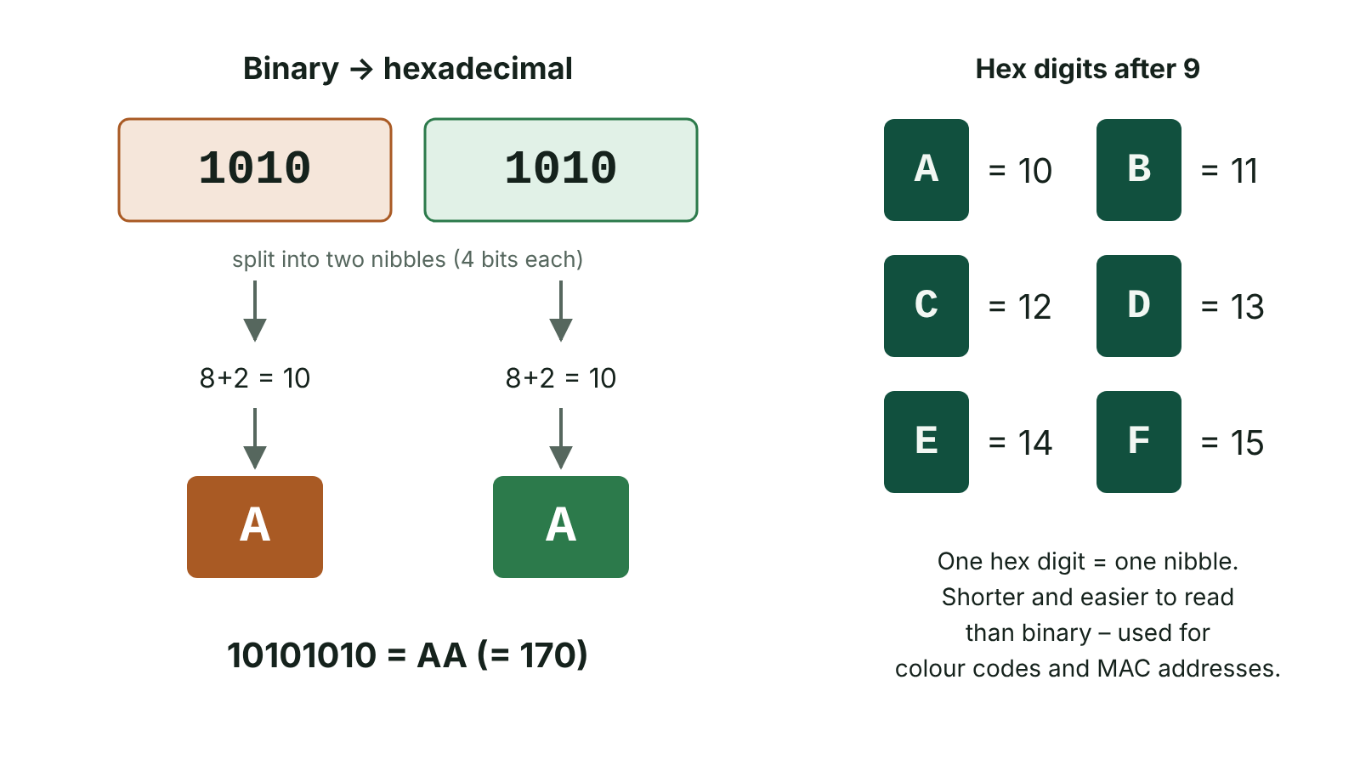
The big picture
Converting the byte 10101010 to hexadecimal AA by splitting it into nibbles
☰ Menu
Notes:
Explain the diagram in your own words before you read on.

Slide 24
What is hexadecimal?
Hexadecimal (hex) is base 16
It uses 16 symbols: 0–9 then A, B, C, D, E, F
A = 10, B = 11, C = 12, D = 13, E = 14, F = 15
Each hex digit represents exactly one nibble (4 bits), so a byte is two hex digits
☰ Menu

Slide 25
Why use hex?
It is a shorthand for binary – far shorter and easier for humans to read and remember
Fewer mistakes when reading or copying long binary numbers
Easy to convert to and from binary
Uses: colour codes in HTML/CSS (#1D6B53), MAC addresses, memory addresses, error codes
The computer still stores everything in binary – hex is for people
☰ Menu

Slide 26
Binary to hex
Split the byte into two nibbles from the right
Convert each nibble to denary (8 4 2 1), then to a hex digit
10101010 → 1010 | 1010 → 10 | 10 → AA
01111011 → 0111 | 1011 → 7 | 11 → 7B
☰ Menu

Slide 27
Hex to binary
Convert each hex digit into a 4-bit nibble
3F → 3 = 0011, F = 1111 → 00111111
C4 → 1100 0100 → 11000100
☰ Menu

Slide 28
Denary to hex
Method 1: divide by 16 – the answer is the first digit, the remainder is the second
80 ÷ 16 = 5 r 0 → 50
66 ÷ 16 = 4 r 2 → 42
Method 2: convert to binary first, then to hex using nibbles
Larger numbers: divide by 16 repeatedly and read remainders upwards
☰ Menu

Slide 29
Hex to denary
Two-digit hex: first digit × 16, plus second digit
3B = 3 × 16 + 11 = 59
AA = 10 × 16 + 10 = 170
FF = 15 × 16 + 15 = 255 – the largest byte
☰ Menu

Slide 30
Exit quiz: question 1 of 5
Tap an answer to check it. Presenting? Click to reveal the answer.
What is 1111 0000 in hex?
A F0
B 0F
✓
✗
C FF
D E0
✗
✗
✓ A: F0 – 1111 = F, 0000 = 0
☰ Menu

Slide 31
Exit quiz: question 2 of 5
Tap an answer to check it. Presenting? Click to reveal the answer.
Hex digit D represents…
A 12
B 13
✗
✓
C 14
D 15
✗
✗
✓ B: 13 – A=10, B=11, C=12, D=13
☰ Menu

Slide 32
Exit quiz: question 3 of 5
Tap an answer to check it. Presenting? Click to reveal the answer.
2F in denary is…
A 32
B 45
✗
✗
C 47
D 215
✓
✗
✓ C: 47 – 2×16 + 15 = 47
☰ Menu

Slide 33
Exit quiz: question 4 of 5
Tap an answer to check it. Presenting? Click to reveal the answer.
Why is hex used?
A Computers can only store hex
B It is a shorter, easier-to-read form of binary
✗
✓
C It uses less memory
D It encrypts data
✗
✗
✓ B: It is a shorter, easier-to-read form of binary – Shorthand for binary.
☰ Menu

Slide 34
Exit quiz: question 5 of 5
Tap an answer to check it. Presenting? Click to reveal the answer.
80 in hexadecimal is…
A 80
B 50
✗
✓
C 48
D A0
✗
✗
✓ B: 50 – 80 ÷ 16 = 5 r 0
☰ Menu

Slide 35
Exit quiz answers
Q | Answer | Why
1 | A F0 | 1111 = F, 0000 = 0
2 | B 13 | A=10, B=11, C=12, D=13
3 | C 47 | 2×16 + 15 = 47
4 | B It is a shorter, easier-to-read form of binary | Shorthand for binary.
5 | B 50 | 80 ÷ 16 = 5 r 0
☰ Menu

Slide 36
In the exam
Paper | Question | Marks | What it tested
Unit 4 2019 | Q8 | 18 | Binary, hexadecimal and its uses, binary addition and overflow, logic gates
Unit 4 2022 | Q6 | 14 | Binary digit, 54 to binary, nibble, hex, overflow, storage capacity
Unit 4 2023 | Q7 | 13 | Bit, 47 to binary, 66 to hex, advantage of hex, binary addition and overflow
Unit 4 2024 | Q4 | 19 | Bit, nibble, byte; denary–binary–hex conversions; binary addition and overflow; truth tables
Papers and mark schemes: ccea.org.uk → GCSE Digital Technology → Past Papers & Mark Schemes.
☰ Menu

Slide 37
Binary addition and overflow
UNIT 4: DIGITAL DEVELOPMENT CONCEPTS · D05
Learning objectives
Apply the four rules of binary addition with carries
Add two bytes and check the answer in denary
Explain overflow and its effect on a result
Notes:
Specification: Perform the addition of two bytes and explain the meaning of overflow

Slide 38
In this lesson
Tap a button to jump straight there. The ☰ Menu button on every slide brings you back here.
The big picture
Spotting overflow
Rules of binary addition
Exit quiz
Adding two bytes
↑ Topic menu
Overflow
Notes:
Lesson menu: each button jumps to that part of the lesson in Slide Show. The ☰ Menu button on each slide returns here.

Slide 39
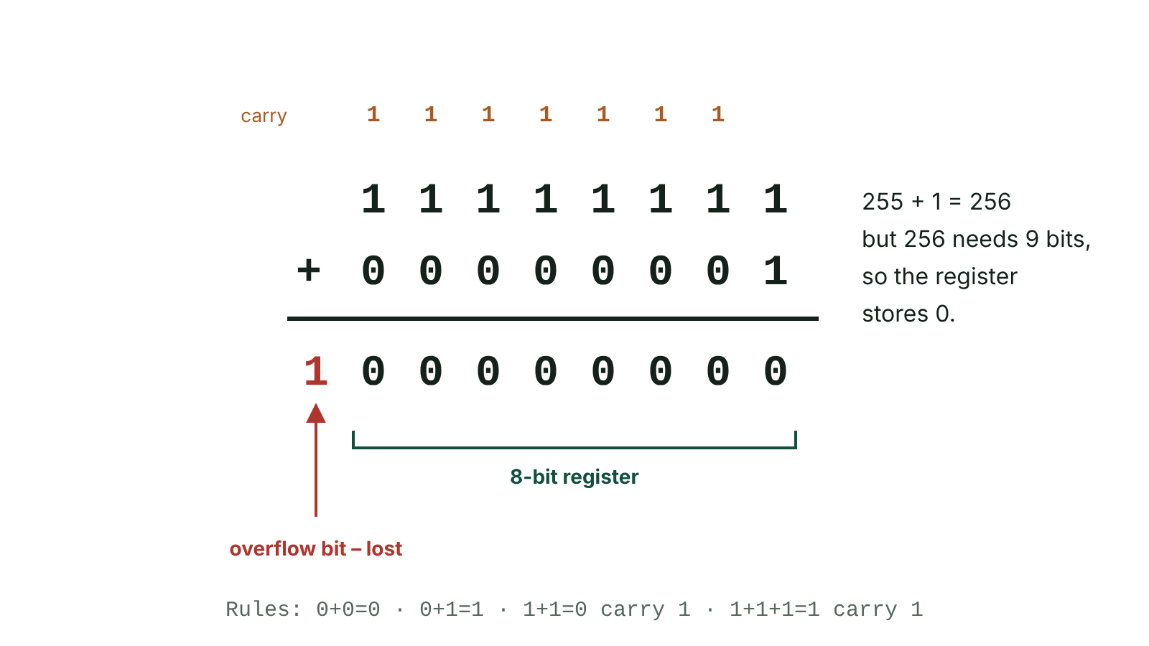
The big picture
Adding 11111111 and 00000001 in 8 bits causes overflow
☰ Menu
Notes:
Explain the diagram in your own words before you read on.

Slide 40
Rules of binary addition
Sum | Write | Carry
0 + 0 | 0 | 0
0 + 1 or 1 + 0 | 1 | 0
1 + 1 | 0 | 1
1 + 1 + 1 | 1 | 1
☰ Menu

Slide 41
Adding two bytes
Line the numbers up in columns
Add from right to left, writing carries above/below the next column
Example 26 + 12: 00011010 + 00001100 = 00100110 (38)
Check by converting each number and the answer to denary
Show the carries – they earn working marks
☰ Menu

Slide 42
Overflow
Overflow occurs when the result of a calculation is too large to be stored in the number of bits available
An 8-bit register can hold up to 255
11111111 + 00000001 = 1 00000000 – the 9th bit cannot be stored
The stored answer becomes 00000000 (0) instead of 256
Effect: the result is incorrect, which can cause errors or crashes in the program
☰ Menu

Slide 43
Spotting overflow
If there is a carry out of the leftmost (128) column, overflow has occurred
Quick check: if the denary total is greater than 255, an 8-bit addition overflows
2022 Q6(c)(ii): decide yes/no for three additions – convert to denary to check
Larger registers (16, 32, 64 bits) reduce overflow but it can still happen
☰ Menu

Slide 44
Exit quiz: question 1 of 5
Tap an answer to check it. Presenting? Click to reveal the answer.
What is 1 + 1 in binary?
A 2
B 11
✗
✗
C 10
D 01
✓
✗
✓ C: 10 – 0 carry 1.
☰ Menu

Slide 45
Exit quiz: question 2 of 5
Tap an answer to check it. Presenting? Click to reveal the answer.
00001111 + 00000001 =
A 00010000
B 00011111
✓
✗
C 00001110
D 11110000
✗
✗
✓ A: 00010000 – 15 + 1 = 16
☰ Menu

Slide 46
Exit quiz: question 3 of 5
Tap an answer to check it. Presenting? Click to reveal the answer.
Overflow occurs when…
A a number is negative
B a result is too large for the available bits
✗
✓
C a carry is used
D two nibbles are added
✗
✗
✓ B: a result is too large for the available bits – Too big to store.
☰ Menu

Slide 47
Exit quiz: question 4 of 5
Tap an answer to check it. Presenting? Click to reveal the answer.
Which 8-bit addition overflows?
A 100 + 100
B 200 + 50
✗
✗
C 128 + 127
D 200 + 60
✗
✓
✓ D: 200 + 60 – 260 > 255
☰ Menu

Slide 48
Exit quiz: question 5 of 5
Tap an answer to check it. Presenting? Click to reveal the answer.
After overflow the stored result is…
A correct
B incorrect because a bit is lost
✗
✓
C always zero
D converted to hex
✗
✗
✓ B: incorrect because a bit is lost – The extra bit is lost.
☰ Menu

Slide 49
Exit quiz answers
Q | Answer | Why
1 | C 10 | 0 carry 1.
2 | A 00010000 | 15 + 1 = 16
3 | B a result is too large for the available bits | Too big to store.
4 | D 200 + 60 | 260 > 255
5 | B incorrect because a bit is lost | The extra bit is lost.
☰ Menu

Slide 50
In the exam
Paper | Question | Marks | What it tested
Unit 4 2019 | Q8 | 18 | Binary, hexadecimal and its uses, binary addition and overflow, logic gates
Unit 4 2022 | Q6 | 14 | Binary digit, 54 to binary, nibble, hex, overflow, storage capacity
Unit 4 2023 | Q7 | 13 | Bit, 47 to binary, 66 to hex, advantage of hex, binary addition and overflow
Unit 4 2024 | Q4 | 19 | Bit, nibble, byte; denary–binary–hex conversions; binary addition and overflow; truth tables
Unit 4 2025 | Q4 | 15 | Binary conversion, addition and overflow, units, Unicode vs ASCII
Papers and mark schemes: ccea.org.uk → GCSE Digital Technology → Past Papers & Mark Schemes.
☰ Menu

Slide 51
Character sets: ASCII and Unicode
UNIT 4: DIGITAL DEVELOPMENT CONCEPTS · D06
Learning objectives
Explain what a character set is
Describe 7-bit ASCII, 8-bit (extended) ASCII and Unicode
Compare ASCII and Unicode
Notes:
Specification: Demonstrate understanding of the following types of character representation: ASCII (7-bit and 8-bit) and Unicode

Slide 52
In this lesson
Tap a button to jump straight there. The ☰ Menu button on every slide brings you back here.
The big picture
Comparing ASCII and Unicode
Character sets
Exam tip
ASCII
Exit quiz
Extended (8-bit) ASCII
↑ Topic menu
Unicode
Notes:
Lesson menu: each button jumps to that part of the lesson in Slide Show. The ☰ Menu button on each slide returns here.

Slide 53
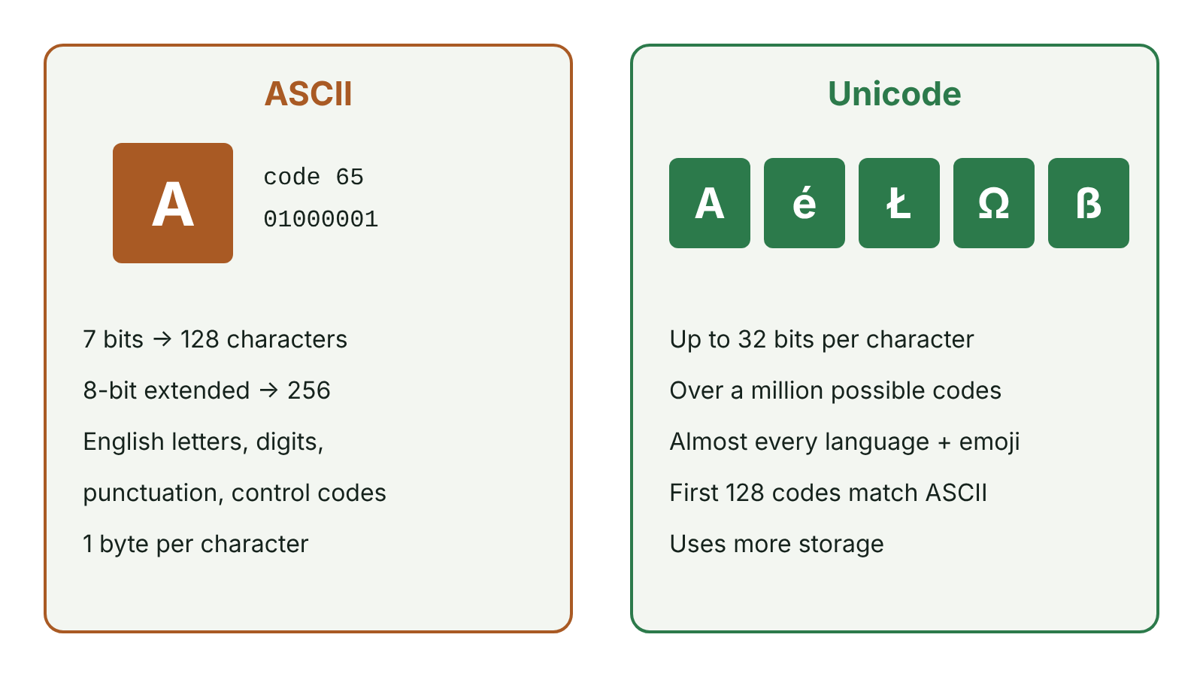
The big picture
ASCII compared with Unicode
☰ Menu
Notes:
Explain the diagram in your own words before you read on.

Slide 54
Character sets
A character set is a list of characters a computer recognises, each with a unique binary code
When you press a key, the code for that character is stored
Both devices must use the same character set to display text correctly
☰ Menu

Slide 55
ASCII
ASCII = American Standard Code for Information Interchange
7-bit ASCII: 2⁷ = 128 characters (codes 0–127)
Codes 0–31 are control characters (e.g. carriage return), unprintable
Code 32 = space; 'A' = 65 (01000001), 'B' = 66, … 'a' = 97
Letters are in order, so codes can be compared to sort text
☰ Menu

Slide 56
Extended (8-bit) ASCII
Uses 8 bits: 2⁸ = 256 characters
Adds extra symbols such as some accented letters, £ and line-drawing characters
Still only covers a small set of mainly English/Western European characters
Each character uses 1 byte
☰ Menu

Slide 57
Unicode
A worldwide standard that gives every character in every language a unique code
Can represent over a million characters, including Chinese, Arabic, Irish fadas and emoji
Uses more bits per character (commonly 16 bits, up to 32; UTF-8 uses 1–4 bytes)
The first 128 Unicode codes are the same as ASCII, so ASCII text is still readable
Allows text to be exchanged between countries and systems
☰ Menu

Slide 58
Comparing ASCII and Unicode
 | ASCII | Unicode
Bits per character | 7 (or 8 extended) | Up to 32 (UTF-8: 8–32)
Number of characters | 128 (256) | Over a million possible
Languages | Mainly English | Almost all world languages and emoji
Storage | Smaller files | Can use more storage per character
☰ Menu

Slide 59
Exam tip
2025 examiners: candidates confused bits used with number of characters, and wrote the same difference twice in reverse
Give two distinct differences, e.g. range of characters AND storage used
Expand ASCII exactly – asked in 2019 Q7(a) and 2023 Q1(a)
☰ Menu

Slide 60
Exit quiz: question 1 of 5
Tap an answer to check it. Presenting? Click to reveal the answer.
What does ASCII stand for?
A American Standard Code for Information Interchange
B Advanced System Code for Internet Input
✓
✗
C American System for Computer Information
D Automatic Standard Character Index
✗
✗
✓ A: American Standard Code for Information Interchange
☰ Menu

Slide 61
Exit quiz: question 2 of 5
Tap an answer to check it. Presenting? Click to reveal the answer.
How many characters in 7-bit ASCII?
A 64
B 128
✗
✓
C 256
D 1024
✗
✗
✓ B: 128 – 2⁷
☰ Menu

Slide 62
Exit quiz: question 3 of 5
Tap an answer to check it. Presenting? Click to reveal the answer.
Which can represent Chinese characters and emoji?
A 7-bit ASCII
B Extended ASCII
✗
✗
C Unicode
D Hexadecimal
✓
✗
✓ C: Unicode
☰ Menu

Slide 63
Exit quiz: question 4 of 5
Tap an answer to check it. Presenting? Click to reveal the answer.
A drawback of Unicode compared with ASCII is…
A fewer characters
B more bits per character, so more storage
✗
✓
C it only supports English
D it cannot store digits
✗
✗
✓ B: more bits per character, so more storage
☰ Menu

Slide 64
Exit quiz: question 5 of 5
Tap an answer to check it. Presenting? Click to reveal the answer.
If 'a' = 97, what is 'c'?
A 98
B 99
✗
✓
C 100
D 67
✗
✗
✓ B: 99 – Codes are consecutive.
☰ Menu

Slide 65
Exit quiz answers
Q | Answer
1 | A American Standard Code for Information Interchange
2 | B 128 – 2⁷
3 | C Unicode
4 | B more bits per character, so more storage
5 | B 99 – Codes are consecutive.
☰ Menu

Slide 66
In the exam
Paper | Question | Marks | What it tested
Unit 4 2019 | Q7 | 5 | ASCII and Unicode
Unit 4 2022 | Q1(d)–(g) | 4 | Abstraction, decomposition, search efficiency, ASCII
Unit 4 2023 | Q1 | 10 | ASCII acronym and capacity; AND/OR truth table; Unicode vs ASCII
Unit 4 2025 | Q4 | 15 | Binary conversion, addition and overflow, units, Unicode vs ASCII
Papers and mark schemes: ccea.org.uk → GCSE Digital Technology → Past Papers & Mark Schemes.
☰ Menu

Slide 67
Data types
UNIT 4: DIGITAL DEVELOPMENT CONCEPTS · D07
Learning objectives
Describe integer, real, character, string, Boolean and date/time data types
Choose and justify a data type for a variable
Use type conversion (casting) in C#
Notes:
Specification: Describe and use appropriately the following data types: numeric (integer and real), date/time, character and string

Slide 68
In this lesson
Tap a button to jump straight there. The ☰ Menu button on every slide brings you back here.
The big picture
Type conversion (casting)
Why data types matter
Dates and times in C#
Data types
Exit quiz
Choosing a type
↑ Topic menu
Notes:
Lesson menu: each button jumps to that part of the lesson in Slide Show. The ☰ Menu button on each slide returns here.

Slide 69
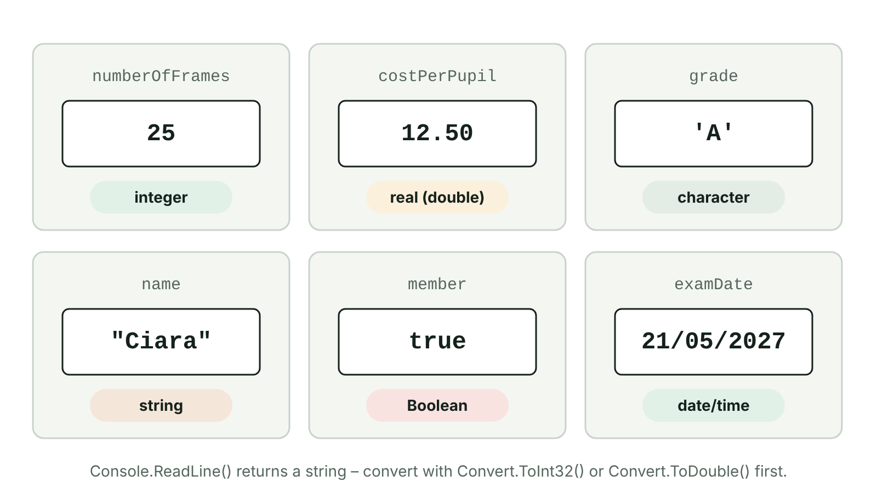
The big picture
Six variables, each holding a value of a different data type
☰ Menu
Notes:
Explain the diagram in your own words before you read on.

Slide 70
Why data types matter
The data type tells the computer what kind of value a variable holds
It decides how much memory is used
It decides which operations are allowed – you can add integers, but joining strings is different
Choosing the right type prevents errors and makes validation possible
☰ Menu

Slide 71
Data types
Type | Holds | Example | C#
Integer | Whole numbers | int numberOfFrames = 25; | int
Real | Numbers with a decimal part | double costPerPupil = 12.50; | double
Character | A single letter, digit or symbol | char grade = 'A'; | char
String | A sequence of characters (text) | string name = "Ciara"; | string
Boolean | true or false only | bool member = true; | bool
Date/time | A date and/or time | new DateTime(2026, 10, 18) | DateTime
☰ Menu

Slide 72
Choosing a type
Calculations with whole numbers → integer (number of tickets, votes)
Money or measurements → real (price, height, race time)
Two possible states → Boolean (paid? hasEquipment?)
Text, codes, phone numbers, postcodes → string
A single initial or Y/N code → character
2025 Q6(b): describe Boolean and identify the Boolean variable
☰ Menu

Slide 73
Type conversion (casting)
Console.ReadLine() always returns a string
Convert before doing maths: Convert.ToInt32(), Convert.ToDouble() (or int.Parse(), double.Parse())
A cast such as (double) changes the type of a value; int / int gives a whole-number answer
Numbers join onto strings automatically with +, or use ToString()
☰ Menu

Slide 74
Type conversion (casting) – code
C#
Console.Write("Age? ");
int age = Convert.ToInt32(Console.ReadLine());
Console.WriteLine("Next year you will be " + (age + 1));
double price = Convert.ToDouble("3.99");
Console.WriteLine(price * 2);
int marks = 7;
double average = (double)marks / 2; // cast: 3.5, not 3
Console.WriteLine(average);
☰ Menu

Slide 75
Dates and times in C#
Dates and times are stored in a DateTime
new DateTime(year, month, day) creates a date
Parts can be read: exam.Day, exam.Month, exam.Year
☰ Menu

Slide 76
Dates and times in C# – code
C#
DateTime exam = new DateTime(2027, 5, 21);
Console.WriteLine(exam.ToShortDateString()); // 21/05/2027
Console.WriteLine(exam.Month); // 5
DateTime revisionStart = new DateTime(2027, 4, 1);
Console.WriteLine((exam - revisionStart).Days + " days to revise");
☰ Menu

Slide 77
Exit quiz: question 1 of 5
Tap an answer to check it. Presenting? Click to reveal the answer.
Best data type for the number of pupils on a trip?
A Real
B Integer
✗
✓
C Boolean
D String
✗
✗
✓ B: Integer
☰ Menu

Slide 78
Exit quiz: question 2 of 5
Tap an answer to check it. Presenting? Click to reveal the answer.
Best data type for 'Has the pupil paid?'
A Boolean
B Character
✓
✗
C Integer
D Date/time
✗
✗
✓ A: Boolean – Two states.
☰ Menu

Slide 79
Exit quiz: question 3 of 5
Tap an answer to check it. Presenting? Click to reveal the answer.
Which C# method converts "12" into a whole number?
A Convert.ToString()
B Convert.ToDouble()
✗
✗
C Convert.ToInt32()
D Console.ReadLine()
✓
✗
✓ C: Convert.ToInt32()
☰ Menu

Slide 80
Exit quiz: question 4 of 5
Tap an answer to check it. Presenting? Click to reveal the answer.
What is the value of 7 / 2 in C# when both are int?
A 3.5
B 3
✗
✓
C 4
D Error
✗
✗
✓ B: 3 – Integer division drops the remainder; use (double)7 / 2 for 3.5.
☰ Menu

Slide 81
Exit quiz: question 5 of 5
Tap an answer to check it. Presenting? Click to reveal the answer.
Best data type for a customer's surname?
A Character
B String
✗
✓
C Real
D Boolean
✗
✗
✓ B: String
☰ Menu

Slide 82
Exit quiz answers
Q | Answer
1 | B Integer
2 | A Boolean – Two states.
3 | C Convert.ToInt32()
4 | B 3 – Integer division drops the remainder; use (double)7 / 2 for 3.5.
5 | B String
☰ Menu

Slide 83
In the exam
Paper | Question | Marks | What it tested
Unit 4 2023 | Q3 | 12 | Data types; constants and a benefit; sales total and average algorithm
Unit 4 2024 | Q3 | 17 | Travel insurance cost algorithm; validation; real data type; WHILE range-check loop
Unit 4 2024 | Q8 | 18 | String and Boolean types; unit testing; test plan; black vs white box
Unit 4 2025 | Q1 | 5 | String type, compound AND, IF output, NOT/AND table, bubble sort
Unit 4 2025 | Q3 | 15 | Musician hire algorithm; variables and data types; IDE aids; syntax vs logic
Unit 4 2025 | Q6 | 25 | Tent hire algorithm; Boolean; constants; validation true/false; Y/N validation loop
4 more past questions on the website. Papers and mark schemes: ccea.org.uk → GCSE Digital Technology → Past Papers & Mark Schemes.
☰ Menu

Slide 84
Boolean operators and truth tables
UNIT 4: DIGITAL DEVELOPMENT CONCEPTS · D08
Learning objectives
Describe the AND, OR and NOT operators
Complete truth tables for single and combined expressions
Use Boolean operators in program conditions
Notes:
Specification: Demonstrate understanding of and use Boolean operators (AND, OR and NOT) and truth tables

Slide 85
In this lesson
Tap a button to jump straight there. The ☰ Menu button on every slide brings you back here.
The big picture
Example: (P OR Q) AND R
Boolean logic
Boolean operators in code
AND, OR, NOT
Exit quiz
Combined expressions
↑ Topic menu
Notes:
Lesson menu: each button jumps to that part of the lesson in Slide Show. The ☰ Menu button on each slide returns here.

Slide 86
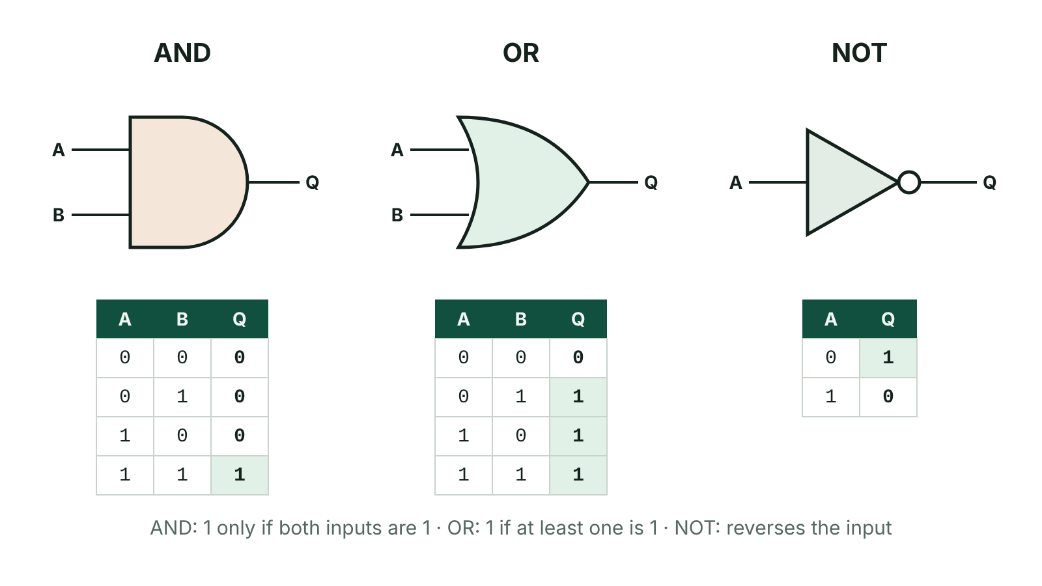
The big picture
AND, OR and NOT logic gates with their truth tables
☰ Menu
Notes:
Explain the diagram in your own words before you read on.

Slide 87
Boolean logic
A Boolean value is True (1) or False (0)
Boolean operators combine or change conditions
They are used in IF statements and loop conditions
A truth table shows the output for every combination of inputs
☰ Menu

Slide 88
AND, OR, NOT
A | B | A AND B | A OR B | NOT A
0 | 0 | 0 | 0 | 1
0 | 1 | 0 | 1 | 1
1 | 0 | 0 | 1 | 0
1 | 1 | 1 | 1 | 0
☰ Menu

Slide 89
Combined expressions
Work in steps: add a column for each part of the expression
NOT (P AND Q): first work out P AND Q, then reverse it
(P OR Q) AND R: with 3 inputs there are 2³ = 8 rows
List inputs in binary order: 000, 001, 010, … 111 so no row is missed
☰ Menu

Slide 90
Example: (P OR Q) AND R
P | Q | R | P OR Q | (P OR Q) AND R
0 | 0 | 0 | 0 | 0
0 | 0 | 1 | 0 | 0
0 | 1 | 0 | 1 | 0
0 | 1 | 1 | 1 | 1
1 | 0 | 0 | 1 | 0
1 | 0 | 1 | 1 | 1
1 | 1 | 0 | 1 | 0
1 | 1 | 1 | 1 | 1
☰ Menu

Slide 91
Boolean operators in code
Relational operators make conditions: == != < > <= >=
Boolean operators join them: && (AND), || (OR), ! (NOT)
Note: = assigns, == compares
C#
Console.Write("Age: ");
int age = Convert.ToInt32(Console.ReadLine());
bool hasTicket = true;
if (age >= 12 && age <= 16 && hasTicket)
{
Console.WriteLine("Welcome to the disco");
}
if (!hasTicket)
{
Console.WriteLine("Please buy a ticket");
}
☰ Menu

Slide 92
Exit quiz: question 1 of 5
Tap an answer to check it. Presenting? Click to reveal the answer.
1 AND 1 =
A 0
B 1
✗
✓
C 2
D 10
✗
✗
✓ B: 1
☰ Menu

Slide 93
Exit quiz: question 2 of 5
Tap an answer to check it. Presenting? Click to reveal the answer.
0 OR 0 =
A 0
B 1
✓
✗
C True
D Error
✗
✗
✓ A: 0 – OR is false only when both are false.
☰ Menu

Slide 94
Exit quiz: question 3 of 5
Tap an answer to check it. Presenting? Click to reveal the answer.
NOT (1 AND 0) =
A 0
B 1
✗
✓
C 10
D None
✗
✗
✓ B: 1 – 1 AND 0 = 0, NOT 0 = 1
☰ Menu

Slide 95
Exit quiz: question 4 of 5
Tap an answer to check it. Presenting? Click to reveal the answer.
Which condition is true only for ages 13 to 19?
A age > 13 || age < 19
B age >= 13 && age <= 19
✗
✓
C !(age == 13)
D age >= 13 || age <= 19
✗
✗
✓ B: age >= 13 && age <= 19
☰ Menu

Slide 96
Exit quiz: question 5 of 5
Tap an answer to check it. Presenting? Click to reveal the answer.
How many rows for 4 inputs?
A 8
B 12
✗
✗
C 16
D 4
✓
✗
✓ C: 16 – 2⁴
☰ Menu

Slide 97
Exit quiz answers
Q | Answer | Why
1 | B 1
2 | A 0 | OR is false only when both are false.
3 | B 1 | 1 AND 0 = 0, NOT 0 = 1
4 | B age >= 13 && age <= 19
5 | C 16 | 2⁴
☰ Menu

Slide 98
In the exam
Paper | Question | Marks | What it tested
Unit 4 2019 | Q8 | 18 | Binary, hexadecimal and its uses, binary addition and overflow, logic gates
Unit 4 2022 | Q1(a)–(c) | 4 | Truth tables for NOT (P AND Q), (P OR Q) AND R; tracing outputs
Unit 4 2023 | Q1 | 10 | ASCII acronym and capacity; AND/OR truth table; Unicode vs ASCII
Unit 4 2024 | Q4 | 19 | Bit, nibble, byte; denary–binary–hex conversions; binary addition and overflow; truth tables
Unit 4 2025 | Q1 | 5 | String type, compound AND, IF output, NOT/AND table, bubble sort
Papers and mark schemes: ccea.org.uk → GCSE Digital Technology → Past Papers & Mark Schemes.
☰ Menu

