Slide 1
Digital design principles
UNIT 4: DIGITAL DEVELOPMENT CONCEPTS · TOPIC
Lessons in this topic
D09 Computational thinking: abstraction and decomposition
D10 Designing algorithms: flowcharts and pseudocode
D11 Sorting algorithms: bubble sort and insertion sort
D12 Searching algorithms: linear and binary search
D13 Dry runs, trace tables, data requirements and interfaces

Slide 2

Topic menu
Tap a button to jump straight there. The ☰ Menu button on every slide brings you back here.
Specification map
D11 Sorting algorithms: bubble sort and insertion sort
D09 Computational thinking: abstraction and decomposition
D12 Searching algorithms: linear and binary search
D10 Designing algorithms: flowcharts and pseudocode
D13 Dry runs, trace tables, data requirements and interfaces

Slide 3
Specification map
Lesson | Specification: students should be able to
D09 | Explain in simple terms the underlying concepts of computational thinking – abstraction and decomposition
D10 | Design solutions using algorithms, flow diagrams and pseudo-code; Refine a solution to a problem during design
D11 | Create and evaluate algorithms, including those for basic sorting; Simple sorting techniques such as the bubble sort and the insertion sort
D12 | Create and evaluate algorithms, including those for basic searching; Simple searching techniques such as linear and binary searching
D13 | Use a dry run to test a solution; Identify data requirements for a solution and develop an appropriate user interface
☰ Menu
Notes:
Each lesson below is its own section in PowerPoint (View → Slide Sorter shows them). To split this deck by specification point, right-click a section → Move Section, or delete the sections you do not need.

Slide 4
Computational thinking: abstraction and decomposition
UNIT 4: DIGITAL DEVELOPMENT CONCEPTS · D09
Learning objectives
Define abstraction and decomposition
Apply both to a real problem
Explain the benefits of each for programmers
Notes:
Specification: Explain in simple terms the underlying concepts of computational thinking – abstraction and decomposition

Slide 5
In this lesson
Tap a button to jump straight there. The ☰ Menu button on every slide brings you back here.
The big picture
Example: school canteen app
Computational thinking
Exam technique
Abstraction
Exit quiz
Decomposition
↑ Topic menu
Notes:
Lesson menu: each button jumps to that part of the lesson in Slide Show. The ☰ Menu button on each slide returns here.

Slide 6
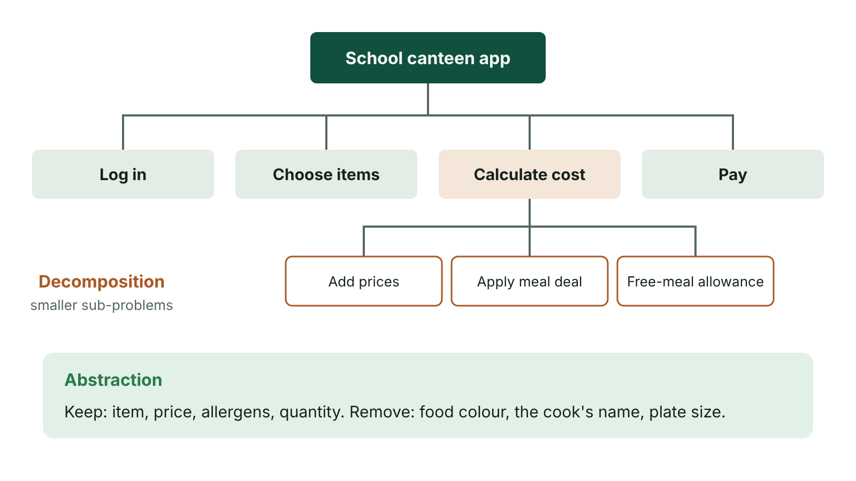
The big picture
Decomposition of a school canteen app into sub-problems, with an abstraction note
☰ Menu
Notes:
Explain the diagram in your own words before you read on.

Slide 7
Computational thinking
A way of approaching problems so a computer can help solve them
Key concepts in the CCEA specification: abstraction and decomposition
They lead to an algorithm – a step-by-step solution
2023 Q4(a) linked all three in a scenario
☰ Menu

Slide 8
Abstraction
Removing or hiding details that are not needed to solve the problem
Focus only on what is important
Example: a route map shows stations and lines, not every building
Example: a ticket program needs age and journey type, not the passenger's favourite colour
Benefits: simpler problem, less to code and store, quicker to develop
☰ Menu

Slide 9
Decomposition
Breaking a large, complex problem into smaller, more manageable sub-problems
Each sub-problem can be solved (and tested) separately, then combined
Often shown with a structure diagram (top-down design)
Benefits: easier to understand; work shared across a team; parts reused; errors easier to find
☰ Menu

Slide 10
Example: school canteen app
Decompose: log in → view menu → choose items → calculate cost → pay → print receipt
Further decompose 'calculate cost': add item prices → apply meal deal → apply free-meal allowance
Abstract: the app needs item, price, allergy flags – not the food's colour or the cook's name
☰ Menu

Slide 11
Exam technique
2019 Q6 was a 6-mark QWC on abstraction and decomposition and their benefits
2022 Q1(d)–(e): pick the correct definitions
Define each term, give an example in context, then a benefit
☰ Menu

Slide 12
Exit quiz: question 1 of 5
Tap an answer to check it. Presenting? Click to reveal the answer.
Removing unnecessary detail is…
A decomposition
B abstraction
✗
✓
C iteration
D validation
✗
✗
✓ B: abstraction
☰ Menu

Slide 13
Exit quiz: question 2 of 5
Tap an answer to check it. Presenting? Click to reveal the answer.
Breaking a problem into sub-problems is…
A decomposition
B abstraction
✓
✗
C compilation
D encryption
✗
✗
✓ A: decomposition
☰ Menu

Slide 14
Exit quiz: question 3 of 5
Tap an answer to check it. Presenting? Click to reveal the answer.
Which diagram shows decomposition?
A Truth table
B Structure diagram
✗
✓
C Trace table
D Pie chart
✗
✗
✓ B: Structure diagram
☰ Menu

Slide 15
Exit quiz: question 4 of 5
Tap an answer to check it. Presenting? Click to reveal the answer.
A benefit of decomposition is…
A programs never have errors
B parts can be developed and tested separately
✗
✓
C no algorithm is needed
D it removes all data
✗
✗
✓ B: parts can be developed and tested separately
☰ Menu

Slide 16
Exit quiz: question 5 of 5
Tap an answer to check it. Presenting? Click to reveal the answer.
The London Underground map is an example of…
A abstraction
B overflow
✓
✗
C iteration
D a protocol
✗
✗
✓ A: abstraction
☰ Menu

Slide 17
Exit quiz answers
Q | Answer
1 | B abstraction
2 | A decomposition
3 | B Structure diagram
4 | B parts can be developed and tested separately
5 | A abstraction
☰ Menu

Slide 18
In the exam
Paper | Question | Marks | What it tested
Unit 4 2019 | Q6 | 6 | Abstraction and decomposition (levelled)
Unit 4 2022 | Q1(d)–(g) | 4 | Abstraction, decomposition, search efficiency, ASCII
Unit 4 2023 | Q4 | 23 | Decomposition and abstraction; flowchart symbols; syntax/logic errors; functions; menu validation loop
Papers and mark schemes: ccea.org.uk → GCSE Digital Technology → Past Papers & Mark Schemes.
☰ Menu

Slide 19
Designing algorithms: flowcharts and pseudocode
UNIT 4: DIGITAL DEVELOPMENT CONCEPTS · D10
Learning objectives
Define an algorithm and pseudocode
Use the standard flowchart symbols
Write and refine algorithms in pseudocode using sequence, selection and iteration
Notes:
Specification: Design solutions using algorithms, flow diagrams and pseudo-code | Refine a solution to a problem during design

Slide 20
In this lesson
Tap a button to jump straight there. The ☰ Menu button on every slide brings you back here.
The big picture
Selection in a flowchart
Algorithms
Refining a design
Flowchart symbols
Exit quiz
Pseudocode
↑ Topic menu
Pseudocode style used here
Notes:
Lesson menu: each button jumps to that part of the lesson in Slide Show. The ☰ Menu button on each slide returns here.

Slide 21
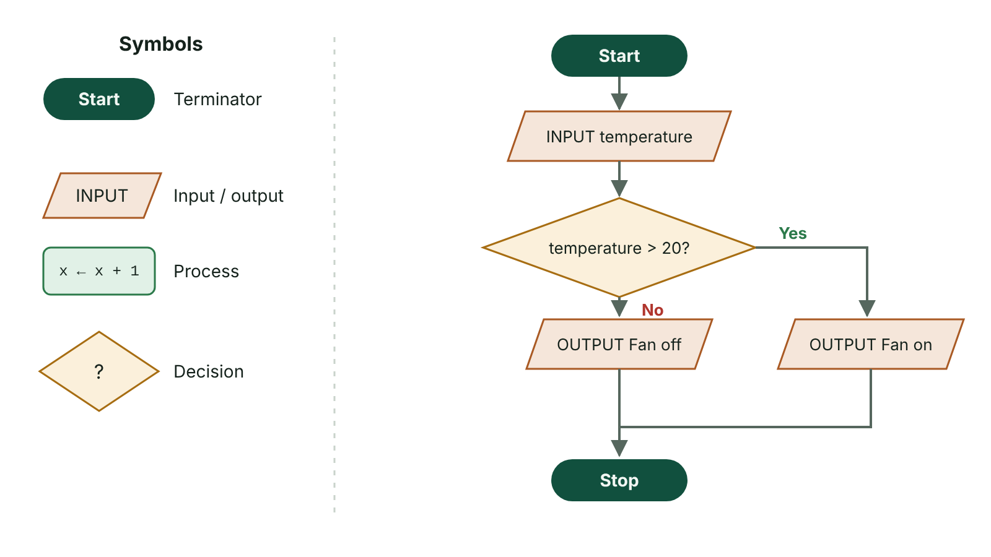
The big picture
Flowchart symbols and a flowchart that turns a fan on above 20 degrees
☰ Menu
Notes:
Explain the diagram in your own words before you read on.

Slide 22
Algorithms
An algorithm is a precise, step-by-step set of instructions to solve a problem
Can be represented as a flowchart or pseudocode before coding
Built from three constructs: sequence, selection, iteration
Independent of any programming language
☰ Menu

Slide 23
Flowchart symbols
Symbol | Name | Use
Rounded rectangle | Terminator | Start / Stop
Parallelogram | Input/Output | INPUT a value, OUTPUT a result
Rectangle | Process | A calculation or assignment, e.g. total ← total + mark
Diamond | Decision | A Yes/No question – two exits
Arrow | Flow line | Shows the direction of flow
Rectangle with double sides | Subroutine | Call a predefined procedure/function
☰ Menu

Slide 24
Pseudocode
Pseudocode is a language-independent, English-like description of an algorithm
It uses programming-style keywords but ignores exact syntax
Easy to convert into any language; lets designers focus on the logic
CCEA accepts any clear, consistent pseudocode – these slides use one common style
☰ Menu

Slide 25
Pseudocode style used here
INPUT name / OUTPUT "Hello ", name
total ← total + price (assignment)
IF … THEN … ELSE … END IF
WHILE condition … END WHILE
FOR count ← 1 TO 10 … NEXT count
REPEAT … UNTIL condition
PSEUDOCODE
total ← 0
FOR count ← 1 TO 5
INPUT distance
total ← total + distance
NEXT count
km ← total * 1.609
OUTPUT "Total in km: ", km
☰ Menu

Slide 26
Selection in a flowchart
2022 Q8(a): fan control – if temperature > 20 turn fan on, else off
A decision diamond has one entry and two labelled exits (Yes/No)
To make it run continuously, loop the flow line back to the input
☰ Menu

Slide 27
Refining a design
A first design is rarely perfect – walk through it with test values
Refine by adding missing steps (validation, error messages), fixing logic, simplifying repeated steps into loops
Keep a record of refinements – required in Unit 5 controlled assessment
Get feedback from the end user before coding
☰ Menu

Slide 28
Exit quiz: question 1 of 5
Tap an answer to check it. Presenting? Click to reveal the answer.
Which flowchart symbol represents a decision?
A Rectangle
B Diamond
✗
✓
C Parallelogram
D Oval
✗
✗
✓ B: Diamond
☰ Menu

Slide 29
Exit quiz: question 2 of 5
Tap an answer to check it. Presenting? Click to reveal the answer.
Pseudocode is…
A machine code
B a language-independent description of an algorithm
✗
✓
C only used in C#
D a type of flowchart
✗
✗
✓ B: a language-independent description of an algorithm
☰ Menu

Slide 30
Exit quiz: question 3 of 5
Tap an answer to check it. Presenting? Click to reveal the answer.
In pseudocode, total ← total + 5 is…
A selection
B an assignment
✗
✓
C a comparison
D an input
✗
✗
✓ B: an assignment
☰ Menu

Slide 31
Exit quiz: question 4 of 5
Tap an answer to check it. Presenting? Click to reveal the answer.
Which symbol is used for INPUT and OUTPUT?
A Parallelogram
B Diamond
✓
✗
C Terminator
D Arrow
✗
✗
✓ A: Parallelogram
☰ Menu

Slide 32
Exit quiz: question 5 of 5
Tap an answer to check it. Presenting? Click to reveal the answer.
Repeating a set of steps is called…
A sequence
B selection
✗
✗
C iteration
D abstraction
✓
✗
✓ C: iteration
☰ Menu

Slide 33
Exit quiz answers
Q | Answer
1 | B Diamond
2 | B a language-independent description of an algorithm
3 | B an assignment
4 | A Parallelogram
5 | C iteration
☰ Menu

Slide 34
In the exam
Paper | Question | Marks | What it tested
Unit 4 2019 | Q9 | 19 | Test strategies, data types, validation loop, design, discount selection
Unit 4 2022 | Q8 | 9 | Flowchart selection and iteration; dry runs
Unit 4 2023 | Q4 | 23 | Decomposition and abstraction; flowchart symbols; syntax/logic errors; functions; menu validation loop
Unit 4 2024 | Q7 | 35 | Arrays, pseudocode, FOR/WHILE totals, minimum, bubble sort, linear and binary search
Papers and mark schemes: ccea.org.uk → GCSE Digital Technology → Past Papers & Mark Schemes.
☰ Menu

Slide 35
Sorting algorithms: bubble sort and insertion sort
UNIT 4: DIGITAL DEVELOPMENT CONCEPTS · D11
Learning objectives
Describe how a bubble sort and an insertion sort work
Show each pass of a sort on a list of values
Compare the efficiency of the two sorts
Notes:
Specification: Create and evaluate algorithms, including those for basic sorting | Simple sorting techniques such as the bubble sort and the insertion sort

Slide 36
In this lesson
Tap a button to jump straight there. The ☰ Menu button on every slide brings you back here.
The big picture
Insertion sort
Why sort?
Insertion sort: example
Bubble sort
Comparing the sorts
Bubble sort: example
Exit quiz
Bubble sort in C#
↑ Topic menu
Notes:
Lesson menu: each button jumps to that part of the lesson in Slide Show. The ☰ Menu button on each slide returns here.

Slide 37
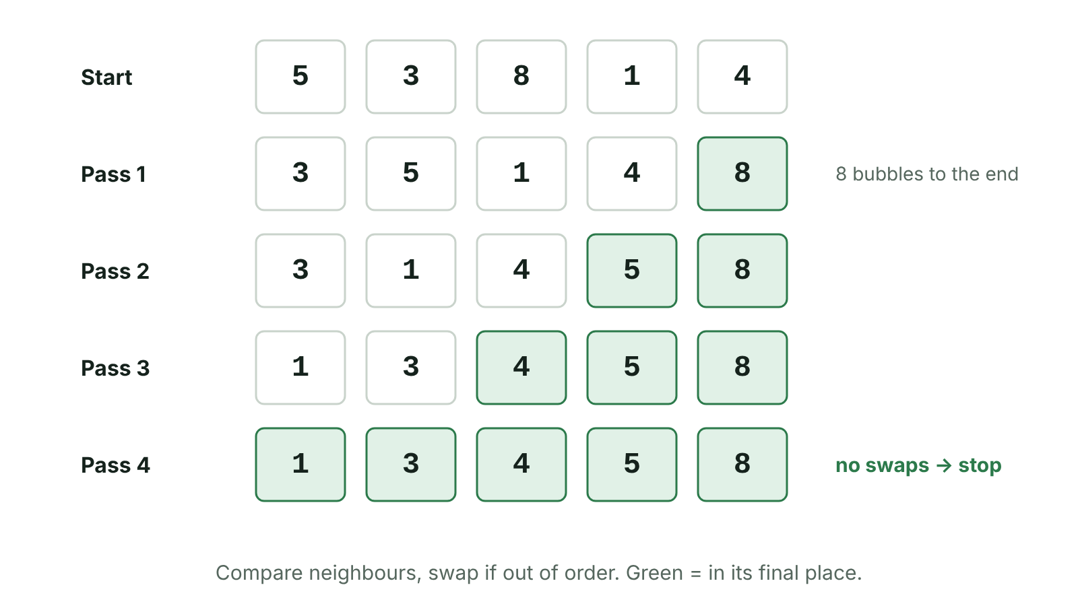
The big picture
Bubble sort passes on 5, 3, 8, 1, 4
☰ Menu
Notes:
Explain the diagram in your own words before you read on.

Slide 38
Why sort?
Sorting puts data in order: ascending (smallest first) or descending
Sorted data is easier to read and much faster to search (binary search needs sorted data)
Examples: league tables, names in a register, prices low to high
☰ Menu

Slide 39
Bubble sort
Compare the first two items; if they are in the wrong order, swap them
Move along one position and compare the next pair – repeat to the end of the list (one pass)
After each pass the largest remaining item 'bubbles' to its correct place at the end
Repeat passes until a whole pass makes no swaps
A list of n items needs at most n − 1 passes
☰ Menu

Slide 40
Bubble sort: example
Pass | List after the pass
Start | 5 3 8 1 4
1 | 3 5 1 4 8
2 | 3 1 4 5 8
3 | 1 3 4 5 8
4 | 1 3 4 5 8 (no swaps – stop)
☰ Menu

Slide 41
Bubble sort in C#
A swapped flag stops the sort early when the list is already sorted
☰ Menu

Slide 42
Bubble sort in C# – code
C#
int[] items = { 5, 3, 8, 1, 4 };
bool swapped = true;
while (swapped)
{
swapped = false;
for (int i = 0; i < items.Length - 1; i++)
{
if (items[i] > items[i + 1])
{
int temp = items[i];
items[i] = items[i + 1];
items[i + 1] = temp;
swapped = true;
}
}
}
Console.WriteLine(string.Join(", ", items));
☰ Menu

Slide 43
Insertion sort
Treat the first item as a sorted sub-list
Take the next item and insert it into the correct position in the sorted part, shifting larger items one place right
Repeat until every item has been inserted
Like sorting a hand of playing cards
☰ Menu

Slide 44
Insertion sort: example
Step | Sorted part | unsorted part
Start | 5 | 3 8 1 4
Insert 3 | 3 5 | 8 1 4
Insert 8 | 3 5 8 | 1 4
Insert 1 | 1 3 5 8 | 4
Insert 4 | 1 3 4 5 8
☰ Menu

Slide 45
Comparing the sorts
 | Bubble sort | Insertion sort
Method | Compare and swap neighbours, repeated passes | Insert each item into a growing sorted list
Efficiency | Slow on large lists – many comparisons and swaps | Usually faster than bubble sort; very quick on nearly sorted data
Ease of coding | Very simple | Simple
Memory | Sorts in place | Sorts in place
☰ Menu

Slide 46
Exit quiz: question 1 of 5
Tap an answer to check it. Presenting? Click to reveal the answer.
In a bubble sort, which items are compared?
A First and last
B Adjacent items
✗
✓
C Random pairs
D Middle item and target
✗
✗
✓ B: Adjacent items
☰ Menu

Slide 47
Exit quiz: question 2 of 5
Tap an answer to check it. Presenting? Click to reveal the answer.
After pass 1 of an ascending bubble sort on 4 2 5 1:
A 2 4 1 5
B 1 2 4 5
✓
✗
C 2 1 4 5
D 4 2 1 5
✗
✗
✓ A: 2 4 1 5 – 4>2 swap, 4<5 keep, 5>1 swap.
☰ Menu

Slide 48
Exit quiz: question 3 of 5
Tap an answer to check it. Presenting? Click to reveal the answer.
When does a bubble sort stop?
A After one pass
B When a pass makes no swaps
✗
✓
C When the first item is smallest
D Never
✗
✗
✓ B: When a pass makes no swaps
☰ Menu

Slide 49
Exit quiz: question 4 of 5
Tap an answer to check it. Presenting? Click to reveal the answer.
Insertion sort works by…
A halving the list
B inserting each item into its place in a sorted sub-list
✗
✓
C swapping the first and last items
D searching for the middle item
✗
✗
✓ B: inserting each item into its place in a sorted sub-list
☰ Menu

Slide 50
Exit quiz: question 5 of 5
Tap an answer to check it. Presenting? Click to reveal the answer.
Which is usually faster on nearly sorted data?
A Bubble sort
B Insertion sort
✗
✓
C Both are identical
D Linear search
✗
✗
✓ B: Insertion sort
☰ Menu

Slide 51
Exit quiz answers
Q | Answer
1 | B Adjacent items
2 | A 2 4 1 5 – 4>2 swap, 4<5 keep, 5>1 swap.
3 | B When a pass makes no swaps
4 | B inserting each item into its place in a sorted sub-list
5 | B Insertion sort
☰ Menu

Slide 52
In the exam
Paper | Question | Marks | What it tested
Unit 4 2019 | Q12 | 8 | Linear vs binary search; showing sort passes
Unit 4 2022 | Q5 | 6 | Bubble and insertion sort, efficiency (QWC)
Unit 4 2023 | Q9 | 18 | Arrays: update, reset to zero, find maximum; bubble sort steps; searching sorted data
Unit 4 2024 | Q7 | 35 | Arrays, pseudocode, FOR/WHILE totals, minimum, bubble sort, linear and binary search
Unit 4 2025 | Q1 | 5 | String type, compound AND, IF output, NOT/AND table, bubble sort
Papers and mark schemes: ccea.org.uk → GCSE Digital Technology → Past Papers & Mark Schemes.
☰ Menu

Slide 53
Searching algorithms: linear and binary search
UNIT 4: DIGITAL DEVELOPMENT CONCEPTS · D12
Learning objectives
Describe linear and binary search
Trace a binary search to find or not find an item
Compare the efficiency and requirements of each
Notes:
Specification: Create and evaluate algorithms, including those for basic searching | Simple searching techniques such as linear and binary searching

Slide 54
In this lesson
Tap a button to jump straight there. The ☰ Menu button on every slide brings you back here.
The big picture
Binary search in C#
Linear search
Comparing searches
Binary search
Exit quiz
Binary search: example
↑ Topic menu
Notes:
Lesson menu: each button jumps to that part of the lesson in Slide Show. The ☰ Menu button on each slide returns here.

Slide 55
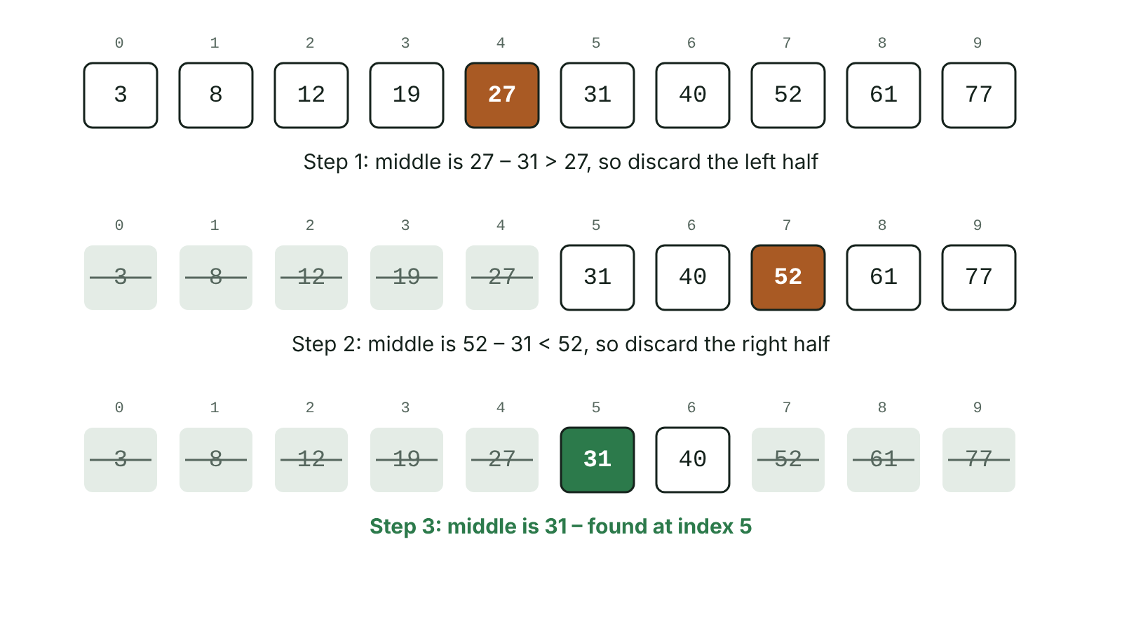
The big picture
Binary search for 31 in a sorted list, halving the search each step
☰ Menu
Notes:
Explain the diagram in your own words before you read on.

Slide 56
Linear search
Start at the first item and check each item in turn
Stop when the target is found or the end of the list is reached
Works on unsorted or sorted data
Simple, but slow for large lists – may need to check every item
☰ Menu

Slide 57
Linear search – code
C#
static int LinearSearch(int[] items, int target)
{
for (int i = 0; i < items.Length; i++)
{
if (items[i] == target)
{
return i;
}
}
return -1;
}
int[] data = { 12, 7, 31, 4 };
Console.WriteLine(LinearSearch(data, 31)); // 2
☰ Menu

Slide 58
Binary search
The data MUST be sorted first
Look at the middle item
If it is the target – found
If the target is smaller, discard the upper half; if larger, discard the lower half
Repeat on the remaining half until found or no items are left
Each step halves the number of items left
☰ Menu

Slide 59
Binary search: example
Step | List (searching for 31) | Middle | Action
1 | 3 8 12 19 27 31 40 52 61 77 | 27 | 31 > 27: keep right half
2 | 31 40 52 61 77 | 52 | 31 < 52: keep left half
3 | 31 40 | 31 | Found
☰ Menu

Slide 60
Binary search in C#
mid = (low + high) / 2 uses integer division in C#
low and high close in until the target is found or low > high
C#
int[] items = { 3, 8, 12, 19, 27, 31, 40 };
int target = 31;
int low = 0;
int high = items.Length - 1;
int found = -1;
while (low <= high && found == -1)
{
int mid = (low + high) / 2;
if (items[mid] == target)
found = mid;
else if (items[mid] < target)
low = mid + 1;
else
high = mid - 1;
}
Console.WriteLine("Found at index " + found);
☰ Menu

Slide 61
Comparing searches
 | Linear | Binary
Data must be sorted? | No | Yes
Method | Check every item in turn | Check the middle; halve the list each time
Large lists | Slow – up to n checks | Fast – about 10 checks for 1000 items
Ease | Very simple | More complex to code
☰ Menu

Slide 62
Exit quiz: question 1 of 5
Tap an answer to check it. Presenting? Click to reveal the answer.
Which search requires sorted data?
A Linear
B Binary
✗
✓
C Both
D Neither
✗
✗
✓ B: Binary
☰ Menu

Slide 63
Exit quiz: question 2 of 5
Tap an answer to check it. Presenting? Click to reveal the answer.
The first item a binary search checks is…
A the first
B the last
✗
✗
C the middle
D a random item
✓
✗
✓ C: the middle
☰ Menu

Slide 64
Exit quiz: question 3 of 5
Tap an answer to check it. Presenting? Click to reveal the answer.
Searching 1 000 items, which is likely fastest?
A Linear
B Binary
✗
✓
C Bubble sort
D Insertion sort
✗
✗
✓ B: Binary
☰ Menu

Slide 65
Exit quiz: question 4 of 5
Tap an answer to check it. Presenting? Click to reveal the answer.
Linear search on [4, 9, 2, 7] for 7 needs how many comparisons?
A 1
B 2
✗
✗
C 3
D 4
✗
✓
✓ D: 4 – Item is last.
☰ Menu

Slide 66
Exit quiz: question 5 of 5
Tap an answer to check it. Presenting? Click to reveal the answer.
After checking the middle item and finding the target is larger, a binary search…
A stops
B discards the lower half
✗
✓
C discards the upper half
D restarts
✗
✗
✓ B: discards the lower half
☰ Menu

Slide 67
Exit quiz answers
Q | Answer
1 | B Binary
2 | C the middle
3 | B Binary
4 | D 4 – Item is last.
5 | B discards the lower half
☰ Menu

Slide 68
In the exam
Paper | Question | Marks | What it tested
Unit 4 2019 | Q12 | 8 | Linear vs binary search; showing sort passes
Unit 4 2022 | Q1(d)–(g) | 4 | Abstraction, decomposition, search efficiency, ASCII
Unit 4 2023 | Q9 | 18 | Arrays: update, reset to zero, find maximum; bubble sort steps; searching sorted data
Unit 4 2024 | Q7 | 35 | Arrays, pseudocode, FOR/WHILE totals, minimum, bubble sort, linear and binary search
Papers and mark schemes: ccea.org.uk → GCSE Digital Technology → Past Papers & Mark Schemes.
☰ Menu

Slide 69
Dry runs, trace tables, data requirements and interfaces
UNIT 4: DIGITAL DEVELOPMENT CONCEPTS · D13
Learning objectives
Carry out a dry run using a trace table
Predict the output of an algorithm, including loops
Identify data requirements and design a simple user interface
Notes:
Specification: Use a dry run to test a solution | Identify data requirements for a solution and develop an appropriate user interface

Slide 70
In this lesson
Tap a button to jump straight there. The ☰ Menu button on every slide brings you back here.
The big picture
Data requirements
Dry runs
Designing a user interface
Trace tables
Exit quiz
Trace example
↑ Topic menu
Predicting loop output
Notes:
Lesson menu: each button jumps to that part of the lesson in Slide Show. The ☰ Menu button on each slide returns here.

Slide 71
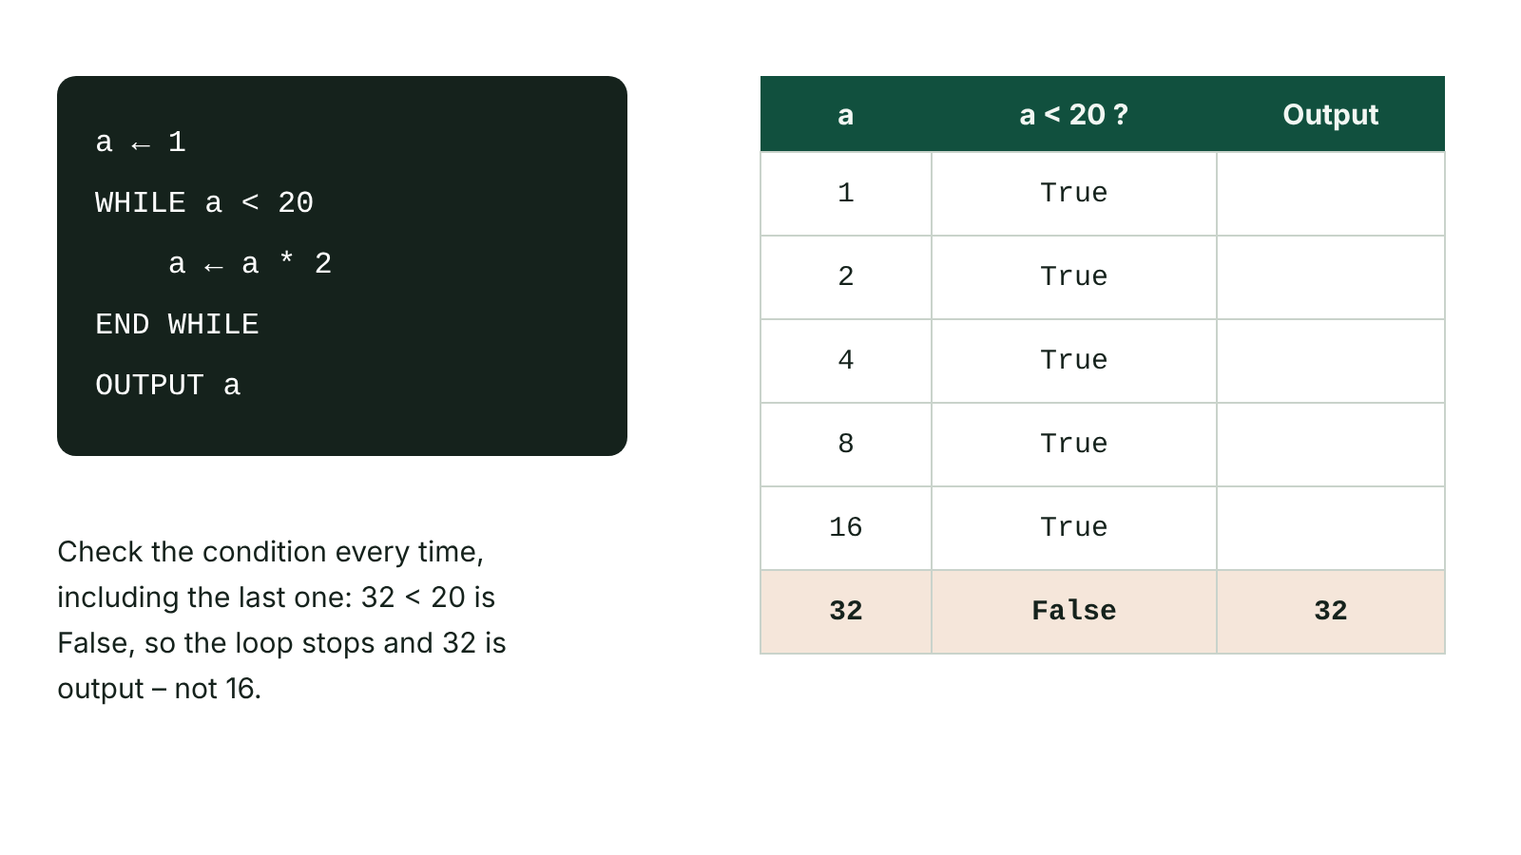
The big picture
A dry run of a WHILE loop recorded in a trace table
☰ Menu
Notes:
Explain the diagram in your own words before you read on.

Slide 72
Dry runs
A dry run is working through an algorithm or program by hand, line by line, without a computer
Used to find logic errors and check expected output before (or without) running code
Helps check every path through the code
2025 examiners: give two points – e.g. finds logic errors AND checks expected output
☰ Menu

Slide 73
Trace tables
A trace table records the value of each variable (and any output) after each step
One column per variable, one for the condition, one for output
Add a new row each time a value changes
Unbounded (WHILE) loops: carefully check the condition before each repeat
☰ Menu

Slide 74
Trace example
a | a < 20? | Output
1 | True
2 | True
4 | True
8 | True
16 | True
32 | False | 32
☰ Menu

Slide 75
Trace example – code
PSEUDOCODE
a ← 1
WHILE a < 20
a ← a * 2
END WHILE
OUTPUT a
☰ Menu

Slide 76
Predicting loop output
FOR loops: write the counter values first, then the work done each time
Nested loops: the inner loop completes fully for each value of the outer loop
2025 Q2(a): candidates who wrote long lists or four numbers lost marks – the loop produced exactly 15, 18, 21
C#
for (int i = 5; i < 8; i++)
{
Console.WriteLine(i * 3);
}
☰ Menu

Slide 77
Data requirements
Before coding, list every item of data the solution needs: inputs, outputs and stored/processed values
For each: name, data type, example value, validation rule
This is often called a data dictionary or variable table
Unit 5: specify data requirements as part of your design
Name | Type | Example | Validation
numNights | Integer | 3 | Range 1–14
hireCost | Real | 45.50 | > 0
equipment | Boolean | True | Y/N only
☰ Menu

Slide 78
Designing a user interface
Clear prompts telling the user what to enter and in what format
Sensible layout, consistent fonts/colours (GUI) or menus (text)
Helpful error messages when input is invalid
Confirmation of output in a readable form
Consider the target user – age, ability, accessibility
☰ Menu

Slide 79
Exit quiz: question 1 of 5
Tap an answer to check it. Presenting? Click to reveal the answer.
What is the output? x ← 3; WHILE x < 30: x ← x * 3; OUTPUT x
A 9
B 27
✗
✗
C 81
D 30
✓
✗
✓ C: 81 – 3→9→27→81, then 81 < 30 is false.
☰ Menu

Slide 80
Exit quiz: question 2 of 5
Tap an answer to check it. Presenting? Click to reveal the answer.
A trace table records…
A CPU speed
B variable values at each step
✗
✓
C test plan results only
D file sizes
✗
✗
✓ B: variable values at each step
☰ Menu

Slide 81
Exit quiz: question 3 of 5
Tap an answer to check it. Presenting? Click to reveal the answer.
for (int i = 2; i < 5; i++) Console.Write(i + " "); outputs…
A 2 3 4 5
B 2 3 4
✗
✓
C 1 2 3 4
D 3 4 5
✗
✗
✓ B: 2 3 4 – The condition i < 5 stops the loop before 5.
☰ Menu

Slide 82
Exit quiz: question 4 of 5
Tap an answer to check it. Presenting? Click to reveal the answer.
A dry run is mainly used to find…
A syntax errors
B logic errors
✗
✓
C hardware faults
D viruses
✗
✗
✓ B: logic errors
☰ Menu

Slide 83
Exit quiz: question 5 of 5
Tap an answer to check it. Presenting? Click to reveal the answer.
Which belongs in data requirements?
A Variable names and data types
B The colour of the PC
✓
✗
C The CPU clock speed
D The programmer's name
✗
✗
✓ A: Variable names and data types
☰ Menu

Slide 84
Exit quiz answers
Q | Answer
1 | C 81 – 3→9→27→81, then 81 < 30 is false.
2 | B variable values at each step
3 | B 2 3 4 – The condition i < 5 stops the loop before 5.
4 | B logic errors
5 | A Variable names and data types
☰ Menu

Slide 85
In the exam
Paper | Question | Marks | What it tested
Unit 4 2022 | Q8 | 9 | Flowchart selection and iteration; dry runs
Unit 4 2023 | Q2 | 4 | Tracing nested selection
Unit 4 2024 | Q1 | 4 | Dry-run a nested IF (shape calculator)
Unit 4 2024 | Q2 | 3 | Tracing FOR and WHILE loops
Unit 4 2025 | Q2 | 12 | Loop output, nested loops, loop count, infinite loop, fixing a condition
Unit 4 2025 | Q5 | 7 | Desk checking, trace table, final value
2 more past questions on the website. Papers and mark schemes: ccea.org.uk → GCSE Digital Technology → Past Papers & Mark Schemes.
☰ Menu

