Slide 1
Programming constructs
UNIT 4: DIGITAL DEVELOPMENT CONCEPTS · TOPIC
Lessons in this topic
D14 Variables, constants, operators, input, output and assignment
D15 Selection: IF, ELSE IF and nested IF
D16 Iteration: FOR, WHILE and REPEAT loops
D17 One-dimensional arrays
D18 String manipulation
D19 Subroutines: user-defined functions and procedures
D20 Basic file handling

Slide 2

Topic menu
Tap a button to jump straight there. The ☰ Menu button on every slide brings you back here.
Specification map
D17 One-dimensional arrays
D14 Variables, constants, operators, input, output and assignment
D18 String manipulation
D15 Selection: IF, ELSE IF and nested IF
D19 Subroutines: user-defined functions and procedures
D16 Iteration: FOR, WHILE and REPEAT loops
D20 Basic file handling

Slide 3
Specification map
Lesson | Specification: students should be able to
D14 | Demonstrate understanding of and use the functionality of variables, constants, and Boolean and arithmetic operators; Input, output and assignment statements
D15 | Controlling the flow of a program through sequence, selection and iteration (selection)
D16 | Controlling the flow of a program through sequence, selection and iteration (iteration)
D17 | One-dimensional array structures
D18 | String manipulation functions, including splitting, concatenating, character searching and substring searching
D19 | Building reusable code that utilises user-defined functions or methods
D20 | Basic file handling
☰ Menu
Notes:
Each lesson below is its own section in PowerPoint (View → Slide Sorter shows them). To split this deck by specification point, right-click a section → Move Section, or delete the sections you do not need.

Slide 4
Variables, constants, operators, input, output and assignment
UNIT 4: DIGITAL DEVELOPMENT CONCEPTS · D14
Learning objectives
Explain the difference between a variable and a constant and the benefits of constants
Use input, output and assignment statements
Use arithmetic operators including DIV, MOD and powers
Notes:
Specification: Demonstrate understanding of and use the functionality of variables, constants, and Boolean and arithmetic operators | Input, output and assignment statements

Slide 5
In this lesson
Tap a button to jump straight there. The ☰ Menu button on every slide brings you back here.
The big picture
Using MOD and DIV
Variables
Relational and Boolean operators
Constants
Exit quiz
Input, output, assignment
↑ Topic menu
Arithmetic operators
Notes:
Lesson menu: each button jumps to that part of the lesson in Slide Show. The ☰ Menu button on each slide returns here.

Slide 6
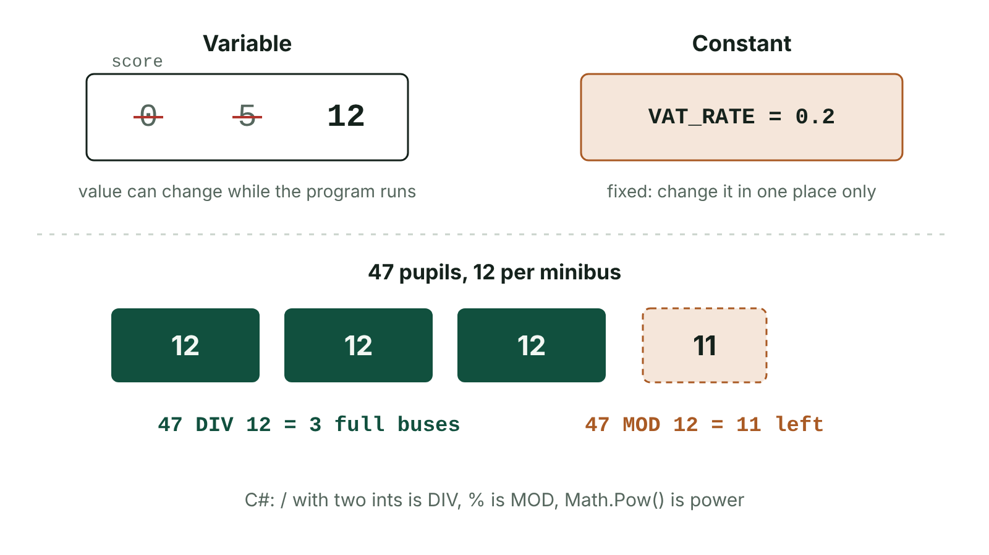
The big picture
A variable whose value changes compared with a constant, and DIV and MOD
☰ Menu
Notes:
Explain the diagram in your own words before you read on.

Slide 7
Variables
A variable is a named location in memory that stores a value
The value can change while the program runs
Use meaningful identifiers: totalCost, not x
Must be given a value (initialised) before it is used – e.g. total ← 0 before a running total
☰ Menu

Slide 8
Constants
A constant is a named value that does not change while the program runs
Examples: const double VAT_RATE = 0.2; const double MILES_TO_KM = 1.609; const int MAX_PUPILS = 30;
Benefits: improves readability (a name not a 'magic number'); easier maintenance – change it in one place; prevents the value being changed by mistake
2025 examiners: many explained what a constant is instead of giving an advantage
☰ Menu

Slide 9
Input, output, assignment
Input: takes data from the user (keyboard) into a variable – Console.ReadLine()
Output: displays data/results on screen – Console.WriteLine()
Assignment: stores a value in a variable – ← in pseudocode, = in C#
Every statement in C# ends with a semicolon ;
☰ Menu

Slide 10
Input, output, assignment – code
C#
const double MILES_TO_KM = 1.609; // constant
Console.Write("Name: ");
string name = Console.ReadLine(); // input
Console.Write("Miles walked: ");
double miles = Convert.ToDouble(Console.ReadLine());
double km = miles * MILES_TO_KM; // assignment
Console.WriteLine(name + " walked " + Math.Round(km, 2) + " km"); // output
☰ Menu

Slide 11
Arithmetic operators
Operation | Pseudocode | C# | Example → result
Add / subtract | + - | + - | 7 + 2 → 9
Multiply | * | * | 7 * 2 → 14
Divide | / | / (with a double) | 7.0 / 2 → 3.5
Integer division | DIV | / (both int) | 7 / 2 → 3
Modulo (remainder) | MOD | % | 7 % 2 → 1
Power | ^ | Math.Pow | Math.Pow(2, 3) → 8
☰ Menu

Slide 12
Using MOD and DIV
MOD finds remainders: n MOD 2 = 0 means n is even
DIV gives whole groups: 47 pupils DIV 12 per minibus = 3 full buses, 47 MOD 12 = 11 left over
Order of operations: brackets, powers, × ÷, + −
☰ Menu

Slide 13
Using MOD and DIV – code
C#
int pupils = 47;
int buses = pupils / 12; // DIV: both int, so 3
int leftOver = pupils % 12; // MOD: 11
Console.WriteLine(buses + " full buses, " + leftOver + " pupils left");
☰ Menu

Slide 14
Relational and Boolean operators
== equal to, != not equal to, <, >, <=, >=
&& (AND), || (OR), ! (NOT) combine conditions
Remember: = assigns, == compares
☰ Menu

Slide 15
Exit quiz: question 1 of 5
Tap an answer to check it. Presenting? Click to reveal the answer.
Which value should be a constant?
A A pupil's score
B The VAT rate
✗
✓
C A running total
D The user's name
✗
✗
✓ B: The VAT rate
☰ Menu

Slide 16
Exit quiz: question 2 of 5
Tap an answer to check it. Presenting? Click to reveal the answer.
What is 14 MOD 4?
A 3
B 2
✗
✓
C 3.5
D 1
✗
✗
✓ B: 2
☰ Menu

Slide 17
Exit quiz: question 3 of 5
Tap an answer to check it. Presenting? Click to reveal the answer.
What is 14 DIV 4?
A 3
B 2
✓
✗
C 3.5
D 4
✗
✗
✓ A: 3
☰ Menu

Slide 18
Exit quiz: question 4 of 5
Tap an answer to check it. Presenting? Click to reveal the answer.
Which is an assignment?
A OUTPUT total
B total ← total + 1
✗
✓
C IF total > 10
D INPUT total
✗
✗
✓ B: total ← total + 1
☰ Menu

Slide 19
Exit quiz: question 5 of 5
Tap an answer to check it. Presenting? Click to reveal the answer.
An advantage of a constant is…
A it changes automatically
B it only needs updating in one place
✗
✓
C it uses no memory
D it speeds up the CPU
✗
✗
✓ B: it only needs updating in one place
☰ Menu

Slide 20
Exit quiz answers
Q | Answer
1 | B The VAT rate
2 | B 2
3 | A 3
4 | B total ← total + 1
5 | B it only needs updating in one place
☰ Menu

Slide 21
In the exam
Paper | Question | Marks | What it tested
Unit 4 2019 | Q1 | 18 | Data types, range and presence checks, extending a program, IDE features, translation
Unit 4 2019 | Q2 | 13 | Variables and constants; miles-to-km algorithm with running total
Unit 4 2023 | Q3 | 12 | Data types; constants and a benefit; sales total and average algorithm
Unit 4 2025 | Q6 | 25 | Tent hire algorithm; Boolean; constants; validation true/false; Y/N validation loop
Papers and mark schemes: ccea.org.uk → GCSE Digital Technology → Past Papers & Mark Schemes.
☰ Menu

Slide 22
Selection: IF, ELSE IF and nested IF
UNIT 4: DIGITAL DEVELOPMENT CONCEPTS · D15
Learning objectives
Describe sequence and selection
Write IF, IF–ELSE and multi-branch selection in pseudocode and C#
Write tiered-pricing algorithms using single-condition IFs
Notes:
Specification: Controlling the flow of a program through sequence, selection and iteration (selection)

Slide 23
In this lesson
Tap a button to jump straight there. The ☰ Menu button on every slide brings you back here.
The big picture
Nested IF
Sequence and selection
Testing selection
IF and IF–ELSE
Exit quiz
Multi-branch: ELSE IF
↑ Topic menu
Single-condition IFs (exam style)
Notes:
Lesson menu: each button jumps to that part of the lesson in Slide Show. The ☰ Menu button on each slide returns here.

Slide 24
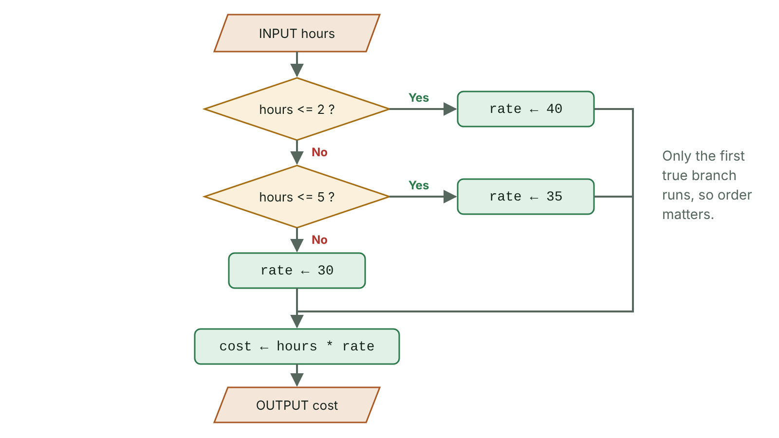
The big picture
Flowchart of an IF, ELSE IF, ELSE price calculation
☰ Menu
Notes:
Explain the diagram in your own words before you read on.

Slide 25
Sequence and selection
Sequence: statements run one after another in order – order matters (calculate a total before outputting it)
Selection: the program chooses which statements to run depending on whether a condition is True
Implemented with if, if–else and else if statements
☰ Menu

Slide 26
IF and IF–ELSE
PSEUDOCODE
C#
INPUT mark
IF mark >= 50 THEN
OUTPUT "Pass"
ELSE
OUTPUT "Fail"
END IF
Console.Write("Mark: ");
int mark = Convert.ToInt32(Console.ReadLine());
if (mark >= 50)
{
Console.WriteLine("Pass");
}
else
{
Console.WriteLine("Fail");
}
☰ Menu

Slide 27
Multi-branch: ELSE IF
Conditions are checked in order – the first True branch runs and the rest are skipped
So a later condition does not need to repeat earlier checks
else has no condition and comes last
☰ Menu

Slide 28
Multi-branch: ELSE IF – code
C#
Console.Write("Hours booked: ");
int hours = Convert.ToInt32(Console.ReadLine());
int rate;
if (hours <= 2)
{
rate = 40;
}
else if (hours <= 5)
{
rate = 35;
}
else
{
rate = 30;
}
int cost = hours * rate;
Console.WriteLine("Cost: £" + cost);
☰ Menu

Slide 29
Single-condition IFs (exam style)
Some questions say 'use only one condition in each IF' – you must follow this (2025 Q3 examiners)
Use separate IFs with one comparison each, or an ELSE IF chain
Every bullet point in the question usually earns a mark – tick them off
PSEUDOCODE
IF numPupils < 20 THEN
costPerPupil ← 15
END IF
IF numPupils >= 20 THEN
costPerPupil ← 12
END IF
total ← numPupils * costPerPupil
OUTPUT total
☰ Menu

Slide 30
Nested IF
An IF inside another IF – the inner condition is only tested if the outer one is True
Useful when a second decision depends on the first
☰ Menu

Slide 31
Nested IF – code
C#
Console.Write("Member? Y/N ");
string member = Console.ReadLine();
Console.Write("Age: ");
int age = Convert.ToInt32(Console.ReadLine());
if (member == "Y")
{
if (age < 18)
Console.WriteLine("Junior member price £3");
else
Console.WriteLine("Member price £5");
}
else
{
Console.WriteLine("Visitor price £8");
}
☰ Menu

Slide 32
Testing selection
Test every branch: a value for each band
Test the boundaries: e.g. hours = 2, 3, 5, 6
Common errors: using > where >= is needed; using = instead of ==
☰ Menu

Slide 33
Exit quiz: question 1 of 5
Tap an answer to check it. Presenting? Click to reveal the answer.
x = 15. IF x > 10 AND x < 20 THEN OUTPUT 'Yes' ELSE 'No'
A Yes
B No
✓
✗
C Error
D Nothing
✗
✗
✓ A: Yes
☰ Menu

Slide 34
Exit quiz: question 2 of 5
Tap an answer to check it. Presenting? Click to reveal the answer.
In C#, which keywords add another condition after an if?
A else
B else if
✗
✓
C then
D elif
✗
✗
✓ B: else if
☰ Menu

Slide 35
Exit quiz: question 3 of 5
Tap an answer to check it. Presenting? Click to reveal the answer.
int score = 50; if (score > 50) "Merit" else if (score >= 40) "Pass" else "Fail"
A Merit
B Pass
✗
✓
C Fail
D Merit Pass
✗
✗
✓ B: Pass
☰ Menu

Slide 36
Exit quiz: question 4 of 5
Tap an answer to check it. Presenting? Click to reveal the answer.
An IF inside another IF is…
A a loop
B a nested IF
✗
✓
C a function
D an array
✗
✗
✓ B: a nested IF
☰ Menu

Slide 37
Exit quiz: question 5 of 5
Tap an answer to check it. Presenting? Click to reveal the answer.
Which construct runs statements in order?
A Sequence
B Selection
✓
✗
C Iteration
D Recursion
✗
✗
✓ A: Sequence
☰ Menu

Slide 38
Exit quiz answers
Q | Answer
1 | A Yes
2 | B else if
3 | B Pass
4 | B a nested IF
5 | A Sequence
☰ Menu

Slide 39
In the exam
Paper | Question | Marks | What it tested
Unit 4 2023 | Q6 | 10 | Candle shop billing algorithm; storing data in files
Unit 4 2024 | Q1 | 4 | Dry-run a nested IF (shape calculator)
Unit 4 2024 | Q3 | 17 | Travel insurance cost algorithm; validation; real data type; WHILE range-check loop
Unit 4 2025 | Q1 | 5 | String type, compound AND, IF output, NOT/AND table, bubble sort
Unit 4 2025 | Q3 | 15 | Musician hire algorithm; variables and data types; IDE aids; syntax vs logic
Unit 4 2025 | Q6 | 25 | Tent hire algorithm; Boolean; constants; validation true/false; Y/N validation loop
5 more past questions on the website. Papers and mark schemes: ccea.org.uk → GCSE Digital Technology → Past Papers & Mark Schemes.
☰ Menu

Slide 40
Iteration: FOR, WHILE and REPEAT loops
UNIT 4: DIGITAL DEVELOPMENT CONCEPTS · D16
Learning objectives
Describe bounded (count-controlled) and unbounded (condition-controlled) iteration
Write FOR and WHILE loops including running totals and counters
Use sentinel values and avoid infinite loops
Notes:
Specification: Controlling the flow of a program through sequence, selection and iteration (iteration)

Slide 41
In this lesson
Tap a button to jump straight there. The ☰ Menu button on every slide brings you back here.
The big picture
Running totals and counters
Iteration
Infinite loops and errors
FOR loops
Exit quiz
WHILE loops
↑ Topic menu
REPEAT…UNTIL
Notes:
Lesson menu: each button jumps to that part of the lesson in Slide Show. The ☰ Menu button on each slide returns here.

Slide 42
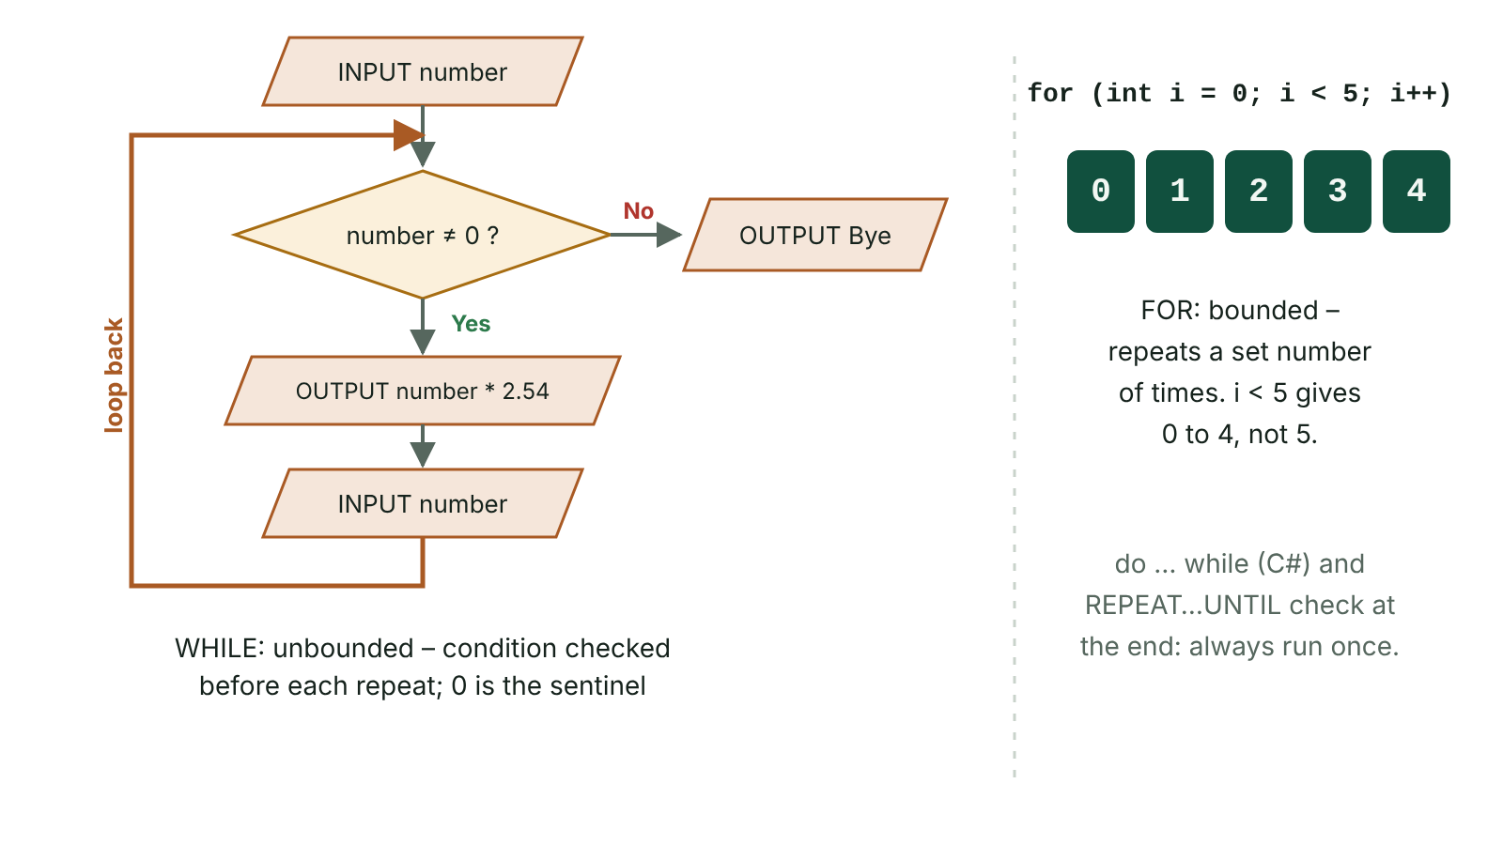
The big picture
Flowchart of a WHILE loop with a sentinel value, and a FOR loop counting
☰ Menu
Notes:
Explain the diagram in your own words before you read on.

Slide 43
Iteration
Iteration means repeating a block of code
Bounded (count-controlled): repeats a known number of times – FOR loop
Unbounded (condition-controlled): repeats until a condition changes – WHILE or REPEAT UNTIL
Avoids writing the same statements many times
☰ Menu

Slide 44
FOR loops
PSEUDOCODE
C#
total ← 0
FOR count ← 1 TO 5
INPUT mark
total ← total + mark
NEXT count
OUTPUT total / 5
int total = 0;
for (int count = 1; count <= 5; count++)
{
Console.Write("Mark: ");
int mark = Convert.ToInt32(Console.ReadLine());
total = total + mark;
}
Console.WriteLine("Average: " + (double)total / 5);
☰ Menu

Slide 45
WHILE loops
The condition is checked before each repeat – the loop may run zero times
The loop variable must be initialised before the loop
Something inside the loop must eventually make the condition False
☰ Menu

Slide 46
WHILE loops – code
C#
Console.Write("Inches (0 to stop): ");
int inches = Convert.ToInt32(Console.ReadLine());
while (inches != 0)
{
Console.WriteLine(inches * 2.54 + " cm");
Console.Write("Inches (0 to stop): ");
inches = Convert.ToInt32(Console.ReadLine());
}
Console.WriteLine("Goodbye");
☰ Menu

Slide 47
REPEAT…UNTIL
Condition checked at the end – the loop always runs at least once
C# uses do … while: it repeats WHILE the condition is true (REPEAT UNTIL stops when it becomes true)
C#
string answer;
do
{
Console.Write("Continue? Y/N ");
answer = Console.ReadLine();
} while (answer != "Y" && answer != "N");
Console.WriteLine("You chose " + answer);
☰ Menu

Slide 48
Running totals and counters
Running total: total ← total + value inside the loop; initialise total ← 0 before it
Counter: count ← count + 1 to count how many items meet a condition
Calculations using the total (e.g. average) and final outputs go AFTER the loop (2025 examiners: outputs inside the loop got no credit)
☰ Menu

Slide 49
Infinite loops and errors
An infinite loop never ends because its condition never becomes False
Causes: forgetting to change the loop variable; wrong comparison (e.g. while inches > 0 when the stop value is 0)
Off-by-one errors: for (int i = 1; i < 10; i++) stops at 9 – use <= 10 to include 10
Dry run loops carefully, checking the condition each time
☰ Menu

Slide 50
Exit quiz: question 1 of 5
Tap an answer to check it. Presenting? Click to reveal the answer.
Which loop is count-controlled?
A WHILE
B REPEAT UNTIL
✗
✗
C FOR
D IF
✓
✗
✓ C: FOR
☰ Menu

Slide 51
Exit quiz: question 2 of 5
Tap an answer to check it. Presenting? Click to reveal the answer.
How many times does for (int i = 3; i < 7; i++) run?
A 3
B 4
✗
✓
C 5
D 7
✗
✗
✓ B: 4 – i = 3, 4, 5, 6
☰ Menu

Slide 52
Exit quiz: question 3 of 5
Tap an answer to check it. Presenting? Click to reveal the answer.
x ← 10; WHILE x > 0: x ← x - 3; OUTPUT x
A 0
B 1
✗
✗
C -2
D -1
✓
✗
✓ C: -2 – 10, 7, 4, 1, -2
☰ Menu

Slide 53
Exit quiz: question 4 of 5
Tap an answer to check it. Presenting? Click to reveal the answer.
Where should the output of a final total go?
A Inside the loop
B After the loop
✗
✓
C Before the loop
D In the condition
✗
✗
✓ B: After the loop
☰ Menu

Slide 54
Exit quiz: question 5 of 5
Tap an answer to check it. Presenting? Click to reveal the answer.
A loop that never ends is…
A a nested loop
B an infinite loop
✗
✓
C a bounded loop
D a sentinel
✗
✗
✓ B: an infinite loop
☰ Menu

Slide 55
Exit quiz answers
Q | Answer
1 | C FOR
2 | B 4 – i = 3, 4, 5, 6
3 | C -2 – 10, 7, 4, 1, -2
4 | B After the loop
5 | B an infinite loop
☰ Menu

Slide 56
In the exam
Paper | Question | Marks | What it tested
Unit 4 2019 | Q4 | 3 | Sequence, selection, iteration
Unit 4 2023 | Q3 | 12 | Data types; constants and a benefit; sales total and average algorithm
Unit 4 2024 | Q2 | 3 | Tracing FOR and WHILE loops
Unit 4 2024 | Q7 | 35 | Arrays, pseudocode, FOR/WHILE totals, minimum, bubble sort, linear and binary search
Unit 4 2025 | Q2 | 12 | Loop output, nested loops, loop count, infinite loop, fixing a condition
Unit 4 2025 | Q8 | 20 | Array properties, initialise, count, WHILE totals
1 more past questions on the website. Papers and mark schemes: ccea.org.uk → GCSE Digital Technology → Past Papers & Mark Schemes.
☰ Menu

Slide 57
One-dimensional arrays
UNIT 4: DIGITAL DEVELOPMENT CONCEPTS · D17
Learning objectives
Describe an array and its index
Initialise, access, update and loop through an array
Use arrays with running totals, counts, maximum and minimum
Notes:
Specification: One-dimensional array structures

Slide 58
In this lesson
Tap a button to jump straight there. The ☰ Menu button on every slide brings you back here.
The big picture
Using a WHILE loop with an array
What is an array?
Finding the minimum or maximum
Creating and accessing
Exit quiz
Initialising with a loop
↑ Topic menu
Total, count, average
Notes:
Lesson menu: each button jumps to that part of the lesson in Slide Show. The ☰ Menu button on each slide returns here.

Slide 59
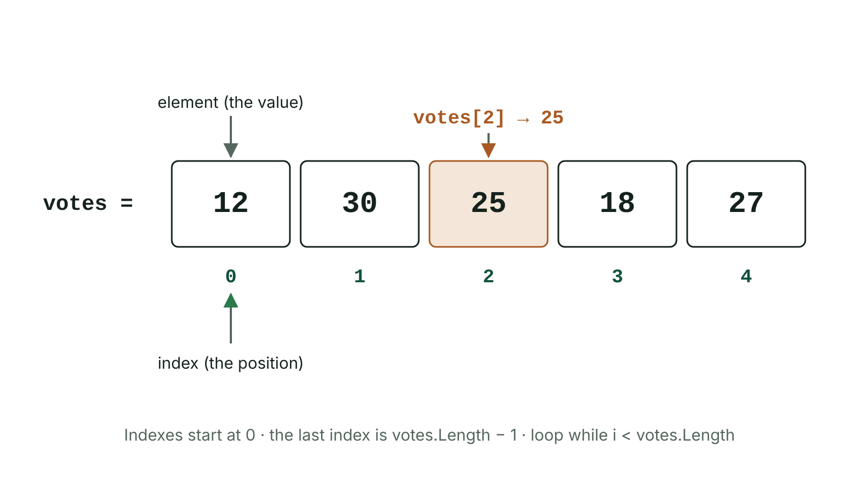
The big picture
An array of five votes showing elements and zero-based indexes
☰ Menu
Notes:
Explain the diagram in your own words before you read on.

Slide 60
What is an array?
An array is a data structure that stores many values of the same data type under one name
Each value is an element; its position is its index
Indexes start at 0 (zero-indexed) – the first element is cars[0]
The index is the position, not the value stored there
In C#, an array has a fixed size set when it is created: int[] cars = new int[7];
☰ Menu

Slide 61
Creating and accessing
PSEUDOCODE
C#
DECLARE votes[5]
votes[0] ← 12
OUTPUT votes[2]
int[] votes = { 12, 30, 25, 18, 27 }; // 5 elements, indexes 0-4
Console.WriteLine(votes[0]); // 12 – first element
Console.WriteLine(votes[4]); // 27 – last element
votes[2] = 26; // update the third element
Console.WriteLine(votes.Length); // 5
string[] names = new string[3]; // empty array of 3 strings
names[0] = "Ali";
☰ Menu

Slide 62
Initialising with a loop
2024 Q7(c)(i), 2023 Q9(a)(iii), 2025 Q8(b)(i): set every element to 0 – you must use a loop when asked
Use the array name given in the question
C#
int[] sales = new int[8];
for (int i = 0; i < 8; i++)
{
sales[i] = 0;
}
☰ Menu

Slide 63
Total, count, average
C#
int[] cars = { 120, 95, 143, 101, 88, 60, 72 };
int total = 0;
int busyDays = 0;
for (int i = 0; i < cars.Length; i++)
{
total = total + cars[i];
if (cars[i] > 100)
{
busyDays = busyDays + 1;
}
}
Console.WriteLine("Total: " + total);
Console.WriteLine("Average: " + (double)total / cars.Length);
Console.WriteLine("Busy days: " + busyDays);
☰ Menu

Slide 64
Using a WHILE loop with an array
Use a counter as the index; increase it inside the loop
Condition: index < length of array
Outputs after the loop
☰ Menu

Slide 65
Using a WHILE loop with an array – code
C#
int[] tickets = { 105, 98, 120, 87 };
int i = 0;
int total = 0;
while (i < tickets.Length)
{
total = total + tickets[i];
i = i + 1;
}
Console.WriteLine("Tickets sold: " + total);
Console.WriteLine("Money collected: £" + total * 2);
☰ Menu

Slide 66
Finding the minimum or maximum
Start with the first element as the 'best so far'
Loop through the rest, replacing it when a smaller (or larger) value is found
C#
int[] heights = { 151, 163, 148, 170, 159 };
int tallest = heights[0];
for (int i = 1; i < heights.Length; i++)
{
if (heights[i] > tallest)
{
tallest = heights[i];
}
}
Console.WriteLine("Tallest: " + tallest);
☰ Menu

Slide 67
Exit quiz: question 1 of 5
Tap an answer to check it. Presenting? Click to reveal the answer.
string[] names = { "Ali", "Bea", "Cal" }; names[1] is…
A Ali
B Bea
✗
✓
C Cal
D Error
✗
✗
✓ B: Bea – Zero-indexed.
☰ Menu

Slide 68
Exit quiz: question 2 of 5
Tap an answer to check it. Presenting? Click to reveal the answer.
The index of the first element is…
A 1
B 0
✗
✓
C -1
D Its value
✗
✗
✓ B: 0
☰ Menu

Slide 69
Exit quiz: question 3 of 5
Tap an answer to check it. Presenting? Click to reveal the answer.
Which loop processes every element of a 10-element array?
A for (int i = 0; i < 10; i++)
B for (int i = 1; i < 10; i++)
✓
✗
C for (int i = 0; i <= 10; i++)
D while (i > 10)
✗
✗
✓ A: for (int i = 0; i < 10; i++) – Indexes 0 to 9; i <= 10 would go out of bounds.
☰ Menu

Slide 70
Exit quiz: question 4 of 5
Tap an answer to check it. Presenting? Click to reveal the answer.
To find the largest value you should start with…
A largest = 0 always
B largest = the first element
✗
✓
C largest = the last index
D largest = array.Length
✗
✗
✓ B: largest = the first element – Safer than 0.
☰ Menu

Slide 71
Exit quiz: question 5 of 5
Tap an answer to check it. Presenting? Click to reveal the answer.
int[] arr = { 3, 6, 9 }; arr[0] + arr[2] =
A 9
B 12
✗
✓
C 15
D 18
✗
✗
✓ B: 12
☰ Menu

Slide 72
Exit quiz answers
Q | Answer | Why
1 | B Bea | Zero-indexed.
2 | B 0
3 | A for (int i = 0; i < 10; i++) | Indexes 0 to 9; i <= 10 would go out of bounds.
4 | B largest = the first element | Safer than 0.
5 | B 12
☰ Menu

Slide 73
In the exam
Paper | Question | Marks | What it tested
Unit 4 2022 | Q7 | 18 | Array indexing; weekly totals and average algorithm; functions and their benefits
Unit 4 2023 | Q9 | 18 | Arrays: update, reset to zero, find maximum; bubble sort steps; searching sorted data
Unit 4 2024 | Q7 | 35 | Arrays, pseudocode, FOR/WHILE totals, minimum, bubble sort, linear and binary search
Unit 4 2025 | Q8 | 20 | Array properties, initialise, count, WHILE totals
Papers and mark schemes: ccea.org.uk → GCSE Digital Technology → Past Papers & Mark Schemes.
☰ Menu

Slide 74
String manipulation
UNIT 4: DIGITAL DEVELOPMENT CONCEPTS · D18
Learning objectives
Use concatenation, Length, indexing and Substring
Split strings and search for characters and substrings
Apply string functions to validation problems
Notes:
Specification: String manipulation functions, including splitting, concatenating, character searching and substring searching

Slide 75
In this lesson
Tap a button to jump straight there. The ☰ Menu button on every slide brings you back here.
The big picture
Splitting and case
String basics
Strings for validation
Concatenation
Exit quiz
Substrings
↑ Topic menu
Searching
Notes:
Lesson menu: each button jumps to that part of the lesson in Slide Show. The ☰ Menu button on each slide returns here.

Slide 76
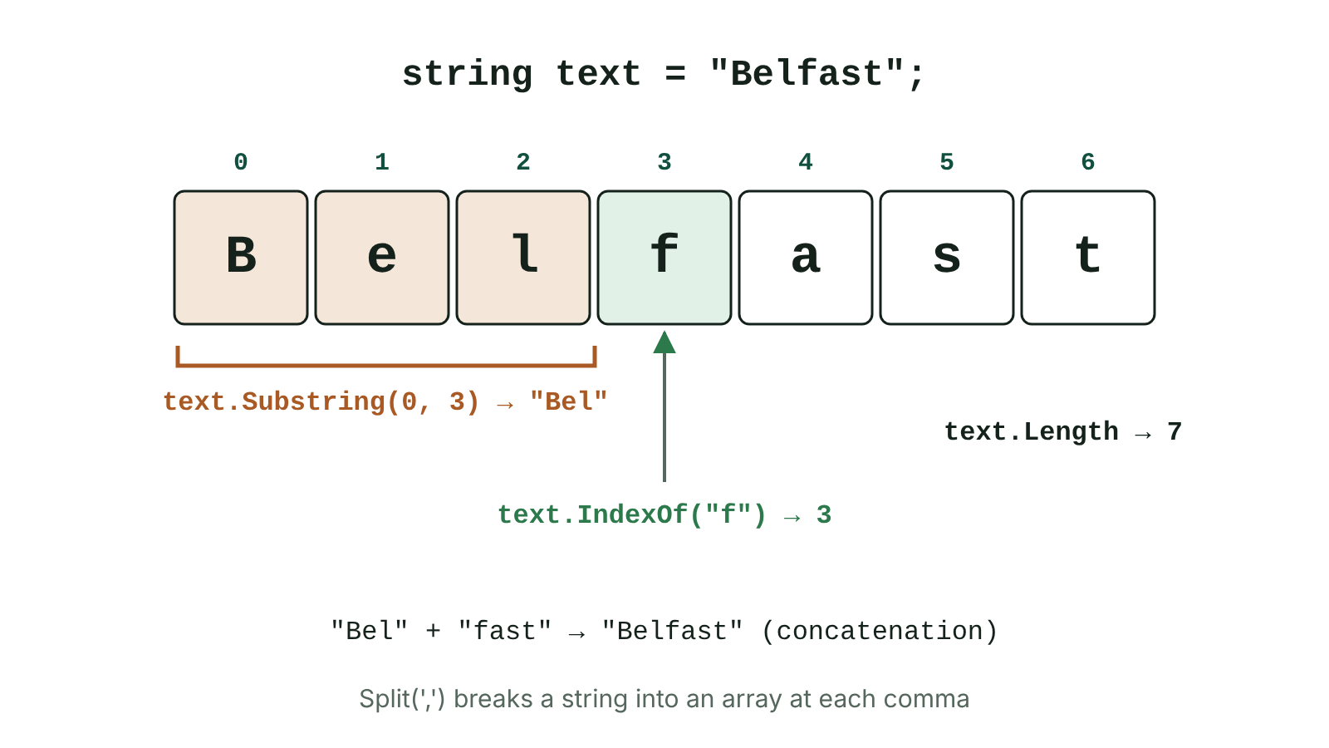
The big picture
String indexes, Substring, IndexOf and Length for the word Belfast
☰ Menu
Notes:
Explain the diagram in your own words before you read on.

Slide 77
String basics
A string is a sequence of characters, written in quotation marks
Each character has an index starting at 0
The Length property gives the number of characters (2022 Q4(c)(iii))
Compare strings with ==; for alphabetical order use string.Compare(a, b)
☰ Menu

Slide 78
String basics – code
C#
string name = "Enniskillen";
Console.WriteLine(name.Length); // 11
Console.WriteLine(name[0]); // E
Console.WriteLine(name[name.Length - 1]); // n (last character)
☰ Menu

Slide 79
Concatenation
Joining strings together with + (2022 Q4(c)(i)–(ii))
Numbers are converted to text automatically when joined to a string with + (or use ToString())
C#
string first = "Aoife";
string surname = "Taylor";
int year = 22;
string username = first[0] + surname + year;
Console.WriteLine(username); // ATaylor22
☰ Menu

Slide 80
Substrings
A substring is part of a string
Substring(start, length) – start index and number of characters
Substring(start) – from start to the end
☰ Menu

Slide 81
Substrings – code
C#
string postcode = "BT74 6AA";
Console.WriteLine(postcode.Substring(0, 2)); // BT
Console.WriteLine(postcode.Substring(5)); // 6AA
☰ Menu

Slide 82
Searching
Character/substring search: Contains() returns true/false; IndexOf() returns the position or -1
StartsWith() and EndsWith() check the beginning and end
☰ Menu

Slide 83
Searching – code
C#
string email = "j.smith@school.ni";
Console.WriteLine(email.Contains("@")); // True
Console.WriteLine(email.IndexOf("@")); // 7
Console.WriteLine(email.IndexOf("xyz")); // -1
☰ Menu

Slide 84
Splitting and case
Split(',') breaks a string into an array of parts at a separator
ToUpper()/ToLower() change case – useful to compare inputs
C#
string line = "Murphy,11B,87";
string[] parts = line.Split(',');
Console.WriteLine(parts[0]); // Murphy
Console.WriteLine(parts[2]); // 87
Console.Write("Y/N? ");
string answer = Console.ReadLine().ToUpper();
☰ Menu

Slide 85
Strings for validation
Length check: password.Length >= 8
Format check: password must end with a symbol – check password[password.Length - 1]
Presence check: name != ""
2023 Q5: password rules using length, presence and format checks plus two string functions
☰ Menu

Slide 86
Exit quiz: question 1 of 5
Tap an answer to check it. Presenting? Click to reveal the answer.
"Bel" + "fast" =
A Bel fast
B Belfast
✗
✓
C fastBel
D Error
✗
✗
✓ B: Belfast
☰ Menu

Slide 87
Exit quiz: question 2 of 5
Tap an answer to check it. Presenting? Click to reveal the answer.
"Derry".Length =
A 4
B 5
✗
✓
C 6
D 0
✗
✗
✓ B: 5
☰ Menu

Slide 88
Exit quiz: question 3 of 5
Tap an answer to check it. Presenting? Click to reveal the answer.
"Antrim".Substring(2, 2) =
A nt
B tr
✗
✓
C tri
D ntr
✗
✗
✓ B: tr – Start at index 2, take 2 characters.
☰ Menu

Slide 89
Exit quiz: question 4 of 5
Tap an answer to check it. Presenting? Click to reveal the answer.
"a,b,c".Split(',') gives…
A "abc"
B an array {"a", "b", "c"}
✗
✓
C 3
D {"a,b,c"}
✗
✗
✓ B: an array {"a", "b", "c"}
☰ Menu

Slide 90
Exit quiz: question 5 of 5
Tap an answer to check it. Presenting? Click to reveal the answer.
"jo@ni.uk".Contains("@") returns…
A true
B false
✓
✗
C 2
D -1
✗
✗
✓ A: true
☰ Menu

Slide 91
Exit quiz answers
Q | Answer
1 | B Belfast
2 | B 5
3 | B tr – Start at index 2, take 2 characters.
4 | B an array {"a", "b", "c"}
5 | A true
☰ Menu

Slide 92
In the exam
Paper | Question | Marks | What it tested
Unit 4 2022 | Q4 | 17 | Tiered pricing algorithm; validation loop 1–50; data types; string functions
Unit 4 2023 | Q5 | 8 | Length, presence and format checks; string functions for a password
Papers and mark schemes: ccea.org.uk → GCSE Digital Technology → Past Papers & Mark Schemes.
☰ Menu

Slide 93
Subroutines: user-defined functions and procedures
UNIT 4: DIGITAL DEVELOPMENT CONCEPTS · D19
Learning objectives
Define subroutine, procedure and function
Write functions with parameters and return values
Explain the benefits of user-defined functions
Notes:
Specification: Building reusable code that utilises user-defined functions or methods

Slide 94
In this lesson
Tap a button to jump straight there. The ☰ Menu button on every slide brings you back here.
The big picture
Benefits of user-defined functions
Subroutines
Built-in and mathematical functions
Parameters and return values
Exit quiz
A procedure
↑ Topic menu
Example: biggest of three
Notes:
Lesson menu: each button jumps to that part of the lesson in Slide Show. The ☰ Menu button on each slide returns here.

Slide 95
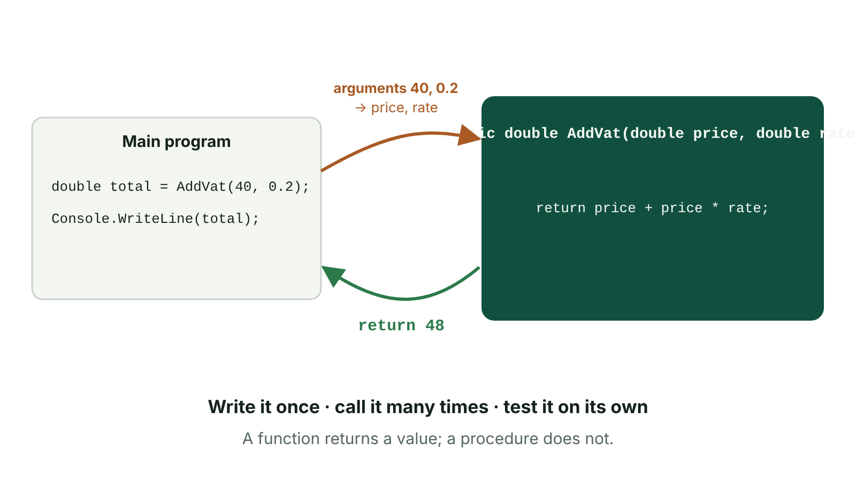
The big picture
A main program passing arguments into a function and receiving the return value
☰ Menu
Notes:
Explain the diagram in your own words before you read on.

Slide 96
Subroutines
A subroutine is a named block of code that carries out a specific task
It is defined once and can be called many times
Procedure: carries out a task, does not return a value
Function: carries out a task and returns a single value
In OOP, subroutines inside a class are called methods
☰ Menu

Slide 97
Parameters and return values
Parameters are the inputs a subroutine needs, listed with their data types in its definition
Arguments are the actual values passed when it is called
The return type (double, int, string, bool) says what a function sends back; return sends the value
☰ Menu

Slide 98
Parameters and return values – code
C#
static double AddVat(double price, double rate)
{
return price + price * rate;
}
double total = AddVat(40, 0.2);
Console.WriteLine(total); // 48
☰ Menu

Slide 99
A procedure
A procedure has the return type void – it does a job but returns nothing
C#
static void ShowMenu()
{
Console.WriteLine("1. Book a lesson");
Console.WriteLine("2. Cancel a lesson");
Console.WriteLine("3. Quit");
}
ShowMenu();
☰ Menu

Slide 100
Example: biggest of three
C#
static int Biggest(int a, int b, int c)
{
int big = a;
if (b > big) big = b;
if (c > big) big = c;
return big;
}
Console.WriteLine(Biggest(4, 19, 7)); // 19
☰ Menu

Slide 101
Benefits of user-defined functions
Code is written once and reused – shorter programs, less repetition
Easier to test and debug: each function can be tested on its own (unit testing)
Easier to maintain: fix or change it in one place
Supports decomposition: different programmers can write different functions
Makes programs easier to read – the name describes the task
Functions can be reused in other programs
☰ Menu

Slide 102
Built-in and mathematical functions
Built-in: Console.WriteLine(), Console.ReadLine(), Convert.ToInt32(), text.Length, ToUpper()
Mathematical: Math.Abs(), Math.Round(x, 2), Math.Sqrt(), Math.Pow(), and random numbers with new Random().Next(1, 7)
User-defined: written by the programmer, e.g. static int Biggest(int a, int b, int c)
☰ Menu

Slide 103
Exit quiz: question 1 of 5
Tap an answer to check it. Presenting? Click to reveal the answer.
A subroutine that returns a value is a…
A procedure
B function
✗
✓
C loop
D constant
✗
✗
✓ B: function
☰ Menu

Slide 104
Exit quiz: question 2 of 5
Tap an answer to check it. Presenting? Click to reveal the answer.
In static int Total(int a, int b), a and b are…
A return values
B parameters
✗
✓
C constants
D indexes
✗
✗
✓ B: parameters
☰ Menu

Slide 105
Exit quiz: question 3 of 5
Tap an answer to check it. Presenting? Click to reveal the answer.
Which is a benefit of functions?
A Code is repeated many times
B Each part can be tested separately
✗
✓
C Programs run without a CPU
D They remove the need for variables
✗
✗
✓ B: Each part can be tested separately
☰ Menu

Slide 106
Exit quiz: question 4 of 5
Tap an answer to check it. Presenting? Click to reveal the answer.
Which keyword sends a value back from a C# function?
A Console.WriteLine
B return
✗
✓
C void
D static
✗
✗
✓ B: return
☰ Menu

Slide 107
Exit quiz: question 5 of 5
Tap an answer to check it. Presenting? Click to reveal the answer.
Math.Round() is an example of a…
A user-defined function
B built-in function
✗
✓
C procedure
D class
✗
✗
✓ B: built-in function
☰ Menu

Slide 108
Exit quiz answers
Q | Answer
1 | B function
2 | B parameters
3 | B Each part can be tested separately
4 | B return
5 | B built-in function
☰ Menu

Slide 109
In the exam
Paper | Question | Marks | What it tested
Unit 4 2022 | Q7 | 18 | Array indexing; weekly totals and average algorithm; functions and their benefits
Unit 4 2023 | Q4 | 23 | Decomposition and abstraction; flowchart symbols; syntax/logic errors; functions; menu validation loop
Papers and mark schemes: ccea.org.uk → GCSE Digital Technology → Past Papers & Mark Schemes.
☰ Menu

Slide 110
Basic file handling
UNIT 4: DIGITAL DEVELOPMENT CONCEPTS · D20
Learning objectives
Explain why programs store data in files
Open, write to, append to, read and close a text file
Process records read from a file
Notes:
Specification: Basic file handling

Slide 111
In this lesson
Tap a button to jump straight there. The ☰ Menu button on every slide brings you back here.
The big picture
File handling functions
Why use files?
Errors with files
Three steps
Exit quiz
Writing and appending
↑ Topic menu
Reading
Notes:
Lesson menu: each button jumps to that part of the lesson in Slide Show. The ☰ Menu button on each slide returns here.

Slide 112
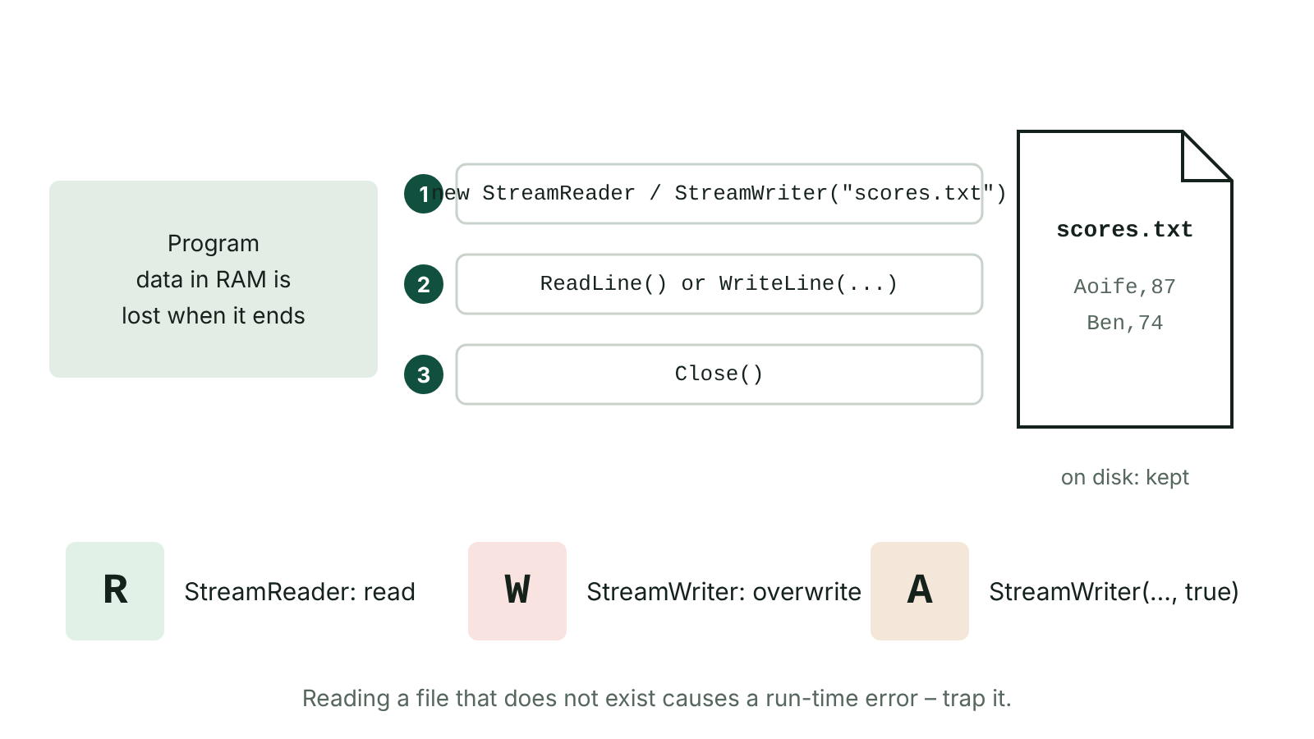
The big picture
Opening, reading or writing, and closing a text file, with read, write and append modes
☰ Menu
Notes:
Explain the diagram in your own words before you read on.

Slide 113
Why use files?
Variables are held in RAM, which is volatile – data is lost when the program ends
Saving to a file gives persistent storage on non-volatile media (disk/SSD)
Data can be loaded next time or shared with other programs and users
2023 Q6(b): explain how orders could be stored for later reports
☰ Menu

Slide 114
Three steps
1. Open the file, choosing a mode
2. Read from it or write to it
3. Close it – always, or data may be lost or the file left locked
Mode | C# | Effect
Read | new StreamReader("scores.txt") | Read from the start of an existing file
Write | new StreamWriter("scores.txt") | Create a new file or overwrite an existing one
Append | new StreamWriter("scores.txt", true) | Add to the end of the file without deleting existing data
☰ Menu

Slide 115
Writing and appending
C#
StreamWriter sw = new StreamWriter("scores.txt"); // write
sw.WriteLine("Aoife,87");
sw.WriteLine("Ben,74");
sw.Close();
StreamWriter sa = new StreamWriter("scores.txt", true); // append
sa.WriteLine("Cara,91");
sa.Close();
☰ Menu

Slide 116
Reading
Run 'Writing and appending' first – files are kept while this page is open
ReadLine() returns null at the end of the file
☰ Menu

Slide 117
Reading – code
C#
StreamReader sr = new StreamReader("scores.txt");
string line = sr.ReadLine();
while (line != null)
{
string[] parts = line.Split(',');
Console.WriteLine(parts[0] + " scored " + parts[1]);
line = sr.ReadLine();
}
sr.Close();
☰ Menu

Slide 118
File handling functions
Open: new StreamReader(...) / new StreamWriter(...) opens or creates a file (add using System.IO; at the top)
ReadLine() reads one line; ReadToEnd() reads the whole file; File.ReadAllLines() reads every line into an array
WriteLine() writes a line of text
Close() closes the file – always do this
Also: append mode, File.Exists() to check a file exists, File.Delete() to delete one
2022 Q9(a): name and describe two file handling functions other than read and write
☰ Menu

Slide 119
Errors with files
Opening a file that does not exist for reading causes an execution (run-time) error
Trap it with try … catch (FileNotFoundException), or check File.Exists() first
Opening a StreamWriter without append (true) overwrites all existing data
☰ Menu

Slide 120
Exit quiz: question 1 of 5
Tap an answer to check it. Presenting? Click to reveal the answer.
Which C# statement opens scores.txt to add data to the end?
A new StreamReader("scores.txt")
B new StreamWriter("scores.txt")
✗
✗
C new StreamWriter("scores.txt", true)
D File.Delete("scores.txt")
✓
✗
✓ C: new StreamWriter("scores.txt", true)
☰ Menu

Slide 121
Exit quiz: question 2 of 5
Tap an answer to check it. Presenting? Click to reveal the answer.
Why are files used?
A To make programs faster
B To store data permanently
✗
✓
C To translate code
D To create loops
✗
✗
✓ B: To store data permanently
☰ Menu

Slide 122
Exit quiz: question 3 of 5
Tap an answer to check it. Presenting? Click to reveal the answer.
What should happen after writing to a file?
A Delete it
B Close it
✗
✓
C Compile it
D Reopen it in w mode
✗
✗
✓ B: Close it
☰ Menu

Slide 123
Exit quiz: question 4 of 5
Tap an answer to check it. Presenting? Click to reveal the answer.
Opening an existing file with new StreamWriter("data.txt") will…
A add to it
B overwrite it
✗
✓
C read it
D lock it forever
✗
✗
✓ B: overwrite it
☰ Menu

Slide 124
Exit quiz: question 5 of 5
Tap an answer to check it. Presenting? Click to reveal the answer.
Which splits a CSV line into fields?
A line.Split(',')
B line.Length
✓
✗
C sr.Close()
D line.ToUpper()
✗
✗
✓ A: line.Split(',')
☰ Menu

Slide 125
Exit quiz answers
Q | Answer
1 | C new StreamWriter("scores.txt", true)
2 | B To store data permanently
3 | B Close it
4 | B overwrite it
5 | A line.Split(',')
☰ Menu

Slide 126
In the exam
Paper | Question | Marks | What it tested
Unit 4 2022 | Q9 | 7 | File handling functions; three error types
Unit 4 2023 | Q6 | 10 | Candle shop billing algorithm; storing data in files
Papers and mark schemes: ccea.org.uk → GCSE Digital Technology → Past Papers & Mark Schemes.
☰ Menu

