Slide 1
Simple error handling techniques
UNIT 4: DIGITAL DEVELOPMENT CONCEPTS · TOPIC
Lessons in this topic
D21 Validation, error types and error trapping

Slide 2

Topic menu
Tap a button to jump straight there. The ☰ Menu button on every slide brings you back here.
Specification map
D21 Validation, error types and error trapping

Slide 3
Specification map
Lesson | Specification: students should be able to
D21 | Data validation, including presence, length, type and format checks; Detection and correction techniques for syntax, execution and logic errors; Simple error trapping techniques
☰ Menu
Notes:
Each lesson below is its own section in PowerPoint (View → Slide Sorter shows them). To split this deck by specification point, right-click a section → Move Section, or delete the sections you do not need.

Slide 4
Validation, error types and error trapping
UNIT 4: DIGITAL DEVELOPMENT CONCEPTS · D21
Learning objectives
Describe presence, length, type, format and range checks and write validation loops
Distinguish syntax, execution (run-time) and logic errors and how each is found
Use try … catch to trap errors
Notes:
Specification: Data validation, including presence, length, type and format checks | Detection and correction techniques for syntax, execution and logic errors | Simple error trapping techniques

Slide 5
In this lesson
Tap a button to jump straight there. The ☰ Menu button on every slide brings you back here.
The big picture
Error trapping
Validation
How error trapping improves a program
Validation loops
Exit quiz
Three types of error
↑ Topic menu
Detecting and correcting errors
Notes:
Lesson menu: each button jumps to that part of the lesson in Slide Show. The ☰ Menu button on each slide returns here.

Slide 6
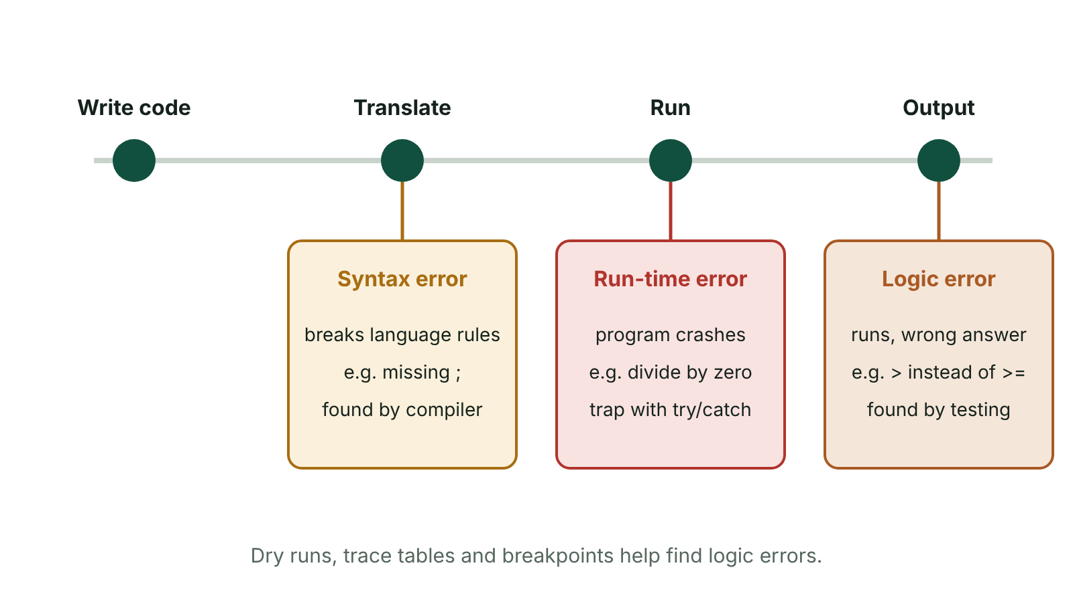
The big picture
When syntax, run-time and logic errors appear during development
☰ Menu
Notes:
Explain the diagram in your own words before you read on.

Slide 7
Validation (1 of 2)
Validation is an automatic check that input data is sensible and follows set rules before it is used
Garbage in, garbage out: wrong input gives wrong output
Validation CANNOT tell whether data is correct – 21 instead of 22 for an age passes (2025 Q6(d)(i) common error)
Check | Purpose | Example (C#)
Presence | Field is not left empty | name != ""
Length | Number of characters is acceptable | password.Length >= 8
Type | Data is the right type | int.TryParse(input, out age)
Format | Matches a pattern | password ends with a symbol
☰ Menu

Slide 8
Validation (2 of 2)
Check | Purpose | Example (C#)
Range | Value is within limits | frames >= 10 && frames <= 50
☰ Menu

Slide 9
Validation loops
Keep asking until valid data is entered – use a WHILE (not a FOR) loop
Give an error message inside the loop
Use the variable names in the question; check AND vs OR carefully
☰ Menu

Slide 10
Validation loops – code
C#
Console.Write("Frames (10-40): ");
int frames = Convert.ToInt32(Console.ReadLine());
while (frames < 10 || frames > 40)
{
Console.WriteLine("Error: enter a number from 10 to 40");
Console.Write("Frames (10-40): ");
frames = Convert.ToInt32(Console.ReadLine());
}
Console.WriteLine("Accepted");
☰ Menu

Slide 11
Three types of error
Error | What it is | Example | How it is found
Syntax | Breaks the rules (grammar) of the language; the program will not compile | Missing semicolon ;, misspelt keyword (Consle), missing } or ), = instead of == | Compiler error list, IDE red underlining
Execution (run-time) | Program crashes while running | Divide by zero, missing file, index out of range, letters typed into Convert.ToInt32() | Crashes with an exception message; error trapping prevents it
Logic | Program runs but gives wrong output | Wrong formula, > instead of >=, int / int giving a whole number when a decimal was needed | Testing with expected results, dry runs, trace tables, breakpoints
☰ Menu

Slide 12
Detecting and correcting errors
Read the error message: type of error and line number
IDE tools: error highlighting, breakpoints, stepping, watching variables
Dry runs and trace tables for logic errors
Test with valid, invalid and extreme data so every path runs
Fix one error at a time and retest
☰ Menu

Slide 13
Error trapping
An exception is thrown when a run-time error happens
try … catch catches the exception and handles it instead of crashing
Lets the program show a helpful message and continue
☰ Menu

Slide 14
Error trapping – code
C#
try
{
Console.Write("First number: ");
int a = Convert.ToInt32(Console.ReadLine());
Console.Write("Second number: ");
int b = Convert.ToInt32(Console.ReadLine());
Console.WriteLine(a / b);
}
catch (FormatException)
{
Console.WriteLine("Please type whole numbers only");
}
catch (DivideByZeroException)
{
Console.WriteLine("You cannot divide by zero");
}
☰ Menu

Slide 15
How error trapping improves a program
The program does not crash – more robust
The user gets a clear message telling them how to fix the input
Data and work in progress are not lost
2022 Q10(b): define error trapping and explain one way it improves a program
☰ Menu

Slide 16
Exit quiz: question 1 of 5
Tap an answer to check it. Presenting? Click to reveal the answer.
A missing semicolon at the end of a C# statement is a…
A logic error
B syntax error
✗
✓
C run-time error
D overflow
✗
✗
✓ B: syntax error
☰ Menu

Slide 17
Exit quiz: question 2 of 5
Tap an answer to check it. Presenting? Click to reveal the answer.
Which error is found by comparing output with expected results?
A Syntax
B Logic
✗
✓
C Compile
D Type
✗
✗
✓ B: Logic
☰ Menu

Slide 18
Exit quiz: question 3 of 5
Tap an answer to check it. Presenting? Click to reveal the answer.
Checking that a password is at least 8 characters is a…
A presence check
B length check
✗
✓
C range check
D type check
✗
✗
✓ B: length check
☰ Menu

Slide 19
Exit quiz: question 4 of 5
Tap an answer to check it. Presenting? Click to reveal the answer.
Which C# construct traps run-time errors?
A if/else
B try/catch
✗
✓
C foreach
D static/return
✗
✗
✓ B: try/catch
☰ Menu

Slide 20
Exit quiz: question 5 of 5
Tap an answer to check it. Presenting? Click to reveal the answer.
while (x < 1 || x > 10) is a validation loop for…
A 1 to 10 inclusive
B below 1 only
✓
✗
C over 10 only
D exactly 10
✗
✗
✓ A: 1 to 10 inclusive – Repeats while out of range.
☰ Menu

Slide 21
Exit quiz answers
Q | Answer
1 | B syntax error
2 | B Logic
3 | B length check
4 | B try/catch
5 | A 1 to 10 inclusive – Repeats while out of range.
☰ Menu

Slide 22
In the exam
Paper | Question | Marks | What it tested
Unit 4 2023 | Q4 | 23 | Decomposition and abstraction; flowchart symbols; syntax/logic errors; functions; menu validation loop
Unit 4 2023 | Q5 | 8 | Length, presence and format checks; string functions for a password
Unit 4 2024 | Q3 | 17 | Travel insurance cost algorithm; validation; real data type; WHILE range-check loop
Unit 4 2024 | Q6 | 6 | Execution and logic errors and handling (QWC)
Unit 4 2025 | Q3 | 15 | Musician hire algorithm; variables and data types; IDE aids; syntax vs logic
Unit 4 2025 | Q6 | 25 | Tent hire algorithm; Boolean; constants; validation true/false; Y/N validation loop
6 more past questions on the website. Papers and mark schemes: ccea.org.uk → GCSE Digital Technology → Past Papers & Mark Schemes.
☰ Menu

