Slide 1
Developing test plans and testing a solution
UNIT 4: DIGITAL DEVELOPMENT CONCEPTS · TOPIC
Lessons in this topic
D22 Testing approaches, test plans and test data

Slide 2

Topic menu
Tap a button to jump straight there. The ☰ Menu button on every slide brings you back here.
Specification map
D22 Testing approaches, test plans and test data

Slide 3
Specification map
Lesson | Specification: students should be able to
D22 | Explain the following iterative approaches to testing: white box; black box; system, unit and integration testing; Create and use a test plan that identifies test procedures for use during and after development to check a system against success criteria; Devise and use the following types of test data: valid, invalid and extreme
☰ Menu
Notes:
Each lesson below is its own section in PowerPoint (View → Slide Sorter shows them). To split this deck by specification point, right-click a section → Move Section, or delete the sections you do not need.

Slide 4
Testing approaches, test plans and test data
UNIT 4: DIGITAL DEVELOPMENT CONCEPTS · D22
Learning objectives
Describe white box, black box, unit, integration and system testing
Explain iterative testing
Create a test plan with valid, invalid, extreme and null test data
Notes:
Specification: Explain the following iterative approaches to testing: white box; black box; system, unit and integration testing | Create and use a test plan that identifies test procedures for use during and after development to check a system against success criteria | Devise and use the following types of test data: valid, invalid and extreme

Slide 5
In this lesson
Tap a button to jump straight there. The ☰ Menu button on every slide brings you back here.
The big picture
Test plans
Why test?
Exam tips
White box and black box
Exit quiz
Unit, integration and system testing
↑ Topic menu
Test data
Notes:
Lesson menu: each button jumps to that part of the lesson in Slide Show. The ☰ Menu button on each slide returns here.

Slide 6
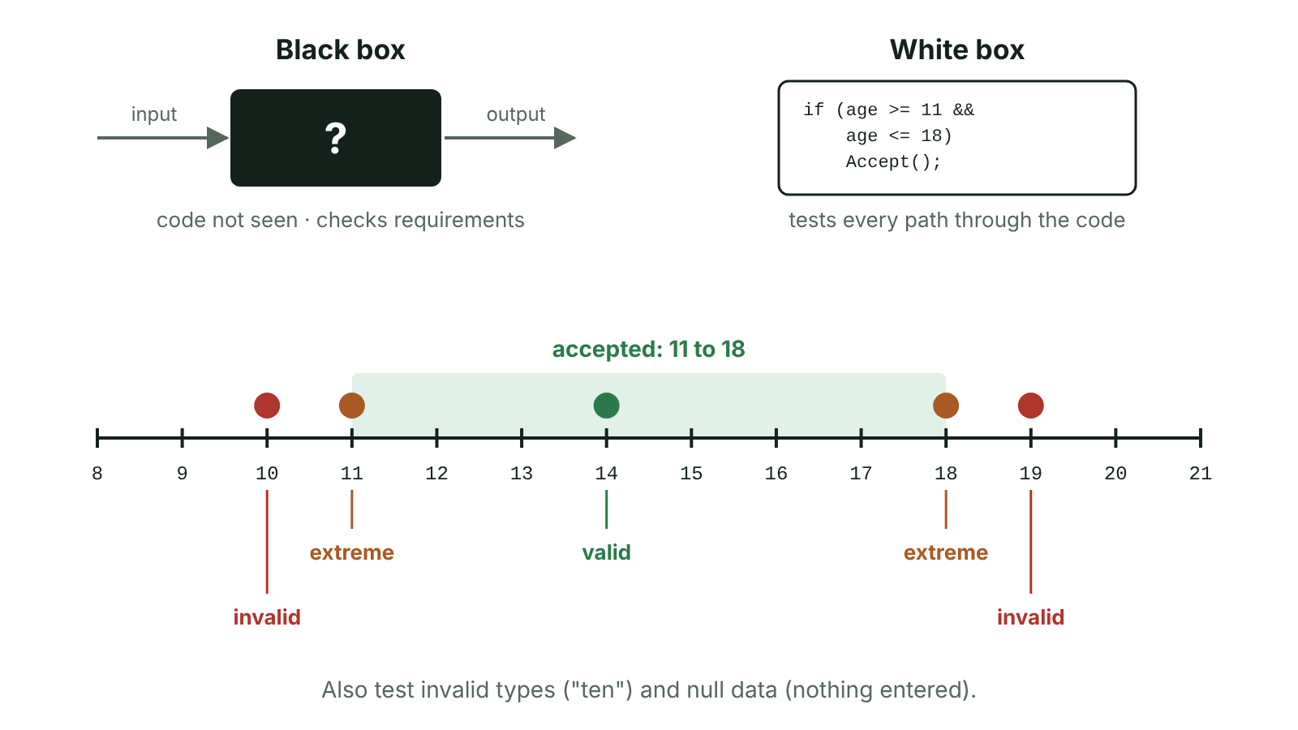
The big picture
Black box and white box testing, and test data on a number line for an 11 to 18 age range
☰ Menu
Notes:
Explain the diagram in your own words before you read on.

Slide 7
Why test?
To find and remove errors before users find them
To check the program meets its user requirements/success criteria
Iterative testing: test throughout development – code a part, test it, fix it, retest, then move on
Testing continues after development with the complete system
☰ Menu

Slide 8
White box and black box
 | White box | Black box
Looks at | Internal code, logic and structure | Inputs and outputs only – code not seen
Who | Usually the programmer | Independent testers/end users
Aim | Test every path, condition and line | Check functions meet the requirements
Typical tools | Dry runs, trace tables, breakpoints | Test plan of inputs and expected outputs
☰ Menu

Slide 9
Unit, integration and system testing
Unit testing: testing one module/function on its own – done first, by the developer
Integration testing: testing that separately built units work correctly together (interfaces between them)
System testing: testing the complete system against its specification, using the test plan, including extreme and invalid data
Usual order: unit → integration → system
☰ Menu

Slide 10
Test data
Type | Meaning | Example (age 11–18)
Valid (normal) | Typical data that should be accepted | 14
Extreme (boundary) | Values at the limits of the valid range | 11, 18
Invalid (erroneous) | Data that should be rejected | 25, -3, 'ten'
Invalid extreme | Just outside the limits | 10, 19
Null | No data entered | (blank)
☰ Menu

Slide 11
Test plans
Test no. | Purpose | Test data | Type | Expected outcome | Actual outcome | Action
1 | Accept a valid age | 14 | Valid | Accepted | Accepted | None
2 | Accept lower limit | 11 | Extreme | Accepted | Rejected | Changed > to >=
3 | Reject too high | 19 | Invalid | Error message | Error message | None
4 | Reject blank entry | (null) | Null | Error message | Program crashed | Added presence check
☰ Menu

Slide 12
Exam tips
Test plans appear every year: 2019 Q10, 2024 Q8(b)(ii) (8 marks), 2025 Q9(a)
Expected outcome must be specific: 'error message: age must be 11–18', not 'it works'
Robustness testing: high volumes of valid, invalid and exceptional data (2024 Q9(b), 2025 Q10(b))
Unit 5 moderators: extreme data and corrective action were often missing
☰ Menu

Slide 13
Exit quiz: question 1 of 5
Tap an answer to check it. Presenting? Click to reveal the answer.
Testing every path through the code is…
A black box
B white box
✗
✓
C beta
D alpha
✗
✗
✓ B: white box
☰ Menu

Slide 14
Exit quiz: question 2 of 5
Tap an answer to check it. Presenting? Click to reveal the answer.
For an age range 11–18, 18 is…
A valid normal
B extreme
✗
✓
C invalid
D null
✗
✗
✓ B: extreme
☰ Menu

Slide 15
Exit quiz: question 3 of 5
Tap an answer to check it. Presenting? Click to reveal the answer.
Testing modules work together is…
A unit
B integration
✗
✓
C system
D acceptance
✗
✗
✓ B: integration
☰ Menu

Slide 16
Exit quiz: question 4 of 5
Tap an answer to check it. Presenting? Click to reveal the answer.
Which column records what actually happened?
A Expected outcome
B Actual outcome
✗
✓
C Test data
D Purpose
✗
✗
✓ B: Actual outcome
☰ Menu

Slide 17
Exit quiz: question 5 of 5
Tap an answer to check it. Presenting? Click to reveal the answer.
Usual order of testing:
A system → unit → integration
B unit → integration → system
✗
✓
C integration → system → unit
D system only
✗
✗
✓ B: unit → integration → system
☰ Menu

Slide 18
Exit quiz answers
Q | Answer
1 | B white box
2 | B extreme
3 | B integration
4 | B Actual outcome
5 | B unit → integration → system
☰ Menu

Slide 19
In the exam
Paper | Question | Marks | What it tested
Unit 4 2019 | Q10 | 8 | Black and white box, test table with dry run, system vs integration
Unit 4 2022 | Q2 | 14 | Data type for a race time; lowest of three algorithm; test data
Unit 4 2022 | Q10 | 9 | Matching five testing methods; error trapping
Unit 4 2023 | Q10 | 9 | Testing types gap fill; invalid and extreme test data
Unit 4 2024 | Q8 | 18 | String and Boolean types; unit testing; test plan; black vs white box
Unit 4 2025 | Q9 | 11 | Test plan components; black vs white box
2 more past questions on the website. Papers and mark schemes: ccea.org.uk → GCSE Digital Technology → Past Papers & Mark Schemes.
☰ Menu

