Slide 1
Evaluation of digitally authored systems
UNIT 4: DIGITAL DEVELOPMENT CONCEPTS · TOPIC
Lessons in this topic
D23 Evaluating a solution

Slide 2

Topic menu
Tap a button to jump straight there. The ☰ Menu button on every slide brings you back here.
Specification map
D23 Evaluating a solution

Slide 3
Specification map
Lesson | Specification: students should be able to
D23 | Explain how evaluation is used to ensure that a solution: meets the original design criteria; is a full and complete solution; is an efficient solution; and is a robust solution
☰ Menu
Notes:
Each lesson below is its own section in PowerPoint (View → Slide Sorter shows them). To split this deck by specification point, right-click a section → Move Section, or delete the sections you do not need.

Slide 4
Evaluating a solution
UNIT 4: DIGITAL DEVELOPMENT CONCEPTS · D23
Learning objectives
Explain the purpose of evaluation during and after development
Evaluate a solution against design criteria, completeness, efficiency and robustness
Use user requirements and test evidence in an evaluation
Notes:
Specification: Explain how evaluation is used to ensure that a solution: meets the original design criteria; is a full and complete solution; is an efficient solution; and is a robust solution

Slide 5
In this lesson
Tap a button to jump straight there. The ☰ Menu button on every slide brings you back here.
The big picture
Robustness
What is evaluation?
Writing an evaluation (Unit 5)
Four questions
Exit quiz
Using user requirements
↑ Topic menu
Notes:
Lesson menu: each button jumps to that part of the lesson in Slide Show. The ☰ Menu button on each slide returns here.

Slide 6
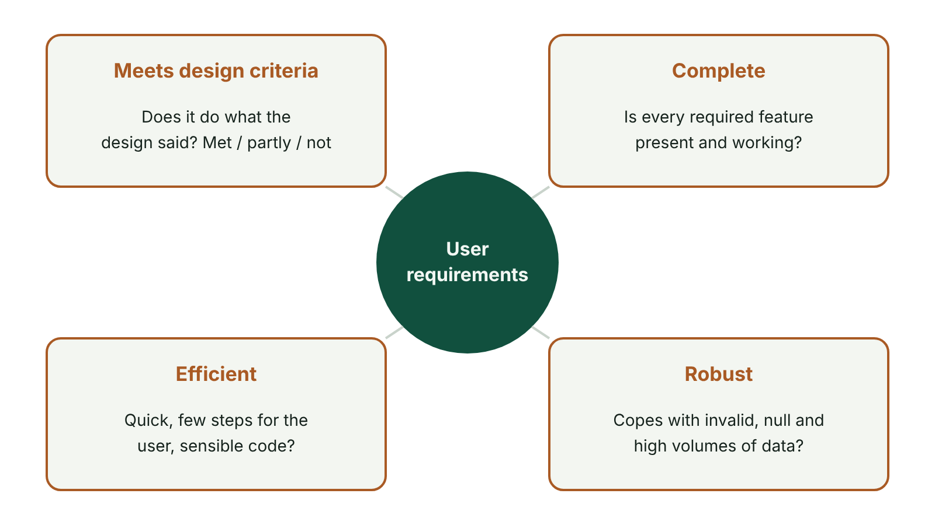
The big picture
Evaluating a solution against the user requirements: meets design criteria, complete, efficient, robust
☰ Menu
Notes:
Explain the diagram in your own words before you read on.

Slide 7
What is evaluation?
Judging how well a solution solves the original problem
Carried out during development (to refine) and at the end
Uses evidence: test results, user feedback, the original user requirements and design
Stakeholders: client, end users, developers
☰ Menu

Slide 8
Four questions
Criterion | Question | Evidence
Meets design criteria | Does it do what the user requirements and design said? | Each requirement checked: fully met / partially met / not met
Full and complete | Are all required features present and working? | Test plan results for every function
Efficient | Does it work quickly without wasting resources or user effort? | Response times, few steps for the user, sensible code (loops, functions)
Robust | Does it cope with invalid, unexpected and high volumes of data without crashing? | Invalid/extreme/null tests, error trapping, high-volume tests
☰ Menu

Slide 9
Using user requirements
The user requirements are the agreed standard the solution is measured against
Work through them as a checklist
If a feature is missing, the requirements show what must be added before the solution is complete
2025 Q10(a): explain how the requirements help when features are missing – not just what they contain
☰ Menu

Slide 10
Robustness
A robust system handles errors and unexpected input gracefully
Test with valid, invalid, exceptional and null data – and in large volumes
Validation and error trapping improve robustness
2025 Q10(b): refer to at least two kinds of data for the mark
☰ Menu

Slide 11
Writing an evaluation (Unit 5)
Be evaluative, not descriptive: say how well, with evidence
For each requirement: met/partly met/not met + evidence + improvement
Discuss performance and robustness seen in testing
Identify refinements made and further improvements
Moderators: descriptions of the solution earned few marks
☰ Menu

Slide 12
Exit quiz: question 1 of 5
Tap an answer to check it. Presenting? Click to reveal the answer.
Evaluation measures a solution against…
A the CPU speed
B the user requirements
✗
✓
C the number of lines of code
D the font used
✗
✗
✓ B: the user requirements
☰ Menu

Slide 13
Exit quiz: question 2 of 5
Tap an answer to check it. Presenting? Click to reveal the answer.
A solution that copes with invalid input without crashing is…
A efficient
B robust
✗
✓
C complete
D abstract
✗
✗
✓ B: robust
☰ Menu

Slide 14
Exit quiz: question 3 of 5
Tap an answer to check it. Presenting? Click to reveal the answer.
Testing with very large amounts of data checks…
A syntax
B robustness
✗
✓
C abstraction
D compilation
✗
✗
✓ B: robustness
☰ Menu

Slide 15
Exit quiz: question 4 of 5
Tap an answer to check it. Presenting? Click to reveal the answer.
A complete solution…
A has every required feature working
B has no comments
✓
✗
C uses only FOR loops
D is written in Java
✗
✗
✓ A: has every required feature working
☰ Menu

Slide 16
Exit quiz: question 5 of 5
Tap an answer to check it. Presenting? Click to reveal the answer.
Which is an evaluative comment?
A The program has a menu.
B Requirement 2 is fully met: all 10 test bookings were stored correctly.
✗
✓
C I used C#.
D The program is in a file.
✗
✗
✓ B: Requirement 2 is fully met: all 10 test bookings were stored correctly.
☰ Menu

Slide 17
Exit quiz answers
Q | Answer
1 | B the user requirements
2 | B robust
3 | B robustness
4 | A has every required feature working
5 | B Requirement 2 is fully met: all 10 test bookings were stored correctly.
☰ Menu

Slide 18
In the exam
Paper | Question | Marks | What it tested
Unit 4 2019 | Q11 | 10 | Evaluation: purpose, stakeholders, requirements, original plan
Unit 4 2022 | Q11 | 7 | Evaluation statements; complete, robust, efficient
Unit 4 2023 | Q11 | 7 | Evaluation using requirements and design documents
Unit 4 2024 | Q9 | 7 | Evaluation and robustness
Unit 4 2025 | Q10 | 4 | User requirements; robustness
Papers and mark schemes: ccea.org.uk → GCSE Digital Technology → Past Papers & Mark Schemes.
☰ Menu

