Slide 1
Computer hardware
UNIT 1: DIGITAL TECHNOLOGY · TOPIC
Lessons in this topic
L13 The CPU and the fetch–execute cycle
L14 CPU performance and memory: RAM, ROM and cache
L15 Input, output and storage devices

Slide 2

Topic menu
Tap a button to jump straight there. The ☰ Menu button on every slide brings you back here.
Specification map
L14 CPU performance and memory: RAM, ROM and cache
L13 The CPU and the fetch–execute cycle
L15 Input, output and storage devices

Slide 3
Specification map (1 of 2)
Lesson | Specification: students should be able to
L13 | Explain the purpose of the central processing unit (CPU); Describe the role of the following components of the CPU: the arithmetic logic unit (ALU), control unit and immediate-access store; Describe the role the following play in the fetch-execute cycle: program counter, memory address register (MAR), memory data register (MDR), instruction address register (IAR) and ALU
L14 | Describe the impact of clock speed, cache size, and number of cores on CPU performance; Explain the purpose of random access memory (RAM), read only memory (ROM) and cache; Describe the role of ROM in the boot-up process; Compare RAM, ROM and cache in terms of volatility, read/write access, size and speed
☰ Menu

Slide 4
Specification map (2 of 2)
Lesson | Specification: students should be able to
L15 | Describe the characteristics, typical uses, and advantages and disadvantages of: microphone, mouse, graphics digitiser, touch screens, speakers, printers (laser and 3D), hard disc drive (HDD), high definition (HD) storage media and solid state drive (SSD); Describe other solid-state storage: USB flash drives, memory cards and smart cards; Compare storage devices using capacity, access speed, portability, durability and cost; Recommend and justify suitable devices for a given scenario
☰ Menu
Notes:
Each lesson below is its own section in PowerPoint (View → Slide Sorter shows them). To split this deck by specification point, right-click a section → Move Section, or delete the sections you do not need.

Slide 5
The CPU and the fetch–execute cycle
UNIT 1: DIGITAL TECHNOLOGY · L13
Learning objectives
Explain the purpose of the CPU using processing language, not just 'the brain'
Describe what the control unit, ALU and immediate-access store each do
Describe the job of the PC, MAR, MDR, IAR and accumulator
Describe each stage of the fetch–decode–execute cycle in the correct order
Notes:
Specification: Explain the purpose of the central processing unit (CPU) | Describe the role of the following components of the CPU: the arithmetic logic unit (ALU), control unit and immediate-access store | Describe the role the following play in the fetch-execute cycle: program counter, memory address register (MAR), memory data register (MDR), instruction address register (IAR) and ALU

Slide 6
In this lesson
Tap a button to jump straight there. The ☰ Menu button on every slide brings you back here.
The big picture
The fetch–decode–execute cycle
Purpose of the CPU
Worked example: a canteen till adds two prices
The three main components
Tracing the first instruction
The control unit in detail
Exam tips
The ALU and the accumulator
Exit quiz
The immediate-access store (main memory)
↑ Topic menu
Registers: tiny, very fast stores inside the CPU
Notes:
Lesson menu: each button jumps to that part of the lesson in Slide Show. The ☰ Menu button on each slide returns here.

Slide 7
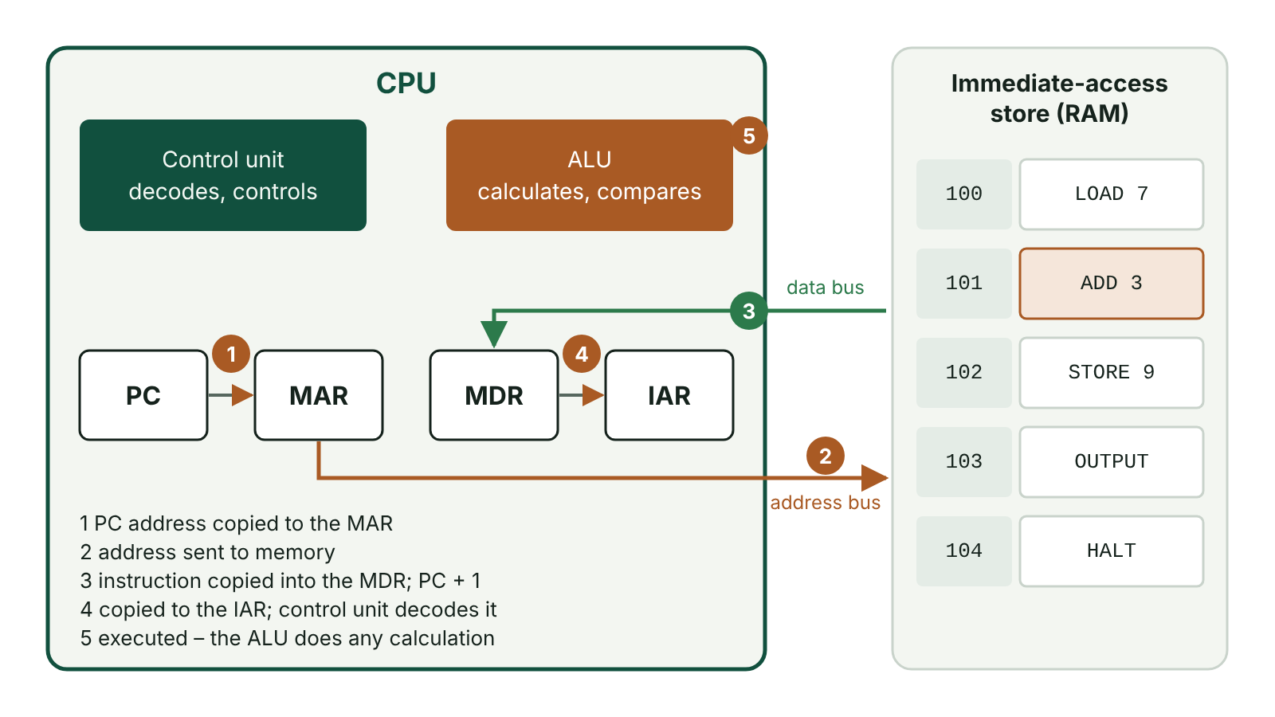
The big picture
Inside the CPU: the fetch–execute cycle using the PC, MAR, MDR and IAR with main memory
☰ Menu
Notes:
Explain the diagram in your own words before you read on.

Slide 8
Purpose of the CPU
CPU = central processing unit. It is a microprocessor: a single chip that does the processing
Its purpose is to process data and carry out (execute) the instructions of programs
It manages the functions of the computer by sending signals that control the other hardware
It works by fetching an instruction from memory, decoding it and executing it, over and over
You may hear it called the 'brain' of the computer, but that nickname alone earns no marks
☰ Menu

Slide 9
The three main components
Component | What it does
Control unit (CU) | Decides which instruction comes next, fetches it, decodes it and sends control signals so it is carried out. It co-ordinates every other part
Arithmetic logic unit (ALU) | Does arithmetic (add, subtract, multiply, divide) and logic (AND, OR, NOT and comparisons such as 'is A greater than B?')
Immediate-access store (IAS) | Main memory. Holds the programs and data in use right now, so the CPU can reach them directly
☰ Menu

Slide 10
The control unit in detail
Job 1: work out which instruction is next and fetch it from memory
Job 2: decode the instruction – work out what it means and what has to happen
Job 3: make the instruction happen by sending control signals to the ALU, memory and other devices
Usually handles one instruction at a time, in order, unless an instruction tells it to jump
Think of it as a conductor: it does not play the music, it tells every section when to play
☰ Menu

Slide 11
The ALU and the accumulator
Arithmetic: e.g. adding up the cost of items scanned at a school canteen till
Logic: comparisons that help a program make decisions, e.g. 'is the pupil's balance less than £2.50?'
Logical operators used: AND, OR, NOT
The accumulator is a register inside the ALU
The result of each calculation is held in the accumulator first, before being stored back in memory
☰ Menu

Slide 12
The immediate-access store (main memory)
Holds programs and data temporarily while they are being used
The same programs and files are also kept permanently on a storage device such as an SSD
Memory is split into locations. Each location has its own unique address (a number)
The CPU uses the address to find the exact instruction or data it needs
Without the IAS the CPU would have nothing to fetch, so the cycle could not run
☰ Menu

Slide 13
Registers: tiny, very fast stores inside the CPU
Register | What it holds
Program counter (PC) | The address of the next instruction to fetch. Goes up by 1 after each fetch
Memory address register (MAR) | The address of the memory location being read from or written to right now
Memory data register (MDR) | The instruction or data just fetched from memory, or about to be written to it. Everything going to or from memory passes through it
Instruction address register (IAR) | In CCEA wording: the instruction currently being decoded and executed (the textbook calls this the instruction register)
Accumulator (ACC) | The result of the latest ALU calculation
☰ Menu

Slide 14
The fetch–decode–execute cycle
FETCH 1: the address in the PC is copied into the MAR
FETCH 2: the instruction at that address is copied from main memory into the MDR, then into the IAR
FETCH 3: the PC is increased by 1 so it points to the next instruction
DECODE: the control unit works out what the instruction means
EXECUTE: the instruction is carried out; any calculation or comparison is done by the ALU
The cycle then starts again – billions of times every second
☰ Menu

Slide 15
Worked example: a canteen till adds two prices
Address | Contents of main memory
100 | LOAD 200 (copy the value at address 200 into the accumulator)
101 | ADD 201 (add the value at address 201 to the accumulator)
102 | STORE 202 (copy the accumulator into address 202)
200 | 180 (a panini costs 180p)
201 | 95 (a bottle of water costs 95p)
202 | (empty – the total will go here)
☰ Menu

Slide 16
Tracing the first instruction
Start: PC = 100
Fetch: 100 is copied to the MAR; 'LOAD 200' is copied from address 100 to the MDR, then to the IAR; PC becomes 101
Decode: the control unit sees that it must load the value from address 200
Execute: 200 goes into the MAR, the value 180 comes back through the MDR and is placed in the accumulator
Next two cycles: ADD 201 makes the accumulator 275, then STORE 202 writes 275 into address 202
Total price stored: 275p = £2.75
☰ Menu

Slide 17
Exam tips
Write acronyms in full the first time: 'memory address register (MAR)'
Describe what each part does, not just its name – 'the ALU does calculations' is better than 'the ALU'
Keep the fetch order: PC → MAR → memory → MDR → IAR, then PC + 1
Do not mix up the MAR (holds an address) with the MDR (holds data or an instruction)
Decoding is done by the control unit, not the ALU
☰ Menu

Slide 18
Exit quiz: question 1 of 8
Tap an answer to check it. Presenting? Click to reveal the answer.
Which part of the CPU carries out calculations and logical comparisons?
A Control unit
B Arithmetic logic unit (ALU)
✗
✓
C Memory address register
D Program counter
✗
✗
✓ B: Arithmetic logic unit (ALU) – The ALU does arithmetic (e.g. addition) and logic (e.g. comparisons using AND, OR, NOT).
☰ Menu

Slide 19
Exit quiz: question 2 of 8
Tap an answer to check it. Presenting? Click to reveal the answer.
Which register holds the address of the next instruction to be fetched?
A Program counter
B Memory data register
✓
✗
C Accumulator
D Instruction address register
✗
✗
✓ A: Program counter – The program counter holds the next address and is increased by one after each fetch.
☰ Menu

Slide 20
Exit quiz: question 3 of 8
Tap an answer to check it. Presenting? Click to reveal the answer.
What does the memory data register (MDR) hold?
A The address of the location being accessed
B The address of the next instruction
✗
✗
C The instruction or data just fetched from, or about to be written to, memory
D The clock speed of the CPU
✓
✗
✓ C: The instruction or data just fetched from, or about to be written to, memory – The MDR holds data or instructions travelling to or from memory. The MAR holds the address.
☰ Menu

Slide 21
Exit quiz: question 4 of 8
Tap an answer to check it. Presenting? Click to reveal the answer.
Which component decodes instructions and sends control signals?
A ALU
B Accumulator
✗
✗
C Immediate-access store
D Control unit
✗
✓
✓ D: Control unit – The control unit decodes each instruction and co-ordinates the other components.
☰ Menu

Slide 22
Exit quiz: question 5 of 8
Tap an answer to check it. Presenting? Click to reveal the answer.
What is the correct order of the cycle?
A Execute, fetch, decode
B Fetch, decode, execute
✗
✓
C Decode, fetch, execute
D Fetch, execute, decode
✗
✗
✓ B: Fetch, decode, execute – An instruction must be fetched before it can be decoded, and decoded before it can be executed.
☰ Menu

Slide 23
Exit quiz: question 6 of 8
Tap an answer to check it. Presenting? Click to reveal the answer.
Which best explains the purpose of the CPU?
A It stores files permanently
B It displays output to the user
✗
✗
C It processes data and carries out the instructions of programs
D It connects the computer to a network
✓
✗
✓ C: It processes data and carries out the instructions of programs – This is the processing explanation that mark schemes credit.
☰ Menu

Slide 24
Exit quiz: question 7 of 8
Tap an answer to check it. Presenting? Click to reveal the answer.
In the first step of the fetch stage, the contents of the program counter are copied into…
A the MAR
B the MDR
✓
✗
C the accumulator
D the ALU
✗
✗
✓ A: the MAR – The address of the next instruction goes into the memory address register so that memory location can be read.
☰ Menu

Slide 25
Exit quiz: question 8 of 8
Tap an answer to check it. Presenting? Click to reveal the answer.
Where is the result of an ALU calculation first held?
A Program counter
B Memory address register
✗
✗
C Hard disc
D Accumulator
✗
✓
✓ D: Accumulator – The accumulator is the ALU's register for results, before they are stored back in memory.
☰ Menu

Slide 26
Exit quiz answers
Q | Answer | Why
1 | B Arithmetic logic unit (ALU) | The ALU does arithmetic (e.g. addition) and logic (e.g. comparisons using AND, OR, NOT).
2 | A Program counter | The program counter holds the next address and is increased by one after each fetch.
3 | C The instruction or data just fetched from, or about to be written to, memory | The MDR holds data or instructions travelling to or from memory. The MAR holds the address.
4 | D Control unit | The control unit decodes each instruction and co-ordinates the other components.
5 | B Fetch, decode, execute | An instruction must be fetched before it can be decoded, and decoded before it can be executed.
6 | C It processes data and carries out the instructions of programs | This is the processing explanation that mark schemes credit.
7 | A the MAR | The address of the next instruction goes into the memory address register so that memory location can be read.
8 | D Accumulator | The accumulator is the ALU's register for results, before they are stored back in memory.
☰ Menu

Slide 27
In the exam
Paper | Question | Marks | What it tested
Unit 1 2019 | Q5(c)–(d) | 6 | ALU, control unit, fetch–execute terms
Unit 1 2021 | Q5 | 6 | CPU, registers, speed, clock speed
Unit 1 2022 | Q4 | 4 | ALU and immediate-access store (levelled)
Unit 1 2023 | Q5 | 10 | CPU, system software resources, real-time vs multi-user, utilities, I/O devices
Unit 1 2024 | Q5 | 10 | Spreadsheet functions, CPU purpose and components, immediate-access store
Unit 1 2025 | Q7 | 8 | Fetch–execute cycle; input devices and uses
Papers and mark schemes: ccea.org.uk → GCSE Digital Technology → Past Papers & Mark Schemes.
☰ Menu

Slide 28
CPU performance and memory: RAM, ROM and cache
UNIT 1: DIGITAL TECHNOLOGY · L14
Learning objectives
Explain how clock speed, cache size and number of cores each affect CPU performance
Explain the purpose of RAM, ROM and cache
Compare RAM, ROM and cache using the terms volatile and non-volatile
Recommend and justify a processor and memory specification for a given user
Notes:
Specification: Describe the impact of clock speed, cache size, and number of cores on CPU performance | Explain the purpose of random access memory (RAM), read only memory (ROM) and cache | Describe the role of ROM in the boot-up process | Compare RAM, ROM and cache in terms of volatility, read/write access, size and speed

Slide 29
In this lesson
Tap a button to jump straight there. The ☰ Menu button on every slide brings you back here.
The big picture
When RAM runs out: virtual memory
What makes a CPU fast?
Internal memory: ROM and booting up
Clock speed
Comparing RAM, ROM and cache
Worked example: comparing clock speeds
Worked example: choosing a laptop for a sixth-former
Number of cores
Exam tips
Cache size
Exit quiz
Internal memory: RAM
↑ Topic menu
Notes:
Lesson menu: each button jumps to that part of the lesson in Slide Show. The ☰ Menu button on each slide returns here.

Slide 30
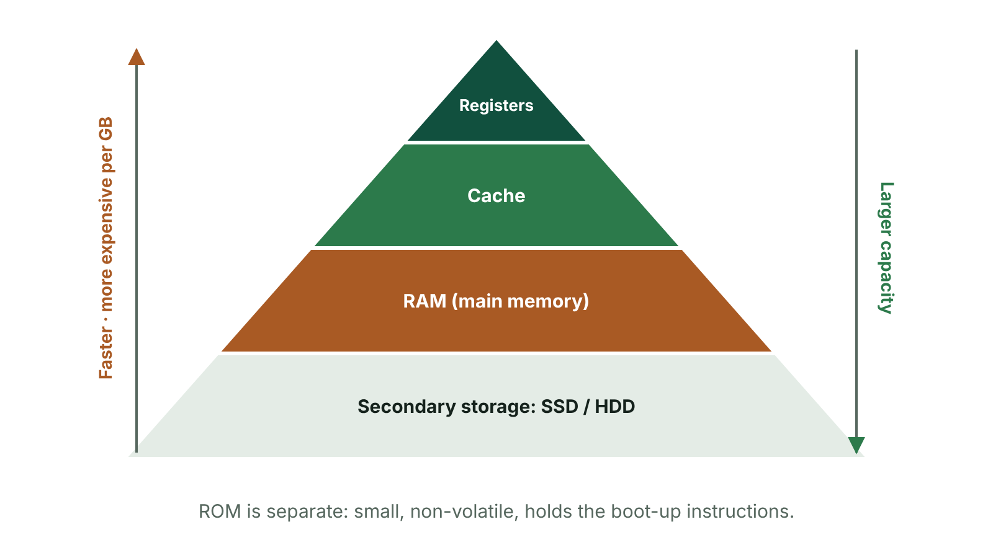
The big picture
Memory hierarchy pyramid from registers to secondary storage
☰ Menu
Notes:
Explain the diagram in your own words before you read on.

Slide 31
What makes a CPU fast?
Three factors in the specification: clock speed, cache size and number of cores
Each one changes how many instructions can be processed per second
None of them works alone – a fast CPU can still be held back by too little RAM or slow storage
In exam answers, always say what the factor is AND how it changes performance
☰ Menu

Slide 32
Clock speed
The CPU has a clock that sends out a steady stream of pulses. Each pulse lets the CPU move on a step
Clock speed = the number of fetch–execute cycles the CPU can carry out per second
Measured in hertz (Hz). 1 Hz = 1 cycle per second; 1 GHz = 1 billion cycles per second
Higher clock speed → more instructions processed per second → programs run faster
Limits: faster clocks create more heat and use more power; other slow parts can still hold the CPU back
☰ Menu

Slide 33
Worked example: comparing clock speeds
Laptop A: 2.4 GHz → 2.4 × 1,000,000,000 = 2,400,000,000 cycles per second
Laptop B: 3.6 GHz → 3,600,000,000 cycles per second
Difference: 3.6 − 2.4 = 1.2 GHz, so B can do 1,200,000,000 more cycles every second
3.6 ÷ 2.4 = 1.5, so B's clock is 1.5 times as fast
But if both have the same number of cores and cache, B will usually be quicker – not exactly 1.5 times, as other parts also limit speed
☰ Menu

Slide 34
Number of cores
A core is a full processing unit: each one has a control unit, an ALU and a set of registers
Dual-core = 2 cores, quad-core = 4, octa-core = 8
Each core can fetch, decode and execute its own instructions, so several can be processed at the same time (in parallel)
Helps most with multitasking, e.g. streaming music while editing a video
Doubling the cores does not double the speed: the software must be written to use several cores, and cores must share work and memory
☰ Menu

Slide 35
Cache size
Cache is a small amount of very fast memory built into or right next to the CPU
It holds instructions and data that are used often, so they do not have to be fetched from slower RAM
The CPU checks the cache first. If what it needs is there, it gets it much more quickly
Larger cache → more can be kept close to the CPU → fewer slow trips to RAM → faster processing
Cache is expensive, so it is measured in megabytes, while RAM is measured in gigabytes
☰ Menu

Slide 36
Internal memory: RAM
Random access memory: the main memory of the computer
Purpose: holds the operating system, programs and data currently in use, e.g. the open essay and the word processor
Can be read from and written to; its contents change as you open and close apps
Volatile: everything in it is lost when the power is switched off, which is why you must save work to storage
More RAM lets more programs stay open at once without slowing down
☰ Menu

Slide 37
When RAM runs out: virtual memory
If RAM is full, the operating system moves some data out to the hard disc or SSD
This area of storage used as extra memory is called virtual memory
Storage is much slower than RAM, so the computer slows down as data is swapped back and forth
Adding RAM reduces the need for virtual memory, which is why it can make a computer feel faster
It does not make the CPU's clock faster – it removes a bottleneck
☰ Menu

Slide 38
Internal memory: ROM and booting up
Read only memory: can be read but not normally changed by the user
Non-volatile: keeps its contents when the power is off
Purpose: holds the start-up instructions (the boot program / BIOS) that must be there every time the computer is switched on
Boot-up: the CPU runs the ROM instructions → hardware is checked → the operating system is loaded from storage into RAM
RAM cannot do this job because it is empty when the computer is switched on
☰ Menu

Slide 39
Comparing RAM, ROM and cache
 | RAM | ROM | Cache
Purpose | Holds OS, programs and data in use | Holds start-up (boot) instructions | Holds frequently used instructions and data
Volatile? | Yes | No | Yes
Read/write? | Read and write | Read only | Read and write
Typical size | Gigabytes (e.g. 8–32 GB) | Small (KB–MB) | Megabytes
Speed | Fast | Slower than RAM | Fastest of the three
Where | Memory modules on the motherboard | Chip on the motherboard | Inside or next to the CPU
☰ Menu

Slide 40
Worked example: choosing a laptop for a sixth-former
 | Laptop X | Laptop Y
Clock speed | 2.8 GHz | 3.4 GHz
Cores | 2 | 6
Cache | 4 MB | 12 MB
RAM | 8 GB | 16 GB
Verdict for video editing for a Moving Image Arts project | Will struggle | Better: higher clock speed, more cores for rendering, larger cache and more RAM for big video files
☰ Menu

Slide 41
Exam tips
Link each factor to its effect: 'more cores, so more instructions can be processed at the same time'
Clock speed is cycles per second – it is not the number of cores, and it is not measured in bytes
For cache, mention BOTH that it is faster than RAM AND that it stores frequently used data
For ROM, name the boot program; for RAM, say 'currently in use'
Use volatile / non-volatile and explain them: volatile means data is lost when the power is off
☰ Menu

Slide 42
Exit quiz: question 1 of 8
Tap an answer to check it. Presenting? Click to reveal the answer.
Clock speed is measured in…
A bytes
B hertz
✗
✓
C pixels
D bits per second
✗
✗
✓ B: hertz – Clock speed is cycles per second, measured in hertz, usually gigahertz (GHz) today.
☰ Menu

Slide 43
Exit quiz: question 2 of 8
Tap an answer to check it. Presenting? Click to reveal the answer.
Why does a larger cache usually improve performance?
A It increases the clock speed
B It adds more cores
✗
✗
C More frequently used data is kept close to the CPU, so there are fewer slow trips to RAM
D It stores the operating system permanently
✓
✗
✓ C: More frequently used data is kept close to the CPU, so there are fewer slow trips to RAM – Cache is faster than RAM, so the more the CPU can find there, the less time it waits.
☰ Menu

Slide 44
Exit quiz: question 3 of 8
Tap an answer to check it. Presenting? Click to reveal the answer.
Which type of memory is volatile and holds the programs currently in use?
A ROM
B SSD
✗
✗
C Blu-ray
D RAM
✗
✓
✓ D: RAM – RAM is main memory; it is volatile, so its contents are lost without power.
☰ Menu

Slide 45
Exit quiz: question 4 of 8
Tap an answer to check it. Presenting? Click to reveal the answer.
What is stored in ROM?
A The start-up (boot) instructions
B Your saved documents
✓
✗
C The web pages you are viewing
D Frequently used data copied from RAM
✗
✗
✓ A: The start-up (boot) instructions – ROM holds the boot program/BIOS that runs when the computer is switched on.
☰ Menu

Slide 46
Exit quiz: question 5 of 8
Tap an answer to check it. Presenting? Click to reveal the answer.
Extra cores help most when…
A the screen resolution is higher
B software can split its work to run in parallel
✗
✓
C the computer is switched off
D the ROM is larger
✗
✗
✓ B: software can split its work to run in parallel – Each core can process its own instructions at the same time as the others.
☰ Menu

Slide 47
Exit quiz: question 6 of 8
Tap an answer to check it. Presenting? Click to reveal the answer.
A processor runs at 4 GHz. How many cycles can it carry out per second?
A 4,000
B 4,000,000
✗
✗
C 4,000,000,000
D 400,000,000
✓
✗
✓ C: 4,000,000,000 – Giga means billion (10⁹), so 4 GHz = 4,000,000,000 cycles per second.
☰ Menu

Slide 48
Exit quiz: question 7 of 8
Tap an answer to check it. Presenting? Click to reveal the answer.
Which statement about cache is correct?
A It is faster than RAM and has a smaller capacity
B It is non-volatile
✓
✗
C It is part of the hard disc
D It is read only
✗
✗
✓ A: It is faster than RAM and has a smaller capacity – Cache is the fastest internal memory but is small because it is expensive.
☰ Menu

Slide 49
Exit quiz: question 8 of 8
Tap an answer to check it. Presenting? Click to reveal the answer.
What is virtual memory?
A Memory inside the CPU
B Another name for ROM
✗
✗
C Memory on a cloud server
D Part of the storage drive used as extra RAM when RAM is full
✗
✓
✓ D: Part of the storage drive used as extra RAM when RAM is full – Because storage is slower than RAM, heavy use of virtual memory slows the computer down.
☰ Menu

Slide 50
Exit quiz answers
Q | Answer | Why
1 | B hertz | Clock speed is cycles per second, measured in hertz, usually gigahertz (GHz) today.
2 | C More frequently used data is kept close to the CPU, so there are fewer slow trips to RAM | Cache is faster than RAM, so the more the CPU can find there, the less time it waits.
3 | D RAM | RAM is main memory; it is volatile, so its contents are lost without power.
4 | A The start-up (boot) instructions | ROM holds the boot program/BIOS that runs when the computer is switched on.
5 | B software can split its work to run in parallel | Each core can process its own instructions at the same time as the others.
6 | C 4,000,000,000 | Giga means billion (10⁹), so 4 GHz = 4,000,000,000 cycles per second.
7 | A It is faster than RAM and has a smaller capacity | Cache is the fastest internal memory but is small because it is expensive.
8 | D Part of the storage drive used as extra RAM when RAM is full | Because storage is slower than RAM, heavy use of virtual memory slows the computer down.
☰ Menu

Slide 51
In the exam
Paper | Question | Marks | What it tested
Unit 1 2021 | Q5 | 6 | CPU, registers, speed, clock speed
Unit 1 2022 | Q12 | 7 | WAN, encryption, firewall, processor performance
Unit 1 2024 | Q5 | 10 | Spreadsheet functions, CPU purpose and components, immediate-access store
Unit 1 2024 | Q6 | 13 | Network statements, bus disadvantages, LAN, encryption, HTTPS, RAM vs ROM, malware routes
Unit 1 2025 | Q4 | 7 | Boot process, OS roles, storage conversion
Unit 1 2025 | Q13 | 10 | Term matching: hardware, memory, networking, malware
1 more past questions on the website. Papers and mark schemes: ccea.org.uk → GCSE Digital Technology → Past Papers & Mark Schemes.
☰ Menu

Slide 52
Input, output and storage devices
UNIT 1: DIGITAL TECHNOLOGY · L15
Learning objectives
Describe how each device in the specification works and what it is used for
Give advantages and disadvantages of each device, linked to a context
Compare HDD, SSD and HD optical storage using capacity, speed, durability, portability and cost
Recommend devices for a scenario and justify the choice
Notes:
Specification: Describe the characteristics, typical uses, and advantages and disadvantages of: microphone, mouse, graphics digitiser, touch screens, speakers, printers (laser and 3D), hard disc drive (HDD), high definition (HD) storage media and solid state drive (SSD) | Describe other solid-state storage: USB flash drives, memory cards and smart cards | Compare storage devices using capacity, access speed, portability, durability and cost | Recommend and justify suitable devices for a given scenario

Slide 53
In this lesson
Tap a button to jump straight there. The ☰ Menu button on every slide brings you back here.
The big picture
Laser printer
Comparing storage
Input, output and storage
3D printer
Worked example: choosing devices
Microphone and mouse
Hard disc drive (HDD)
Exam tips
Graphics digitiser and touch screen
Solid state drive (SSD) and other flash storage
Exit quiz
Speakers
High-definition (HD) storage media
↑ Topic menu
Notes:
Lesson menu: each button jumps to that part of the lesson in Slide Show. The ☰ Menu button on each slide returns here.

Slide 54
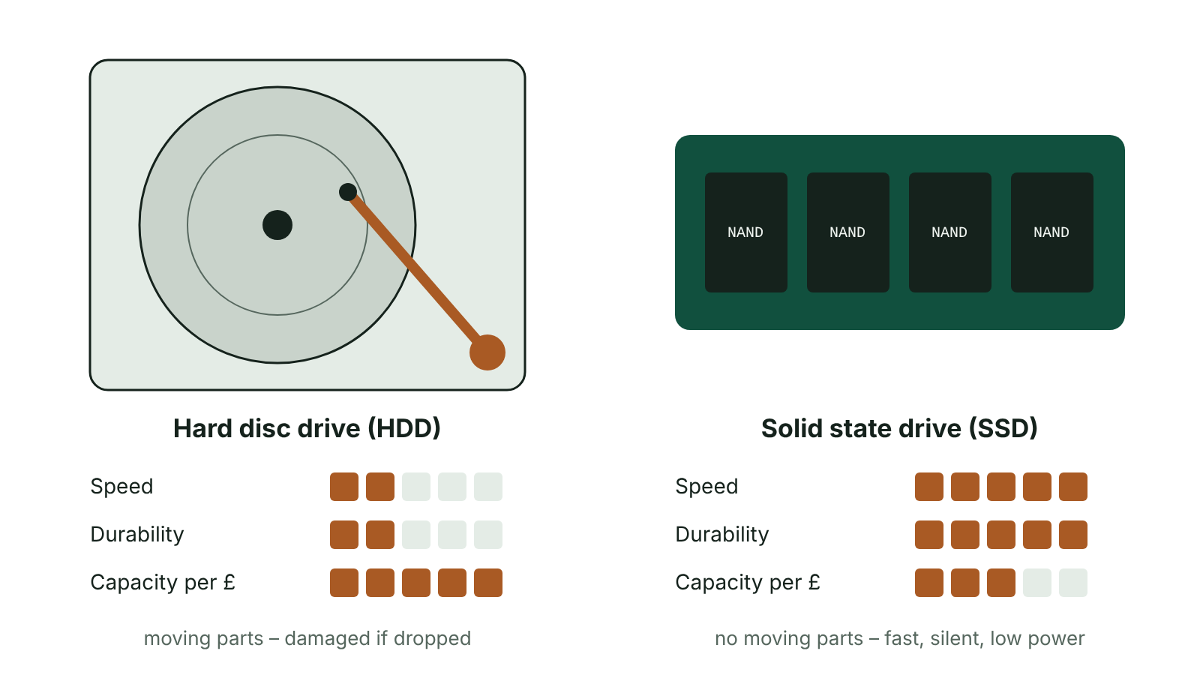
The big picture
Hard disc drive with spinning platter compared with a solid state drive made of memory chips
☰ Menu
Notes:
Explain the diagram in your own words before you read on.

Slide 55
Input, output and storage
Input device: gets data into the computer (microphone, mouse, graphics digitiser, touch screen)
Output device: presents results from the computer (speakers, laser printer, 3D printer)
Storage device: keeps data permanently, even with the power off (HDD, SSD, HD optical discs)
A touch screen is both an input and an output device
Exam answers need a CONTEXT: an advantage for a gamer may be a disadvantage in a quiet library
☰ Menu

Slide 56
Microphone and mouse
 | Microphone | Mouse
How it works | Turns sound into an electrical signal, which is converted to digital data | Sensors detect movement and move the pointer; buttons select; wheel scrolls
Typical uses | Voice recognition (dictation, commands to a smart speaker), online gaming headsets, video calls, recording music and podcasts | Selecting menus and icons, positioning the cursor, drag and drop
Advantages | Speaking is faster than typing; hands-free, so the user can do other things | Easy to use with little training; quicker than the keyboard for selecting items
Disadvantages | Background noise lowers recognition accuracy; sound files take much more storage than text | Needs a flat surface; slower than keyboard shortcuts (e.g. Ctrl + P) for experienced users
☰ Menu

Slide 57
Graphics digitiser and touch screen
 | Graphics digitiser | Touch screen
How it works | A flat pad and a stylus; drawing on the pad is captured freehand and shown on the monitor | A glass panel with a touch-sensitive surface; a touch changes the electrical signal, and the position is worked out as x, y co-ordinates
Typical uses | Artwork, design, animation, capturing signatures | Phones and tablets, self-service tills, fast-food kiosks, information points, interactive whiteboards
Advantages | More natural than a mouse for drawing; more accurate, detailed drawings (often pressure-sensitive) | Little IT skill needed; selecting options is quick; no separate mouse or keyboard
Disadvantages | Expensive compared to a mouse; not suited to selecting menus | Only a limited number of options fit on screen; screens get dirty quickly
☰ Menu

Slide 58
Speakers
Turn electrical signals from the computer's sound card into sound
Uses: music, video, games, spoken output, alert sounds when an error happens
Advantage: helps visually impaired users, as text can be read aloud by the computer
Advantage: a natural way to communicate, and many people can hear at once
Disadvantage: can distract other people working nearby – headphones may be better in an office or classroom
Disadvantage: external speakers take up desk space
☰ Menu

Slide 59
Laser printer
The computer sends the page to the printer as data
A laser draws the page onto a drum as a pattern of static electric charge
Toner (powder ink) sticks to the charged areas, is transferred to the paper and fixed with heat
Advantages: fast for large print runs; high-quality text and graphics; ideal for school and office networks
Disadvantages: colour laser printers are expensive to buy and run; as a non-impact printer it cannot print on multipart (carbon-copy) forms
☰ Menu

Slide 60
3D printer
Builds a solid object one thin layer at a time
Works from a model designed in CAD (computer-aided design) software
Materials include plastic, metal and ceramics
Uses: prototypes to test before mass production, replacement parts, custom medical items such as prosthetic hands
Advantages: objects made faster and more cheaply than by traditional methods; easy to make one-off, custom designs
Disadvantages: slow for large objects; limited size; not yet economical for large-scale manufacturing
☰ Menu

Slide 61
Hard disc drive (HDD)
Several rigid magnetic discs (platters) on a spindle, sealed to keep out dust
Each surface is divided into circular tracks, and each track into sectors that store blocks of data
Read/write heads move across the spinning surfaces to find the data
Advantages: very large capacity; lowest cost per gigabyte
Disadvantages: moving parts can break or be damaged if dropped; slower access than flash storage; heavier and noisier
☰ Menu

Slide 62
Solid state drive (SSD) and other flash storage
SSD: flash memory chips on a circuit board, with no moving parts. Non-volatile
Advantages: much faster access, so faster boot-up and loading; durable if dropped; silent, light, uses less power
Disadvantages: higher cost per gigabyte than an HDD; each memory cell can only be rewritten a limited number of times
USB flash drive: small, portable, 'plug and play'
Memory cards (e.g. SD, microSD): extra storage in phones and cameras
Smart cards: a chip in bank cards, door entry cards and ID cards; small capacity but reliable
☰ Menu

Slide 63
High-definition (HD) storage media
Optical discs such as Blu-ray, read and written using a laser
Blu-ray uses a blue-violet laser, which has a shorter wavelength than the red laser in a DVD player
The smaller beam means smaller pits, packed more tightly – so much more data fits on the same size disc
Single-layer Blu-ray holds 25 GB and dual-layer 50 GB, compared with 4.7 GB on a single-layer DVD
Uses: distributing HD films and games without loss of quality; archive copies
Advantages: cheap to mass-produce, portable. Disadvantages: scratches easily, needs a drive, smaller capacity than HDD or SSD
☰ Menu

Slide 64
Comparing storage
Criterion | HDD | SSD | Blu-ray
Technology | Magnetic | Flash (solid state) | Optical
Capacity | Very large (several TB) | Large | 25–50 GB per disc
Access speed | Medium | Fastest | Slowest
Durability | Moving parts – can be damaged if dropped | No moving parts – very durable | Scratches easily
Portability | Heavier | Light and small | Light, but needs a drive
Cost per GB | Lowest | Higher | Low when mass-produced
☰ Menu

Slide 65
Worked example: choosing devices
Scenario: an estate agent in Newry visits houses and takes photos on a laptop
Storage: SSD – no moving parts, so not damaged if the laptop is knocked in the car; fast to open large photo files
Input: touch screen – quick to tick options while standing in a house, no mouse or flat surface needed
Office printing: laser printer – fast and high quality for printing many property brochures
Back-up of every photo at the office: HDD – huge capacity at low cost per GB
Notice the pattern: device + feature + why it matters in THIS scenario
☰ Menu

Slide 66
Exam tips
'Cheap' or 'fast' alone rarely earns a mark – compare: 'lower cost per GB than an SSD'
Always link to the scenario given in the question
Give different points for advantages – do not repeat the same idea in other words
Remember 3D printers build objects layer by layer; laser printers use toner and a drum
SSD has no moving parts – this is the reason it is durable, quiet and fast
☰ Menu

Slide 67
Exit quiz: question 1 of 8
Tap an answer to check it. Presenting? Click to reveal the answer.
Which storage device has no moving parts?
A Hard disc drive
B Solid state drive
✗
✓
C Blu-ray drive
D DVD drive
✗
✗
✓ B: Solid state drive – SSDs use flash memory chips, which makes them fast, quiet and durable.
☰ Menu

Slide 68
Exit quiz: question 2 of 8
Tap an answer to check it. Presenting? Click to reveal the answer.
How does a 3D printer create an object?
A It prints toner onto paper using a drum
B It scans a real object with a laser
✗
✗
C It builds the object one layer at a time
D It carves the object from a solid block
✓
✗
✓ C: It builds the object one layer at a time – 3D printing builds an object up in thin layers from a CAD design.
☰ Menu

Slide 69
Exit quiz: question 3 of 8
Tap an answer to check it. Presenting? Click to reveal the answer.
Which device is both an input and an output device?
A Touch screen
B Microphone
✓
✗
C Speakers
D Laser printer
✗
✗
✓ A: Touch screen – A touch screen displays output and accepts input when it is touched.
☰ Menu

Slide 70
Exit quiz: question 4 of 8
Tap an answer to check it. Presenting? Click to reveal the answer.
Blu-ray is an example of…
A magnetic storage
B solid state storage
✗
✗
C RAM
D high-definition optical storage
✗
✓
✓ D: high-definition optical storage – Blu-ray discs are read and written by a blue-violet laser.
☰ Menu

Slide 71
Exit quiz: question 5 of 8
Tap an answer to check it. Presenting? Click to reveal the answer.
What is the main advantage of an HDD over an SSD?
A Faster access speed
B More durable
✗
✗
C Lower cost per gigabyte
D Silent operation
✓
✗
✓ C: Lower cost per gigabyte – HDDs offer large capacities cheaply; SSDs win on speed, durability and noise.
☰ Menu

Slide 72
Exit quiz: question 6 of 8
Tap an answer to check it. Presenting? Click to reveal the answer.
Which device would best suit a designer who needs to draw detailed artwork by hand?
A Graphics digitiser
B Microphone
✓
✗
C Mouse
D Speakers
✗
✗
✓ A: Graphics digitiser – The stylus gives natural, accurate freehand drawing.
☰ Menu

Slide 73
Exit quiz: question 7 of 8
Tap an answer to check it. Presenting? Click to reveal the answer.
Which is a disadvantage of using a microphone for voice input?
A It is slower than typing
B Background noise can cause words to be recognised wrongly
✗
✓
C It needs a flat surface
D It cannot be used hands-free
✗
✗
✓ B: Background noise can cause words to be recognised wrongly – Noise lowers recognition accuracy; sound files also need more storage than text.
☰ Menu

Slide 74
Exit quiz: question 8 of 8
Tap an answer to check it. Presenting? Click to reveal the answer.
Why is a laser printer a good choice for a busy school office?
A It can print 3D objects
B It is cheap to buy in colour
✗
✗
C It can print carbon-copy forms
D It prints large volumes quickly at high quality
✗
✓
✓ D: It prints large volumes quickly at high quality – Laser printers are fast for bulk printing and give sharp output.
☰ Menu

Slide 75
Exit quiz answers
Q | Answer | Why
1 | B Solid state drive | SSDs use flash memory chips, which makes them fast, quiet and durable.
2 | C It builds the object one layer at a time | 3D printing builds an object up in thin layers from a CAD design.
3 | A Touch screen | A touch screen displays output and accepts input when it is touched.
4 | D high-definition optical storage | Blu-ray discs are read and written by a blue-violet laser.
5 | C Lower cost per gigabyte | HDDs offer large capacities cheaply; SSDs win on speed, durability and noise.
6 | A Graphics digitiser | The stylus gives natural, accurate freehand drawing.
7 | B Background noise can cause words to be recognised wrongly | Noise lowers recognition accuracy; sound files also need more storage than text.
8 | D It prints large volumes quickly at high quality | Laser printers are fast for bulk printing and give sharp output.
☰ Menu

Slide 76
In the exam
Paper | Question | Marks | What it tested
Unit 1 2022 | Q2 | 3 | Optical, capacity, cloud storage terms
Unit 1 2022 | Q5 | 6 | 3D printing, utilities and security, graphics digitiser
Unit 1 2023 | Q5 | 10 | CPU, system software resources, real-time vs multi-user, utilities, I/O devices
Unit 1 2024 | Q9 | 7 | Input devices, health risks, gaming and internet risks
Unit 1 2025 | Q7 | 8 | Fetch–execute cycle; input devices and uses
Unit 1 2025 | Q13 | 10 | Term matching: hardware, memory, networking, malware
3 more past questions on the website. Papers and mark schemes: ccea.org.uk → GCSE Digital Technology → Past Papers & Mark Schemes.
☰ Menu

