Slide 1
Network technologies
UNIT 1: DIGITAL TECHNOLOGY · TOPIC
Lessons in this topic
L16 Networks: LAN, WAN, internet, hardware and topologies
L17 Network communication technologies

Slide 2

Topic menu
Tap a button to jump straight there. The ☰ Menu button on every slide brings you back here.
Specification map
L17 Network communication technologies
L16 Networks: LAN, WAN, internet, hardware and topologies

Slide 3
Specification map
Lesson | Specification: students should be able to
L16 | Describe the main features of a local area network (LAN) and a wide area network (WAN); Describe the advantages and disadvantages of using a network in an organisation; Describe the difference between the internet, the World Wide Web, an intranet and the Internet of Things; Describe the function of a network interface card, network cables, a switch and a router; Describe the bus, star and ring network topologies, including their advantages and disadvantages
L17 | Describe Wi-Fi, Bluetooth, optical fibre and mobile communication technology (4G and 5G); Evaluate the effectiveness of each communication technology in terms of speed, range, reliability, security and cost; Compare wireless communication with optical fibre communication; Select and justify a suitable communication technology for a given scenario
☰ Menu
Notes:
Each lesson below is its own section in PowerPoint (View → Slide Sorter shows them). To split this deck by specification point, right-click a section → Move Section, or delete the sections you do not need.

Slide 4
Networks: LAN, WAN, internet, hardware and topologies
UNIT 1: DIGITAL TECHNOLOGY · L16
Learning objectives
Compare a LAN and a WAN and give examples of each
Weigh up the advantages and disadvantages of a network for an organisation
Explain how the internet, the World Wide Web, an intranet and the Internet of Things differ
Describe what a NIC, network cables, a switch and a router do
Describe and compare the bus, star and ring topologies
Notes:
Specification: Describe the main features of a local area network (LAN) and a wide area network (WAN) | Describe the advantages and disadvantages of using a network in an organisation | Describe the difference between the internet, the World Wide Web, an intranet and the Internet of Things | Describe the function of a network interface card, network cables, a switch and a router | Describe the bus, star and ring network topologies, including their advantages and disadvantages

Slide 5
In this lesson
Tap a button to jump straight there. The ☰ Menu button on every slide brings you back here.
The big picture
Intranets
Star topology
What is a network?
The Internet of Things (IoT)
Ring topology
LAN and WAN
Network hardware
Worked example: a sports club in Omagh
Advantages and disadvantages of a network
Switch or router?
Exit quiz
The internet and the World Wide Web
Bus topology
↑ Topic menu
Notes:
Lesson menu: each button jumps to that part of the lesson in Slide Show. The ☰ Menu button on each slide returns here.

Slide 6
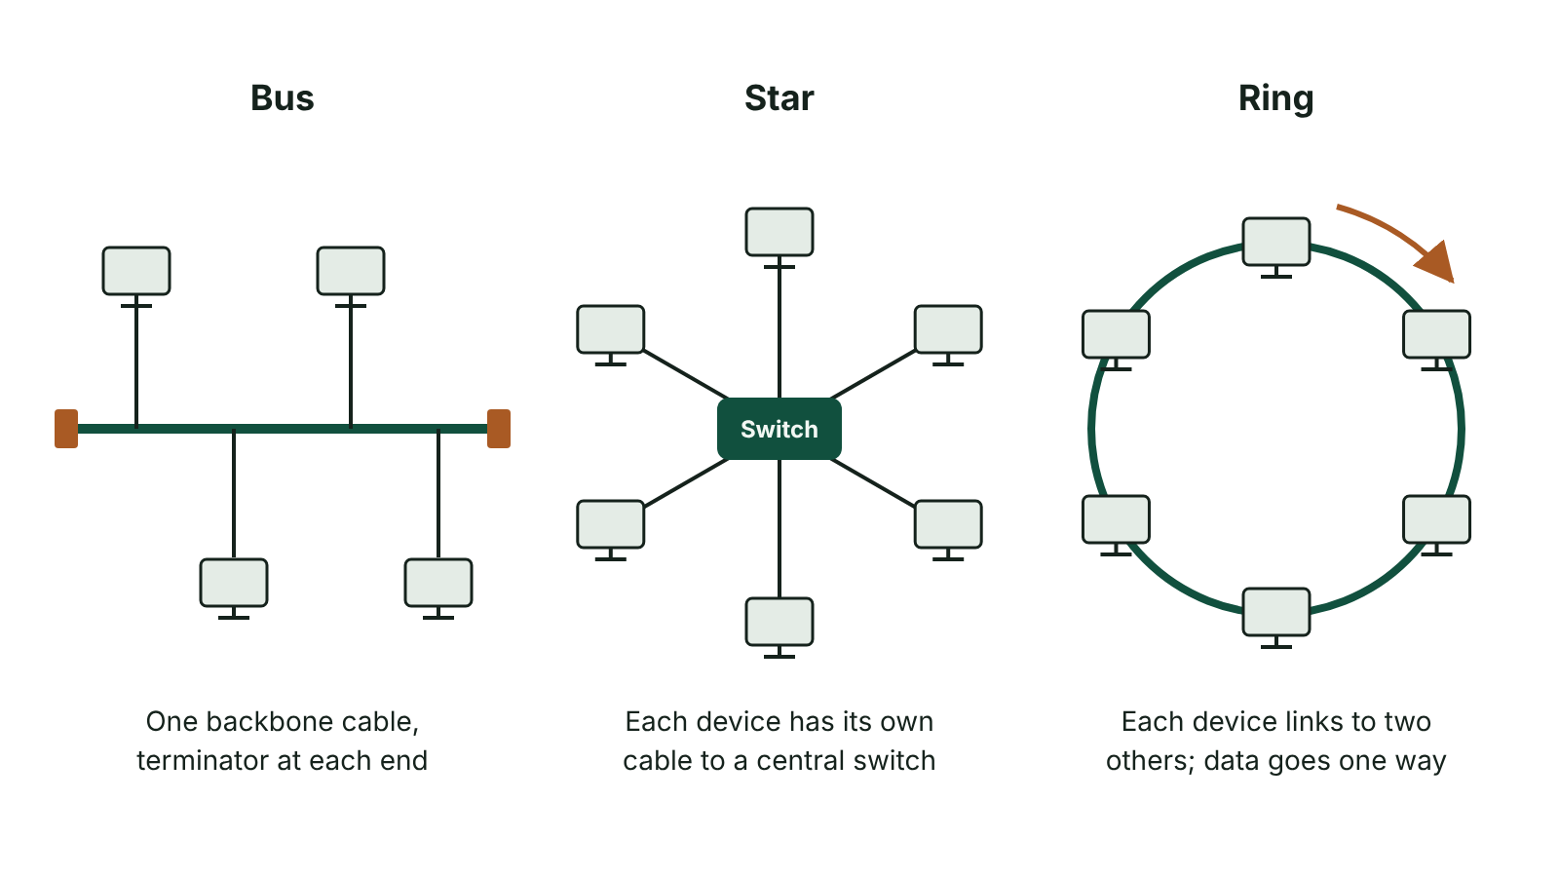
The big picture
Bus, star and ring network topologies
☰ Menu
Notes:
Explain the diagram in your own words before you read on.

Slide 7
What is a network?
A network is two or more computers or devices linked together by cables or wirelessly so they can share resources and communicate
A standalone computer is not connected to any network – its files, printer and software can only be used on that machine
Networks let users share hardware (printers), software, files and an internet connection
Many networks have a file server: a powerful computer that stores users' files and controls access to them
Users usually log on with a username and password, so the network knows who they are and what they may access
☰ Menu

Slide 8
LAN and WAN
Feature | Local area network (LAN) | Wide area network (WAN)
Area covered | Small geographical area – one building or site | Large geographical area – across towns, countries or the world
Ownership | Hardware usually owned and managed by the organisation | Uses links rented from telecommunications companies
How it connects | Network cables and Wi-Fi | Telecommunications links: fibre optic cables, telephone lines, satellites, mobile networks
Example | The computers in one school or one shop | The internet; a bank linking all its NI branches to head office
☰ Menu

Slide 9
Advantages and disadvantages of a network (1 of 2)
Advantages | Disadvantages
Users save work on the file server and can open it from any computer on the network | Set-up is expensive: servers, NICs, switches, routers and cabling must be bought
Expensive hardware such as a laser printer can be shared by everyone | A network manager or technician is needed, which adds staff costs
Data and files can be shared across the whole organisation | A virus can spread quickly to every computer on the network
Backups are made centrally on the server – quicker than backing up each PC | The network can slow down when many users transfer large files and bandwidth is limited
Security is managed centrally: user accounts and access rights control who sees what | If the file server fails, users may be unable to reach their files
☰ Menu

Slide 10
Advantages and disadvantages of a network (2 of 2)
Advantages | Disadvantages
Software and updates are installed once and made available to all computers | Hackers may target the network to steal data
☰ Menu

Slide 11
The internet and the World Wide Web
The internet is a worldwide network of networks – a WAN. It is the hardware and connections that carry data around the world
The World Wide Web (WWW) is a service that uses the internet: billions of web pages stored on web servers and viewed in a browser
Each website has a unique address called a URL (uniform resource locator), e.g. https://www.nidirect.gov.uk
Web pages are written in HTML (hypertext markup language) and are joined together by hyperlinks; the first page of a site is the home page
Web pages are requested and sent using HTTP or its secure version HTTPS (hypertext transfer protocol)
Other services also use the internet without the WWW, e.g. email, online gaming and video calls
☰ Menu

Slide 12
Intranets
An intranet is a private network owned and managed by an organisation; it uses the same technology and protocols as the internet
Only authorised users can get in – they must log on with a username and password
Used to share documents, notices, forms, staff news, bulletin boards and messages inside the organisation
Staff can work remotely and still reach their documents securely
Schools in NI use C2k services so pupils and staff can reach learning resources and class material at any time, 24/7
The internet is open to anyone with a connection; an intranet is closed to the public
☰ Menu

Slide 13
The Internet of Things (IoT)
IoT stands for Internet of Things: everyday physical objects with built-in sensors and connectivity that send and receive data over the internet
A fitness watch records heart rate, steps and sleep and sends the data to an app on a phone for analysis
A smart thermostat lets a family turn their heating on from their phone on the way home
Other examples: video doorbells, smart speakers, smart plugs and lights, smart fridges, connected cars
IoT is growing because sensors are cheaper, more devices have Wi-Fi built in and fast broadband is more widely available
Concerns: privacy of the data collected, devices with weak passwords being hacked, needing an internet connection to work
☰ Menu

Slide 14
Network hardware
Device | Function
Network interface card (NIC) | A circuit board fitted in a computer so it can connect to a network; provides a port (e.g. Ethernet) for the cable. Laptops have a wireless NIC (WNIC)
Network cables | Physically connect a computer's NIC to a device such as a switch. Usually copper (CAT5e, CAT6 – CAT6 is faster); fibre optic for long or very fast links
Switch | A single central connection point for many computers on a LAN. It checks the destination of the data it receives and forwards it only to the intended computer
Router | Connects two or more networks, e.g. a LAN to the internet. It reads the IP address of the data and forwards it along the best route to its destination
☰ Menu

Slide 15
Switch or router?
A switch works inside one network (a LAN); a router joins different networks together
A switch sends data to the right computer on the LAN using each device's MAC address (a unique number built into every NIC)
A router decides which route data should take across networks using IP addresses
Routers sit at a gateway – the point where two networks meet, e.g. where a school LAN meets the internet
A home 'router' box usually combines a router, a small switch, a wireless access point and a firewall that filters incoming and outgoing data
☰ Menu

Slide 16
Bus topology
A topology is the way the devices in a LAN are arranged and connected
Bus: every computer is attached to a single shared cable, the backbone, and signals can move either way along it
A terminator at each end of the backbone absorbs the signal so it does not bounce back and cause errors
Advantages: cheap and easy to set up because little cable is needed; a new computer is simply attached to the backbone
Disadvantages: if the backbone fails, the whole network stops; data collisions slow it down when traffic is heavy; all computers can see the data, so it is less secure
If only the cable from one computer to the backbone fails, just that computer is affected
☰ Menu

Slide 17
Star topology
Every computer has its own cable to a central device – today usually a switch (some textbooks show a central file server)
All data passes through the central device, which sends it on to the correct computer
Advantages: if one cable fails only that computer is affected; easy to add a computer with a new cable; fast and reliable because data goes only where it is needed
Disadvantages: if the central switch or server fails, the whole network stops; more cable is needed, so it costs more to install
Star is the most common layout in schools and offices
☰ Menu

Slide 18
Ring topology
Each computer is connected to the two computers next to it, forming a closed loop; there is no central computer
Data moves round the loop one way only, handed on from computer to computer until it arrives where it is going
Advantages: no data collisions because data flows one way; performs steadily even when many computers send data
Disadvantages: if one cable or computer fails, the whole ring is broken
Adding a computer is hard: the cable between two computers must be broken and both ends attached to the new one, which disrupts the network
☰ Menu

Slide 19
Worked example: a sports club in Omagh
The club has 5 standalone PCs and one printer in the office; the coaches want shared membership files and internet access
Step 1 – Network type: everything is in one building, so it needs a LAN
Step 2 – Hardware: a NIC in each PC, CAT6 cables to a switch, and a router to connect the LAN to the internet
Step 3 – Topology: star, so a broken cable only stops one PC and new PCs are easy to add later
Step 4 – Benefits: one shared printer, files stored and backed up centrally on a server, logins control who sees members' data
Step 5 – Drawbacks to plan for: cost of hardware, someone to maintain it, antivirus so malware cannot spread
☰ Menu

Slide 20
Exit quiz: question 1 of 9
Tap an answer to check it. Presenting? Click to reveal the answer.
Which device connects a school's LAN to the internet and uses IP addresses to send data along the best route?
A Switch
B Router
✗
✓
C Network interface card
D Terminator
✗
✗
✓ B: Router – A router connects different networks and routes data using IP addresses. A switch only works within one LAN.
☰ Menu

Slide 21
Exit quiz: question 2 of 9
Tap an answer to check it. Presenting? Click to reveal the answer.
In which topology is every computer connected by its own cable to a central switch?
A Bus
B Ring
✗
✗
C Star
D Backbone
✓
✗
✓ C: Star – In a star topology each device has its own link to the central device, so one broken cable only affects one computer.
☰ Menu

Slide 22
Exit quiz: question 3 of 9
Tap an answer to check it. Presenting? Click to reveal the answer.
What is the job of a terminator in a bus network?
A To connect the bus to the internet
B To stop signals bouncing back along the backbone
✗
✓
C To speed up the backbone
D To give each computer an IP address
✗
✗
✓ B: To stop signals bouncing back along the backbone – Terminators absorb the signal at each end of the backbone so it does not reflect back and cause errors.
☰ Menu

Slide 23
Exit quiz: question 4 of 9
Tap an answer to check it. Presenting? Click to reveal the answer.
What does IoT stand for?
A Internet of Technology
B Intranet of Things
✗
✗
C Internet of Things
D Input of Things
✓
✗
✓ C: Internet of Things – The Internet of Things: everyday objects with sensors that connect to the internet to share data.
☰ Menu

Slide 24
Exit quiz: question 5 of 9
Tap an answer to check it. Presenting? Click to reveal the answer.
Which best describes the World Wide Web?
A The cables and routers linking computers worldwide
B A collection of linked web pages accessed over the internet
✗
✓
C A private network for one company
D A type of LAN
✗
✗
✓ B: A collection of linked web pages accessed over the internet – The WWW is a service that runs on the internet; the internet is the network itself.
☰ Menu

Slide 25
Exit quiz: question 6 of 9
Tap an answer to check it. Presenting? Click to reveal the answer.
Which is a disadvantage of a network compared with standalone computers?
A Files can be backed up centrally
B Printers can be shared
✗
✗
C A virus can spread quickly to all computers
D Software can be installed once for everyone
✓
✗
✓ C: A virus can spread quickly to all computers – Because the computers are linked, malware can spread from one machine to the others.
☰ Menu

Slide 26
Exit quiz: question 7 of 9
Tap an answer to check it. Presenting? Click to reveal the answer.
Which statement about a ring network is true?
A Data travels in one direction around the loop
B It needs a terminator at each end
✓
✗
C Each computer connects to a central switch
D A fault in one cable affects only one computer
✗
✗
✓ A: Data travels in one direction around the loop – Data passes around the ring in one direction; a single break stops the whole ring.
☰ Menu

Slide 27
Exit quiz: question 8 of 9
Tap an answer to check it. Presenting? Click to reveal the answer.
A WAN differs from a LAN because a WAN…
A is always wireless
B covers a large geographical area using telecommunications links
✗
✓
C cannot connect to the internet
D only links two computers
✗
✗
✓ B: covers a large geographical area using telecommunications links – WANs span towns, countries or the world and rely on links such as fibre optic cables or satellites.
☰ Menu

Slide 28
Exit quiz: question 9 of 9
Tap an answer to check it. Presenting? Click to reveal the answer.
Which device inside a computer provides the port for a network cable?
A Router
B Switch
✗
✗
C File server
D Network interface card
✗
✓
✓ D: Network interface card – The NIC is a circuit board fitted inside the computer; it provides the port (e.g. Ethernet) that the network cable plugs into.
☰ Menu

Slide 29
Exit quiz answers
Q | Answer | Why
1 | B Router | A router connects different networks and routes data using IP addresses. A switch only works within one LAN.
2 | C Star | In a star topology each device has its own link to the central device, so one broken cable only affects one computer.
3 | B To stop signals bouncing back along the backbone | Terminators absorb the signal at each end of the backbone so it does not reflect back and cause errors.
4 | C Internet of Things | The Internet of Things: everyday objects with sensors that connect to the internet to share data.
5 | B A collection of linked web pages accessed over the internet | The WWW is a service that runs on the internet; the internet is the network itself.
6 | C A virus can spread quickly to all computers | Because the computers are linked, malware can spread from one machine to the others.
7 | A Data travels in one direction around the loop | Data passes around the ring in one direction; a single break stops the whole ring.
8 | B covers a large geographical area using telecommunications links | WANs span towns, countries or the world and rely on links such as fibre optic cables or satellites.
9 | D Network interface card | The NIC is a circuit board fitted inside the computer; it provides the port (e.g. Ethernet) that the network cable plugs into.
☰ Menu

Slide 30
In the exam
Paper | Question | Marks | What it tested
Unit 1 2022 | Q12 | 7 | WAN, encryption, firewall, processor performance
Unit 1 2023 | Q6 | 5 | Communication technologies; IoT
Unit 1 2023 | Q7 | 8 | LAN, router and switch, bus diagram, NIC
Unit 1 2024 | Q6 | 13 | Network statements, bus disadvantages, LAN, encryption, HTTPS, RAM vs ROM, malware routes
Unit 1 2025 | Q8 | 10 | IoT, Internet vs WWW, uses of networks, networking concepts
Unit 1 2025 | Q13 | 10 | Term matching: hardware, memory, networking, malware
5 more past questions on the website. Papers and mark schemes: ccea.org.uk → GCSE Digital Technology → Past Papers & Mark Schemes.
☰ Menu

Slide 31
Network communication technologies
UNIT 1: DIGITAL TECHNOLOGY · L17
Learning objectives
Describe how Wi-Fi, Bluetooth, optical fibre, 4G and 5G transmit data
Give advantages, disadvantages and typical uses of each technology
Compare wireless and optical fibre for cost, speed and reliability
Choose and justify the best technology for a scenario
Notes:
Specification: Describe Wi-Fi, Bluetooth, optical fibre and mobile communication technology (4G and 5G) | Evaluate the effectiveness of each communication technology in terms of speed, range, reliability, security and cost | Compare wireless communication with optical fibre communication | Select and justify a suitable communication technology for a given scenario

Slide 32
In this lesson
Tap a button to jump straight there. The ☰ Menu button on every slide brings you back here.
The big picture
Mobile communication: 5G
How networks communicate
Comparing the technologies
Wi-Fi
Worked example: choosing the right technology
Wi-Fi: evaluation
Wireless versus optical fibre
Bluetooth
Exit quiz
Optical fibre
↑ Topic menu
Mobile communication: 4G
Notes:
Lesson menu: each button jumps to that part of the lesson in Slide Show. The ☰ Menu button on each slide returns here.

Slide 33
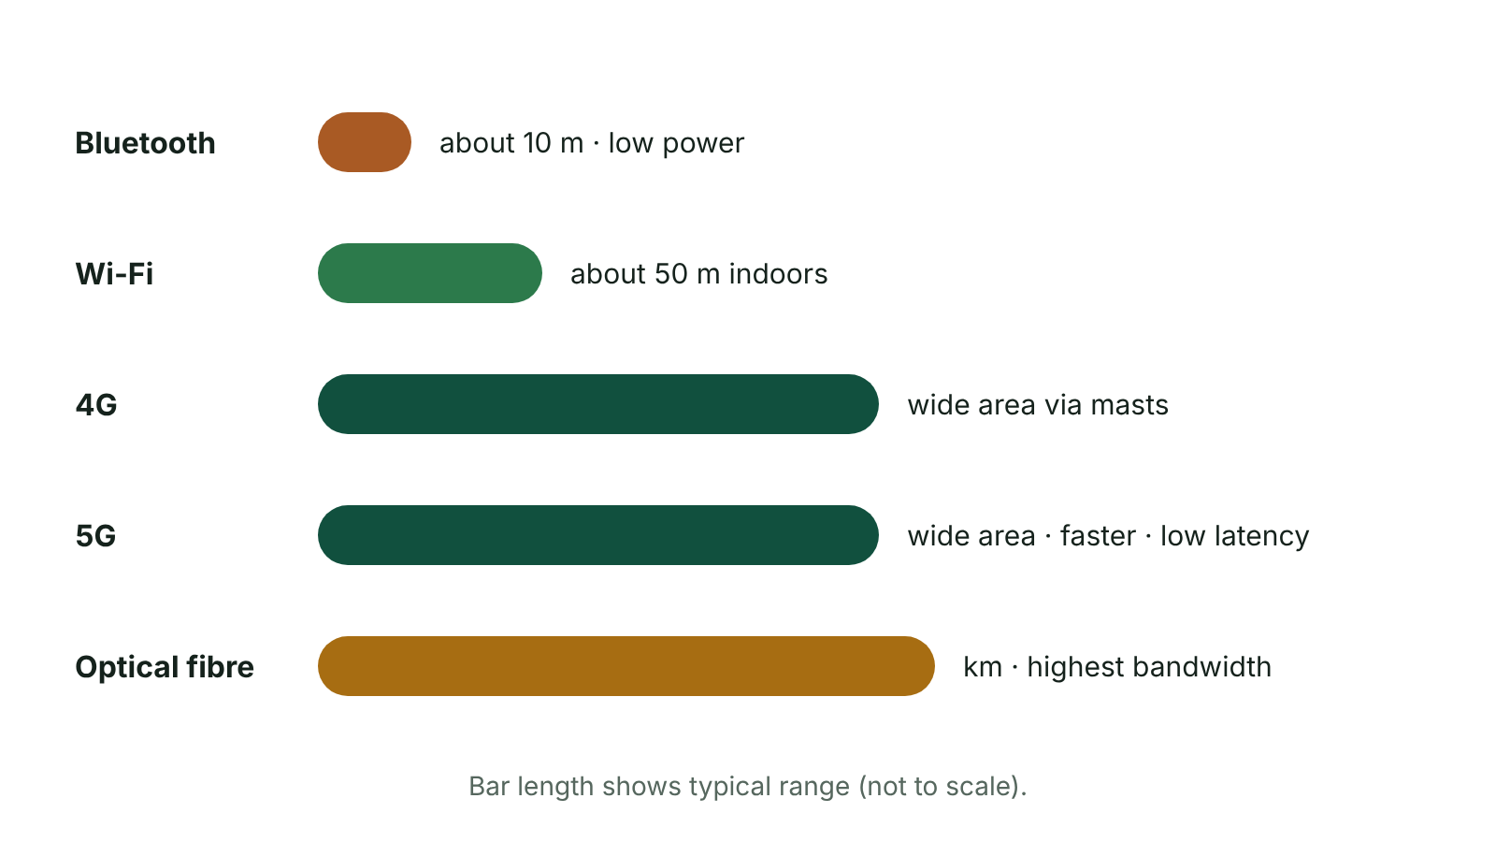
The big picture
Typical range of Bluetooth, Wi-Fi, 4G, 5G and optical fibre
☰ Menu
Notes:
Explain the diagram in your own words before you read on.

Slide 34
How networks communicate
Data can be sent between devices by cable (copper or optical fibre) or wirelessly using radio waves
Bandwidth: the amount of data that can be sent in a given time, measured in bits per second (e.g. Mbps = megabits per second)
Range: how far apart the devices can be and still communicate
Latency: the delay between data being sent and arriving – important for gaming and video calls
Interference: other signals or obstacles that weaken or corrupt the data
Wireless and fibre technologies have made networks, including mobile phone networks, far more widely used
☰ Menu

Slide 35
Wi-Fi
Wi-Fi (wireless fidelity) connects devices to a network using radio waves and a wireless router or access point – no network cables
Most laptops, phones, tablets and smart devices have a wireless adapter built in
Used in homes, schools, libraries, airports and cafés; typical indoor range is tens of metres, reduced by walls
Speed depends on the Wi-Fi standard: older standards reach about 54 Mbps, newer ones (Wi-Fi 5, 6) are far faster
Networks should be protected with a password and encryption (WPA2 or WPA3) so outsiders cannot join or read the data
☰ Menu

Slide 36
Wi-Fi: evaluation
Advantages | Disadvantages
No cabling, so quick and cheap to set up | Signal strength drops the further you are from the router
Users can move around a building and stay connected | Walls, floors and other devices cause interference
Easy to add new devices, including visitors' phones | Usually slower and less reliable than a cabled connection
Many devices can connect at the same time | Speed falls when many users share the same access point
Ideal for laptops, tablets and IoT devices | Signals travel through the air, so an unsecured network can be joined or intercepted
☰ Menu

Slide 37
Bluetooth
Short-range wireless technology using radio signals to connect two devices directly to each other
Devices must be close together – typically about 10 m – and must be paired (synchronised) before data can be sent
No router or third-party provider is needed, so it is cheap to use
Uses very little power, so it suits battery devices
Uses: wireless earbuds and headphones, hands-free calls in a car, wireless mouse or keyboard, smartwatch to phone, camera to printer
Drawbacks: very short range, slower than Wi-Fi, few devices at once, a device left 'discoverable' could be connected to by a stranger
☰ Menu

Slide 38
Optical fibre
Optical fibre cables contain bundles of very thin glass strands; data is sent as pulses of light
Each strand carries its own signal, so many signals travel at once – very high bandwidth and very fast speeds
Light is not affected by electrical interference, and the fibre is very hard to tap into, so data is secure
Signals travel long distances with little loss; repeaters are only needed to boost the signal over very long distances
Drawbacks: very expensive to install (often roads must be dug up), fibres can break if bent sharply, specialist repair skills
Used for internet backbones, undersea cables, links between buildings and full-fibre broadband to homes (FTTP)
☰ Menu

Slide 39
Mobile communication: 4G
Mobile networks send data by radio waves between a phone and nearby masts (cells), giving wireless internet almost anywhere
4G (fourth generation) gives high-speed data access – fast enough for HD video streaming, video calls and online games
It made multimedia apps on phones common and lowered the cost of downloading each bit of data
Masts are expensive, so coverage is best where more people live; rural areas such as parts of Fermanagh and Tyrone can have weak signal
Using 4G data drains a phone's battery faster than Wi-Fi and uses up a data allowance
☰ Menu

Slide 40
Mobile communication: 5G
5G (fifth generation) offers much higher speeds and much lower latency than 4G
It can handle far more connected devices in one area – useful at concerts, sports grounds and for IoT
It supports new uses: cloud gaming on phones, connected or self-driving cars, remote-controlled machinery
The fastest 5G frequencies have a shorter range and are blocked more easily by buildings, so many more masts are needed
Coverage is still patchy outside towns, and users need a 5G-capable phone
Note: some older textbooks say 5G has a greater range than 4G – each high-speed 5G mast actually covers a smaller area
☰ Menu

Slide 41
Comparing the technologies
Technology | Speed | Range | Reliability | Security | Cost
Wi-Fi | Medium to high | Tens of metres | Drops with distance and walls | Needs a password and WPA2/WPA3 | Cheap – a router
Bluetooth | Low | About 10 m | Good at close range | Risk if left discoverable | Very cheap, no network needed
Optical fibre | Very high | Kilometres | Very reliable, no interference | Very hard to tap | Expensive to install
4G | High | Wide area via masts | Weak in some rural areas | Encrypted by the network | Monthly data plan
5G | Very high, low latency | Wide area but needs more masts | Patchy coverage so far | Encrypted by the network | Data plan + 5G phone
☰ Menu

Slide 42
Worked example: choosing the right technology
Scenario | Best choice | Justification
Linking two buildings of a Belfast hospital with huge scan files | Optical fibre | Very high bandwidth, no interference from medical equipment, hard to tap patient data
Pupils using tablets around a school in Newry | Wi-Fi | No cables, pupils can move between rooms, many devices connect at once
A farmer in Fermanagh checking livestock sensors in a field | 4G/5G mobile | Works outdoors over a wide area where there is no Wi-Fi; check coverage first
Wireless earbuds and a phone on the bus | Bluetooth | Devices are close together, low power saves battery, no network needed
Live drone video at a GAA or Ulster Rugby match | 5G | High speed and low latency for live video; copes with many devices in a crowd
☰ Menu

Slide 43
Wireless versus optical fibre
Cost: wireless is cheap to set up (no cables); fibre is expensive to install but lasts a long time
Speed: fibre is much faster with greater bandwidth; wireless speed falls with distance and number of users
Reliability: fibre is not affected by interference or weather; wireless signals are weakened by walls, distance and other devices
Security: fibre is very hard to intercept; wireless signals travel through the air and must be encrypted
Mobility: wireless lets users move around; fibre is fixed in place
Many networks combine both: fibre to the building, then Wi-Fi inside it
☰ Menu

Slide 44
Exit quiz: question 1 of 9
Tap an answer to check it. Presenting? Click to reveal the answer.
A hospital needs a very fast link between two buildings that cannot be affected by electrical interference from medical equipment. Which technology is best?
A Bluetooth
B Optical fibre
✗
✓
C Wi-Fi
D 4G
✗
✗
✓ B: Optical fibre – Optical fibre carries light, so it is immune to electrical interference, and it has very high bandwidth.
☰ Menu

Slide 45
Exit quiz: question 2 of 9
Tap an answer to check it. Presenting? Click to reveal the answer.
A pupil wants to connect wireless earbuds to their phone. Which technology will they use?
A Bluetooth
B Optical fibre
✓
✗
C 5G
D A network cable
✗
✗
✓ A: Bluetooth – Bluetooth is designed for short-range, low-power links between two nearby devices.
☰ Menu

Slide 46
Exit quiz: question 3 of 9
Tap an answer to check it. Presenting? Click to reveal the answer.
What is a key benefit of 5G compared with 4G?
A Each mast covers a larger area
B Much lower latency
✗
✓
C No masts are needed
D It works without a SIM or network
✗
✗
✓ B: Much lower latency – 5G gives higher speeds and much lower delay, but needs more masts.
☰ Menu

Slide 47
Exit quiz: question 4 of 9
Tap an answer to check it. Presenting? Click to reveal the answer.
What is latency?
A The amount of data sent per second
B The range of a signal
✗
✗
C The delay before data arrives
D The number of users on a network
✓
✗
✓ C: The delay before data arrives – Latency is delay; bandwidth is the amount of data per second.
☰ Menu

Slide 48
Exit quiz: question 5 of 9
Tap an answer to check it. Presenting? Click to reveal the answer.
Which is a disadvantage of Wi-Fi?
A It needs a cable to every device
B It cannot connect phones
✗
✗
C It only works for headphones
D Signal is weakened by walls and distance
✗
✓
✓ D: Signal is weakened by walls and distance – Wi-Fi signals get weaker with distance and are blocked by walls and floors.
☰ Menu

Slide 49
Exit quiz: question 6 of 9
Tap an answer to check it. Presenting? Click to reveal the answer.
Why is optical fibre considered secure?
A It is very hard to tap into the cable
B It is password protected
✓
✗
C It only works over 10 metres
D It uses radio waves
✗
✗
✓ A: It is very hard to tap into the cable – Signals stay as light inside the glass, so the cable is very hard to intercept without being detected.
☰ Menu

Slide 50
Exit quiz: question 7 of 9
Tap an answer to check it. Presenting? Click to reveal the answer.
Before two Bluetooth devices can share data they must be…
A connected to a router
B plugged into a switch
✗
✗
C paired
D given a URL
✓
✗
✓ C: paired – Bluetooth devices are paired (synchronised) so they recognise each other.
☰ Menu

Slide 51
Exit quiz: question 8 of 9
Tap an answer to check it. Presenting? Click to reveal the answer.
Which unit is used to measure Wi-Fi speed?
A Megabytes of storage (MB)
B Gigahertz (GHz)
✗
✗
C Pixels per inch
D Megabits per second (Mbps)
✗
✓
✓ D: Megabits per second (Mbps) – Network speed is measured in bits per second, such as Mbps.
☰ Menu

Slide 52
Exit quiz: question 9 of 9
Tap an answer to check it. Presenting? Click to reveal the answer.
A farmer in a remote field with no Wi-Fi needs internet access for sensors. What is the most likely choice?
A Bluetooth
B Mobile data (4G/5G)
✗
✓
C Optical fibre to each sensor
D A bus network
✗
✗
✓ B: Mobile data (4G/5G) – Mobile networks cover wide outdoor areas, although rural coverage should be checked.
☰ Menu

Slide 53
Exit quiz answers
Q | Answer | Why
1 | B Optical fibre | Optical fibre carries light, so it is immune to electrical interference, and it has very high bandwidth.
2 | A Bluetooth | Bluetooth is designed for short-range, low-power links between two nearby devices.
3 | B Much lower latency | 5G gives higher speeds and much lower delay, but needs more masts.
4 | C The delay before data arrives | Latency is delay; bandwidth is the amount of data per second.
5 | D Signal is weakened by walls and distance | Wi-Fi signals get weaker with distance and are blocked by walls and floors.
6 | A It is very hard to tap into the cable | Signals stay as light inside the glass, so the cable is very hard to intercept without being detected.
7 | C paired | Bluetooth devices are paired (synchronised) so they recognise each other.
8 | D Megabits per second (Mbps) | Network speed is measured in bits per second, such as Mbps.
9 | B Mobile data (4G/5G) | Mobile networks cover wide outdoor areas, although rural coverage should be checked.
☰ Menu

Slide 54
In the exam
Paper | Question | Marks | What it tested
Unit 1 2021 | Q11 | 8 | Key term matching
Unit 1 2022 | Q8 | 11 | IoT, Wi-Fi and Bluetooth, Internet vs WWW, fibre optic
Unit 1 2023 | Q6 | 5 | Communication technologies; IoT
Papers and mark schemes: ccea.org.uk → GCSE Digital Technology → Past Papers & Mark Schemes.
☰ Menu

