Slide 1
Cyberspace, network security and data transfer
UNIT 1: DIGITAL TECHNOLOGY · TOPIC
Lessons in this topic
L18 Cybercrime and malware
L19 Protecting networks and data; protocols

Slide 2

Topic menu
Tap a button to jump straight there. The ☰ Menu button on every slide brings you back here.
Specification map
L19 Protecting networks and data; protocols
L18 Cybercrime and malware

Slide 3
Specification map
Lesson | Specification: students should be able to
L18 | Define the term cybercrime and give examples of threats to cybersecurity, including hacking, pornography, cyber stalking, data theft, denial of service, digital forgery, cyber defamation, spamming and phishing; Define the term malware and describe the following forms of malware: virus, Trojan horse, worm, key logger and spyware; Describe how malware can get onto a computer system and how anti-virus software helps to prevent it
L19 | Explain how networks and data can be protected using encryption, passwords, levels of access, backup and firewalls; Describe the role of a protocol in data transfer; Describe the purpose of the following protocols: File Transfer Protocol (FTP), HyperText Transfer Protocol (HTTP) and HyperText Transfer Protocol Secure (HTTPS)
☰ Menu
Notes:
Each lesson below is its own section in PowerPoint (View → Slide Sorter shows them). To split this deck by specification point, right-click a section → Move Section, or delete the sections you do not need.

Slide 4
Cybercrime and malware
UNIT 1: DIGITAL TECHNOLOGY · L18
Learning objectives
Define cybercrime and describe each of the nine threats to cybersecurity in the specification
Recognise the threat being described in a scenario and explain its effect on a person or organisation
Define malware and describe how it gets onto a computer
Distinguish between a virus, worm, Trojan horse, key logger and spyware
Explain how anti-virus software protects a computer
Notes:
Specification: Define the term cybercrime and give examples of threats to cybersecurity, including hacking, pornography, cyber stalking, data theft, denial of service, digital forgery, cyber defamation, spamming and phishing | Define the term malware and describe the following forms of malware: virus, Trojan horse, worm, key logger and spyware | Describe how malware can get onto a computer system and how anti-virus software helps to prevent it

Slide 5
In this lesson
Tap a button to jump straight there. The ☰ Menu button on every slide brings you back here.
The big picture
Forms of malware
What is cybercrime?
Virus vs worm vs Trojan horse
Threats to cybersecurity (1)
Key loggers and spyware
Threats to cybersecurity (2)
Worked example: name the threat
Why these threats matter
Defending against malware
Worked example: spot the phishing
Exit quiz
What is malware?
↑ Topic menu
Notes:
Lesson menu: each button jumps to that part of the lesson in Slide Show. The ☰ Menu button on each slide returns here.

Slide 6
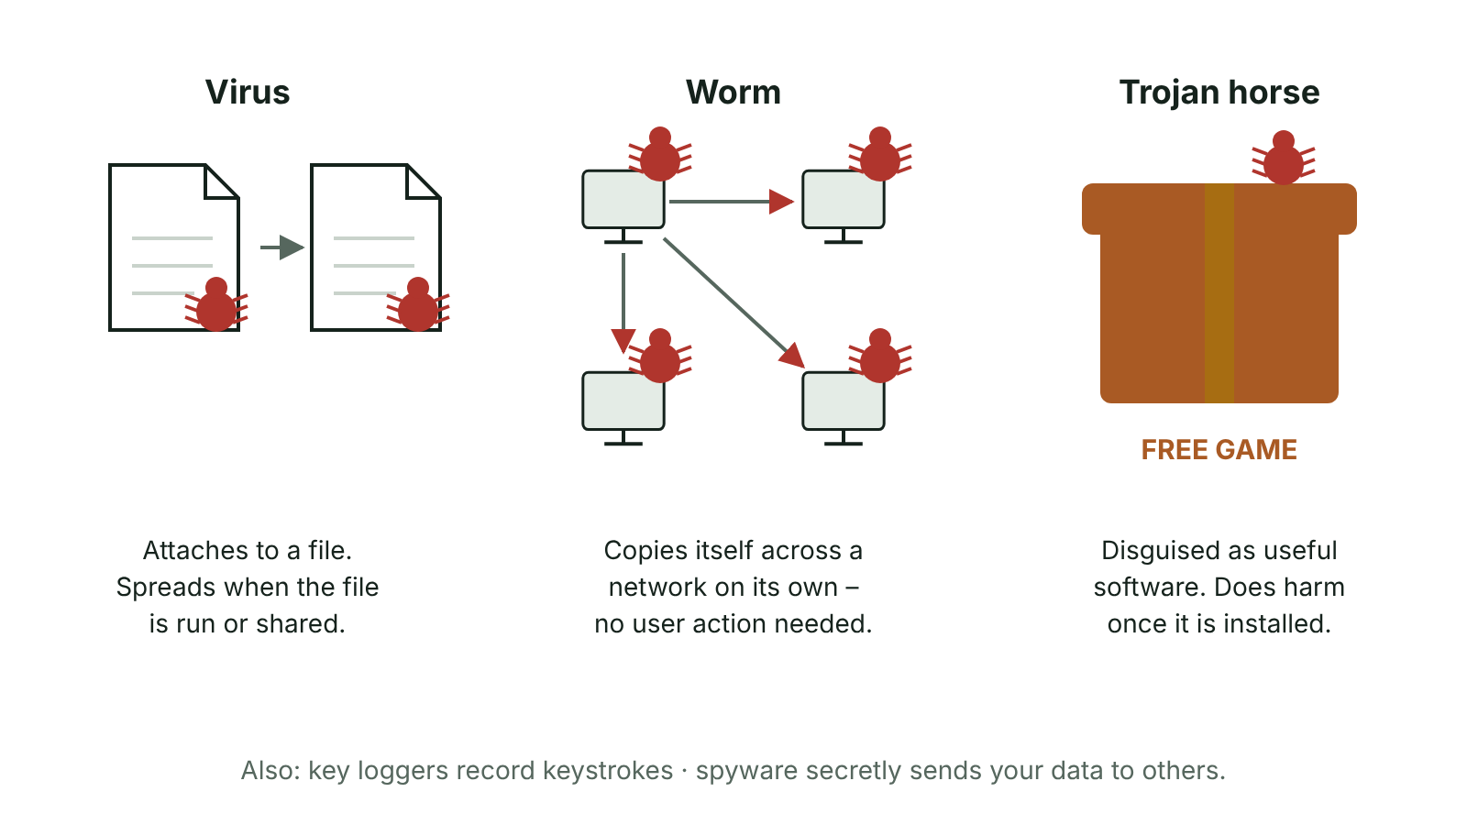
The big picture
How a virus, a worm and a Trojan horse spread
☰ Menu
Notes:
Explain the diagram in your own words before you read on.

Slide 7
What is cybercrime?
Cybercrime: any crime committed using a computer, a network or the internet
The computer can be the target (hacking a school network, crashing a website) or the tool (stalking, fraud, forgery)
Cyber criminals want money, data, revenge, attention or to cause disruption
Cybersecurity: the methods used to protect computers, networks and data from these attacks
In the UK, unauthorised access and deliberately damaging systems are offences under the Computer Misuse Act 1990
☰ Menu

Slide 8
Threats to cybersecurity (1)
Threat | What it is | Example
Hacking | Gaining unauthorised access to a computer system or its data | Breaking into a council server to read or change records
Pornography | Illegal or indecent images shared online; adult sites are also a common way of hiding malware | An employee visits an adult site at work and infects the office network
Cyber stalking | Using technology to repeatedly harass, track or frighten a person | Sending threatening messages and tracking someone's location posts
Data theft | Stealing personal or company data, often to sell it or commit identity fraud | Customer names and card numbers copied from an online shop
Denial of service (DoS) | Flooding a server with requests so genuine users cannot use it | A ticket website crashes on the day concert tickets go on sale
☰ Menu

Slide 9
Threats to cybersecurity (2)
Threat | What it is | Example
Digital forgery | Deliberately and falsely altering digital content to deceive | Editing a photo or name on a scanned passport; a deepfake video
Cyber defamation | Posting untrue statements online that harm the good name of a person or an organisation | Untrue claims on a forum that a local café gave customers food poisoning
Spamming | Sending bulk unwanted messages, usually adverts or scams | Hundreds of junk emails fill a teacher's inbox
Phishing | Messages pretending to be from a trusted organisation to trick people into giving personal details | A fake 'parcel delivery' text with a link asking for card details
☰ Menu

Slide 10
Why these threats matter
Data theft can lead to identity theft: criminals open bank accounts or apply for credit cards in the victim's name
DoS attacks lose a business sales and customers' trust while the site is down; attacks from many computers at once are called DDoS
Spam wastes time, fills storage and uses bandwidth; it can also carry phishing links or malware
Cyber stalking and cyber defamation cause distress and harm to people's reputations and mental health
Hacking may lead to data being stolen, deleted or changed, and the organisation can be fined if personal data is not kept secure
☰ Menu

Slide 11
Worked example: spot the phishing
Text received: 'NI Bank: unusual activity on your account. Verify your details within 24 hours at nib-secure-login.co'
Clue 1: urgency and a threat, to rush you into acting without thinking
Clue 2: the link goes to a look-alike web address, not the bank's real site
Clue 3: real banks never ask for your full PIN or password by text or email
Result if you click: a fake login page captures your details, which are used for identity theft or to empty your account
Safe action: do not click; contact the bank using the number on your card
☰ Menu

Slide 12
What is malware?
Malware (malicious software): software designed to damage or disrupt a computer system, or to gain unauthorised access to it or its data
It usually arrives without the user meaning to install it
Routes in: email attachments, links in messages, downloads from untrusted websites, infected USB sticks, fake apps
Exam tip: 'malicious software' alone is not enough. Say what the malware does
☰ Menu

Slide 13
Forms of malware
Malware | How it works | Effect
Virus | Attaches itself to a file or program; runs when that file is opened, sometimes triggered by a date or event | Deletes or corrupts data; slows the computer; copies itself to other files
Worm | Copies itself and spreads across a network on its own, e.g. by emailing itself to every contact | Uses up bandwidth so the network slows down; can carry other malware
Trojan horse | Disguised as useful software (e.g. a free game or fake anti-virus) so the user installs it | Deletes files or opens a 'back door' so a hacker can get in
Key logger | Secretly records every key pressed and saves it in a log file sent to the criminal | Passwords, card numbers and messages are stolen
Spyware | Installed secretly, often bundled with free downloads; monitors what the user does | Sends browsing habits or personal details to a third party; uses memory and slows the computer
☰ Menu

Slide 14
Virus vs worm vs Trojan horse
Feature | Virus | Worm | Trojan horse
Needs a host file? | Yes | No | No, it is a whole program in disguise
Copies itself? | Yes, to other files | Yes, across the network | No
Needs the user to act? | Yes, the infected file must be run | No, spreads by itself | Yes, the user is tricked into installing it
Main giveaway | Infects files | Slows the network | Looks like genuine software
☰ Menu

Slide 15
Key loggers and spyware
Both work secretly: the user does not know they are there
A key logger captures keystrokes, e.g. an email address and password typed into a banking site
Spyware watches wider activity: websites visited, what is bought, sometimes screenshots
Stolen details are used for fraud or sold, e.g. to advertisers or other criminals
Some employers use key-logging software legally to monitor work computers, but must tell staff
☰ Menu

Slide 16
Worked example: name the threat
Scenario | Threat
A free 'homework helper' app installs and lets a stranger access the laptop's files | Trojan horse
A Fermanagh hotel's booking site is flooded with fake requests and goes offline | Denial of service
Someone posts false claims online that a football coach cheated, and the club loses members | Cyber defamation
Malware spreads by itself to every PC on the school network and slows it down | Worm
A pupil's social media password is captured as they type it on a shared PC | Key logger
A forged exam certificate is created by editing a scanned copy | Digital forgery
☰ Menu

Slide 17
Defending against malware
Anti-virus software scans files, downloads and memory, and quarantines or deletes anything that matches a known threat
It must be updated often (usually automatically, at least daily) so it can recognise new malware
Keep the operating system and apps updated to close security holes
Do not open unexpected attachments or links, and only download from trusted sources
Network protection (firewalls, passwords, encryption, backups) is covered in the next lesson
☰ Menu

Slide 18
Exit quiz: question 1 of 8
Tap an answer to check it. Presenting? Click to reveal the answer.
Malware that is disguised as a useful program, so the user installs it themselves, is a…
A worm
B Trojan horse
✗
✓
C spam
D key logger
✗
✗
✓ B: Trojan horse – A Trojan horse is named after the wooden horse used to trick its way into Troy: it looks harmless but carries something harmful.
☰ Menu

Slide 19
Exit quiz: question 2 of 8
Tap an answer to check it. Presenting? Click to reveal the answer.
A text claiming to be from your bank asks you to click a link and 'verify' your PIN. What is this?
A Spamming
B Hacking
✗
✗
C Phishing
D Cyber defamation
✓
✗
✓ C: Phishing – Phishing pretends to come from a trusted organisation to trick people into handing over personal details.
☰ Menu

Slide 20
Exit quiz: question 3 of 8
Tap an answer to check it. Presenting? Click to reveal the answer.
Which malware spreads across a network by itself without a host file?
A Worm
B Virus
✓
✗
C Trojan horse
D Spyware
✗
✗
✓ A: Worm – Worms self-replicate and travel across networks, using up bandwidth.
☰ Menu

Slide 21
Exit quiz: question 4 of 8
Tap an answer to check it. Presenting? Click to reveal the answer.
Flooding a website with requests so genuine customers cannot use it is…
A digital forgery
B cyber stalking
✗
✗
C data theft
D denial of service
✗
✓
✓ D: denial of service – A DoS attack overloads the server so it cannot respond to real users.
☰ Menu

Slide 22
Exit quiz: question 5 of 8
Tap an answer to check it. Presenting? Click to reveal the answer.
Publishing false, damaging claims about a person or business online is…
A cyber defamation
B spamming
✓
✗
C phishing
D hacking
✗
✗
✓ A: cyber defamation – Cyber defamation damages someone's reputation with untrue statements.
☰ Menu

Slide 23
Exit quiz: question 6 of 8
Tap an answer to check it. Presenting? Click to reveal the answer.
Which malware records every key a user presses?
A Worm
B Virus
✗
✗
C Key logger
D Firewall
✓
✗
✓ C: Key logger – A key logger saves keystrokes to a log file that is sent to the criminal, revealing passwords.
☰ Menu

Slide 24
Exit quiz: question 7 of 8
Tap an answer to check it. Presenting? Click to reveal the answer.
Stolen customer details used to apply for a credit card in someone else's name is…
A identity theft
B spamming
✓
✗
C a worm
D digital forgery
✗
✗
✓ A: identity theft – Data theft often leads to identity theft, where the criminal pretends to be the victim.
☰ Menu

Slide 25
Exit quiz: question 8 of 8
Tap an answer to check it. Presenting? Click to reveal the answer.
Editing a scanned passport photo to make a fake document is…
A cyber stalking
B digital forgery
✗
✓
C denial of service
D spyware
✗
✗
✓ B: digital forgery – Digital forgery is deliberately altering digital content to deceive.
☰ Menu

Slide 26
Exit quiz answers
Q | Answer | Why
1 | B Trojan horse | A Trojan horse is named after the wooden horse used to trick its way into Troy: it looks harmless but carries something harmful.
2 | C Phishing | Phishing pretends to come from a trusted organisation to trick people into handing over personal details.
3 | A Worm | Worms self-replicate and travel across networks, using up bandwidth.
4 | D denial of service | A DoS attack overloads the server so it cannot respond to real users.
5 | A cyber defamation | Cyber defamation damages someone's reputation with untrue statements.
6 | C Key logger | A key logger saves keystrokes to a log file that is sent to the criminal, revealing passwords.
7 | A identity theft | Data theft often leads to identity theft, where the criminal pretends to be the victim.
8 | B digital forgery | Digital forgery is deliberately altering digital content to deceive.
☰ Menu

Slide 27
In the exam
Paper | Question | Marks | What it tested
Unit 1 2023 | Q8 | 9 | Protocols, HTTPS, phishing, malware, encryption
Unit 1 2024 | Q6 | 13 | Network statements, bus disadvantages, LAN, encryption, HTTPS, RAM vs ROM, malware routes
Unit 1 2024 | Q8 | 6 | Two cyber threats: phishing and denial of service (levelled)
Unit 1 2024 | Q10 | 8 | Key term matching
Unit 1 2025 | Q11 | 6 | Cybercrime types; malware
Unit 1 2025 | Q13 | 10 | Term matching: hardware, memory, networking, malware
4 more past questions on the website. Papers and mark schemes: ccea.org.uk → GCSE Digital Technology → Past Papers & Mark Schemes.
☰ Menu

Slide 28
Protecting networks and data; protocols
UNIT 1: DIGITAL TECHNOLOGY · L19
Learning objectives
Explain how encryption protects data that is intercepted or stolen
Describe how usernames, strong passwords and levels of access stop unauthorised use of a network
Explain how backups and firewalls protect a network and its data
Describe what a protocol is and why devices need one
Describe the purpose of FTP, HTTP and HTTPS and compare HTTP with HTTPS
Notes:
Specification: Explain how networks and data can be protected using encryption, passwords, levels of access, backup and firewalls | Describe the role of a protocol in data transfer | Describe the purpose of the following protocols: File Transfer Protocol (FTP), HyperText Transfer Protocol (HTTP) and HyperText Transfer Protocol Secure (HTTPS)

Slide 29
In this lesson
Tap a button to jump straight there. The ☰ Menu button on every slide brings you back here.
The big picture
Levels of access
FTP, HTTP and HTTPS
Encryption
Why levels of access protect data
How HTTP works
Worked example: a simple cipher
Backup
HTTP vs HTTPS
Usernames and passwords
Firewalls
Exit quiz
Strong passwords and 2FA
What is a protocol?
↑ Topic menu
Notes:
Lesson menu: each button jumps to that part of the lesson in Slide Show. The ☰ Menu button on each slide returns here.

Slide 30
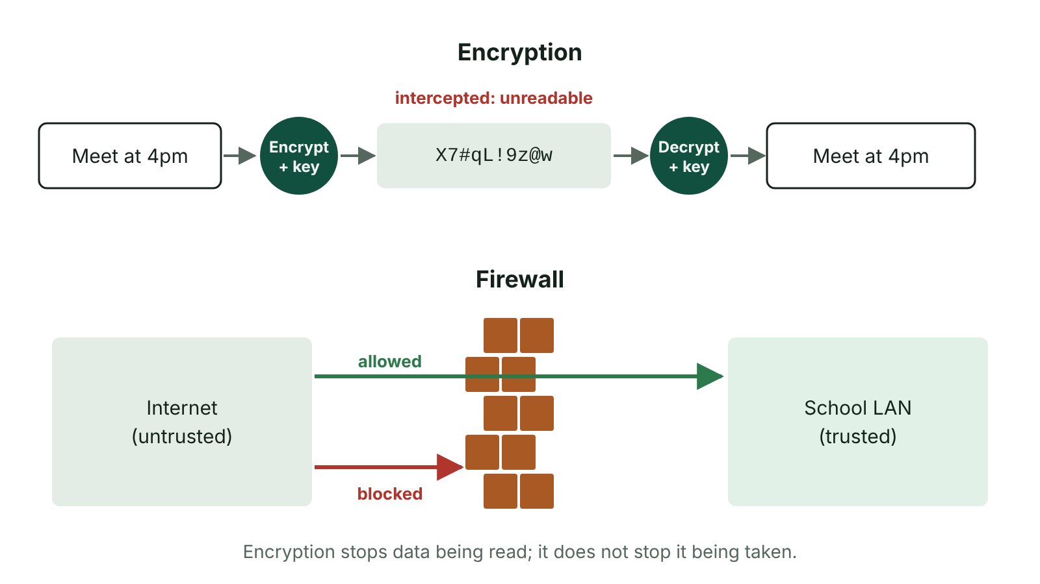
The big picture
Encryption makes intercepted data unreadable; a firewall filters network traffic
☰ Menu
Notes:
Explain the diagram in your own words before you read on.

Slide 31
Encryption
Encryption scrambles data using an algorithm and a key, so it is unreadable to anyone without the key
Plain text → encrypted (cipher) text → sent → decrypted back to plain text by the recipient, who has the key
If data is intercepted on a network or a device is stolen, the data is meaningless to the thief
Encryption does not stop data being intercepted or stolen; it stops it being understood
Used for Wi-Fi (WPA2/WPA3), HTTPS websites, messaging apps and encrypted laptops and USB sticks
☰ Menu

Slide 32
Worked example: a simple cipher
Key: shift each letter 3 places forward in the alphabet (a Caesar cipher)
Plain text: MEET AT GATE
M→P, E→H, E→H, T→W … A→D, T→W … G→J, A→D, T→W, E→H
Cipher text sent: PHHW DW JDWH
The recipient knows the key, so shifts each letter back 3 to decrypt it
Real encryption uses far longer keys and complex algorithms, so it cannot be guessed
☰ Menu

Slide 33
Usernames and passwords
Every person who logs on gives their own user ID plus a password, and the system compares the pair with its secure user database
If they do not match, access is refused; many systems lock the account after a set number of failed attempts
Passwords appear as asterisks or dots on screen so people nearby cannot read them
Users may be forced to change passwords regularly, and must type a new one twice to confirm it
Unique IDs let the network manager keep a log of who logged on, when and from which computer
☰ Menu

Slide 34
Strong passwords and 2FA
Password | Strong? | Why
fermanagh | No | A dictionary/place word, all lower case, easily guessed
Liam2010 | No | A name and birth year: personal details are easy to find on social media
password123 | No | One of the most commonly used passwords
t7#Rq!9vLm2p | Yes | 12 characters with upper and lower case, digits and symbols, and not a word
Two-factor authentication | Extra layer | A second check, e.g. a code sent to a phone, so a stolen password alone is not enough
☰ Menu

Slide 35
Levels of access
Level | What the user can do | School example
No access | Cannot open the file or folder at all | Pupils cannot see the staff area
Read only | Can view the contents but not change them | Pupils can view the homework sheet
Read and copy | Can view and make their own copy, but not change the original | Pupils copy a template into their own area
Read and write | Can view and change (edit, add, delete) the data | Teachers can edit pupils' marks
Full control / admin | Can change settings, permissions and install software | The network manager
☰ Menu

Slide 36
Why levels of access protect data
Access rights are stored in a table linked to each user ID and checked every time a file is opened
Users only get the access they need for their job, so confidential data stays private
Read-only access stops data being changed or deleted by accident or on purpose
If a hacker steals one user's login, they can only reach that user's data, which limits the damage
Example: in a hospital, receptionists see appointment times but only doctors and nurses can read medical notes
☰ Menu

Slide 37
Backup
Backup: a copy of data kept separately so it can be restored if the original is lost, corrupted, deleted or stolen
Usually scheduled automatically, e.g. every night after the school day ends
Stored away from the original: an external drive kept off-site or cloud storage, so a fire or theft does not destroy both
To recover, restore software copies the backup back onto the server
Backups are the main defence if ransomware locks files, and should be tested to make sure they work
☰ Menu

Slide 38
Firewalls
A firewall is hardware or software that monitors and filters all data entering or leaving a network
It checks traffic against rules (the security policy): allowed data passes, anything else is blocked
Stops hackers getting into the network from the internet
Can block some viruses and spam, and stop users uploading or downloading unsuitable data or visiting blocked sites
Produces reports of blocked access attempts for the network manager
A firewall is not anti-virus software: it filters traffic, it does not scan and clean files
☰ Menu

Slide 39
What is a protocol?
A protocol is an agreed set of rules for sending and receiving data between devices
Devices must 'speak the same language': both sender and receiver must use the same protocol
Rules cover the format of the data, how it is addressed, error checking, and how communication starts and ends
Protocols mean devices from different manufacturers (a phone, a laptop, a smart TV) can communicate
The internet uses TCP/IP; routers use the addresses to send data along the right path to the right computer
☰ Menu

Slide 40
FTP, HTTP and HTTPS
Protocol | Full name | Purpose
FTP | File Transfer Protocol | Sending and receiving files between computers over a network or the internet, e.g. uploading a website's files to a web server
HTTP | HyperText Transfer Protocol | Requesting web pages from a web server and transferring them to a browser
HTTPS | HyperText Transfer Protocol Secure | Same as HTTP, but data is encrypted; used for logins, online banking and shopping
☰ Menu

Slide 41
How HTTP works
A user types a URL into the browser's address bar or clicks a link
The browser uses HTTP to send a request to the web server for that page
The server sends the page back, and the browser displays it
If the page cannot be found, the server sends back a status code such as '404 Not Found'
If the address starts https://, the same request and reply happen but the data is encrypted
☰ Menu

Slide 42
HTTP vs HTTPS
 | HTTP | HTTPS
Encrypted? | No: data is sent as plain text | Yes: encrypted using SSL/TLS
If intercepted | Data such as card numbers can be read | Data is scrambled and meaningless
Browser shows | 'Not secure' warning | Padlock icon; address starts https://
Used for | Ordinary pages with no personal data | Logins, banking, shopping, any form with personal details
☰ Menu

Slide 43
Exit quiz: question 1 of 8
Tap an answer to check it. Presenting? Click to reveal the answer.
What does a firewall do?
A Removes viruses from infected files
B Monitors and filters network traffic, blocking anything that breaks the security rules
✗
✓
C Makes a copy of data each night
D Encrypts all passwords
✗
✗
✓ B: Monitors and filters network traffic, blocking anything that breaks the security rules – A firewall checks data entering or leaving a network against rules and blocks what is not allowed.
☰ Menu

Slide 44
Exit quiz: question 2 of 8
Tap an answer to check it. Presenting? Click to reveal the answer.
How does HTTPS differ from HTTP?
A HTTPS encrypts the data sent
B HTTPS is only used for files
✓
✗
C HTTPS needs no web browser
D HTTPS works without the internet
✗
✗
✓ A: HTTPS encrypts the data sent – The S stands for Secure: data is encrypted, so intercepted data cannot be read.
☰ Menu

Slide 45
Exit quiz: question 3 of 8
Tap an answer to check it. Presenting? Click to reveal the answer.
Which protocol is used to upload a website's files to a web server?
A HTTP
B HTTPS
✗
✗
C FTP
D TCP
✓
✗
✓ C: FTP – File Transfer Protocol is used to send and receive files.
☰ Menu

Slide 46
Exit quiz: question 4 of 8
Tap an answer to check it. Presenting? Click to reveal the answer.
A protocol is…
A a type of malware
B a network cable
✗
✗
C a strong password
D an agreed set of rules for transmitting data
✗
✓
✓ D: an agreed set of rules for transmitting data – Protocols let devices from different makers communicate by following the same rules.
☰ Menu

Slide 47
Exit quiz: question 5 of 8
Tap an answer to check it. Presenting? Click to reveal the answer.
Which is the strongest password?
A password123
B Liam2010
✗
✗
C t7#Rq!9vLm2p
D fermanagh
✓
✗
✓ C: t7#Rq!9vLm2p – It is long, mixes character types and is not a word or personal detail.
☰ Menu

Slide 48
Exit quiz: question 6 of 8
Tap an answer to check it. Presenting? Click to reveal the answer.
A pupil can open the class notes but cannot change them. What access level is this?
A Read only
B Read and write
✓
✗
C Full control
D No access
✗
✗
✓ A: Read only – Read only lets a user view but not modify data.
☰ Menu

Slide 49
Exit quiz: question 7 of 8
Tap an answer to check it. Presenting? Click to reveal the answer.
Why should a backup be stored off-site or in the cloud?
A It makes the backup run faster
B A fire or theft at the building will not destroy both copies
✗
✓
C It encrypts the data
D It stops hackers logging in
✗
✗
✓ B: A fire or theft at the building will not destroy both copies – Keeping the copy in a different place protects it from events that destroy the original.
☰ Menu

Slide 50
Exit quiz: question 8 of 8
Tap an answer to check it. Presenting? Click to reveal the answer.
What happens to encrypted data if it is intercepted?
A It is deleted automatically
B It is sent back to the sender
✗
✗
C It cannot be understood without the key
D It becomes a virus
✓
✗
✓ C: It cannot be understood without the key – Encryption does not stop interception, but the data is meaningless without the key.
☰ Menu

Slide 51
Exit quiz answers
Q | Answer | Why
1 | B Monitors and filters network traffic, blocking anything that breaks the security rules | A firewall checks data entering or leaving a network against rules and blocks what is not allowed.
2 | A HTTPS encrypts the data sent | The S stands for Secure: data is encrypted, so intercepted data cannot be read.
3 | C FTP | File Transfer Protocol is used to send and receive files.
4 | D an agreed set of rules for transmitting data | Protocols let devices from different makers communicate by following the same rules.
5 | C t7#Rq!9vLm2p | It is long, mixes character types and is not a word or personal detail.
6 | A Read only | Read only lets a user view but not modify data.
7 | B A fire or theft at the building will not destroy both copies | Keeping the copy in a different place protects it from events that destroy the original.
8 | C It cannot be understood without the key | Encryption does not stop interception, but the data is meaningless without the key.
☰ Menu

Slide 52
In the exam
Paper | Question | Marks | What it tested
Unit 1 2022 | Q7 | 11 | Ring topology, protocols, FTP, HTTPS, malware
Unit 1 2022 | Q12 | 7 | WAN, encryption, firewall, processor performance
Unit 1 2023 | Q8 | 9 | Protocols, HTTPS, phishing, malware, encryption
Unit 1 2024 | Q6 | 13 | Network statements, bus disadvantages, LAN, encryption, HTTPS, RAM vs ROM, malware routes
Unit 1 2024 | Q10 | 8 | Key term matching
Unit 1 2024 | Q11 | 6 | Legislation matching, online harms, protection methods
3 more past questions on the website. Papers and mark schemes: ccea.org.uk → GCSE Digital Technology → Past Papers & Mark Schemes.
☰ Menu

