Slide 1
Cloud technology
UNIT 1: DIGITAL TECHNOLOGY · TOPIC
Lessons in this topic
L20 Cloud technology

Slide 2

Topic menu
Tap a button to jump straight there. The ☰ Menu button on every slide brings you back here.
Specification map
L20 Cloud technology

Slide 3
Specification map
Lesson | Specification: students should be able to
L20 | Define the term cloud computing; Describe the advantages of cloud computing for an organisation; Describe the disadvantages of cloud computing for an organisation; Describe the impact of cloud computing on gaming; Describe the impact of cloud computing on file storage and file sharing, including collaborative tools
☰ Menu
Notes:
Each lesson below is its own section in PowerPoint (View → Slide Sorter shows them). To split this deck by specification point, right-click a section → Move Section, or delete the sections you do not need.

Slide 4
Cloud technology
UNIT 1: DIGITAL TECHNOLOGY · L20
Learning objectives
Define cloud computing and give examples of cloud services
Describe the advantages and disadvantages of the cloud for an organisation
Evaluate the impact of the cloud on gaming for players and game producers
Explain how cloud storage and collaborative tools change the way people store and share files
Notes:
Specification: Define the term cloud computing | Describe the advantages of cloud computing for an organisation | Describe the disadvantages of cloud computing for an organisation | Describe the impact of cloud computing on gaming | Describe the impact of cloud computing on file storage and file sharing, including collaborative tools

Slide 5
In this lesson
Tap a button to jump straight there. The ☰ Menu button on every slide brings you back here.
The big picture
Impact on gaming: players
What is cloud computing?
Impact on file storage
Advantages for an organisation (1)
Impact on file sharing and collaboration
Advantages for an organisation (2)
Worked example: a council planning team
Disadvantages for an organisation
Exit quiz
Impact on gaming: game producers
↑ Topic menu
Notes:
Lesson menu: each button jumps to that part of the lesson in Slide Show. The ☰ Menu button on each slide returns here.

Slide 6
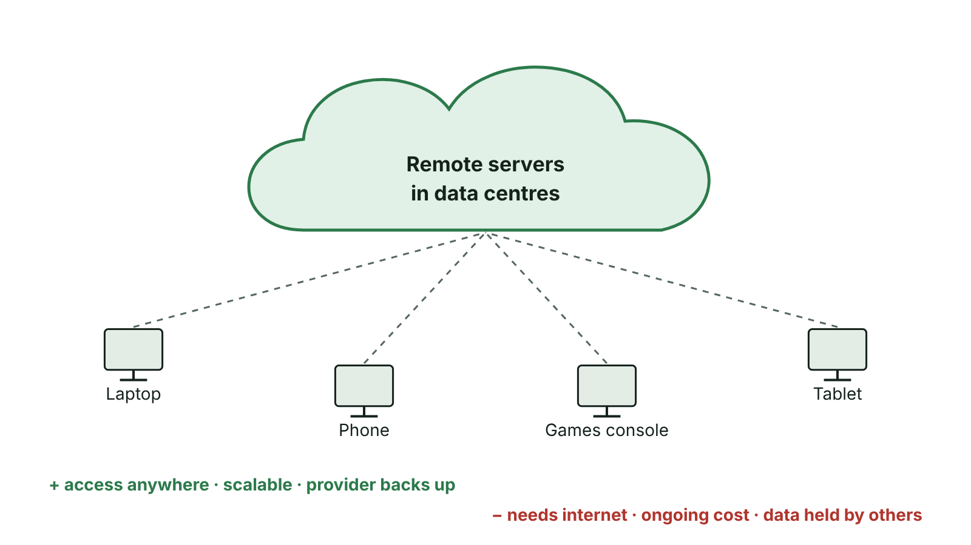
The big picture
Cloud computing: devices reach remote servers over the internet
☰ Menu
Notes:
Explain the diagram in your own words before you read on.

Slide 7
What is cloud computing?
Cloud computing: computing resources such as storage and software are delivered on demand over the internet from remote servers, instead of from a local hard drive
The servers are kept in large data centres run by cloud providers such as Microsoft, Google and Amazon
Any device with an internet connection – PC, laptop, tablet or phone – can reach the data and programs
Organisations usually pay a subscription or 'pay as you go' for what they use
Examples: OneDrive, Google Drive, iCloud, Microsoft 365, Google Docs, Xbox Cloud Gaming
☰ Menu

Slide 8
Advantages for an organisation (1)
Cost effective: no need to buy and maintain servers or many software licences; pay-as-you-go plans mean paying only for what is used
Scalable: storage and bandwidth can be increased or decreased quickly as the organisation grows or shrinks
Huge storage capacity: providers offer far more space than local hard drives, and more can be bought at any time
Software updates are applied automatically by the provider, saving staff time
☰ Menu

Slide 9
Advantages for an organisation (2)
Backup and recovery: the provider backs up data automatically at regular intervals and can restore it, so no separate backup devices are needed
Accessibility: staff can reach their files anywhere, at any time, on any device with internet access – supports home and hybrid working
Collaboration: several staff can work on the same file at the same time
Data survives local disasters: if the office has a fire, flood or theft, the files are still safe in the cloud
Smaller carbon footprint: less equipment in the building means less electricity used on site
☰ Menu

Slide 10
Disadvantages for an organisation
Needs a reliable internet connection: if the broadband or router fails, staff cannot reach their files or software (downtime)
Provider outages or maintenance can make data unavailable, and the organisation cannot fix it itself
Bandwidth limits: some plans include a limited allowance and charge extra if it is exceeded; large uploads can be slow
Security and privacy: data is held by a third party and could be hacked; personal data must still be protected under the UK GDPR and Data Protection Act 2018
Ongoing subscription costs never end, and customer support can be slow or cost extra
Less control: the organisation depends on the provider's decisions, prices and data centre locations
☰ Menu

Slide 11
Impact on gaming: game producers
Games can be sold and downloaded online, so producers no longer pay shops or make discs – savings can be passed on as lower prices
Players can download a game the moment it is released instead of waiting for it to reach shops
Cloud-based games are much harder to pirate than discs, protecting sales and funding for new games
The internet gives access to a global customer base, which can lead to more sales and profit
Updates, patches and new content can be released through game servers immediately
Demo versions can be offered online to attract new customers
☰ Menu

Slide 12
Impact on gaming: players
Cloud gaming (game streaming): the game runs on powerful servers in a data centre and video of it is streamed to the player's device
Players can enjoy high-quality graphics on a cheap laptop, tablet or phone, without buying the newest console or PC
Less need for big downloads or extra local storage; game saves are kept in the cloud and synced across devices
Drawbacks: needs fast broadband with low latency – lag spoils fast games; streaming high-quality video uses a lot of data
Subscriptions are ongoing, and if the service closes or a game is removed, the player may lose access
☰ Menu

Slide 13
Impact on file storage
Files are stored on high-capacity cloud servers rather than only on a local hard drive or USB stick
Many cloud apps save work automatically every few seconds, so very little is lost if a device crashes
Files stay online until the user deletes them, and many services keep deleted files in a recycle bin for a time
Providers keep copies on several servers and can restore files if a server fails – the user does not need technical knowledge
Files are synchronised, so the latest version appears on a phone, laptop and school PC
Users must keep their account secure: a strong password and two-factor authentication
☰ Menu

Slide 14
Impact on file sharing and collaboration
Users upload a file once and share a link, instead of emailing large attachments
Permissions control who can view, comment on or edit each file or folder
Collaborative tools (Google Docs, Sheets and Slides, Microsoft 365 with Word, Excel and PowerPoint online, Teams) let several people edit the same document at the same time
Synchronisation (sync) means a change made by one user appears in everyone's copy
Version history records who changed what and lets earlier versions be restored; automatic email alerts can tell users when a file changes
Teams in different towns or countries can work on the same project as if they were in one room
☰ Menu

Slide 15
Worked example: a council planning team
Situation at Mid Ulster District Council | How the cloud helps | What to watch out for
Officers work in Dungannon, Cookstown, Magherafelt and at home | All files reachable from any office or home | Every site needs reliable broadband
Four officers write one planning report together | Real-time co-editing; comments and version history | Permissions must be set correctly
Plans and photos take up a lot of space | Buy more storage when needed (scalable) | Subscription cost rises with storage
Files hold residents' personal data | Provider handles backups and security updates | Must comply with the UK GDPR; data held by a third party
A burst pipe floods one office | Files are safe off site and can be opened elsewhere | If the provider has an outage, no one can work
☰ Menu

Slide 16
Exit quiz: question 1 of 9
Tap an answer to check it. Presenting? Click to reveal the answer.
Which of these best defines cloud computing?
A Storing data on a USB stick
B Using storage and software on remote servers accessed over the internet
✗
✓
C Connecting devices with Bluetooth
D Working on a standalone computer offline
✗
✗
✓ B: Using storage and software on remote servers accessed over the internet – Cloud computing delivers storage and software on demand from remote servers over the internet.
☰ Menu

Slide 17
Exit quiz: question 2 of 9
Tap an answer to check it. Presenting? Click to reveal the answer.
A school's broadband fails for a morning. Why is this a problem if its files are in the cloud?
A Cloud files are deleted when the internet goes down
B Staff cannot reach the files or cloud software until the connection returns
✗
✓
C The cloud provider charges a fine
D The files become corrupted
✗
✗
✓ B: Staff cannot reach the files or cloud software until the connection returns – Cloud services depend on an internet connection; without it there is downtime for the school.
☰ Menu

Slide 18
Exit quiz: question 3 of 9
Tap an answer to check it. Presenting? Click to reveal the answer.
In cloud gaming, where is the game actually processed?
A On the player's device
B On a game disc
✗
✗
C On the provider's remote servers
D On the router
✓
✗
✓ C: On the provider's remote servers – The server runs the game and streams video to the player, so the player's device can be low-powered.
☰ Menu

Slide 19
Exit quiz: question 4 of 9
Tap an answer to check it. Presenting? Click to reveal the answer.
Several pupils editing the same Google Doc at the same time is an example of…
A a collaborative tool
B batch processing
✓
✗
C a standalone system
D a bus network
✗
✗
✓ A: a collaborative tool – Collaborative cloud tools such as Google Docs and Microsoft 365 allow real-time co-editing.
☰ Menu

Slide 20
Exit quiz: question 5 of 9
Tap an answer to check it. Presenting? Click to reveal the answer.
What does 'scalable' mean when describing cloud storage?
A It is very secure
B It uses optical fibre
✗
✗
C It cannot be changed
D Capacity can easily be increased or decreased
✗
✓
✓ D: Capacity can easily be increased or decreased – The organisation can buy more or less storage as its needs change.
☰ Menu

Slide 21
Exit quiz: question 6 of 9
Tap an answer to check it. Presenting? Click to reveal the answer.
Which is a disadvantage of cloud computing for an organisation?
A Staff can work from home
B Software is updated automatically
✗
✗
C Data is held by a third party and could be hacked
D Data is backed up regularly
✓
✗
✓ C: Data is held by a third party and could be hacked – Security and privacy are concerns because the provider, not the organisation, holds the data.
☰ Menu

Slide 22
Exit quiz: question 7 of 9
Tap an answer to check it. Presenting? Click to reveal the answer.
How does selling games through the cloud help game producers?
A Games can no longer be updated
B It removes the cost of discs and shops and reaches a global market
✗
✓
C Players need more powerful consoles
D It makes broadband unnecessary
✗
✗
✓ B: It removes the cost of discs and shops and reaches a global market – Online distribution cuts costs and reaches customers worldwide.
☰ Menu

Slide 23
Exit quiz: question 8 of 9
Tap an answer to check it. Presenting? Click to reveal the answer.
What does version history allow a user to do?
A See who changed a file and restore an earlier version
B Speed up the internet
✓
✗
C Make files smaller
D Stop anyone else opening the file
✗
✗
✓ A: See who changed a file and restore an earlier version – Version history records changes and lets users go back to earlier versions.
☰ Menu

Slide 24
Exit quiz: question 9 of 9
Tap an answer to check it. Presenting? Click to reveal the answer.
Why does cloud gaming need a connection with low latency?
A To store more games
B To reduce the price of the game
✗
✗
C To make the screen brighter
D So the game responds quickly without lag
✗
✓
✓ D: So the game responds quickly without lag – High latency causes a delay between pressing a button and seeing the result, which spoils fast games.
☰ Menu

Slide 25
Exit quiz answers
Q | Answer | Why
1 | B Using storage and software on remote servers accessed over the internet | Cloud computing delivers storage and software on demand from remote servers over the internet.
2 | B Staff cannot reach the files or cloud software until the connection returns | Cloud services depend on an internet connection; without it there is downtime for the school.
3 | C On the provider's remote servers | The server runs the game and streams video to the player, so the player's device can be low-powered.
4 | A a collaborative tool | Collaborative cloud tools such as Google Docs and Microsoft 365 allow real-time co-editing.
5 | D Capacity can easily be increased or decreased | The organisation can buy more or less storage as its needs change.
6 | C Data is held by a third party and could be hacked | Security and privacy are concerns because the provider, not the organisation, holds the data.
7 | B It removes the cost of discs and shops and reaches a global market | Online distribution cuts costs and reaches customers worldwide.
8 | A See who changed a file and restore an earlier version | Version history records changes and lets users go back to earlier versions.
9 | D So the game responds quickly without lag | High latency causes a delay between pressing a button and seeing the result, which spoils fast games.
☰ Menu

Slide 26
In the exam
Paper | Question | Marks | What it tested
Unit 1 2019 | Q7 | 4 | Cloud computing benefits for gaming (QWC)
Unit 1 2022 | Q2 | 3 | Optical, capacity, cloud storage terms
Unit 1 2023 | Q9 | 6 | Cloud computing, business benefits, cloud gaming
Unit 1 2024 | Q2 | 4 | Cloud definition, benefits and risks
Papers and mark schemes: ccea.org.uk → GCSE Digital Technology → Past Papers & Mark Schemes.
☰ Menu

