Slide 1
Ethical, legal and environmental impact
UNIT 1: DIGITAL TECHNOLOGY · TOPIC
Lessons in this topic
L21 Legislation 1: Consumer Contracts, Copyright and Computer Misuse
L22 Legislation 2: Data protection (UK GDPR and the Data Protection Act 2018)
L23 Ethics, employment and health and safety

Slide 2

Topic menu
Tap a button to jump straight there. The ☰ Menu button on every slide brings you back here.
Specification map
L22 Legislation 2: Data protection (UK GDPR and the Data Protection Act 2018)
L21 Legislation 1: Consumer Contracts, Copyright and Computer Misuse
L23 Ethics, employment and health and safety

Slide 3
Specification map (1 of 2)
Lesson | Specification: students should be able to
L21 | Demonstrate knowledge and understanding of the Consumer Contracts (Information, Cancellation and Additional Charges) Regulations 2013; Demonstrate knowledge and understanding of the Copyright, Designs and Patents Act 1988; Identify typical breaches of the Copyright, Designs and Patents Act 1988, including software piracy and software licensing infringements; Demonstrate knowledge and understanding of the Computer Misuse Act 1990 and its offences; Describe the terms hacker, virus and spyware and explain how they relate to the Computer Misuse Act 1990; Apply knowledge of legislation to identify which law has been broken in a given scenario
L22 | Demonstrate knowledge and understanding of data protection law: the UK GDPR and the Data Protection Act 2018 (which replaced the Data Protection Act 1998 named in the specification); Demonstrate and apply knowledge and understanding of the data protection principles, including how they relate to the eight principles of the 1998 Act; Describe the rights of the data subject; Describe the responsibilities of the data controller, the Data Protection Officer and the Information Commission (formerly the ICO) in making sure the law is followed; Describe measures organisations use to comply with data protection law
☰ Menu

Slide 4
Specification map (2 of 2)
Lesson | Specification: students should be able to
L23 | Describe the ethical impact of technology on society, referring to internet misuse, access to personal information, social media misuse, the implications of GPS and tracking, and concerns about the security of personal data; Describe the impact of digital technology on employment, including increased job opportunities in the digital technology and computing sector, job displacement, changes in work patterns and the need for upskilling; Demonstrate understanding of digital technology related health and safety issues, including RSI, back strain and eye strain; Identify the measures that both the employee and employer should take to promote good health and safety practice in the workplace, including the Health and Safety (Display Screen Equipment) Regulations 1992 (in Northern Ireland, the Health and Safety (Display Screen Equipment) Regulations (Northern Ireland) 1992)
☰ Menu
Notes:
Each lesson below is its own section in PowerPoint (View → Slide Sorter shows them). To split this deck by specification point, right-click a section → Move Section, or delete the sections you do not need.

Slide 5
Legislation 1: Consumer Contracts, Copyright and Computer Misuse
UNIT 1: DIGITAL TECHNOLOGY · L21
Learning objectives
Give the full, exact title of each law and say what it protects
Describe the rights online shoppers have under the Consumer Contracts Regulations 2013, including the exceptions
Explain copyright and software licences and identify breaches such as software piracy
Describe the offences in the Computer Misuse Act 1990 and link hackers, viruses and spyware to them
Match a scenario to the correct law and explain why
Notes:
Specification: Demonstrate knowledge and understanding of the Consumer Contracts (Information, Cancellation and Additional Charges) Regulations 2013 | Demonstrate knowledge and understanding of the Copyright, Designs and Patents Act 1988 | Identify typical breaches of the Copyright, Designs and Patents Act 1988, including software piracy and software licensing infringements | Demonstrate knowledge and understanding of the Computer Misuse Act 1990 and its offences | Describe the terms hacker, virus and spyware and explain how they relate to the Computer Misuse Act 1990 | Apply knowledge of legislation to identify which law has been broken in a given scenario

Slide 6
In this lesson
Tap a button to jump straight there. The ☰ Menu button on every slide brings you back here.
The big picture
Software licences
Learn the exact titles
Typical breaches of the CDPA
Consumer Contracts Regulations 2013: what they cover
Computer Misuse Act 1990: the offences
Cancelling and getting a refund
Hacker, virus and spyware
Exceptions and extra charges
Worked example: which law?
Worked example: buying online from a Derry shop
Exit quiz
Copyright, Designs and Patents Act 1988
↑ Topic menu
Notes:
Lesson menu: each button jumps to that part of the lesson in Slide Show. The ☰ Menu button on each slide returns here.

Slide 7
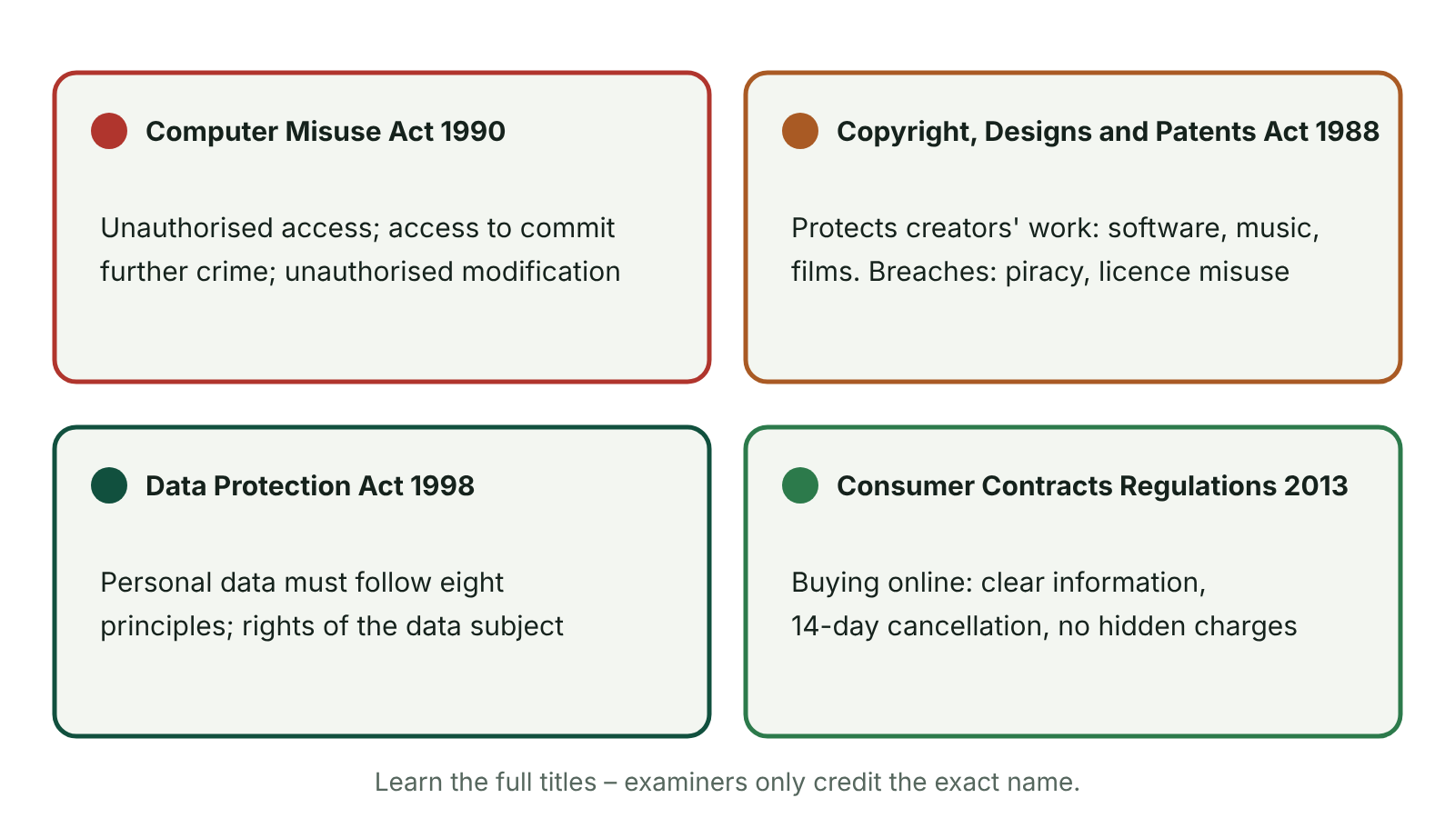
The big picture
Four laws examined in Unit 1 and what each covers
☰ Menu
Notes:
Explain the diagram in your own words before you read on.

Slide 8
Learn the exact titles
The Consumer Contracts (Information, Cancellation and Additional Charges) Regulations 2013
The Copyright, Designs and Patents Act 1988
The Computer Misuse Act 1990
Data protection (next lesson): the UK GDPR and the Data Protection Act 2018, which replaced the Data Protection Act 1998
Examiners have reported that many candidates lost marks because they could not give a title precisely – write the full name and the year
☰ Menu

Slide 9
Consumer Contracts Regulations 2013: what they cover
Protect consumers who buy at a distance (online, by phone, by mail order) or away from the trader's premises (e.g. a doorstep sale)
Before you pay, the trader must tell you who they are, their address and contact details, and the main features of the product
They must show the total price, including VAT and delivery charges, and how you can pay
They must explain your right to cancel and how to return items
For digital content (apps, games, e-books) they must say what devices and software it works with (compatibility)
At checkout you must clearly confirm that you are agreeing to pay, e.g. a button labelled 'Buy now – pay'
☰ Menu

Slide 10
Cancelling and getting a refund
For goods: you can cancel within 14 days, starting the day after the goods arrive – this is the cooling-off period
You do not have to give a reason for cancelling
For services: the 14 days start the day after you agree the contract
The trader must refund you within 14 days – once the goods are returned, or you show proof you have sent them back
The refund includes standard delivery costs; you may have to pay to post the goods back if you were told this beforehand
If the trader never told you about your right to cancel, the cooling-off period can be extended by up to 12 months
☰ Menu

Slide 11
Exceptions and extra charges
Digital downloads: you lose the right to cancel once the download or stream starts, if you agreed to this and accepted you would lose the right
Sealed DVDs, Blu-rays, games or software: once you break the seal, you cannot cancel
Personalised or made-to-order items (e.g. a printed hoodie or custom photo book) cannot be cancelled
Pre-ticked boxes that add extra payments (e.g. insurance) are banned – you must choose to opt in
Customer helplines for things you have bought must not cost more than a basic-rate call
Since April 2025 the Digital Markets, Competition and Consumers Act 2024 adds more protection, e.g. banning fake reviews and hidden fees
☰ Menu

Slide 12
Worked example: buying online from a Derry shop
What happens | Position under the Regulations
Aoife orders trainers online on 2 March; they arrive on 6 March | Her 14-day cancellation period starts on 7 March and ends on 20 March
She returns them unworn on 15 March with proof of posting | She is within the 14 days; the shop must refund her within 14 days of her proof of return
A box for '£4.99 shoe protection' was already ticked at checkout | Not allowed – extra charges need her active consent, so she can get the £4.99 back
She also bought a game download and started playing it | She agreed to lose the right to cancel when the download began, so no refund is due
She ordered a phone case printed with her name | Personalised item – no right to cancel (but still protected if it arrives faulty)
☰ Menu

Slide 13
Copyright, Designs and Patents Act 1988
Protects intellectual property – original work created by a person or organisation, such as software, music, films, images, books and designs
Computer programs count as literary works, so source code is protected
Copyright is automatic: there is no need to register it or use the © symbol
Only the copyright owner can copy, share, sell, adapt or rent out the work – anyone else needs permission or a licence
For software, copyright normally lasts for the life of the author plus 70 years
Breaking the Act can lead to unlimited fines and, for serious commercial or online infringement, up to 10 years in prison
☰ Menu

Slide 14
Software licences
Licence type | What it allows
Single-user | One person or one computer may use the software
Multi-user / network | A set number of users or computers, e.g. 30 PCs in a school ICT suite
Site licence | Any number of computers at one site, e.g. a whole school
Subscription | Use while you keep paying, e.g. a yearly office or design package
Freeware | Free to use, but the code is still protected by copyright
Open source | Free to use, view, change and share the source code under the licence terms
☰ Menu

Slide 15
Typical breaches of the CDPA
Software piracy: illegally copying, downloading, distributing or selling software without permission
Installing software on more computers than the licence allows, or sharing a licence key with friends
Using a home or student licence for business, or carrying on using software after a licence or subscription has ended
Downloading or streaming films, music or games from illegal sites
Using someone else's photos, music or code in your own website, video or app without permission
Plagiarism – copying someone else's work and presenting it as your own – is an ethical issue and may also breach copyright
☰ Menu

Slide 16
Computer Misuse Act 1990: the offences
Section | Offence | Example
1 | Unauthorised access to computer material | Logging in with a friend's guessed password to read their messages
2 | Unauthorised access with intent to commit or help commit further offences | Hacking into an online bank account to transfer money (fraud)
3 | Unauthorised acts with intent to impair, or reckless as to impairing, a computer (e.g. modifying or deleting data) | Planting a virus, deleting files, changing someone's password, a denial-of-service attack
3ZA | Unauthorised acts causing, or risking, serious damage | Attacking a hospital or power network's systems
3A | Making, supplying or obtaining tools for use in these offences | Selling hacking software or malware kits online
☰ Menu

Slide 17
Hacker, virus and spyware
Term | Meaning | Link to the Computer Misuse Act 1990
Hacker | Someone who gets into a computer system, or the data held on it, without permission | Section 1; section 2 if they intend a further crime such as fraud; section 3 if they change or delete data
Virus | Malware that attaches itself to files or programs and copies itself, often damaging or deleting data | Creating and spreading it is section 3 – an unauthorised act that impairs a computer; making it to supply to others is section 3A
Spyware | Malware that secretly records what a user does (e.g. keystrokes) and sends it to a third party | Installing it secretly is section 3; using stolen passwords to get into accounts is section 1 or 2
☰ Menu

Slide 18
Worked example: which law?
Scenario | Law broken
A pupil copies a paid game from a friend's console onto his own without buying it | Copyright, Designs and Patents Act 1988 (software piracy)
A sports club installs one single-user licence on all five of its office laptops | Copyright, Designs and Patents Act 1988 (licence infringement)
Someone guesses a teacher's password and changes pupils' marks | Computer Misuse Act 1990 (sections 1 and 3)
An online shop in Newry refuses a refund on unopened headphones returned within 10 days | Consumer Contracts Regulations 2013
A gamer sends a friend a link that installs spyware to steal their account login | Computer Misuse Act 1990 (section 3, then sections 1/2 when the login is used)
☰ Menu

Slide 19
Exit quiz: question 1 of 8
Tap an answer to check it. Presenting? Click to reveal the answer.
A secondary school installs a single-user licence for a design package on 30 PCs in its ICT suite. Which law has it broken?
A Computer Misuse Act 1990
B Copyright, Designs and Patents Act 1988
✗
✓
C Consumer Contracts Regulations 2013
D Data Protection Act 2018
✗
✗
✓ B: Copyright, Designs and Patents Act 1988 – Using software on more computers than the licence allows is a licensing infringement under the Copyright, Designs and Patents Act 1988.
☰ Menu

Slide 20
Exit quiz: question 2 of 8
Tap an answer to check it. Presenting? Click to reveal the answer.
How long is the cooling-off period for most goods bought online under the Consumer Contracts Regulations 2013?
A 7 days
B 28 days
✗
✗
C 14 days
D 30 days
✓
✗
✓ C: 14 days – Consumers can cancel within 14 days, counted from the day after the goods are delivered.
☰ Menu

Slide 21
Exit quiz: question 3 of 8
Tap an answer to check it. Presenting? Click to reveal the answer.
Guessing a friend's password and reading their messages, without changing anything, is…
A unauthorised access under the Computer Misuse Act 1990
B legal because nothing was changed
✓
✗
C a breach of copyright
D a consumer rights issue
✗
✗
✓ A: unauthorised access under the Computer Misuse Act 1990 – Section 1 of the Computer Misuse Act 1990 makes unauthorised access an offence even if no data is altered.
☰ Menu

Slide 22
Exit quiz: question 4 of 8
Tap an answer to check it. Presenting? Click to reveal the answer.
Which practice is banned by the Consumer Contracts Regulations 2013?
A Charging for delivery
B Selling digital games
✗
✗
C Asking for a delivery address
D Pre-ticked boxes for extra charges
✗
✓
✓ D: Pre-ticked boxes for extra charges – Extra payments need the customer's active consent, so pre-ticked boxes are not allowed.
☰ Menu

Slide 23
Exit quiz: question 5 of 8
Tap an answer to check it. Presenting? Click to reveal the answer.
Which of these can usually be returned within the cooling-off period?
A A game download that has been started
B Unworn trainers in their box
✗
✓
C A hoodie printed with your name
D An unsealed Blu-ray
✗
✗
✓ B: Unworn trainers in their box – Downloads that have begun, personalised goods and unsealed discs are exceptions; ordinary unused goods can be returned.
☰ Menu

Slide 24
Exit quiz: question 6 of 8
Tap an answer to check it. Presenting? Click to reveal the answer.
Software that secretly records keystrokes and sends them to a criminal is called…
A a firewall
B freeware
✗
✗
C spyware
D a licence key
✓
✗
✓ C: spyware – Spyware monitors a user without their knowledge; installing it is an unauthorised act under the Computer Misuse Act 1990.
☰ Menu

Slide 25
Exit quiz: question 7 of 8
Tap an answer to check it. Presenting? Click to reveal the answer.
A hacker gets into an online bank account in order to transfer money. Which section of the Computer Misuse Act 1990 best fits?
A Section 2 – unauthorised access with intent to commit further offences
B Section 1 – unauthorised access only
✓
✗
C Section 3A – supplying hacking tools
D It is not covered by the Act
✗
✗
✓ A: Section 2 – unauthorised access with intent to commit further offences – The access is made in order to commit fraud, which is a further offence, so section 2 applies.
☰ Menu

Slide 26
Exit quiz: question 8 of 8
Tap an answer to check it. Presenting? Click to reveal the answer.
Under UK law, copyright in an original piece of software…
A must be registered with the government
B only applies if the © symbol is used
✗
✗
C lasts for exactly 10 years
D applies automatically when it is created
✗
✓
✓ D: applies automatically when it is created – Copyright arises automatically; for software it normally lasts for the author's life plus 70 years.
☰ Menu

Slide 27
Exit quiz answers
Q | Answer | Why
1 | B Copyright, Designs and Patents Act 1988 | Using software on more computers than the licence allows is a licensing infringement under the Copyright, Designs and Patents Act 1988.
2 | C 14 days | Consumers can cancel within 14 days, counted from the day after the goods are delivered.
3 | A unauthorised access under the Computer Misuse Act 1990 | Section 1 of the Computer Misuse Act 1990 makes unauthorised access an offence even if no data is altered.
4 | D Pre-ticked boxes for extra charges | Extra payments need the customer's active consent, so pre-ticked boxes are not allowed.
5 | B Unworn trainers in their box | Downloads that have begun, personalised goods and unsealed discs are exceptions; ordinary unused goods can be returned.
6 | C spyware | Spyware monitors a user without their knowledge; installing it is an unauthorised act under the Computer Misuse Act 1990.
7 | A Section 2 – unauthorised access with intent to commit further offences | The access is made in order to commit fraud, which is a further offence, so section 2 applies.
8 | D applies automatically when it is created | Copyright arises automatically; for software it normally lasts for the author's life plus 70 years.
☰ Menu

Slide 28
In the exam
Paper | Question | Marks | What it tested
Unit 1 2019 | Q1(d)–(e) | 2 | Consumer law; data protection rights (MCQ)
Unit 1 2021 | Q10(b)–(e) | 10 | Cybercrime, access rights, DPA principles, encryption, legislation
Unit 1 2022 | Q9 | 8 | RSI, monitor ergonomics, copyright, ICO, DPA principles
Unit 1 2023 | Q10 | 5 | Copyright, DPA principles, DPO and data controller
Unit 1 2024 | Q11 | 6 | Legislation matching, online harms, protection methods
Unit 1 2025 | Q9 | 4 | Consumer law title; data, computer misuse and copyright scenarios
Papers and mark schemes: ccea.org.uk → GCSE Digital Technology → Past Papers & Mark Schemes.
☰ Menu

Slide 29
Legislation 2: Data protection (UK GDPR and the Data Protection Act 2018)
UNIT 1: DIGITAL TECHNOLOGY · L22
Learning objectives
Explain what personal data and special category data are, with examples
State and apply the data protection principles to a scenario
Describe the rights of a data subject, including a subject access request
Describe the roles of the data controller, Data Protection Officer and the regulator
Notes:
Specification: Demonstrate knowledge and understanding of data protection law: the UK GDPR and the Data Protection Act 2018 (which replaced the Data Protection Act 1998 named in the specification) | Demonstrate and apply knowledge and understanding of the data protection principles, including how they relate to the eight principles of the 1998 Act | Describe the rights of the data subject | Describe the responsibilities of the data controller, the Data Protection Officer and the Information Commission (formerly the ICO) in making sure the law is followed | Describe measures organisations use to comply with data protection law

Slide 30
In this lesson
Tap a button to jump straight there. The ☰ Menu button on every slide brings you back here.
The big picture
Rights of the data subject
Why data protection law exists
Responsibilities
Which law applies now?
How organisations comply
Key people and terms
Worked example: a data breach at a sports club
Special category data
Exit quiz
The data protection principles
↑ Topic menu
Accountability and the old eight principles
Notes:
Lesson menu: each button jumps to that part of the lesson in Slide Show. The ☰ Menu button on each slide returns here.

Slide 31
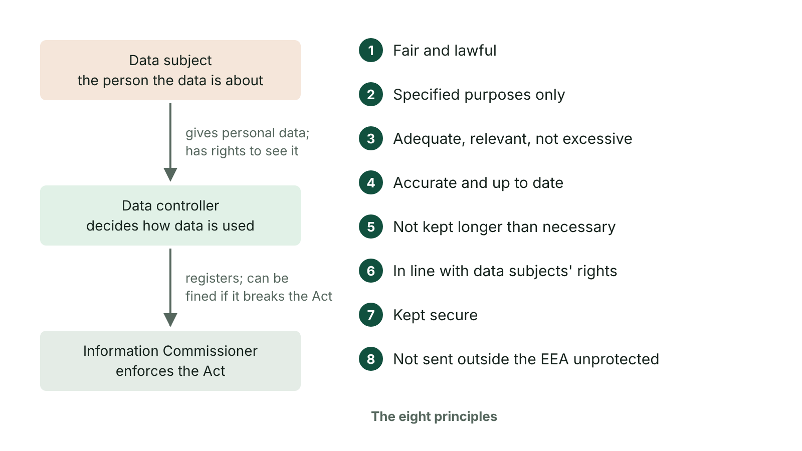
The big picture
Data Protection Act roles and its eight principles
☰ Menu
Notes:
Explain the diagram in your own words before you read on.

Slide 32
Why data protection law exists
Schools, shops, hospitals and apps hold huge amounts of personal data – data about a living person who can be identified from it
Examples: name, address, date of birth, photo, email, exam results, location data, an online identifier such as an IP address
If it is lost, stolen or misused, people can suffer identity theft, fraud, embarrassment or discrimination
The law controls how personal data is collected, stored, used and shared, and gives people rights over their own data
Organisations that break it can be fined up to £17.5 million or 4% of worldwide yearly turnover, whichever is higher
☰ Menu

Slide 33
Which law applies now?
The Data Protection Act 1998 (named in the CCEA specification and older textbooks) was replaced in May 2018
Current UK law: the UK GDPR together with the Data Protection Act 2018 – this applies in Northern Ireland as in the rest of the UK
The Data (Use and Access) Act 2025 updated these laws, e.g. organisations must now have a way to handle data protection complaints
The ideas are the same as in the 1998 Act: data must be handled fairly, kept accurate and secure, and used only for its stated purpose
In the exam, name the law accurately – 'the Data Protection Act 2018' or 'the UK GDPR' – and recent mark schemes also credit the 1998 Act principles
☰ Menu

Slide 34
Key people and terms (1 of 2)
Term | Meaning | Example
Data subject | The living person the personal data is about | A pupil, a patient, a customer
Data controller | The organisation (or person) that decides why and how personal data is processed, and is responsible for following the law | A school, a GP practice, a bank
Data processor | An organisation that processes data on behalf of the controller | A company that runs the school's online payment system
Data Protection Officer (DPO) | Person who advises the organisation on the law and checks it is being followed; required for public bodies such as schools | The named DPO for a school or district council
☰ Menu

Slide 35
Key people and terms (2 of 2)
Term | Meaning | Example
Information Commission (formerly the ICO) | The independent UK regulator that enforces data protection law; it took over from the Information Commission (formerly the ICO) on 30 September 2026 | Investigates complaints and fines organisations
☰ Menu

Slide 36
Special category data
Some personal data is more sensitive, because misuse could lead to discrimination or serious harm
Special category data includes racial or ethnic origin, religious beliefs, political opinions, trade union membership, health, sex life or sexual orientation, genetic and biometric data
In the 1998 Act this was called sensitive personal data
It needs extra protection and a stronger legal reason before it can be processed, e.g. a school recording a pupil's medical condition to keep them safe
Criminal records are also protected by extra rules
☰ Menu

Slide 37
The data protection principles (1 of 2)
Principle | Personal data must be… | Example
Lawfulness, fairness and transparency | processed legally and fairly, and people must be told how it is used | A gym's privacy notice explains what it collects and why
Purpose limitation | collected for a stated purpose and not used for something different | Addresses for a school trip are not sold to a travel firm
Data minimisation | adequate, relevant and limited to what is needed | A youth club does not ask members for their religion
Accuracy | accurate and kept up to date | A pupil's new address is updated straight away
Storage limitation | kept no longer than necessary | Unsuccessful job applications are deleted after a set time
☰ Menu

Slide 38
The data protection principles (2 of 2)
Principle | Personal data must be… | Example
Integrity and confidentiality (security) | kept secure against unauthorised access, loss or damage | Passwords, encryption, access levels, backups
☰ Menu

Slide 39
Accountability and the old eight principles
A seventh principle, accountability, says the controller must be able to prove it follows the other principles, e.g. by keeping records and policies
Old principles 1–5 and 7 match the new ones: fair and lawful, specified purpose, adequate and not excessive, accurate, not kept too long, kept secure
Old principle 6 (processed in line with the data subject's rights) is now covered by the rights in the UK GDPR
Old principle 8 (not transferred outside the European Economic Area without adequate protection) is now a rule that data must not leave the UK without adequate protection
Either set of wording earns credit if it is clearly stated and applied to the scenario
☰ Menu

Slide 40
Rights of the data subject
Right | What it means
To be informed | To be told what data is collected, why, and how long it is kept (usually in a privacy notice)
Of access | To see a copy of their data – a subject access request, normally answered free within one month
To rectification | To have inaccurate or incomplete data corrected
To erasure | To have data deleted in some cases, e.g. when it is no longer needed ('right to be forgotten')
To object / restrict | To stop data being used for direct marketing, or limit how it is used while a problem is checked
To complain and claim compensation | To complain to the organisation and then the Information Commission, and to claim compensation for harm
☰ Menu

Slide 41
Responsibilities
Data controller: follow all the principles; pay the data protection fee to the regulator; keep data secure; answer subject access requests; correct wrong data
Data controller: report serious data breaches to the regulator within 72 hours; tell affected people if they are at high risk; handle complaints
Data Protection Officer: advises staff on the law, trains them, monitors compliance and is the contact for the regulator and data subjects
Information Commission: keeps a public register of organisations that pay the fee; gives advice and promotes good practice
Information Commission: investigates complaints and breaches; can carry out audits, order changes (enforcement notices) and issue fines
Data subjects should also be told their rights so that they can use them
☰ Menu

Slide 42
How organisations comply
Security: strong passwords, two-factor authentication, encryption on laptops and USB drives, firewalls and anti-malware
Access rights: staff only see the data they need for their job, e.g. office staff see contact details, not medical notes
Backups so data is not lost, and secure deletion or shredding when it is no longer needed
Accuracy checks: e.g. sending families a data collection sheet each September to confirm details
Staff training and clear policies, e.g. not leaving screens unlocked or emailing pupil lists to the wrong person
Privacy notices and consent forms, e.g. asking parents before pupils' photos are posted on social media
☰ Menu

Slide 43
Worked example: a data breach at a sports club (1 of 2)
What happened at a Lisburn hockey club | Principle or duty involved
Membership forms asked for each player's religion | Data minimisation – the club does not need this
Players' emails were used to advertise a partner's betting company | Purpose limitation – data used for a different purpose without consent
An unencrypted laptop holding medical details was stolen from a car | Security – and health is special category data
The club still keeps details of players who left ten years ago | Storage limitation
A parent asked to see her son's records and heard nothing for three months | Right of access – a reply is normally due within one month
☰ Menu

Slide 44
Worked example: a data breach at a sports club (2 of 2)
What happened at a Lisburn hockey club | Principle or duty involved
The club did not report the laptop theft | Controller's duty to report a serious breach to the regulator within 72 hours
☰ Menu

Slide 45
Exit quiz: question 1 of 8
Tap an answer to check it. Presenting? Click to reveal the answer.
Under data protection law, who is the 'data subject'?
A The organisation that decides how the data is used
B The regulator that enforces the law
✗
✗
C The living person the data is about
D The company that stores the data for an organisation
✓
✗
✓ C: The living person the data is about – The data subject is the identifiable living individual whom the personal data describes.
☰ Menu

Slide 46
Exit quiz: question 2 of 8
Tap an answer to check it. Presenting? Click to reveal the answer.
Which body enforces data protection law in the UK?
A The Information Commission
B The police only
✓
✗
C The data subject
D CCEA
✗
✗
✓ A: The Information Commission – The Information Commission (formerly the ICO), which replaced the Information Commissioner's Office in September 2026, investigates complaints and issues fines.
☰ Menu

Slide 47
Exit quiz: question 3 of 8
Tap an answer to check it. Presenting? Click to reveal the answer.
A gym asks for your blood group even though it has no need for it. Which principle is broken?
A Security
B Accuracy
✗
✗
C Storage limitation
D Data minimisation
✗
✓
✓ D: Data minimisation – Data collected must be adequate, relevant and limited to what is needed (not excessive).
☰ Menu

Slide 48
Exit quiz: question 4 of 8
Tap an answer to check it. Presenting? Click to reveal the answer.
A request to see the personal data an organisation holds about you is called a…
A data breach
B subject access request
✗
✓
C privacy notice
D licence request
✗
✗
✓ B: subject access request – A subject access request must normally be answered within one month and free of charge.
☰ Menu

Slide 49
Exit quiz: question 5 of 8
Tap an answer to check it. Presenting? Click to reveal the answer.
Which of these is special category data?
A Home address
B Email address
✗
✗
C Religious beliefs
D Date of birth
✓
✗
✓ C: Religious beliefs – Religious beliefs are special category data because misuse could lead to discrimination; the others are ordinary personal data.
☰ Menu

Slide 50
Exit quiz: question 6 of 8
Tap an answer to check it. Presenting? Click to reveal the answer.
Within how many hours must a serious personal data breach be reported to the regulator?
A 24
B 72
✗
✓
C 48
D 168
✗
✗
✓ B: 72 – Controllers must report a reportable breach within 72 hours of becoming aware of it.
☰ Menu

Slide 51
Exit quiz: question 7 of 8
Tap an answer to check it. Presenting? Click to reveal the answer.
A school emails a list of pupils' addresses to a local takeaway for a marketing campaign. Which principle is broken?
A Purpose limitation
B Accuracy
✓
✗
C Accountability
D Storage limitation
✗
✗
✓ A: Purpose limitation – The data was collected for school purposes and must not be used for a different purpose such as marketing.
☰ Menu

Slide 52
Exit quiz: question 8 of 8
Tap an answer to check it. Presenting? Click to reveal the answer.
Which person advises an organisation on data protection and checks that it follows the law?
A The data subject
B The network manager
✗
✗
C The Data Protection Officer
D The data processor
✓
✗
✓ C: The Data Protection Officer – Public bodies such as schools must appoint a Data Protection Officer to monitor compliance.
☰ Menu

Slide 53
Exit quiz answers
Q | Answer | Why
1 | C The living person the data is about | The data subject is the identifiable living individual whom the personal data describes.
2 | A The Information Commission | The Information Commission (formerly the ICO), which replaced the Information Commissioner's Office in September 2026, investigates complaints and issues fines.
3 | D Data minimisation | Data collected must be adequate, relevant and limited to what is needed (not excessive).
4 | B subject access request | A subject access request must normally be answered within one month and free of charge.
5 | C Religious beliefs | Religious beliefs are special category data because misuse could lead to discrimination; the others are ordinary personal data.
6 | B 72 | Controllers must report a reportable breach within 72 hours of becoming aware of it.
7 | A Purpose limitation | The data was collected for school purposes and must not be used for a different purpose such as marketing.
8 | C The Data Protection Officer | Public bodies such as schools must appoint a Data Protection Officer to monitor compliance.
☰ Menu

Slide 54
In the exam
Paper | Question | Marks | What it tested
Unit 1 2019 | Q1(d)–(e) | 2 | Consumer law; data protection rights (MCQ)
Unit 1 2021 | Q10(b)–(e) | 10 | Cybercrime, access rights, DPA principles, encryption, legislation
Unit 1 2022 | Q9 | 8 | RSI, monitor ergonomics, copyright, ICO, DPA principles
Unit 1 2023 | Q10 | 5 | Copyright, DPA principles, DPO and data controller
Unit 1 2024 | Q11 | 6 | Legislation matching, online harms, protection methods
Unit 1 2025 | Q9 | 4 | Consumer law title; data, computer misuse and copyright scenarios
Papers and mark schemes: ccea.org.uk → GCSE Digital Technology → Past Papers & Mark Schemes.
☰ Menu

Slide 55
Ethics, employment and health and safety
UNIT 1: DIGITAL TECHNOLOGY · L23
Learning objectives
Describe examples of internet and social media misuse and how personal data is collected without people realising
Weigh up the benefits and concerns of GPS and tracking
Describe four impacts of digital technology on employment, with examples
Describe the causes of RSI, back strain and eye strain and how employees and employers can reduce them
Notes:
Specification: Describe the ethical impact of technology on society, referring to internet misuse, access to personal information, social media misuse, the implications of GPS and tracking, and concerns about the security of personal data | Describe the impact of digital technology on employment, including increased job opportunities in the digital technology and computing sector, job displacement, changes in work patterns and the need for upskilling | Demonstrate understanding of digital technology related health and safety issues, including RSI, back strain and eye strain | Identify the measures that both the employee and employer should take to promote good health and safety practice in the workplace, including the Health and Safety (Display Screen Equipment) Regulations 1992 (in Northern Ireland, the Health and Safety (Display Screen Equipment) Regulations (Northern Ireland) 1992)

Slide 56
In this lesson
Tap a button to jump straight there. The ☰ Menu button on every slide brings you back here.
The big picture
Teleworking: working from home using ICT
Internet misuse
Health problems from computer use
Access to personal information
Prevention: employee and employer
Social media misuse
The law and a safe workstation
GPS and tracking
Worked example: a call centre in Belfast
Security of personal data
Exit quiz
Impact on employment
↑ Topic menu
Notes:
Lesson menu: each button jumps to that part of the lesson in Slide Show. The ☰ Menu button on each slide returns here.

Slide 57
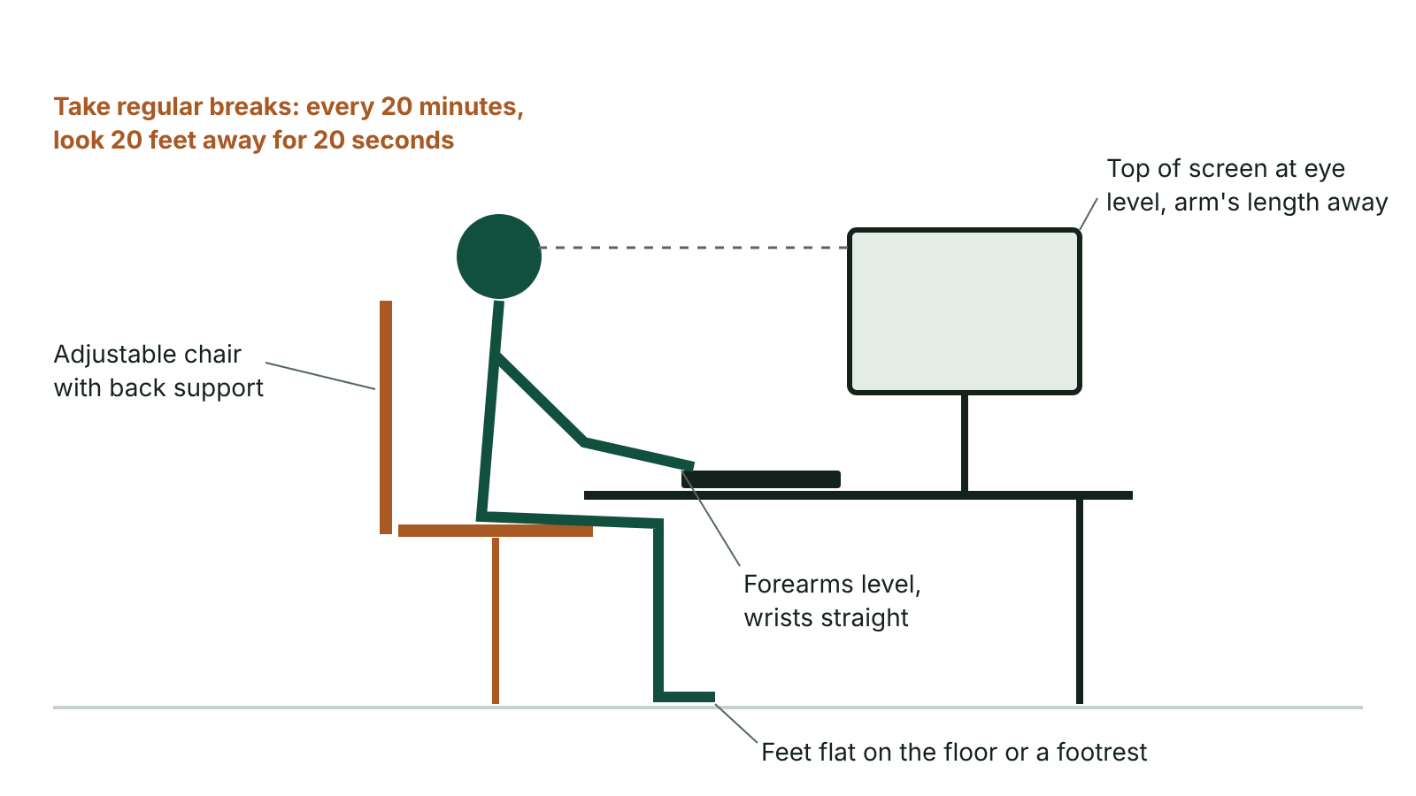
The big picture
A correctly set-up computer workstation
☰ Menu
Notes:
Explain the diagram in your own words before you read on.

Slide 58
Internet misuse
Stealing usernames and passwords, then using the accounts to buy things or steal money
Phishing: fake emails, texts or adverts that look official and trick people into giving personal details
Piracy (illegal downloads) and plagiarism – copying work and handing it in as your own
Websites that promote violence, hatred or harmful behaviour; illegal content on the dark web (hidden, encrypted sites)
Spreading fake news – false or misleading stories – which can mislead people quickly
Staff using work time for personal browsing, which is why employers have an acceptable use policy that staff must agree to
☰ Menu

Slide 59
Access to personal information
Much of our data is collected without us fully noticing it
Loyalty cards record what we buy so shops can target their advertising
Card payments and online shopping reveal spending patterns, which may be shared with or sold to other companies
Phones and apps can record our location; websites use cookies to track what we look at
CCTV cameras record people in town centres, shops and on buses
Ethical questions: did people really agree? Who is the data shared with? Is it fair to build a detailed profile of someone?
☰ Menu

Slide 60
Social media misuse (1 of 2)
Misuse | What it is
Cyberbullying | Repeatedly using technology to hurt, threaten or embarrass a particular person
Trolling | Deliberately posting offensive or provocative comments to upset people or start arguments
Hate speech | Posting racist, sectarian or religious hatred, even though platforms ban it in their terms
Identity theft / fake profiles | Creating an account pretending to be someone else, sometimes to commit a crime in their name
Oversharing | Leaving addresses, phone numbers, school or location public, so strangers can find you
☰ Menu

Slide 61
Social media misuse (2 of 2)
Misuse | What it is
Sharing without consent | Posting photos or videos of other people without their permission
☰ Menu

Slide 62
GPS and tracking
Benefits | Concerns
Sat-nav and map apps help people find their way | Location can be tracked without a person knowing or agreeing – an invasion of privacy
Parents can locate a child; lost phones can be found | Stalking or controlling behaviour by sharing someone's live location
Electronic tags monitor offenders; trackers help find people with dementia who wander | Employers may monitor staff all day, including outside work hours
Bus, taxi and delivery tracking tells customers when to expect them | Apps may sell location data to advertisers
Emergency services can find a caller quickly | Geotagged photos and posts can reveal where you live or go to school
☰ Menu

Slide 63
Security of personal data
Data breaches can expose millions of records, leading to identity theft and fraud
Cloud services may store our data on servers in other countries, where privacy laws can be weaker than in the UK
Companies may share data with partners without clear permission, and it can then be misused
Organisations have a duty to keep data secure – but people also need to protect themselves
Good habits: strong unique passwords, two-factor authentication, privacy settings, thinking before you post
☰ Menu

Slide 64
Impact on employment
Impact | What it means | Examples
Increased job opportunities | New jobs in the digital and computing sector | Software engineers, app and web designers, game developers, cyber security analysts, database administrators, data scientists
Job displacement | Jobs lost or changed because technology now does the work | Self-service tills; robots painting cars; automated warehouses; online banking replacing branch staff; chatbots
Changes in work patterns | How, when and where people work has changed | Teleworking and hybrid working; video calls; shift work in 24-hour call centres; staff in other countries
Need for upskilling | Workers must keep learning new digital skills | Office staff trained on new software; factory workers trained to maintain robots
☰ Menu

Slide 65
Teleworking: working from home using ICT
Advantages | Disadvantages
No commute, saving time and travel costs | Can feel isolated from colleagues
Flexible hours to fit around family | Harder to switch off – home and work life blur together
Less traffic and pollution, lowering the carbon footprint | Distractions at home; needs self-discipline
Employer saves on office space and can recruit from further away | Employer has less direct supervision; needs secure remote access (e.g. VPN)
Made possible by broadband, laptops, cloud apps and video calls | Poor broadband in some rural areas of NI makes it difficult
☰ Menu

Slide 66
Health problems from computer use
Problem | Cause | Symptoms
RSI (repetitive strain injury) | Repeating the same movements, e.g. typing or using a mouse for long periods | Pain, aching, swelling and stiffness in wrists, hands, arms, neck or shoulders; can lead to carpal tunnel syndrome
Back strain | Poor posture, an unsuitable chair, sitting still for a long time | Back and neck pain; can lead to long-term mobility problems
Eye strain | Looking at a screen for long periods, glare, reflections, poor lighting, screen too bright or too close | Headaches, blurred vision, tired or dry eyes
☰ Menu

Slide 67
Prevention: employee and employer
Problem | Employee should… | Employer should…
RSI | Take regular breaks; use a wrist rest; keep wrists straight; learn keyboard shortcuts | Provide ergonomic keyboards and mice and wrist rests; plan work so it includes breaks or changes of task
Back strain | Sit back in the chair with feet flat (or on a footrest); adjust the chair; get up and move | Provide adjustable swivel chairs with back support and footrests; train staff in good posture
Eye strain | Take screen breaks (e.g. every 20 minutes look 20 feet away for 20 seconds); adjust brightness; avoid glare | Provide anti-glare screens, blinds and good lighting; tilting or swivel monitors; pay for eye tests for regular screen users
☰ Menu

Slide 68
The law and a safe workstation
Health and Safety at Work (Northern Ireland) Order 1978: employers must provide a safe workplace and a health and safety policy that staff know about (the NI equivalent of the GB 1974 Act)
Health and Safety (Display Screen Equipment) Regulations (Northern Ireland) 1992: employers must assess workstations, reduce risks and plan breaks for regular screen users
They must provide free eye tests on request for regular screen users, and glasses if needed specially for screen work
Ideal set-up: top of monitor at or just below eye level, about an arm's length away; elbows about 90°; wrists straight; feet flat
Other safety: tidy cables to avoid trips, PAT testing of electrical equipment, no food or drink near computers, air conditioning
Keep the right fire extinguisher nearby – CO₂ for electrical fires, never water
☰ Menu

Slide 69
Worked example: a call centre in Belfast
What staff report | Likely problem | One employee measure | One employer measure
Aching wrists after typing all shift | RSI | Take short breaks and keep wrists straight | Supply ergonomic keyboards and wrist rests
Headaches by late afternoon; sun reflects on screens | Eye strain | Adjust screen brightness and look away regularly | Fit blinds and anti-glare screens; offer eye tests
Sore lower back from old fixed chairs | Back strain | Sit upright, use the backrest, stand up and stretch | Buy adjustable chairs with lumbar support; footrests
Cables trailing across the floor | Trip hazard | Report it and do not overload sockets | Use cable trays and carry out PAT testing
☰ Menu

Slide 70
Exit quiz: question 1 of 8
Tap an answer to check it. Presenting? Click to reveal the answer.
Which health problem is most likely to be caused by typing for long periods every day?
A Eye strain
B Hearing loss
✗
✗
C Back strain
D RSI
✗
✓
✓ D: RSI – Repetitive strain injury comes from repeating the same movements, such as typing or clicking.
☰ Menu

Slide 71
Exit quiz: question 2 of 8
Tap an answer to check it. Presenting? Click to reveal the answer.
A supermarket installs self-service tills and needs fewer checkout staff. This is an example of…
A upskilling
B job displacement
✗
✓
C teleworking
D phishing
✗
✗
✓ B: job displacement – Job displacement is when technology takes over work previously done by people.
☰ Menu

Slide 72
Exit quiz: question 3 of 8
Tap an answer to check it. Presenting? Click to reveal the answer.
Which is an employer measure to reduce back strain?
A Provide adjustable chairs with back support
B Take regular breaks
✓
✗
C Blink more often
D Keep wrists straight
✗
✗
✓ A: Provide adjustable chairs with back support – Employers supply ergonomic furniture; taking breaks and posture are things the employee does.
☰ Menu

Slide 73
Exit quiz: question 4 of 8
Tap an answer to check it. Presenting? Click to reveal the answer.
Office staff attending a course to learn a new database package is an example of…
A job displacement
B teleworking
✗
✗
C upskilling
D data minimisation
✓
✗
✓ C: upskilling – Upskilling means training workers in new skills so they can keep up with technology.
☰ Menu

Slide 74
Exit quiz: question 5 of 8
Tap an answer to check it. Presenting? Click to reveal the answer.
Which of these is an ethical concern about GPS tracking?
A Finding a lost phone
B Getting delivery updates
✗
✗
C Better navigation
D Location being tracked without consent
✗
✓
✓ D: Location being tracked without consent – Tracking without consent invades privacy and could allow stalking; the others are benefits.
☰ Menu

Slide 75
Exit quiz: question 6 of 8
Tap an answer to check it. Presenting? Click to reveal the answer.
An email that looks as if it is from your bank asks you to 'confirm' your password. This is…
A phishing
B trolling
✓
✗
C teleworking
D piracy
✗
✗
✓ A: phishing – Phishing uses official-looking messages to trick people into revealing personal details.
☰ Menu

Slide 76
Exit quiz: question 7 of 8
Tap an answer to check it. Presenting? Click to reveal the answer.
Which law requires employers to assess computer workstations and offer eye tests to regular screen users?
A Computer Misuse Act 1990
B Health and Safety (Display Screen Equipment) Regulations (NI) 1992
✗
✓
C Consumer Contracts Regulations 2013
D Copyright, Designs and Patents Act 1988
✗
✗
✓ B: Health and Safety (Display Screen Equipment) Regulations (NI) 1992 – In Northern Ireland, the Health and Safety (Display Screen Equipment) Regulations (NI) 1992 cover people who use screens regularly at work (Great Britain has matching 1992 Regulations).
☰ Menu

Slide 77
Exit quiz: question 8 of 8
Tap an answer to check it. Presenting? Click to reveal the answer.
Which of these is an advantage of teleworking for an employee?
A It is easier to switch off from work
B Closer supervision by a manager
✗
✗
C No time or money spent commuting
D More face-to-face contact with colleagues
✓
✗
✓ C: No time or money spent commuting – Working from home removes the daily commute; the other options are usually disadvantages or untrue.
☰ Menu

Slide 78
Exit quiz answers
Q | Answer | Why
1 | D RSI | Repetitive strain injury comes from repeating the same movements, such as typing or clicking.
2 | B job displacement | Job displacement is when technology takes over work previously done by people.
3 | A Provide adjustable chairs with back support | Employers supply ergonomic furniture; taking breaks and posture are things the employee does.
4 | C upskilling | Upskilling means training workers in new skills so they can keep up with technology.
5 | D Location being tracked without consent | Tracking without consent invades privacy and could allow stalking; the others are benefits.
6 | A phishing | Phishing uses official-looking messages to trick people into revealing personal details.
7 | B Health and Safety (Display Screen Equipment) Regulations (NI) 1992 | In Northern Ireland, the Health and Safety (Display Screen Equipment) Regulations (NI) 1992 cover people who use screens regularly at work (Great Britain has matching 1992 Regulations).
8 | C No time or money spent commuting | Working from home removes the daily commute; the other options are usually disadvantages or untrue.
☰ Menu

Slide 79
In the exam
Paper | Question | Marks | What it tested
Unit 1 2022 | Q9 | 8 | RSI, monitor ergonomics, copyright, ICO, DPA principles
Unit 1 2023 | Q11(a) | 6 | Impacts on employment (QWC)
Unit 1 2024 | Q9 | 7 | Input devices, health risks, gaming and internet risks
Unit 1 2024 | Q10 | 8 | Key term matching
Unit 1 2024 | Q11 | 6 | Legislation matching, online harms, protection methods
Unit 1 2025 | Q10 | 4 | RSI/posture causes and ergonomic prevention
3 more past questions on the website. Papers and mark schemes: ccea.org.uk → GCSE Digital Technology → Past Papers & Mark Schemes.
☰ Menu

