Slide 1

VoxelNet&&VoTr

Slide 2
VoxelNet: End-to-End Learning for Point Cloud Based 3D Object Detection
*apple.com 2017

Slide 3
目录
一
CATALOGUE
VoxelNet
01
Abstract
02
VoxelNet
03
Experiments
04
Conclusion

Slide 4
COMPANY NAME
POWER POINT
Abstract

Slide 5
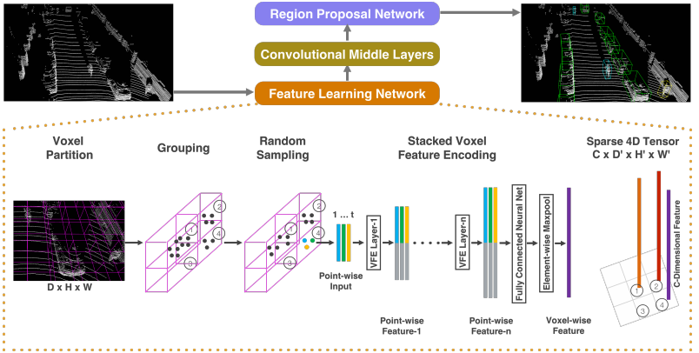
COMPANY NAME
POWER POINT
Abstract
01
VoxelNet: a generic 3D detection network that unifies feature extraction and bounding box prediction into a single stage, end-to-end trainable deep network.
VoxelNet 3D检测网络 融合 特征抽取 Bbox预测 单步
divides a point cloud into equally spaced 3D voxels
分割点云 空间均等 3D voxel
transforms voxel into a unified feature representation through voxel feature encoding (VFE) layer
转换 voxel 成 指定维度的特征 用的是VFE层 是本文引出的
then connected to a RPN to generate detections.
然后连接 Region Prosal Network 生成检测框
PART

Slide 6
COMPANY NAME
POWER POINT
Abstract
01
Point cloud 特点:
LiDAR provides depth information that can be used to accurately localize objects and characterize their shapes
提供深度信息 可用于 物体的准确定位并描述其形状
LiDAR point clouds are sparse and have highly variable point density
点云 是 又稀疏又密集
PART

Slide 7
COMPANY NAME
POWER POINT
VoxelNet

Slide 8
VoxelNet Architecture:
The proposed VoxelNet consists of three functional blocks:
(1) Feature learning network,
(2) Convolutional middle layers
(3) Region proposal network

Slide 9
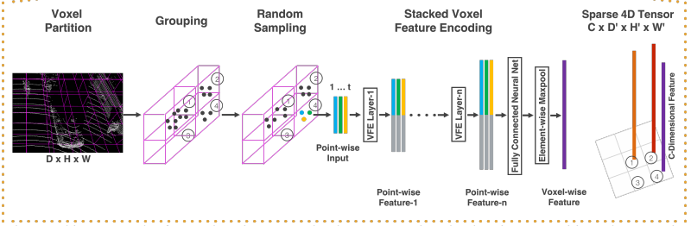
Feature learning network,
Voxel Partition
3D space with range D, H, W along the Z, Y, X axes respectively
define voxel size
3D voxel grid is of size
Grouping
after grouping, a voxel will contain a variable number of points.
Voxel-1 has significantly more points than Voxel-2 and Voxel-4, while Voxel-3 contains no point.
Random Sampling
Typically a high-definition LiDAR point cloud is composed of ∼100k points.
we randomly sample a fixed number, T(实验=48)
two purposes：(1) computational savings (2)reduces the sampling bias, and adds more variation to training.

Slide 10
Feature learning network,
Stacked Voxel Feature Encoding
Denote
where contains XYZ coordinates & :received reflectance
first compute the local mean denoted as
augment each point 4维 --> 7维
transformed to through FCN which is composed of a linear layer, a batch normalization (BN) layer, and a rectified linear unit (ReLU) layer.
use element-wise MaxPooling across all locally aggregated feature
each to form the point-wise concatenated feature as
the output feature set
we obtain a list of voxel features, each associated to the spatial coordinates of a particular non-empty voxel. can be represented as a sparse 4D tensor

Slide 11
Convolutional Middle Layers
We use represent dimensional convolution operator
the number of input and output channels,
kernel size, stride size and padding size
Each convolutional middle layer applies 3D convolution,， BN layer, and ReLU layer sequentially

Slide 12
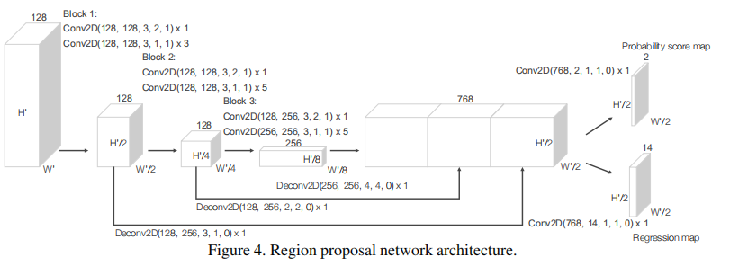
Region Proposal Network
The input to our RPN is the feature map provided by the convolutional middle layers.
The network has three blocks of fully convolutional layers：
The first layer downsamples the feature map by half via a stride size of 2, followed by a sequence of convolutions of stride 1 .After each convolution layer, BN and ReLU operations areapplied.
then upsample the output of every block to a fixed size and concatanate to construct the high resolution feature map.
Finally, this feature map is mapped to the desired learning targets:
(1) a probability score map and (2) aregression map.

Slide 13
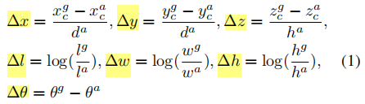
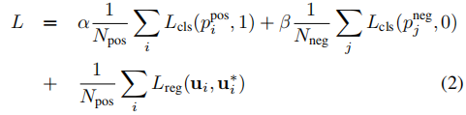

Loss Function
3D ground truth box
To retrieve the ground truth box from a matching positive anchorparameterized as
define the residual vector containing the 7 regression targets corresponding to center location
three dimensions
and the rotation
represent the softmax output for positive anchor and negative anchor
are the regression output and ground truth for positive anchor
The first two terms are the normalized classification loss for and
stands for binary cross entropy loss
are postive constants balancing the relative importance.
is the regression loss

Slide 14
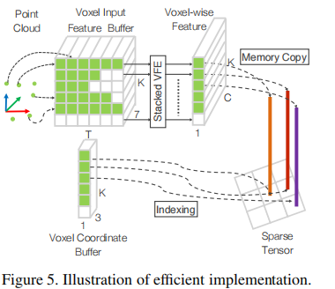
Efficient Implementation
We initialize a K × T × 7 dimensional tensor structure to store the voxel input feature buffer：
K ：maximum number of non-empty voxels
T ：maximum number of pointsper voxel,
7 ：the input encoding dimension for each point.
After the voxel input buffer is constructed, the stacked VFE only involves point level and voxel level dense oper_x0002_ations which can be computed on a GPU in parallel
The following convolutional middle layers and RPN operations work on a dense voxel grid which can be efficiently implemented on a GPU

Slide 15
COMPANY NAME
POWER POINT
THANK YOU
汇报人：李柏坤 时间：2022/3/10

Slide 16
VoTr：Voxel Transformer for 3D Object Detection
The Chinese University of Hong Kong* 2021

Slide 17
目录
一
CATALOGUE
VoTr
01
Abstract
02
Voxel Transformer
03
Experiments
04
Conclusion

Slide 18
COMPANY NAME
POWER POINT
Abstract

Slide 19
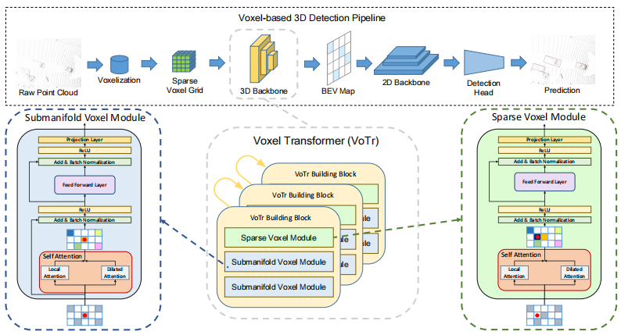
COMPANY NAME
POWER POINT
Abstract
01
VoTr: a novel and effective voxel-based Transformer backbone for 3D object detection from point clouds. 关键词: VoTr 3D检测 backbone 基于voxel transformer
PART

Slide 20
COMPANY NAME
POWER POINT
Abstract
01
3D sparse convolutional network voxel-based 缺点:
虽然是至关重要的部分，而且确实很有效，但是
cannot efficiently capture large context information,owing to the limited receptive fields.
例子: second[33]这个模型 voxel size as (0.05m, 0.05m, 0.1m) 最后一层卷积的 maximum receptive field 是 (3.65m, 3.65m, 7.3m) 不能覆盖超过4m的车
这会影响检测结果，尤其在object 只有少数的voxel情况下
CNN 扩大感受野的传统方式是 voxel size V , kernel size K, stride S, layer number L
改变这些参数都会大大增加计算量
事实上，大的感受野是非常重要的尤其是在点云这种天然稀疏而且不完整情况下的3D检测
PART

Slide 21
COMPANY NAME
POWER POINT
Abstract
01
直接应用standard transformer 是不可行的:
on the Waymo Open dataset non-empty voxels are sparsely
e.g normally occupy less than 0.1% of the total voxel space
on the Waymo Open dataset the number of non-empty voxels is still large in a scene
e.g. nearly 90k non-empty voxels generated per frame
PART

Slide 22
COMPANY NAME
POWER POINT
Abstract
01
To effectively handle the sparse characteristic of non-empty voxels:
sparse voxel module: can output features at the empty locations
submanifold voxel module: operate strictly on the non-emptyvoxels, to retain the original 3D geometric structure
PART
To resolve the problem that non-empty voxels are too numerous for self-attention:
Local Attention: focuses on the neighboring region to preserve detailed information
Dilated Attention: obtains a large attention range with only a few attending voxels
To accelerate the querying process for Local and Dilated Attention, we propose Fast Voxel Query: which contains a GPU-based hash table to efficiently store and lookup the non-empty voxels.

Slide 23
COMPANY NAME
POWER POINT
Voxel Transformer

Slide 24
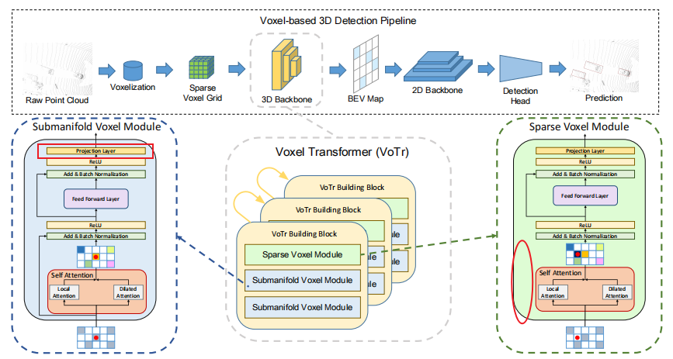
COMPANY NAME
POWER POINT
02
PART
Overall Architecture
contains 3 sparse voxel modules and 6 submanifold voxel modules
Each sparse voxel module is followed by 2 submanifold voxel modules
attending voxels are determined by Local Attention and Dilated Attention
Fast Voxel Query is proposed to accelerate the searchingprocess for the non-empty voxels in self-attention.
Voxel features extracted by our proposed VoTr are then projected to a BEV feature map to generate 3D proposals
voxels and corresponding features can also be utilized on the second stage for RoI refinement.

Slide 25
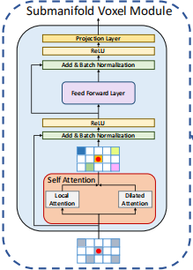

COMPANY NAME
POWER POINT
Voxel Transformer Module
In this section, we present the design of sparse and submanifold voxel modules.
02
The major difference：
submanifold voxel modules strictly operate on the non-empty voxels
sparse voxel modules can extract voxel features at the empty locations
PART
0.Self-attention on sparse voxels.
1.Submanifold voxel module.
2.Sparse voxel module.
define a dense voxel-grid ，the number of non-empty voxels
non-empty voxels with a indices array
non-empty voxels with a feature array
given a querying voxel attention range ， determined by attention mechanisms
aim to to obtain the feature
Let
first transform the indices
compute Q K V
to 3D coordinates of the real voxel centers by
where r is the voxel size

Slide 26
COMPANY NAME
POWER POINT
Voxel Transformer Module
0.Self-attention on sparse voxels.
1.Submanifold voxel module.
2.Sparse voxel module.
02
The outputs of submanifold voxel modules are exactly at the same locations with the input non-empty voxels, which indicates its ability tokeep the original 3D structures of inputs。
PART
The major differences between the standard Transformer module：
1) We append an additional linear projection layer after the feed-forward layer for channel ad_x0002_justment of voxel features.
2) We replace layer normalization with batch normalization.
3) We remove all the dropout layers in the module, since the number of attending voxels is already small and randomly rejecting some of those voxels hampers the learning process.

Slide 27
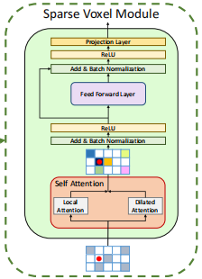

COMPANY NAME
POWER POINT
Voxel Transformer Module
0.Self-attention on sparse voxels.
1.Submanifold voxel module.
2.Sparse voxel module.
02
sparse voxel module can extract features for the empty locations
leading to the expansion of the original non-empty space
it is typically required in the voxel downsampling process
PART
there is no feature ，we give an approximation of at the empty location from the attending features :
as the maxpooling of all the attending features
The architecture of sparse voxel modules is similar to submanifold voxel modules, except that we remove the first residual connection around the self-attention layer,
since the inputs and outputs are no longer the same.

Slide 28
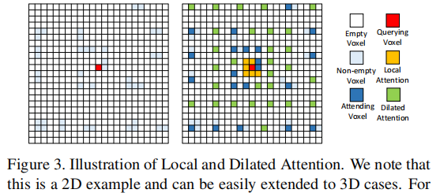
COMPANY NAME
POWER POINT
Efficient Attention Mechanism
contain attending voxels for each query ,satisfy the following requirements:
02
1) should cover the neighboring voxels to retain the fine-grained 3D structure.
2) should reach as far as possible to obtain a large context information.
3) the number of attending voxels in should be small enough,
e.g. less than 50, to avoid heavy computational overhead.
PART
two attention mechanisms to control the attention range
Local Attention.
Dilated Attention.

Slide 29
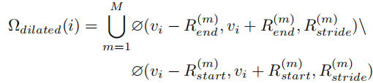
COMPANY NAME
POWER POINT
02
PART
Local Attention.
Dilated Attention.
defined
define as a function that returns the non-empty indices in a closed
set with the step as .
example: searches the set
where“\”is the set subtraction operator
takes the union of all the non-empty voxel sets.
in experiments:
the attention range is able to reach more than 15m but the number of attending voxels for each querying voxel is still kept less than 50

Slide 30
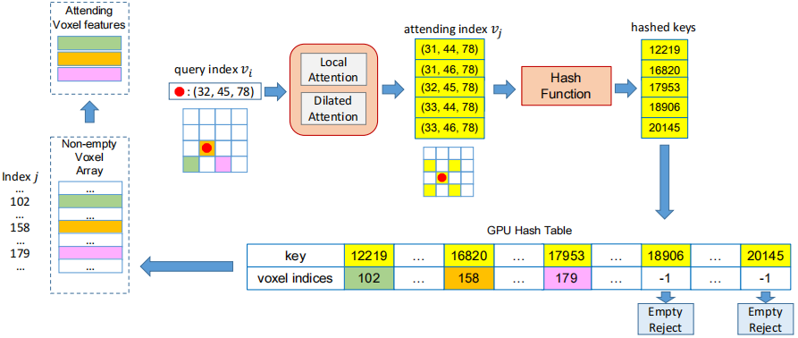
COMPANY NAME
POWER POINT
02
PART
Fast Voxel Query
1) we build a hash-table on GPUs which stores the hashed non-empty integer voxel indices vj as keys, and the corresponding indices j for the array V as values.
2) For each query i, we apply Local Attention and Dilated Attention to obtain the attending voxel indices vj ∈ Ω(i).
3) We look up the respective indices j for V using the hashed key vj in the hash table, and vj is judged as an empty voxel and rejected if the hash value returns −1.
4) We can finally gather the attending voxel indices vj and features fj from V and F with j for voxel self-attention

Slide 31
COMPANY NAME
POWER POINT
Experiments

Slide 32
COMPANY NAME
POWER POINT
Experimental Setup
Waymo Open Dataset.
KITTI Dataset.
03
training set: 798
validation set 202
metrics: mAP and mAPH
IoU threshold: 0.7(for car)
IoU threshold: 0.5(other)
training set: 3712
validation set 3769
testing set: 7518
metrics: mAP
IoU threshold: 0.7(for car)
IoU threshold: 0.5(other)
PART
testing samples are split in two ways:
1.based on the distances of objects to the sensor: 0 − 30m, 30 − 50m and > 50m.
2. according to the difficulty levels: LEVEL 1 for boxes with more than five LiDAR points and LEVEL 2 for boxes with at least one LiDAR point.

Slide 33
COMPANY NAME
POWER POINT
Experimental Setup
VoTr-SSD
VoTr-TSD
03
framework: SECOND [33]
framework: PV-RCNN [25]
PART
on the first stage of PV-RCNN:
Voxel Transformer
-->
3D sparse convolutional backbone
Voxel Transformer
-->
3D sparse convolutional backbone
Loss function 要分别看SECOND [33] PV-RCNN [25]

Slide 34
COMPANY NAME
POWER POINT
Experimental Setup
Implementation Details && Training and Inference Details.
03
non-empty voxel coordinates --> linear projection layer --> 16-channel initial features
the initial features are fed into VoTr for voxel feature extraction
Then channels of voxel features are lifted up to 64
The number of total attending voxels is set to 48
the number of heads is set to 4
The GPU hash table size Nhash is set to 400k.
PART
VoTr-SSD VoTr-TSD
KITTI batch size 32 16
learning rate 0.01 0.01
epoch 80 80
GPU 8*V100 8*V100
Waymo batch size 16 16
learning rate 0.003 0.003
epoch 60 80
GPU 8*V100 8*V100
learning rate decay cosine annealing strategy
optimizer ADAM

Slide 35
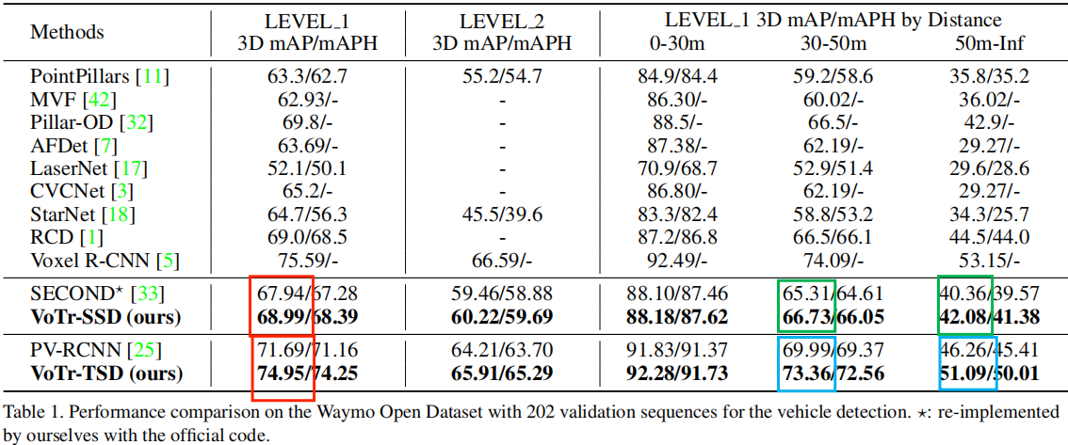
Comparisons on the Waymo Open Dataset
VoTr gives 1.05% and 3.26% LEVEL 1 mAP improvements for SECOND [33] and PV-RCNN [25]
In the range of 30-50m and 50m-Inf, VoTr-SSD gives 1.42% and 1.72% improvements,
VoTr-TSD gives 3.37% and 4.83% improvements

Slide 36
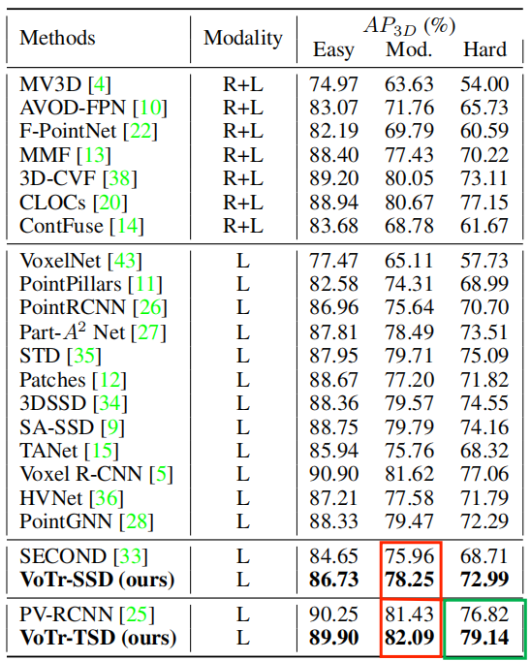
Comparisons on the KITTI Dataset
VoTr-SSD and VoTr-TSD brings 2.29% mAP and 0.66% mAP improvement on the moderate car class
For the hard car class, VoTr-TSD achieves 79.14% mAP, indicates the long-range relationships between voxels captured by VoTr is significant for detecting 3D objects that only have a few points.

Slide 37
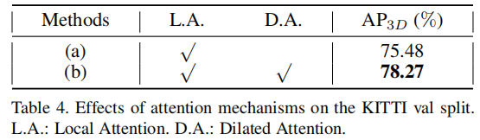
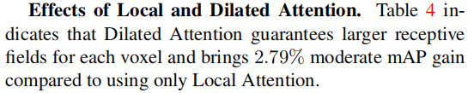
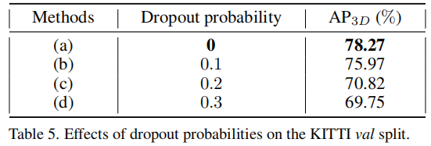
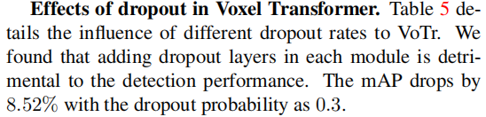
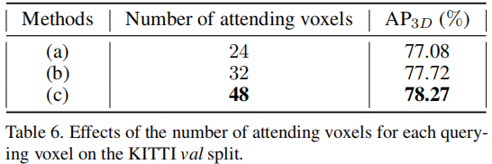
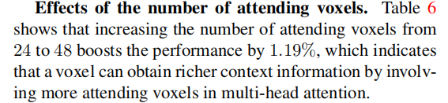

Slide 38
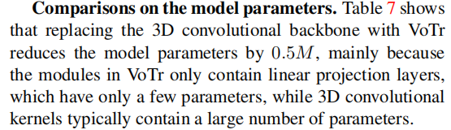
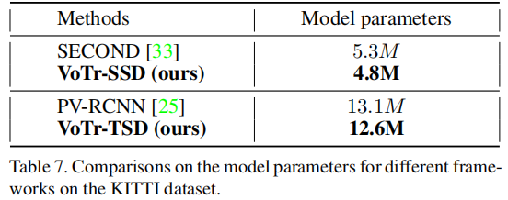
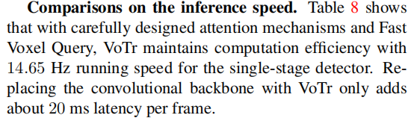
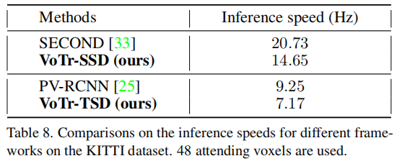
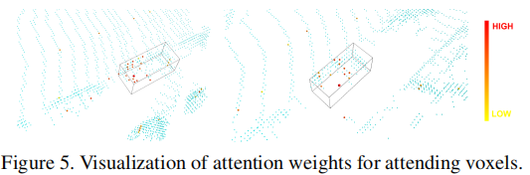
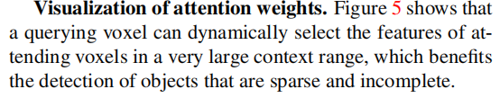

Slide 39
COMPANY NAME
POWER POINT
THANK YOU
汇报人：李柏坤 时间：2022/3/10

