Slide 1

强化学习-continuous
汇报人：李柏坤 时间：2022/1/16

Slide 2

目录
CATALOGUE
01
Deterministic Policy Gradient (DPG)
Stochastic Policy
VS
Deterministic Policy
02
03
Stochastic Policy for Continuous Control

Slide 3
COMPANY NAME
POWER POINT
Deterministic Policy Gradient (DPG)

Slide 4
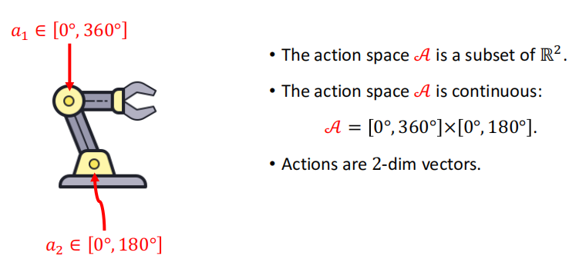
COMPANY NAME
POWER POINT
01
Continuous Action Space
PART

Slide 5
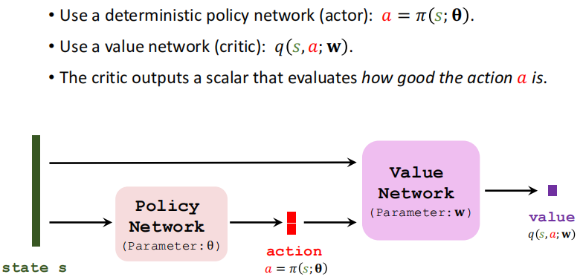
COMPANY NAME
POWER POINT
01
Deterministic Actor-Critic
PART

Slide 6
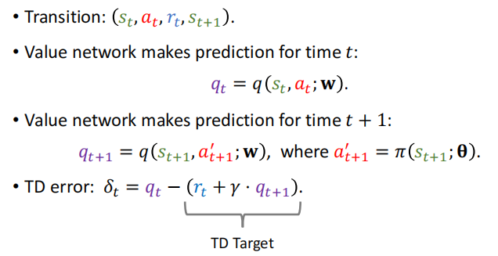
COMPANY NAME
POWER POINT
01
Updating Value Network by TD
PART

Slide 7
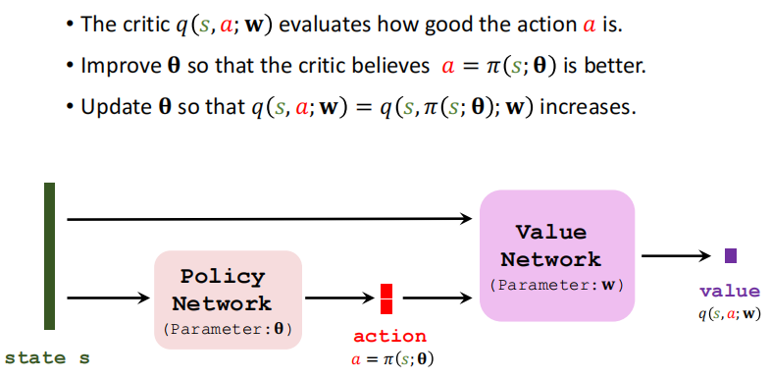
COMPANY NAME
POWER POINT
01
Updating Policy Network by DPG
PART

Slide 8
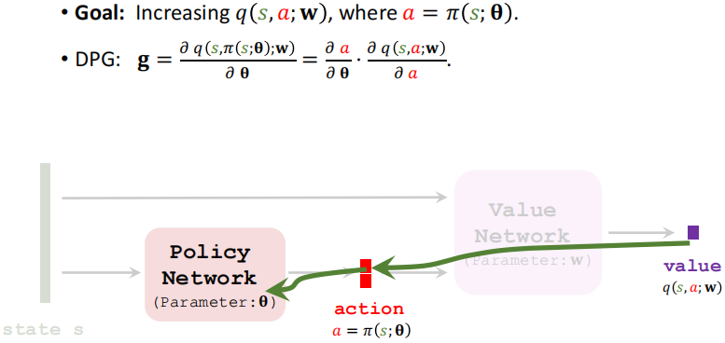
COMPANY NAME
POWER POINT
01
Updating Policy Network by DPG
PART

Slide 9
COMPANY NAME
POWER POINT
Improvement: Using Target Networks

Slide 10
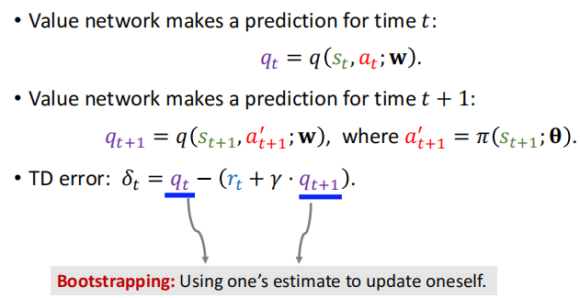

COMPANY NAME
POWER POINT
01
Bootstrapping
PART

Slide 11
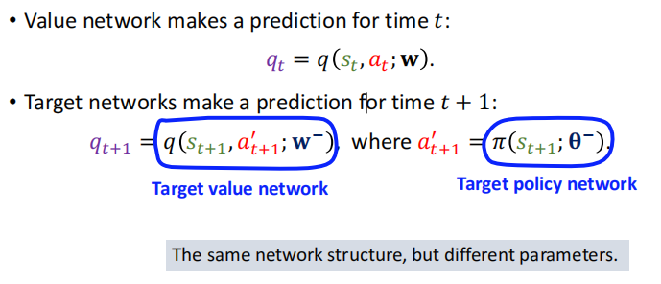
COMPANY NAME
POWER POINT
01
Using target networks
PART

Slide 12
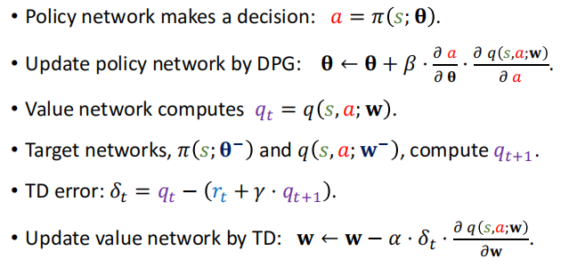
COMPANY NAME
POWER POINT
01
Updating policy and value networks
PART

Slide 13
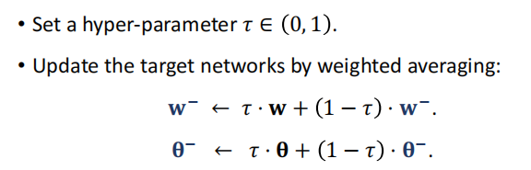
COMPANY NAME
POWER POINT
01
Updating target networks
PART

Slide 14
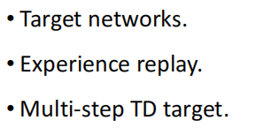
COMPANY NAME
POWER POINT
01
Improvements
PART

Slide 15
COMPANY NAME
POWER POINT
Stochastic Policy
VS
Deterministic Policy

Slide 16
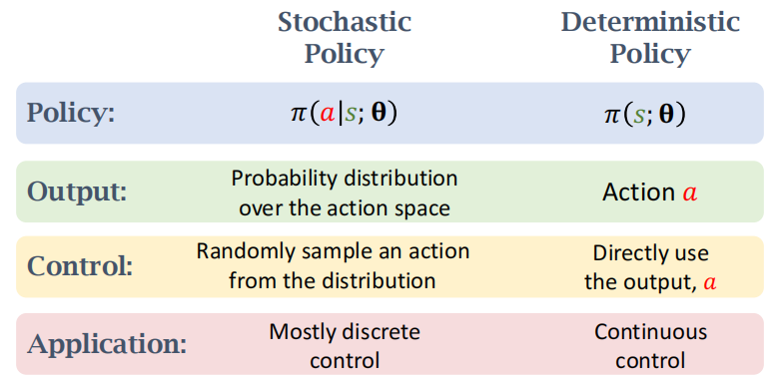
COMPANY NAME
POWER POINT
01
Stochastic Policy VS Deterministic Policy
PART

Slide 17
COMPANY NAME
POWER POINT
Stochastic Policy for
Continuous Control

Slide 18
COMPANY NAME
POWER POINT
Policy Network

Slide 19
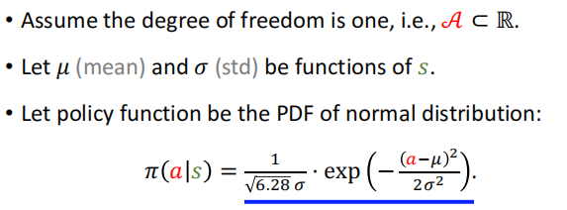
COMPANY NAME
POWER POINT
01
Univariate Normal Distribution
PART

Slide 20
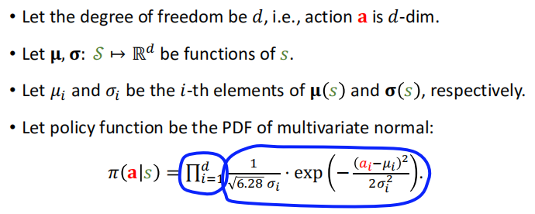
COMPANY NAME
POWER POINT
01
Multivariate Normal Distribution
PART

Slide 21
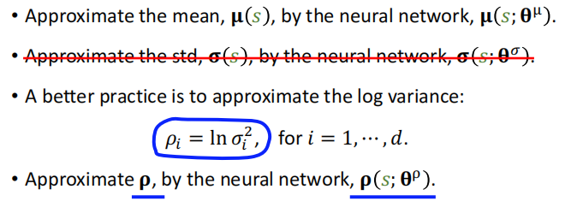
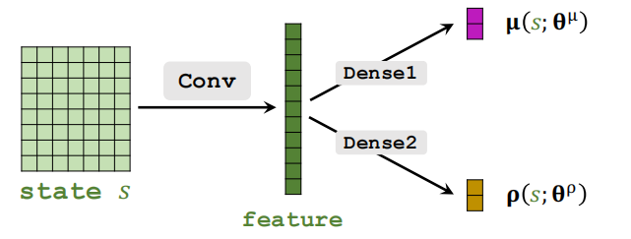
COMPANY NAME
POWER POINT
01
Function Approximation
PART

Slide 22
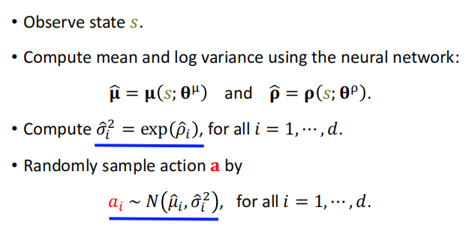
COMPANY NAME
POWER POINT
01
Continuous Control
PART

Slide 23
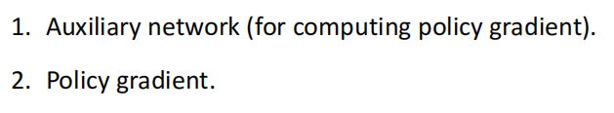
COMPANY NAME
POWER POINT
01
Training Policy Network
PART

Slide 24
COMPANY NAME
POWER POINT
Training (1/2): Auxiliary Network

Slide 25
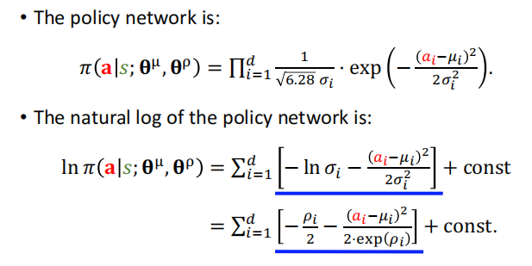
COMPANY NAME
POWER POINT
01
Policy Network
PART

Slide 26
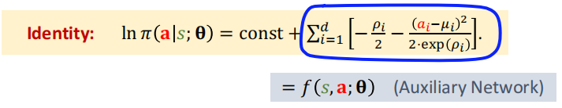

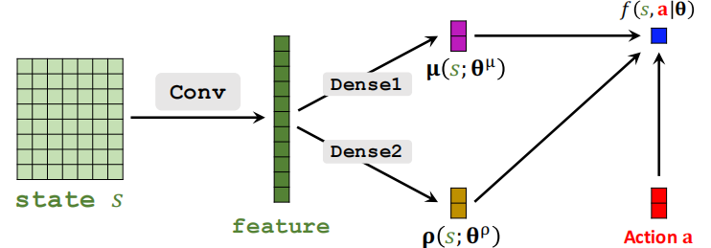
COMPANY NAME
POWER POINT
01
Auxiliary Network
PART

Slide 27
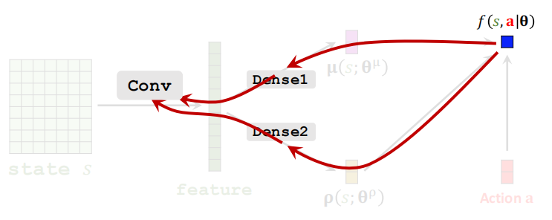
COMPANY NAME
POWER POINT
01
Auxiliary Network
PART

Slide 28
COMPANY NAME
POWER POINT
Training (2/2): Policy Gradient

Slide 29


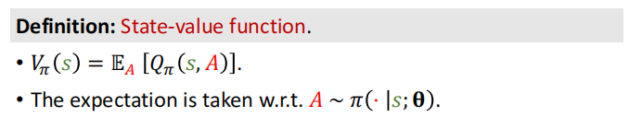
COMPANY NAME
POWER POINT
01
Return & Value Functions
PART

Slide 30

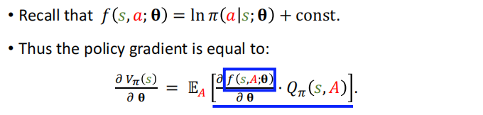

COMPANY NAME
POWER POINT
01
Policy Gradient
PART

Slide 31
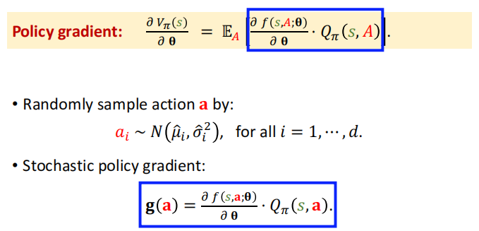
COMPANY NAME
POWER POINT
01
Monte Carlo Approximation
PART

Slide 32
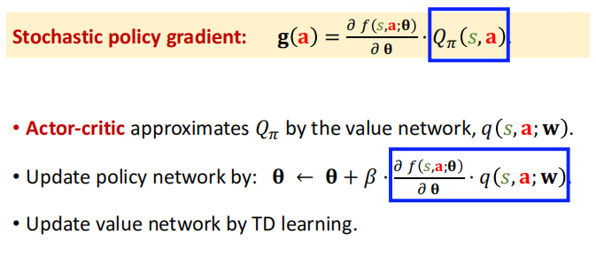
COMPANY NAME
POWER POINT
01
Approximations to Action-Value
PART

Slide 33
COMPANY NAME
POWER POINT
THANK YOU
汇报人：李柏坤 时间：2022/1/16

