Slide 1

强化学习
Policy Gradient with Baseline
汇报人：李柏坤 时间：2022/1/16

Slide 2

目录
CATALOGUE
01
Baseline
02
Monte Carlo Approximation
03
Choices of Baselines
04
Advantage Actor-Critic (A2C)
05
Advantage Actor-Critic (A2C)的数学推导
06
A2C with Multi-Step TD Target

Slide 3
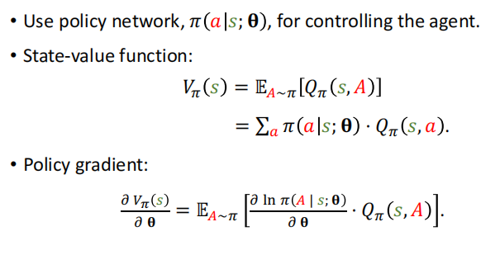
COMPANY NAME
POWER POINT
01
Policy Gradient
PART

Slide 4
COMPANY NAME
POWER POINT
Baseline

Slide 5
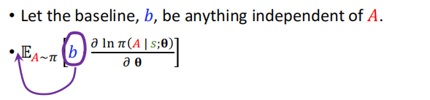

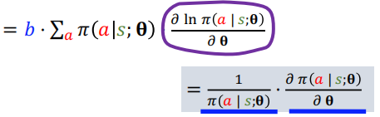

COMPANY NAME
POWER POINT
01
Baseline
PART

Slide 6
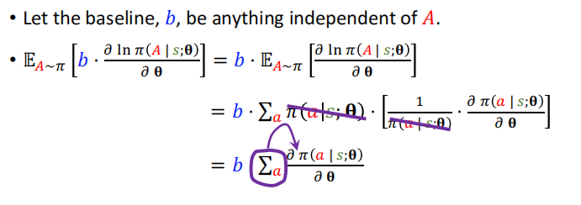
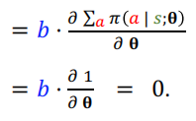
COMPANY NAME
POWER POINT
01
Baseline
PART

Slide 7
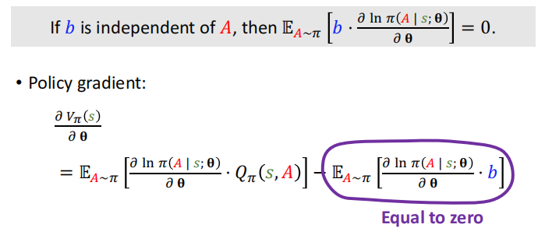

COMPANY NAME
POWER POINT
01
Policy Gradient with Baseline
PART

Slide 8
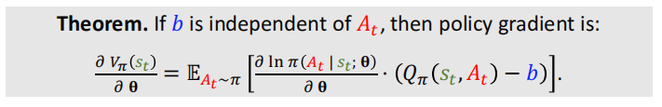
COMPANY NAME
POWER POINT
01
Policy Gradient with Baseline
PART

Slide 9
COMPANY NAME
POWER POINT
Monte Carlo Approximation

Slide 10
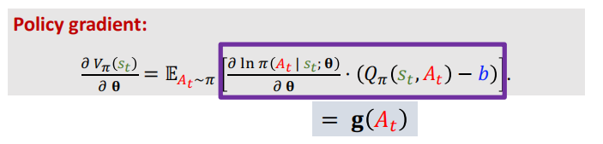
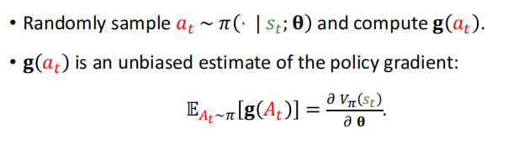
COMPANY NAME
POWER POINT
01
Monte Carlo Approximation
PART

Slide 11
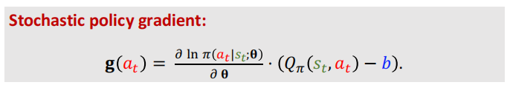

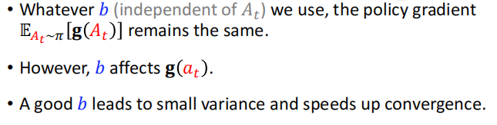
COMPANY NAME
POWER POINT
01
Stochastic Policy Gradient
PART

Slide 12
COMPANY NAME
POWER POINT
Choices of Baselines

Slide 13
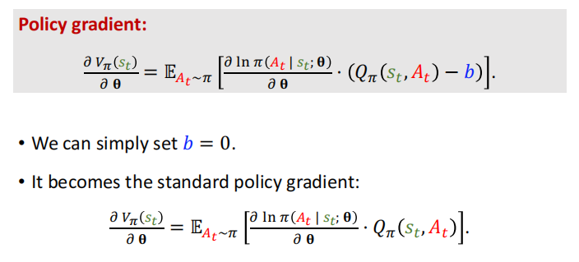
COMPANY NAME
POWER POINT
01
Choice 1: b=0
PART

Slide 14
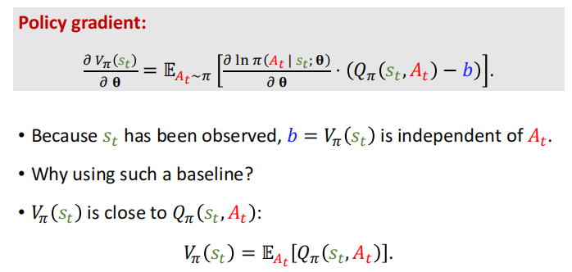
COMPANY NAME
POWER POINT
01
Choice 2: b is state-value
PART

Slide 15
COMPANY NAME
POWER POINT
Advantage Actor-Critic (A2C)

Slide 16
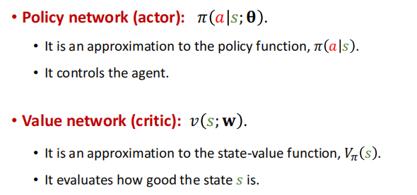
COMPANY NAME
POWER POINT
01
Actor and Critic
PART

Slide 17
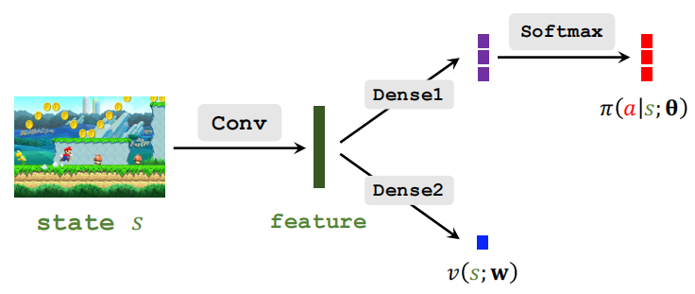
COMPANY NAME
POWER POINT
01
Actor and Critic
PART

Slide 18
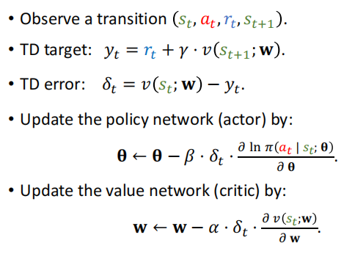
COMPANY NAME
POWER POINT
01
Training of A2C
PART

Slide 19
COMPANY NAME
POWER POINT
Advantage Actor-Critic (A2C)
的数学推导

Slide 20
COMPANY NAME
POWER POINT
Properties of Value Functions

Slide 21
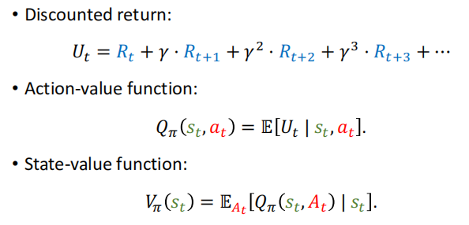


COMPANY NAME
POWER POINT
01
Value Functions
PART

Slide 22



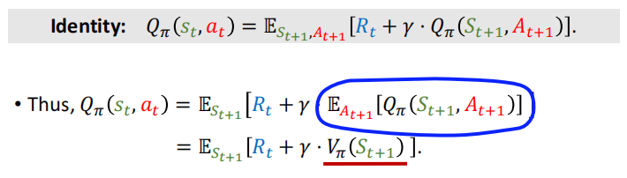
COMPANY NAME
POWER POINT
01
Property of Action-Value Function
PART

Slide 23
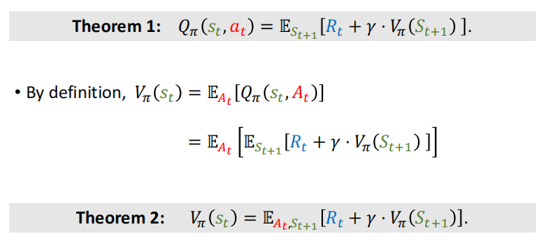
COMPANY NAME
POWER POINT
01
Property of Action-Value Function
PART

Slide 24
COMPANY NAME
POWER POINT
Monte Carlo Approximations

Slide 25
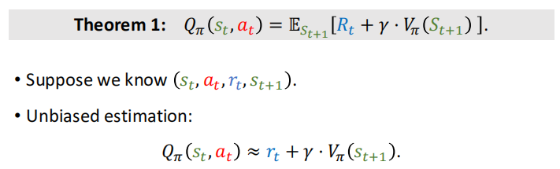
COMPANY NAME
POWER POINT
01
Approximation to Action-Value
PART

Slide 26
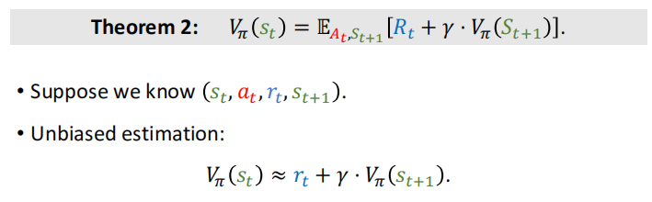
COMPANY NAME
POWER POINT
01
Approximation to State-Value
PART

Slide 27
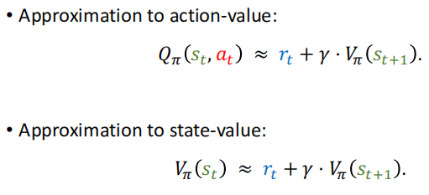
COMPANY NAME
POWER POINT
01
Approximations
PART

Slide 28
COMPANY NAME
POWER POINT
Updating Policy Network

Slide 29
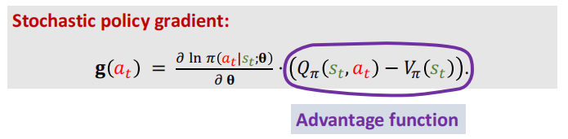
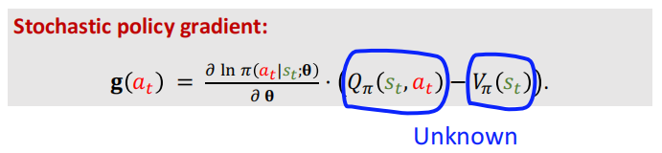
COMPANY NAME
POWER POINT
01
Policy Gradient with Baseline
PART

Slide 30
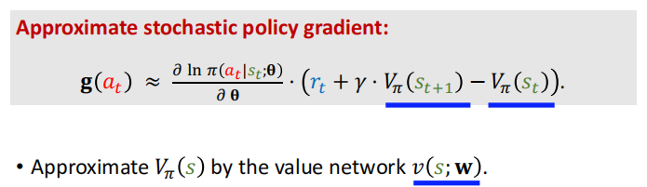

COMPANY NAME
POWER POINT
01
Function Approximation to State-Value
PART

Slide 31
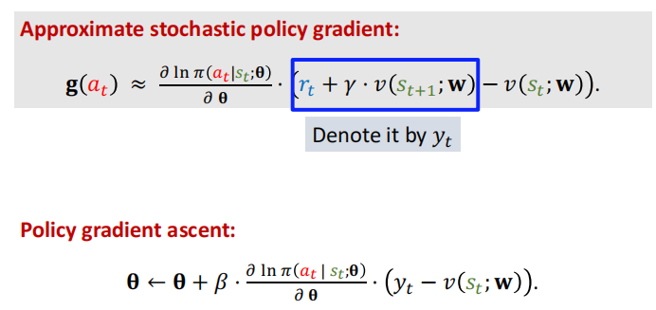
COMPANY NAME
POWER POINT
01
Updating Policy Network
PART

Slide 32
COMPANY NAME
POWER POINT
Updating Value Network

Slide 33
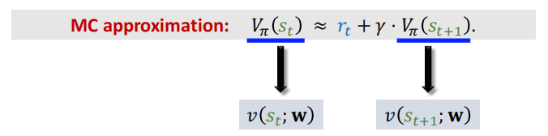
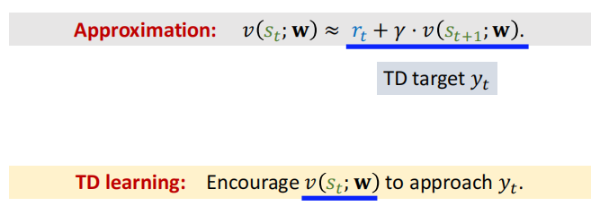
COMPANY NAME
POWER POINT
01
Derive TD Target
PART

Slide 34
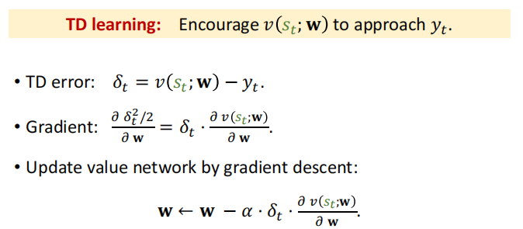
COMPANY NAME
POWER POINT
01
Updating Value Network
PART

Slide 35
COMPANY NAME
POWER POINT
A2C with Multi-Step TD Target

Slide 36
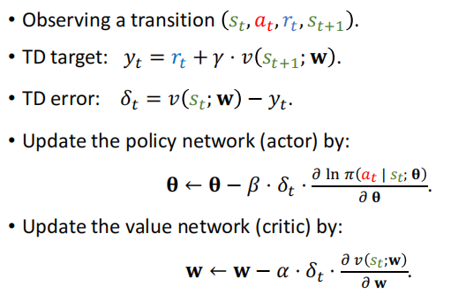
COMPANY NAME
POWER POINT
01
Advantage Actor-Critic (A2C)
PART

Slide 37
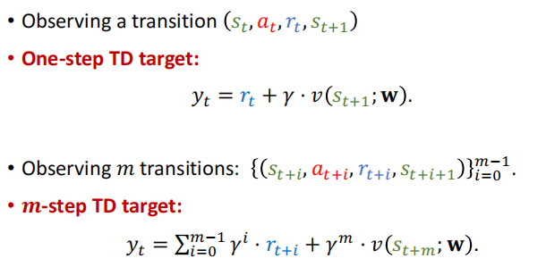
COMPANY NAME
POWER POINT
01
One-Step VS Multi-Step Target
PART

Slide 38
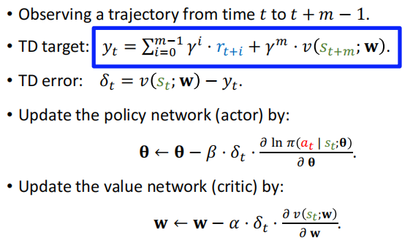
COMPANY NAME
POWER POINT
01
A2C with Multi-Step TD Target
PART

Slide 39
COMPANY NAME
POWER POINT
THANK YOU
汇报人：李柏坤 时间：2022/1/16

