Slide 1

PV-RCNN++: Point-Voxel Feature Set
Abstraction With Local Vector Representation for
3D Object Detection

Slide 2
目录
一
CATALOGUE
VoxelNet
01
Abstract
02
PRELIMINARIES
03
PV-RCNN
04
PV-RCNN++

Slide 3
COMPANY NAME
POWER POINT
Abstract

Slide 4
COMPANY NAME
POWER POINT
Abstract
01
In this paper, we first introduce a novel two-stage detector, PV-RCNN：
The first step is voxel-to-keypoint scene encoding：
goal ： voxel feature learning and proposal generation
method：voxel CNN with sparse convolutions
detail：
The multi-scale voxel features are then summarized into a small set of keypoints by set abstraction
The keypoints with accurate point locations are sampled by farthest point sampling (FPS) from the raw point cloud
The second step is keypoint-to-grid RoI feature abstraction
goal： encodes multi-scale contextual information to form regular grid features for the following proposal refinement
method： propose the RoI-grid pooling module to aggregate the above keypoint features to the RoI grids of each proposal.
PART

Slide 5
COMPANY NAME
POWER POINT
Abstract
01
an advanced two-stage detection network, PV-RCNN++：
a sectorized proposal-centric keypoint sampling strategy：
goal：the limited number of keypoints is concentrated in and around the 3D
proposals to encode more effective features for proposal refinement
method： sectorized farthest point sampling is conducted to parallelly sample keypoints in different sectors
a novel local feature aggregation module, VectorPool aggregation：
goal：for more effective and efficient local feature encoding on sparse and irregular point cloud
method：Equipped with the VectorPool aggregation in both voxel-based backbone and RoI-grid pooling module
PART

Slide 6
COMPANY NAME
POWER POINT
PRELIMINARIES

Slide 7
3D Voxel CNN and Proposal Generation
The input points P are first divided into small voxels with spatial resolution of L×W×H
non-empty voxel features are directly calculated by averaging the features of inside points
utilizes a series of 3D sparse convolution to gradually convert the points into feature volumes with 1×, 2×, 4×, 8× downsampled sizes
The Voxel CNN backbone can be naturally combined with the 2D detection heads by converting the encoded 8× downsampled 3D feature volumes into 2D bird-view feature maps

Slide 8
Discussions on 3D Proposal Refinement
3D feature volumes from the 3D voxel CNN have major limitations：
(i) low spatial resolution as they are downsampled by up to 8 times, which hinders accurate localization of objects.
(ii) The commonly used trilinear or bilinear interpolation in the RoIPool/RoIAlign operations can only extract features from very small neighborhoods(i.e., 4 and 8 for bilinear and trilinear interpolation respectively) which would therefore obtain features with mostly zeros and waste much compu_x0002_tations and memory for proposal refinement
the point-based local feature aggrega_x0002_tion methods [19] have shown strong capability of encoding sparse features from local neighborhoods with arbitrary scales.
We therefore propose to incorporate a 3D voxel CNN with the point-based local feature aggregation operation for conducting accurate and robust proposal refinement.

Slide 9
COMPANY NAME
POWER POINT
PV-RCNN

Slide 10
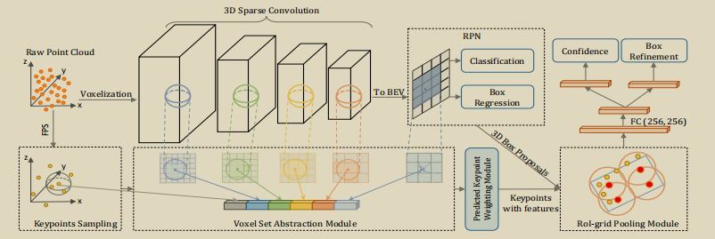
COMPANY NAME
POWER POINT
PV-RCNN
03
PART
PV-RCNN consists of a 3D voxel CNN with sparse convolution as the backbone for efficient feature encoding and proposal generation
Given each 3D proposal, we propose to generate the proposal-aligned features in two novel steps for proposal refinement
( voxel-to-keypoint scene encoding + keypoint-to-grid RoI feature abstraction)

Slide 11
COMPANY NAME
POWER POINT
Voxel-to-Keypoint Scene Encoding
03
goal： bridge the 3D voxel CNN feature encoder and the proposal refinement network
method：aggregates the voxel-wise scene features at multiple neural layers of 3D voxel CNN into a small number of keypoints
PART
Keypoints Sampling.
We simply adopt the farthest point sampling (FPS) algorithm to sample a small number of keypoints from the point clouds where (n=4,096 for Waymo Open Dataset and n=2,048 for KITTI dataset )

Slide 12



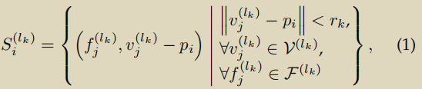

COMPANY NAME
POWER POINT
Voxel-to-Keypoint Scene Encoding
03
Voxel Set Abstraction Module.
goal：We propose the Voxel Set Abstraction (VSA) module to encode multi-scale semantic features from 3D feature volumes to the keypoints.
PART
：the set of voxel-wise features in the k-th level of 3D voxel CNN
：their corresponding 3D coor_x0002_dinates in the uniform 3D metric space
：is the number of non-empty voxels in the k-th level
： For each keypoint the set of neighboring voxel-wise feature vectors
randomly sampling at most voxels
a MLP network to encode voxel-wise features and relative locations.
maps diverse number of neighboring voxel features to a single keypoint feature
Here multiple radii are utilized to capture richer contextual information.
the multi-scale semantic feature for keypoint as：

Slide 13
COMPANY NAME
POWER POINT
Voxel-to-Keypoint Scene Encoding
03
Further Enriching Keypoint Features.
We further enrich the keypoint features with the raw points and with the 8× downsampled 2D bird-view feature maps
PART
which have the strong capacity of preserving 3D structural information of the entire scene for the following fine-grained proposal refinement step.

Slide 14

COMPANY NAME
POWER POINT
Voxel-to-Keypoint Scene Encoding
03
Predicted Keypoint Weighting
some of them might only represent the background regions.
PART
keypoints belonging to the foreground objects should contribute more to the proposal refinement
while the ones from the background regions should contribute less
propose a Predicted Keypoint Weighting (PKW) module to re-weight the keypoint features with extra supervisions from point segmentation.
where is a three-layer MLP network with a sigmoid function to predict foreground confidence.
It is trained with focal loss (default hyper-parameters) to handle the imbalanced

Slide 15
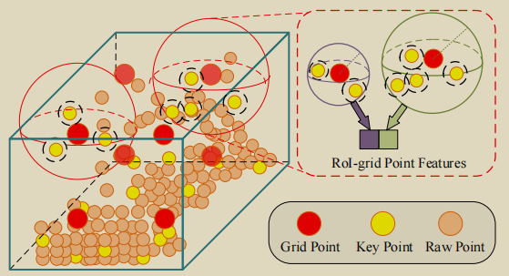



COMPANY NAME
POWER POINT
Keypoint-to-Grid RoI Feature Abstraction
03
keypoint features
RoI-grid Pooling via Set Abstraction.
PART
Given each 3D proposal
propose the RoI-grid pooling module to aggregate the keypoint features to the RoI-grid points with multiple receptive fields.
uniformly sample 6×6×6 within each 3D proposal, which are then flattened and denoted as

Slide 16


COMPANY NAME
POWER POINT
Training Losses
03
(i) region proposal loss
PART
anchor classification lossis calculated with the focal loss
is a binary classification loss for orientation to eliminate the ambiguity of
smooth-L1 loss is for anchor box regression with the predicted residual and regression target .
(ii) The keypoint segmentation loss Lseg is also conducted with the focal loss as mentioned in Sec. 4.1.
(iii) The proposal refinement loss includes the IoU-guided confidence prediction loss and the box refinement loss as
is the predicted box residual
is the proposal regression target that is encoded same with

Slide 17
COMPANY NAME
POWER POINT
PV-RCNN++

Slide 18
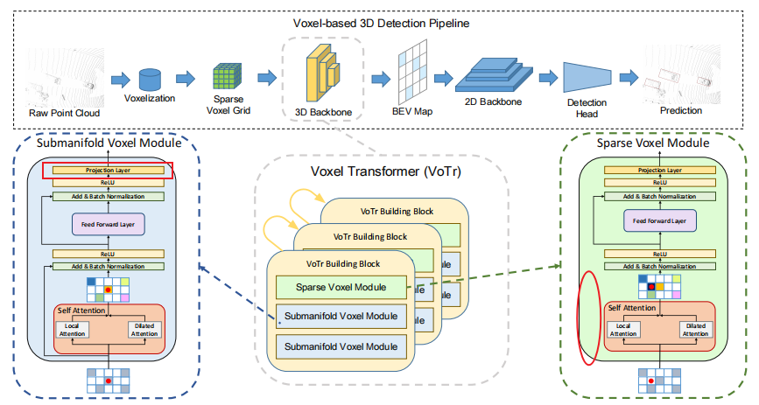
COMPANY NAME
POWER POINT
04
PART
Overall Architecture
contains 3 sparse voxel modules and 6 submanifold voxel modules
Each sparse voxel module is followed by 2 submanifold voxel modules
attending voxels are determined by Local Attention and Dilated Attention
Fast Voxel Query is proposed to accelerate the searchingprocess for the non-empty voxels in self-attention.
Voxel features extracted by our proposed VoTr are then projected to a BEV feature map to generate 3D proposals
voxels and corresponding features can also be utilized on the second stage for RoI refinement.

Slide 19
COMPANY NAME
POWER POINT
Experiments

Slide 20
COMPANY NAME
POWER POINT
Experimental Setup
Waymo Open Dataset.
KITTI Dataset.
05
training set: 798
validation set 202
metrics: mAP and mAPH
IoU threshold: 0.7(for car)
IoU threshold: 0.5(other)
training set: 3712
validation set 3769
testing set: 7518
metrics: mAP
IoU threshold: 0.7(for car)
IoU threshold: 0.5(other)
PART
testing samples are split in two ways:
1.based on the distances of objects to the sensor: 0 − 30m, 30 − 50m and > 50m.
2. according to the difficulty levels: LEVEL 1 for boxes with more than five LiDAR points and LEVEL 2 for boxes with at least one LiDAR point.

Slide 21
COMPANY NAME
POWER POINT
THANK YOU
汇报人：李柏坤 时间：2022/4/7

