Slide 1
Inventory Management System
Business Operations Presentation
For Shop Owners and System Users
Generated: 27-02-2026
Data Footprint: 46 items | 53 sales invoices | 53 purchase entries
Master Data: 2 customers | 12 suppliers | 132 audit events
Presentation Quality: Formal design, visual analytics, and practical operational insights

Slide 2
Executive Snapshot
Total Stock Quantity: 1,339.00
Estimated Stock Value: Rs 2,450.00
Total Sales Value: Rs 649,914.70
Total Purchase Value: Rs 1,308,488.80
Customer Outstanding Due: Rs 456,033.30
Supplier Outstanding Due: Rs 1,105,061.20
Why this system matters
- Unified billing, purchase, stock, and due control
- Faster day-to-day shop operations
- Better financial visibility and accountability
- Role-based access for secure collaboration

Slide 3
System Architecture At A Glance
Sales Module
Purchase Module
Inventory Engine
Reporting & Export
Core design: UI modules -> validation -> transaction write -> audit trail -> report/export layer
JSON Data Store

Slide 4
Role-Based Access Matrix
Configured users: Admin / User / Shop Manager
Functionality
Admin
User
Shop Manager
New Invoice
Yes
Yes
Yes
New Purchase
Yes
Yes
Yes
Item Summary: Purchase Price
Editable
View
Hidden
Item Summary: Selling Price
Editable
View
Editable
Item Summary: Available Qty
Editable
View
Editable
Audit Log Viewer
Yes
Yes
Yes

Slide 5
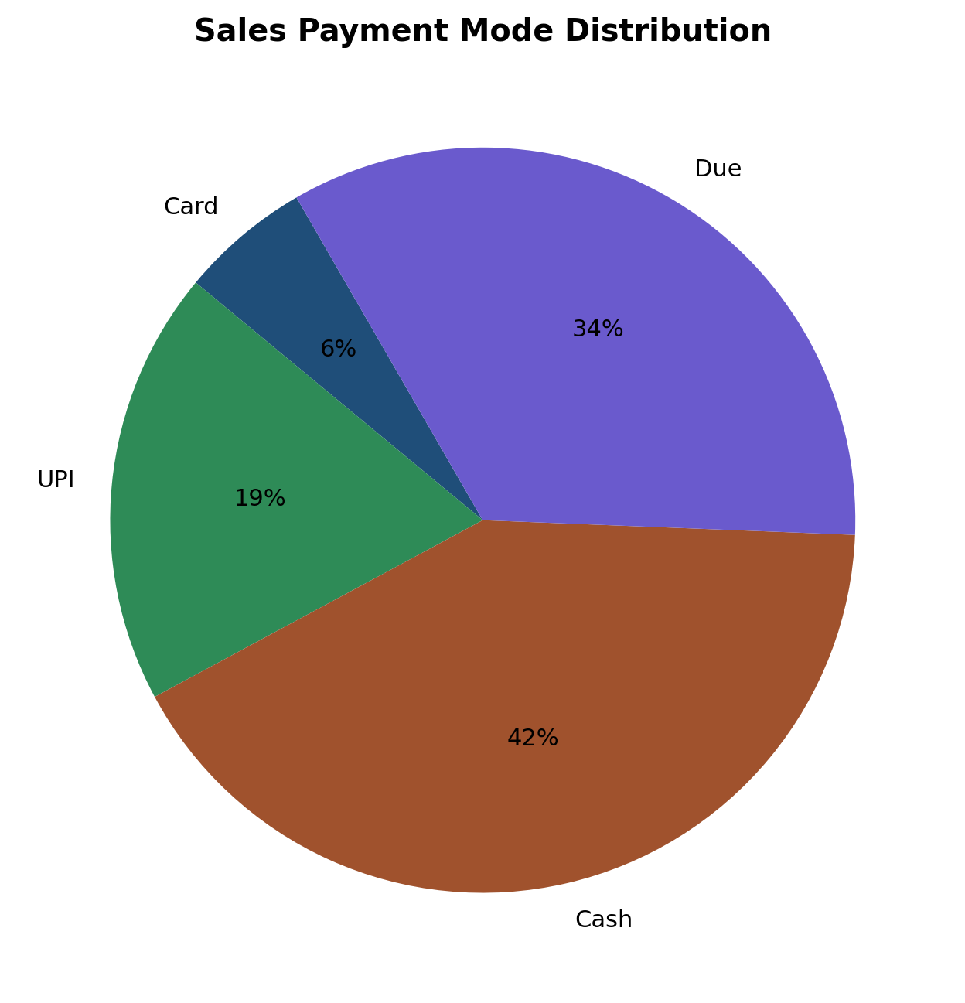
Sales Workflow (New Invoice)
1. Capture customer details with smart suggestion and auto-fill
2. Select or type item, set type/qty/rate/GST, and add to cart
3. Stock validation prevents over-sale
4. Calculate taxable, CGST/SGST and payable balance
5. Generate invoice -> write sales record -> reduce stock
6. Auto-create invoice PDF and audit log entry

Slide 6
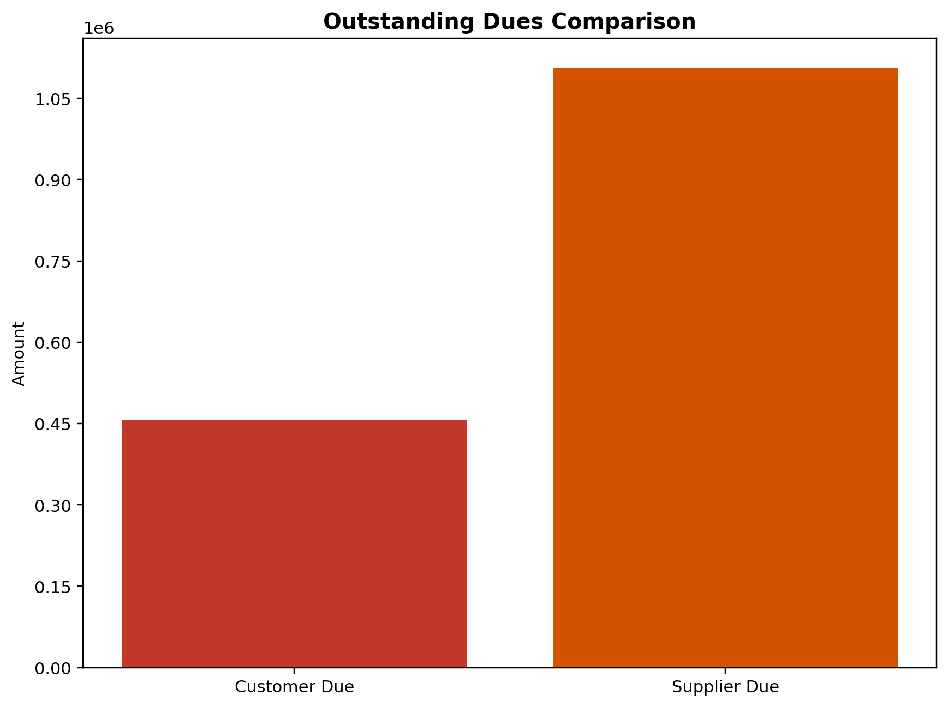
Purchase Workflow (New Purchase)
1. Supplier select/auto-fill; new supplier can be auto-created
2. Add purchased line items with HSN, unit, GST and totals
3. Track payment mode including Other
4. Save purchase record and compute supplier due
5. Add stock into inventory and capture audit event
6. Cash payments post into cash ledger automatically

Slide 7
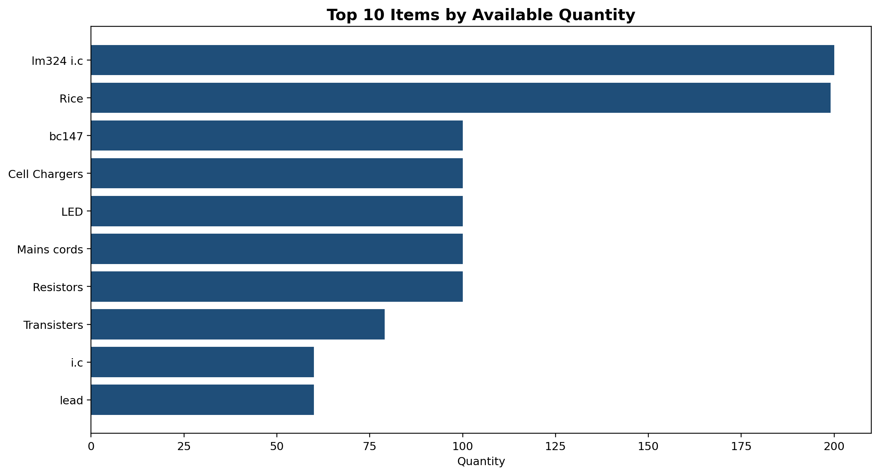
Inventory Intelligence
Item summary is fixed in alphabetical order
Editable fields are role controlled
Stock valuation and quantity tracking are built-in
Item transaction drilldown is available

Slide 8
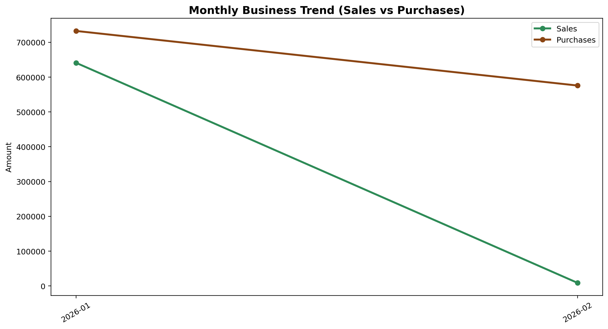
Financial Trend Visibility

Slide 9
Reliability And Edge-Case Handling
Validation guards: mandatory fields, numeric checks, and amount ranges
No duplicate save on rapid clicks (action locks and save locks)
Large report views load in chunks to avoid UI freezing
Date parsing supports multiple formats with safe fallback
Data consistency routine sanitizes records and rebuilds inventory baseline
Audit viewer sorted latest-first for traceability

Slide 10
Performance Improvements Implemented
Cached New Invoice/New Purchase tabs preserve data and cut reload delays
Lazy imports reduce screen-open lag
In-memory stock cache reduces repeated disk reads
Navigation debounce prevents non-responding behavior from rapid clicks
Chunked table rendering used in heavy report screens
Operational Impact
- Faster form opening
- Fewer temporary hangs
- Better user confidence
- Smoother reporting

Slide 11
Conclusion
The system now provides integrated billing, purchase, inventory, due, and audit visibility.
For shop owners: better control over stock, dues, and operational accountability.
For users: faster entry flow, clearer reports, and safer transaction handling.
Next step recommendation: periodic backup + monthly KPI review using report exports.
Prepared from live system implementation details (BS5.6 - Edited v2)

