Slide 1

1. Car Information
2. Insured’s Information
3. Summary
Start date of the policy
10/05/2018
Which is the type of car?
Search...
Audi A3
2018
Is it a new or used car?
Type of use
New
Used
Personal
Number of drivers
Number of doors
2
3
5
Fuel type
Plate number
Gasoline
CJF4578
< Home
Next >

Slide 2
1. Car Information
2. Insured’s Information
3. Summary
> First driver
First name
Last name
John
Doe
Birthdate
Age
10/05/1977
41
Nationality
Search...
Address
Street
ZIP code
Bocskai 201
Search...
> Second driver
> Package
< Home
< Back
Next >

Slide 3
1. Car Information
2. Insured’s Information
3. Summary
> First driver
> Second driver
> Package
Basic Package | Premium Light | Premium Plus
$ 2,500 | $ 7,560 | $ 11,500
< Home
< Back
Next >

Slide 4
1. Car Information
2. Insured’s Information
3. Summary
Congratulations!
You have successfully issued a quote.
First name: John Last name: Doe
Age: 41 Nationality: Hungarian
Address: Bocskai 201, 1132
Package: Premium Light
Premium: $ 7,560
Home

Slide 5
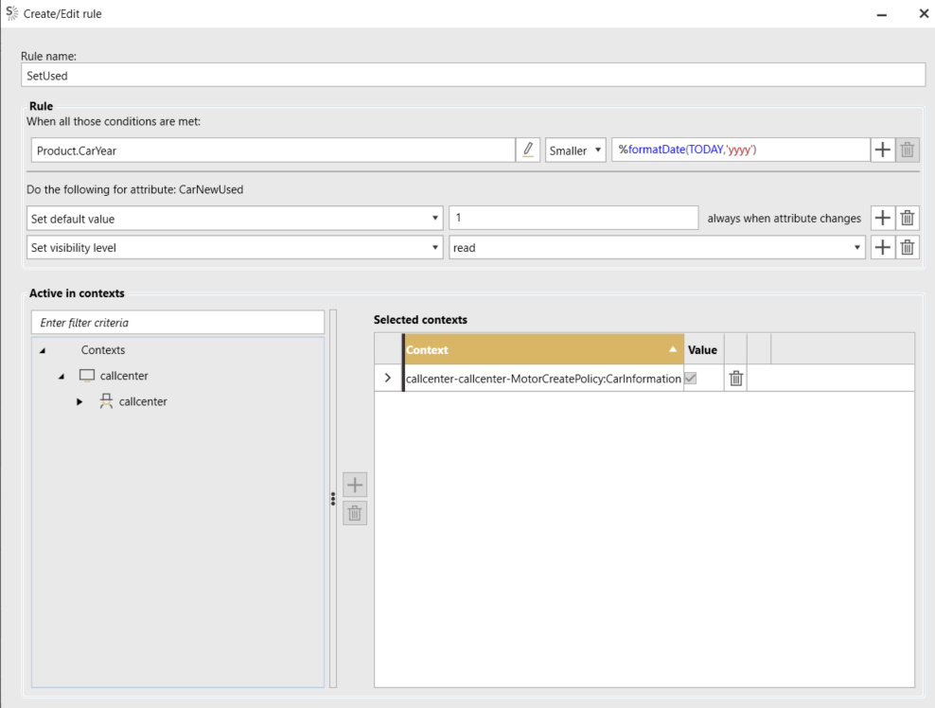
NEW
USED

