Slide 1
Chapter 6
Developing Data Models for
Business Databases
Notes:
Welcome to Chapter 6 on developing data models for business databases
- Extends your knowledge of the notation of ERDs
- Data modeling practice on narrative problems
- Convert from ERD to table design
- Data modeling is challenging
- Ambiguity: part science, part art
- Opportunity for some creative problem solving
Objectives:
- Data modeling practice:
- Strategies for analyzing a narrative problem
- Transformations for considering alternative designs
- Avoidance of common design errors
- Master data modeling with lots of practice
- Apply conversion rules to transform ERD into a table design

Slide 2
Outline
Guidelines for analyzing business information needs
Transformations for generating alternative designs
Finalizing an ERD
Schema Conversion
Notes:
Analysis of narrative problems: steps to identify entity types, primary keys, and relationships
Transformations:
Generation of alternatives
Can help depict feasible alternatives
Finalizing an ERD
Documentation
Avoiding common design errors
Schema conversion: basic rules and specialized rules
Alternative notations: Chen, UML

Slide 3
Characteristics of Business Data Modeling Problems
Poorly defined
  Conflicting statements
  Wide scope
  Missing details
  Many stakeholders
  Requirements in many formats
Add structure
  Eliminate irrelevant details
  Add missing details
  Narrow scope
Notes:
Business requirements are rarely well structured. Rather, as an analyst you will often face an ill-defined business situation in which you need to add structure. You will need to interact with a variety of stakeholders who sometimes provide competing statements about the database requirements. In collecting the requirements, you will conduct interviews, review documents and system documentation, and examine existing data. To determine the scope of the database, you will need to eliminate irrelevant details and add missing details. On large projects, you may work on a subset of the requirements and then collaborate with a team of designers to determine the complete data model.

Slide 4
Goals of Narrative Problem Analysis
Consistency with narrative
  No contradictions of explicit narrative statements
Identify shortcomings
  Ambiguous statements
  Missing details
Simplicity preference
  Choose simpler designs especially in initial design
  Add refinements and additional details later
Notes:
The main goal when analyzing narrative problem statements is to create an ERD that is consistent with the narrative. The ERD should not contradict the implied ERD elements in the problem narrative. For example, if the problem statement indicates that concepts are related by words indicating more than one, the ERD should have a cardinality of many to match that part of the problem statement.
you should have a bias toward simpler rather than more complex designs. For example, an ERD with one entity type is less complex than an entity type with two entity types and a relationship. In general, when a choice exists between two ERDs, you should choose the simpler design especially in the initial stages of the design process. As the design process progresses, you can add details and refinements to the original design.

Slide 5
Steps of Narrative Problem Analysis
Identify entity types and attributes
Determine primary keys
Add relationships
  Determine connections
  Determine relationship cardinalities
  Simplify relationships

Slide 6
Determine Entity Types and Attributes
For entity types, find nouns that represent groups of people, places, things, and events
For attributes, look for properties that provide details about the entity types
Simplicity principal: consider as an attribute unless other details
Notes:
The simplicity principle should be applied during the search for entity types in the initial ERD, especially involving choices between attributes and entity types. Unless the problem description contains additional sentences or details about a noun, you should consider it initially as an attribute. For example, if courses have an instructor name listed in the catalog, you should consider instructor name as an attribute of the course entity type rather than as an entity type unless additional details are provided about instructors in the problem statement. If there is confusion between considering a concept as an attribute or entity type, you should followup with more requirements collection later.

Slide 7
Determine Primary Keys
Stable: never change after assigned
Single purpose: no other purpose
Good choices: automatically generated values
Compromise choice for industry practices
Identify other unique attributes
Notes:
Identification of primary keys is an important part of entity type identification. Ideally, primary keys should be stable and single purpose. “Stable” means that a primary key should never change after it has been assigned to an entity. “Single purpose” means that a primary key attribute should have no purpose other than entity identification. Typically, good choices for primary keys are integer values automatically generated by a DBMS. For example, Access has the AutoNumber data type for primary keys and Oracle has the Sequence object for primary keys.
If the requirements indicate the primary key for an entity type, you should ensure that the proposed primary key is stable and single purpose. If the proposed primary key does not meet either criterion, you should probably reject it as a primary key. If the proposed primary key only meets one criterion, you should explore other attributes for the primary key. Sometimes, industry or organizational practices dictate the choice of a primary key even if the choice is not ideal.

Slide 8
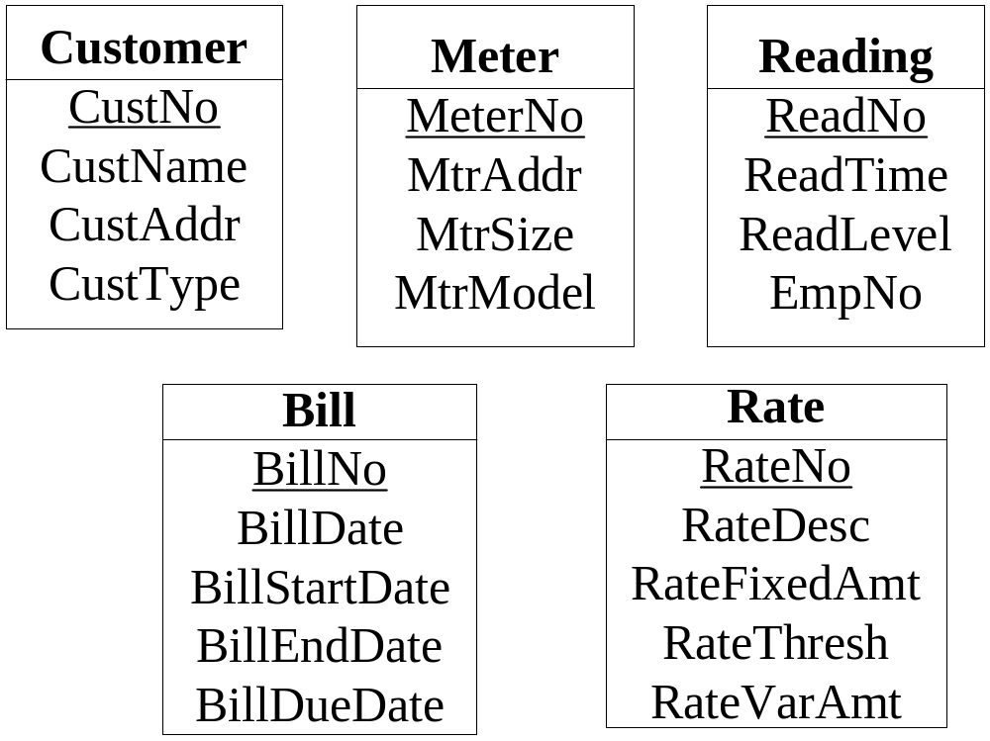
Entity Identification Example
Notes:
Derivation of entity types
Customer data include a unique customer number, a name, a billing address, a type (commercial or residential), an applicable rate, and a collection (one or more) of meters
Meter data include a unique meter number, an address, a size, and a model.
A bill consists of a heading part and a list of detail lines. The heading part contains a customer number, a preparation date, a payment due date, and a date range for the consumption period.
When a meter is read, a meter reading document is created containing a unique meter reading number, an employee number, a meter number, a time-stamp (includes date and time), and a consumption level.
A rate includes a unique rate code, a description, a fixed dollar amount, a consumption threshold, and a variable amount (dollars per cubic foot).
Derivation of primary keys
Unique customer number
Unique meter number
Unique meter reading number
Unique rate code
Unique bill number: not specified in the problem statement

Slide 9
Identify Relationships
Identify relationships connecting previously identified entity types
  Relationship references involve associations among nouns representing entity types
  Sentences that involve an entity type having another entity type as a property
  Sentences that involve an entity type having a collection of another entity type
Notes:
Identifying relationships:
Examine sentences that describe entity types
Look for associations among nouns
Noun as a property: single valued maximum cardinality
Noun as a collection: M maximum cardinality

Slide 10
Relationship Simplification
Problem statement requires direct or indirect connections
Hub entity types to simplify
  Connect other entity types
  Sometimes associated with important documents
  Reduce number of direct connections
Notes:
you should look for entity types that are involved in multiple relationships. These entity types can reduce the number of relationships in an ERD by being placed in the center as a hub connected directly to other entity types as spokes of a wheel. Entity types derived from important documents (orders, registrations, purchase orders, etc.) are often hubs in an ERD.

Slide 11
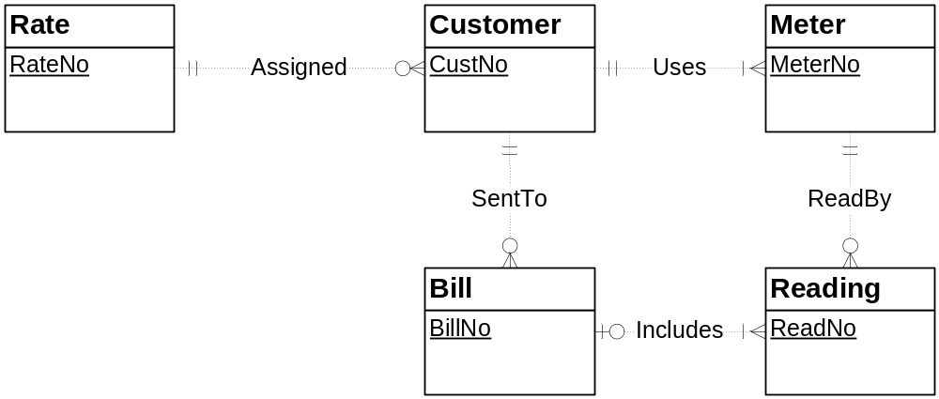
Relationship Identification Example
Notes:
Derivation of relationships
For the Assigned relationship, the narrative states that a customer has a rate, and many customers can be assigned the same rate. These two statements indicate a 1-M relationship from Rate to Customer. For the minimum cardinalities, the narrative indicates that a rate is required for a customer, and that rates are proposed before being associated with customers.
For the Uses relationship, the narrative states that a customer includes a collection of meters and a meter is associated with one customer at a time. These two statements indicate a 1-M relationship from Customer to Meter.
For the ReadBy relationship, the narrative states that a meter reading contains a meter number, and meters are periodically read. These two statements indicate a 1-M relationship from Meter to Reading.
For the SentTo relationship, the narrative indicates that the heading part of a bill contains a customer number and bills are periodically sent to customers. These two statements indicate a 1-M relationship from Customer to Bill.
The Includes relationship is 1-M because a bill may involve a collection of readings (one on each detail line), and a reading relates to one bill. s

Slide 12
Diagram Refinements
Construct initial ERD
Revise many times
Generate feasible alternatives and evaluate according to requirements
Gather additional requirements if needed
Use transformations to suggest feasible alternatives
Notes:
Data modeling is usually an iterative or repetitive process. You construct a preliminary data model and then refine it many times. In refining a data model, you should generate feasible alternatives and evaluate them according to user requirements. You typically need to gather additional information from users to evaluate alternatives. This process of refinement and evaluation may continue many times for large databases.

Slide 13
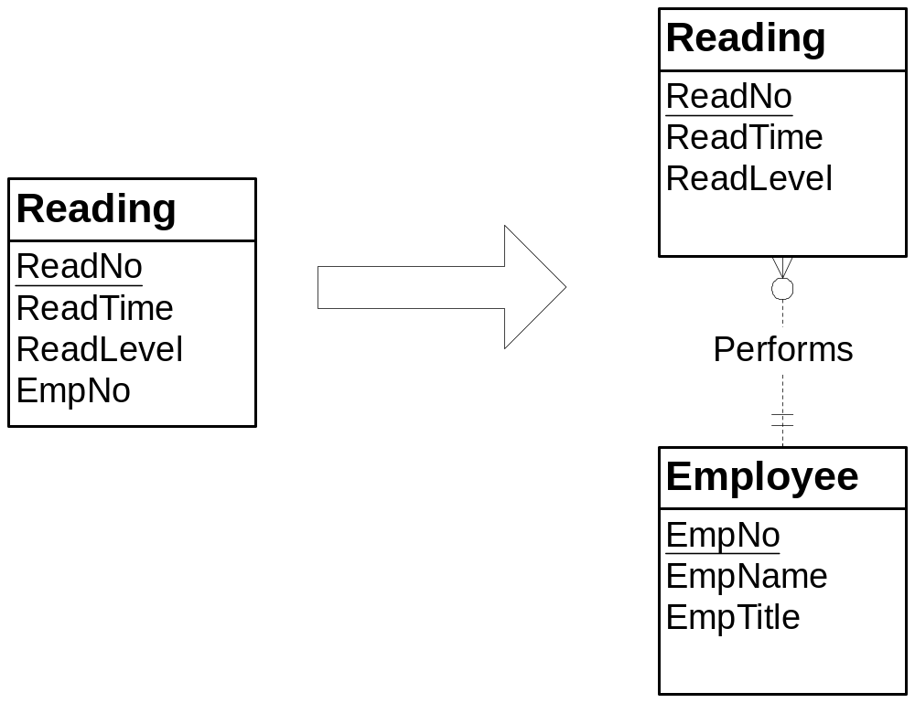
Attribute to Entity Type Transformation
Notes:
Allows more detail in an ERD
Design approach:
- Initial design: Reading only includes EmpNo
- Revised design: learn more about employee details important to the problem
- Add employee entity type

Slide 14
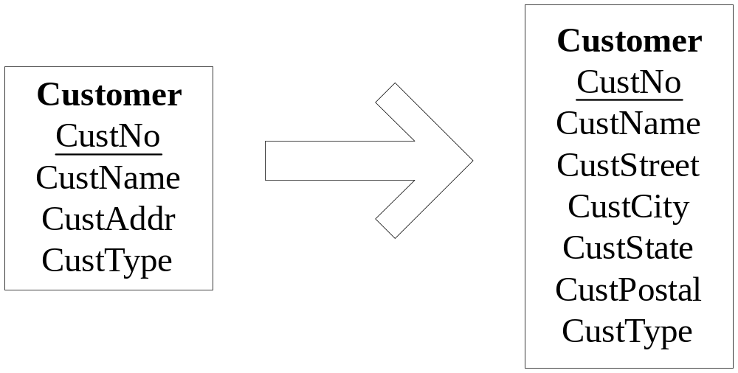
Compound Attribute Transformation
Notes:
Finer level of detail supports improved search:
- More difficult to search address (compound) because of lack of standardization
- Primitive attributes: easier to search about address details
- Initial design: compound attributes
- Revised design: split into smaller attributes

Slide 15
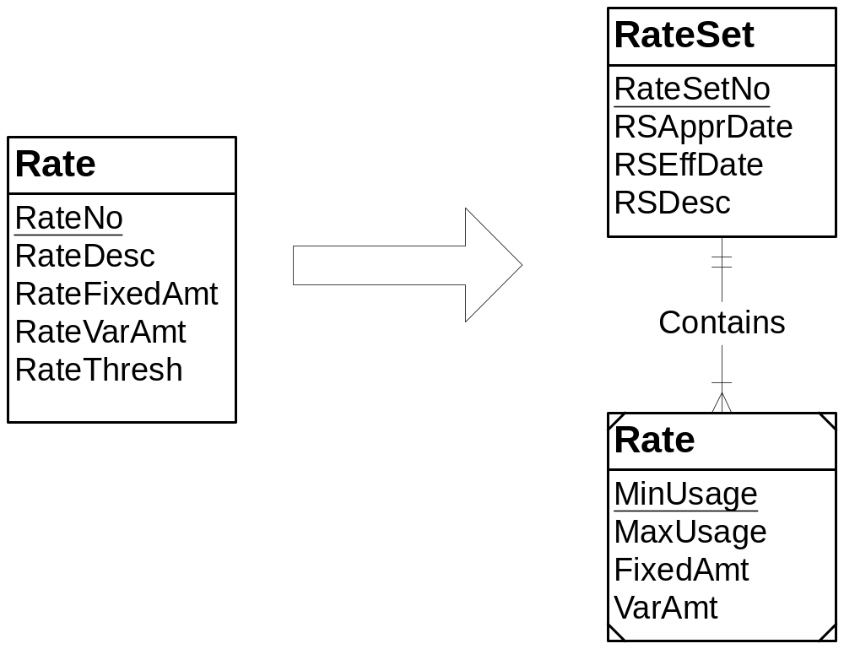
Entity Type Expansion Transformation
Notes:
Usage:
- Change in requirements
- Initially each rate contains a fixed and variable component
- Add multiple tiers of fixed and variable components for each rate
- Rates can be highly complex
- Lots of effort to understand requirements and represent correctly
- Identification dependency is not necessarily part of this transformation
- In this situation, identification dependency is reasonable

Slide 16
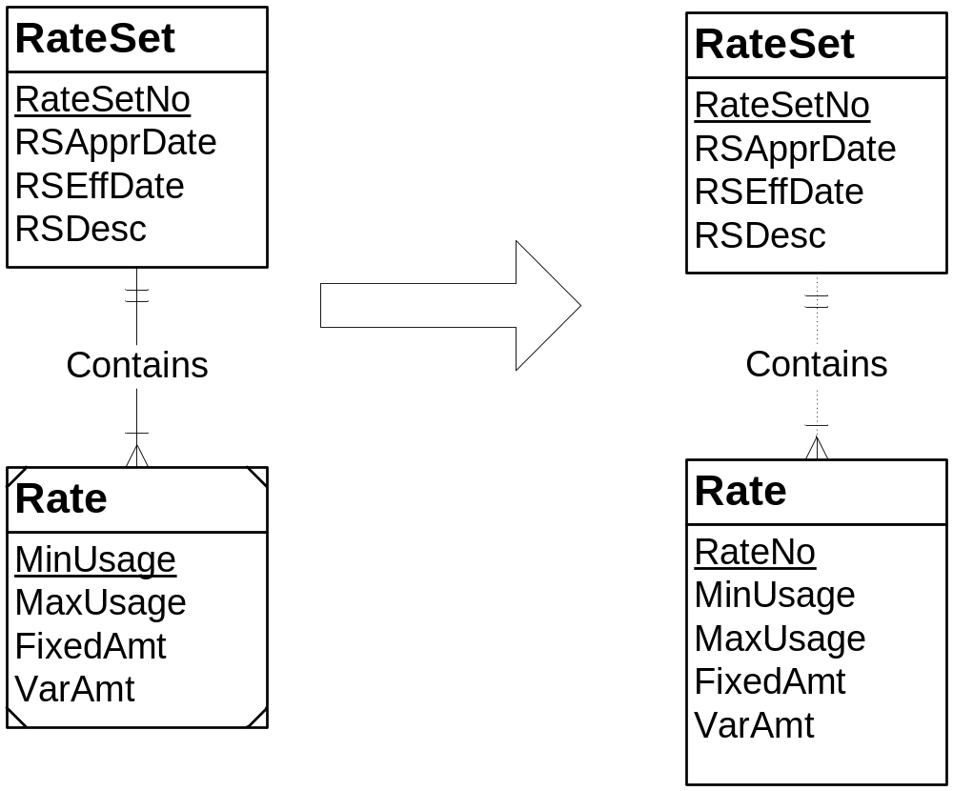
Weak to Strong Entity Transformation
Notes:
Usage:
- Facilitates references after conversion to a table design
- Table design involves a combined PK for a weak entity
- Most useful for associative entity types that are on the 1 side in other 1-M relationships
- Remove identification dependency symbols (identifying relationships and weak entity)
- Find a PK: can use INTEGER data type with DBMS generated values

Slide 17
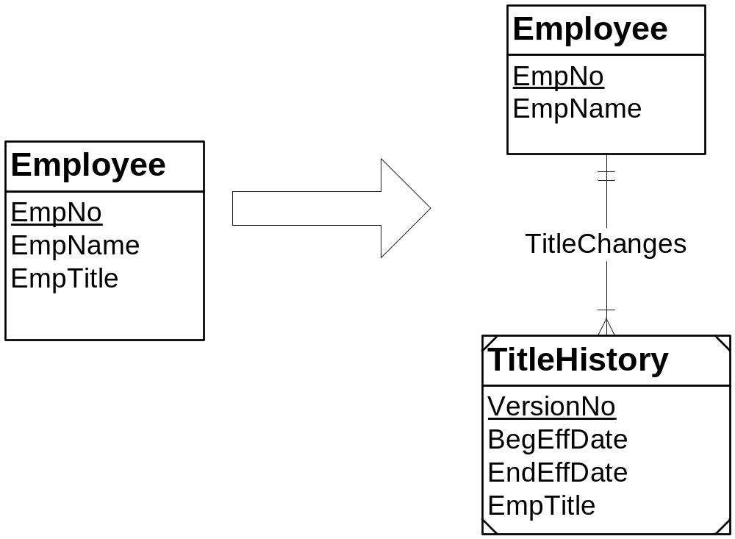
Attribute History Transformation
Notes:
Usage:
- May be necessary for legal requirements as well as strategic reporting requirements
- Can be done for attributes and relationships
- When applied to attributes, the transformation is similar to the attribute to entity type transformation
- EmpTitle attribute is replaced with an entity type and a 1-M relationship
Use version number as a local key
Record effective dates (beginning and ending) of change

Slide 18
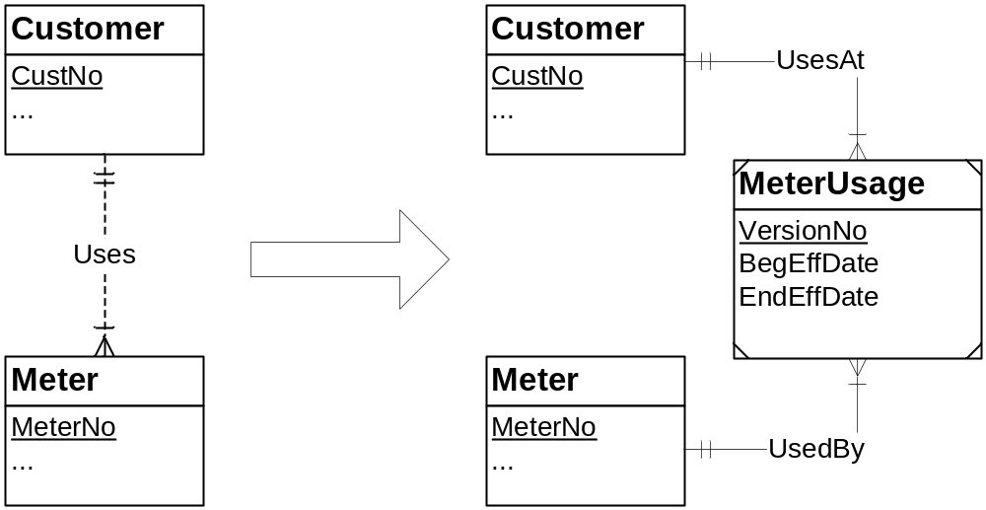
1-M Relationship Transformation
Notes:
When applied to a relationship, this transformation typically involves changing a 1-M relationship into an associative entity type and a pair of identifying 1-M relationships. The ERD depicts the transformation of the 1-M Uses relationship into an associative entity type with attributes for the version number and effective dates. The associative entity type is necessary because the combination of customer and meter may not be unique without a version number.

Slide 19
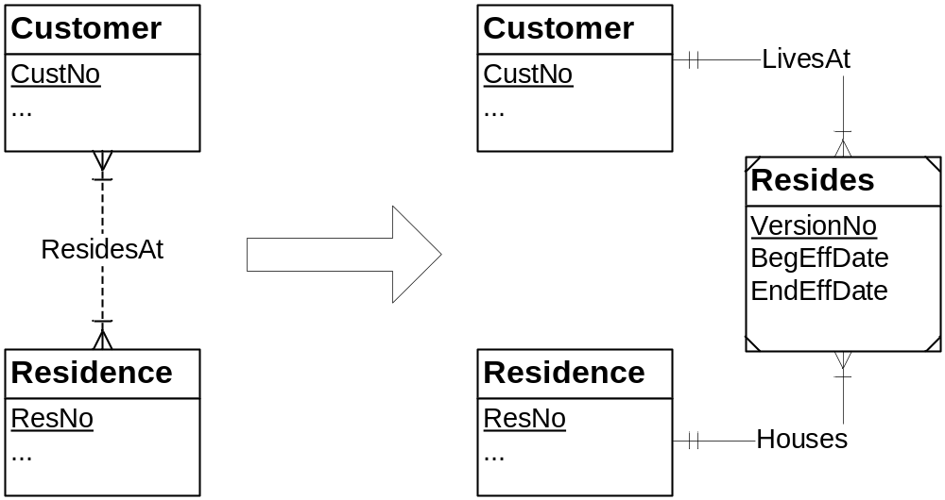
M-N Relationship Transformation
Notes:
When applied to an M-N relationship, this transformation involves a similar result. The ERD depicts the transformation of the M-N ResidesAt relationship into an associative entity type with a version number and effective change date attributes.

Slide 20
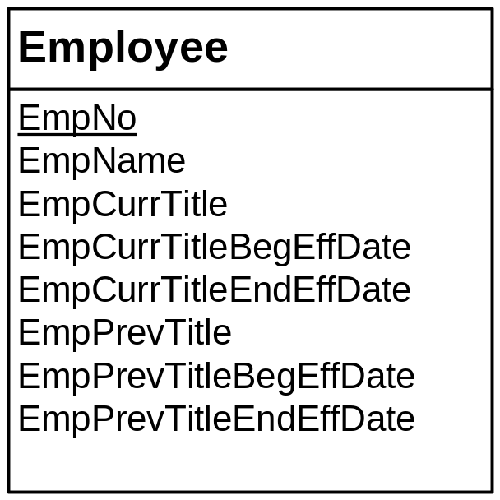
Limited History Transformation
Notes:
For a limited history, a fixed number of attributes can be added to the same entity type. For example, to maintain a history of the current and the most recent employee titles, two attributes (EmpCurrTitle and EmpPrevTitle) can be used as depicted in Figure 6.10. To record the change dates for employee titles, two effective date attributes per title attribute can be added.

Slide 21
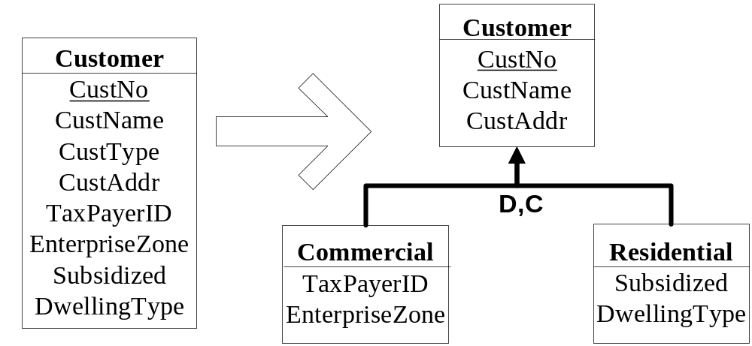
Generalization Hierarchy Transformation
Notes:
Usage of generalization hierarchy:
- Use this transformation sparingly because generalization hierarchies are specialized modeling tools
- Subtypes have specialized attributes that do not apply to all entity types
- Accepted classification of entity types
- Avoid null values
- Residential customers do not have taxpayerid and enterprise zone
- Instances of original Customer entity type have null values for specialized attributes

Slide 22
Summary of Transformations
Attribute to entity type
Compound attribute split
Entity type expansion
Weak entity to strong entity
Add history: attributes, 1-M relationships, and M-N relationships
Generalization hierarchy addition
Notes:
See Table 6-2 in the Chapter06FiguresTables file

Slide 23
Documenting an ERD
Important for resolving questions and communicating a design
Identify inconsistency and incompleteness in a specification
Identify situations when more than one feasible alternative exists
Do not repeat the details of the ERD
Incorporate documentation into the ERD
Notes:
A large specification typically contains many points of inconsistency and incompleteness. Recording each point allows systematic resolution through additional requirements gathering activities.
An information system can undergo a long cycle of repair and enhancement before there is sufficient justification to redesign the system. Good documentation enhances an ERD by communicating the justification for important design decisions.
If you are using an ERD tool that has a data dictionary, you should include design justifications in the data dictionary. The ER Assistant supports design justifications as well as comments associated with each item on a diagram. You can use the comments to describe the meaning of attributes.

Slide 24
Documentation with the ER Assistant
Attribute comments
Entity type comments
Relationship comments
Design justifications
Diagram notes
Notes:
Comments:
Enter in the editing window for entity types, attributes, and relationships
Attribute comments are most useful: units of measure, descriptive sentence, uniqueness
Entity type comments: combined candidate keys; descriptive sentence
Design justifications
Numbered
Arrange in the diagram so that the numbers indicate the applicable part of the ERD
Hide/Show design justifications
Explain choice among feasible alternatives; explain design subtleties
Diagram notes
Use for general information about the design (who, when, what, revision information)
Can hide/show

Slide 25
Common Design Errors
Misplaced relationships: wrong entity types connected
Incorrect cardinalities: typically using a 1-M relationship instead of a M-N relationship
Missing relationships: entity types should be connected directly
Overuse of specialized modeling tools: generalization hierarchies, identification dependency, self-referencing relationships, M-way associative entity types
Redundant relationships: derived from other relationships
Notes:
Design errors:
More difficult to detect and resolve than diagram errors
Design errors involve the meaning (semantics) of ERD components, not just the structure of components
Misplaced relationships:
In a large ERD, it is easy to connect the wrong entity types.
To help focus, you can look for clusters of entity types in which an entity type in the center is connected to other entity types.
Incorrect cardinality:
Typical error involves the usage of a 1-M relationship instead of a M-N relationship.
This error can be caused by an omission in the requirements.
Missing relationships:
Sometimes the requirements do not directly indicate a relationship
Consider indirect implications to detect whether a relationship is required.
Overuse of specialized modeling tools:
A typical novice mistake is to use them inappropriately.
Generalization hierarchies should not be used just because an entity can exist in multiple states.
An associative entity type representing an M-way relationship should be used when the database should record combinations of three (or more) objects rather than just combinations of two objects. In most cases, only combinations of two objects should be recorded.
Redundant relationships:
Cycles in an ERD may indicate redundant relationships. A cycle involves a collection of relationships arranged in a loop starting and ending with the same entity type.
In a cycle, a relationship is redundant if it can be derived from other relationships.

Slide 26
Resolving Design Errors
Misplaced relationships: use entity type clusters to reason about connections
Incorrect cardinalities: incomplete requirements: inferences beyond the requirements
Missing relationships: examine implications of requirements
Overuse of specialized modeling tools: only use when usage criteria are met
Redundant relationships: examine relationship cycles for derived relationships
Notes:
Misplaced relationships:
In a large ERD, it is easy to connect the wrong entity types.
To help focus, you can look for clusters of entity types in which an entity type in the center is connected to other entity types.
Incorrect cardinality:
Typical error involves the usage of a 1-M relationship instead of a M-N relationship.
This error can be caused by an omission in the requirements.
Missing relationships:
Sometimes the requirements do not directly indicate a relationship
you should consider indirect implications to detect whether a relationship is required.
Overuse of specialized modeling tools:
A typical novice mistake is to use them inappropriately.
Generalization hierarchies should not be used just because an entity can exist in multiple states.
An associative entity type representing an M-way relationship should be used when the database should record combinations of three (or more) objects rather than just combinations of two objects. In most cases, only combinations of two objects should be recorded.
Redundant relationships:
Cycles in an ERD may indicate redundant relationships. A cycle involves a collection of relationships arranged in a loop starting and ending with the same entity type.
In a cycle, a relationship is redundant if it can be derived from other relationships.

Slide 27
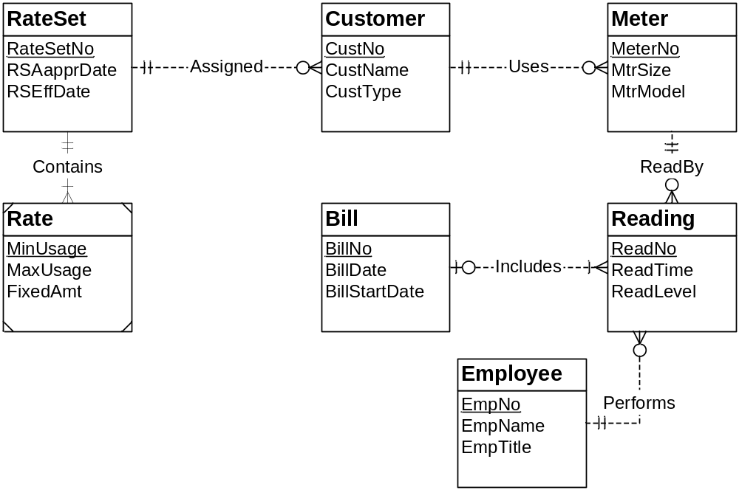
Example Entity Type Cluster
Notes:
Entity type cluster:
Star pattern with an entity type in the center with 1-M relationships
Simplifies connections among entity types
Reading is hub (center) or a cluster connecting Bill, Meter, and Employee
Other cluster examples:
Order entry database with Order connected to Customer, Employee, and Supplier
Hospital database with Visit connected to Patient, Physician, and Care Facility

Slide 28
Summary of Data Modeling Guidelines
Use notation precisely
Strive for simplicity
ERD connections
  Avoid over connecting the ERD
  Identify hub(s) of the ERD
Use specialized patterns carefully
Justify important design decisions
Notes:
Notation:
- Communication tool: poor communication if misused
- Avoid common errors (next page)
Simplicity:
- Start with simple design
- Use attributes instead of entity types
- Consider alternatives that add more detail
Connections:
- Common mistake: over connecting
- In small ERDs: one entity type is typically the hub
- In larger ERDs: multiple hub entity types
Specialized patterns:
- M-way relationships, self-referencing relationships, ID dependency, Gen hierarchies
- Not common
- Important when they occur
- Do not overuse: do not specifically look for specialized patterns
Design justifications:
- Design can be long-lived
- More than one feasible alternative
- Requirements that may be unclear: ambiguity and incompleteness are common

Slide 29
Summary of Basic Conversion Rules
Each entity type becomes a table.
Each 1-M relationship becomes a foreign key in the table corresponding to the child entity type (the entity type near the crow’s foot symbol).
Each M-N relationship becomes an associative table with a combined primary key.
Each identifying relationship adds a column to a primary key.
Notes:
For more details see textbook Chapter 6 (section 6.4.1)
Apply rules in order: all applications of rule 1, then rule 2, then rule 3, and rule 4.
Second rule: fundamental difference between models
M-N relationship becomes an associative table with a combined PK.

Slide 30
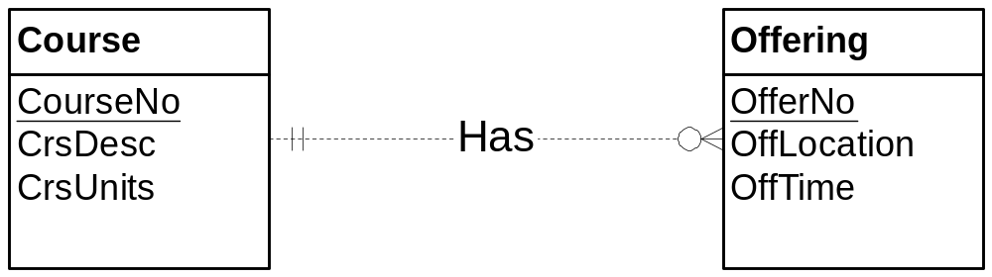
Application of Basic Rules (I)
CREATE TABLE Course (… PRIMARY KEY (CourseNo) )
CREATE TABLE Offering (… PRIMARY KEY (OfferNo), FOREIGN KEY (CourseNo) REFERENCES Course )
Notes:
Entity type rule:
- Two applications
- Convert PK and attributes in the table
1-M relationship rule:
- 1 application
- Offering.CourseNo becomes a FK in the child (M) table (Offering)

Slide 31
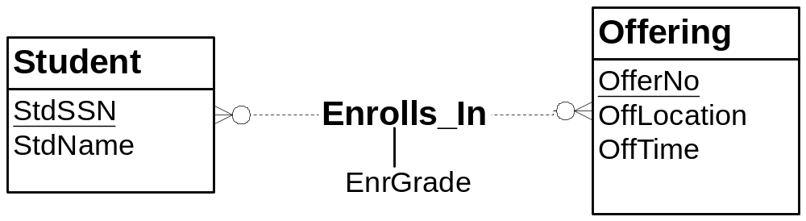
Application of Basic Rules (II)
CREATE TABLE Enrollment (…
PRIMARY KEY (StdSSN, OfferNo),
FOREIGN KEY (StdSSN) REFERENCES Student,
FOREIGN KEY OfferNo REFERENCES Offering )
Notes:
Enrolls_In conversion:
- Enrollment table: name change not necessary; use noun for table name
- Foreign keys: StdSSN and OfferNo

Slide 32
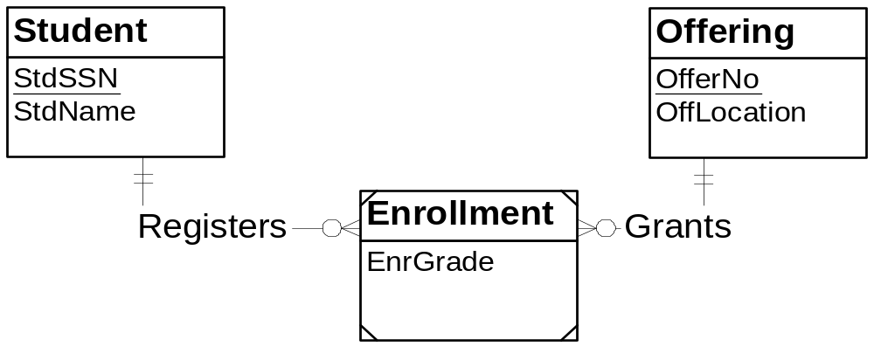
Application of Basic Rules (III)
Same conversion result as the previous slide
Different application of rules
Notes:
Conversion process:
- Entity type rule: 3 applications
- 1-M relationship rule: 2 applications (FKs in the Enrollment table)
- Identifying relationship rule: 2 applications
- Each application of the identifying relationship rule adds a PK component

Slide 33
Generalization Hierarchy Rule
Mimic generalization hierarchy as much as possible
  Each subtype table contains specific columns plus the primary key of its parent table.
  Foreign key constraints for subtype tables
  CASCADE DELETE option for referenced rows
Reduce need for null values
Need joins and outer joins to combine tables
Notes:
Generalization hierarchy rule:
- Simulate generalization hierarchy with tables and foreign keys
- Minimize null values in the tables
- Little redundancy except for PK: repeated for each subtype table
- CASCADE DELETE: delete parent, automatically delete rows in subtype tables
Combining tables:
- Join: combine table and all of its parent tables
- Full Outer join: combine a table with its sibling tables
Other conversion possibilities:
- One table: many null values but no need for join and outer join operations
- Combine some subtype tables: fewer tables, more nulls, fewer join and outer joins

Slide 34
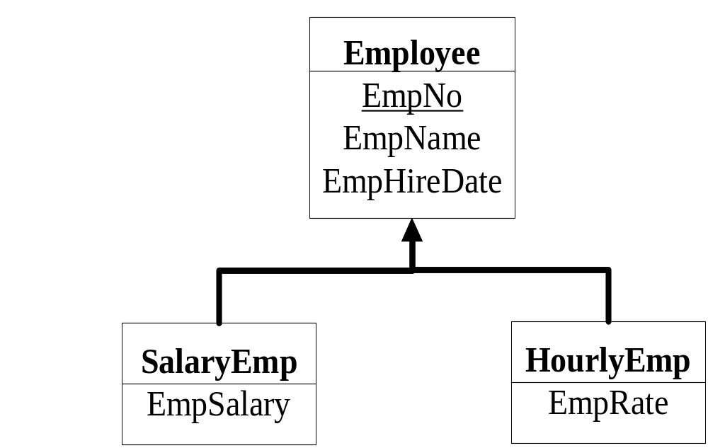
Generalization Hierarchy Example
Employee table: EmpNo (PK)
SalaryEmp table: EmpNo (PK), EmpNo (FK)
HourlyEmp table: EmpNo (PK), EmpNo (FK)
Notes:
CASCADE DELETE for Foreign Keys
- SalaryEmp
- HourlyEmp

Slide 35
Optional 1-M Rule
Separate table for each optional 1-M relationship
Avoids null values
Requires an extra table and join operation
Controversial: in most cases 1-M rule is preferred
Notes:
Optional 1-M relationship:
- Relationship in which min cardinality is 0
- No existence dependency
- Offering-Faculty: offering can be stored without a faculty assigned
- Order-Employee: order can be stored without an employee (internet order)
Rule:
- Optional 1-M relationship becomes a table instead of just a FK in the M table
- Avoids null values
- Adds another table and join operation to combine
- Rule is controversial
- Rule is not necessary
- 1-M relationship rule is more widely used for optional 1-M relationships

Slide 36
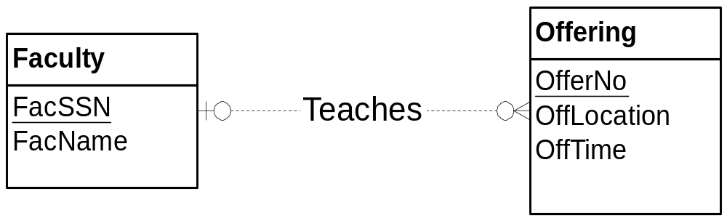
Optional 1-M Example
CREATE TABLE Teaches (… PRIMARY KEY (OfferNo) , FOREIGN KEY(OfferNo) REFERENCES Offering, FOREIGN KEY(FacSSN) REFERENCES Faculty )
Notes:
Other conversion:
- Faculty table
- Offering table: no FK
Teaches conversion:
- Teaches table
- OfferNo: PK
- FacSSN: FK
- No null values: Teaches only contains rows for Offerings with assigned faculty

Slide 37
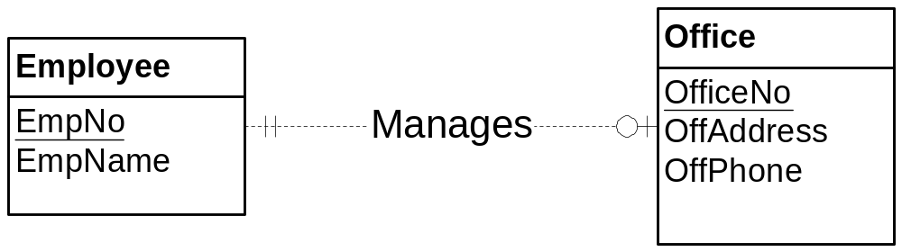
1-1 Relationships
CREATE TABLE Office (… PRIMARY KEY (OfficeNo) , FOREIGN KEY(EmpNo) REFERENCES Employee, UNIQUE (EmpNo) )
Notes:
1-1 relationships: not common
Use FKs in each mandatory 1-1 relationship:
- Can also use for optional 1-1 relationship but will have null values
- Office must have an employee: use FK in Office
- Employee must be assigned to an office: use FK in Employee
UNIQUE constraint:
- FK is unique because of the 1-1 relationship
- The same employee can be assigned to only one office.

Slide 38
Summary
Data modeling is an important skill
Use notation precisely
Preference for simpler designs
Consider alternative designs
Review design for common errors
Work many problems
Notes:
Data modeling
- Important skill
- Use notation precisely
- Problem solving requires careful consideration of alternatives
Advanced concepts:
- Avoid overuse: typical beginner's mistake
- Important when occur but not common

