Slide 1
CIS/CSC 384: Database Design
Understanding Entity Relationship Diagrams (Chapter 5)
Notes:
Welcome to Chapter 5 on Understanding Entity Relationship Models:
- First data modeling chapter
- Focused on the notation (syntax) not on the application of the ERD notation
- Chapter 6 emphasizes application of the notation
- Important skill for database development: data modeling
- Data modeling is challenging
- Ambiguity: part science, part art
- Opportunity for some creative problem solving
Objectives: understand notation
- Entity types, relationships, attributes
- Cardinalities
- Relationship patterns
- Generalization hierarchies
- Representation of business rules in an ERD
- Use notation to precisely
- Construct diagrams without notational errors
- Detect notational errors
- Explore CASE tools: ER Assistant

Slide 2
Outline
Notation basics
Understanding relationships
Generalization hierarchies
Business rule representation
Diagram rules
Alternative notations
Notes:
Basic notation:
- Entities
- Relationships
- Cardinalities
Understanding relationships:
- Identification dependency
- M-N relationships with attributes
- Self-referencing relationships
- M-way relationships
- Equivalence between M-N relationships and 1-M relationships
Generalization hierarchies:
- Notation: supertypes and subtypes, inheritance
- When to use
Representation of business rules
Formally in an ERD
Informally in associated documentation
Diagram rules:
- Completeness rules
- Consistency rules
- Support in the ER Assistant

Slide 3
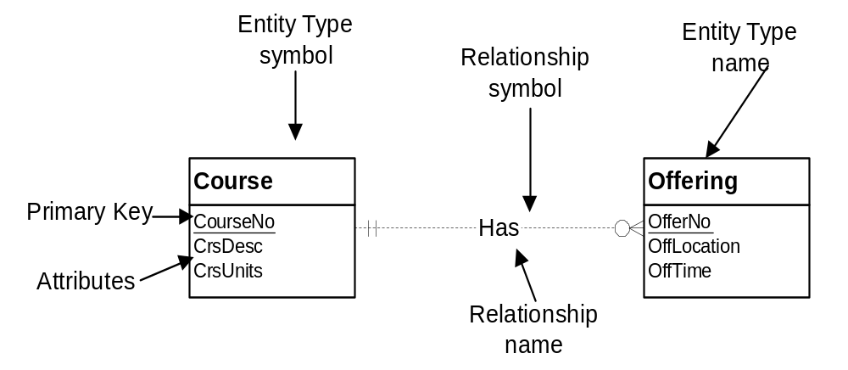
Basic Symbols
Notes:
Entity type:
- Collection of things of interest: persons, places, things, events
- Contains attributes: like columns
- Primary key
- Entity: instance or member of an entity type
Relationship:
- Named association among entities: name is significant (gives it more status)
- Similar to a foreign key in relational model except for name and cardinalities
- Usually between two entity types: can involve multiple entity types and one
- Bidirectional:
- Can be used to navigate in both directions
- Two names
- Course to Offering: Has, Provides
- Offering to Course: IsProvidedFor
- Which name to use: try to use active verb; not always possible
Attribute:
- Properties of entity types or relationships
- Data type to indicate the kind of values and permissible operations on the attribute
- Shown inside entity type or next to relationship

Slide 4
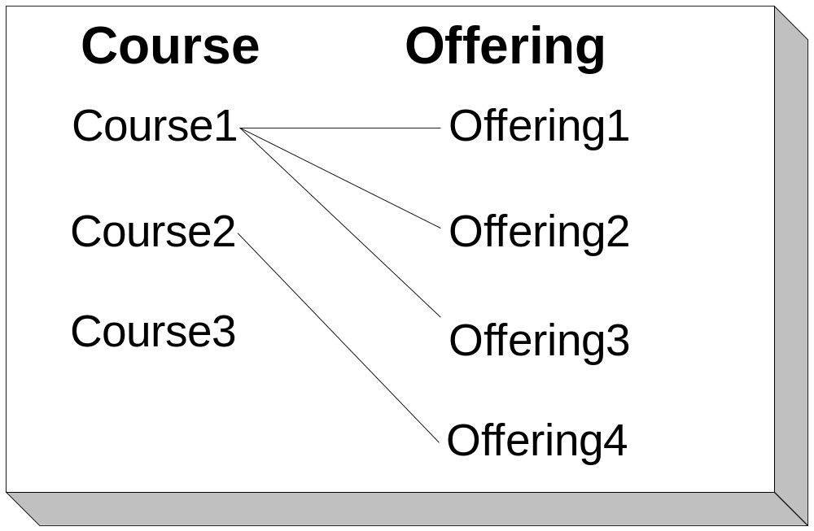
Cardinalities
Notes:
Definition:
- a constraint on the number of entities that participate in a relationship
- Specify the minimum and maximum cardinalities in both directions
Instance diagram:
- Shows occurrences of entity types (entities)
- Useful to understand some relationships (similar to sample table usage)
- Lines show relationships among entities
- Course1 related to Offering1, Offering2, and Offering3
- Course2 related to Offering4
- Course3 not related to any offerings
- Course related to a minimum of 0 and maximum of many
- Offering: each related to exactly one course

Slide 5
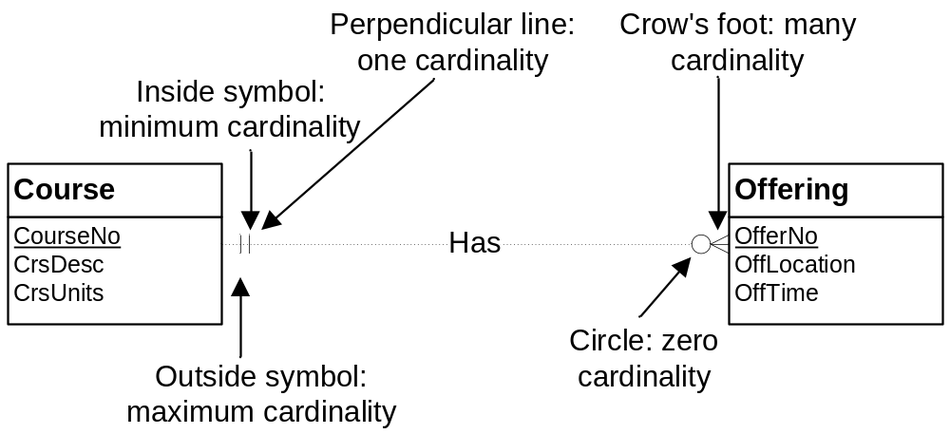
Cardinality Notation
Notes:
Symbols:
- Oval: means 0
- Perpendicular line: means 1
- Crow's foot: means many (0 or more); unconstrained
- Some drawing tools support exact cardinalities (numbers)
Placement:
- Inside symbol: minimum cardinality
- Outside symbol: maximum cardinality
- Interpret the far cardinality symbols: near the other entity type
- Course is related to a min of 0 and max of many offerings
- Offering is related to a min of 1 and max of 1 courses (exactly one)

Slide 6
Classification of Cardinalities
Minimum cardinality based
  Mandatory: existence dependent
  Optional
Maximum cardinality based
  Functional
  1-M
  M-N
  1-1
Notes:
Classification by common values for minimum and maximum cardinalities
Minimum cardinality based:
- Min cardinality of one: mandatory; makes entity types existent dependent
- Min cardinality of 0: optional; similar to a FK that allows null values
Maximum cardinality based:
- Functional: max cardinality of 1; mathematics based
- 1-M: max cardinalities are 1 and M
- M-N: max cardinalities are many in both directions
- 1-1: max cardinality is one in both directions (not common)

Slide 7
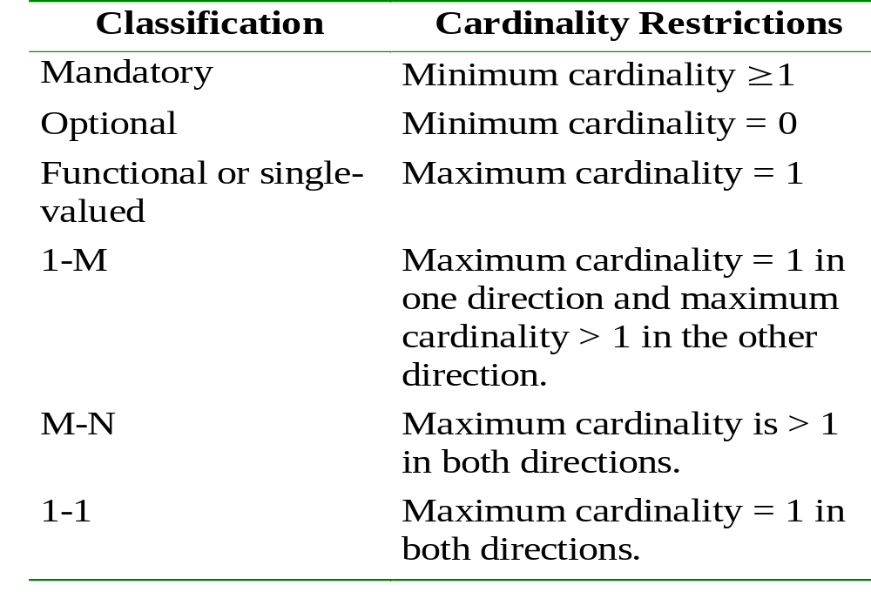
Summary of Cardinalities
Notes:
Existence dependency: an entity that cannot exist unless another related entity exists. A mandatory relationship produces an existence dependency.

Slide 8
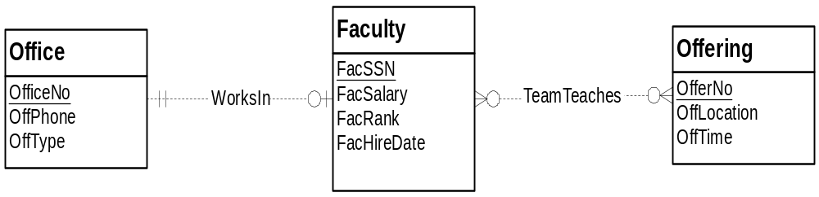
More Relationship Examples
Notes:
TeamTeaches:
- M-N
- Optional in both directions
WorksIn:
- 1-1
- Optional: office can be empty
- Mandatory: faculty must be assigned to an office

Slide 9
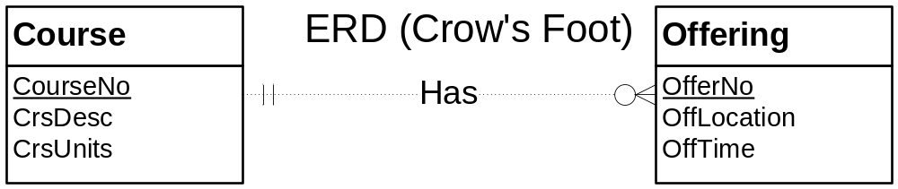
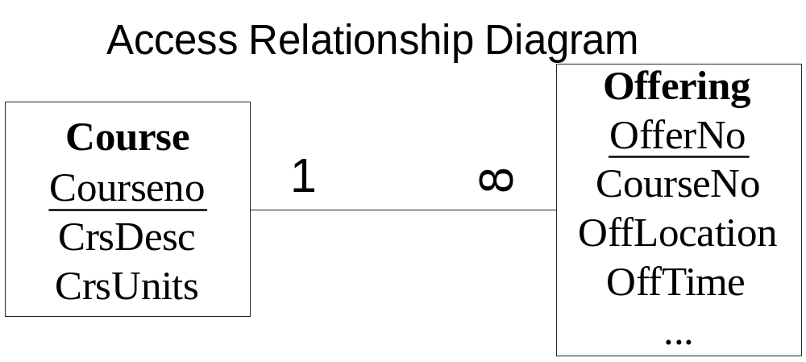
Comparison to Access Notation
Notes:
Skip slide if class has not yet covered chapter 3 on the relational data model
Differences:
- Preference rather than one model being more powerful
- Named relationships: no name in relational model (FKs instead)
- ERD does not need FKs: redundant with relationship
- No maximum cardinalities in relational model: M cardinality is implied by lack of FK
- Relationships with attributes: not permitted in the relational model

Slide 10
Understanding Relationships
Identification dependency
M-N relationships with attributes
Self identifying relationships
M-way relationships
Equivalence between M-N and 1-M relationships
Notes:
Understand relationships more deeply:
- 1-M relationships are most common
- To extend data modeling skills, learn more about relationships

Slide 11
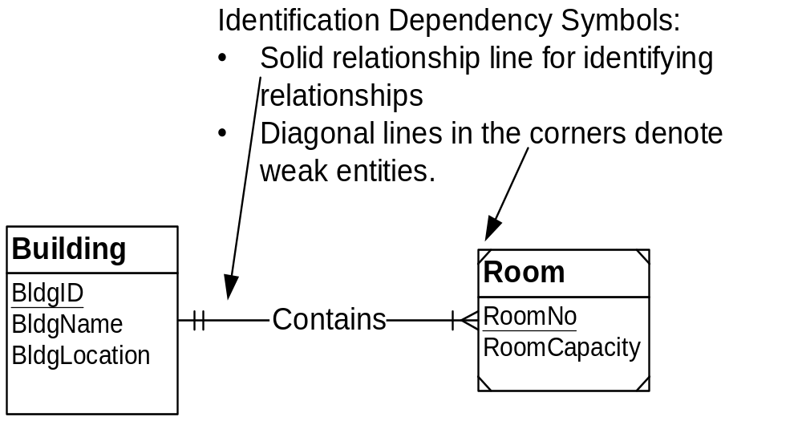
Identification Dependency
Notes:
Concept:
- Some entity types borrow part or entire PK
- Specialized concept: important when it occurs but not too common
- Similar to FK part of PK in relational model
- Closely related entities: physical containment
- Room is physically contained in a building
- Identification of room includes building
- Others: country-state, order-orderline
Symbols:
- Weak entity:
- Borrows part or all of PK
- Diagonal lines in the corners
- Identifying relationship:
- Solid line
- Indicates the source of PK
- Ambiguity if entity type participates in more than one relationship
Example:
- PK of Room is a combination of RoomNo (local key) and BldgID (borrowed attribute)
- Cardinality of weak entity in the identifying relationship must be 1-1
- Room cannot exist unless associated building exists
- Identification dependency involves existence dependency:
- Weak entity is existent dependent on other entity
- Also borrows part of all of PK

Slide 12
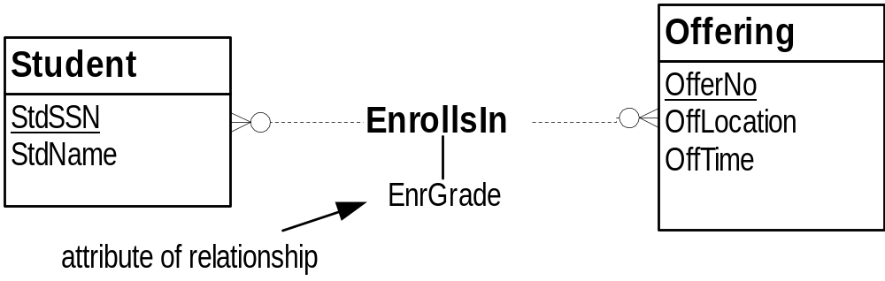
M-N Relationships with Attributes
Notes:
Relationships are first class citizens
- Can have attributes just like entity types
- Most typical for M-N relationships
- Attribute depends on both entity types, not just one entity type
- 1-M relationships with attributes is controversial
Example:
- EnrGrade: grade recorded for a student in a particular course
- Depends on the combination of Student and Offering
-EnrGrade is not part of the Student or Offering entity types

Slide 13
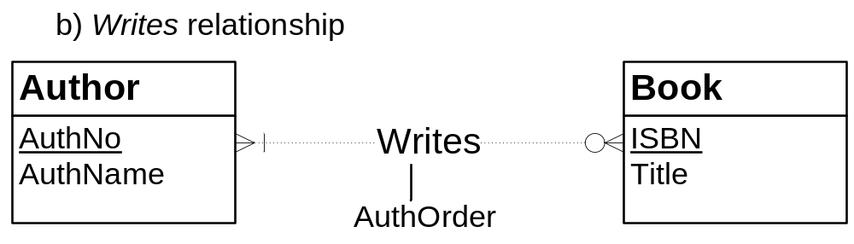
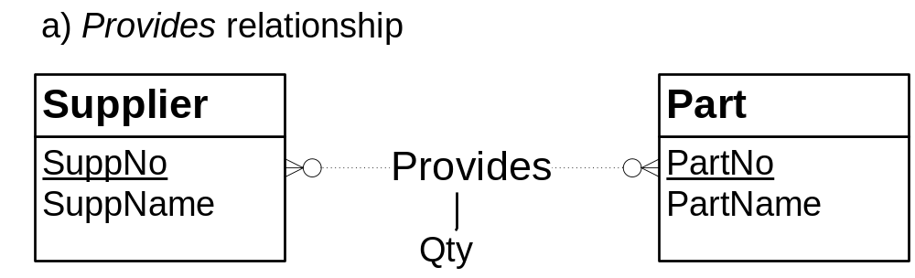
M-N Relationships with Attributes (II)
Notes:
AuthOrder: the order in which the author’s name appears in the title of a book
- Record order of authors: important in publishing disciplines
- AuthOrder is part of the Writes relationship (combination of Author and Book)
- AuthOrder is not part of the Author or Book entity types
Qty: quantity of part supplied by a supplier; quantity varies by part and supplier

Slide 14
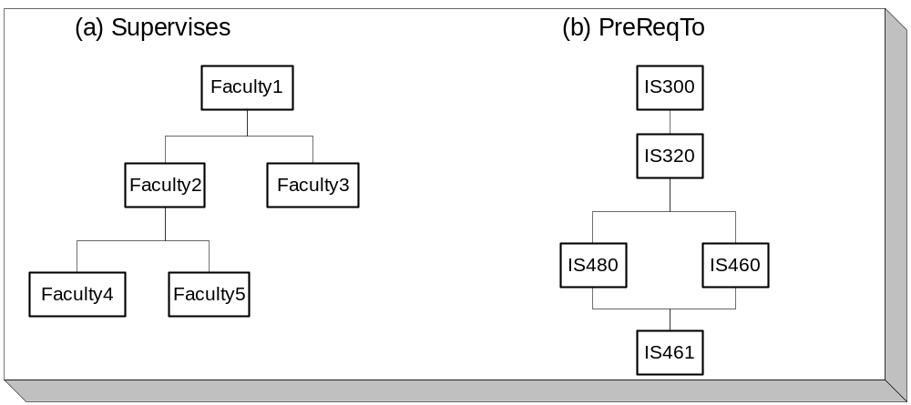
Instance Diagrams for Self-Referencing Relationships
Notes:
Basic idea:
- Associations among members of the same set
- Employees: supervisory relationships
- Courses: prerequisite structures
- Specialized concept: important when occurs but not too common
Instance diagram:
- Useful to depict self-referencing relationships
- 1-M self-referencing: at most one upward connection (traditional org chart)
- M-N self-referencing: more than one upward connection
- IS461 has multiple prerequisites (IS480 and IS460)
- IS320 is the prerequisite for multiple courses

Slide 15
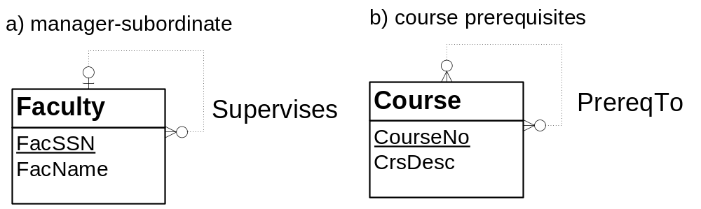
ERD Notation for
Self-Referencing Relationships
Notes:
Relationship connects entity type to itself
Position of cardinalities is not important: relationship involves the same entity type
Otherwise, nothing is different about self-referencing relationships
Key point:
- 1-M vs. M-N
- Use instance diagrams to help you reason

Slide 16
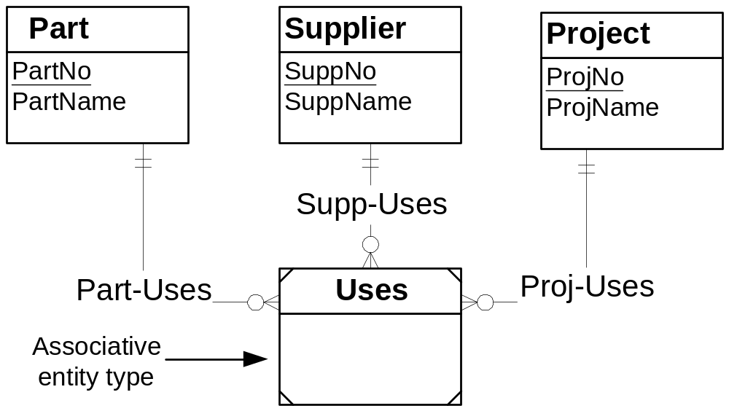
Associative Entity Types for
M-way Relationships
Notes:
Basic concept:
- Relationships can involve more than 2 entity types
- Specialized concept: important when occurs but not common
- Difficult concept: easy to use inappropriately
- Track interaction of 3 entity types: 3 way relationship
- 3 way relationship tracks who supplies a part on a specified project
- Do not use when only who supplies a part and what parts are used on which projects
- Local purchasing: suppliers chosen for each project rather than centrally
- Chapters 6, 7, and 12 provide guidelines to reason about the need for M-way relationships
ERD notation:
- Crow's Foot does not support M-way relationships
- Some ERD notations do support
- Use an associative entity type and identifying relationships
- Associative entity type:
- Weak entity that depends on two or more entity types
- Replacement for M-N or M-way relationship
- Usually borrows entire PK

Slide 17
Relationship Equivalence
Replace M-N relationship
  Associative entity type
  Two identifying 1-M relationships
M-N relationship versus associative entity type
  Largely preference
  Associative entity type is more flexible in some situations
Notes:
Similar to Relational Model representation:
- associative or linking table
- 2 FKs
Choice:
- Some students find associative entity type easier to understand than M-N relationship
- Neither representation is inherently better
- Associative entity type is more flexible in some situations (next slide)
Applies to M-way relationships
- Some ERD notations do not directly support M-way relationships such as the Crow’s Foot notation
- Replace with associative entity and M identifying 1-M relationships

Slide 18
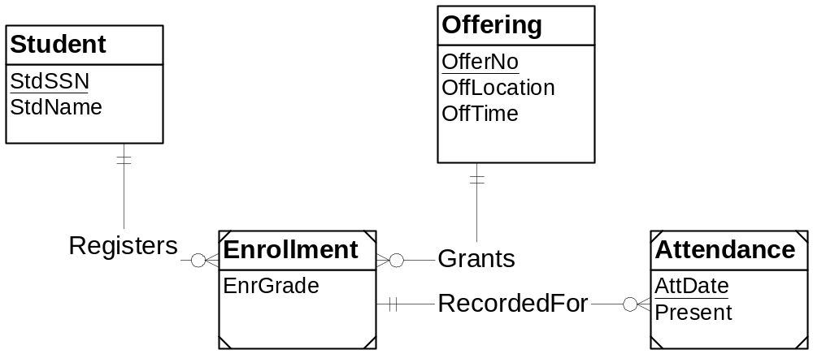
Associative Entity Type Example
Notes:
Enrollment:
- Associative entity type
- Represents M-N relationship between Student and Offering
Attendance:
- Weak entity
- PK: Combination of AttDate and PK of Enrollment
Must use associative entity type for Enrollment rather than M-N relationship:
- Relate Enrollment to other entity types (Attendance)
- Cannot connect a relationship to other relationships
- Use associative entity type when other relationships involved

Slide 19
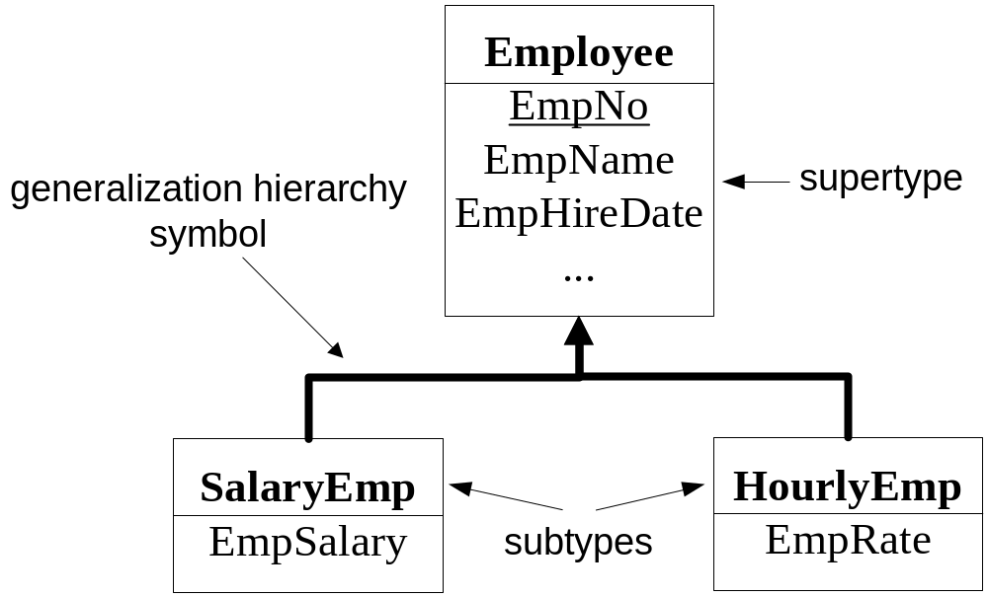
Generalization Hierarchies
Notes:
Classification:
- Group objects by similarity
- Pervasive in life and business:
- Understand animal species by similarity of characteristics
- Conduct business by classifying entities: investments, loans, customers, …
Generalization hierarchy:
- Shows similarity of entity types
- Differences in attributes: use when entity types have similar but different attributes
- Specialized technique: do not overuse; important when occurs but not common
Vocabulary:
- Supertype: parent entity type
- Subtype: child entity type (additional attributes)
- Generalization hierarchy: ISA (not an acronym)
- SalaryEmp IS AN Employee
- HourlyEmp IS AN Employee
Set inclusion:
- Subtypes are subsets of supertypes
- Set of SalaryEmp entities is a subset of Employee entities

Slide 20
Inheritance
Subtypes inherit attributes of supertypes (direct and indirect)
Allows abbreviation of attribute list
Applies to code (methods) as well as attributes (data)
Notes:
Inheritance related to sharing of characteristics (data and code)
First developed for object-oriented programming languages:
- Reduce the amount of code by inheriting code from similar objects
- Later applied to databases
- Chapter 18 on object database management
Notation:
- Do not show inherited attributes
- Assume existence: SalaryEmp includes all attributes of Employee
- Sometimes exception for PK: for emphasis can show it

Slide 21
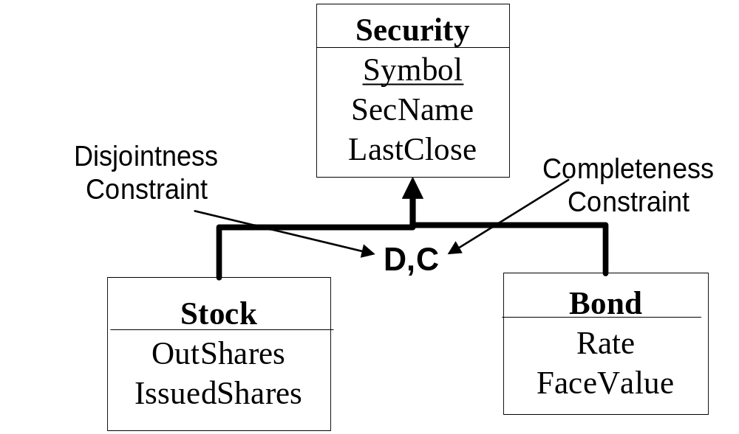
Generalization Constraints
Notes:
Cardinality of generalization hierarchy:
- No need to specify
- Subtype: min and max cardinalities are both 1
- Supertype: min cardinality is zero or one; max cardinality is one
Disjointness:
- Subtypes have common entities:
- D means intersection is empty
- No symbol means intersection is not empty: Faculty and Student
Completeness:
- Supertype have free standing entities (not in any subtype)
- C: Complete; union of subtype entities is the set of supertype entities
- Nothing: supertype can have free standing entities; Union of subtypes has few entities than supertype

Slide 22
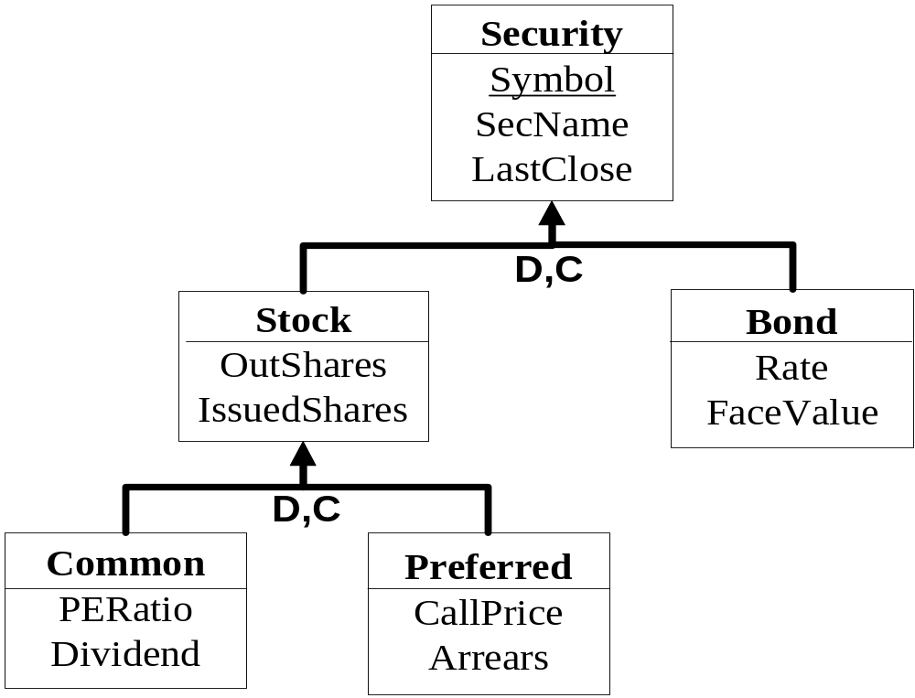
Multiple Levels of Generalization
Notes:
Each subtype inherits from direct and indirect supertypes
- Common inherits from Stock and Security
Provide constraints for each level of generalization hierarchy
Specialized technique:
- Need for multiple levels is less common than a single level
- Do not overuse generalization hierarchies
- Use only to show similarity among attributes

Slide 23
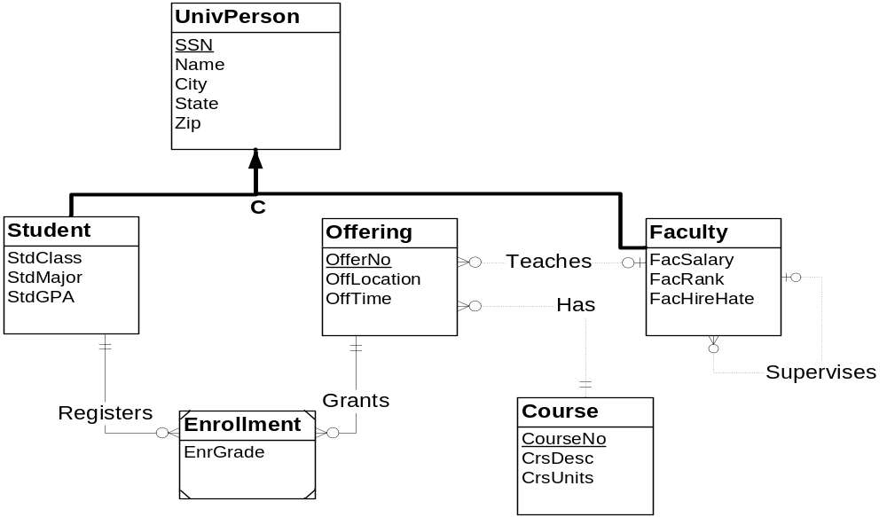
Comprehensive Example
Notes:
Demonstrates most of the notation previously shown
- 1-M relationships: Has, Teaches, Supervises, Registers, Grants
- Optional relationships: Teaches, Supervises
- Mandatory relationship: Has, Registers, Grants
- Self referencing relationship: Supervises
- Weak entity (also associative entity type): Enrollment
- Identifying relationships: Registers, Grants
- Generalization hierarchy: UnivPerson, Student, Faculty
- Could apply relationship equivalence to transform Enrollment, Registers, and Grants into a M-N relationship with an attribute

Slide 24
Business Rules
Enforce organizational policies
Promote efficient communication
Formal representation in ERD
Informal representation in documentation associated with an ERD
Use rules language to formally represent in relational database after conversion
Notes:
Rules language:
Possible to have a rule language with the ERD
Since relational model has a rules language, no need to use with ERD
Rule representation in relational model: PK, FK, Unique constraint, CHECK constraints (Chapter 14), and triggers (Chapter 11)

Slide 25
Formal Representation
Primary key constraints: entity identification
Named relationships: direct connections among business entities
Identification dependency: knowledge of other entities for identification
Cardinalities: restrict number of related entities in a business situation
Generalization hierarchies: classification of business entities and organizational policies
Notes:
Primary keys support entity identification, an important requirement in business communication. Identification dependency involves an entity that depends on other entities for identification, a requirement in some business communication. Relationships indicate direct connections among units of business communication. Cardinalities restrict the number of related entities in relationships supporting organizational policies and consistent business communication. Generalization hierarchies with disjointness and completeness constraints support classification of business entities and organizational policies. Thus, the elements of an ERD are crucial for enforcement of organizational policies and efficient business communication.

Slide 26
Informal Representation
Specify as documentation associated elements of an ERD
Candidate key constraints: alternate ways to identify business entities
Reasonable values: fixed collection of values or consistent with another attribute
Null value constraints: data collection completeness
Default values: simplify data entry and provide value when unknown
Notes:
In the absence of a formal rules language, business rules can be stored as informal documentation associated with entity types, attributes, and relationships. Typical kinds of business rules to specify as information documentation are candidate key constraints, attribute comparison constraints, null value constraints, and default values. Candidate keys provide alternative ways to identify business entities. Attribute comparison constraints restrict the values of attributes either to a fixed collection of values or to values of other attributes. Null value constraints and default values support policies about completeness of data collection activities.

Slide 27
Diagram Rules
Ensure that ERD notation is correctly used
Similar to syntax rules for a computer language
Completeness rules: no missing specifications
Consistency rules: no conflicts among specifications
Supported by the ER Assistant
Notes:
Apply these rules when completing an ERD to ensure that there are no notation errors in your ERD
Similar to syntax rules for a computer language:
Ensures proper language structure, not correct meaning
Diagram rules ensure proper structure among symbols
Do not ensure that you have considered multiple alternatives, correctly represented user requirements, and properly documented your design
Completeness rules: no missing symbols or specifications
Consistency rules: no conflicts among symbols or specifications
Second version of ER Assistant supports the diagram rules

Slide 28
Completeness Rules
Primary Key Rule: all entity types have a PK (direct, indirect, or inherited)
Naming Rule: all entity types, relationships, and attributes have a name
Cardinality Rule: cardinality is specified in both directions for each relationship
Entity Participation Rule: all entity types participate in an at least one relationship except for entity types in a generalization hierarchy
Generalization Hierarchy Participation Rule: at least one entity type in a generalization hierarchy participates in a relationship
Notes:
Completeness rules: no missing specifications
The first three rules are mandatory. A finished ERD should not violate the PK, Naming, and Cardinality rules.
PK rule:
Direct: Table contains the primary key attribute(s)
Indirect: Table borrows (id dependent) for part or all of PK
Inherited: Table inherits PK from a supertype
The next two rules are optional. Most ERDs will not violate the Entity Participation and Generalization Hierarchy Participation rules.
Rule 5 applies to an entire generalization hierarchy, not to each entity type in a generalization hierarchy. In other words, at least one entity type in a generalization hierarchy should be connected to at least one entity type not in the generalization hierarchy. In many generalization hierarchies, multiple entity types participate in relationships. Generalization hierarchies permit subtypes to participate in relationships thus constraining relationship participation.

Slide 29
Primary Key Rule Issue
Primary key rule is simple in most cases
For some weak entities, the PK rule is subtle
  Weak entity with only one 1-M identifying relationship
  Weak entity must have a local key to augment the borrowed PK from the parent entity type
  Violation of PK rule if local key is missing
Notes:
In some cases, weak entities must contribute partially to PK.
Weak entities with a single 1-M identifying relationship
Must provide a local key to augment borrowed PK from the parent entity type
Borrowed PK alone cannot identify weak entity instances because there can be many weak entity instances related to the same parent entity
Violation of the PK rule if a local key is not provided
Associative entity types do not need to provide a local key although they can if needed

Slide 30
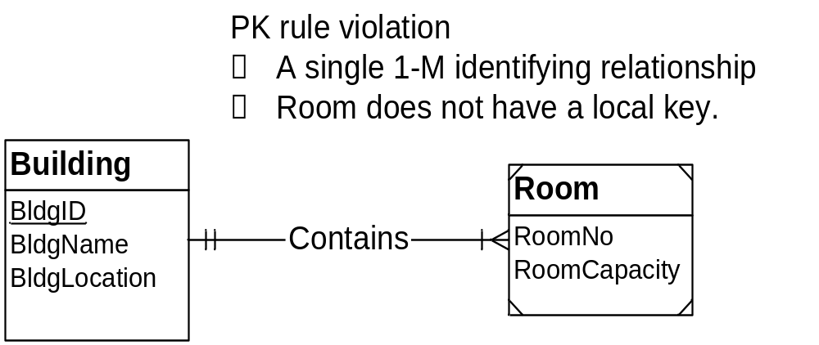
PK Rule Violation Example
Notes:
Room violates the PK rule
A single 1-M identifying relationship
Does not provide a local key to augment the borrowed PK (BldgId)

Slide 31
Naming Consistency Rules
Entity Name Rule: entity type names must be unique
Attribute Name Rule: attribute names must be unique within each entity type and relationship
Inherited Attribute Rule: attribute names in a subtype do not match inherited (direct or indirect) attribute names.
Notes:
Consistency rules: no conflicting specifications
Naming rules: no conflict among names
Entity names must be unique
Attribute names must be unique within each entity type and relationship
Inherited attribute names (direct or indirect) should not conflict with local attribute names; indirect inheritance is from an ancestor that is not a direct parent

Slide 32
Relationship Names
No uniqueness requirement
Participating entities provide a context for relationship names
Use unique names as much as possible to distinguish relationships
Must provide unique names for multiple relationships between the same entity types
Notes:
The consistency rules do not require unique relationship names because participating entity types provide a context for relationship names. However, it is good practice to use unique relationship names as much as possible to make relationships easy to distinguish. In addition, two or more relationships involving the same entity types should be unique because the entity types no longer provide a context to distinguish the relationships. Since it is uncommon to have more than one relationship between the same entity types, the consistency rules do not include this provision.

Slide 33
Connection Consistency Rules
Relationship/Entity Connection Rule: relationships connect two entity types (not necessarily distinct)
Relationship/Relationship Connection Rule: relationships are not connected to other relationships
Redundant Foreign Key Rule: foreign keys are not used.
Notes:
Connection Consistency rules: no conflicts or redundancies among relationships
Relationship formation rules:
Connect two entity types (not necessarily distinct)
Do not connect relationships directly (connect through entity types)
Self referencing relationships: connect the same entity type two times
Redundant foreign key rule:
Foreign keys are redundant with 1-M relationships
Use FKs in the relational model, not in ERDs
Violation of this rule is common: confusion between the ERDs and relational table design
Conversion replaces relationships with foreign keys
How to detect redundant FKs:
- Column in a child entity type (entity type on the M side of the relationship) for a column name that matches the PK of the parent entity type (entity type on the 1 side of the relationship)

Slide 34
Identification Dependency Rules
Weak entity rule: weak entities have at least one identifying relationship
Identifying relationship rule: at least one participating entity type must be weak for each identifying relationship
Identification dependency cardinality rule: the minimum and maximum cardinality must equal 1 for a weak entity in all identifying relationships
Notes:
Identification Dependency Rules:
no conflicts among components of identification dependency (weak entity, identifying relationships, cardinality specification)
Common source of diagram errors
Weak entity rule
At least one identifying relationship
Cannot be a weak entity without at least one identifying relationship
Identifying relationship rule:
At least one participating relationship must be weak
Not an identifying relationship if there is not a weak entity
Identification dependency cardinality rule:
Minimum and maximum cardinality must (1,1) for a weak entity in all identifying relationships
(1,1) cardinality should appear near the parent entity type
Common source of diagram errors

Slide 35
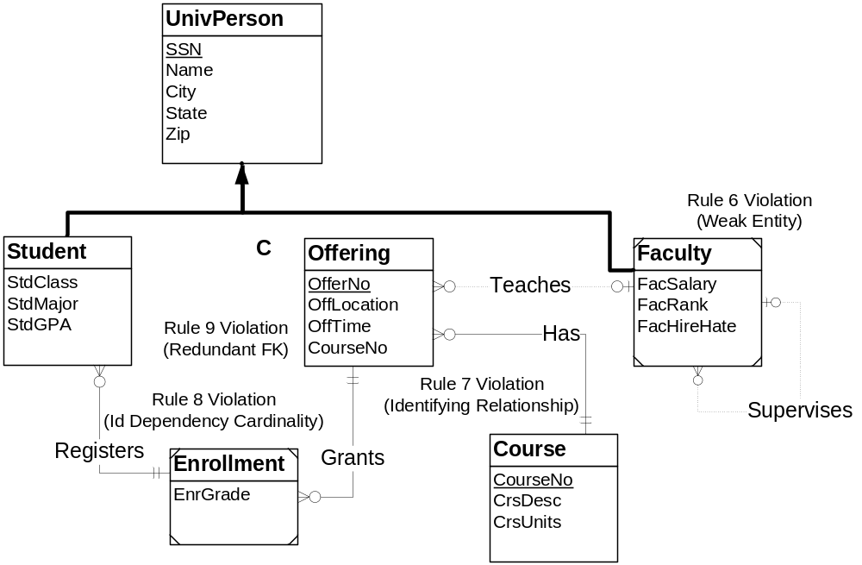
Example of Diagram Errors
Notes:
Weak entity rule violation:
Faculty is a weak entity but it is not involved in any identifying relationships
Resolution: remove weak entity symbols
In some cases, resolution involves changing a relationship to identifying
Identifying relationship rule violation:
Has is an identifying relationship but neither Offering nor Course is a weak entity
Resolution: make Has a regular (non-identifying) relationship
Sometimes resolution involves making an entity type weak
Identification Dependency Cardinality rule:
The min/max cardinality of the Registers relationship should be (1,1) near Student
Resolution: reverse the cardinalities on the Registers relationship
Sometimes the resolution does not involve reversing the cardinality but just changing one cardinality specification
Redundant foreign key rule:
CourseNo in Offering is redundant with the Has relationship
Resolution: remove the CourseNo attribute in Offering
This rule can be violated even if the FK attribute has a different name than associated PK. It is more difficult to detect a redundancy if the FK has a different name.

Slide 36
Corrected ERD
Notes:
Weak entity rule violation:
Faculty is a weak entity but it is not involved in any identifying relationships
Resolution: remove weak entity symbols
In some cases, resolution involves changing a relationship to identifying
Identifying relationship rule violation:
Has is an identifying relationship but neither Offering nor Course is a weak entity
Resolution: make Has a regular (non-identifying) relationship
Sometimes resolution involves making an entity type weak
Identification Dependency Cardinality rule:
The min/max cardinality of the Registers relationship should be (1,1) near Student
Resolution: reverse the cardinalities on the Registers relationship
Sometimes the resolution does not involve reversing the cardinality but just changing one cardinality specification
Redundant foreign key rule:
CourseNo in Offering is redundant with the Has relationship
Resolution: remove the CourseNo attribute in Offering
This rule can be violated even if the FK attribute has a different name than associated PK. It is more difficult to detect a redundancy if the FK has a different name.

Slide 37
Support in the ER Assistant
Relationship formation rules are supported by diagram construction
Other rules are supported by the Check Diagram feature
For the Redundant Foreign Key rule, the ER Assistant detects FKs that have the same name as the associated PKs
Notes:
ER Assistant support:
Construction of diagrams ensures that relationships connect two entity types (not necessarily distinct
Check diagram button generates a report for violations of the other rules
ER Assistant does not force corrections

Slide 38
ERD Variations
No standard ERD notation
Symbol variations
Placement of cardinality symbols
Rule variations
Be prepared to adjust to the ERD notation in use by each employer
Notes:
No ERD standard:
Many notations: too many; source of confusion
Many variations of a given notation: many variations of the Crow’s Foot notation
Crow’s foot notation is widely used but it has many variations
Symbol variations:
Different symbols for entity types, relationships, and attributes
Different symbols for identification dependency and generalization hierarchies
Different definitions for commonly used terms: existent dependent is defined incorrectly by some authors to mean identification dependency
No standard placement for cardinality symbols
Be flexible with ERD notation: you need to adjust to the notation at use by each employer

Slide 39
ERD Rule Variations
Lack of ERD standards
M-way relationships
M-N relationships
Relationships with attributes
Self-referencing relationships
Relationships connected to other relationships
Adapt to notations in work environments
Notes:
Use notation precisely
Notations controlled by CASE tools
Expect to see variations because of lack of ERD standards: be adaptable
Some notations do not support M-way relationships.
Some notations do not support M-N relationships.
Some notations do not support relationships with attributes.
Some notations do not support self-referencing (unary) relationships.
Some notations permit relationships to be connected to other relationships.
Some notations show foreign keys as attributes.
Some notations allow attributes to have more than one value (multi-valued attributes).

Slide 40
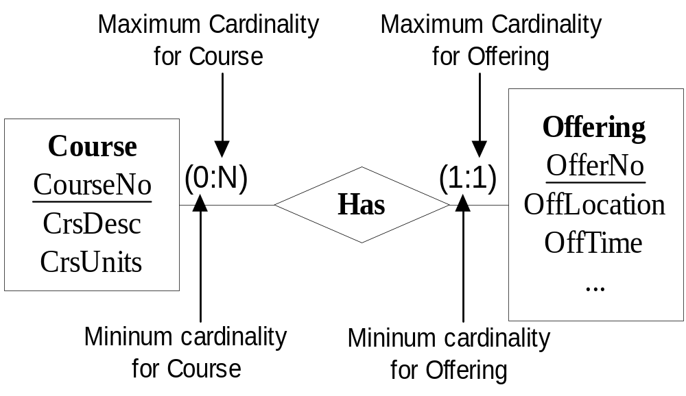
Chen ERD Notation
Notes:
Original ERD notation
Widely known and used
Variations:
Different relationship symbols
Reversed cardinality positions
Attributes are sometimes shown in ovals attached to entity types and relationships
M-way relationships supported
Different symbol for associative entity types and weak entities

Slide 41
Unified Modeling Language
Standard notation for object-oriented modeling
  Objects
  Object features
  Interactions among objects
UML supports class diagrams, interface diagrams, and interaction diagrams
More complex than ERD notation
Notes:
Object-oriented modeling is a separate subject
Can be studied as part of object-oriented programming and as part of a systems analysis course
Class diagrams are an alternative to ERDs
Class diagrams should be studied as part of the entire UML, not just as an alternative to data modeling
Need an entire course (or more) to study the UML

Slide 42
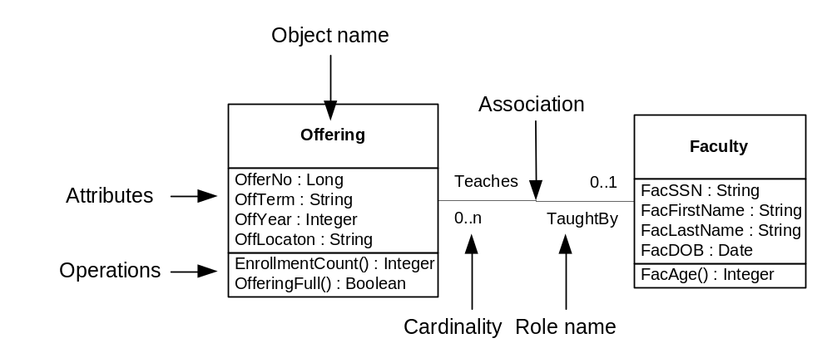
Simple Class Diagram
Notes:
Operations depicted because the UML involves not just data modeling but also process modeling
Association is similar to a relationship
Two role names

Slide 43
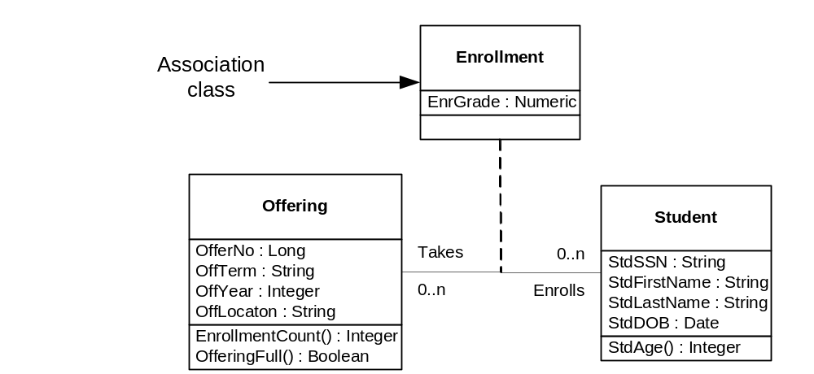
Association Class
Notes:
Association class: similar to a M-N relationship with attributes

Slide 44
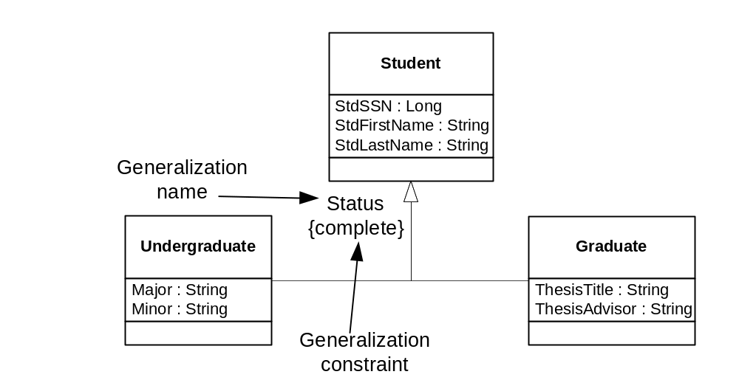
Generalization Relationship
Notes:
Generalization and inheritance are original features of the UML, not added later as generalization hierarchies are for ERDs

Slide 45
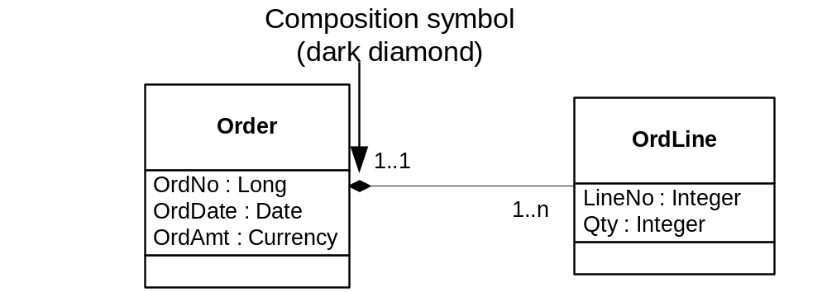
Composition Relationship
Notes:
Composition is similar to identification dependency
Dark diamond for a composition class

Slide 46
Summary
Data modeling is an important skill
Crow’s Foot ERD notation is widely used
Use notation precisely
Use the diagram rules to ensure structural consistency and completeness
Understanding the ERD notation is a prerequisite to applying the notation on business problems
Notes:
Data modeling
- Most important skill for database design
- Must understand the notation before you can apply it well
- Chapter 6 covers the application of the notation
- Important to use the notation precisely just as you use a programming language
precisely
- Diagram rules cover structure (similar to syntax for text language)
- Use the diagram rules by yourself and with Check Diagram feature of the ER Assistant

