Slide 1
CIS/CSC 384: Database Design
Introduction to Database Development
Notes:
Welcome to Chapter 2
- Introduction to database development: background for Part 3 and 4 chapters
Objectives:
- Descriptive chapter: no specific skills
- Understand relationship of information systems development and db development
- Describe goals of database development
- Grasp the steps of the db development process
- Explore CASE tools: functions typically provided

Slide 2
Outline
Context for database development
Goals of database development
Phases of database development
CASE tools
Notes:
Context:
- Information systems development
- Graphical models
Goals:
- Broad objectives
- General guidelines of desired results; not quantifiable
Phases:
- Inputs, outputs of each phase
- Skill requirements
CASE tools:
- Classification of features
- ER Assistant

Slide 3
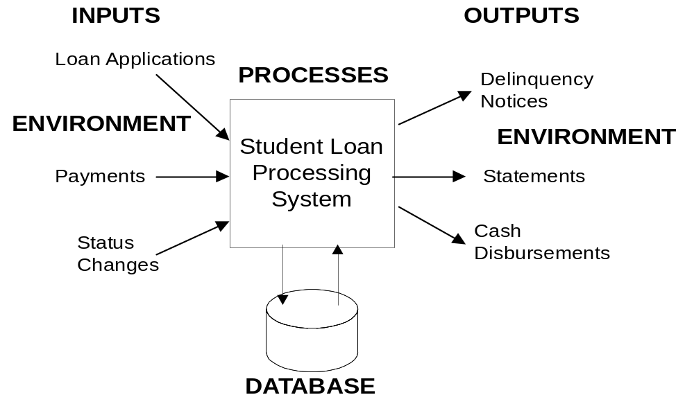
Information System
Notes:
Information system:
- Accepts data from its environment, processes data, and produces output data
for decision making
- Interacts with environment
- Database provides the long-term memory
- Database is a key component but not the only component
- Other components: inputs, outputs, processes, software, hardware, people
- Developing info system more than db development
Student Loan System:
- Full case study in Chapter 13
- Environment: lenders, students, government agencies

Slide 4
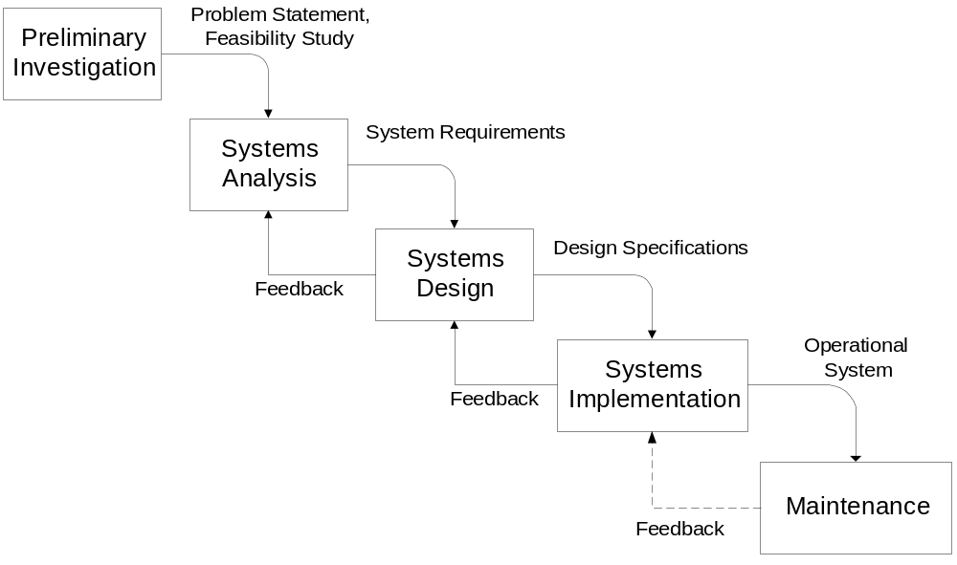
Traditional Life Cycle
Notes:
Figure 2.2 shows the phases of the traditional systems development life cycle. The particular phases of the life cycle are not standard. Different authors and organizations have proposed from 3 to 20 phases. The traditional life cycle is often known as the waterfall model or methodology because the result of each phase flows to the next phase. The traditional life-cycle is mostly a reference framework. For most systems, the boundary between phases is blurred and there is considerable backtracking between phases. But the traditional life-cycle is still useful because it describes the kind of activities and shows addition of detail until an operational system emerges.

Slide 5
Development Alternatives
Difficulties
  Operational system is produced late
  Rush to begin implementation
  Requirements are difficult to capture
Alternative methodologies
  Spiral approaches
  Rapid application development
Prototypes may reduce risk
Notes:
Requirements:
- Users do not know some or a large number of requirements
- Requirement changes are natural given users' evolving knowledge
- Use prototypes to make system more concrete to a user: experience the system
- Prototypes can help clarify all parts of a design
Alternative methodologies:
- Spiral: the life-cycle phases are performed for subsets of a system, progressively producing a larger system until the complete system emerges.
- Rapid application development: delay producing design documents until requirements are clear. Scaled-down versions of a system known as prototypes are used to clarify requirements.

Slide 6
Graphical Models
Data model
Process model
Environment interaction model
Emphasize data model
Notes:
Graphical models
- Explicit or implicit (derived from a prototype with default behavior)
- Process model: relationships among processes (inputs, outputs); Data flow diagram
- Environment interaction model:
- Dynamic interaction: what triggers a process (user behavior, environment)
- Micro level model: user interaction with forms
- Macro level model: workflow
- Data model:
- Entities and relationships: structure of permanent memory
- Focus of this textbook
Even though models of data, processes, and environment interactions are necessary to develop an information system, this book emphasizes data models only. In many information systems development efforts, the data model is the most important. For business information systems, the process and environment interaction models are usually produced after the data model. Rather than present notation for the process and environment interaction models, this book emphasizes prototypes to depict connections among data, processes, and the environment.

Slide 7
Broad Goals of Database Development
Develop a common vocabulary
Define data meaning
Ensure data quality
Provide efficient implementation
Notes:
See next slides for more details about each goal

Slide 8
Develop a Common Vocabulary
Diverse groups of users
Difficult to obtain acceptance of a common vocabulary
Compromise to find least objectionable solution
Unify organization by establishing a common vocabulary
Notes:
Define data meaning:
- Business rules: how an organization operates
- How restrictive should rules be?
- Too restrictive: reject valid business interactions
- Too loose: allow erroneous business interactions
- Role of exceptions: area between clear cut correct and errors
- Example:
- Faculty assignment to courses: timing issue
- Prerequisite check: allow prerequisites to be violated
Data quality:
- Many measures
- Poor data quality leads to poor decision making
- Difficult customer communication: lost sales; more time with complaints
- Poor sales forecasts: inventory problems
- More data quality is better but at what cost
- Consider tradeoffs to improve data quality measures
- Some measures may not be apparent until later: consistency across systems
- Long term vs. short term considerations
Efficient implementation:
- Trumps other goals: no system if not efficient enough
- Complex subject: focus of advanced db course
- DBMS specific

Slide 9
Define Meaning of Data
Business rules support organizational policies
Restrictiveness of business rules
  Too restrictive: reject valid business interactions
  Too loose: allow erroneous business interactions
Exceptions allow flexibility
Notes:
Example:
- Faculty assignment to courses: timing issue
- Prerequisite check: allow prerequisites to be violated
Efficient implementation:
- Trumps other goals: no system if not efficient enough
- Complex subject: focus of advanced db course
- DBMS specific

Slide 10
Data Quality
Poor data quality leads to poor decision making
  Difficult customer communication
  Inventory shortages
Cost-benefit tradeoff to achieve desired level of data quality
Long-term effects of poor data quality
Notes:
Apply resources to improve: cost-benefit tradeoff
Timeliness:
- Frequency of sampling prices
- Automated equipment to synchronize prices

Slide 11
Data Quality Measures
Completeness
Lack of ambiguity
Timeliness
Correctness
Consistency
Reliability
Notes:
Measures:
- Completeness: database represents all important parts of an information system
- Lack of ambiguity: each part of a database has only one meaning
- Timeliness: business changes are posted to a database without excessive delays
- Correctness: database contains values perceived by the user
- Consistency: different parts of a database do not conflict
- Reliability: failures or interference do not corrupt database
Importance of measure depends on the database, system, and organization
Each measure can be quantified

Slide 12
Efficient Implementation
Supersedes other goals
Optimization problem
  Maximize performance
  Subject to constraints of data quality, data meaning, and resource usage
Difficult problem:
  Number of choices
  Relationships among choices
  DBMS specific
Notes:
Efficient implementation:
- Trumps other goals: no system if not efficient enough
- Complex subject: focus of advanced db course
- DBMS specific

Slide 13
Database Development Phases
Conceptual Data
Modeling
Data requirements
ERD
Logical Database
Design
Tables
Distributed Database
Design
Distribution Schema
Physical Database
Design
Internal Schema, Populated DB
Notes:
Input:
- Data requirements come in many formats
- Description of data needs
- Documentation of existing system
- Proposed forms and reports
Phases:
- Logical information content: Conceptual data modeling and logical database design
- Performance: distributed and physical db design

Slide 14
Conceptual Data Modeling
Information content of the database
Entity relationship diagram (ERD) showing entity types and relationships
Historically, DBMSs did not support many constraints.
Diverse formats for database requirements
Notes:
DBMS neutral
- Artifact of time when DBMS could support only simple constraints
- Not necessary to have a DBMS independent modeling phase now because of universality of relational databases
ERD notation covered in Chapter 5
Data modeling covered in Chapter 6

Slide 15
Logical Database Design
Refine conceptual design
Convert ERD to table design
Analyze design for excessive redundancies
Normalization: tool to reason about redundancies
Add constraints to enforce business rules
Notes:
Conversion covered in Chapter 6
Normalization covered in Chapter 5

Slide 16
Distributed Database Design
Location of data and processing
Performance orientation, not information content orientation
Allocate subsets of database to different sites
Replicate subsets of database to improve availability
Notes:
Covered in Chapter 17: client-server processing, parallel database architectures, and distributed database processing

Slide 17
Physical Database Design
Performed at each independent database site
Minimize response time without consuming excessive resources
Tradeoffs: retrieval versus update
Flexible designs versus specialized designs
Decisions: indexes, data placement
Notes:
Physical DB Design:
- Performance oriented
- Chapter 8
- Minimize response time without consuming excessive resources (disk space,memory)
- Index: auxiliary file to improve performance
- Data placement (clustering): proximity of data on disk
- Tradeoffs: retrieval vs. update; flexible design vs. fixed design

Slide 18
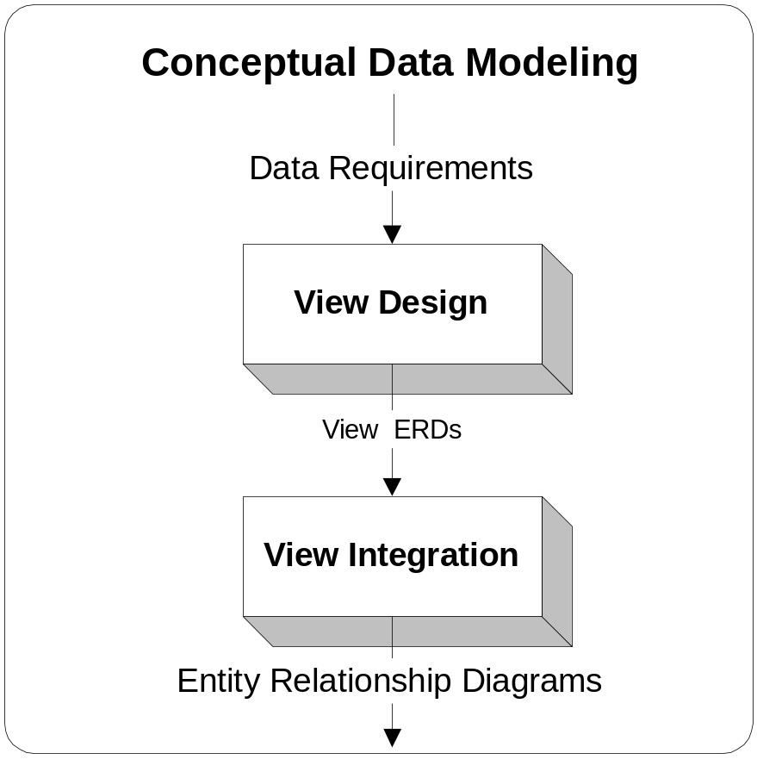
Splitting Conceptual Design
Notes:
Large projects:
- Divide work into smaller units
- Assign work to team members
View design: ERD for a subset of requirements
View integration: combine small ERDs into a larger ERD
Chapter 12: specialized topic; This chapter is in Part 3 (Database Application Development) because it involves both database design and application development.

Slide 19
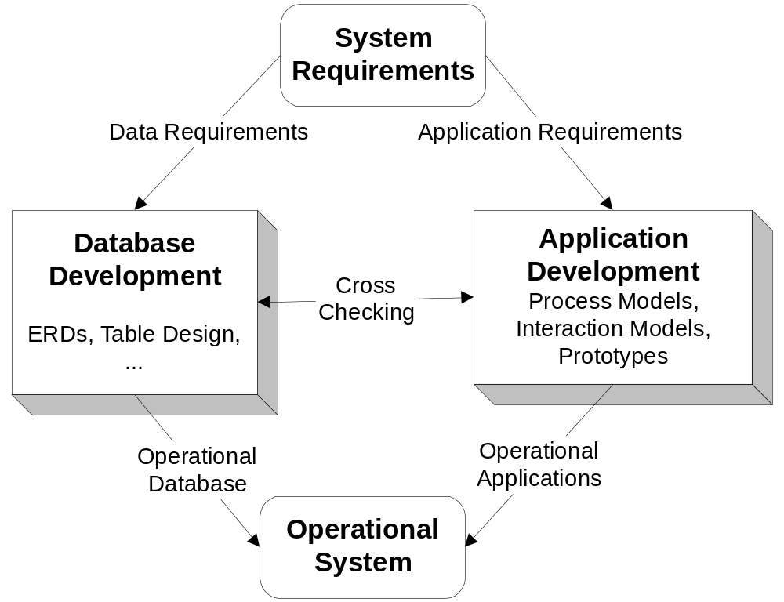
Cross Checking Requirements
Notes:
Database development does not occur in isolation
Prototypes can help reveal mismatches between database and application requirements
Prototypes can also help users clarify and elaborate requirements

Slide 20
Design Skills
Soft
  Qualitative
  Degree of subjectivity
  People-oriented
Hard
  Quantitative
  Objective
  Intensive data analysis
Notes:
Soft skills for information content
- Qualitative: search for feasible alternatives
- Interpretation of rules can be subjective
Hard skills for performance orientation
- Optimization problems: objective function and constraints
- Data analysis: causation of problems
- Most solutions are heuristic rather than directly from mathematical models
- Modeling disciplines are useful: operations management

Slide 21
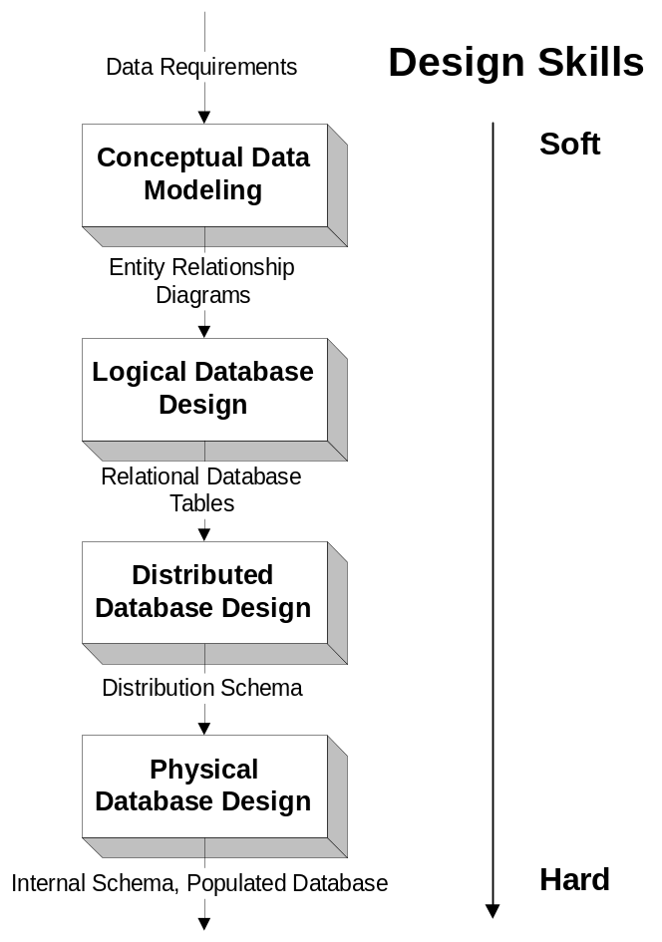
Design Skills in Phases
Notes:
See the Chapter2Figures file for a more readable version of this slide.
Soft skills important to determine the information content of a database
Hard skills important to determine an efficient implementation

Slide 22
Features of CASE Tools
Diagramming
Documentation
Analysis
Prototyping
Notes:
CASE tools:
- Studies have demonstrated that they can improve productivity of IT professionals
- 5 to 10 major products that support the entire info system lifecycle
Diagramming:
- Basic function of any CASE tool
- Predefined shapes and behavior for data modeling
- Glue to hold shapes together
Documentation:
- Data dictionary to supplement diagramming tools
- Version support to track changes over time
Analysis:
- Automated reasoning functions
- Forward engineering: convert ERD to table design
- Reverse engineering: convert table design to ERD
- Normalization (Chapter 7): remove unnecessary redundancy
- Automated diagram layout
Prototyping:
- Wizards to help construct application
- Create initial db design: select from a library of designs

Slide 23
Classification of CASE Tools
Front-end vs. Back-end
  Front-end emphasize data modeling and logical analysis
  Back-end emphasize code generation and physical design
DBMS dependent vs. DBMS independent
Notes:
CASE tools often are classified as front-end and back-end tools. Front-end CASE tools can help designers diagram, analyze, and document models used in the database development process. Back-end CASE tools create prototypes and generate code that can be used to cross check a database with other components of an information system. This section discusses the functions of CASE tools in more detail and demonstrates a commercial CASE tool, Visio Professional.

Slide 24
Commercial CASE Tools
PowerDesigner 10
Oracle Designer 10g
Visual Studio .Net Enterprise Architect
ERWin Data Modeler
ER/Studio
Visible Analyst
Notes:
There are a number of CASE tools that provide extensive functionality for database development. Each of the products is a complex product that supports the full life-cycle of information systems development. Although the features of the products look similar, the quality, the depth, and the breadth of the features may vary across products. In addition, most of the products have several different versions that vary in price and features. All of the products are relatively neutral to a particular DBMS despite that companies with major DBMSs offer four of these products. There are a number of other products that specialize in one or more phases of database development, although the products are not listed above.

Slide 25
ER Assistant
CASE tool distributed with the textbook
Customized for this textbook: supports the ERD notation used in Chapters 5 and 6
Drawing tool
Diagram checking
Easy to use and powerful tool
Notes:
ER Assistant:
- Simple tool: specialized for this textbook
- Excellent tool for moderate size ERDs in Chapter5 and 6 problems and projects
- Easy to use
- Bundled with the textbook
- Extensively revised for the second and third editions

Slide 26
Visio Professional
Entry level version of Visual Studio .Net Enterprise Architect
Drawing tools
  Stencils for database diagrams
  Glue feature to retain connections
Data dictionary support
Analysis tools
  Diagram layout
  Reverse engineering
Notes:
See Chapter02Figures for screen snapshots

Slide 27
Summary
Background for Chapters 5 to 8
Relationship to information systems development
Broad goals
Development phases
CASE tool features
Notes:
Chapter 2 is background material for the Chapters 5 to 8, 12 to 13
- No specific skills: descriptive material
- Reread chapter 2 after finishing chapters 5 through 8
Major lessons:
- Database development is part of information systems development
- Ignore other aspects in this class but just for pedagogy reasons
- Focus on phases that involve the information content of the db
- Use CASE tool (ER Assistant) for data modeling assignments

