Slide 1
CIS/CSC 384: Database Design
Normalization of Relational Tables
(Chapter 7)
Notes:
Welcome to Chapter 7
- Logical database design: converting and refining the ERD
- Major part of logical database design: normalization
- Normalization: refinement; identifying and resolving unwanted redundancy
Objectives:
- Identify modification anomalies
- Define functional dependencies
- Apply normalization rules to modest size problems: BCNF and simple synthesis procedure
- Understand relationship independence problems
- Appreciate the role and objective of normalization in the db development process

Slide 2
Outline
Modification anomalies
Functional dependencies
Major normal forms
Relationship independence
Practical concerns
Notes:
Modification anomalies: motivation for normalization; unwanted redundancy
Functional dependencies:
- Assertions or constraints about the data
- Most important part of the process: recording FDs
Normal forms:
- Rules about allowable patterns of FDs
- Apply on modest size problems
- CASE tool for large problems
Relationship independence:
- More specialized redundancy problem
- Not as common and important as BCNF
Practical concerns:
- Role of normalization in the development process: when to use; how important
- Analyzing the objective

Slide 3
Modification Anomalies
Unexpected side effect
Insert, modify, and delete more data than desired
Caused by excessive redundancies
Strive for one fact in one place
Notes:
Side effect: unintended consequence; sometimes good, sometimes bad
Modification anomaly:
- Cannot modify just the desired data
- Must modify more than the desired data
Cause:
- Redundancy: facts stored multiple times
- Remove unwanted redundancies to eliminate anomalies

Slide 4
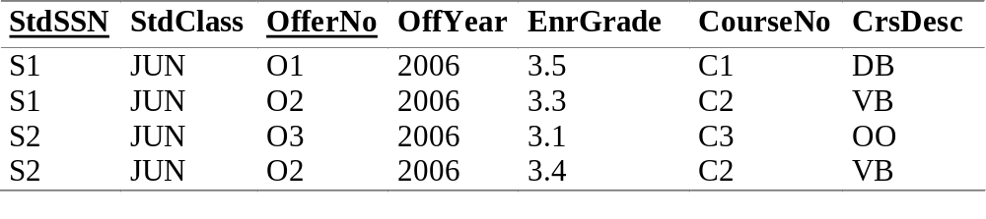
Big University Database Table
Notes:
Big University Database Table:
- Table 7-1 except for omission of two columns (StdCity and OffTerm)
- Typical beginner's mistake: use one table for the entire database
Anomalies:
- PK: combination of StdSSN and OfferNo
- Insert: cannot insert a new student without enrolling in an offering (OfferNo part of PK)
- Update: change a course description; change every enrollment of the course
- Delete: remove third row; lose information about course C3
Table has obvious redundancies
- Easier to query: no joins
- More difficult to change: can work around problems (dummy PK) but tedious to do

Slide 5
Modification Anomaly Examples
Insertion
  Insert more column data than desired
  Must know student number and offering number to insert a new course
Update
  Change multiple rows to change one fact
  Must change two rows to change student class of student S1
Deletion
  Deleting a row causes other facts to disappear
  Deleting enrollment of student S2 in offering O3 causes loss of information about offering O3 and course C3
Notes:
To deal with these anomalies, users may circumvent them (such as using a default primary key to insert a new course) or database programmers may write code to prevent inadvertent loss of data. A better solution is to modify the table design to remove the redundancies that cause the anomalies.

Slide 6
Functional Dependencies
Constraint on the possible rows in a table
Value neutral like FKs and PKs
Asserted
Understand business rules
Notes:
Assert:
- Defining a business rule
- Normative: should be statement
- Look at data to see existing practices
- Most important part of normalization: asserting FDs
Value neutral:
- no specific value mentioned in an FD
- PK: can be any value but it must be unique
- FK: can be any value that matches a row in the PK table

Slide 7
FD Definition
X → Y
X (functionally) determines Y
X: left-hand-side (LHS) or determinant
For each X value, there is at most one Y value
Similar to candidate keys
Notes:
Notation:
- X->Y
- X determines Y (more properly X functionally determines Y)
- Refer to X as the LHS or determinant
- Each X has at most one Y
- Like a mathematical function: f(X) = Y
Example StdSSN -> StdClass
- There is at most one class for each student
- Place StdSSN and StdClass alone in the same table: StdSSN is a candidate key

Slide 8
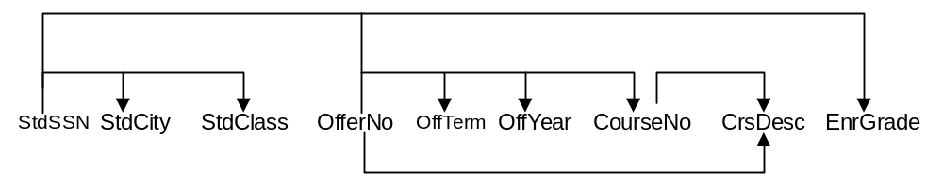
FD Diagrams and Lists
StdSSN → StdCity, StdClass
OfferNo → OffTerm, OffYear, CourseNo, CrsDesc
CourseNo → CrsDesc
StdSSN, OfferNo → EnrGrade
Notes:
FD diagram:
- 7.2 of textbook chapter 7
- See related FDs (same LHS) by line height
- Useful for small sets of FDs
- Unwieldy for large sets of FDs
FD list:
- Group by LHS
- Shortcut notation: X -> Y, Z is a shortcut for X -> Y and X -> Z
Compound LHS:
- Similar to a combined PK
- Compound LHS is not a shortcut (as is a compound RHS)
- Combination of StdSSN and OfferNo determine EnrGrade (not either column alone)
Minimality:
- LHS must be minimal
- Cannot remove columns from LHS without making the FD invalid
- Usually non minimal LHS is not a problem: important that LHS does not have
extraneous columns
- Properly known as full functional dependence: minimal LHS makes full functional dep.

Slide 9
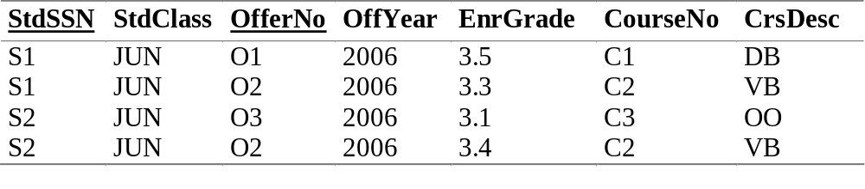
FDs in Data
Prove non existence (but not existence) by looking at data
Two rows that have the same X value but a different Y value
Notes:
Looking at data:
- Useful when explaining to a user
- Automated tools ask for example rows to eliminate FDs
Example:
- OfferNo -> StdSSN: contradicting rows ( 2, 4) (same OfferNo but a different StdSSN)
- StdSSN -> OfferNo: contradicting rows (<1,2>, <3,4>)
- StdSSN -> OffYear: data has no contradictions
- Add rows to provide contradiction (enroll S1 in a 2001 offering)
Assignment 5:
- Questions similar to this line of reasoning
- Find contradictory rows or add rows if no contradiction is found

Slide 10
Identifying FDs
Easy identification
  Statements about uniqueness
  PKs and CKs resulting from ERD conversion
  1-M relationship: FD from child to parent
Difficult identification
  LHS is not a PK or CK in a converted table
  LHS is part of a combined primary or candidate key
Ensure minimality of LHS
Notes:
Functional dependencies in which the LHS is not a primary or candidate key can also be difficult to identify. These FDs are especially important to identify after converting an ERD to a table design. You should carefully look for FDs in which the LHS is not a candidate key or primary key. You should also consider FDs in tables with a combined primary or candidate key in which the LHS is part of a key, but not the entire key. The presentation of normal forms in Section 7.2 explains that these kinds of FDs can lead to modification anomalies.
Minimality: no extra columns in LHS
Difficult FDs to identify: most important because most FDs are identified in developing ERD

Slide 11
Normalization
Process of removing unwanted redundancies
Apply normal forms
  Identify FDs
  Determine whether FDs meet normal form
  Split the table to meet the normal form if there is a violation
Notes:
Normal form:
- Rule about allowable pattern of FDs (1NF through BCNF)
- Higher normal forms are not rules about FDs: more difficult to understand and use
- Most important part is to record FDs: CASE tool can perform normalization
- Check FDs to see if they violate the pattern permitted in the normal form
Split table
- Smaller tables do not violate the normal form
- Smaller tables should not lose information contained in the larger table
Difficulty:
- Normalization is easy to apply to small tables with simple dependency structures
- Use CASE tool for large databases and tables with complex dependency structures

Slide 12
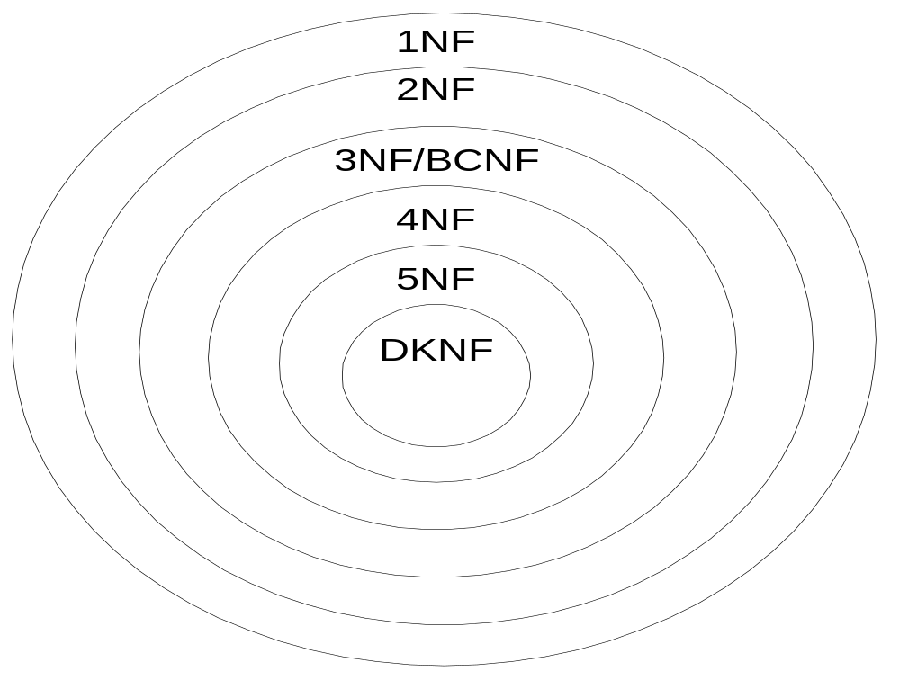
Relationships of Normal Forms
Notes:
1NF: least restrictive; every table in 1NF
2NF: more restrictive than 1NF; every table in 2NF is also in 1NF
3NF/BCNF: BCNF is a revised definition of 3NF; BCNF is more restrictive than BCNF
4NF: Inappropriate usage of an M-way relationship; Relationship independence and MVDs; does not involve FDs
5NF: does not involve FDs; Inappropriate usage of an M-way relationship; more specialized than 4NF
DKNF: ideal rather than a practical normal form

Slide 13
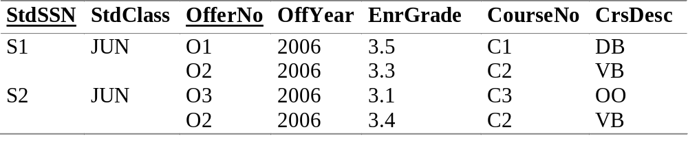
1NF
Starting point for most relational DBMSs
No repeating groups: flat rows
Notes:
Big university database table is not normalized
- Not in 1NF
- S1 row has repeating values (O1 and O2)
- S2 row has repeating values (O3 and O2)
Convert to 1NF:
- Flatten rows
- Split each repeating group into a separate row
- Repeat the implied values in the new rows:
- S1 JUN for row two with O2 2000 3.3 C2 VB
- S2 JUN for row four with O2 2000 3.4 C2 VB
Nested tables are permitted in SQL:2003 (Chapter 18) but nested tables are not important in most business databases. Nested tables are not in 1NF.

Slide 14
Combined Definition of 2NF/3NF
Key column: candidate key or part of candidate key
Analogy to the traditional justice oath
Every non key column depends on all candidate keys, whole candidate keys, and nothing but candidate keys
Usually taught as separate definitions
Notes:
Candidate key:
- Unique
- Minimal: no extraneous columns without losing uniqueness property
- Can have multiple candidate keys per table
Key column:
- A candidate key by itself
- Part of a combined CK
- Nonkey: a column that is not a key column
Combined definition:
- Analogy to traditional justice oath
- So help me: Ted Codd (father of relational databases)
- Usually taught as separate definitions for simplicity

Slide 15
2NF
Every nonkey column depends on all candidate keys, not a subset of any candidate key
Violations
  Part of key → nonkey
  Violations only for combined keys
Notes:
First of combined 2NF/3NF definition: dependent on the whole key
Violation:
- Part of a key determines a non key
- If FDs for a table contain such an FD, split the table

Slide 16
2NF Example
Many violations for the big university database table
  StdSSN → StdCity, StdClass
  OfferNo → OffTerm, OffYear, CourseNo, CrsDesc
Splitting the table
  UnivTable1 (StdSSN, StdCity, StdClass)
  UnivTable2 (OfferNo, OffTerm, OffYear, CourseNo, CrsDesc)
Notes:
Violating FDs:
- All FDs violate except StdSSN, OfferNo -> EnrGrade
- StdSSN: part of a key (not the entire key)
- OfferNo: part of a key (not the entire key)
Splitting:
- Place each FD group in a separate table
- UnivTable1: StdSSN group
- UnivTable2: OfferNo group
- UnivTable3: StdSSN, OfferNo group
- No violations among new tables
- CourseNo -> CrsDesc (CourseNo is not part of a key)
- This FD violates 3NF, not 2NF
Splitting process:
- Recover original table with natural join
- Not lose any FDs: all FDs are derivable
- Books on normalization theory explain criteria: theory not important here

Slide 17
3NF
Every nonkey column depends only on candidate keys, not on non key columns
Violations: Nonkey → Nonkey
Alterative formulation
  No transitive FDs
  A → B, B → C then A → C
  OfferNo → CourseNo, CourseNo → CrsDesc then OfferNo → CrsDesc
Notes:
Second part of combined 2NF/3NF definition: nothing but the key
Violation:
- Non key determines a non key
- If FDs for a table contain such an FD, split the table
Alternative formulation:
- No transitive FDs
- Law of transitivity: A < B, B < C then A < C
- Transitivity applies to FDs
- Not the preferred definition of 3NF: should not write down transitively derived FDs
- Simple synthesis procedure for BCNF

Slide 18
3NF Example
One violation in UnivTable2
  CourseNo → CrsDesc
Splitting the table
  UnivTable2-1 (OfferNo, OffTerm, OffYear, CourseNo)
  UnivTable2-2 (CourseNo, CrsDesc)
Notes:
Violating FDs:
- CourseNo is non key
- Alternatively, OfferNo -> CrsDesc is a transitively derived FD
Splitting UnivTable2:
- Arrange by LHS
- UnivTable2-2: CourseNo is the PK

Slide 19
BCNF
Every determinant must be a candidate key.
Simpler definition
Apply with simple synthesis procedure
Special cases not covered by 3NF
  Part of key → Part of key
  Nonkey → Part of key
  Special cases are not common
Notes:
Boyce-Codd Normal Form
Determinant: LHS
Candidate key: unique column(s) for the table
Important because it is simpler and more direct to apply
Revised 3NF definition
Special case is not common

Slide 20
BCNF Example
Primary key: (OfferNo, StdSSN)
Many violations for the big university database table
  StdSSN → StdCity, StdClass
  OfferNo → OffTerm, OffYear, CourseNo
  CourseNo → CrsDesc
Split into four tables
Notes:
Violating FDs:
- All FDs violate except StdSSN, OfferNo -> EnrGrade
- StdSSN: not a candidate key (part of a candidate key)
- OfferNo: part of a key (not the entire key)
Splitting:
- Place each FD group in a separate table
- UnivTable1: StdSSN group
- UnivTable2: OfferNo group
- UnivTable3: CourseNo group
- UnivTable4: StdSSN, OfferNo group
- No violations among new tables

Slide 21
Simple Synthesis Procedure (to get to 3NF)
Eliminate extraneous columns from the LHSs
Remove derived FDs
Arrange the FDs into groups with each group having the same determinant.
For each FD group, make a table with the determinant as the primary key.
Merge tables in which one table contains all columns of the other table.
Notes:
Synthesis:
- Combine parts into whole
- Musical synthesis: combine individual sounds into larger musical units
- Combine FDs into tables
Simple synthesis procedure
- Procedure to apply 3NF: result are 3NF tables
- Simple: second step is much more complex in practice
- Many ways to derive FDs
- Compute minimal cover: difficult to compute by hand except for small FD lists
- Use CASE tool for moderate to large FD lists
Step 1:
- Nake sure LHSs are minimal
- Usually not a problem
Step 2:
- Many ways to derive FDs
- For this class, only consider law of transitivity
- Reduce amount of work by not recording derived FDs
Step 3:
- Sort FDs by LHS
- Little work because natural to write FDs in this manner
Step 4:
- One table per FD group
- LHS becomes PK
Step 5:
- Deals with tables that have multiple candidate keys
- Merge FD groups when one table contains another table
- Choose the primary key of one of the separate tables as the primary of the new, merged table.
- Define unique constraints for the other primary keys that were not designated as the primary key of the new table.
Add FKs:
- Not formally part of normalization process
- Ensure consistency
- Add FK: PK or CK used in another table

Slide 22
Simple Synthesis Example I
Begin with FDs shown in Slide 8
Step 1: no extraneous columns
Step 2: eliminate OfferNo → CrsDesc
Step 3: already arranged by LHS
Step 4: four tables (Student, Enrollment, Course, Offering)
Step 5: no redundant tables
Notes:
Step 1:
- No work
- StdSSN, StdClass -> StdCity: remove StdClass
Step 2:
- OfferNo -> CrsDesc is derived by transitivity
- Remove from the FD list
Step 3:
- StdSSN -> StdCity, StdClass
- OfferNo -> OffTerm, OffYear, CourseNo
- CourseNo -> CrsDesc
- StdSSN, OfferNo -> EnrGrade
Step 4:
- Student table: StdSSN (PK)
- Offering table: OfferNO (PK)
- Course table: CourseNo (PK)
- Enrollment table: StdSSN, OfferNo (combined PK)
Step 5:
- No redundant tables
- Email -> StdSSN
- Merge email and StdSSN tables
- StdSSN the PK: more stable than Email; missing email addresses
FKs:
- Offering: CourseNo
- Enrollment: StdSSN and OfferNo

Slide 23
Simple Synthesis Example II
AuthNo → AuthName, AuthEmail, AuthAddress
AuthEmail → AuthNo
PaperNo → Primary-AuthNo, Title, Abstract, Status
RevNo → RevName, RevEmail, RevAddress
RevEmail → RevNo
RevNo, PaperNo → Auth-Comm, Prog-Comm, Date, Rating1, Rating2, Rating3, Rating4, Rating5
Notes:
database to track reviews of papers submitted to an academic conference. Prospective authors submit papers for review and possible acceptance in the published conference proceedings.

Slide 24
Simple Synthesis Example II Solution
Author(AuthNo, AuthName, AuthEmail, AuthAddress) UNIQUE (AuthEmail)
Paper(PaperNo, Primary-Auth, Title, Abstract, Status)
FOREIGN KEY (Primary-Auth) REFERENCES Author
Reviewer(RevNo, RevName, RevEmail, RevAddress)
UNIQUE (RevEmail)
Review(PaperNo, RevNo, Auth-Comm, Prog-Comm, Date, Rating1, Rating2, Rating3,Rating4, Rating5)
FOREIGN KEY (PaperNo) REFERENCES Paper
FOREIGN KEY (RevNo) REFERENCES Reviewer
Notes:
Because the LHS is minimal in each FD, the first step is finished. The second step is not necessary because there are no transitive dependencies. Note that the FDs AuthEmail → AuthName, AuthAddress, and RevEmail → RevName, RevAddress can be transitively derived. If any of these FDs were part of the original list, they should be removed. For each of the six FD groups, you should define a table. In the last step, you combine the FD groups with AuthNo and AuthEmail and RevNo and RevEmail as determinants. In addition, you should add unique constraints for AuthEmail and RevEmail because these columns were not selected as the primary keys of the new tables.

Slide 25
Multiple Candidate Keys
Multiple candidate keys do not violate either 3NF or BCNF
Step 5 of the Simple Synthesis Procedure creates tables with multiple candidate keys.
You should not split a table just because it contains multiple candidate keys.
Splitting a table unnecessarily can slow query performance.
Notes:
As this additional example demonstrates, multiple candidate keys do not violate BCNF. The fifth step of the Simple Synthesis Procedure creates tables with multiple candidate keys because it merges tables. Multiple candidate keys do not violate 3NF either. There is no reason to split a table just because it has multiple candidate keys. Splitting a table with multiple candidate keys can slow query performance due to extra joins.

Slide 26
Relationship Independence and 4NF
M-way relationship that can be derived from binary relationships
Split into binary relationships
Specialized problem
4NF does not involve FDs
Notes:
Analogy to statistical independence:
- Do not store joint probabilities when variables are independent
- Age of rock and age of person holding the rock are independent
- Joint probability (Person age = X and rock age = y) can be derived from marginal
probabilities
Relationship independence:
- Independent relationships: binary relationships that combine to show all
possible combinations
- Combine using the join operator
- No need to store the join (M-way relationship) when it can be derived
More specialized problem than BCNF:
- M-way relationships are not common: important when occurring
- Analysis of M way relationships is not a typical situation
- Two ways to analyze M-way relationships:
- Given binary relationships, should there be an M-way relationship instead
- Given M-way relationship, should it be split into M-1 binary relationships
- Relationship independence and 4NF only involve the splitting question
- Chapter 12 (Section 12.2.2) provides a more general (but less rigorous) way
to reason about both questions

Slide 27
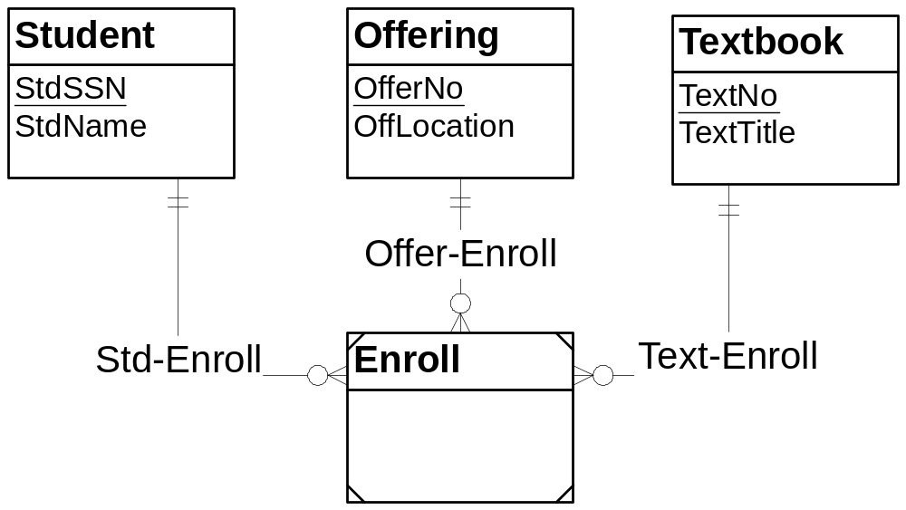
Relationship Independence Problem
Notes:
Enroll:
- Associative entity type containing combinations of students, offerings, and textbooks
- All key: StdSSN, OfferNo, TextNo
Design problem:
- Should Enroll be split into two binary relationships
- Student-Offering: students register for course offerings
- Offering-Textbook: professors choose textbooks
- Student-Textbook: can be derived from other two relationships
- Student-Offering and Offering-Textbook are independent
Solution: next slide

Slide 28
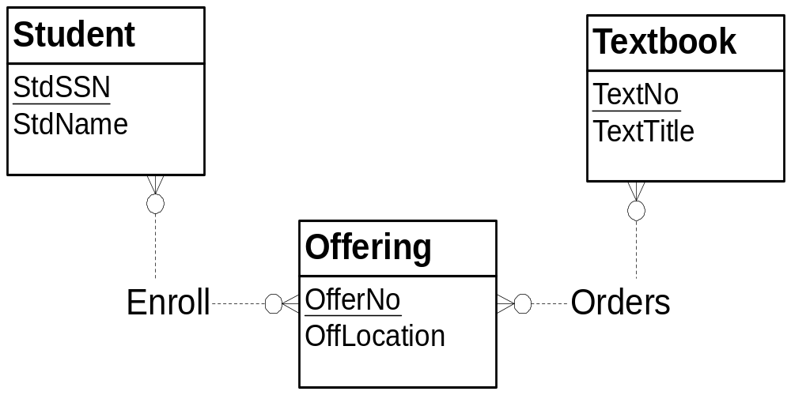
Relationship Independence Solution
Notes:
Solution:
- Split enroll entity type into two M-N relationships
- Enroll relationship: Student-Offering
- Orders relationship: Offering-Textbook
3 Way relationship would probably not been considered because of knowledge of business process
- Enrollment and textbook ordering are independent events
- Occur in different points in time
- Separate data entry forms

Slide 29
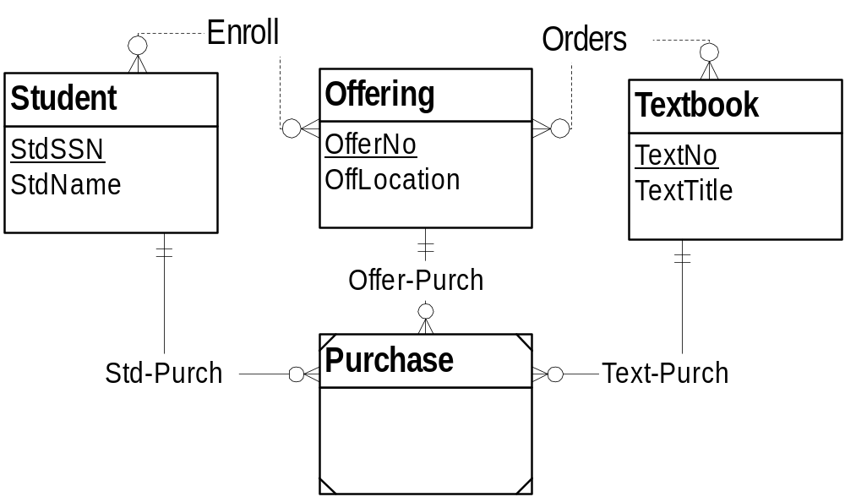
Extension to the Relationship Independence Solution
Notes:
Problem extension:
- Record textbook purchases
- Add an associative entity type but keep the two binary relationships
- Purchasing behavior cannot be derived from enrollment and ordering data
If the assumptions change slightly, an argument can be made for an associative entity type representing a three-way relationship. Suppose that the bookstore wants to record textbook purchases by offering and student to estimate textbook demand. Then, the relationship between students and textbooks is no longer independent of the other two relationships. Even though a student is enrolled in an offering and the offering uses a textbook, the student may not purchase the textbook (perhaps borrow it) for the offering. In this situation, there is no independence and a three-way relationship is needed. In addition to the M-N relationships in Figure 7.8, there should be a new associative entity type and three 1-M relationships, as shown in Figure 7.9. You need the Enroll relationship to record student selections of offerings and the Orders relationship to record professor selections of textbooks. The Purchase entity type records purchases of textbooks by students in a course offering. However, a purchase cannot be known from the other relationships.

Slide 30
MVDs and 4NF
MVD: difficult to identify
  A →→ B | C (multi-determines)
  A associated with a collection of B and C values
  B and C are independent
  Non trivial MVD: not also an FD
4NF: no non trivial MVDs
Notes:
MVDs:
- Difficult to identify
- Rigorous definition of relationship independence
- Concept is confusing to many practitioners: independence concept is often omitted
- I stress the independence idea (the key idea) rather than the multi value idea
MVD:
- Association with a set of values (not just one)
- Independence: key idea
- An FD is an MVD with collection is a single value
- Non trivial MVD: associated with one or more values

Slide 31
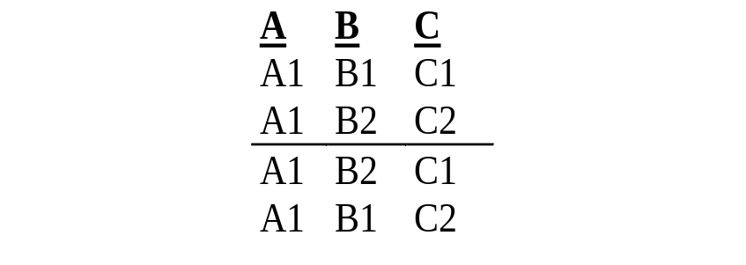
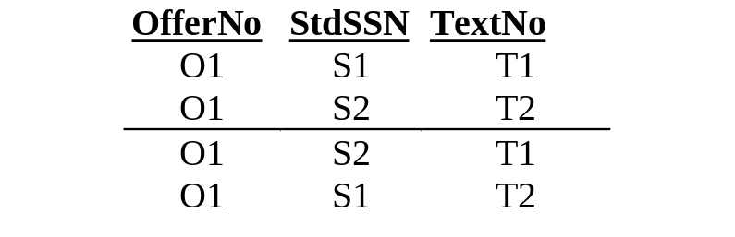
MVD Representation
Given the two rows above the line, the two rows below the line are in the table if the MVD is true.
A →→ B | C
OfferNo →→ StdSSN | TextNo
Notes:
Given the two rows above the line, the two rows below the line are in the table if A multi determines B | C.
Independence means that A is associated with every combination of B and C values.

Slide 32
Higher Level Normal Forms
5NF for M-way relationships
DKNF: absolute normal form
DKNF is an ideal, not a practical normal form
Notes:
5NF:
- More specialized than 4NF
- More difficult to understand than 4NF
- Split a three way relationship into three (not two) binary relationships
DKNF (Domain Key Normal Form)
- Domain: sets of values
- Key: candidate key (uniqueness property)
- All constraints derivable from domains and keys
- Not possible to test a table for DKNF compliance
- No known procedure to construct a DKNF table

Slide 33
Role of Normalization
Refinement
  Use after ERD
  Apply to table design or ERD
Initial design
  Record attributes and FDs
  No initial ERD
  May reverse engineer an ERD after normalization
Notes:
Approach in textbook:
- Refinement
- Apply normalization after conversion
- Normalization can be applied directly to an ERD
Initial design approach:
- Use attributes and FDs
- May reverse engineer ERD later
- Some strongly advocate this approach

Slide 34
Advantages of Refinement Approach
Easier to translate requirements into an ERD than list of FDs
Fewer FDs to specify
Fewer tables to split
Easier to identify relationships especially M-N relationships without attributes
Notes:
This book clearly favors using normalization as a refinement tool, not as an initial design tool. Through development of an ERD, you intuitively group related fields. Much normalization is accomplished in an informal manner without the tedious process of recording functional dependencies. As a refinement tool, there are fewer FDs to specify and less normalization to perform. Applying normalization ensures that candidate keys and redundancies have not been overlooked.
Another reason for favoring the refinement approach is that relationships can be overlooked when using normalization as the initial design approach. 1-M relationships must be identified in the child-to-parent direction. For novice data modelers, identifying relationships is easier when considering both sides of a relationship. For an M-N relationship without attributes, there will not be any functional dependencies that show the need for a table. For example, in a design about textbooks and course offerings, if the relationship between them has no attributes, there are no functional dependencies that relate textbooks and course offerings[1]. In drawing an ERD, however, the need for an M-N relationship becomes clear.
[1] An FD can be written with a null right-hand side to represent M-N relationships. The FD for the offering-textbook relationship can be expressed as TextId, OfferNo →∅. However, this kind of FD is awkward to state. It is much easier to define an M-N relationship.

Slide 35
Normalization Objective
Update biased
Not a concern for databases without updates (data warehouses)
Denormalization
  Purposeful violation of a normal form
  Some FDs may not cause anomalies
  May improve performance
Notes:
Carefully analyze objective:
- Ignore normalization for FDs that do not cause anomalies
- Be careful: most FDs will lead to anomalies
Classic example:
- ZipCode -> City
- Only holds for the city in which the post office is located
- Even when it holds, it may not lead to anomalies
- Mail order business: track tax rates by zip code (not really accurate)
- Important for mail order databases
Performance:
- Chapter 8
- Consider performance implications after logical design is complete

Slide 36
Summary
Beware of unwanted redundancies
FDs are important constraints
Strive for BCNF
Use a CASE tool for large problems
Important tool of database development
Focus on the normalization objective
Notes:
Cause of difficult modifications:
- Unwanted redundancies
- Anomalies can occur with unwanted redundancies
FD:
- Like a candidate key constraint
- Must be able to record FDs
- Normalization can be performed by CASE tool: necessary for large databases
- BCNF: revised definition of 3NF; most important in practice
Role of normalization:
- Refinement rather than initial design (my expert opinion)
- Can be applied after conversion or directly to an ERD
Normalization objective:
- Update biased: make a db easier to change
- Normalization makes many tables
- Difficult and inefficient to query
- If an FD does not cause a significant anomaly, perhaps relax from full BCNF
- Denomalization can be done to improve performance (Chapter 8)

