Slide 1
Oracle Setup
Download Oracle SQL Developer : http://www.oracle.com/technology/products/database/sql_developer/index.html
Open a new connection:

Slide 2
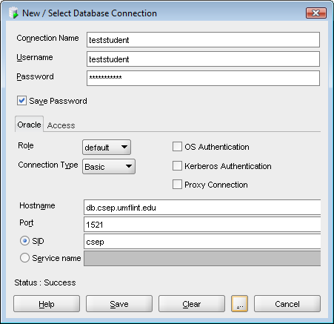
Specifying a New Connection

Slide 3
Connecting to Oracle (contd..)
suppose there is a student with unique ID ‘teststudent‘
connection parameters in SQL Developer:
User: teststudent
Pass: teststudent
SID: csep
Port: 1521
Type: Basic
Host: db.csep.umflint.edu
Role: Default

Slide 4
Changing password
Alter User your_login_name identified by Your_new_password ;

Slide 5
Use SQLPlus Interface
C:\Documents and Settings\mmani>
sqlplus teststudent/teststudent@db.csep.umflint.edu/csep

Slide 6
A Few Simple Tasks from SQL Developer
Create a Table, Add columns etc
Insert Rows
Delete Rows
Import Data from an Excel file (using SQL Developer)
SQL Worksheet
Creating a table, running SQL queries; running a SQL script; set timing on; seeing the plan

