Slide 1
CIS/CSC 384: Database Design
Physical Database Design
(Chapter 8)
Notes:
Welcome to Chapter 8 on Physical Database Design.
This is the final phase of the database development process. Physical database design transforms a table design from the logical design phase to database implementation.
Objectives
Describe the inputs, outputs, and objectives of physical database design
List characteristics of sequential, Btree, hash, and bitmap index file structures
Appreciate the difficulties of performing physical database design and the need for periodic review of physical database design choices
Understand the trade-offs in index selection and denormalization decisions
Understand the need for good tools to help make physical database design decisions
Understand the choices made by a query optimizer and the areas in which optimization decisions can be improved

Slide 2
Outline
Overview of Physical Database Design
File Structures
Query Optimization
Index Selection
Additional Choices in Physical Database Design
Notes:
You need to understand Physical Database Design in order to achieve an efficient implementation of your table design.
To become proficient in physical database design, you need to understand the process and environment.
The process of physical database design includes the inputs, outputs, and objectives.
The process works along with 2 critical parts of the environment, File Structures and Query Optimization.
Index selection is the most important choice of physical database design.
Additional Choices in Physical Database Design, this chapter presents denormalization, record formatting, and parallel processing as techniques to improve database performance.

Slide 3
Overview of Physical Database Design
Sequence of decision-making processes.
Decisions involve the storage level of a database: file structure and optimization choices.
Importance of providing detailed inputs and using tools that are integrated with DBMS usage of file structures and optimization decisions
Notes:
Overview of Physical Database Design
Storage Level of Databases
Objectives and Constraints
Inputs, Outputs, and Environment
Difficulties

Slide 4
Storage Level of Databases
Closest to the hardware and operating system.
Physical records organized into files.
The number of physical record accesses is an important measure of database performance.
Difficult to predict physical record accesses
Notes:
Physical records (also known as blocks or pages) is a collection of bytes that are transferred between volatile storage in main memory and stable storage on a disk.
Main memory is considered volatile storage because the contents of main memory may be lost if a failure occurs.

Slide 5
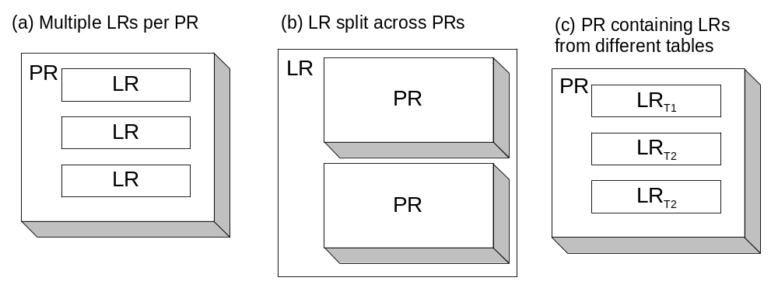
Logical Records (LR) and Physical Records (PR)
Notes:
This figure depicts relationships between logical records (rows of a table) and physical records stored in a file.
Typically, a physical record contains multiple logical records (picture (a)).
A large logical record may be split over multiple physical records (picture (b)).
Another possibility is that logical records from more than one table are stored in the same physical record (picture (c)).

Slide 6
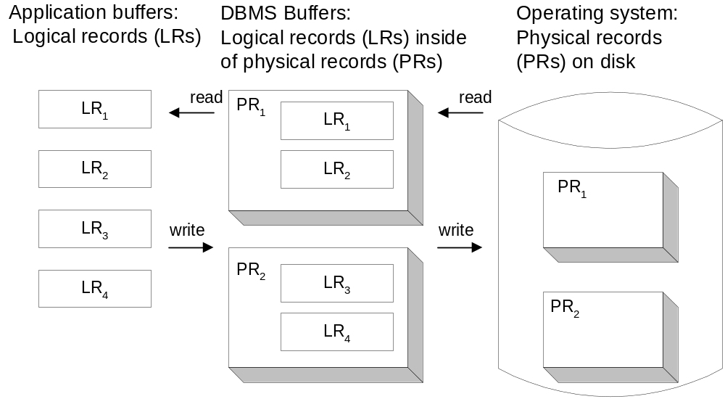
Transferring Physical Records
Notes:
The DBMS and operating system work together to satisfy requests for logical records made by applications. This figure depicts the process of transferring physical and logical records between a disk, DBMS buffers, and application buffers.
Normally, the DBMS and the application have separate memory areas known as buffers. When an application makes a request for a logical record, the DBMS locates the physical record containing it. In the case of a read operation, the operating system transfers the physical record from disk to the memory area of the DBMS. The DBMS then transfers the logical record to the application’s buffer. In the case of a write operation, the transfer process is reversed.

Slide 7
Objectives
Minimize response time to access and change a database.
Minimizing computing resources is a substitute measure for response time.
Database resources
  Physical record transfers
  CPU operations
  Communication network usage (distributed processing)
Notes:
The goal of physical database design is to minimize response time to access and change a database.
Because response time is difficult to estimate directly, minimizing computing resources is used as a substitute measure.
The resources that are consumed by database processing are physical record transfers, central processing unit (CPU) operations, main memory, and disk space.
In distributed environments, minimizing communication network usage can cause higher response times so communication network usage is not minimized.

Slide 8
Constraints
Main memory and disk space
Minimizing main memory and disk space can lead to high response times.
Useful to consider additional memory and disk space
Notes:
For most choices in physical database design, the amounts of main memory and disk space are usually fixed. In other words, main memory and disk space are constraints of the physical database design process. As with constraints in other optimization problems, you should consider the effects of changing the given amounts of main memory and disk space. Increasing the amounts of these resources can improve performance. The amount of performance improvement may depend on many factors such as the DBMS, the table design, and the applications using the database. CPU usage also can be a factor in some database applications. For example, sorting requires a large number of comparisons and assignments. However, these operations performed by the CPU are many times faster than a physical record access.

Slide 9

Combined Measure of Database Performance
Weight combines physical record accesses and CPU usage
Weight is usually close to 0
Many CPU operations can be performed in the time to perform one physical record transfer.
Notes:
The objective of physical database design is to minimize the combined measure for all applications using the database.
Combined Measure of Database Performance: PRA + W * CPU-OP where
PRA is the number of physical record accesses,
CPU-OP is the number of CPU operations such as comparisons and assignments, and
W is a weight, a real number between 0 and 1.
Generally, improving performance on retrieval applications comes at the expense of update applications and vice-versa. Therefore, an important theme of physical database design is to balance the needs of retrieval and update applications.
The measures of performance are too detailed to estimate by hand except for simple situations. Complex optimization software calculates estimates using detailed cost formulas. The optimization software is usually part of the SQL compiler. Understanding the nature of the performance measure helps one to interpret choices made by the optimization software.
For most choices in physical database design, the amounts of main memory and disk space are usually fixed. In other words, main memory and disk space are constraints of the physical database design process. As with constraints in other optimization problems, you should consider the effects of changing the given amounts of main memory and disk space. Increasing the amounts of these resources can improve performance. The amount of performance improvement may depend on many factors such as the DBMS, table design, and applications using the database.

Slide 10
Components of a Disk
Spindle
Disk head
Tracks
The platters spin (say, 90 rps).
The arm assembly is moved in or out to position a head on a desired track.
Tracks under heads make a cylinder (imaginary!).
Only one head reads/writes at any one time.
Sector
Arm movement
Platters
Arm assembly
Block (Physical Record) size is a multiple of sector size (which is fixed).
Notes:
21

Slide 11
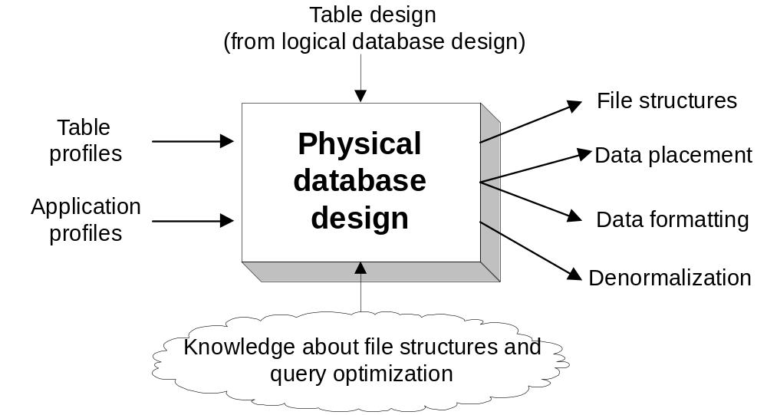
Inputs, Outputs, and Environment
Notes:
Physical database design consists of a number of different inputs and outputs as depicted in this figure.
The starting point is the table design from the logical database design phase. The table and application profiles (Inputs) are used specifically for physical database design.
The most important outputs are decisions about file structures and data placement.
Knowledge about file structures and query optimization is in the environment of physical database design rather than being an input.
Physical database design is better characterized as a sequence of decision-making processes rather than one large process.

Slide 12
Difficulty of physical database design
Number of decisions
Relationship among decisions
Detailed inputs
Complex environment
Uncertainty in predicting physical record accesses
Notes:
Physical database design is difficult due to the following factors.
- The number of possible choices available to the designer can be large. For databases with many fields, the number of possible choices can be too large to evaluate even on large computers.
- The decisions cannot be made in isolation of each other. For example, file structure decisions for one table can influence the decisions for other tables.
- The quality of decisions is limited to the precision of the table and application profiles. However, these inputs can be large and difficult to collect. In addition, the inputs change over time so that periodic collection is necessary.
- The environment knowledge is specific to each DBMS. Much of the knowledge is either a trade secret or too complex to fully know.
− The number of physical record accesses is difficult to predict because of uncertainty about the contents of DBMS buffers. The uncertainty arises because the mix of applications accessing the database changes over time.

Slide 13
Inputs of Physical Database Design
Physical database design requires inputs specified in sufficient detail.
Table profiles used to estimate performance measures.
Application profiles provide importance of applications.
Notes:
Inputs specified without enough detail can lead to poor decisions in physical database design and query optimization.

Slide 14
Table Profile
Tables
  Number of rows
  Number of physical records
Columns
  Number of unique values
  Distribution of values
  Correlation of columns
Relationships: distribution of related rows
Notes:
A table profile summarizes a table as a whole, the columns within a table, and the relationships between tables.
Most enterprise DBMSs have programs to generate statistics. The designer may need to periodically run the statistics program so that the profiles do not become obsolete. For large databases, table profiles may be estimated on samples of the database. Using the entire database can be too time consuming and disruptive.
For column and relationship summaries, the distribution conveys the number of rows and related rows for column values. The distribution of values can be specified in a number of ways. A simple way is to assume that the column values are uniformly distributed. Uniform distribution means that each value has an equal number of rows.
A more detailed way to specify a distribution is to use a histogram where the x-axis represents column ranges and the y-axis represents the number of rows containing the range of values.

Slide 15
Histogram
Specify distribution of values
Two dimensional graph
  Column values on the x axis
  Number of rows on the y axis
Variations
  Equal-width: do not work well with skewed data
  Equal-height: control error by the number of ranges
Notes:
A table profile summarizes a table as a whole, the columns within a table, and the relationships between tables.
Most enterprise DBMSs have programs to generate statistics. The designer may need to periodically run the statistics program so that the profiles do not become obsolete. For large databases, table profiles may be estimated on samples of the database. Using the entire database can be too time consuming and disruptive.
For column and relationship summaries, the distribution conveys the number of rows and related rows for column values. The distribution of values can be specified in a number of ways. A simple way is to assume that the column values are uniformly distributed. Uniform distribution means that each value has an equal number of rows.
A more detailed way to specify a distribution is to use a histogram where the x-axis represents column ranges and the y-axis represents the number of rows containing the range of values.

Slide 16
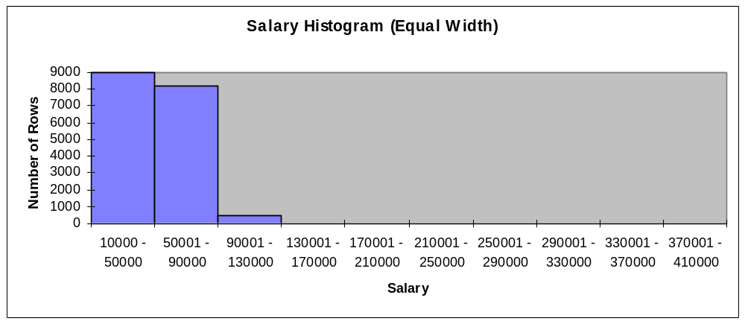
Equal-Width Histogram
Notes:
For example, the first bar in Figure 8.4 means that 9,000 rows have a salary between $10,000 and $50,000. Traditional equal-width histograms do not work well with skewed data because a large number of ranges are necessary to control estimation errors. In the slide, estimating the number of employee rows using the first two ranges may lead to large estimation errors because more than 97% of employees have salaries less than $80,000. For example, you would calculate about 1,125 rows (12.5% of 9,000) to estimate the number of employees earning between $10,000 and $15,000 using the slide. However, the actual number of rows is much lower because few employees earn less than $15,000.

Slide 17
Equal-Height Histogram
Salary Histogram (equal height)
5000
4500
4000
3500
Number of rows
3000
2500
2000
1500
1000
500
0
[10000,
21400]
(21400,
27504]
(27504,32350]
(32350,35600]
(35600,39032]
(39032,42500]
(42500,49010]
(49010,58100]
(58100,67044]
(67044,
410000]
Salary
Notes:
Because skewed data can lead to poor estimates using traditional (equal-width) histograms, most DBMSs use equal-height histograms as shown in Figure 8.5. In an equal-height histogram, the ranges are determined so that each range has about the same number of rows. Thus the width of the ranges varies, but the height is about the same. Most DBMSs use equal-height histograms because the maximum and expected estimation errors can be controlled by increasing the number of ranges.

Slide 18
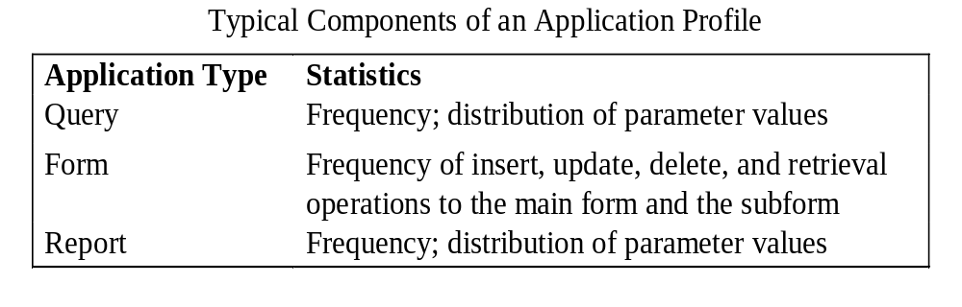
Application profiles
Application profiles summarize the queries, forms, and reports that access a database.
Notes:
Application profiles summarize the queries, forms, and reports that access a database.
For forms, the frequency of using the main form and the subform for each kind of operation (insert, update, delete, and retrieval) should be specified. For queries and reports, the distribution of parameter values encodes the number of times the query/report is executed with various parameter values.

Slide 19
File structures
Selecting among alternative file structures is one of the most important choices in physical database design.
In order to choose intelligently, you must understand characteristics of available file structures.

Slide 20
Sequential Files
Simplest kind of file structure
Unordered: insertion order
Ordered: key order
Simple to maintain
Provide good performance for processing large numbers of records

Slide 21
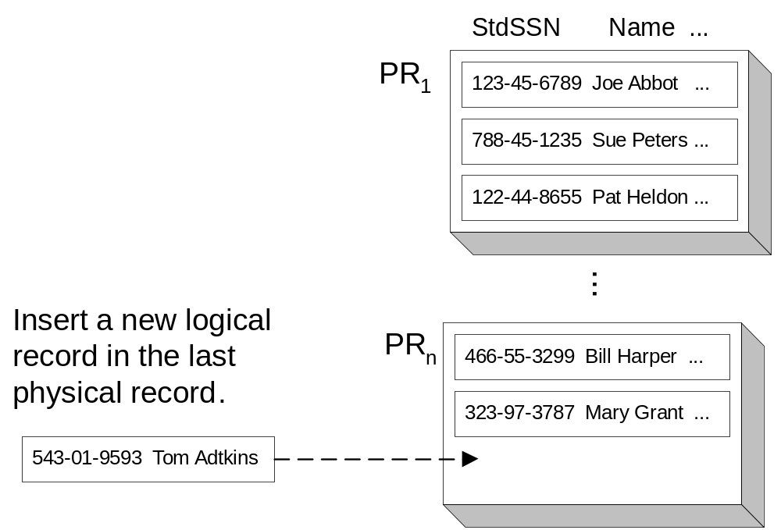
Unordered Sequential File
Notes:
Inserting a New Logical Record into an Unordered Sequential File:
New logical records are appended to the last physical record in the file.
Unordered files are sometimes known as heap files because of the lack of order.
The primary advantage of unordered sequential files is fast insertion. However, when logical records are deleted, insertion becomes more complicated.

Slide 22
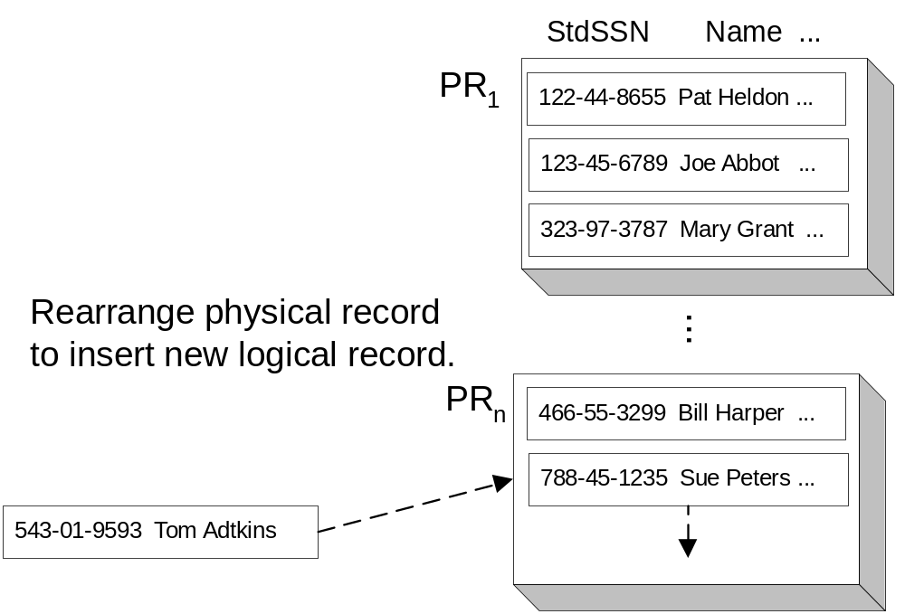
Ordered Sequential File
Notes:
Inserting a New Logical Record into an Ordered Sequential File.
Ordered sequential files can be preferable to unordered sequential files when ordered retrieval is needed. Logical records are arranged in key order where the key can be any column, although it is often the primary key. Ordered sequential files are faster when retrieving in key order, either the entire file or a subset of records. The primary disadvantage to ordered sequential files is slow insertion speed.
This figure demonstrates that records must sometimes be rearranged during the insertion process. The rearrangement process can involve movement of logical records between blocks and maintenance of an ordered list of physical records.

Slide 23
Hash Files
Support fast access by unique key value
Convert a key value into a physical record address
Mod function: typical hash function
  Divisor: large prime number close to the file capacity
  Physical record number: hash function plus the starting physical record number
Notes:
Hash File is a specialized file structure that supports search by unique key.
The basic idea behind hash files is a function that converts a key value into a physical record address. The mod function (remainder division) is a simple hash function.

Slide 24
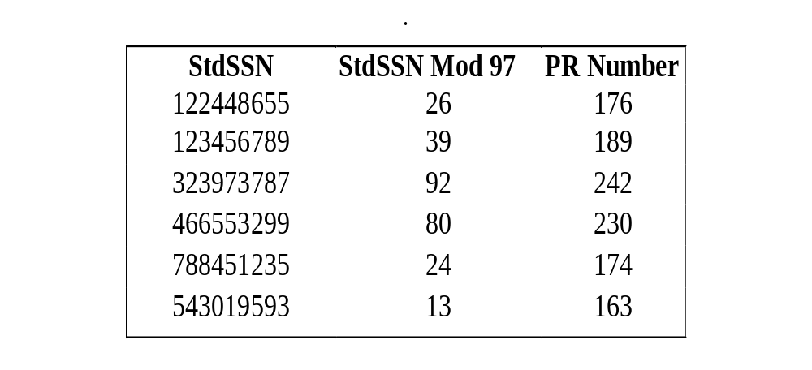
Example: Hash Function Calculations for StdSSN Key
Notes:
This example applies the mod function to the StdSSN column values.
For simplicity, assume that the file capacity is 100 physical records. The divisor for the mod function is 97, a large prime number close to the file capacity. The physical record number is the result of the hash function result plus the starting physical record number, assumed to be 150.

Slide 25
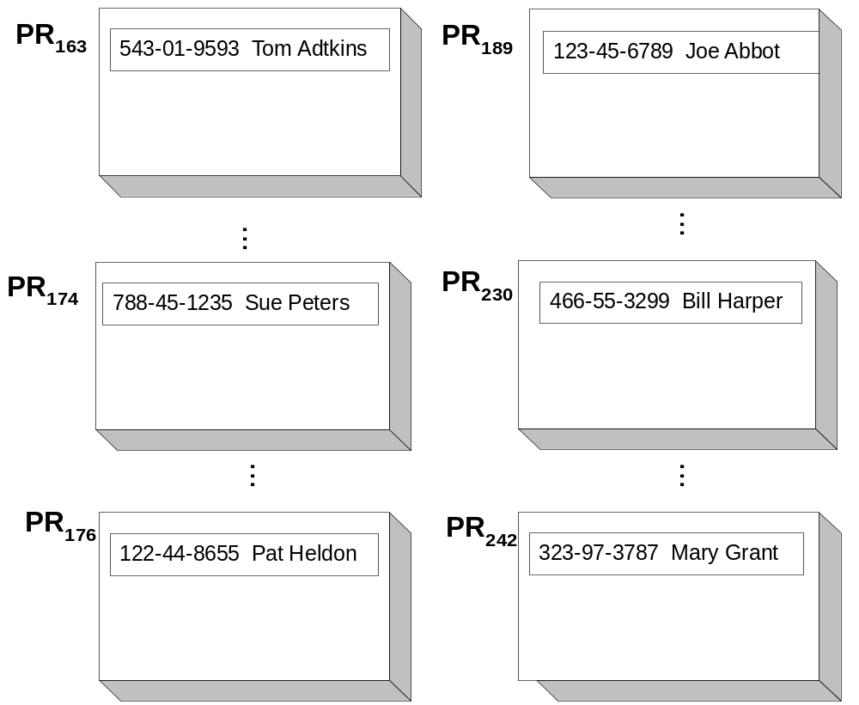
Hash File after Insertions
Notes:
This figure shows selected physical records of the hash file from previous slide.

Slide 26
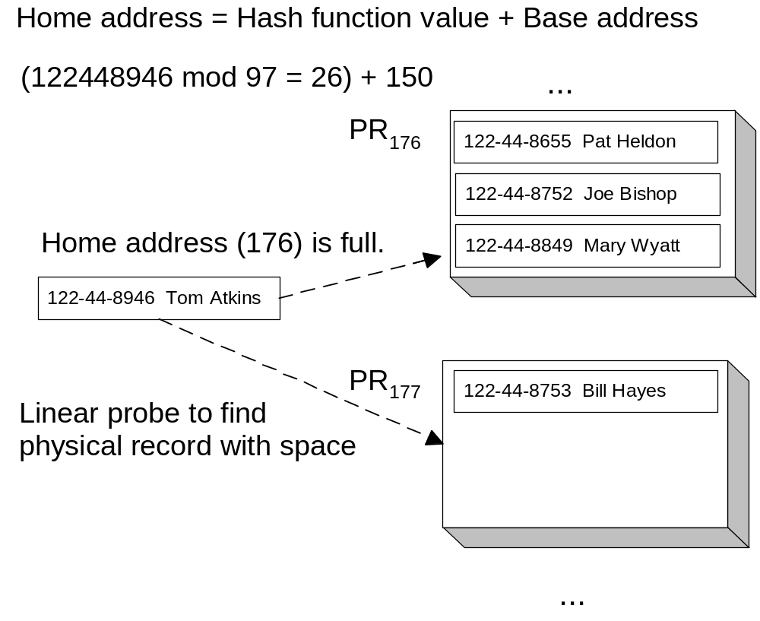
Collision Handling Example
Notes:
During insertion, collision may occur. Hash functions may assign more than one key to the same physical record address. A collision occurs when two keys hash to the same physical record address. As long as the physical record has free space, a collision is no problem. However, if the original or home physical record is full, a collision-handling procedure locates a physical record with free space.
This figure demonstrates the linear probe procedure for collision handling. In the linear probe procedure, a logical record is placed in the next available physical record if its home address is occupied. To retrieve a record by its key, the home address is initially searched. If the record is not found in its home address, a linear probe is initiated.
The existence of collisions highlights a potential problem with hash files. If collisions do not occur often, insertions and retrievals are very fast. If collisions occur often, insertions and retrievals can be slow. The likelihood of a collision depends on how full the file is. Generally, if the file is less than 70 percent full, collisions do not occur often. However, maintaining a hash file that is only 70 percent full can be a problem if the table grows. If the hash file becomes too full, a reorganization is necessary. A reorganization can be time consuming and disruptive because a larger hash file is allocated and all logical records are inserted into the new file.

Slide 27
Hash File Limitations
Poor performance for sequential search
Reorganization when capacity exceeds 70%
Dynamic hash files reduce random search performance but eliminate periodic reorganization
Notes:
Generally, if the file is less than 70 percent full, collisions do not occur often. However, maintaining a hash file that is only 70 percent full can be a problem if the table grows. If the hash file becomes too full, a reorganization is necessary. A reorganization can be time-consuming and disruptive because a larger hash file is allocated and all logical records are inserted into the new file.
Good hash functions tend to spread logical records uniformly among physical records. Because of gaps between physical records, sequential search may examine empty physical records.
To eliminate reorganizations, dynamic hash files have been proposed. In a dynamic hash file, periodic reorganization is never necessary and search performance does not degrade after many insert operations. However, the average number of physical record accesses to retrieve a record may be slightly higher as compared to a static hash file that is not too full. The basic idea in dynamic hashing is that the size of the hash file grows as records are inserted.

Slide 28
Multi-Way Tree (Btrees) Files
A popular file structure supported by most DBMSs.
Btree provides good performance on both sequential search and key search.
Btree characteristics:
  Balanced
  Bushy: multi-way tree
  Block-oriented
  Dynamic
Notes:
While Sequential files perform well on sequential search but poorly on key search and Hash files perform well on key search but poorly on sequential search, Btree is a compromise and widely used file structure.
Balanced: all leaf nodes (nodes without children) reside on the same level of the tree. A balanced tree ensures that all leaf nodes can be retrieved with the same access cost.
Bushy: the number of branches from a node is large, perhaps 10 to 100 branches. Multi-way, meaning more than two, is a synonym for bushy. The width (number of arrows from a node) and height (number of nodes between root and leaf nodes) are inversely related: increase width, decrease height. The ideal Btree is wide (bushy) but short (few levels).
Block-Oriented: each node in a Btree is a block or physical record. To search a Btree, you start in the root node and follow a path to a leaf node containing data of interest. The height of a Btree is important because it determines the number of physical record accesses for searching.
Dynamic: the shape of a Btree changes as logical records are inserted and deleted. Periodic reorganization is never necessary for a Btree.

Slide 29
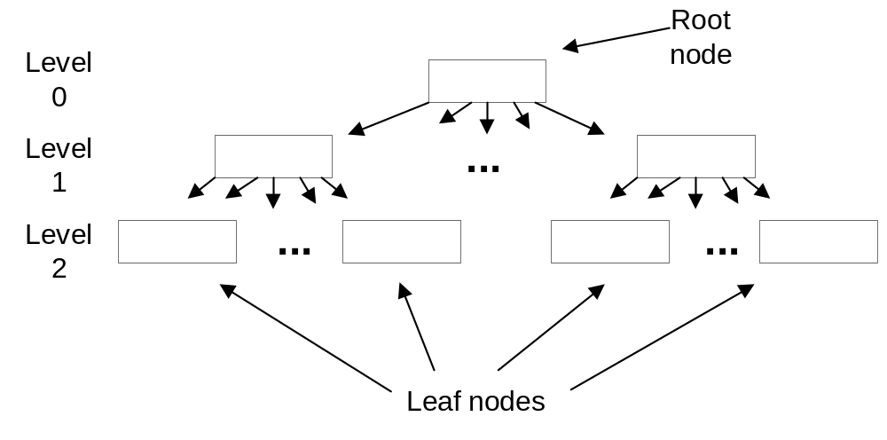
Structure of a Btree of Height 3
Notes:
A Btree is a special kind of tree as depicted in this figure. A tree is a structure in which each node has at most one parent except for the root or top node. The Btree structure possesses a number of characteristics, discussed in the following list, that make it a useful file structure. Some of the characteristics are possible meanings for the letter “B” in the name.
- Balanced: all leaf nodes (nodes without children) reside on the same level of the tree. In this figure, all leaf nodes are two levels beneath the root. A balanced tree ensures that all leaf nodes can be retrieved with the same access cost.
- Bushy: the number of branches from a node is large, perhaps 10 to 100 branches. Multi-way, meaning more than two, is a synonym for bushy. The width (number of arrows from a node) and height (number of nodes between root and leaf nodes) are inversely related: increase width, decrease height. The ideal Btree is wide (bushy) but short (few levels).
- Block-Oriented: each node in a Btree is a block or physical record. To search a Btree, you start in the root node and follow a path to a leaf node containing data of interest. The height of a Btree is important because it determines the number of physical record accesses for searching.
- Dynamic: the shape of a Btree changes as logical records are inserted and deleted. Periodic reorganization is never necessary for a Btree. The next subsection describes node splitting and concatenation, the ways that a Btree changes as records are inserted and deleted.
- Ubiquitous: the Btree is a widely implemented and used file structure.

Slide 30
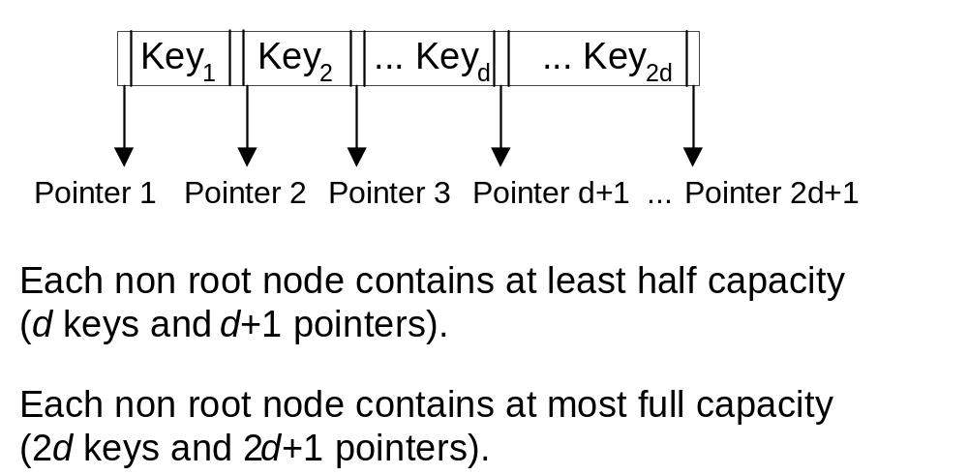
Btree Node Containing Keys and Pointers
Notes:
This figure depicts the contents of a node in the tree.
Each node consists of pairs with a key value and a pointer, sorted by key value. The pointer identifies the physical record that contains the logical record with the key value.
Other data in a logical record, besides the key, do not usually reside in the nodes. The other data may be stored in separate physical records or in the leaf nodes.
An important property of a Btree is that each node, except the root, must be at least half full. The physical record size, the key size, and the pointer size determine node capacity.

Slide 31
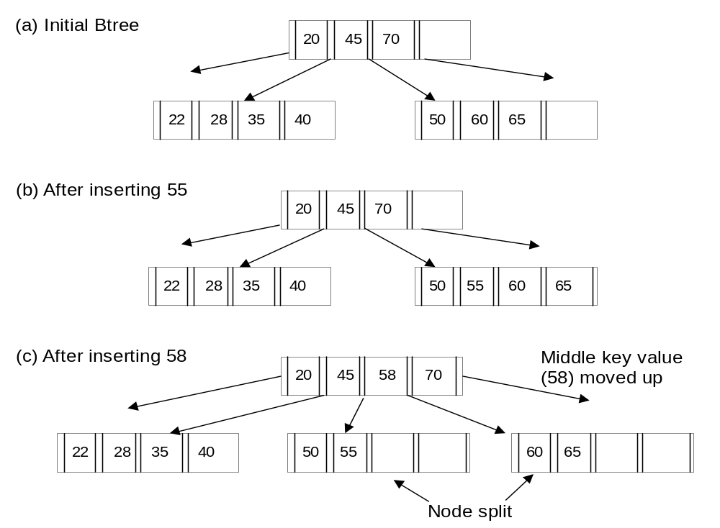
Btree Insertion Examples
Notes:
Insertions are handled by placing the new key in a nonfull node or by splitting nodes, as depicted in this figure.
In the partial Btree in (a), each node contains a maximum of four keys. Inserting the key value 55 in (b) requires rearrangement in the right-most leaf node. Inserting the key value 58 in (c) requires more work because the right-most leaf node is full. To accommodate the new value, the node is split into two nodes and a key value is moved to the root node.
When a split occurs at the root, the tree grows another level.

Slide 32
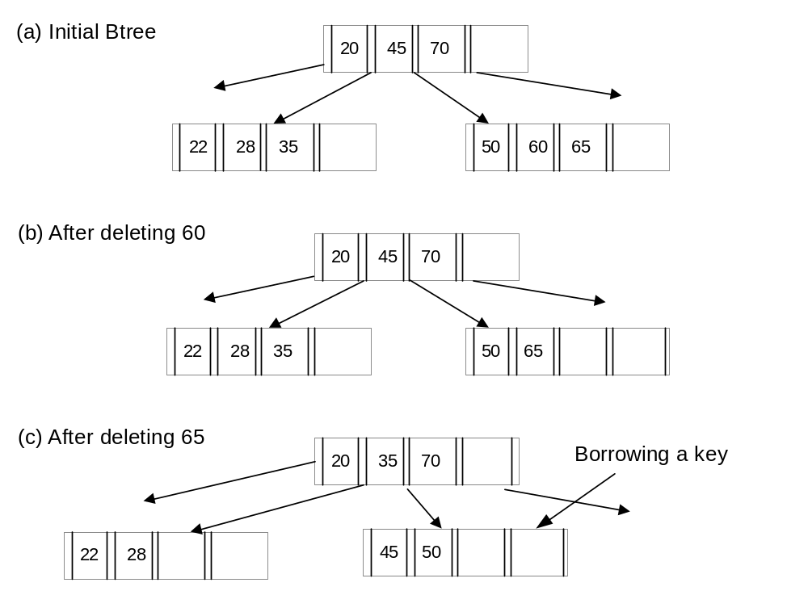
Btree Deletion Examples
Notes:
Deletions are handled by removing the deleted key from a node and repairing the structure if needed as demonstrated in this figure. If the node is still at least half-full, no additional action is necessary (figure(b)). However, if the node is less than half-full, the structure must be changed. If a neighboring node contains more than half capacity, a key can be borrowed as shown in Figure (c). If a key cannot be borrowed, nodes must be concatenated.

Slide 33
Cost of Operations
The height of Btree dominates the number of physical record accesses operation.
Logarithmic search cost
  Upper bound of height: log function
  Log base: minimum number of keys in a node
Insertion cost
  Cost to locate the nearest key
  Cost to change nodes
Notes:
The height of a Btree is small even for a large table when the branching factor is large.
The cost in terms of physical record accesses to find a key is less than or equal to the height.
The cost to insert a key includes the cost to locate the nearest key plus the cost to change nodes. In the best case (Btree insertion example (b)), the additional cost is one physical record access to change the index record and one physical record access to write the row data. The worst case occurs when a new level is added to the tree. Even in the worst case, the height of the tree still dominates.

Slide 34
B+Tree
Provides improved performance on sequential and range searches.
In a B+tree, all keys are redundantly stored in the leaf nodes.
To ensure that physical records are not replaced, the B+tree variation is usually implemented.
Notes:
Sequential searches can be a problem with Btrees. To perform a range search, the search procedure must travel up and down the tree. This procedure has problems with retention of physical records in memory. Operating systems may replace physical records if there have not been recent accesses. Because some time may elapse before a parent node is accessed again, the operating system may replace it with another physical record if main memory becomes full. Thus, another physical record access may be necessary when the parent node is accessed again. To ensure that physical records are not replaced, the B+tree variation is usually implemented.

Slide 35
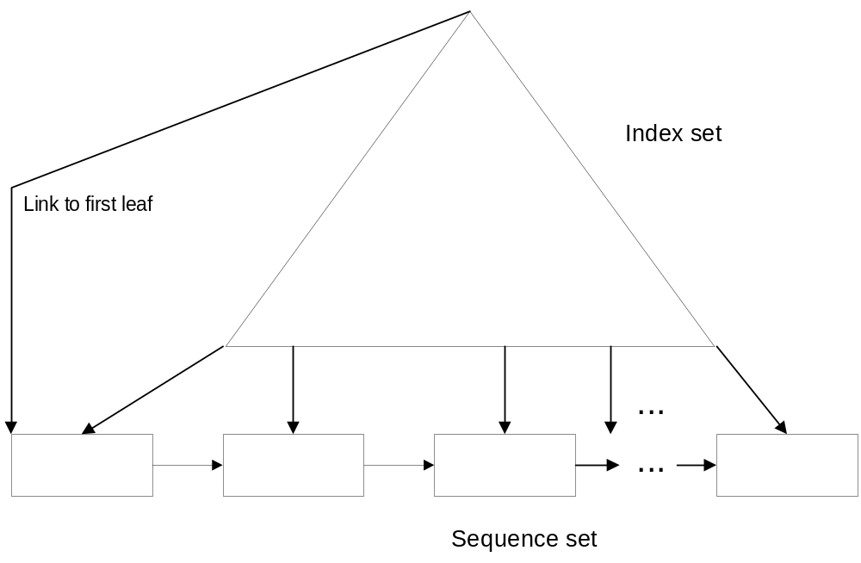
B+tree Illustration
Notes:
B+tree has 2 part: index set and sequence set which contains the leaf node. All keys reside in the leaf nodes even if a key appears in the index set. The leaf nodes are connected together so that sequential searches do not need to move up the tree. Once the initial key is found, the search process accesses only nodes in the sequence set.

Slide 36
Index Matching
Determining usage of an index for a query
Complexity of condition determines match.
Single column indexes: =, <, >, <=, >=, IN <list of values>, BETWEEN, IS NULL, LIKE ‘Pattern’ (meta character not the first symbol)
Composite indexes: more complex and restrictive rules
Notes:
Determining whether an index can be used in a query is known as index matching. When a condition in a WHERE clause references an indexed column, the DBMS must determine if the index can be used. The complexity of a condition determines whether an index can be used. For single column indexes, an index matches a condition if the column appears alone without functions or operators and the comparison operator matches one of the following items.
For composite indexes involving more than one column, the matching rules are more complex and restrictive. Composite indexes are ordered by the most significant (first column in the index) to the least significant (last column in the index) column.

Slide 37
Index Matching Examples
C2 BETWEEN 10 and 20: match on C2
C3 IN (10,20): match on C3
C1 <> 10: no match
C4 LIKE 'A%‘: match on C4
C4 LIKE '%A‘: no match
C2 = 5 AND C3 = 20 AND C1 = 10: matches on index with C1, C2, and C3
Notes:
For complete examples, see Chapter08FiguresTables document

Slide 38
Bitmap Index
Can be useful for stable columns with few values
Bitmap:
  String of bits: 0 (no match) or 1 (match)
  One bit for each row
Bitmap index record
  Column value
  Bitmap
  DBMS converts bit position into row identifier.
Notes:
Btree and hash files work best for columns with unique values. For non unique columns, Btrees index nodes can store a list of row identifiers instead of an individual row identifier for unique columns. However if a column has few values, the list of row identifiers can be very long. As an alternative structure for columns with few values, many DBMSs support bitmap indexes.
A bitmap contains a string of bits (0 or 1 values) with one bit for each row of a table. In A record of a bitmap column index contains a column and a bitmap. A 0 value in a bitmap indicates that the associated row does not have the column value. A 1 value indicates that the associated row has the column value. The DBMS provides an efficient way to convert a position in a bitmap to a row identifier.

Slide 39
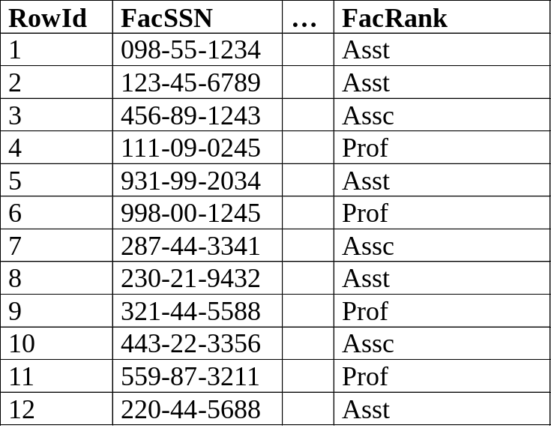
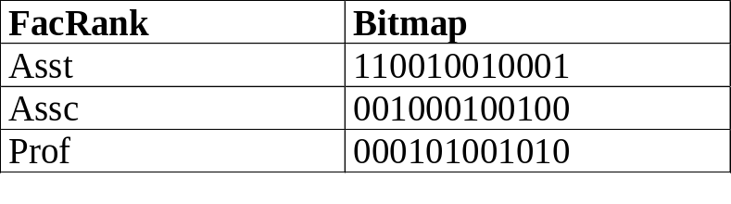
Bitmap Index Example
Faculty Table
Bitmap Index on FacRank
Notes:
This slide depicts a bitmap column index for a sample Faculty table. A bitmap contains a string of bits (0 or 1 values) with one bit for each row of a table. In this slide, the length of the bitmap is 12 positions because there are 12 rows in the sample Faculty table.

Slide 40
Bitmap Join Index
Bitmap identifies rows of a related table.
Represents a precomputed join
Can define for a join column or a non-join column
Typically used in query dominated environments such as data warehouses (Chapter 16)
Notes:
In a bitmap join index, the bitmap identifies the rows of a related table, not the table containing the indexed column. Thus, a bitmap join index represents a pre-computed join from a column in a parent table to the rows of a child table that join with rows of the parent table. A join bitmap index can be defined for a join column such as FacSSN or a non join column such as FacRank.

Slide 41
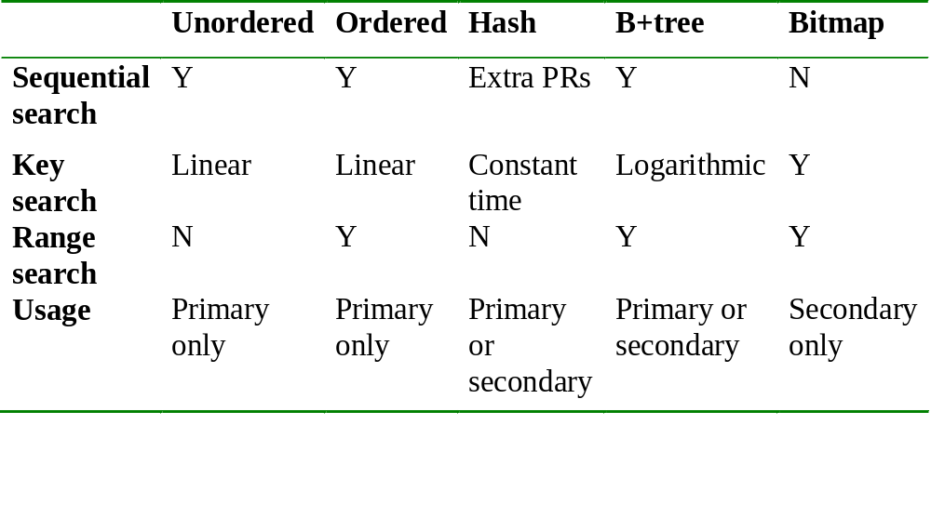
Summary of File Structures
Notes:
In the first row, hash files can be used for sequential access but there may be extra physical records because keys are evenly spread among physical records. In the second row, unordered and ordered sequential files must examine on average half the physical records (linear). Hash files examine a constant number (usually close to 1) of physical records assuming that the file is not too full. Btrees have logarithmic search costs because of the relationship between the height, the log function, and search cost formulas. File structures can store all the data of a table (primary file structure) or store only key data along with pointers to the data records (secondary file structure). A secondary file structure or index provides an alternative path to the data. A bitmap index supports range searches by performing union operations on the bitmaps for each column value in the range.

Slide 42
Query Optimization
Query optimizer determines implementation of queries.
Major improvement in software productivity
Improve performance with knowledge about the optimization process
Notes:
In most relational DBMSs, you do not have the choice of how queries are implemented on the physical database. The query optimization component assumes this responsibility. Your productivity increases because you do not need to make these tedious decisions. However, you can sometimes improve the optimization process if you understand it. To provide you with an understanding of the optimization process, this section describes the tasks performed and discusses tips to improve optimization results.

Slide 43
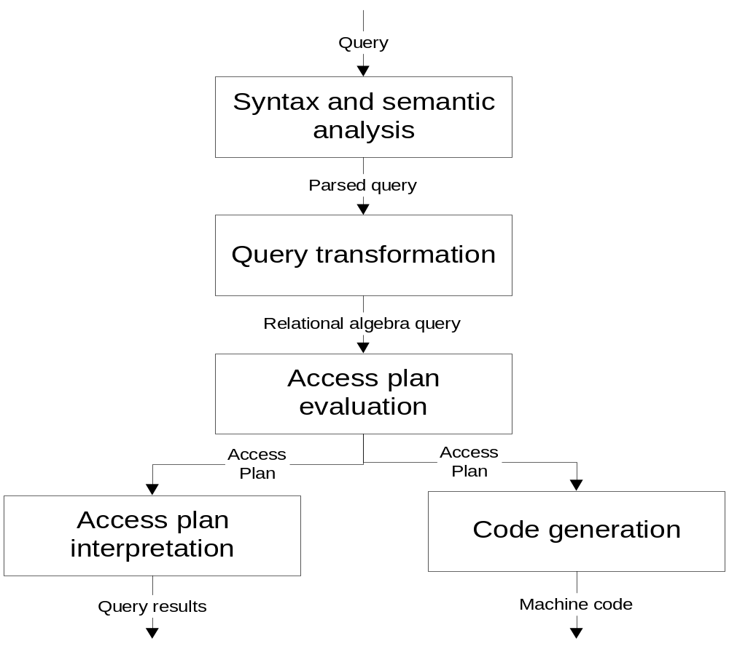
Translation Tasks
Notes:
When you submit an SQL statement for execution, the DBMS translates your query in four phases as shown in this figure. The first and fourth phases are common to any computer language translation process. The second phase has some unique aspects. The third phase is unique to translation of database languages.
The first phase, Syntax and Semantic Analysis, analyzes a query for syntax and simple semantic errors. Syntax errors involve misuse of keywords such as keyword misspelling. Semantic errors involve misuse of columns and tables such as incompatible data types.
The second phase, Query Transformation, transforms a query into a simplified and standardized format so that the query can be executed faster. While the simplification could be eliminating redundant parts of a logical expression, the standardized format is usually based on relational algebra.
The third, Access Plan Evaluation, phase determines how to implement the rearranged relational algebra expression as an access plan. Access Plan is a tree that encodes decisions about file structures to access individual tables, the order of joining tables, and the algorithm to join tables. Typically, The query optimization component evaluates a large number of access plans. Evaluating access plans can involve a significant amount of time when the query contains more than four tables. Each operation in an access plan has a corresponding cost formula that estimates the physical record accesses and CPU operations. The cost formulas use table profiles to estimate the number of rows in a result. The query optimization component chooses the access plan with the lowest cost.
The last phase, Access Plan Execution, executes the selected access plan. The query optimization component either generates machine code or interprets the access plan. Execution of machine code results in faster response than interpreting an access plan. However, most DBMSs interpret access plans because of the variety of hardware supported. The performance difference between interpretation and machine code execution is usually not significant for most users.

Slide 44
Access Plan Evaluation
Optimizer evaluates thousands of access plans
Access plans vary by join order, file structures, and join algorithm.
Some optimizers can use multiple indexes on the same table.
Access plan evaluation can consume significant resources
Notes:
The query optimization component evaluates a large number of access plans. Access plans vary by join orders, file structures, and join algorithms. For file structures, some optimization components can consider set operations to combine the results of multiple indexes on the same table. The query optimization component can evaluate many more access plans than you can mentally comprehend. Typically, the query optimization component evaluates thousands of access plans. Evaluating access plans can involve a significant amount of time when the query contains more than four tables.

Slide 45
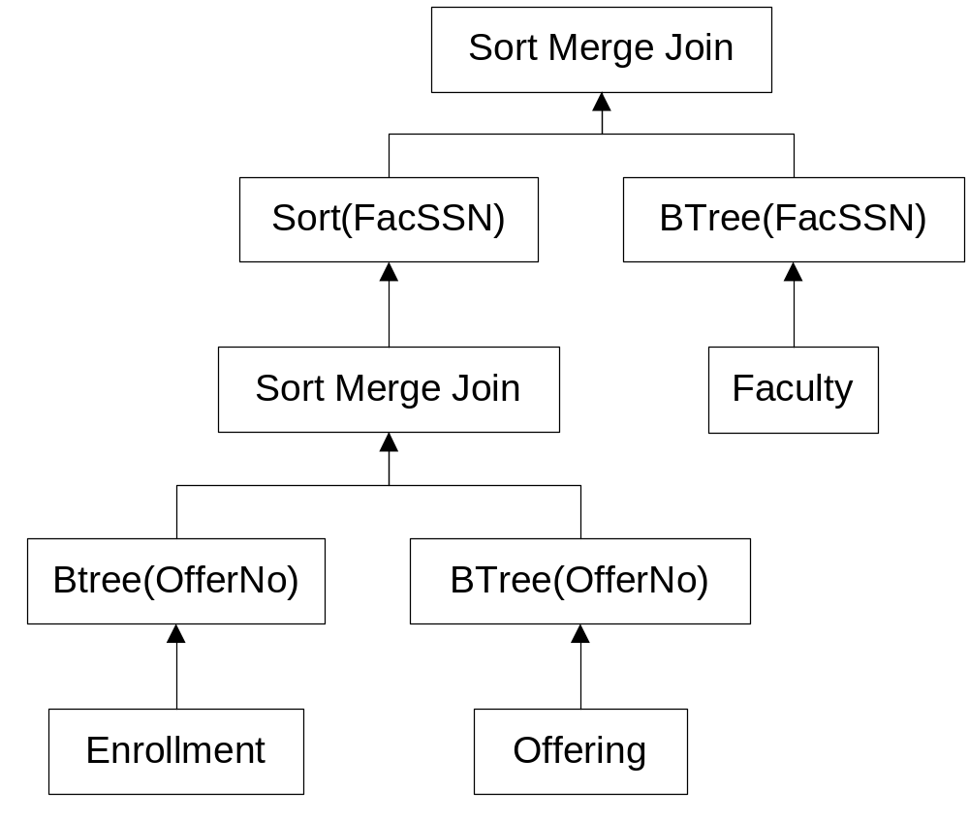
Access Plan Example 1
Notes:
An access plan indicates how to implement a query as operations on files, as depicted in this slide. In an access plan, the leaf nodes are individual tables in the query, and the arrows point upwards to indicate the flow of data. The nodes above the leaf nodes indicate decisions about accessing individual tables. In this slide, Btree indexes are used to access individual tables. The first join combines the Enrollment and the Offering tables. The Btree file structures provide the sorting needed for the merge join algorithm. The second join combines the result of the first join with the Faculty table. The intermediate result must be sorted on FacSSN before the merge join algorithm can be used.

Slide 46
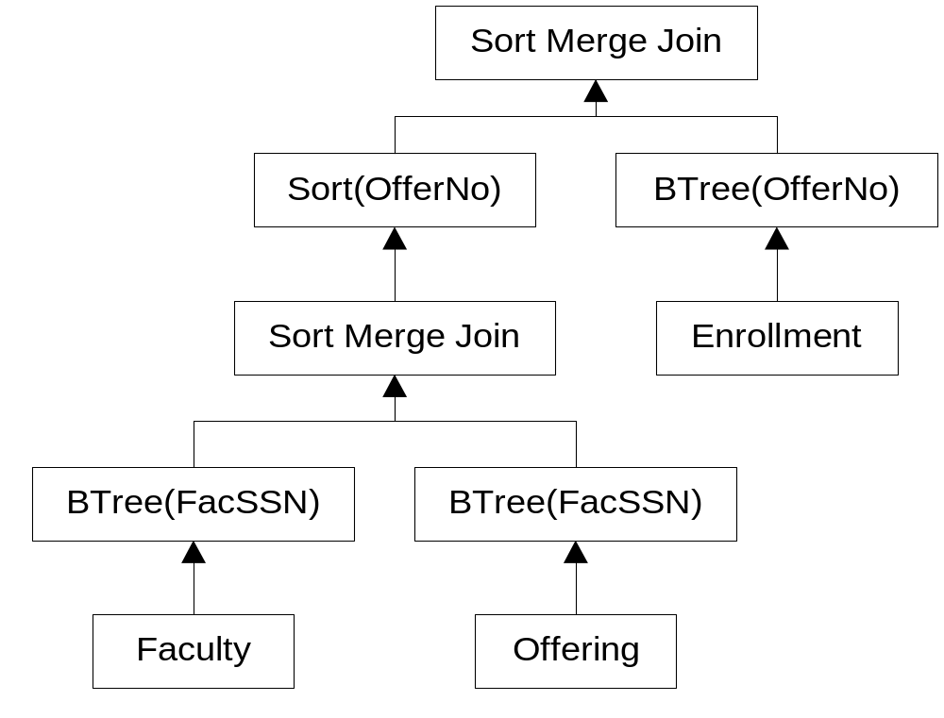
Access Plan Example 2
Notes:
This plan shows a variation of the access plan from the previous slide in which the join order is changed.

Slide 47
Join Algorithms
Nested loops: inner and outer loops; universal
Sort merge: join column sorting or indexes
Hybrid join: combination of nested loops and sort merge
Hash join: uses internal hash table
Star join: uses bitmap join indexes
Notes:
For each join operation in a query, the optimization component considers each supported join algorithm. For the nested loops and the hybrid algorithms, the optimization component also must choose the outer table and the inner table. All algorithms except the star join involve two tables at a time. The star join can combine any number of tables matching the star pattern (a child table surrounded by parent tables in 1-M relationships). The nested loops algorithm can be used with any join operation, not just an equi-join operation.

Slide 48
Improving Optimization Results
Monitor poorly performing access plans
Look for problems involving table profiles and query coding practices
Use hints carefully to improve results
  Override optimizer judgment
  Cover file structures, join algorithms, and join orders
  Use as a last result
Notes:
To improve poor decisions in access plans, some enterprise DBMSs allow hints that influence the choice of access plans. For example, Oracle allows hints to choose the optimization goal, the file structures to access individual tables, the join algorithm, and the join order. Hints should be used with caution because they override the judgment of the optimizer. Hints with join algorithms and join orders are especially problematic because of the subtlety of these decisions. Overriding the judgment of the optimizer should only be done as a last resort after determining the cause of poor performance. In many cases, the database administrator can fix problems with table profile deficiencies and query coding style to improve performance rather than override the judgment of the optimizer.

Slide 49
Table Profile Deficiencies
Detailed and current statistics needed
Beware of uniform value assumption and independence assumption
Use hints to overcome optimization blind spots
  Estimation of result size for parameterized queries
  Correlated columns: multiple index access may be useful
Notes:
A hint can be useful for conditions involving parameter values. If the database administrator knows that the typical parameter values result in the selection of few rows, a hint can be used to force the optimization component to use an index.
An optimization component sometimes needs detailed statistics on combinations of columns. If a combination of columns appears in the WHERE clause of a query, statistics on the column combination are important if the columns are not independent.
Most optimization components assume that combinations of columns are statistically independent to simplify the estimation of the number of rows. Unfortunately, few DBMSs maintain statistics on combinations of columns. If a DBMS does not maintain statistics on column combinations, a database designer may want to use hints to override the judgment of the DBMS when a joint condition in a WHERE clause generates few rows. Using a hint could force the optimization component to combine indexes when accessing a table rather than using a sequential table scan.

Slide 50
Query Coding Practices
Avoid functions on indexable columns
Eliminate unnecessary joins
For conditions on join columns, test the condition on the parent table.
Do not use the HAVING clause for row conditions.
Avoid repetitive binding of complex queries
Beware of queries that use complex views
Notes:
- You should not use functions on indexable columns as functions eliminate the opportunity to use an index. You should be especially aware of implicit type conversions even if a function is not used. An implicit type conversion occurs if the data type of a column and the associated constant value do not match.
- For queries involving 1-M relationships in which there is a condition on the join column, make the condition on the parent table rather than the child table.
- Conditions involving simple comparisons of columns in the GROUP BY clause belong in the WHERE clause, not the HAVING clause. Moving these conditions to the WHERE clause will eliminate rows sooner, thus providing faster execution.

Slide 51
Index Selection
Most important decision
Difficult decision
Choice of clustered and nonclustered indexes
Notes:
Index selection is the most important decision available to the physical database designer. However, it also can be one of the most difficult decisions. As a designer, you need to understand why index selection is difficult and the limitations of performing index selection without an automated tool

Slide 52
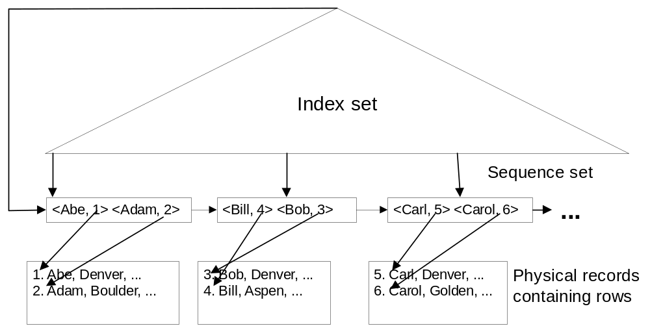
Clustering Index Example
Notes:
In a clustering index, the order of the rows is close to the index order. Close means that physical records containing rows will not have to be accessed more than one time if the index is accessed sequentially.
This figure shows the sequence set of a B+tree index pointing to associated rows inside physical records. Note that for a given node in the sequence set, most associated rows are clustered inside the same physical record.
Ordering the row data by the index field is a simple way to make a clustered index.

Slide 53
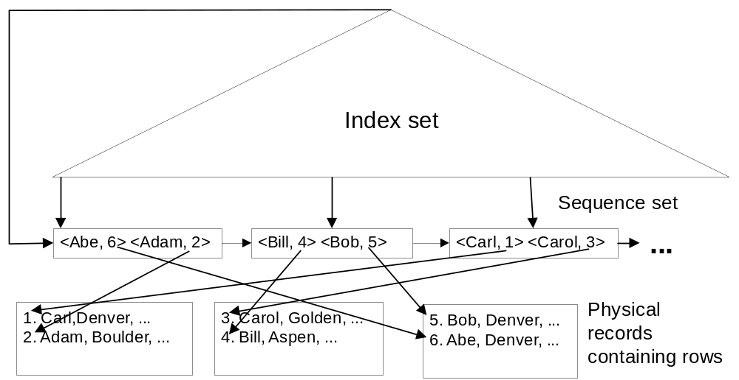
Nonclustering Index Example
Notes:
Contrast to clustering index, a nonclustering index does not have this closeness property. In a non-clustered index, the order of the rows is not related to the index order.
This figure shows that the same physical record may be repeatedly accessed when using the sequence set. The pointers from the sequence set nodes to the rows cross many times, indicating that the index order is different than the row order.

Slide 54
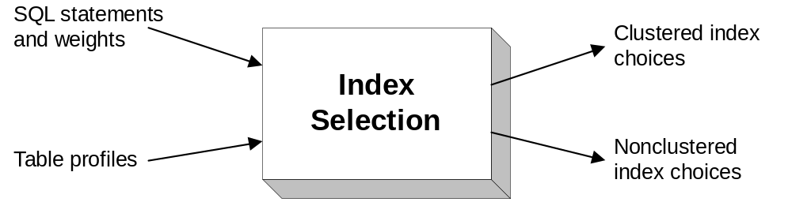
Inputs and Outputs of Index Selection
Notes:
Index selection involves choices about clustered and non-clustered indexes as shown in this figure. It is usually assumed that each table is stored in one file. The SQL statements indicate the database work to be performed by applications. The weights should combine the frequency of a statement with its importance. The table profiles must be specified in the same level of detail as required for query optimization.
Usually, the index selection problem is restricted to Btree indexes and separate files for each table.

Slide 55
Trade-offs in Index Selection
Balance retrieval against update performance
Nonclustering index usage:
  Few rows satisfy the condition in the query
  Join column usage if a small number of rows result in child table
Clustering index usage:
  Larger number of rows satisfy a condition than for nonclustering index
  Use in sort merge join algorithm to avoid sorting
  More expensive to maintain
Notes:
A clustering index can improve retrievals under more situations than a non-clustering index. A clustering index is useful in the same situations as a nonclustering index except that the number of resulting rows can be larger.
Merging rows is often a fast way to join tables if the tables do not need to be sorted (clustered indexes exist).
Clustering index choices are more sensitive to maintenance than nonclustering index choices. Clustering indexes are more expensive to maintain than nonclustering indexes because the data file must be changed similar to an ordered sequential file.

Slide 56
Difficulties of Index Selection
Application weights are difficult to specify.
Distribution of parameter values needed
Behavior of the query optimization component must be known.
The number of choices is large.
Index choices can be interrelated.
Notes:
Index selection is difficult to perform well for a variety of reasons:
− Application weights are difficult to specify. Judgments that combine frequency and importance can make the result subjective.
- Distribution of parameter values is sometimes needed. Many SQL statements in reports and forms use parameter values. If parameter values vary from being highly selective to not very selective, selecting indexes is difficult.
• The behavior of the query optimization component must be known. Even if an index appears useful for a query, the query optimization component must use it. There may be subtle reasons why the query optimization component does not use an index, especially a non-clustering index.
• The number of choices is large. Even if indexes on combinations of columns are ignored, the theoretical number of choices is exponential in the number of columns (2^{NC} where NC is the number of columns). Although many of these choices can be easily eliminated, the number of practical choices is still quite large.
• Index choices can be interrelated. The interrelationships can be subtle especially when choosing indexes to improve join performance.
An index selection tool can help with the last three problems. A good tool should use the query optimization component to derive cost estimates for each application under a given choice of indexes. However, a good tool cannot help alleviate the difficulty of specifying application weights and parameter value distributions.

Slide 57
Selection Rules I
Rule 1: A primary key is a good candidate for a clustering index.
Rule 2: To support joins, consider indexes on foreign keys.
Rule 3: A column with many values may be a good choice for a non-clustering index if it is used in equality conditions.
Rule 4: A column used in highly selective range conditions is a good candidate for a non-clustering index.
Rule 5: A combination of columns used together in query conditions may be good candidates for nonclustering indexes if the joint conditions return few rows, the DBMS optimizer supports multiple index access, and the columns are stable.
Notes:
Despite the difficulties previously discussed, you usually can avoid poor index choices by following some simple rules.

Slide 58
Selection Rules II
Rule 6: A frequently updated column is not a good index candidate.
Rule 7: Volatile tables (lots of insertions and deletions) should not have many indexes.
Rule 8: Stable columns with few values are good candidates for bitmap indexes if the columns appear in WHERE conditions.
Rule 9: Avoid indexes on combinations of columns. Most optimization components can use multiple indexes on the same table.

Slide 59
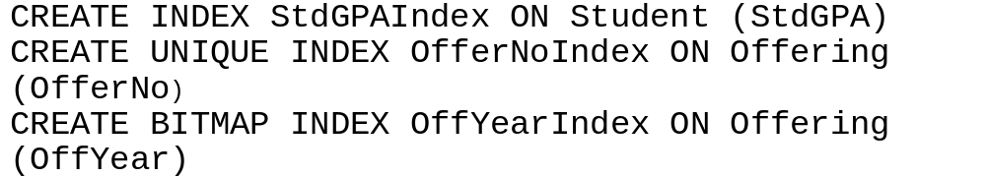
Index Creation
To create the indexes, the CREATE INDEX statement can be used.
The word following the INDEX keyword is the name of the index.
CREATE INDEX is not part of SQL:2003.
Examples

Slide 60
Denormalization
Additional choice in physical database design
Denormalization combines tables so that they are easier to query.
Use carefully because normalized designs have important advantages.
Notes:
Although index selection is the most important decision of physical database design, there are other decisions that can significantly improve performance.

Slide 61
Normalized designs
Better update performance
Require less coding to enforce integrity constraints
Support more indexes to improve query performance
Notes:
Denormalization should always be done with extreme care because a normalized design has important advantages.

Slide 62
Repeating Groups
Collection of associated values.
Normalization rules force repeating groups to be stored in an M table separate from an associated one table.
If a repeating group is always accessed with its associated parent table, denormalization may be a reasonable alternative.
Notes:
Repeating Groups is an additional situation under which denormalization may be justified.

Slide 63
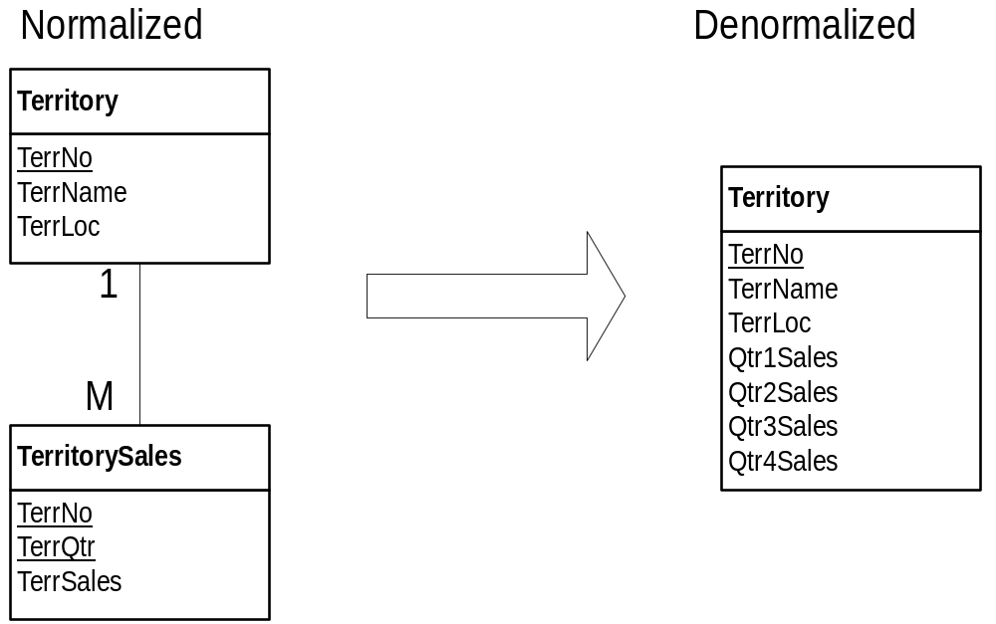
Denormalizing a Repeating Group
Notes:
This figure shows a denormalization example of quarterly sales data. Although the denormalized design does not violate BCNF, it is less flexible for updating than the normalized design. The normalized design supports an unlimited number of quarterly sales as compared to only four quarters of sales results for the denormalized design. However, the denormalized design does not require a join to combine territory and sales data.

Slide 64
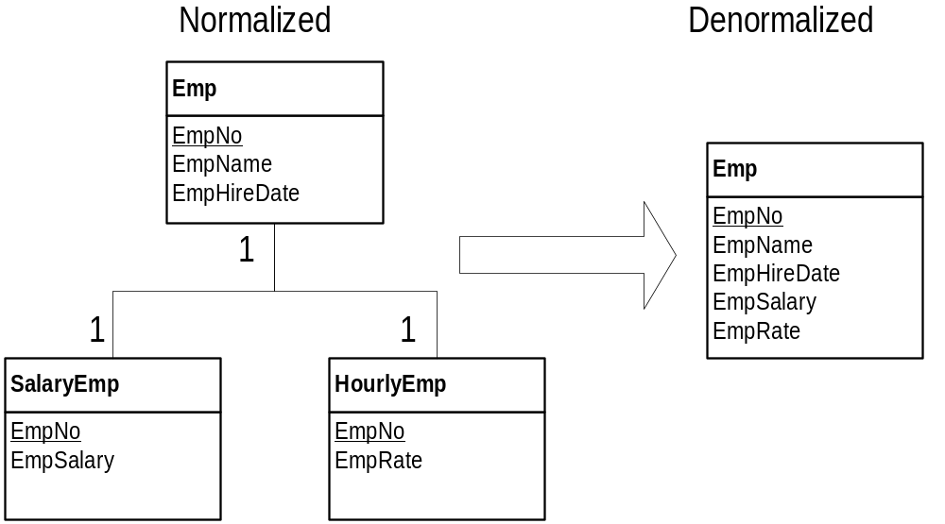
Denormalizing a Generalization Hierarchy
Notes:
Generalization Hierarchies can result in many tables. If queries often need to combine these separate tables, it may be reasonable to store the separate tables as one table.
This figure demonstrates denormalization of the Emp, HourlyEmp, and SalaryEmp tables. They have 1-1 relationships because they represent a generalization hierarchy. Although the denormalized design does not violate BCNF, the combined table may waste much space because of null values. However, the denormalized design avoids the outer join operator to combine the tables.

Slide 65
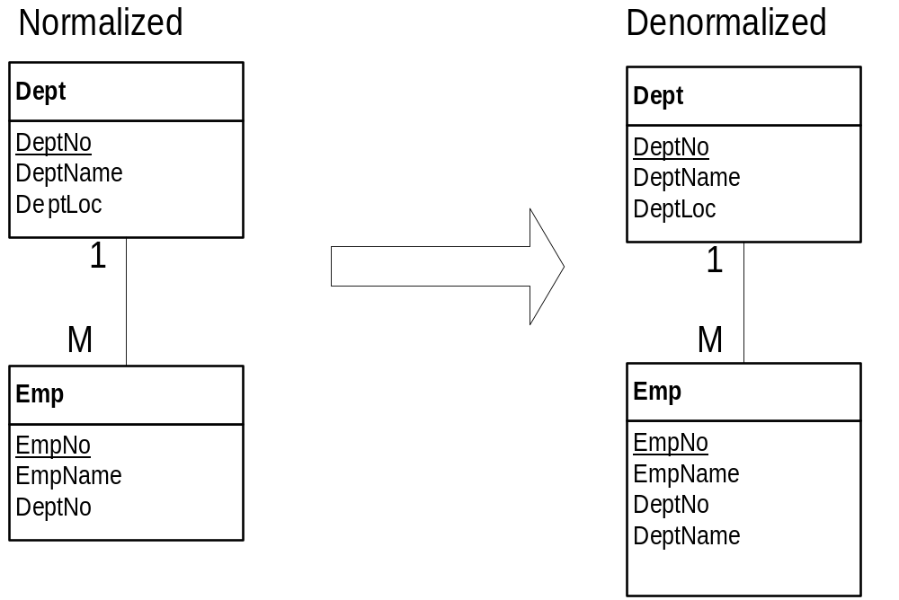
Codes and Meanings
Notes:
Normalization rules require that foreign keys be stored alone to represent 1-M relationships. If a foreign key represents a code, the user often requests an associated name or description in addition to the foreign key value. For example, the user may want to see the state name in addition to the state code. Storing the name or description column along with the code violates BCNF, but it eliminates some join operations. If the name or description column is not changed often, denormalization may be a reasonable choice. This figure demonstrates denormalization for the Dept and Emp tables. In the denormalized design, the DeptName column has been added to the Emp table.

Slide 66
Record Formatting
Record formatting decisions involve compression and derived data.
Compression is a trade-off between input-output and processing effort.
Derived data is a trade-offs between query and update operations.
Notes:
Record Formatting is another choice to improve database performance.
With an increasing emphasis on storing complex data types such as audio, video, and images, compression is becoming an important issue.
Compression reduces the number of physical records transferred but may require considerable processing effort to compress and decompress the data.
For query purposes, storing derived data reduces the need to retrieve data needed to calculate the derived data. However, updates to the underlying data require additional updates to the derived data. Storing derived data to reduce join operations may be reasonable.

Slide 67
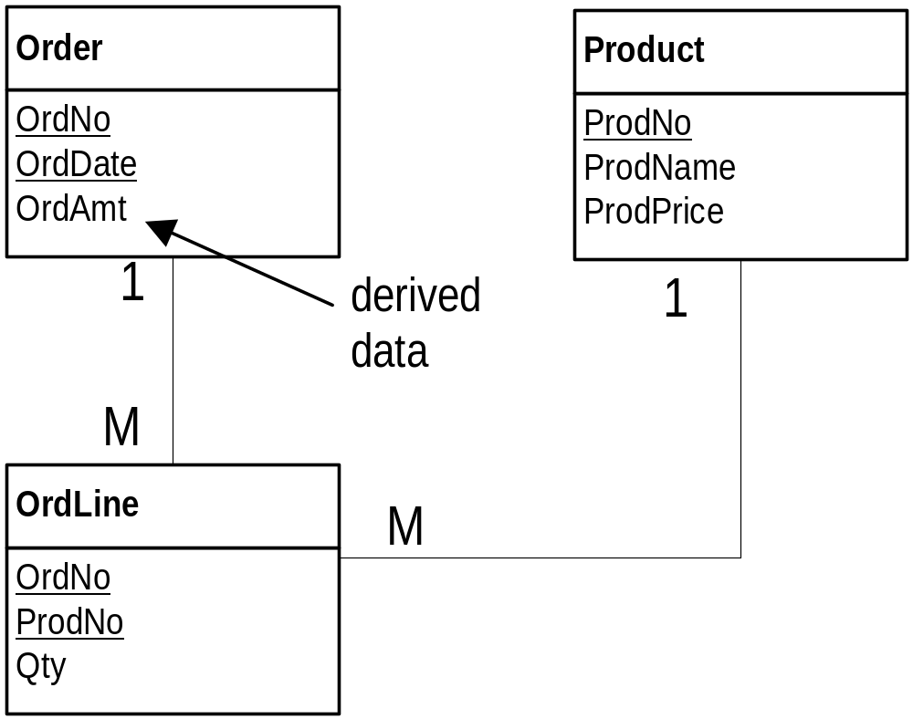
Storing Derived Data to
Improve Query Performance
Notes:
This figure demonstrates derived data in the Order table. If the total amount of an order is frequently requested, storing the derived column OrdAmt may be reasonable. Calculating order amount requires a summary or aggregate calculation of related OrdLine and Product rows to obtain the Qty and ProdPrice columns. Storing the OrdAmt column avoids two join operations.

Slide 68
Parallel Processing
Parallel processing can improve retrieval and modification performance.
Retrieving many records can be improved by reading physical records in parallel.
Many DBMSs provide parallel processing capabilities with RAID systems.
RAID is a collection of disks (a disk array) that operates as a single disk.
Notes:
For example, a report to summarize daily sales activity may read thousands of records from several tables. Parallel reading of physical records can reduce significantly the execution time of the report.
As a response to the potential performance improvements, many DBMSs provide parallel processing capabilities. These capabilities require hardware and software support for Redundant Arrays of Independent Disks (RAID).
More on parallel database processing in Chapter 17.

Slide 69
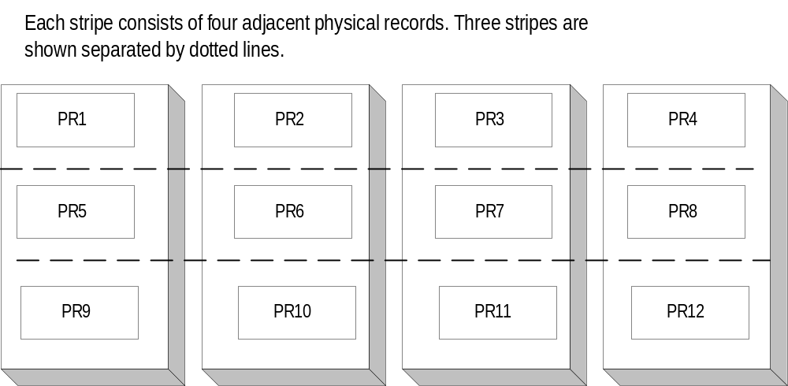
Striping in RAID
Storage Systems
Notes:
Striping is an important concept for RAID storage. Striping involves the allocation of physical records to different disks. A stripe is the set of physical records that can be read or written in parallel. Normally, a stripe contains a set of adjacent physical records. This figure depicts an array of four disks that allows the reading or writing of four physical records in parallel.
To utilize RAID storage, a number of architectures have emerged. The architectures, known as RAID-0 through RAID-6, support parallel processing with varying amounts of performance and reliability. Reliability is an important issue because the mean time between failures (a measure of disk drive reliability) decreases as the number of disk drives increases. To combat reliability concerns, RAID architectures incorporate redundancy and error-correcting codes.

Slide 70
Other Ways to Improve Performance
Transaction processing: add computing capacity and improve transaction design.
Data warehouses: add computing capacity and store derived data.
Distributed databases: allocate processing and data to various computing locations.
Notes:
There are a number of other ways to improve database performance that are related to a specific kind of processing. For transaction processing (Chapter 15), you can add computing capacity (faster and more processors, memory, and hard disk) and make trade-offs in transaction design. For data warehouses (Chapter 16), you can add computing capacity and design new tables with derived data. For distributed database processing (Chapter 17), you can allocate processing and data to various computing locations. Data can be allocated by partitioning a table vertically (column subset) and horizontally (row subset) to locate data close to its usage. These design choices are discussed in the respective chapters in Part 7.
In addition to tuning performance for specific processing requirements, you also can improve performance by utilizing options specific to a DBMS. For example, most DBMSs have options for file structures that can improve performance. You must carefully study the specific DBMS to understand these options. It may take several years of experience and specialized education to understand options of a particular DBMS. However, the payoff of increased salary and demand for your knowledge can be worth the study.

Slide 71
Summary
Goal: minimize response time
Constraints: disk space, memory, communication bandwidth
Table profiles and application profiles must be specified in sufficient detail.
Environment: file structures and query optimization
Monitor and possibly improve query optimization results
Index selection: most important decision
Other techniques: denormalization, record formatting, and parallel processing
Notes:
Response time involves minimization of processing time and disk accesses (most important) in centralized computing environments.
Constraints: disk space, memory, communication bandwidth

