Slide 1
CIS/CSC 384: Database Design
The Relational Data Model
(Based on Chapter 3)
Notes:
Welcome to Chapter 3 covering the Relational Data Model
Careful study of the relational data model
Goal of chapter: Understand existing databases so that you can write queries
Recognize relational database terminology
Understand the meaning of the integrity rules for relational databases
Understand the impact of referenced rows on maintaining relational databases
Understand the meaning of each relational algebra operator
List tables that must be combined to obtain desired results for simple retrieval requests
Relational databases are the dominant commercial standard
- Simplicity and familiarity with table manipulation
- Strong mathematical framework
- Lots of research and development

Slide 2
Outline
Relational model basics
Integrity rules
Rules about referenced rows
Relational Algebra
Notes:
Relational model basics:
- Tables
- Columns and data types
- Matching values
- Alternative terminology
- SQL CREATE TABLE statement
Integrity rules: primary and foreign keys
Referenced rows: actions when referenced rows are modified
Relational algebra
- Cover simple operators
- Provide separate slide shows for join, outer join, and division operators
- May want to mix relational algebra coverage with SQL

Slide 3
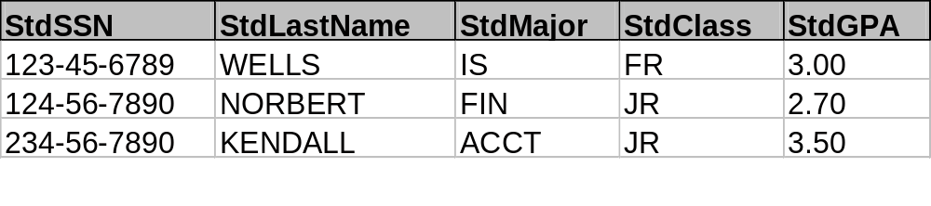
Tables
Relational database is a collection of tables
Heading: table name and column names
Body: rows, occurrences of data
Student
Notes:
Partial Student table:
- 5 columns
- 3 rows
- Real student table: 10 to 50 columns; thousands of rows
Convention:
- Table names begin with uppercase
- Mixed case for column names
- First part of column name is an abbreviation for the table name
- Upper case for data

Slide 4
CREATE TABLE Statement
CREATE TABLE Student
( StdSSN CHAR(11),
StdFirstName VARCHAR(50),
StdLastName VARCHAR(50),
StdCity VARCHAR(50),
StdState CHAR(2),
StdZip CHAR(10),
StdMajor CHAR(6),
StdClass CHAR(6),
StdGPA DECIMAL(3,2) )
Notes:
Define table name, column names, and column data types
Other clauses added later in the lecture
Data type:
- Set of values
- Permissible values
- Vary by DBMS
- CHAR: fixed length character strings
- VARCHAR: variable length character strings
- DECIMAL: fixed precision numbers
- Table 3-2 lists common data types

Slide 5
Common Data Types
CHAR(L)
VARCHAR(L)
INTEGER
FLOAT(P)
Date/Time: DATE, TIME, TIMESTAMP
DECIMAL(W, R)
BOOLEAN
Notes:
CHAR: fixed length character strings
VARCHAR: variable length character strings
Date/Time: SQL standard provides 3 data types; most DBMSs only support one data type; data type name is not standard across DBMSs

Slide 6
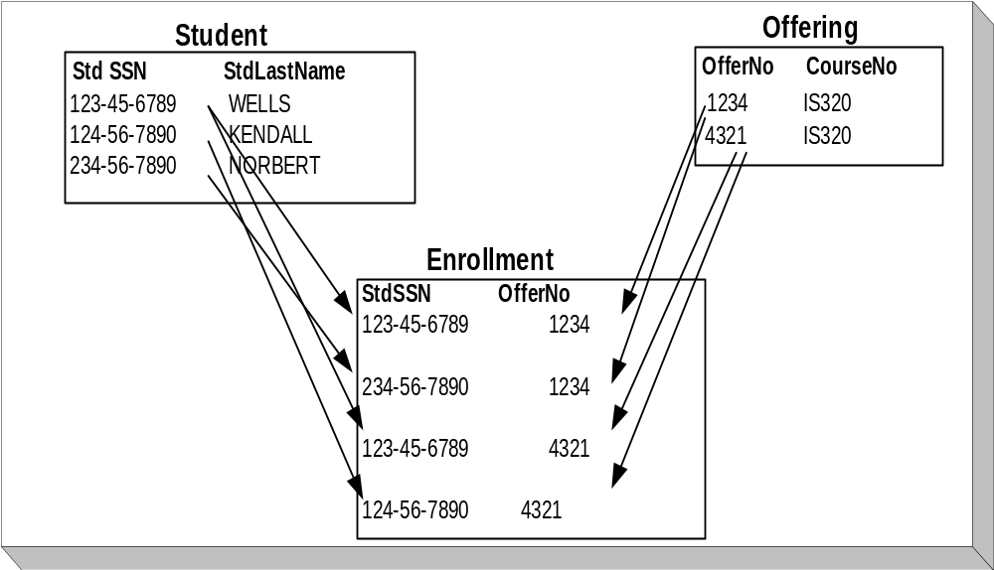
Relationships
Notes:
Shown by matching values
- First Student row (123-45-6789) related to 1st and 3rd rows of Enrollment table
- First Offering row (1234) related to 1st two rows of Enrollment table
Combine tables using matching values
Relational databases can have many tables (hundreds)
Follow matching values to combine tables:
- Combine Student and Enrollment where StdSSN matches
- Join operation

Slide 7
Alternative Terminology
Table-oriented | Set-oriented | Record-oriented
Table | Relation | Record-type, file
Row | Tuple | Record
Column | Attribute | Field
Notes:
Table-oriented: familiar
Set-oriented: mathematical
Record-oriented: IS staff
Terminology is often mixed: table, record, field

Slide 8
Integrity Rules
Entity integrity: primary keys
  Each table has column(s) with unique values
  Ensures entities are traceable
Referential integrity: foreign keys
  Values of a column in one table match values in a source table
  Ensures valid references among tables
Notes:
Informal definitions
Examples:
- Student rows are uniquely identified by StdSSN
- Offering rows are uniquely identified by OfferNo
- Enrollment rows are uniquely identified by the combination of StdSSN and OfferNo
- Enrollment.StdSSN refers to a valid StdSSN value in the Student table
- Enrollment.OfferNo refers to a valid OfferNo in the Offering table

Slide 9
Formal Definitions I
Superkey: column(s) with unique values
Candidate key: minimal superkey
Null value: special value meaning value unknown or inapplicable
Primary key: a designated candidate key; cannot contain null values
Foreign key: column(s) whose values must match the values in a candidate key of another table
Notes:
Prerequisite definitions
Superkey: concept of uniqueness; all columns are a superkey
Candidate key: unique without extra columns
Null value:
- Just moved: do not know phone number (value is unknown)
- Not married: do not have a maiden name (value is inapplicable)
Primary key:
- should be stable; names even if unique can change
- No null values
Foreign keys:
- linking columns
- Usually match to primary keys, not to candidate keys that are not primary keys

Slide 10
Formal Definitions II
Entity integrity
  No two rows with the same primary key value
  No null values in any part of a primary key
Referential integrity
  Foreign keys must match candidate key of source table
  Foreign keys can be null in some cases
  In SQL, foreign keys associated with primary keys
Notes:
Entity integrity rule: each table must have a primary key
Referential integrity: foreign keys are valid references except when null

Slide 11
Course Table Example
CREATE TABLE Course
( CourseNo CHAR(6),
CrsDesc VARCHAR(250),
CrsUnits SMALLINT,
CONSTRAINT PKCourse PRIMARY KEY(CourseNo),
CONSTRAINT UniqueCrsDesc UNIQUE (CrsDesc) )
Notes:
Extended CREATE TABLE statement
Primary key: CourseNo
Candidate key: CrsDesc (course description)
Named constraints: easier to reference; PKCourse, UniqueCrsDesc

Slide 12
Enrollment Table Example
CREATE TABLE Enrollment
( OfferNo INTEGER,
StdSSN CHAR(11),
EnrGrade DECIMAL(3,2),
CONSTRAINT PKEnrollment PRIMARY KEY
(OfferNo, StdSSN),
CONSTRAINT FKOfferNo FOREIGN KEY (OfferNo)
REFERENCES Offering,
CONSTRAINT FKStdSSN FOREIGN KEY (StdSSN) REFERENCES Student )
Notes:
Primary key:
- combination of OfferNo and StdSSN
- combined PK (or composite PK)
Foreign key constraints:
- OfferNo references Offering
- StdSSN references Student

Slide 13
Offering Table Example
CREATE TABLE Offering
( OfferNo INTEGER,
CourseNo CHAR(6) CONSTRAINT OffCourseNoRequired NOT NULL,
OffLocation VARCHAR(50),
OffDays CHAR(6),
OffTerm CHAR(6) CONSTRAINT OffTermRequired
NOT NULL,
OffYear INTEGER CONSTRAINT OffYearRequired
NOT NULL,
FacSSN CHAR(11),
OffTime DATE,
CONSTRAINT PKOffering PRIMARY KEY (OfferNo),
CONSTRAINT FKCourseNo FOREIGN KEY (CourseNo)
REFERENCES Course,
CONSTRAINT FKFacSSN FOREIGN KEY (FacSSN)
REFERENCES Faculty )
Notes:
NOT NULL keywords
Should use constraint names even for inline constraints
Inline constraints associated with a specific column
Easy to trace error when a constraint violation occurs
Two foreign keys:
- CourseNo: nulls not allowed
- FacSSN: nulls allowed; prepare catalog before instructors are assigned; permits flexibility

Slide 14
Self-Referencing Relationships
Foreign key that references the same table
Represents relationships among members of the same set
Not common but important in specialized situations
Notes:
Common self-referencing relationships:
- Organization chart: manages relationship
- Geneology chart: ancestor-descendant
- Courses: prerequisities
Specialized relationship:
- Not common
- Important when occurring

Slide 15
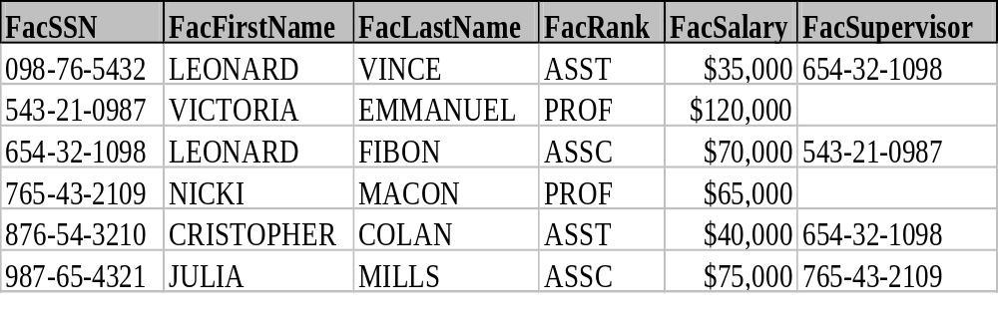
Faculty Data
Notes:
Omitted a few columns for brevity
FacSupervisor:
- Represents the SSN of the supervising faculty
- Null allowed because the top boss does not have a supervisor
- Two top bosses (two professors)

Slide 16
Hierarchical Data Display
543-21-0987
Victoria Emmanual
654-32-1098
Leonard Fibon
098-78-5432
Leonard Vince
876-54-3210
Cristopher Colan
Notes:
Partial hierarchical arrangement of faculty data
Victoria Emmanual has no boss (null value for FacSupervisor column)

Slide 17
Faculty Table Definition
CREATE TABLE Faculty
( FacSSN CHAR(11),
FacFirstName VARCHAR(50) NOT NULL,
FacLastName VARCHAR(50) NOT NULL,
FacCity VARCHAR(50) NOT NULL,
FacState CHAR(2) NOT NULL,
FacZipCode CHAR(10)NOT NULL,
FacHireDate DATE,
FacDept CHAR(6),
FacSupervisor CHAR(11),
CONSTRAINT PKFaculty PRIMARY KEY (FacSSN),
CONSTRAINT FKFacSupervisor FOREIGN KEY (FacSupervisor) REFERENCES Faculty )
Notes:
Omitted a few columns for brevity
Omitted named inline constraints for brevity
FacSupervisor:
- Represents the SSN of the supervising faculty
- Null allowed because the top boss does not have a supervisor

Slide 18
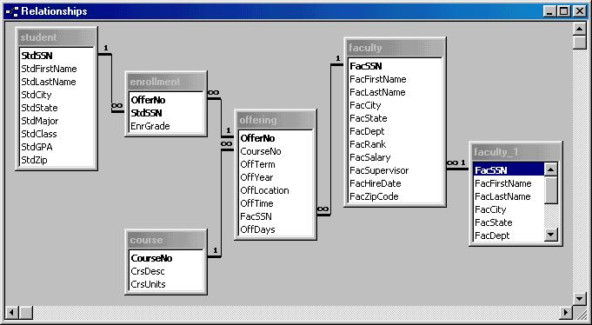
Relationship Window with
1-M Relationships
Notes:
Visual representation is easier to comprehend than CREATE TABLE statements
1 and ∞ symbols:
- 1-M relationships
- Student can have many enrollments
- Student is the parent (1) table
- Enrollment is the child (M) table
- Foreign key is shown near the ∞ symbol
Meaning of the Faculty_1 table
- Access representation for a self referencing relationship
- Faculty_1 is not a real table (placeholder for self referencing relationship)

Slide 19
M-N Relationships
Rows of each table are related to multiple rows of the other table
Not directly represented in the relational model
Use two 1-M relationships and an associative table
Notes:
Example:
- Student and Offering tables
- Student can take many offerings
- Offering can have many enrolled students
- Enrollment table and 1-M relationships represent this M-N relationship

Slide 20
Referenced Rows
Referenced row
  Foreign keys reference rows in the associated primary key table
  Enrollment rows refer to Student and Offering
Actions on referenced rows
  Delete a referenced row
  Change the primary key of a referenced row
  Referential integrity should not be violated
Notes:
Referenced row: has rows in associated foreign key tables that reference it
Actions:
- Delete a referenced row
- Change the PK of a referenced row
- Must maintain referential integrity; both events could invalidate referential integrity

Slide 21
Possible Actions
Restrict: do not permit action on the referenced row (default in Oracle)
Cascade: perform action on related rows
Nullify: only valid if foreign keys accept null values (specified as SET NULL)
Such constraints can be specified ON DELETE/ON UPDATE. (Oracle does not support constraints ON UPDATE).
Notes:
Restrict: do not allow action on the referenced row
- Most conservative (and common) approach
- Foreign key rows must be deleted (PK updates) before primary key (referenced rows)
- Update: awkward; insert a new PK row, update the foreign key row, delete the old PK row
Cascade:
- Use carefully: can cause changes to many rows
- Automation: only specify action on the referenced row
- Use for closely related tables (deleting a PK row always results in deletion of related row); Order – OrderLine tables
Nullify:
- a reasonable option for relationships that accept null values
- do not forget to update the null value

Slide 22
SQL Syntax for Actions
CREATE TABLE Enrollment
( OfferNo INTEGER NOT NULL,
StdSSN CHAR(11) NOT NULL,
EnrGrade DECIMAL(3,2),
CONSTRAINT PKEnrollment PRIMARY KEY(OfferNo, StdSSN),
CONSTRAINT FKOfferNo FOREIGN KEY (OfferNo) REFERENCES Offering
ON DELETE CASCADE,
CONSTRAINT FKStdSSN FOREIGN KEY (StdSSN) REFERENCES Student
ON DELETE SET NULL )
Notes:
NO ACTION means restrict;
Most DBMSs do not allow all options:
- Access permits restrict (default) and cascade
- Oracle does not have the ON UPDATE clause
- Oracle only permits CASCADE/SET NULL for the ON DELETE clause; default is restrict

Slide 23
Relational Algebra Overview
Collection of table operators
Transform one or two tables into a new table
Understand operators in isolation
Classification
  Table specific operators
  Traditional set operators
  Advanced operators
Notes:
You can think of relational algebra similarly to the algebra of numbers except that the objects are different: algebra applies to numbers and relational algebra applies to tables. In algebra, each operator transforms one or more numbers into another number. Similarly, each operator of relational algebra transforms a table (or two tables) into a new table.
This section emphasizes the study of each relational algebra operator in isolation. For each operator, you should understand its purpose and inputs. While it is possible to combine operators to make complicated formulas, this level of understanding is not important for developing query formulation skills. Using relational algebra by itself to write queries can be awkward because of details such as ordering of operations and parentheses. Therefore, you should seek only to understand the meaning of each operator, not how to combine operators to write expressions.
Table specific: restrict, project, join, outer join, cross product
Traditional set: union, intersection, difference
Advanced (specialized): summarize, division
See Chapter03FiguresTables for extended operator examples

Slide 24
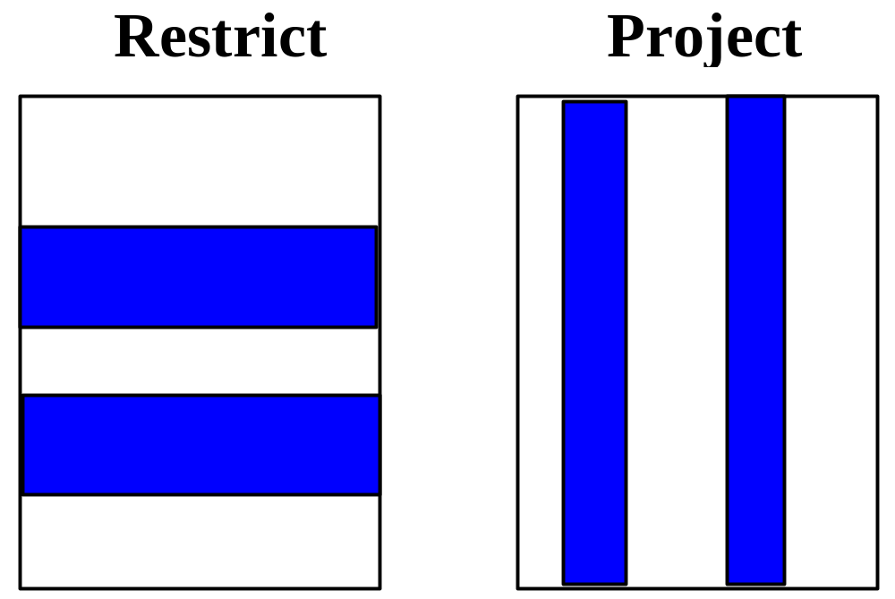
Subset Operators
Notes:
Simple and widely used operators
Restrict: an operator that retrieves a subset of the rows of the input table that satisfy a given condition; also known as select
Project: an operator that retrieves a specified subset of the columns of the input table.

Slide 25
Subset Operator Notes
Restrict
  Logical expression as input
  Example: OffDays = 'MW' AND OffTerm = 'SPRING' AND OffYear = 2006
Project
  List of columns is input
  Duplicate rows eliminated if present
Often used together
Notes:
The logical expression used in the restrict operator can include comparisons involving columns and constants. Complex logical expressions can be formed using the logical operators AND, OR, and NOT.
A project operation can have a side effect. Sometimes after a subset of columns is retrieved, there are duplicate rows. When this occurs, the project operator removes the duplicate rows. For example, if Offering.CourseNo is the only column used in a project operation, only three rows are in the result (Table 3-9) even though the Offering table (Table 3-4) has nine rows. The column Offering.CourseNo contains only three unique values in Table 3-4. Note that if the primary key or a candidate key is included in the list of columns, the resulting table has no duplicates. For example, if OfferNo was included in the list of columns, the result table would have nine rows with no duplicate removal necessary.

Slide 26
Extended Cross Product
Building block for join operator
Builds a table consisting of all combinations of rows from each of the two input tables
Produces excessive data
Subset of cross product is useful (join)
Notes:
Extended Cross Product: an operator that builds a table consisting of all combinations of rows from each of the two input tables.
The extended cross product operator can combine any two tables. Other table combining operators have conditions about the tables to combine. Because of its unrestricted nature, the extended cross product operator can produce tables with excessive data. The extended cross product operator is important because it is a building block for the join operator. When you initially learn the join operator, knowledge of the extended cross product operator can be useful. After you gain experience with the join operator, you will not need to rely on the extended cross product operator.

Slide 27
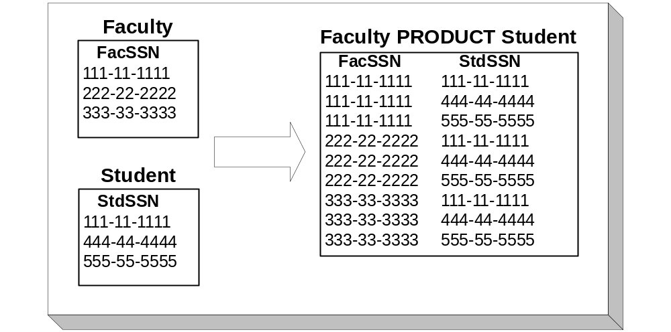
Extended Cross Product Example
Notes:
The extended cross product (product for short) operator shows everything possible from two tables. The product of two tables is a new table consisting of all possible combinations of rows from the two input tables. Figure 4 depicts a product of two single column tables. Each result row consists of the columns of the Faculty table (only FacSSN) and the columns of the Student table (only StdSSN). The name of the operator (product) derives from the number of rows in the result. The number of rows in the resulting table is the product of the number of rows of the two input tables. In contrast, the number of result columns is the sum of the columns of the two input tables. In Figure 4, the result table has nine rows and two columns.
[1] The extended cross product operator is also known as the “Cartesian” product after French mathematician Rene Descartes.

Slide 28
Join Operator
Most databases have many tables
Combine tables using the join operator
Specify matching condition
  Can be any comparison but usually =
  PK = FK most common join condition
  Relationship diagram useful when combining tables
Notes:
Most joins follow relationship diagram
- PK-FK comparisons
- What tables can be combined directly versus indirectly

Slide 29
Natural Join Operator
Most common join operator
Requirements
  Equality matching condition
  Matching columns with the same unqualified names
  Remove one join column in the result
Usually performed on PK-FK join columns

Slide 30
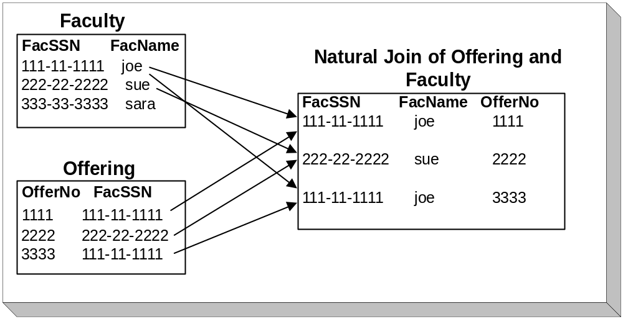
Natural Join Example
Notes:
Work with small tables:
- Useful for understanding the join operation
- Useful for difficult problems
Join condition: Faculty.FacSSN = Offering.FacSSN
Matching rows:
- First Faculty row with row 1 and row 3 of Offering
- Second Faculty row with row 2 of Offering
Join can be applied to multiple tables:
- Join two tables
- Join a third table to the result of the first two tables
- Join Faculty to Offering
- Join the result to Course
Natural join:
- Same unqualified column names (names without table names)
- Equality
- Discard one of the join columns (arbitrary for now which join column is discarded)
- Most popular variation of the join

Slide 31
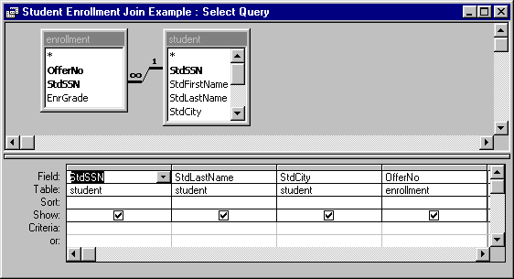
Visual Formulation of Join
Notes:
Microsoft Access Query Design tool
Similar tools in other DBMSs
To form this join, you need only to select the tables. Access determines that you should join over the StdSSN column. Access assumes that most joins involve a primary key and foreign key combination. If Access chooses the join condition incorrectly, you can choose other join columns.

Slide 32
Outer Join Overview
Join excludes non matching rows
Preserving non matching rows is important in some business situations
Outer join variations
  Full outer join
  One-sided outer join
Notes:
Importance of preserving non matching rows:
- Offerings without assigned faculty
- Orders without sales associates
Outer join variations:
- Full: preserves non matching rows of both tables
- One-sided: preserves non matching rows of the designated table
- One-sided outer join is more common

Slide 33
Outer Join Operators
Full outer join
Left Outer Join
Right Outer Join
Join
Unmatched rows of the left table
Matched rows using the join condition
Unmatched rows of the right table
Notes:
Outer join matching:
- join columns, not all columns as in traditional set operators
- One-sided outer join: preserving non matching rows of a designated table
(left or right)
- Full outer join: preserving non matching rows of both tables
- See outer join animation for interactive demonstration

Slide 34
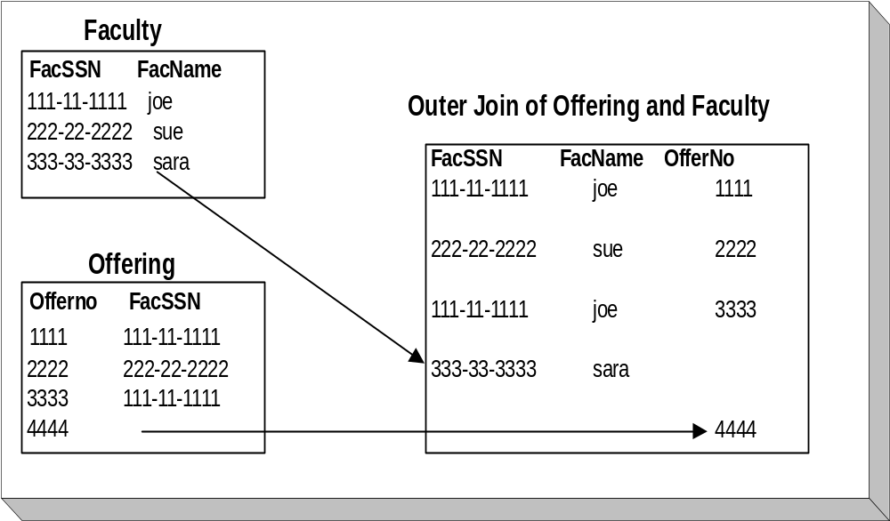
Full Outer Join Example
Notes:
Outer join result:
- Join part: rows 1 – 3
- Outer join part: non matching rows (rows 4 and 5)
- Null values in the non matching rows: columns from the other table
One-sided outer join:
- Preserve non matching rows of the designated table
- Preserve the Faculty table in the result: first four rows
- Preserve the Offering table: first three rows and fifth row

Slide 35
Traditional Set Operators
A UNION B
A INTERSECT B
A MINUS B
Notes:
Rows of table are the analog of members of a set
- Union: rows in either table
- Intersection: rows common to both tables
- Difference: rows in one table but not in the other table
Usage:
- More limited compared to join, restrict, project
- Combine geographically dispersed tables (student tables from different
branch campuses)
- Difference operator: complex matching problems such as to find faculty not
teaching courses in a given semester; Chapter 9 presentation

Slide 36
Union Compatibility
Requirement for the traditional set operators
Strong requirement
  Same number of columns
  Each corresponding column is compatible
  Positional correspondence
Apply to similar tables by removing columns first
Notes:
How are rows compared?
- Join: compares rows on the join column(s)
- Traditional set operators compare on all columns
Strong requirement:
- Usually on identical tables (geographically dispersed tables)
- Compatible columns: data types are comparable (numbers cannot be compared
to strings)
- Positional: 1st column of table A to 1st column of table B, 2nd column etc
Can be applied to similar tables (faculty and student) by removing columns before traditional set operator

Slide 37
Summarize Operator
Decision-making operator
Compresses groups of rows into calculated values
Simple statistical (aggregate) functions
Not part of original relational algebra
Notes:
Summarize: an operator that produces a table with rows that summarize the rows of the input table. Aggregate functions are used to summarize the rows of the input table.
Summarize is a powerful operator for decision making. Because tables can contain many rows, it is often useful to see statistics about groups of rows rather than individual rows. The summarize operator allows groups of rows to be compressed or summarized by a calculated value. Almost any kind of statistical function can be used to summarize groups of rows. Because this is not a statistics book, we will use only simple functions such as count, min, max, average, and sum.

Slide 38
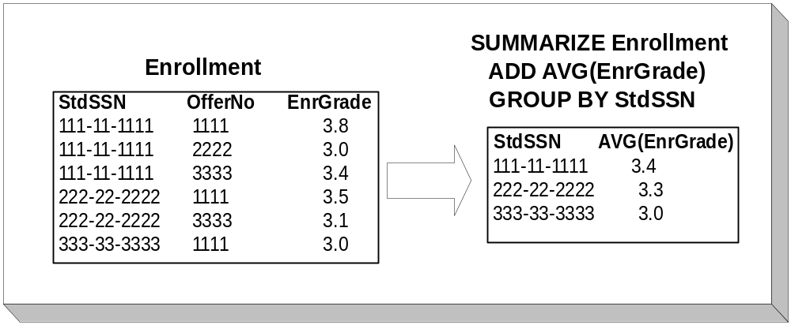
Summarize Example
Notes:
The summarize operator compresses a table by replacing groups of rows with individual rows containing calculated values. A statistical or aggregate function is used for the calculated values. The slide depicts a summarize operation for a sample enrollment table. The input table is grouped on the StdSSN column. Each group of rows is replaced by the average of the grade column.
Relational algebra syntax is not important: study SQL syntax in Chapter 3

Slide 39
Divide Operator
Match on a subset of values
  Suppliers who supply all parts
  Faculty who teach every IS course
Specialized operator
Typically applied to associative tables representing M-N relationships
Notes:
Subset matching:
- Use of every or all connecting different parts of a sentence
- Use any or some: join problem
- Specialized matching but important when necessary
- Conceptually difficult
Table structures:
- Typically applied to associative tables such as Enrollment, Supp-Part, StdClub
- Can also be applied to M tables in a 1-M relationship (Offering table)

Slide 40
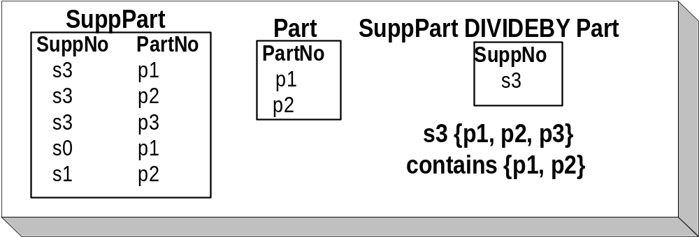
Division Example
Notes:
Table structure:
- SuppPart: associative table between Part and Supp tables
- List suppliers who supply every part
Formulation:
- See Division animation for interactive presentation
- Sort SuppPart table by SuppNo
- Choose Suppliers that are associated with every part
- Set of parts for a supplier contains the set of all parts
- S3 associated with P1, P2, and P3
- Must look at all rows with S3 to decide whether S3 is in the result

Slide 41
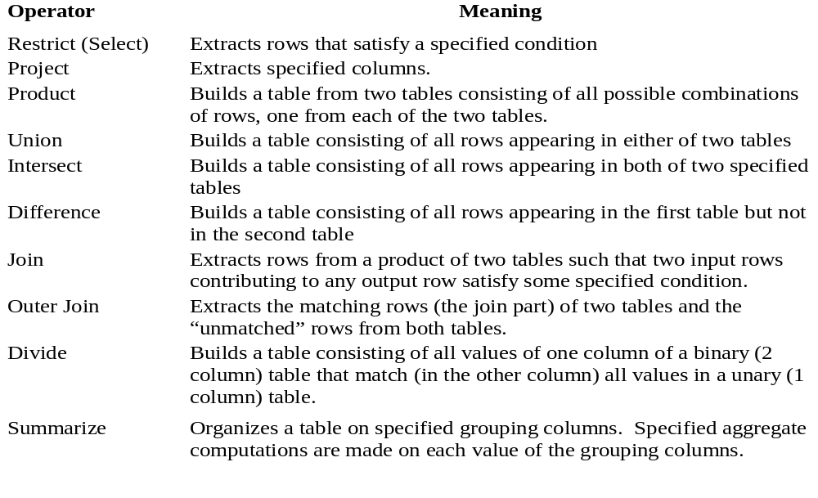
Relational Algebra Summary

Slide 42
Summary
Relational model is commercially dominant
Learn primary keys, data types, and foreign keys
Visualize relationships
Understanding existing databases is crucial to query formulation
Notes:
Commercial dominance:
- Simple and familiar
- Theoretically sound
- Lots of R&D
- SQL standard
Understand a database is a prerequisite to query formulation
- How are rows identified? PKs and CKs
- What data can be compared? Data type knowledge
- How can tables be combined? Foreign keys and relationship details (1-M, M-N, self-referencing)
- Visualization: show the direct and indirect connections among tables

