Slide 1
CIS/CSC 384: Database Design
Query Formulation with SQL
(Chapter 4)
Notes:
Welcome to Chapter 4 on query formulation with SQL
Query formulation is an important skill in application development
Everyone involved in the application dev. must be competent in query formulation
Most students will be involved (at least initially) in application development rather than in a role as a database specialist. Database specialists must also understand query formulation and SQL.
Objectives:
- Query formulation: problem statement into a database representation
- SELECT statement: syntax and patterns for subset operations, joins, summarization,
traditional set operators, and data manipulation operations
- Write English descriptions to document SQL statements
- Need lots of practice with query formulation and SQL

Slide 2
Outline
Background
Getting started
Joining tables
Summarizing tables
Problem solving guidelines
Advanced problems
Data manipulation statements
Notes:
Background:
- SQL history
- SQL usage contexts
Getting started:
- SQL syntax
- Single table problems
- Grouping problems
Join styles:
- Cross product style
- Join operator style
- Joins and grouping
Problem solving guidelines:
- Conceptual process
- Critical questions
Traditional set operators:
- Union, intersection, difference
- Union compatibility: requirement for using the operators
- Data manipulation statements: INSERT, UPDATE, DELETE
Include slides on join and traditional set operators: use these if covering relational algebra as part of SQL

Slide 3
What is SQL?
Structured Query Language
Language for database definition, manipulation, and control
International standard
Standalone and embedded usage
Intergalactic database speak
Notes:
Pronunciation: sequel due to its original name
Comprehensive database language
- Database definition: CREATE TABLE
- Manipulation: retrieval and modification of rows
- Control: integrity and security constraints
Standards:
- American National Standards Institute (ANSI), International Standards Organization (ISO)
- SQL-86: 1986 (1989 revision to SQL-89)
- SQL-92: 1992
- SQL:1999 current standard
- SQL:2003
Usage contexts:
- Write and execute statements using a specialized editor (standalone)
- Embed statements into a procedural language (embedded)
Michael Stonebraker called SQL “intergalactic database speak”

Slide 4
SQL Statements
Statement | Chapter
CREATE TABLE | 3, 18
SELECT | 3, 9, 10
INSERT, UPDATE | 3, 10
DELETE | 3, 9, 10
CREATE VIEW | 10
CREATE TRIGGER | 11
GRANT, REVOKE | 14
COMMIT, ROLLBACK | 15
CREATE TYPE | 18
Notes:
Categories:
- Definition: CREATE TABLE, ALTER TABLE, CREATE VIEW
- Manipulation: SELECT, INSERT, UPDATE, DELETE, COMMIT, ROLLBACK
- Control: GRANT, REVOKE, CREATE ASSERTION
- Other statements: SET (Chapter 15)
- Oracle specific statements: CREATE MATERIALIZED VIEW (16), CREATE DIMENSION (16)

Slide 5
SQL Standardization
Relatively simple standard: SQL-86 and revision (SQL-89)
Modestly complex standard: SQL-92
Complex standards: SQL:1999 and SQL:2003
Notes:
The size and scope of the SQL standard has increased significantly since the first standard was adopted. The original standard (SQL-86) contained about 150 pages, while the SQL-92 standard contained more than 600 pages. In contrast, the most recent standards (SQL:1999 and SQL:2003) contained more than 2,000 pages. The early standards (SQL-86 and SQL-89) had two levels (entry and full). SQL-92 added a third level (entry, intermediate, and full). The SQL:1999 and SQL:2003 standards contain a single level called Core SQL along with additional parts and packages for noncore features. SQL:2003 contains three core parts, six optional parts, and seven optional packages.

Slide 6
SQL Conformance
No official conformance testing
Vendor claims about conformance
Reasonable conformance on Core SQL
Large variance on conformance outside of Core SQL
Difficult to write portable SQL code outside of Core SQL
Notes:
The weakness of the SQL standards is the lack of conformance testing. Until 1996, the U.S. Department of Commerce’s National Institute of Standards and Technology conducted conformance tests to provide assurance that government software can be ported among conforming DBMSs. Since 1996, however, DBMS vendor claims have substituted for independent conformance testing. Even for Core SQL, the major vendors lack support for some features and provide proprietary support for other features. With the optional parts and [MVM1] packages, conformance has much greater variance. Writing portable SQL code requires careful study for Core SQL but is not possible for advanced parts of SQL.

Slide 7
SELECT Statement Overview
SELECT <list of column expressions>
FROM <list of tables and join operations>
WHERE <list of logical expressions for rows>
GROUP BY <list of grouping columns>
HAVING <list of logical expressions for groups>
ORDER BY <list of sorting specifications>
Expression: combination of columns, constants, operators, and functions
Notes:
Conventions:
- Upper case: keywords
- Angle brackets: supply data
Expression examples:
- StdFirstName: student first name
- FacSalary * 1.1 : inflate salary by 10%
Logical expression:
- T/F value
- AND, OR, NOT
- Logical expressions can be rather complex (nested queries); will not
discuss complexities until Unit 4
Rows vs. Groups: distinction will be made clear as lecture proceeds
Show examples in Access SQL and Oracle SQL
- Some important differences
- Most vendors implement a super/subset of SQL92
- Vendors now support some parts of SQL:2003: Chapter 18

Slide 8
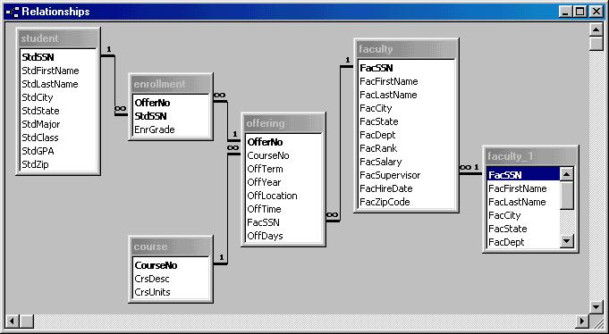
University Database
Notes:
Use university database for examples
Use some new examples not found in the textbook
You should work order entry examples: 40 to 60 problems to be proficient
Both databases are found in the textbook’s web site.

Slide 9
First SELECT Examples
Example 1
SELECT * FROM Faculty
Example 2 (Access)
SELECT *
FROM Faculty
WHERE FacSSN = '543210987'
Example 3
SELECT FacFirstName, FacLastName, FacSalary
FROM Faculty
Example 4
SELECT FacFirstName, FacLastName, FacSalary
FROM Faculty
WHERE FacSalary > 65000 AND FacRank = 'PROF'
Notes:
Example 1:
- Retrieves all rows and columns
- * in the SELECT clause evaluates to all columns of the FROM tables
Example 2:
- Retrieves a single faculty row (subset of rows)
- Relational algebra: restrict operation (row subset)
- Oracle: use hyphens in FacSSN constant (543-21-0987)
Example 3:
- Retrieves a subset of columns
- Relational algebra: subset of columns
Example 4:
- Retrieves a subset of rows and columns
- Sequence of restrict and project operations

Slide 10
Using Expressions
Example 5 (Access)
SELECT FacFirstName, FacLastName, FacCity,
FacSalary*1.1 AS IncreasedSalary,
FacHireDate
FROM Faculty
WHERE year(FacHireDate) > 1996
Example 5 (Oracle)
SELECT FacFirstName, FacLastName, FacCity,
FacSalary*1.1 AS IncreasedSalary,
FacHireDate
FROM Faculty
WHERE to_number(to_char(FacHireDate, 'YYYY'))
> 1996
Notes:
Example 5:
- Retrieves faculty hired after 1996
- Inflates salary by 10%
Different functions by DBMS: need to carefully study documentation

Slide 11
Inexact Matching
Match against a pattern: LIKE operator
Use meta characters to specify patterns
  Wildcard (* or %)
  Any single character (? or _)
Example 6 (Access)
SELECT *
FROM Offering
WHERE CourseNo LIKE 'IS*'
Example 6 (Oracle)
SELECT *
FROM Offering
WHERE CourseNo LIKE 'IS%'
Notes:
Common patterns:
- Strings with specified endings
- Strings with specified beginnings
- Strings containing a substring
Meta characters:
- Special meaning when using the LIKE operator
- Many others available: study DBMS documentation
Example 6:
- Retrieves offerings of IS course numbers
- Access supports SQL standard meta characters (% and _) in SQL-92 query mode

Slide 12
Using Dates
Dates are numbers
Date constants and functions are not standard
Example 7 (Access)
SELECT FacFirstName, FacLastName, FacHireDate
FROM Faculty
WHERE FacHireDate BETWEEN #1/1/1999#
AND #12/31/2000#
Example 7 (Oracle)
SELECT FacFirstName, FacLastName, FacHireDate
FROM Faculty
WHERE FacHireDate BETWEEN '1-Jan-1999'
AND '31-Dec-2000'
Notes:
Date manipulation:
- Not strings: do not use pattern matching characters even though some DBMSs permit
(not portable)
- Study documentation carefully for date functions and constant formats
BETWEEN-AND operator:
- Closed interval (includes end points)
- Short cut for >= AND <=
- No shortcuts for other intervals

Slide 13
Other Single Table Examples
Example 8: Testing for null values
SELECT OfferNo, CourseNo
FROM Offering
WHERE FacSSN IS NULL AND OffTerm = 'SUMMER'
AND OffYear = 2006
Example 9: Mixing AND and OR
SELECT OfferNo, CourseNo, FacSSN
FROM Offering
WHERE (OffTerm = 'FALL' AND OffYear = 2005)
OR (OffTerm = 'WINTER' AND OffYear = 2006)
Notes:
Example 8:
- Retrieve summer 2003 offerings without an assigned instructor
- Use IS NULL to test for null values
Example 9:
- Retrieve offerings in Fall 2002 or Winter 2003
-Always use parentheses when mixing AND and OR
- Reader may not know default evaluation
- Easy to make a mistake
- May not be portable if parentheses are not used

Slide 14
Join Operator
Most databases have many tables
Combine tables using the join operator
Specify matching condition
  Can be any comparison but usually =
  PK = FK most common join condition
  Relationship diagram useful when combining tables
Notes:
Chapter 3 material: can present again for review
Can instead present material in Chapter 4 and skip when initially covering chapter 3
Most joins follow relationship diagram
- PK-FK comparisons
- What tables can be combined directly versus indirectly

Slide 15
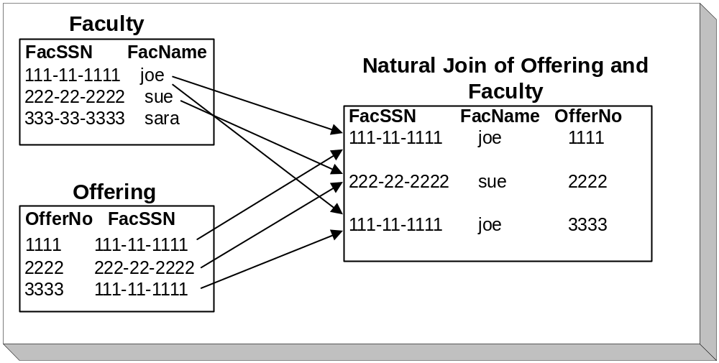
Join Example
Notes:
Work with small tables: Chapter 3 material; present again for review if necessary
- Can instead present material in Chapter 4 and skip when initially covering chapter 3
- Useful for understanding the join operation
- Useful for difficult problems
Join condition: Faculty.FacSSN = Offering.FacSSN
Matching rows:
- First Faculty row with row 1 and row 3 of Offering
- Second Faculty row with row 2 of Offering
Join can be applied to multiple tables:
- Join two tables
- Join a third table to the result of the first two tables
- Join Faculty to Offering
- Join the result to Course
Natural join:
- Same unqualified column names (names without table names)
- Equality
- Discard one of the join columns (arbitrary for now which join column is discarded)
- Most popular variation of the join

Slide 16
Cross Product Style
List tables in the FROM clause
List join conditions in the WHERE clause
Example 10 (Oracle)
SELECT OfferNo, CourseNo, FacFirstName,
FacLastName
FROM Offering, Faculty
WHERE OffTerm = 'FALL' AND OffYear = 2005
AND FacRank = 'ASST' AND CourseNo LIKE 'IS%'
AND Faculty.FacSSN = Offering.FacSSN
Notes:
Meaning: details of offerings and assigned faculty for fall 2005 IS courses taught by assistant professors
Cross Product Style:
- Name comes from derivation of the join operator
- Join is equivalent of a cross product, selection (retain just matching rows)
Extension for multiple tables:
- Add tables to the FROM clause
- Add join conditions to the WHERE clause
Order of tables and join conditions is NOT order dependent
Access version: use * instead of %

Slide 17
Join Operator Style
Use INNER JOIN and ON keywords
FROM clause contains join operations
Example 11
SELECT OfferNo, CourseNo, FacFirstName,
FacLastName
FROM Offering INNER JOIN Faculty
ON Faculty.FacSSN = Offering.FacSSN
WHERE OffTerm = 'FALL' AND OffYear = 2005
AND FacRank = 'ASST' AND CourseNo LIKE 'IS*'
Notes:
Join Operator Style:
- SQL:1999, SQL:2003, Oracle 9i, 10g, and Access
- Oracle 8i does not support
Extension for multiple tables:
- Need to use parentheses in Access
- Conceptually no need for parentheses because join is associative
(order of operations does not matter)
- Nested parentheses are difficult to read
- Harder to find the tables in the statement

Slide 18
Name Qualification
Ambiguous column reference
  More than one table in the query contains a column referenced in the query
  Ambiguity determined by the query not the database
Use column name alone if query is not ambiguous
Qualify with table name if query is ambiguous
Readability versus writability
Notes:
Ambiguous:
- More than one table in the query contains a column referenced in the query
- Ambiguity determined by the query not the database
Example 9:
- Offering and Faculty tables
- Reference to FacSSN is ambiguous unless qualified
- Reference to CourseNo is not ambiguous: Course table is not in the query
Readability:
- qualified names are easier to read (no context to imply)
Writability:
- Unqualified names require fewer keystrokes (less work)
Column naming convention:
- Table name abbreviation: Std for Student
- Column names easy to associate with tables without qualification

Slide 19
Summarizing Tables
Row summaries important for decision-making tasks
Row summary
  Result contains statistical (aggregate) functions
  Conditions involve statistical functions
SQL keywords
  Aggregate functions in the output list
  GROUP BY: summary columns
  HAVING: summary conditions
Notes:
Row summary: compress multiple rows into a single row
Row details are important for operational decision-making (resolving a customer complaint, finding lost shipment, …)
Row summaries are important for tactical and strategic decision-making (remove details)
Problem involves row summaries:
- Result contains aggregate functions: count of students enrolled, average salary, sum of the credit hours
- Conditions involve aggregate functions: number of students enrolled less than 10
SQL features for summarizing tables:
- Aggregate functions in output list
- Standard aggregate functions (COUNT, MIN, MAX, SUM, AVG)
- Most DBMSs have many other functions available
- GROUP BY columns: indicate columns to summarize on
- HAVING (optional): indicate group conditions

Slide 20
GROUP BY Examples
Example 12: Grouping on a single column
SELECT FacRank, AVG(FacSalary) AS AvgSalary
FROM Faculty
GROUP BY FacRank
Example 13: Row and group conditions
SELECT StdMajor, AVG(StdGPA) AS AvgGpa
FROM Student
WHERE StdClass IN ('JR', 'SR')
GROUP BY StdMajor
HAVING AVG(StdGPA) > 3.1
Notes:
Example 12:
- Row summary because output uses AVG function
- Rename output column when using aggregate expressions
- Retrieves a one row per faculty rank (ASST, ASSC, PROF)
Example 13:
- Summarize majors of upperclass students by average gpa; only include majors
with avggpa > 3.1
- Row condition: cannot use aggregate function
- Group condition: uses aggregate functions
- Do not use a condition in HAVING unless the condition involves an aggregate function

Slide 21
SQL Summarization Rules
Columns in SELECT and GROUP BY
  SELECT: non aggregate and aggregate columns
  GROUP BY: list all non aggregate columns
WHERE versus HAVING
  Row conditions in WHERE
  Group conditions in HAVING
Notes:
Columns in SELECT and GROUP BY:
- Syntactic rule: syntax error if you do not follow
- All columns not part of aggregate function must appear in GROUP BY
- Applicable to some difficult problems involving joins and grouping
WHERE vs. HAVING:
- WHERE conditions: cannot have aggregate functions (syntax error)
- HAVING: only use conditions that involve an aggregate function
- Query executes more slowly if HAVING includes row conditions

Slide 22
Summarization and Joins
Powerful combination
List join conditions in the WHERE clause
Example 14: List the number of students enrolled in each fall 2006
offering.
SELECT Offering.OfferNo,
COUNT(*) AS NumStudents
FROM Enrollment, Offering
WHERE Offering.OfferNo = Enrollment.OfferNo
AND OffYear = 2006
GROUP BY Offering.OfferNo
Notes:
Why combine:
- Relational databases have many tables
- Data for decision making is often spread across many tables

Slide 23
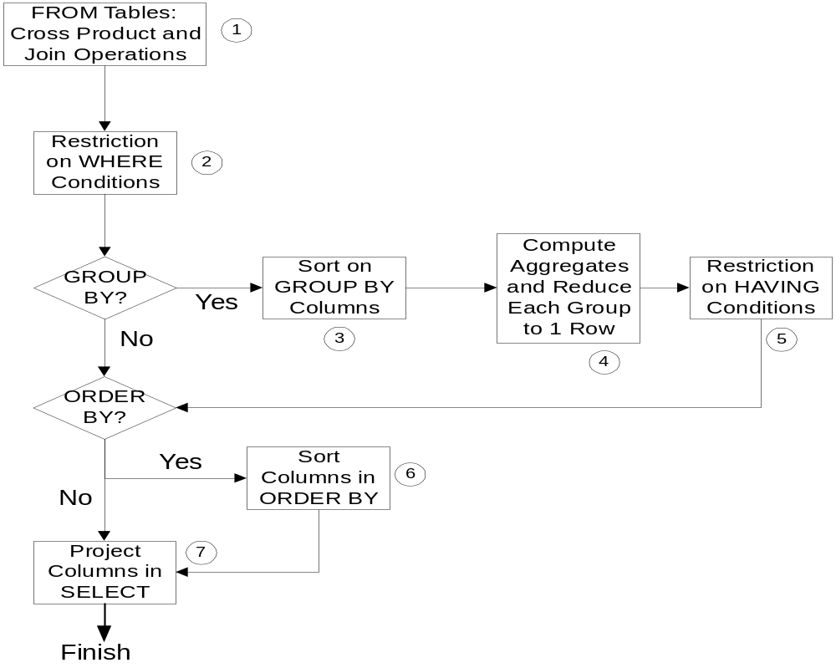
Conceptual Evaluation Process
Notes:
The conceptual evaluation process is a sequence of operations as indicated in this slide. This process is conceptual rather than actual because most SQL compilers can produce the same output using many shortcuts. Because the shortcuts are system specific, rather mathematical, or performance oriented, we will not review them. The conceptual evaluation process provides a foundation for understanding the meaning of SQL statements that is independent of system and performance issues.
Step 1: FROM clause (cross product and join operators)
Step 2: WHERE clause (row conditions)
Step 3: GROUP BY clause (sort on grouping columns, compute aggregrates)
Step 4: HAVING clause (group conditions)
Step 5: ORDER BY clause
Step 6: eliminate columns not in SELECT (projection operation)

Slide 24
Conceptual Evaluation Lessons
Row operations before group operations
  FROM and WHERE before GROUP BY and HAVING
  Check row operations first
Grouping occurs only one time
Use small sample tables
Notes:
Conceptual evaluation process:
- Sequence of steps to evaluate a SELECT statement
- Conceptual not actual: DBMSs use many shortcuts
Row operations occur first
- Errors in formulation usually occur in row operations
- Use small tables to understand relationship of row operations (FROM, WHERE) to
group operations (GROUP, HAVING)
- For large problems, execute row operations separately to ensure that results
before grouping are what you expect
Grouping only occurs one time: only an issue for advanced problems when summarizing on independent columns

Slide 25
Conceptual Evaluation Problem
Example 15: List the number of offerings taught in 2006 by faculty rank and department. Exclude combinations of faculty rank and department with less than two offerings taught.
SELECT FacRank, FacDept,
COUNT(*) AS NumOfferings
FROM Faculty, Offering
WHERE Offering.FacSSN = Faculty.FacSSN
AND OffYear = 2006
GROUP BY FacRank, FacDept
HAVING COUNT(*) > 1
Notes:
Use sample university db
- Try to derive answer by hand (only derive a subset of the cross product)
- Use Access SQL to derive row operations first
- Execute entire query to see final result

Slide 26
Query Formulation Process
Problem Statement
Database
Representation
Database Language
Statement
Notes:
Problem statement:
- Ill formed (without structure)
- Most difficult part is to structure the problem statement (convert to db representation)
- Convert problem vocabulary into database vocabulary
- Problem statement is often ambiguous and incomplete
Database representation: answers to query formulation questions
- Tables
- Columns
- Conditions
DB Language statement:
- SQL or other language
- Easy part after some practice

Slide 27
Critical Questions
What tables?
  Columns in output
  Conditions to test (including join conditions)
How to combine the tables?
  Usually join PK to FK
  More complex ways to combine
Individual rows or groups of rows?
  Aggregate functions in output
  Conditions with aggregate functions
Notes:
Answer questions explicitly or implicitly
- Initially answer explicitly
- As you gain skill, implicitly answer
Chapter 9 for more complex ways to combine tables
- Outer join
- Difference
- Division

Slide 28
Efficiency Considerations
Little concern for efficiency
Intelligent SQL compilers
Correct and non redundant solution
  No extra tables
  No unnecessary grouping
  Use HAVING for group conditions only
Chapter 8 provides additional tips for avoiding inefficient SELECT statements
Notes:
Ideally little concern for efficiency
SQL compilers:
- Consider thousands of alternative plans to evaluate the query
- Should not be sensitive to the order of clauses or join style
- Complex queries do require efficiency concern: advanced db course topic
Eliminate redundancy:
- Slows performance
- Avoid extra tables: performance most sensitive to the number of joins
- Grouping is also expensive: avoid if not necessary
- Slow performance if row conditions in HAVING
- Improve performance by reducing the size of intermediate tables through WHERE conditions

Slide 29
Advanced Problems
Joining multiple tables
Self joins
Grouping after joining multiple tables
Traditional set operators
Notes:
Let’s apply your query formulation skills and knowledge of the SELECT statement to more difficult problems. All problems in this section involve the parts of SELECT discussed in Sections 3.2 and 3.3. The problems involve more difficult aspects such as joining more than two tables, grouping after joins of several tables, joining a table to itself, and traditional set operators.

Slide 30
Joining Three Tables
Example 16: List Leonard Vince’s teaching schedule in fall 2005. For each course, list the offering number, course number, number of units, days, location, and time.
SELECT OfferNo, Offering.CourseNo, OffDays,
CrsUnits, OffLocation, OffTime
FROM Faculty, Course, Offering
WHERE Faculty.FacSSN = Offering.FacSSN
AND Offering.CourseNo = Course.CourseNo
AND OffYear = 2005 AND OffTerm = 'FALL'
AND FacFirstName = 'Leonard'
AND FacLastName = 'Vince'
Notes:
List Leonard Vince’s teaching schedule in fall 1999. For each course, list the offering number, course number, number of units, days, location, and time.

Slide 31
Joining Four Tables
Example 17: List Bob Norbert’s course schedule in spring 2006. For each course, list the offering number, course number, days, location, time, and faculty name.
SELECT Offering.OfferNo, Offering.CourseNo,
OffDays, OffLocation, OffTime,
FacFirstName, FacLastName
FROM Faculty, Offering, Enrollment, Student
WHERE Offering.OfferNo = Enrollment.OfferNo
AND Student.StdSSN = Enrollment.StdSSN
AND Faculty.FacSSN = Offering.FacSSN
AND OffYear = 2006 AND OffTerm = 'SPRING'
AND StdFirstName = 'BOB'
AND StdLastName = 'NORBERT'
Notes:
The Enrollment table is needed even though it does not supply columns in the result or conditions to test. The Enrollment table is needed to connect the Student table with the Offering table.

Slide 32
Self-Join
Join a table to itself
Usually involve a self-referencing relationship
Useful to find relationships among rows of the same table
  Find subordinates within a preset number of levels
  Find subordinates within any number of levels requires embedded SQL
Notes:
Self-Join: a join between a table and itself (two copies of the same table). Self-joins are useful for finding relationships among rows of the same table.
Problems involving self-referencing (unary) relationships are part of tree-structured queries. In tree-structured queries, a table can be visualized as a structure such as a tree or hierarchy. For example, the Faculty table has a structure showing an organization hierarchy. At the top, the college dean resides. At the bottom, faculty members without subordinates reside. Similar structures apply to the chart of accounts in accounting systems, part structures in manufacturing systems, and route networks in transportation systems.
A more difficult problem than a self-join is to find all subordinates (direct or indirect) in an organization hierarchy. This problem can be solved in SQL if the number of subordinate levels is known. One join for each subordinate level is needed. Without knowing the number of subordinate levels, this problem cannot be done in SQL2 although it can be solved in SQL3 and with proprietary extensions of SQL2. In SQL2, tree-structured queries can be solved by using SQL inside a programming language.

Slide 33
Self-Join Example
Example 18: List faculty members who have a higher salary than their supervisor. List the social security number, name, and salary of the faculty and supervisor.
SELECT Subr.FacSSN, Subr.FacLastName,
Subr.FacSalary, Supr.FacSSN,
Supr.FacLastName, Supr.FacSalary
FROM Faculty Subr, Faculty Supr
WHERE Subr.FacSupervisor = Supr.FacSSN
AND Subr.FacSalary > Supr.FacSalary
Notes:
The foreign key, FacSupervisor, shows relationships among Faculty rows. To find the supervisor name of a faculty member, match on the FacSupervisor column with the FacSSN column. The trick is to imagine that you are working with two copies of the Faculty table. One copy plays the role of the subordinate, while the other copy plays the role of the superior. In SQL, a self-join requires alias names (Subr and Supr) in the FROM clause to distinguish between the two roles or copies.

Slide 34
Multiple Joins Between Tables
Example 19: List the names of faculty members and the course number for which the faculty member teaches the same course number as his or her supervisor in 2006.
SELECT FacFirstName, FacLastName, O1.CourseNo
FROM Faculty, Offering O1, Offering O2
WHERE Faculty.FacSSN = O1.FacSSN
AND Faculty.FacSupervisor = O2.FacSSN
AND O1.OffYear = 2006 AND O2.OffYear = 2006
AND O1.CourseNo = O2.CourseNo
Notes:
This problem involves two joins between the same two tables (Offering and Faculty). Alias table names (O1 and O2) are needed to distinguish between the two copies of the Offering table used in the statement.

Slide 35
Multiple Column Grouping
Example 20: List the course number, the offering number, and the number of students enrolled. Only include courses offered in spring 2006.
SELECT CourseNo, Enrollment.OfferNo,
Count(*) AS NumStudents
FROM Offering, Enrollment
WHERE Offering.OfferNo = Enrollment.OfferNo
AND OffYear = 2006 AND OffTerm = 'SPRING'
GROUP BY Enrollment.OfferNo, CourseNo
Notes:
After studying Example 20, you might be confused about the necessity to group on both OfferNo and CourseNo. One simple explanation is that any columns appearing in SELECT must be either a grouping column or an aggregrate expression. However, this explanation does not quite tell the entire story. Grouping on OfferNo alone produces the same values for the computed column (NumStudents) because OfferNo is the primary key. Including non-unique columns such as CourseNo adds information to each result row but does not change the aggregate calculations. If you do not understand this point, use sample tables to demonstrate it. When evaluating your sample tables, remember that joins occur before grouping.

Slide 36
Traditional Set Operators
A UNION B
A INTERSECT B
A MINUS B
Notes:
Rows of table are the analog of members of a set
- Chapter 3 material: present again for review if desired;
- Can present material in Chapter 4 and skip when initially covering chapter 3
- Union: rows in either table
- Intersection: rows common to both tables
- Difference: rows in one table but not in the other table
Usage:
- More limited compared to join, restrict, project
- Combine geographically dispersed tables (student tables from different
branch campuses)
- Difference operator: complex matching problems such as to find faculty not
teaching courses in a given semester; Chapter 9 presentation

Slide 37
Union Compatibility
Requirement for the traditional set operators
Strong requirement
  Same number of columns
  Each corresponding column is compatible
  Positional correspondence
Apply to similar tables by removing columns first
Notes:
How are rows compared?
- Chapter 3 material: present again for review if desired
- Can instead present material in Chapter 4 and skip when initially covering chapter 3
- Join: compares rows on the join column(s)
- Traditional set operators compare on all columns
Strong requirement:
- Usually on identical tables (geographically dispersed tables)
- Compatible columns: data types are comparable (numbers cannot be compared
to strings)
- Positional: 1st column of table A to 1st column of table B, 2nd column etc
Can be applied to similar tables (faculty and student) by removing columns before traditional set operator

Slide 38
SQL UNION Example
Example 21: Retrieve basic data about all university people
SELECT FacSSN AS SSN, FacFirstName AS FirstName,
FacLastName AS LastName, FacCity AS City,
FacState AS State
FROM Faculty
UNION
SELECT StdSSN AS SSN, StdFirstName AS FirstName,
StdLastName AS LastName, StdCity AS City,
StdState AS State FROM Student
Notes:
Example 21:
- UNION keyword can be applied to two SELECT statements (one query)
- Access and Oracle support
- INTERSECT: Access does not support
- MINUS: Access does not support; Other DBMSs use EXCEPT keyword
- Rename columns so that output is meaningful

Slide 39
Oracle INTERSECT Example
Example 22: Show teaching assistants, faculty who are students. Only show the common columns in the result.
SELECT FacSSN AS SSN, FacFirstName AS
FirstName, FacLastName AS LastName,
FacCity AS City, FacState AS State
FROM Faculty
INTERSECT
SELECT StdSSN AS SSN, StdFirstName AS
FirstName, StdLastName AS LastName,
StdCity AS City, StdState AS State
FROM Student
Notes:
Does not execute in Access SQL

Slide 40
Oracle MINUS Example
Example 23: Show faculty who are not students (pure faculty). Only show the common columns in the result.
SELECT FacSSN AS SSN, FacFirstName AS
FirstName, FacLastName AS LastName,
FacCity AS City, FacState AS State
FROM Faculty
MINUS
SELECT StdSSN AS SSN, StdFirstName AS
FirstName, StdLastName AS LastName,
StdCity AS City, StdState AS State
FROM Student
Notes:
Oracle uses the MINUS keyword instead of the EXCEPT keyword used in SQL:2003.
Not supported in Access SQL

Slide 41
Data Manipulation Statements
INSERT: adds one or more rows
UPDATE: modifies one or more rows
DELETE: removes one or more rows
Use SELECT statement to INSERT multiple rows
UPDATE and DELETE can use a WHERE clause
Not as widely used as SELECT statement
Notes:
The modification statements support entering new rows (INSERT), changing columns in one or more rows (UPDATE), and deleting one or more rows (DELETE). Although well designed and powerful, they are not as widely used as SELECT because data entry forms are easier to use for end users.

Slide 42
INSERT Example
Example 24: Insert a row into the Student table supplying values for all columns.
INSERT INTO Student
(StdSSN, StdFirstName, StdLastName,
StdCity, StdState, StdZip, StdClass,
StdMajor, StdGPA)
VALUES ('999999999','JOE','STUDENT','SEATAC',
'WA','98042-1121','FR','IS', 0.0)
Notes:
In the first format, one row at a time can be added. You specify values for each column with the VALUES clause. You must format the constant values appropriate for each column. Refer to the documentation of your DBMS for details about specifying constants especially string and date constants. Specifying a null value for a column is also not standard across DBMSs. In some systems, you simply omit the column name and the value. In other systems, you specify a particular symbol for a null value. Of course, you must be careful that the table definition permits null values for the column of interest. Otherwise, the INSERT statement will be rejected.

Slide 43
UPDATE Example
Example 25: Change the major and class of Homer Wells.
UPDATE Student
SET StdMajor = 'ACCT',
StdClass = 'SO'
WHERE StdFirstName = 'HOMER'
AND StdLastName = 'WELLS'
Notes:
The UPDATE statement allows one or more rows to be changed. Any number of columns can be changed, although typically only one column at a time is changed. When changing the primary key, update rules on referenced rows may not allow the operation.

Slide 44
DELETE Example
Example 26: Delete all IS majors who are seniors.
DELETE FROM Student
WHERE StdMajor = 'IS'
AND StdClass = 'SR'
Notes:
The DELETE statement allows one or more rows to be removed. DELETE is subject to the rules on referenced rows. For example, a Student row cannot be deleted if related Enrollment rows exist and the deletion action is restrict.

Slide 45
Summary
SQL is a broad language
SELECT statement is complex
Use problem solving guidelines
Lots of practice to master query formulation and SQL
Notes:
SQL breadth: database definition, manipulation, and control
SELECT statement:
- Most complex part of SQL
- Covered the basic parts of the SELECT statement
- Textbook chapter 9 covers advanced query formulation
- Textbook chapter 10 covers query formulation for forms and reports
Problem solving guidelines:
- Use small tables and conceptual evaluation process
- Use query formulation questions before writing SQL (at least initially)
- Understanding the database is crucial to query formulation
- Any correct, non redundant solution is acceptable
- Major error: incorrect solution
- Moderate error: correct but redundant solution
Lots of practice
- Work many problems without seeing the solutions
- 50 problems to develop understanding of query formulation and SQL
- Do not rely on Query Design or other visual query tools; use SQL directly

