Slide 1



EDGAR Financial Analysis Computing Project
Robin Multon, Johanna Otto, Jose Zhu, Steven Kircher

Slide 2
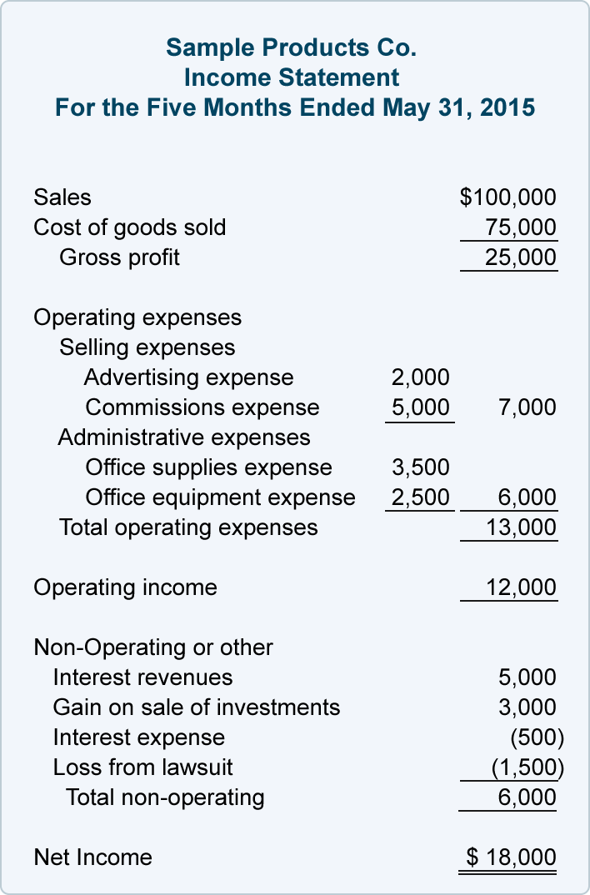
The Problem We Saw
Financial statement analysis Investment, competitive analysis, marketing …
Security and Exchange Commission (SEC) : EDGAR database
Decisions based on key financial ratios

Slide 3


What is the Status Quo?
Manually download data
Time consuming, costs firms money and human capital
Uncertainty, people make mistakes

Slide 4
Our Solution
Security and Exchange Commission (SEC) : EDGAR database
How about using it to automate financial and market analysis?

Slide 5



The Data Sets
We need to control information in quantity and quality
Analysis of the USA market
What it is the data?
What are our objectives?
What are the problems with the database?
Some information is not mandatory
It is updated often
The options we have:
Compiled .txt database files ➔ it is not real time data’s. However it is lighter
XBRL files ➔ it is real time data however it is real heavy

Slide 6
Our Desired Output – Where the Value Lies
I’m lazy and my time costs money
I want my computer to ease my job
My job is to calculate the ratios… → The program must do it Then to analyse the output… → The program must ease it To make choices → The program must ease it
1 . Computed ratios
2 . Graph to ease analysis
3 . Automate choices

Slide 7
How Does Our Program Work?
Part 1 : Find & clean the data
Part 2 : Analyze the data

Slide 8
Part 1 : Finding & Cleaning the Data
Download .zip files from SEC’s website
Unzip to .txt file
Cleaning data and feeding the database
Computing the required ratios
Problems
Missing data for the ratios
GAAP accounting standards are loose
Save or keep in RAM computed data
Data structure

Slide 9
Part 1: Finding & Cleaning the Data
Download .zip files from SEC’s website
Unzip to .txt file
Cleaning data and feeding the database
Computing the required ratios
.zip files
.txt files
Database
.csv file

Slide 10
Part 2: Analysing the Data
Download .zip files from SEC’s website
Unzip to .txt file
Cleaning data and feeding the database
Computing the required ratios
.zip files
.txt files
Database
.csv file
Teaching the program to choose a short list
Dimensionality reduction

Slide 11
Part 2: Analysing the Data
Download .zip files from SEC’s website
Unzip to .txt file
Cleaning data and feeding the database
Computing the required ratios
1 . Computed ratios
.zip files
.txt files
Database
.csv file
Teaching the program to choose a short list
Dimensionality reduction
3 . Automate choices
2 . Graph to ease analysis

Slide 12
Part 2: Analyzing the data
Teaching the program to choose a short list
Dimensionality reduction
Why? Automate a part of analysts’ job
Ex : Creating a short list of companies to invest in
How? K Nearest Neighbors method
Two classes supervised learning : Good / Bad
K optimised in [1,20]
For whom?
Investors, competitors analysts, entrepreneurs …
What is produced? A decision model
Why? Help analysts understand a market
Ex : What are the strategies of a sector’s companies ? Is this sector a monoply ? Which company should I invest in ? What are the key figures that make a company different from the other ?
How? Principal Component Analysis
For whom?
Investors, competitors analysts, entrepreneurs …
What is produced? A graph

Slide 13
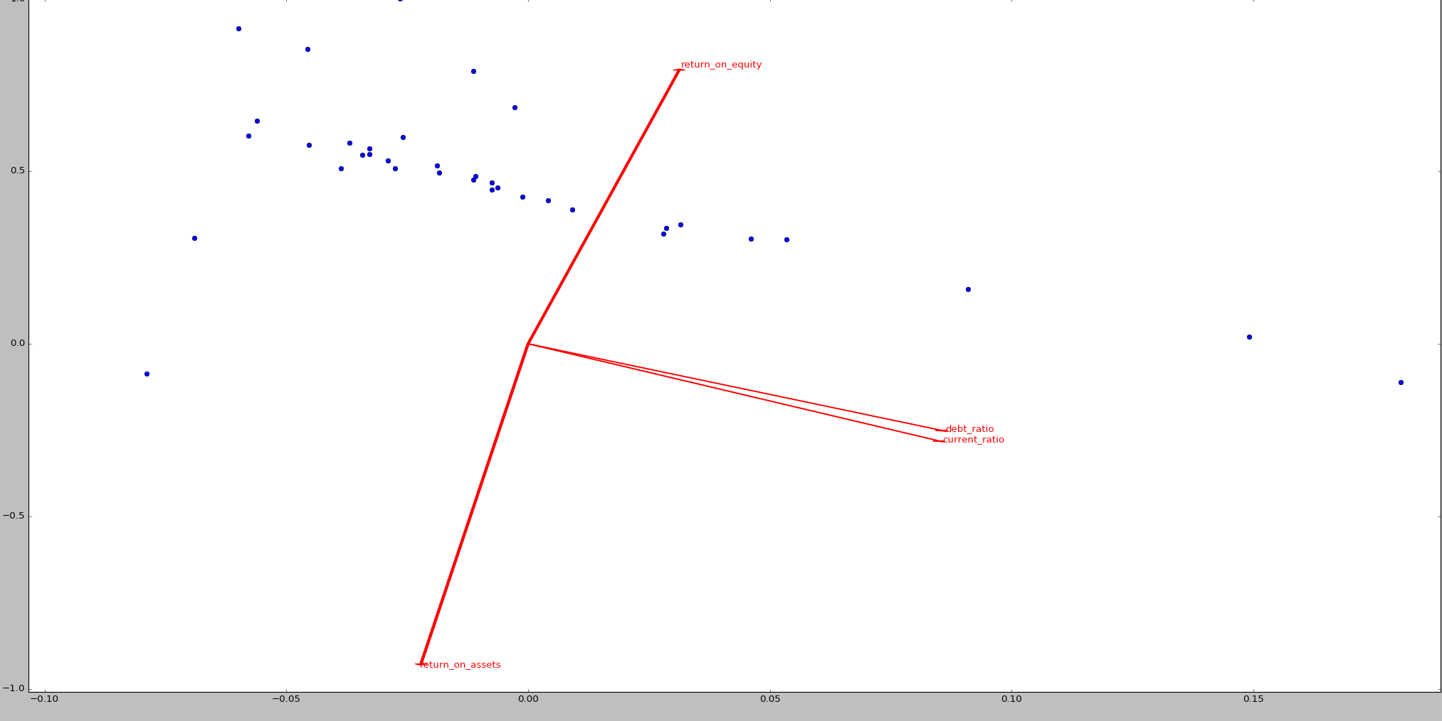
PCA Results for Computer Companies 2015 Q4
Companies
Projection of a ratio’s unit vector on the PCA plan

Slide 14
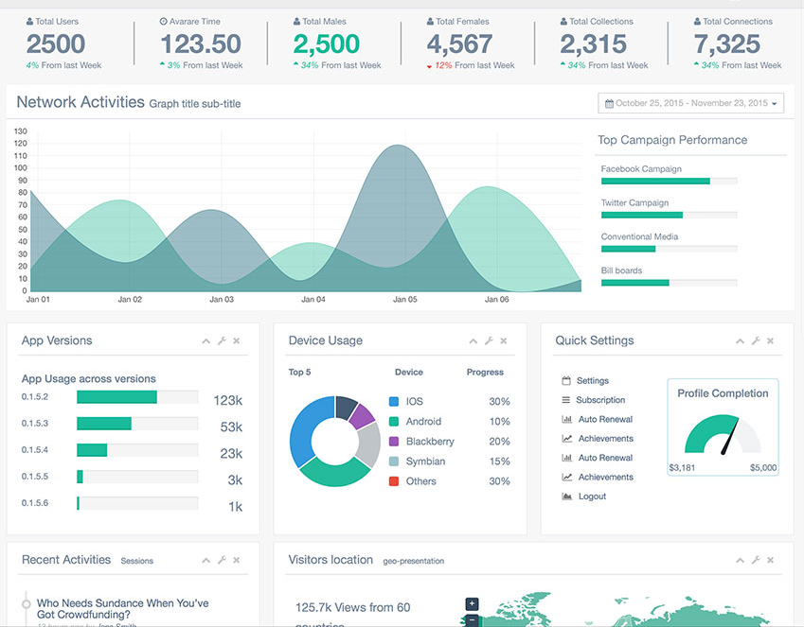
How the Data will be Used
Key financial ratios:
Analysis of successful industry investment compositions
Position in the industry
Published reports
Automation and more accurate

Slide 15
Problems with Our Program and Potential for Version 2
GAAP loose standards
Other methods than K Nearest Neighbors are possible Random tree, …
Accuracy is not great (0.66 in our example)
Poor graph designs Sorry for your eyes
Needs improvements on the way data are handled More pandas, less SQL
But it is a proof of concept!

Slide 16



Acknowledgments for Code Inspiration
SciKit Learn website
Stack Overflow website
Our teacher’s instruction

