Slide 1
The prediction of return on stock price——Two approaches
Team10
赖亚王, 5130719085
邓凡意, 515120910159
刘益鹏, 515120910200
LINJIANG LI, 713120990034

Slide 2

Classification: SVM using features of stock prices and market conditions from the past
Prediction of stock prices via coding and data analysis
Regression: Using ARMA model

Slide 3
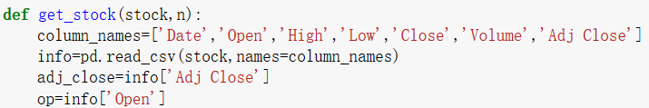
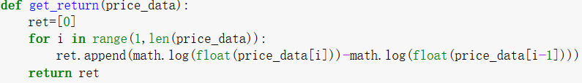
First Step: Get information and handle information
Get stock information from Yahoo:
Read local csv file directly:
Calculate the log return of the asset:

Slide 4
SVM Classification Method: Introduction
support vector machines (SVM):
supervised learning models
constructs a hyperplane or set of hyperplanes in a high-or infinite-dimensional space, which can be used for classification, regression, or other tasks
a good separation is achieved by the hyperplane that has the largest distance to the nearest training-data point of any class, since in general the larger the margin the lower the generalization error of the classifier

Slide 5
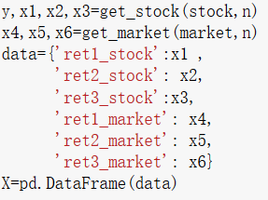
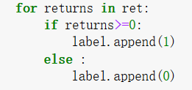
SVM Classification Method: Training
Step 1: building a data frame of the features of training samples
Features
Stock return | Market return
Yesterday | Yesterday
The day before yesterday | The day before yesterday
Three days ago | Three days ago
Labels
The stock prices declines | 0
Otherwise | 1

Slide 6
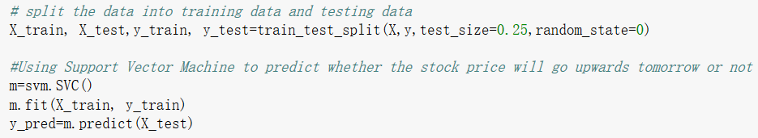
SVM Classification Method: Training
Step 2: Split the data into training data & Train the SVM
Step 3: Check the accuracy of the algorithm

Slide 7
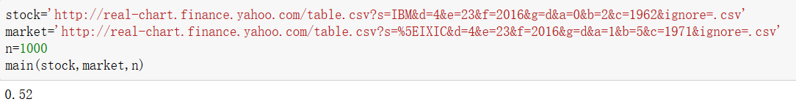
SVM Classification Method: Run and Result
The accuracy rate is only a little more than 50%
when using 1000 training data, predicting IBM stock and using the return on Dow Jones index as the market return
The prediction is only a little better than flipping a coin
However, other models (KNN and logistic regression) and other training data (GOOG, APPL and S&P500) also produce no better accuracy.

Slide 8
The difficulty of stock prediction
The connection between the past price data and the present price is ambiguous.
Other factors such as the change of policy, investors’ attitudes and the condition of the company can also influence the stock price.
Besides, if many people predict that the stock price will rise tomorrow, they are likely to buy stock today, causing the price to rise immediately instead of rise tomorrow.(reflexivity)

Slide 9

ARMA model: Introduction
Autoregressive–moving-average model
The notation ARMA(p, q) refers to the model with p autoregressive terms and q moving-average terms. This model contains the AR(p) and MA(q) models,
ARMA is appropriate when a system is a function of a series of unobserved shocks (the MA part) as well as its own behavior. For example, stock prices may be shocked by fundamental information as well as exhibiting technical trending and mean-reversion effects due to market participants.

Slide 10
ARMA model: Main Purpose
Ordinary data also have poor result, high frequency data turns out to have nice quality.
Using prices and returns of every minute to predict.
Build the model based on the difference between HS300 and A50 to do arbitrage via shorting one asset and long the other.

Slide 11
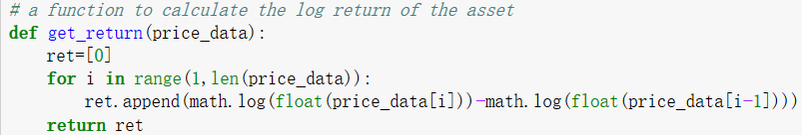
ARMA model: Data & Training
Step 1: get the data and handle it
The data is downloaded from the Wind Database

Slide 12
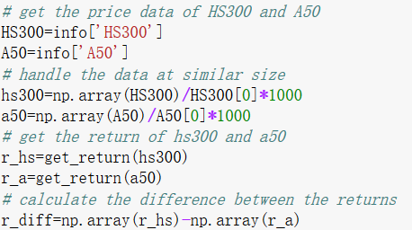
ARMA model: Data & Training
Step 1: get the data and handle it

Slide 13
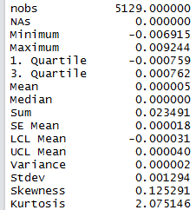
ARMA model: Data & Training
Basic statistic information for three series – returns on both HS300 and A50 and the difference between returns:
HS300 |  | A50
nobs | 5129 | nobs | 5129
Minimum | -0.007359 | Minimum | -0.015929
Maximum | 0.009338 | Maximum | 0.009716
Mean | 0.000021 | Mean | 0.000017
Median | 0 | Median | 0
Variance | 0.000001 | Variance | 0.000001
Stdev | 0.000999 | Stdev | 0.000965
Skewness | 0.219524 | Skewness | -0.636954
Kurtosis | 5.44164 | Kurtosis | 23.424518

Slide 14
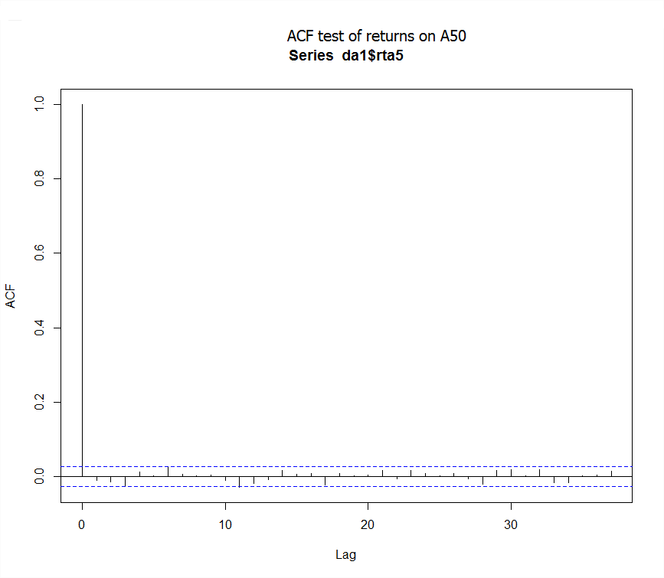
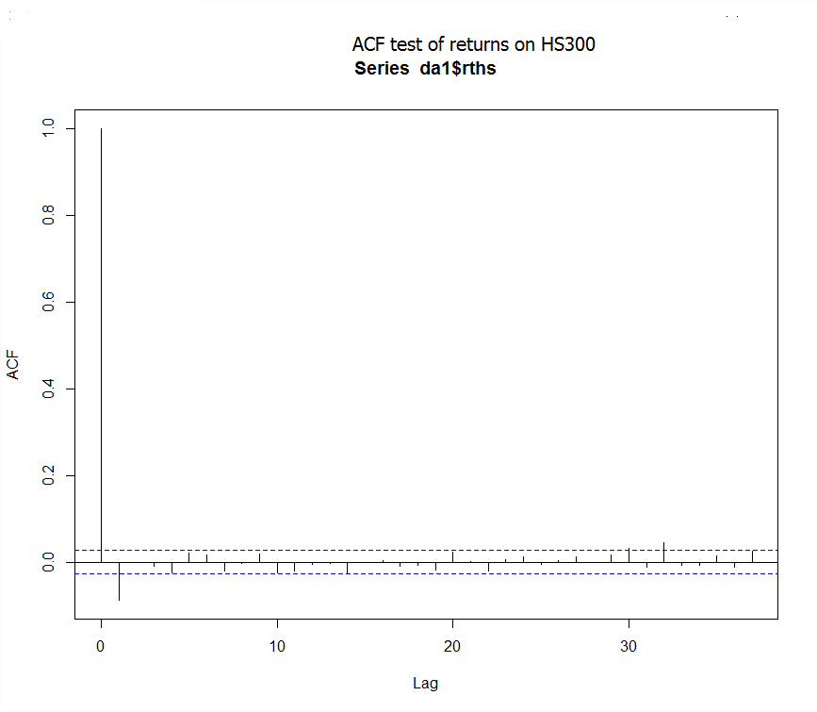
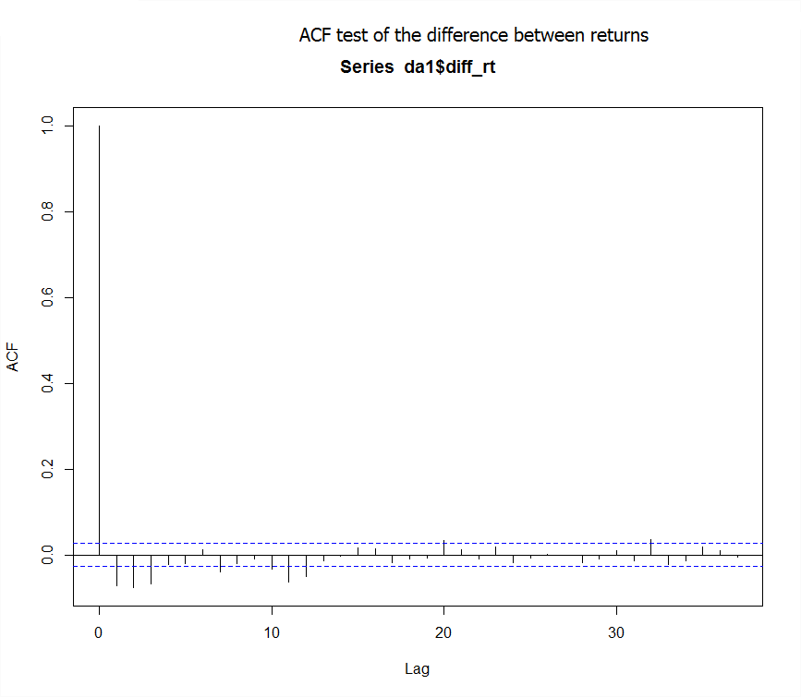
ARMA model: Data & Training
Step2: Statistic tests for autocorrelation and for unit root stability
 | HS300 | A50 | R_diff
X-squared | 44.28 | 5.9418 | 83.369
df | 5 | 5 | 5
p-value | 2.032e-08 | 0.3119 | < 2.2e-16

Slide 15
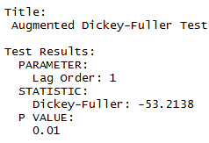
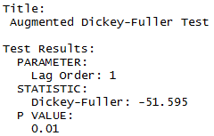
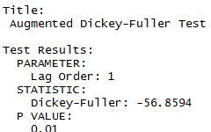
ARMA model: Data & Training
Summary of the test results: nice quality of the data
Precondition: Stationarity & Auto correlation √

Slide 16


ARMA model: Data & Training
Step 3: building the model according to the data
The parameter p and q are determined by several tests.

Slide 17
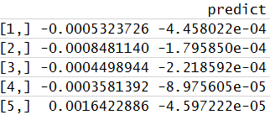
ARMA model: Results and Analysis
model.predict(start, end)

Slide 18
Summary
Although the issue is of great complexity and none of the model manages to solve the problem accurately, there are certain circumstances where we can use machine learning and time series analysis to get accurate predictions.
For example, the second model is extremely powerful, or at least extremely powerful in some circumstances, in the prediction of return series with certain qualities.
And SVM can be combined with data mining of social network(Twitter and Weibo) to get people’s attitudes towards certain stock, which can also be applied to the prediction of stock price

