Slide 1
Railway
——the report of Introduction to business computing
Team project : Real-time bond pricing-railway
Team members : 吉迎 吴琼琳 王蕊 盛竞逸

Slide 2
1
Description
2
Background
CONTENT
3
The process of programming
4
Problems in programming
5
Reflection and Conclusion

Slide 3
1
Description

Slide 4
Name
Real-time bond pricing-Railway
Find out the best feature in bond market
Aim
Predict the price
Provide the information of a bond

Slide 5
2
Background

Slide 6

Huge Gap
Delay
Cost
Hinder
the amount of reference information available to those trading equities
those trading corporate bonds
Free access is available online with a 15 minute delay
more information need pay
Accurate bond pricing is also hindered by lack of liquidity.

Slide 7
So our project was born
one
three
collect previous information
provide you with a reference price
1
3
two
Free and no delay
2
analyse
4

Slide 8
3
The process of programming

Slide 9
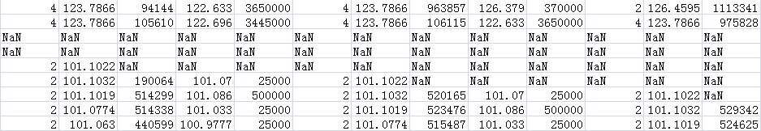
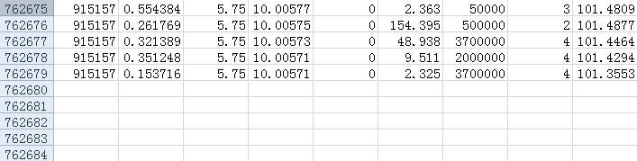
Before start:
>>we find there are countless missing values in the data
>>so we rewrote several codes to remove the NaN (missing value), and saved the new data in another file called “whole_price_data.csv”.
>>the revised data file was still very huge (more than 250MB) to read by the computer
>>we added codes for randomly choosing 150,000 lines of data and saved them in a new file called “150000_price_data.csv”.
Then
Let's begin

Slide 10
Find the best algorithm in training the machine and predicting the price
of bonds:
KNeighbors
AdaBoost
Random
Forest
Decision
Tree
Linear
MSE

Slide 11
Detailed Procedures
Use panda to read the price data
and prepare feature metric
First
Use holdout validation and
train the model in each algorithm
Second
Evaluate the regression model
and choose the best algorithm
Third

Slide 12
Evaluate the regression model
 | KNeighbors Regressor | Linear Regressor | Decision Tree Regressor | Random Forest Regressor | AdaBoost Regressor
MSE | 80.762049 | 0.930923 | 1.372639 | 0.655586 | 10.127853
Find the best algorithm to predict the price of the bond

Slide 13
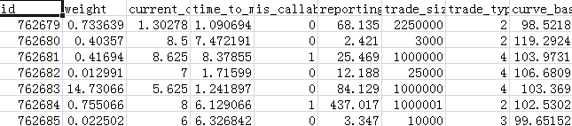
ALL is done!
It’s time to use the program and predict the bond price.
Here
We have a new data which has all detailed information but no trade price.

Slide 14
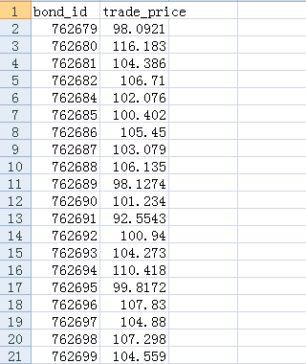
Well
It finally runs well.
Bond
ID
Trade
Price
Detailed information
Exact price

Slide 15
4
Problems in programming

Slide 16
1
The missing value
2
Too huge file to operate
3
Application of the trained model

Slide 17
5
Reflection ＆ Conclusion

Slide 18
Advantage
Disadvantage
approximate real-time price fifteen minutes earlier
the data we used could be out of date
spare the money for buying the information
sometimes the capital market is too changeable to be controlled and predicted
it’s possible to predict the price because the bond market doesn’t change quickly

Slide 19
onclusion
Difficult to get detailed information of so many bonds.
Quite a long time to finish running.
Benefit > Cost, so it is not a bad choice to use it!
Reasonable for problems and worth a try.
Improve it according to the feedback.

Slide 20
THANKS

