Slide 1


CSE311: DBMS
Hospital Patient Management System
Presented By:
Nibedita Das
2411860042
Tanim Ahmed
2312597042
Md. Sajidul Islam
2121935642

Slide 2
Database Design & Modeling
  ER Diagram identifies all major entities (Patient, Doctor, Staff, Appointment, Billing).
  Relational schema converts the ERD into normalized tables for accurate data storage.
Introduction: This project aims to build a Hospital Management System using DBMS principles.
01.
Core Hospital Operations
  Manages patient records, doctor information, appointments, admissions, treatments, lab tests, and prescriptions.
  Ensures secure, fast, and error-free handling of hospital data.
It organizes and manages key hospital information through a structured relational database to ensure accuracy, efficiency, and smooth workflow.
02.
System Implementation
  MySQL used to create and store relational data.
  PHP and HTML used to build a user-friendly interface for interacting with the database.
03.

Slide 3
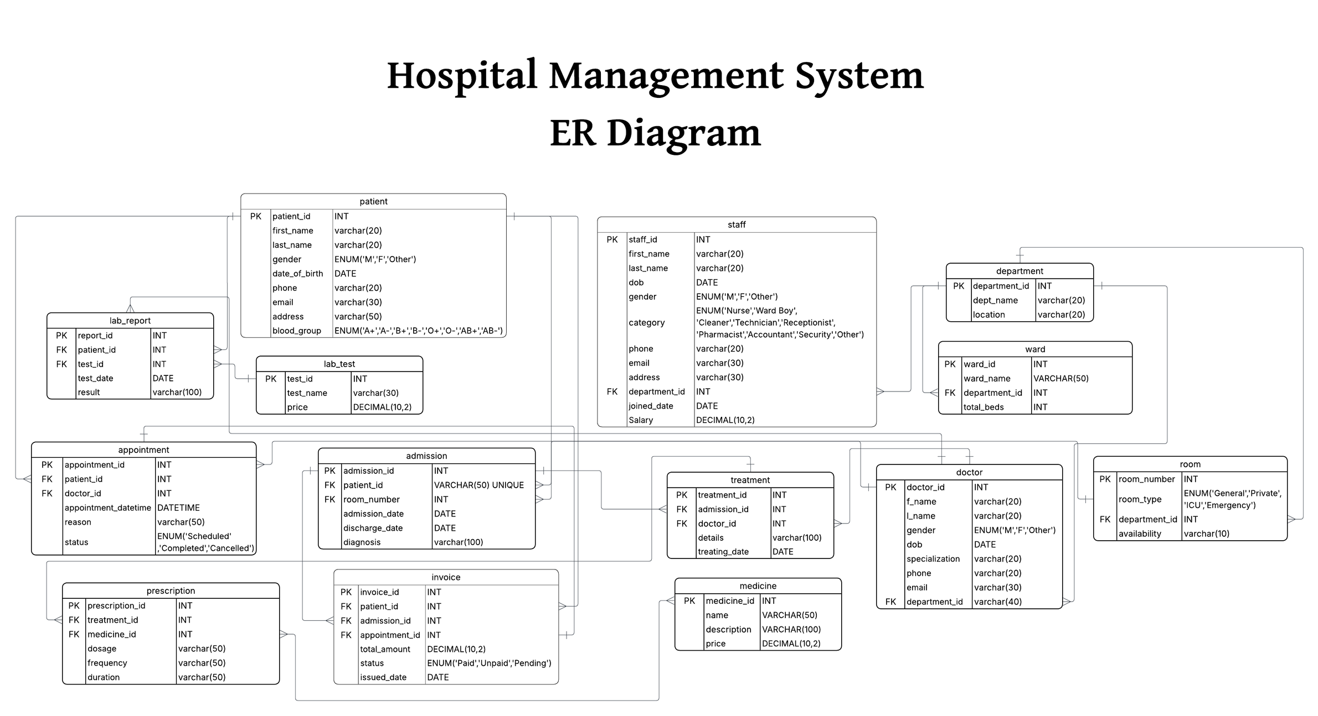

Slide 4
Relational Schema
01. Patient (patient_id PK, first_name, last_name, gender, date_of_birth,
phone, email, address, blood_group)
02. Staff (staff_id PK, first_name, last_name, dob, gender, category, phone, email, address, department_id FK, joined_date, salary)
03. Department (department_id PK, dept_name, location)
04. Ward (ward_id PK, ward_name, department_id FK, total_beds)

Slide 5
05. Room (room_number PK, room_type, department_id FK, availability)
06. Doctor (doctor_id PK, f_name, l_name, gender, dob, specialization,
phone, email, department_id FK)
07. Lab_Test (test_id PK, test_name, price)
08. Lab_Report (report_id PK, patient_id FK, test_id FK, test_date, result)
09. Appointment (appointment_id PK, patient_id FK, doctor_id FK,
appointment_datetime, reason, status)

Slide 6
10. Admission (admission_id PK, patient_id FK, room_number FK,
admission_date, discharge_date, diagnosis)
11. Treatment (treatment_id PK, admission_id FK, doctor_id FK,
details, treating_date)
12. Medicine (medicine_id PK, name, description, price)
13. Prescription (prescription_id PK, treatment_id FK, medicine_id FK,
dosage, frequency, duration)
14. Invoice (invoice_id PK, patient_id FK, admission_id FK, appointment_id FK, total_amount, status, issued_date)

Slide 7
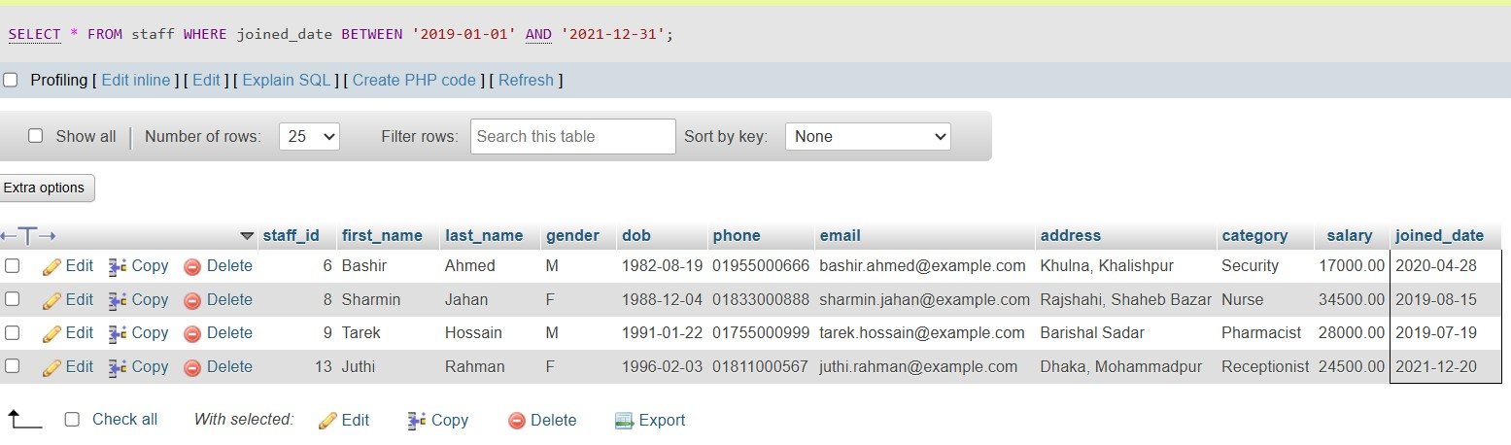
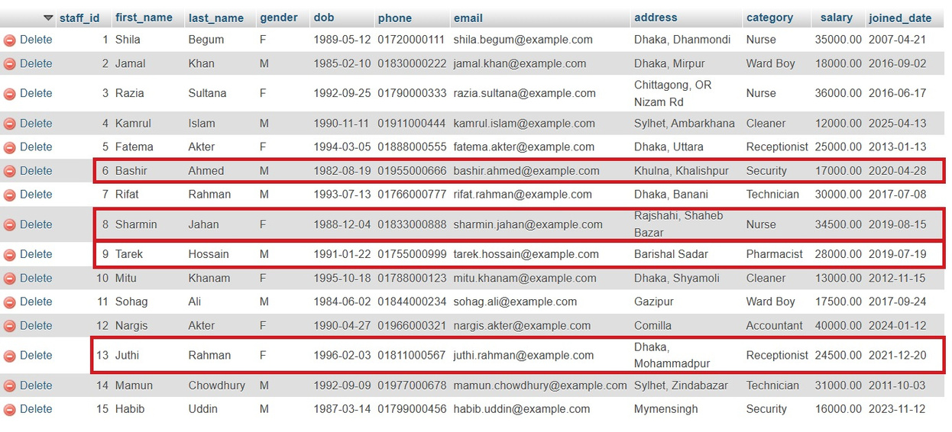
Sample: SQL queries
List all staff members who joined between the years 2019 and 2021 (inclusive)

Slide 8
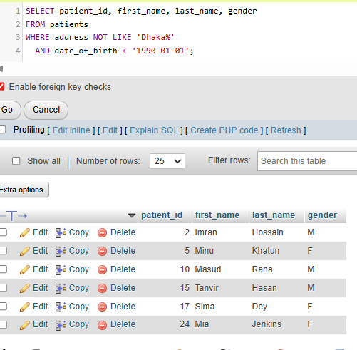
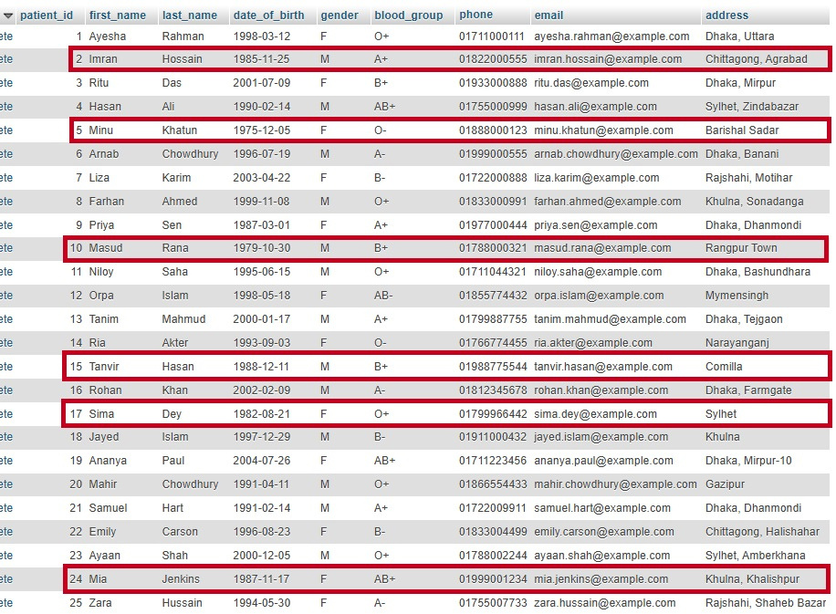
Sample: SQL queries
List all patients whose address is outside Dhaka and whose date of birth is before 1 January 1990.

Slide 9

Thank you very much!

