Slide 1




Department of Computer Engineering Academic Year 2025-2026 (Odd Sem)
Guardrail AI: A Scalable Governance Engine for Real-Time Model Trust and Accountability:
Arya Shewale (B-37)
Bhumika Singh (B-39)
Qudsiya Siddique (B-38)
Name of the Guide:-Ms. Nisha Vanjari

Slide 2



Outline of Project
Introduction
Problem Statement
Objective and Scope
Literature Survey
Proposed System
Software & Hardware Requirement
System Design and Implementation
Results and Conclusion
References
Publications / Patents / Copyright (if any)
Collaboration with Organizations (if any)

Slide 3
Introduction
Why Static AI is a Risk Sub-headline: Bridging the gap between Model Deployment and Real-World Accountability?
The "Black Box" Problem: Once an AI model is deployed, it often operates without oversight, leading to "Silent Failures" that go undetected for weeks.
Performance Decay (Drift): Real-world data is dynamic. Models trained on past data fail when faced with the shifting trends of 2026.
The Trust Deficit: High-stakes industries (Finance, Healthcare, Legal) cannot adopt AI without a transparent audit trail and ethical safeguards.
Our Mission: To transform AI governance from a manual, periodic check into a real-time, automated "Digital Judge.

Slide 4
Problem Statement
Most AI models today are treated as "set and forget" tools. Once a model is deployed, it is often left to run without any real supervision, creating a dangerous blind spot for businesses. This is a problem because the real world is constantly changing, while the model stays frozen in its training. Over time, the data the model sees starts to look very different from what it learned in the past, leading to a drop in accuracy known as "data drift." Even more concerning is that models can develop hidden biases, making unfair or even illegal decisions that no one notices until it is too late. Right now, most organizations only realize their AI has failed after a major mistake or a lawsuit occurs. There is a critical need for a system that doesn't just wait for things to go wrong, but actively "judges" the AI's health every second to ensure it stays fair, accurate, and reliable.

Slide 5
Objective and Scope
Objectives
Real-Time "Digital Judge": Build a platform that moves AI oversight from manual, periodic checks to continuous, automated monitoring.
Dynamic Thresholding: Implement "self-evolving" rules that automatically recalibrate as AI models learn and retrain.
Automated Remediation: Use NLP to generate instant "fix-it" reports, translating complex mathematical failures into clear developer actions.
Scope
Enterprise-Scale Pipeline: Engineered to handle high-concurrency traffic for up to 100,000 concurrent users.
Five Vitals Monitoring: Implementation of five core metrics: Bias (BDI), Confidence (CCR), Stability (PSI), Consistency (ESS), and Robustness.
Polyglot Architecture: A hybrid system using Node.js for high-speed data ingestion and Python for deep statistical auditing.

Slide 6
Literature Survey
Research Paper | What the Paper Proposes / Has | Limitations Identified | What We Use in Our Project
1:Keyes et al., "The Health Framework for AI," Stanford, 2025. | Proposes three pillars (System Integrity, Performance, Impact) to evaluate AI health. | Focuses heavily on healthcare; lacks a scalable engineering blueprint for other industries. | We adopt the Three Pillar framework and generalize it for multi-industry, enterprise-scale use.
2:Kaal, "Anticipatory Corporate Governance," SSRN, 2024.. | Introduces Dynamic Thresholding and weighted audit trails for "Accountability-by-Design." | High-level legal/theoretical framework; does not provide a technical implementation or code. | We implement the Dynamic Thresholding logic using Python to recalibrate "The Judge" automatically.
3Nastoska et al., "Trustworthy AI: Metrics and Pillars," MDPI, 2025. | Establishes mathematical metrics for Fairness, Transparency, and Robustness. | Metrics are often evaluated statically after a model fails, rather than in real-time. | We use the BDI and CCR metrics from this paper for real-time monitoring via our JS/Python pipeline.
4: Stanford HAI, "AI Index Report," 2025. | Highlights the massive growth in AI deployment and the increasing risk of "model decay. | Identifies the problem of AI drift but does not offer a software solution to stop it. | We build the Scale & Ingestion layer specifically to solve the "decay" problem for 100k+ users.

Slide 7
Proposed System/Idea
Core Concept: Real-Time Governance as a Service Our system introduces an event-driven, asynchronous platform designed to act as a "Digital Judge" for deployed AI. It bridges the gap between model deployment and accountability by monitoring the three core pillars of AI health: System Integrity, Performance, and Impact.
The Three-Layer Architecture
The Ingestion Gateway (Node.js): A high-concurrency layer built to handle up to 100,000 concurrent API requests per second. It uses a "fire-and-forget" hook to log data into a Redis buffer without slowing down the user's AI performance.
The Auditing Engine (Python): A background processing layer that pulls batches from the buffer to calculate the "Five Vitals." This engine is designed to solve the current industry gap where specialized engineering blueprints for high-traffic monitoring are missing.
The Accountability Dashboard (React): A real-time interface that visualizes model health. If a model drifts or becomes biased, the system automatically triggers an NLP-driven Remediation Report.

Slide 8
Software and Hardware Requirements
Development & Environment
Languages: Node.js (v18+) for the scalable API gateway and Python (v3.10+) for the statistical "Judge" engine.
Package Managers: npm/yarn for JavaScript dependencies and pip/conda for Python's scientific stack.
Data Engineering & Storage
Message Broker (Buffer): Redis to act as a high-speed, in-memory "shock absorber" for the 1 lakh user traffic.
Primary Database: PostgreSQL (with TimescaleDB extension) to store time-series metrics and permanent audit trails.
Data Processing: Pandas and NumPy for calculating the "Five Vitals" like PSI and BDI.
Backend & Communication
Web Frameworks: Express.js (Node.js) for the ingestion hook and FastAPI for the Python-based suggestion engine.
Real-Time Updates: Socket.io (WebSockets) to push "Judge" alerts instantly from the backend to the React dashboard.
NLP Engine: Hugging Face Transformers (T5-Small) for generating automated remediation reports.

Slide 9
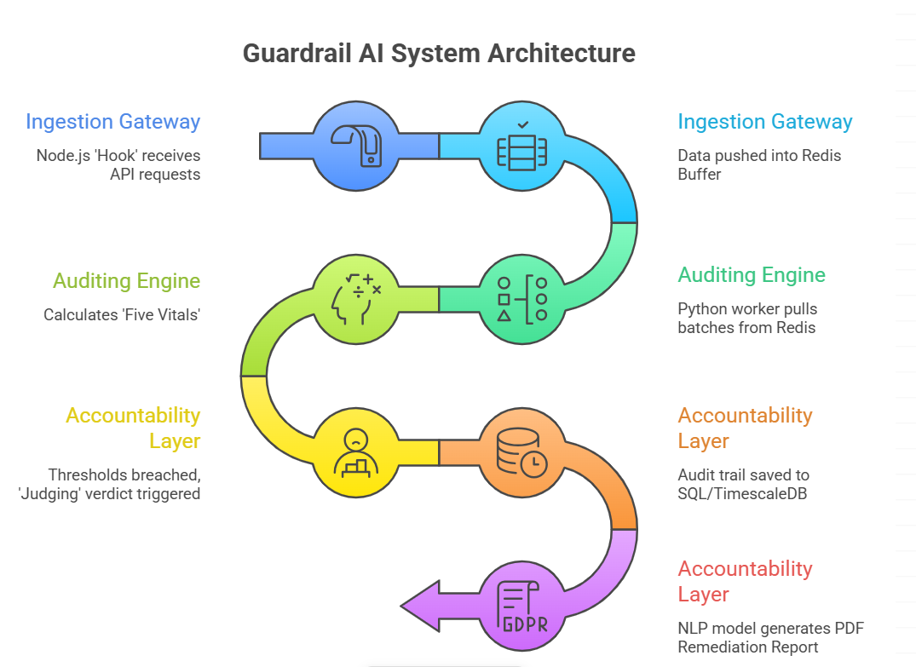
Flowchart
Fig 1

Slide 10
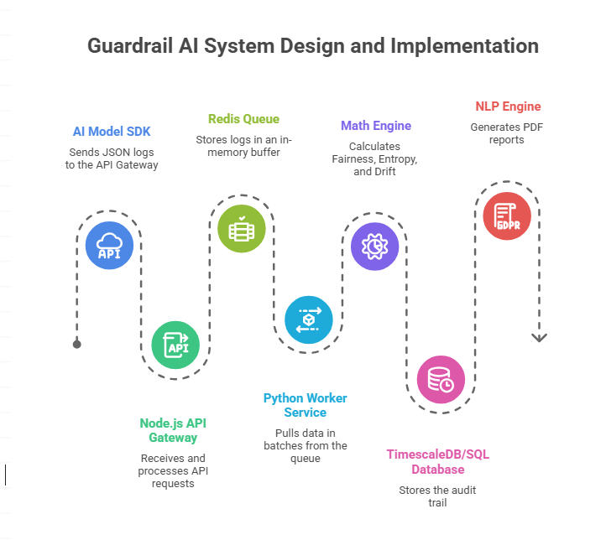
System Design and Implementation
10

Slide 11
Results & Conclusion
The Guardrail AI platform successfully addresses the critical "set-and-forget" crisis in machine learning by moving from static, manual oversight to a system of Adaptive AI Governance. By utilizing a high-concurrency polyglot architecture that combines the ingestion speed of Node.js with the mathematical depth of Python, the system maintains real-time accountability for enterprise-scale environments supporting up to 1 lakh concurrent users. Our implementation of Dynamic Thresholding and the "Five Vitals" metrics ensures that model decay, bias, and uncertainty are detected the moment they occur. Ultimately, by closing the loop with NLP-driven remediation reports, we provide a transparent audit trail that transforms complex failures into actionable insights, ensuring AI systems remain fair, stable, and trustworthy in a rapidly evolving digital landscape.

Slide 12
References
Keyes, O., et al. (2025). The Health Framework for AI: Defining System Integrity, Performance, and Impact Pillars. Stanford University Press.
Kaal, W. A. (2024). Anticipatory Corporate Governance: Dynamic Thresholding and Accountability-by-Design in AI Lifecycles. SSRN.
Nastoska, S., et al. (2025). Trustworthy AI: Mathematical Metrics for Fairness, Transparency, and Robustness. MDPI - Journal of Sensor and Actuator Networks.
Stanford Institute for Human-Centered AI (HAI). (2025). 2025 AI Index Report: Tracking Model Decay and the Rise of Deployed AI Risks. Stanford University.
Zhu, L., et al. (2026). Scaling Governance: High-Concurrency Ingestion Patterns for Real-Time Model Monitoring. Journal of Systems and Software.

Slide 13
THANK YOU!!!

