Slide 1
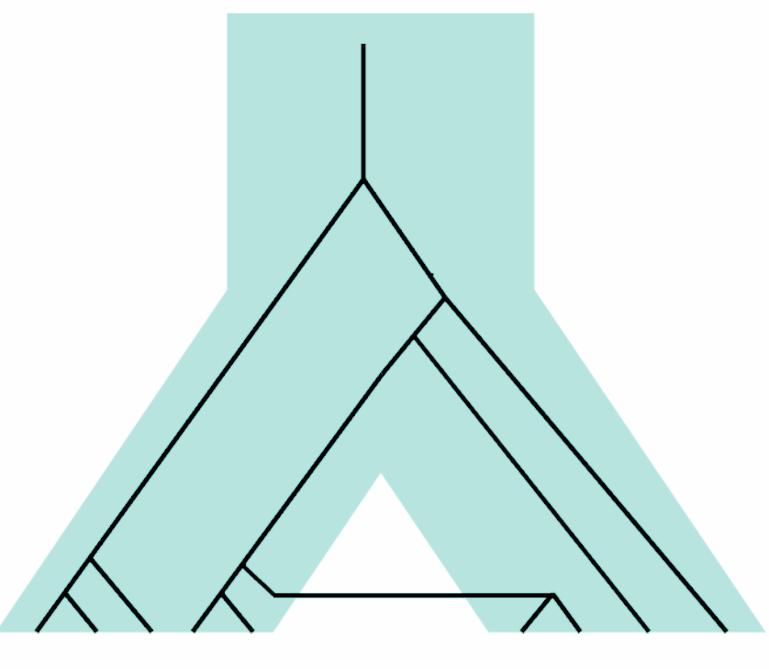
Gene Flow and How to Detect it
Harvi Pawar, PhD
Postdoctoral Researcher
University of Copenhagen
Conservation Genomics Workshop 2026, Mpala

Slide 2
Objectives
What is gene flow?
How can we detect gene flow?
Gene flow in non-humans
Ghost gene flow
What is the impact of gene flow on the genome?
Notes:
Slide 2 - objectives of the lecture - what we will be discussing today is
What is admixture
How to identify patterns of admixture
The impact of admixture on the genome
This will be largely considered in the context of humans, before broadening out to
Admixture in non-humans

Slide 3
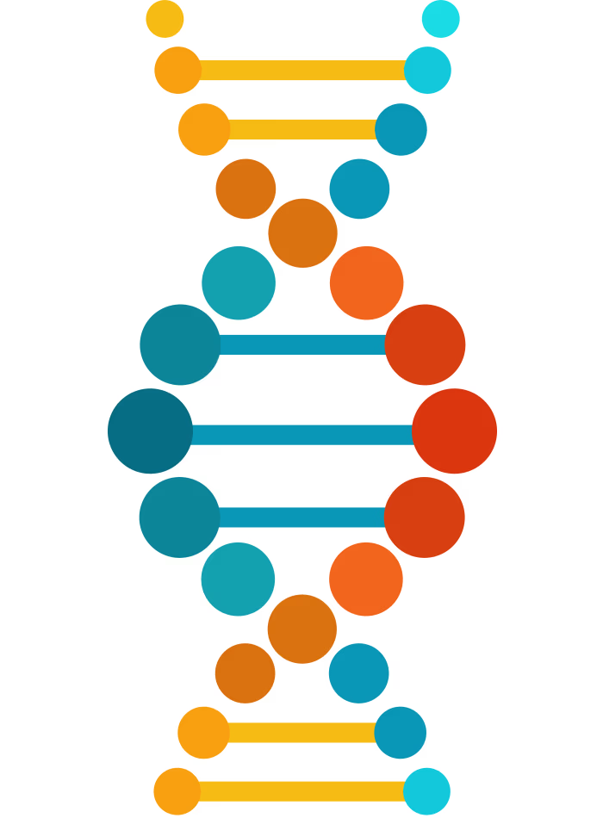
Evolutionary processes give rise to genetic variation
mutation
genetic drift
natural selection
gene flow
Notes:
Slide 3
As we know, the key evolutionary processes impacting genetic variation at the genome & population levels are : mutation, genetic drift, natural selection & gene flow - which we’re focusing on here.
In fact gene flow, as a source of new alleles, is one of the fastest evolutionary processes to change the genetic makeup of a population.
# fig - https://www.science.org/doi/10.1126/science.aay5012

Slide 4
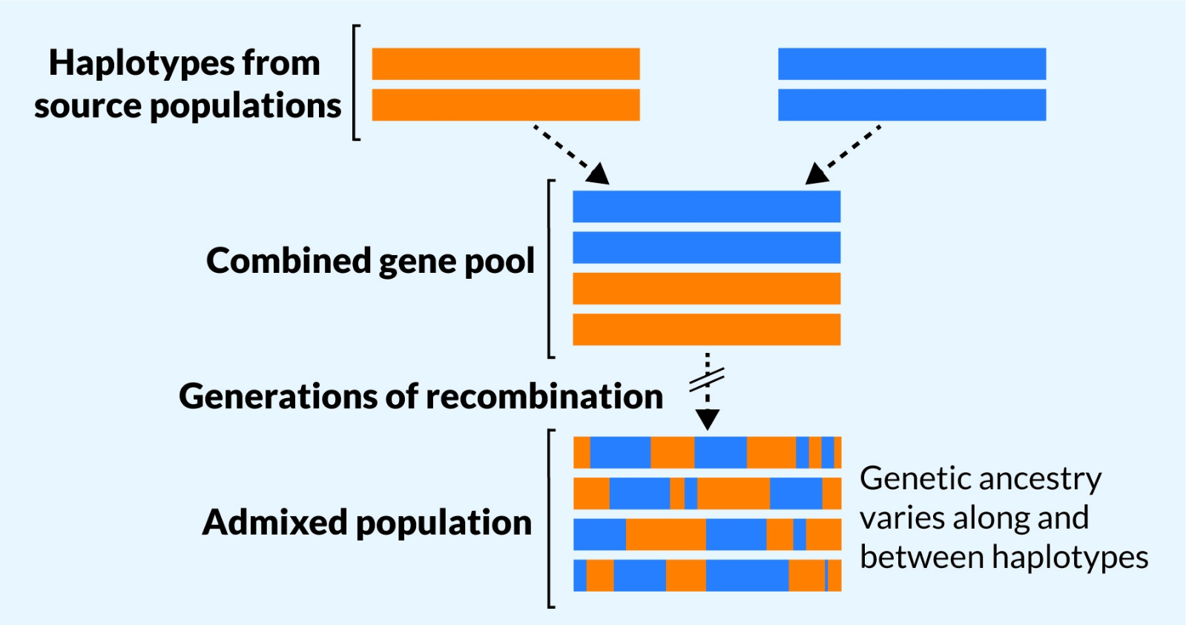
What happens when populations meet?
2 differentiated populations
Encounter each other after time of separation
What happens next?
Notes:
Slide 4
So what happens when populations meet? Say we have 2 differentiated populations that have been following their own evolutionary trajectories, then they encounter each other after a time of separation. What happens next?
https://journals.plos.org/plosgenetics/article?id=10.1371/journal.pgen.1009374

Slide 5
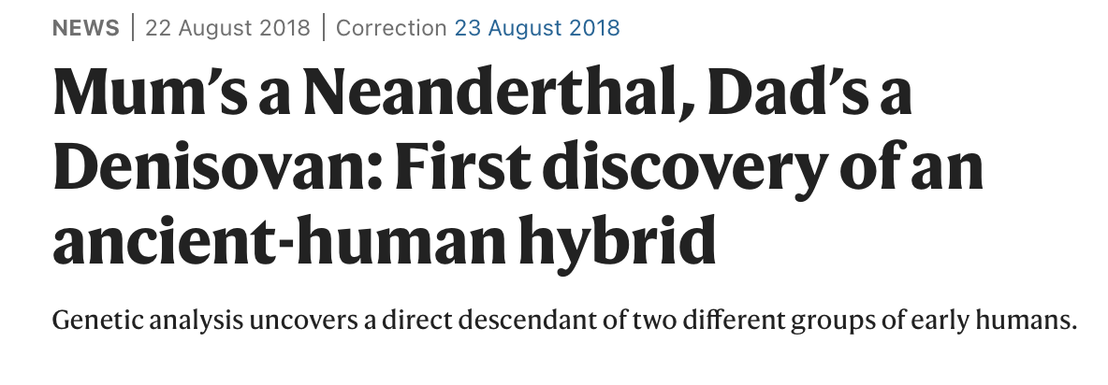
What happens when populations meet?
2 differentiated populations
Encounter each other after time of separation
What happens next?
Gene flow
Skov et al. 2018
Notes:
Slide 5
In the absence of reproductive isolation, it is very likely that gene flow will occur.
We’re increasingly recognizing just how common gene flow is in the natural world, both among living species & among those that are now extinct. A particularly exciting example of which was the finding of a first generation hybrid - with a neanderthal mother & denisovan father - by skov et al. in 2018.

Slide 6
What happens when populations meet?
2 differentiated populations
Encounter each other after time of separation
What happens next?
Gene flow
F1 hybrid
Skov et al. 2018
Skov et al. 2018
Notes:
Slide 5
In the absence of reproductive isolation, it is very likely that gene flow will occur.
We’re increasingly recognizing just how common gene flow is in the natural world, both among living species & among those that are now extinct. A particularly exciting example of which was the finding of a first generation hybrid - with a neanderthal mother & denisovan father - by skov et al. in 2018.

Slide 7
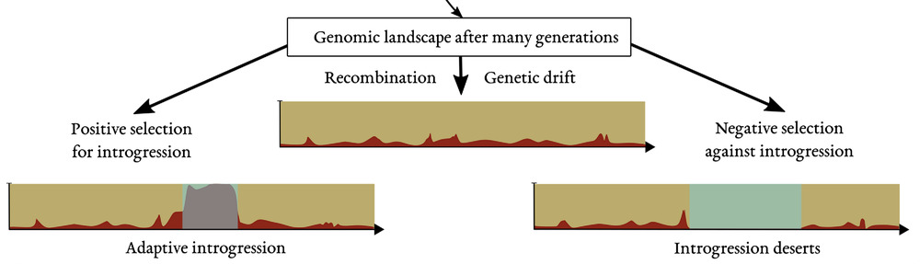
Each generation recombination breaks down the introgressed fragments
Fontsere et al. 2021
Notes:
Slide 5
In the absence of reproductive isolation, it is very likely that gene flow will occur.
We’re increasingly recognizing just how common gene flow is in the natural world, both among living species & among those that are now extinct. A particularly exciting example of which was the finding of a first generation hybrid - with a neanderthal mother & denisovan father - by skov et al. in 2018.

Slide 8
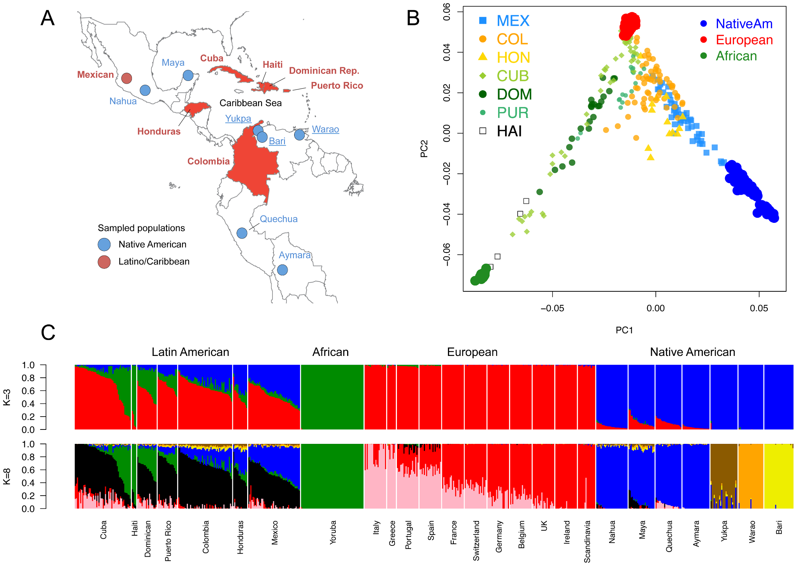
Recent admixture events are easy to detect
Using the approaches you learnt earlier: PCA
Recently admixed individuals are on a cline between source populations
Moreno-Estrada et al. 2013
Notes:
https://www.genomicsengland.co.uk/blog/inclusive-ancestry-group-assignment-in-genetics-research

Slide 9
Recent admixture events are easy to detect
Sources
Using the approaches you learnt earlier: PCA
Recently admixed individuals are on a cline between source populations
Moreno-Estrada et al. 2013
Notes:
Caribbean populations as admixed - https://journals.plos.org/plosgenetics/article%3Fid=10.1371%2Fjournal.pgen.1003925

Slide 10
Recent admixture events are easy to detect
Using the approaches you learnt earlier: PCA
Recently admixed individuals are on a cline between source populations
Q: admixture or isolation by distance?
Moreno-Estrada et al. 2013
Notes:
https://www.genomicsengland.co.uk/blog/inclusive-ancestry-group-assignment-in-genetics-research

Slide 11
Recent admixture events are easy to detect
Using the approaches you learnt earlier: PCA, ADMIXTURE
Model-based clustering
We can infer admixture proportions when admixture is recent and between well-differentiated sources
Cuba
Mexico
Admixed populations
Sources
Moreno-Estrada et al. 2013
Notes:
https://journals.plos.org/plosgenetics/article%3Fid=10.1371%2Fjournal.pgen.1003925

Slide 12
Recent admixture events are easy to detect
Using the approaches you learnt earlier: PCA, ADMIXTURE
Model-based clustering
We can infer admixture proportions when admixture is recent and between well-differentiated sources
Cuba
Mexico
Admixed populations
Sources
Moreno-Estrada et al. 2013
Notes:
https://journals.plos.org/plosgenetics/article%3Fid=10.1371%2Fjournal.pgen.1003925

Slide 13
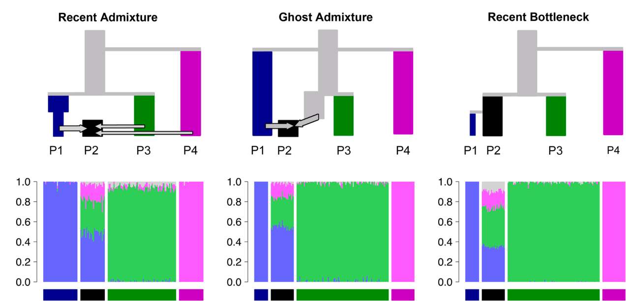
What scenario gave rise to this ADMIXTURE plot?
Lawson et al. 2018

Slide 14
What scenario gave rise to this ADMIXTURE plot?
Lawson et al. 2018

Slide 15
Different demographic scenarios can give indistinguishable ADMIXTURE plots
Lawson et al. 2018

Slide 16
Need to test for gene flow formally
Notes:
https://www.genomicsengland.co.uk/blog/inclusive-ancestry-group-assignment-in-genetics-research

Slide 17
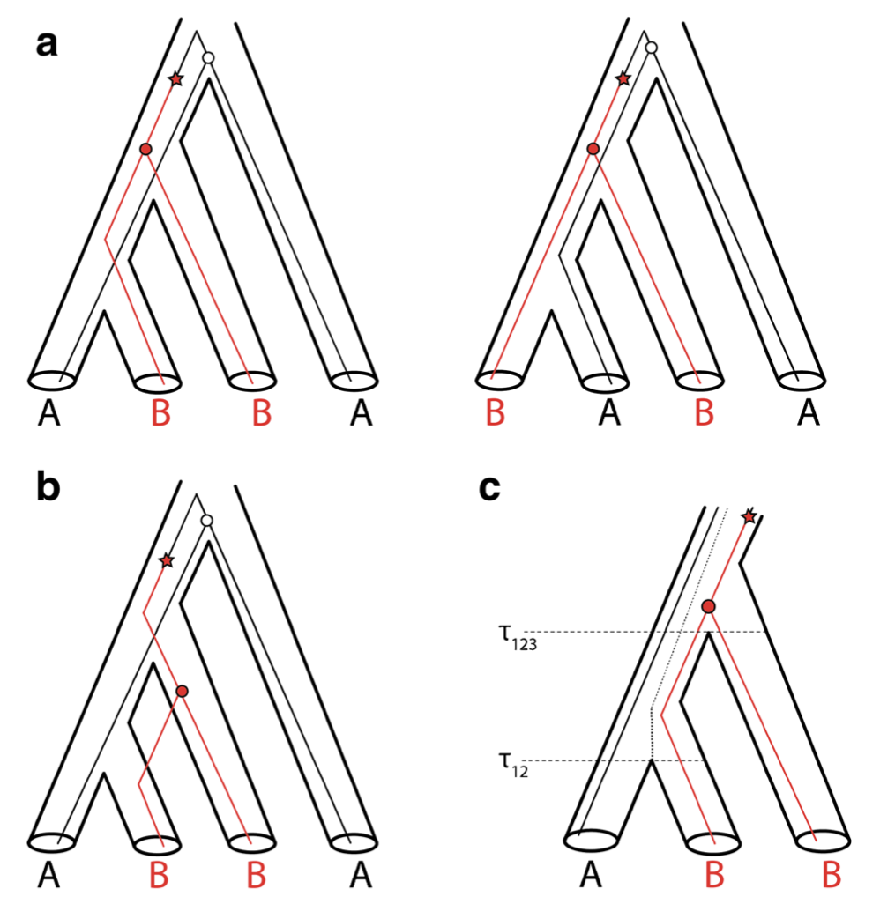
D-statistic
ABBA-BABA
ancestral allele = A
mutation A -> B
4 population tree: 3 ingroups, 1 outgroup
Polymorphism in the ancestral population
Sites where gene tree != species tree
where the B alleles coalesce
P1
P2
P3
Outgroup
Notes:
Slide 8
One simple way to do this is by calculating the ABBA-BABA statistic, also known as the D statistic.
We have four populations, 3 ingroups and one outgroup & we have a haploid genome sample from each.
We see that the ancestral allele is an A. Then in this internal branch, after the split from the outgroup a lineage mutates from A to B. We also see in this internal branch, which is the common ancestor of the 3 ingroup populations, that we now have 2 sites segregating, some individuals carry the ancestral A allele & some the derived B allele.
# Circles represent coalescent events, and stars indicate mutations from the ancestral state BA^ to the derived state BB.^
# fig from https://www.researchgate.net/profile/Todd-Castoe/publication/333298593_Recent_Advances_in_the_Inference_of_Gene_Flow_from_Population_Genomic_Data/links/5e8dd0be92851c2f52888dc0/Recent-Advances-in-the-Inference-of-Gene-Flow-from-Population-Genomic-Data.pdf

Slide 18
D-statistic
ABBA-BABA
ancestral allele = A
ancestral allele = A
mutation A -> B
mutation A -> B
where the B alleles coalesce
where the B alleles coalesce
P1
P2
P3
Outgroup
Notes:
Slide 8
One simple way to do this is by calculating the ABBA-BABA statistic, also known as the D statistic.
We have four populations, 3 ingroups and one outgroup & we have a haploid genome sample from each.
We see that the ancestral allele is an A. Then in this internal branch, after the split from the outgroup a lineage mutates from A to B. We also see in this internal branch, which is the common ancestor of the 3 ingroup populations, that we now have 2 sites segregating, some individuals carry the ancestral A allele & some the derived B allele.
# Circles represent coalescent events, and stars indicate mutations from the ancestral state BA^ to the derived state BB.^
# fig from https://www.researchgate.net/profile/Todd-Castoe/publication/333298593_Recent_Advances_in_the_Inference_of_Gene_Flow_from_Population_Genomic_Data/links/5e8dd0be92851c2f52888dc0/Recent-Advances-in-the-Inference-of-Gene-Flow-from-Population-Genomic-Data.pdf

Slide 19
D-statistic
ABBA-BABA
ancestral allele = A
ancestral allele = A
mutation A -> B
mutation A -> B
where the B alleles coalesce
where the B alleles coalesce
Here P2 and P3 coalesce first
P1
P2
P3
Outgroup
Notes:
Slide 8
One simple way to do this is by calculating the ABBA-BABA statistic, also known as the D statistic.
We have four populations, 3 ingroups and one outgroup & we have a haploid genome sample from each.
We see that the ancestral allele is an A. Then in this internal branch, after the split from the outgroup a lineage mutates from A to B. We also see in this internal branch, which is the common ancestor of the 3 ingroup populations, that we now have 2 sites segregating, some individuals carry the ancestral A allele & some the derived B allele.
# Circles represent coalescent events, and stars indicate mutations from the ancestral state BA^ to the derived state BB.^
# fig from https://www.researchgate.net/profile/Todd-Castoe/publication/333298593_Recent_Advances_in_the_Inference_of_Gene_Flow_from_Population_Genomic_Data/links/5e8dd0be92851c2f52888dc0/Recent-Advances-in-the-Inference-of-Gene-Flow-from-Population-Genomic-Data.pdf

Slide 20

D-statistic
ABBA-BABA
Count number of ABBA sites in genome
Count number of BABA sites in genome
Calculate D statistic
4 population tree: 3 ingroups, 1 outgroup
Polymorphism in the ancestral population
Gene tree != species tree
Can generate ABBA or BABA sites
P1
P2
P3
O
P1
P2
P3
O
P2 and P3 coalesce first
P1 and P3 coalesce first
Notes:
Slide 8
One simple way to do this is by calculating the ABBA-BABA statistic, also known as the D statistic.
We have four populations, 3 ingroups and one outgroup & we have a haploid genome sample from each.
We see that the ancestral allele is an A. Then in this internal branch, after the split from the outgroup a lineage mutates from A to B. We also see in this internal branch, which is the common ancestor of the 3 ingroup populations, that we now have 2 sites segregating, some individuals carry the ancestral A allele & some the derived B allele.
# Circles represent coalescent events, and stars indicate mutations from the ancestral state BA^ to the derived state BB.^
# fig from https://www.researchgate.net/profile/Todd-Castoe/publication/333298593_Recent_Advances_in_the_Inference_of_Gene_Flow_from_Population_Genomic_Data/links/5e8dd0be92851c2f52888dc0/Recent-Advances-in-the-Inference-of-Gene-Flow-from-Population-Genomic-Data.pdf

Slide 21
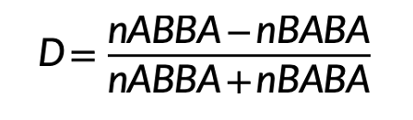
D-statistic
ABBA-BABA
Count number of ABBA sites in genome
Count number of BABA sites in genome
Calculate D statistic
P1
P2
P3
O
P1
P2
P3
O
P2 and P3 coalesce first
P1 and P3 coalesce first
Notes:
Slide 8
One simple way to do this is by calculating the ABBA-BABA statistic, also known as the D statistic.
We have four populations, 3 ingroups and one outgroup & we have a haploid genome sample from each.
We see that the ancestral allele is an A. Then in this internal branch, after the split from the outgroup a lineage mutates from A to B. We also see in this internal branch, which is the common ancestor of the 3 ingroup populations, that we now have 2 sites segregating, some individuals carry the ancestral A allele & some the derived B allele.
# Circles represent coalescent events, and stars indicate mutations from the ancestral state BA^ to the derived state BB.^
# fig from https://www.researchgate.net/profile/Todd-Castoe/publication/333298593_Recent_Advances_in_the_Inference_of_Gene_Flow_from_Population_Genomic_Data/links/5e8dd0be92851c2f52888dc0/Recent-Advances-in-the-Inference-of-Gene-Flow-from-Population-Genomic-Data.pdf

Slide 22
D-statistic
ABBA-BABA
If
=
=> D = 0
P1
P2
P3
O
P1
P2
P3
O
Equally likely for ABBA and BABA sites to be generated
=> expect 1:1 ratio ABBA and BABA sites
assuming neutrality, a fixed mutation rate & no recurrent mutation
Notes:
Slide 8
One simple way to do this is by calculating the ABBA-BABA statistic, also known as the D statistic.
We have four populations, 3 ingroups and one outgroup & we have a haploid genome sample from each.
We see that the ancestral allele is an A. Then in this internal branch, after the split from the outgroup a lineage mutates from A to B. We also see in this internal branch, which is the common ancestor of the 3 ingroup populations, that we now have 2 sites segregating, some individuals carry the ancestral A allele & some the derived B allele.
# Circles represent coalescent events, and stars indicate mutations from the ancestral state BA^ to the derived state BB.^
# fig from https://www.researchgate.net/profile/Todd-Castoe/publication/333298593_Recent_Advances_in_the_Inference_of_Gene_Flow_from_Population_Genomic_Data/links/5e8dd0be92851c2f52888dc0/Recent-Advances-in-the-Inference-of-Gene-Flow-from-Population-Genomic-Data.pdf

Slide 23
D-statistic
Incomplete lineage sorting (ILS)
If
=
=> D = 0
P1
P2
P3
O
P1
P2
P3
O
Equally likely for ABBA and BABA sites to be generated
=> expect 1:1 ratio ABBA and BABA sites
assuming neutrality, a fixed mutation rate & no recurrent mutation
Notes:
Slide 8
One simple way to do this is by calculating the ABBA-BABA statistic, also known as the D statistic.
We have four populations, 3 ingroups and one outgroup & we have a haploid genome sample from each.
We see that the ancestral allele is an A. Then in this internal branch, after the split from the outgroup a lineage mutates from A to B. We also see in this internal branch, which is the common ancestor of the 3 ingroup populations, that we now have 2 sites segregating, some individuals carry the ancestral A allele & some the derived B allele.
# Circles represent coalescent events, and stars indicate mutations from the ancestral state BA^ to the derived state BB.^
# fig from https://www.researchgate.net/profile/Todd-Castoe/publication/333298593_Recent_Advances_in_the_Inference_of_Gene_Flow_from_Population_Genomic_Data/links/5e8dd0be92851c2f52888dc0/Recent-Advances-in-the-Inference-of-Gene-Flow-from-Population-Genomic-Data.pdf

Slide 24
D-statistic
Gene Flow
If
!=
=> D != 0
P1
P2
P3
O
P1
P2
P3
O
Imbalance in ABBA-BABA ratio
Is D significantly different from 0? - use z scores
|Z| >= 3 : statistically significant
Notes:
Slide 8
One simple way to do this is by calculating the ABBA-BABA statistic, also known as the D statistic.
We have four populations, 3 ingroups and one outgroup & we have a haploid genome sample from each.
We see that the ancestral allele is an A. Then in this internal branch, after the split from the outgroup a lineage mutates from A to B. We also see in this internal branch, which is the common ancestor of the 3 ingroup populations, that we now have 2 sites segregating, some individuals carry the ancestral A allele & some the derived B allele.
# Circles represent coalescent events, and stars indicate mutations from the ancestral state BA^ to the derived state BB.^
# fig from https://www.researchgate.net/profile/Todd-Castoe/publication/333298593_Recent_Advances_in_the_Inference_of_Gene_Flow_from_Population_Genomic_Data/links/5e8dd0be92851c2f52888dc0/Recent-Advances-in-the-Inference-of-Gene-Flow-from-Population-Genomic-Data.pdf

Slide 25
D-statistic
Gene Flow
If
!=
P1
P2
P3
O
P1
P2
P3
O
P1
P2
P3
O
Imbalance in ABBA-BABA ratio
Is D significantly different from 0? - use z scores
|Z| >= 3 : statistically significant
Gene flow of derived B alleles from P3 to P2 => excess of ABBA sites compared to BABA sites => D > 0
Notes:
Slide 8
One simple way to do this is by calculating the ABBA-BABA statistic, also known as the D statistic.
We have four populations, 3 ingroups and one outgroup & we have a haploid genome sample from each.
We see that the ancestral allele is an A. Then in this internal branch, after the split from the outgroup a lineage mutates from A to B. We also see in this internal branch, which is the common ancestor of the 3 ingroup populations, that we now have 2 sites segregating, some individuals carry the ancestral A allele & some the derived B allele.
# Circles represent coalescent events, and stars indicate mutations from the ancestral state BA^ to the derived state BB.^
# fig from https://www.researchgate.net/profile/Todd-Castoe/publication/333298593_Recent_Advances_in_the_Inference_of_Gene_Flow_from_Population_Genomic_Data/links/5e8dd0be92851c2f52888dc0/Recent-Advances-in-the-Inference-of-Gene-Flow-from-Population-Genomic-Data.pdf

Slide 26
Real example
Where the D-statistic was first devised and used as one of the lines of evidence
Notes:
https://www.genomicsengland.co.uk/blog/inclusive-ancestry-group-assignment-in-genetics-research

Slide 27
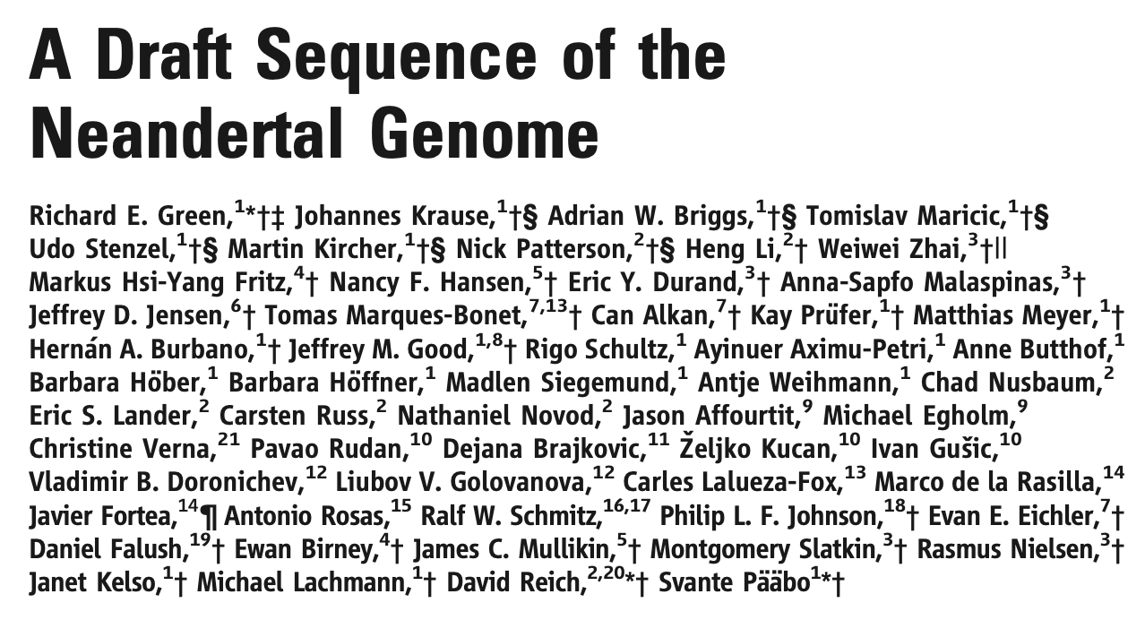
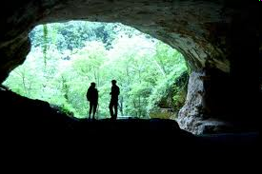
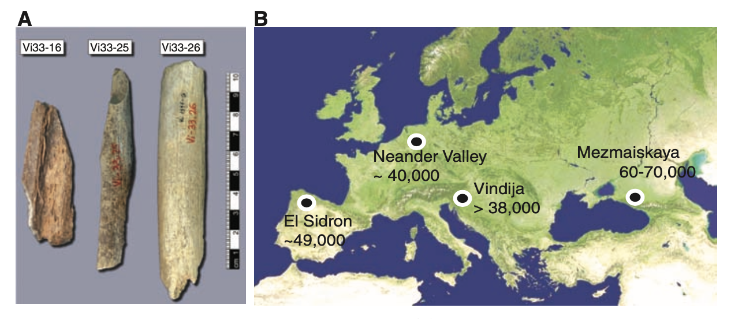
DNA extracted from 3 Neanderthal bones
Green et al. 2010
Notes:
Now let’s take a look at the paper by Green et al. 2010 where the D statistic was first devised & which was one of their lines of evidence for gene flow from Neandertals to a subset of modern humans.
They performed high-throughput sequencing of 3 Neandertal bones from Vindija Cave in Croatia, & from this generated the first draft Neandertal nuclear genome.
At this point in 2010, whether there had been gene flow between Neandertals and modern humans was still unresolved.

Slide 28
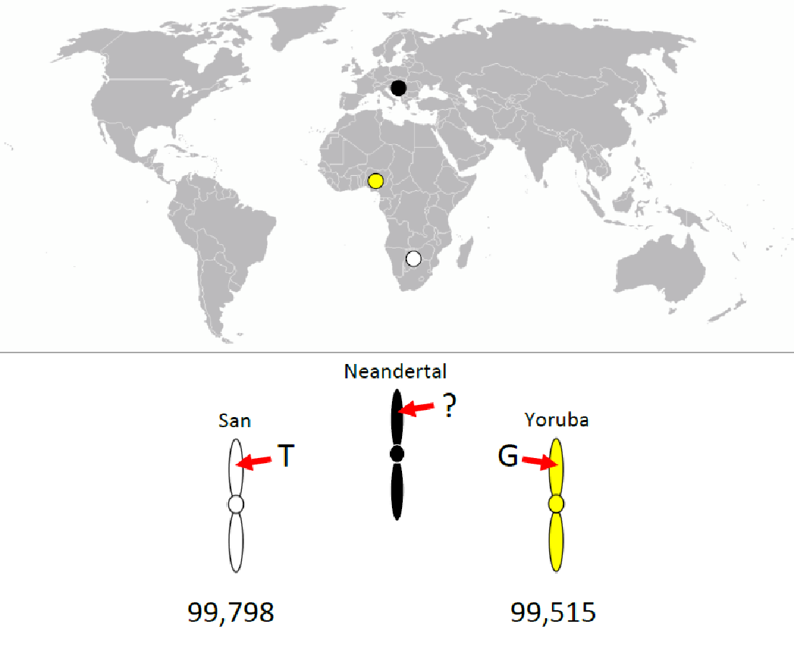
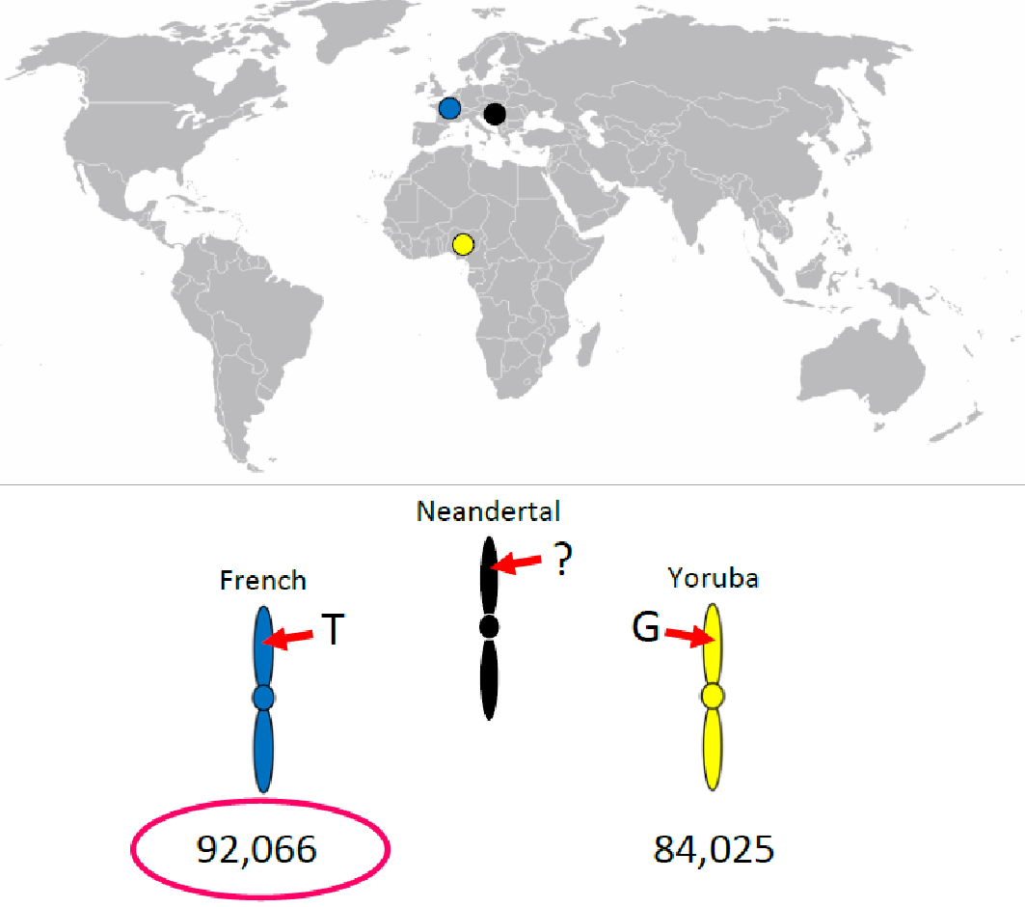
Test gene flow between Neandertals & modern humans
Prediction: If there was gene flow into specific human populations, then the Neanderthal sequence should match alleles in some human populations significantly more often than in others
How to test?
Take biallelic SNPs where 2 humans from different populations carry different alleles & the Neanderthal carries the derived allele
(D from 3.8% to 5.3%, |Z| > 7.0 SD)
Notes:
To test this hypothesis, they took biallelic SNPs where two present-day humans from different populations carry different alleles and where the Neandertal has the derived allele.

Slide 29
Test gene flow between Neandertals & modern humans
Prediction: If there was gene flow into specific human populations, then the Neanderthal sequence should match alleles in some human populations significantly more often than in others
How to test?
Take biallelic SNPs where 2 humans from different populations carry different alleles & the Neanderthal carries the derived allele
(D from 3.8% to 5.3%, |Z| > 7.0 SD)
Notes:
To test this hypothesis, they took biallelic SNPs where two present-day humans from different populations carry different alleles and where the Neandertal has the derived allele.

Slide 30
Prediction: If there was gene flow, then the Neanderthal sequence should match alleles in some humans significantly more often than in others
1 population from West Africa
1 population from South Africa
P1
P2
P3
O
(D from 3.8% to 5.3%, |Z| > 7.0 SD)
San
YRI
Nea
Chimp
Notes:
To test this hypothesis, they took biallelic SNPs where two present-day humans from different populations carry different alleles and where the Neandertal has the derived allele.

Slide 31
Prediction: If there was gene flow, then the Neanderthal sequence should match alleles in some humans significantly more often than in others
1 population from West Africa
1 population from South Africa
D = -0.1 +/- 0.3, , z=-0.4
Same levels of matching to Neanderthal sequence
=
99,515
(# of ABBA sites)
99,788
(# of BABA sites)
=> Neanderthal equally close to both African populations
(D from 3.8% to 5.3%, |Z| > 7.0 SD)
Notes:
To test this hypothesis, they took biallelic SNPs where two present-day humans from different populations carry different alleles and where the Neandertal has the derived allele.

Slide 32
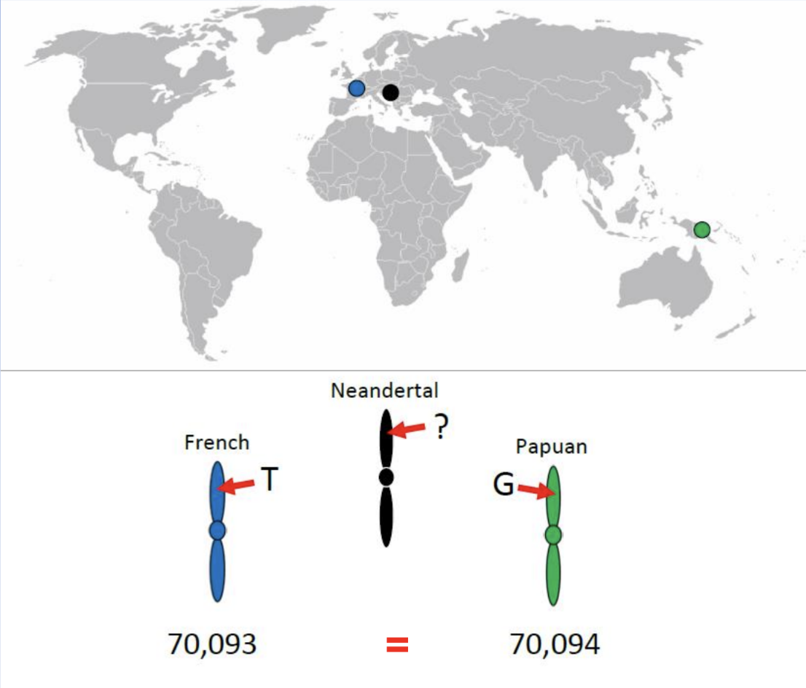
Prediction: If there was gene flow, then the Neanderthal sequence should match alleles in some humans significantly more often than in others
1 population from Europe
1 population from Oceania
P1
P2
P3
O
FR
Pap
Nea
(D from 3.8% to 5.3%, |Z| > 7.0 SD)
Chimp
Notes:
To test this hypothesis, they took biallelic SNPs where two present-day humans from different populations carry different alleles and where the Neandertal has the derived allele.

Slide 33
Prediction: If there was gene flow, then the Neanderthal sequence should match alleles in some humans significantly more often than in others
1 population from Europe
1 population from Oceania
D = 0 +/- 0.5, z=0.0
Same levels of matching to Neanderthal sequence
=
=> Neanderthal equally close to both non-African populations
70,094
(# of ABBA sites)
70,093
(# of BABA sites)
(D from 3.8% to 5.3%, |Z| > 7.0 SD)
Notes:
To test this hypothesis, they took biallelic SNPs where two present-day humans from different populations carry different alleles and where the Neandertal has the derived allele.

Slide 34
Prediction: If there was gene flow, then the Neanderthal sequence should match alleles in some humans significantly more often than in others
1 population from Europe
1 population from West Africa
P1
P2
P3
O
FR
YRI
Nea
Chimp
(D from 3.8% to 5.3%, |Z| > 7.0 SD)
Notes:
They found that the Neandertal matched the alleles of non-Africans significantly more often than Africans. Meaning that Neandertals share significantly more derived alleles with non-Africans than with Africans.

Slide 35
Prediction: If there was gene flow, then the Neanderthal sequence should match alleles in some humans significantly more often than in others
1 population from Europe
1 population from West Africa
!=
(# of BABA sites)
(# of ABBA sites)
(D from 3.8 to 5.3, |Z| > 7.0)
Notes:
They found that the Neandertal matched the alleles of non-Africans significantly more often than Africans. Meaning that Neandertals share significantly more derived alleles with non-Africans than with Africans.

Slide 36
Prediction: If there was gene flow, then the Neanderthal sequence should match alleles in some humans significantly more often than in others
P1
P2
P3
O
FR
YRI
Nea
Chimp
!=
(# of BABA sites)
(# of ABBA sites)
(D from 3.8 to 5.3, |Z| > 7.0)
Notes:
They found that the Neandertal matched the alleles of non-Africans significantly more often than Africans. Meaning that Neandertals share significantly more derived alleles with non-Africans than with Africans.

Slide 37
Prediction: If there was gene flow, then the Neanderthal sequence should match alleles in some humans significantly more often than in others
Finding: Neanderthal shares significantly more derived alleles with French
Neanderthal gene flow with non-Africans
P1
P2
P3
O
FR
YRI
Nea
Chimp
!=
(# of BABA sites)
(# of ABBA sites)
(D from 3.8 to 5.3, |Z| > 7.0)
Notes:
They found that the Neandertal matched the alleles of non-Africans significantly more often than Africans. Meaning that Neandertals share significantly more derived alleles with non-Africans than with Africans.

Slide 38

Evidence of gene flow from Neandertals to modern humans

Slide 39
D-statistic
ABBA-BABA
Tips
ancestral allele = A
Excess of allele sharing between P3 and either P1 or P2
=> important to think which populations make sense for P1,P2
If both P1 and P2 experienced gene flow from P3 cannot detect it!!
4 populations need to fit within this tree;
Ie P1, P2 sister populations
P3 branches next
outgroup
Be careful with reference genome used for mapping the data (avoid reference bias)
mutation A -> B
where the B alleles coalesce
P1
P2
P3
Outgroup
Notes:
Slide 8
One simple way to do this is by calculating the ABBA-BABA statistic, also known as the D statistic.
We have four populations, 3 ingroups and one outgroup & we have a haploid genome sample from each.
We see that the ancestral allele is an A. Then in this internal branch, after the split from the outgroup a lineage mutates from A to B. We also see in this internal branch, which is the common ancestor of the 3 ingroup populations, that we now have 2 sites segregating, some individuals carry the ancestral A allele & some the derived B allele.
# Circles represent coalescent events, and stars indicate mutations from the ancestral state BA^ to the derived state BB.^
# fig from https://www.researchgate.net/profile/Todd-Castoe/publication/333298593_Recent_Advances_in_the_Inference_of_Gene_Flow_from_Population_Genomic_Data/links/5e8dd0be92851c2f52888dc0/Recent-Advances-in-the-Inference-of-Gene-Flow-from-Population-Genomic-Data.pdf

Slide 40

D-statistic
ABBA-BABA
Tips
ancestral allele = A
Excess of allele sharing between P3 and either P1 or P2
=> important to think which populations make sense for P1,P2
If both P1 and P2 experienced gene flow from P3 cannot detect it!!
4 populations need to fit within this tree;
Ie P1, P2 sister populations
P3 branches next
outgroup
Be careful with reference genome used for mapping the data (avoid reference bias)
mutation A -> B
where the B alleles coalesce
P1
P2
P3
Outgroup
Notes:
Slide 8
One simple way to do this is by calculating the ABBA-BABA statistic, also known as the D statistic.
We have four populations, 3 ingroups and one outgroup & we have a haploid genome sample from each.
We see that the ancestral allele is an A. Then in this internal branch, after the split from the outgroup a lineage mutates from A to B. We also see in this internal branch, which is the common ancestor of the 3 ingroup populations, that we now have 2 sites segregating, some individuals carry the ancestral A allele & some the derived B allele.
# Circles represent coalescent events, and stars indicate mutations from the ancestral state BA^ to the derived state BB.^
# fig from https://www.researchgate.net/profile/Todd-Castoe/publication/333298593_Recent_Advances_in_the_Inference_of_Gene_Flow_from_Population_Genomic_Data/links/5e8dd0be92851c2f52888dc0/Recent-Advances-in-the-Inference-of-Gene-Flow-from-Population-Genomic-Data.pdf

Slide 41
D-statistic
ABBA-BABA
Limitations 1
ancestral allele = A
mutation A -> B
Genome-wide signal
Rather than specific introgressed loci
Q: Introgression or ancestral population structure?
where the B alleles coalesce
P1
P2
P3
Outgroup
Ancestral population structure = non-random mating in the ancestor
Notes:
Slide 8
One simple way to do this is by calculating the ABBA-BABA statistic, also known as the D statistic.
We have four populations, 3 ingroups and one outgroup & we have a haploid genome sample from each.
We see that the ancestral allele is an A. Then in this internal branch, after the split from the outgroup a lineage mutates from A to B. We also see in this internal branch, which is the common ancestor of the 3 ingroup populations, that we now have 2 sites segregating, some individuals carry the ancestral A allele & some the derived B allele.
# Circles represent coalescent events, and stars indicate mutations from the ancestral state BA^ to the derived state BB.^
# fig from https://www.researchgate.net/profile/Todd-Castoe/publication/333298593_Recent_Advances_in_the_Inference_of_Gene_Flow_from_Population_Genomic_Data/links/5e8dd0be92851c2f52888dc0/Recent-Advances-in-the-Inference-of-Gene-Flow-from-Population-Genomic-Data.pdf

Slide 42
D-statistic
ABBA-BABA
Limitations 2: Sampling problem
ancestral allele = A
mutation A -> B
Undersampling can confound the D-statistic
Misidentify the donor population & gene flow events
Example in bears
where the B alleles coalesce
P1
P2
P3
Outgroup
Notes:
Slide 8
One simple way to do this is by calculating the ABBA-BABA statistic, also known as the D statistic.
We have four populations, 3 ingroups and one outgroup & we have a haploid genome sample from each.
We see that the ancestral allele is an A. Then in this internal branch, after the split from the outgroup a lineage mutates from A to B. We also see in this internal branch, which is the common ancestor of the 3 ingroup populations, that we now have 2 sites segregating, some individuals carry the ancestral A allele & some the derived B allele.
# Circles represent coalescent events, and stars indicate mutations from the ancestral state BA^ to the derived state BB.^
# fig from https://www.researchgate.net/profile/Todd-Castoe/publication/333298593_Recent_Advances_in_the_Inference_of_Gene_Flow_from_Population_Genomic_Data/links/5e8dd0be92851c2f52888dc0/Recent-Advances-in-the-Inference-of-Gene-Flow-from-Population-Genomic-Data.pdf

Slide 43
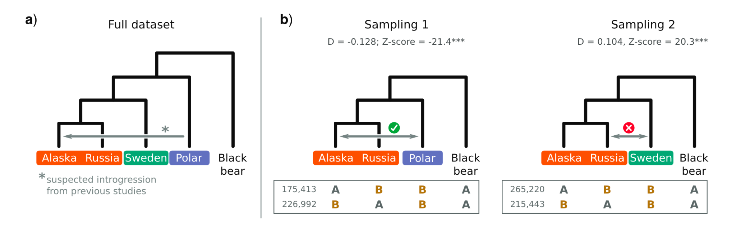
D-statistic
ABBA-BABA
Limitations 2: Sampling problem
Previous work had inferred gene flow from Polar bears to Alaska bears
ABBA-BABA needs 4 populations
Let’s take 4 population subsets & see what happens
5-taxon tree
Tricou et al. 2021
Notes:
Briefly I want to discuss the problem of sampling on the D statistic, so we continue to think about the limitations of any statistic or method we are applying (or that other people have applied).
Here Tricou et al. looked at genomic data of bears, on the left we see the phylogeny of the 5 populations & where previous work has inferred there to be introgression. On the right we see that we obtain different results of the statistic depending on which samples we include in the analysis.
This raises an important point, that we do not necessarily know all the lineages which have contributed to our populations (extinct or living populations).
Extra slide - FIGURE 3. The effect of sampling on the interpretation of the D-statistic, using bear genomic data as an example. a) Phylogenetic relationship of the five bear taxa sampled. The gray arrow shows the introgression inferred from previous studies. b) D-statistic calculated from two 4-taxon subsets. The number of ABBA and BABA patterns is given below the trees. In subset 1, the Slovenian bear, a lineage that is not thought to be involved in introgression, is removed. In subset 2, the donor of the introgression shown in 3A (i.e., the polar bear) is removed. Introgressions were inferred from the D-statistic (grey arrows), and their congruence with other studies (tick-mark = congruent, cross-mark = not congruent) is indicated above the arrow.The latter attribution, however, relies on our knowledge of the existence of polar bears, which are considered a ghost lineage in our example.
we can never assume that we know all the lineages leading to extant or extinct species.

Slide 44
D-statistic
ABBA-BABA
Limitations 2: Sampling problem
Remove Swedish bears
Correct gene flow event inferred
5-taxon tree
Tricou et al. 2021
Notes:
Briefly I want to discuss the problem of sampling on the D statistic, so we continue to think about the limitations of any statistic or method we are applying (or that other people have applied).
Here Tricou et al. looked at genomic data of bears, on the left we see the phylogeny of the 5 populations & where previous work has inferred there to be introgression. On the right we see that we obtain different results of the statistic depending on which samples we include in the analysis.
This raises an important point, that we do not necessarily know all the lineages which have contributed to our populations (extinct or living populations).
Extra slide - FIGURE 3. The effect of sampling on the interpretation of the D-statistic, using bear genomic data as an example. a) Phylogenetic relationship of the five bear taxa sampled. The gray arrow shows the introgression inferred from previous studies. b) D-statistic calculated from two 4-taxon subsets. The number of ABBA and BABA patterns is given below the trees. In subset 1, the Slovenian bear, a lineage that is not thought to be involved in introgression, is removed. In subset 2, the donor of the introgression shown in 3A (i.e., the polar bear) is removed. Introgressions were inferred from the D-statistic (grey arrows), and their congruence with other studies (tick-mark = congruent, cross-mark = not congruent) is indicated above the arrow.The latter attribution, however, relies on our knowledge of the existence of polar bears, which are considered a ghost lineage in our example.
we can never assume that we know all the lineages leading to extant or extinct species.

Slide 45
D-statistic
ABBA-BABA
Limitations 2: Sampling problem
Remove Polar bears
False gene flow event inferred
5-taxon tree
Tricou et al. 2021
Notes:
Briefly I want to discuss the problem of sampling on the D statistic, so we continue to think about the limitations of any statistic or method we are applying (or that other people have applied).
Here Tricou et al. looked at genomic data of bears, on the left we see the phylogeny of the 5 populations & where previous work has inferred there to be introgression. On the right we see that we obtain different results of the statistic depending on which samples we include in the analysis.
This raises an important point, that we do not necessarily know all the lineages which have contributed to our populations (extinct or living populations).
Extra slide - FIGURE 3. The effect of sampling on the interpretation of the D-statistic, using bear genomic data as an example. a) Phylogenetic relationship of the five bear taxa sampled. The gray arrow shows the introgression inferred from previous studies. b) D-statistic calculated from two 4-taxon subsets. The number of ABBA and BABA patterns is given below the trees. In subset 1, the Slovenian bear, a lineage that is not thought to be involved in introgression, is removed. In subset 2, the donor of the introgression shown in 3A (i.e., the polar bear) is removed. Introgressions were inferred from the D-statistic (grey arrows), and their congruence with other studies (tick-mark = congruent, cross-mark = not congruent) is indicated above the arrow.The latter attribution, however, relies on our knowledge of the existence of polar bears, which are considered a ghost lineage in our example.
we can never assume that we know all the lineages leading to extant or extinct species.

Slide 46
How else to test for gene flow?
Identify introgressed regions within the genome
That look divergent from the majority of regions of the target population
Variation that does not coalesce within the target population because has external origin.
Notes:
https://www.genomicsengland.co.uk/blog/inclusive-ancestry-group-assignment-in-genetics-research

Slide 47
How else to test for gene flow?
Real example
Identify introgressed regions within the genome
That look divergent from the majority of regions of the target population
Variation that does not coalesce within the target population because has external origin.
Notes:
https://www.genomicsengland.co.uk/blog/inclusive-ancestry-group-assignment-in-genetics-research

Slide 48
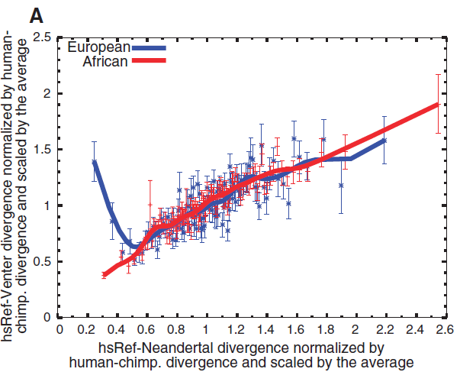
We can go from a genome-wide signal of Neanderthal SNPs to introgressed segments of Neanderthal DNA
Introgressed segments
Low divergence to Neandertal
High divergence to other humans
Green et al. 2010
Notes:
So to narrow down a genome-wide signal of gene flow to individual introgressed segments we need another approach.
The next thing they did was to split the genomes of African & Europeans into segments & look at the divergence of these segments to the Neandertal sequence on the x axis, & their divergence to other present-day human sequences on the y axis. We see that there are segments in Europeans in blue, which have low divergence to the Neandertal & high divergence to other humans - suggesting that these segments are likely Neandertal in origin & have entered the population by introgression

Slide 49
We can go from a genome-wide signal of Neanderthal SNPs to introgressed segments of Neanderthal DNA
Introgressed segments
Low divergence to Neandertal
High divergence to other humans
Y axis = divergence of segments to other present-day humans
X axis = divergence of segments to Neanderthal sequence
Green et al. 2010
Notes:
So to narrow down a genome-wide signal of gene flow to individual introgressed segments we need another approach.
The next thing they did was to split the genomes of African & Europeans into segments & look at the divergence of these segments to the Neandertal sequence on the x axis, & their divergence to other present-day human sequences on the y axis. We see that there are segments in Europeans in blue, which have low divergence to the Neandertal & high divergence to other humans - suggesting that these segments are likely Neandertal in origin & have entered the population by introgression

Slide 50
We can go from a genome-wide signal of Neanderthal SNPs to introgressed segments of Neanderthal DNA
Introgressed segments
Low divergence to Neandertal
High divergence to other humans
Y axis = divergence of segments to other present-day humans
X axis = divergence of segments to Neanderthal sequence
Green et al. 2010
Notes:
So to narrow down a genome-wide signal of gene flow to individual introgressed segments we need another approach.
The next thing they did was to split the genomes of African & Europeans into segments & look at the divergence of these segments to the Neandertal sequence on the x axis, & their divergence to other present-day human sequences on the y axis. We see that there are segments in Europeans in blue, which have low divergence to the Neandertal & high divergence to other humans - suggesting that these segments are likely Neandertal in origin & have entered the population by introgression

Slide 51
We can go from a genome-wide signal of Neanderthal SNPs to introgressed segments of Neanderthal DNA
Introgressed segments
Low divergence to Neandertal
High divergence to other humans
Y axis = divergence of segments to other present-day humans
Blue = Many European segments have equal divergence to both other humans & Neanderthal
Substantial minority of European segments have low divergence to Neanderthal & high divergence to other humans => introgressed segments
X axis = divergence of segments to Neanderthal sequence
Green et al. 2010
Notes:
So to narrow down a genome-wide signal of gene flow to individual introgressed segments we need another approach.
The next thing they did was to split the genomes of African & Europeans into segments & look at the divergence of these segments to the Neandertal sequence on the x axis, & their divergence to other present-day human sequences on the y axis. We see that there are segments in Europeans in blue, which have low divergence to the Neandertal & high divergence to other humans - suggesting that these segments are likely Neandertal in origin & have entered the population by introgression

Slide 52
We can go from a genome-wide signal of Neanderthal SNPs to introgressed segments of Neanderthal DNA
Introgressed segments
Low divergence to Neandertal
High divergence to other humans
Y axis = divergence of segments to other present-day humans
Blue = Many European segments have equal divergence to both other humans & Neanderthal
Substantial minority of European segments have low divergence to Neanderthal & high divergence to other humans => introgressed segments
X axis = divergence of segments to Neanderthal sequence
Green et al. 2010
Notes:
So to narrow down a genome-wide signal of gene flow to individual introgressed segments we need another approach.
The next thing they did was to split the genomes of African & Europeans into segments & look at the divergence of these segments to the Neandertal sequence on the x axis, & their divergence to other present-day human sequences on the y axis. We see that there are segments in Europeans in blue, which have low divergence to the Neandertal & high divergence to other humans - suggesting that these segments are likely Neandertal in origin & have entered the population by introgression

Slide 53
3 lines of evidence of gene flow from Neandertals to modern humans
D-statistics: Count the shared alleles & normalise by their total number
D(non-African, African; Nea, Chimp)
These sites cluster (chunks in the genome)
Independent method: Discordant regions
Regions that are more divergent within non-Africans and have low divergence to Neanderthal sequence
Green et al. 2010
Notes:
So to recap, in this paper they used different lines of evidence supporting gene flow. The first, was D statistics, looking at allele sharing, then they took an independent approach by looking for discordant regions of the genome.

Slide 54
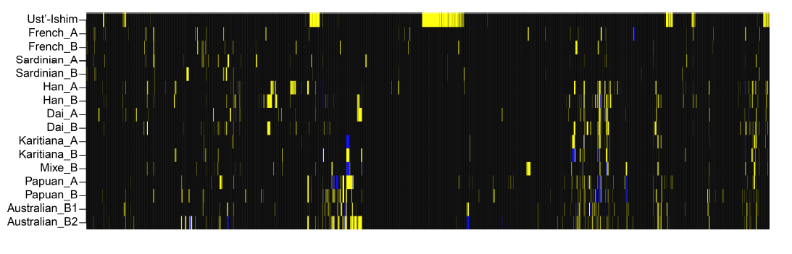
Further evidence of gene flow from Neandertals to modern humans : Ust-Ishim
Modern human, western Siberia, ~45 kya
Slightly more Neandertal admixture
Longer chunks of Neandertal sequence
Differences in space and time
Ancient sample
Present-day samples
non-African populations
black=homozygous ancestral; yellow= heterozygous derived; blue=homozygous derived
Fu et al. 2014

Slide 55
Further evidence of gene flow from Neandertals to modern humans : Ust-Ishim
Modern human, western Siberia, ~45 kya
Carries more Neandertal gene flow
Longer chunks of Neandertal sequence
Differences in space and time
black=homozygous ancestral; yellow= heterozygous derived; blue=homozygous derived
Fu et al. 2014
Notes:
https://pmc.ncbi.nlm.nih.gov/articles/PMC4753769/

Slide 56
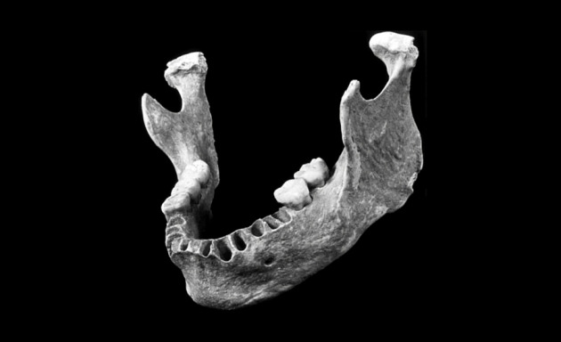
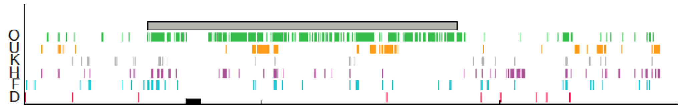
Further evidence of gene flow from Neandertals to modern humans : Oase cu Pestera
Oase cu Pestera (Romania): Human fossil with admixed features
Neandertal ancestor 4-6 generations back
But no descendents are living today
Distinct introgression event
Ancient sample (Oase)
Ancient sample (Ust-Ishim)
Chromosome 12
Fu et al. 2015

Slide 57
Further evidence of gene flow from Neandertals to modern humans : Oase cu Pestera
Oase cu Pestera (Romania): Human fossil with admixed features
Neandertal ancestor 4-6 generations back
But no descendents are living today
Distinct introgression event
Chromosome 12
Fu et al. 2015

Slide 58
Further evidence of gene flow from Neandertals to modern humans : Oase cu Pestera
Oase cu Pestera (Romania): Human fossil with admixed features
Neandertal ancestor 4-6 generations back
But no descendents are living today
Distinct introgression event
Chromosome 12
Fu et al. 2015

Slide 59
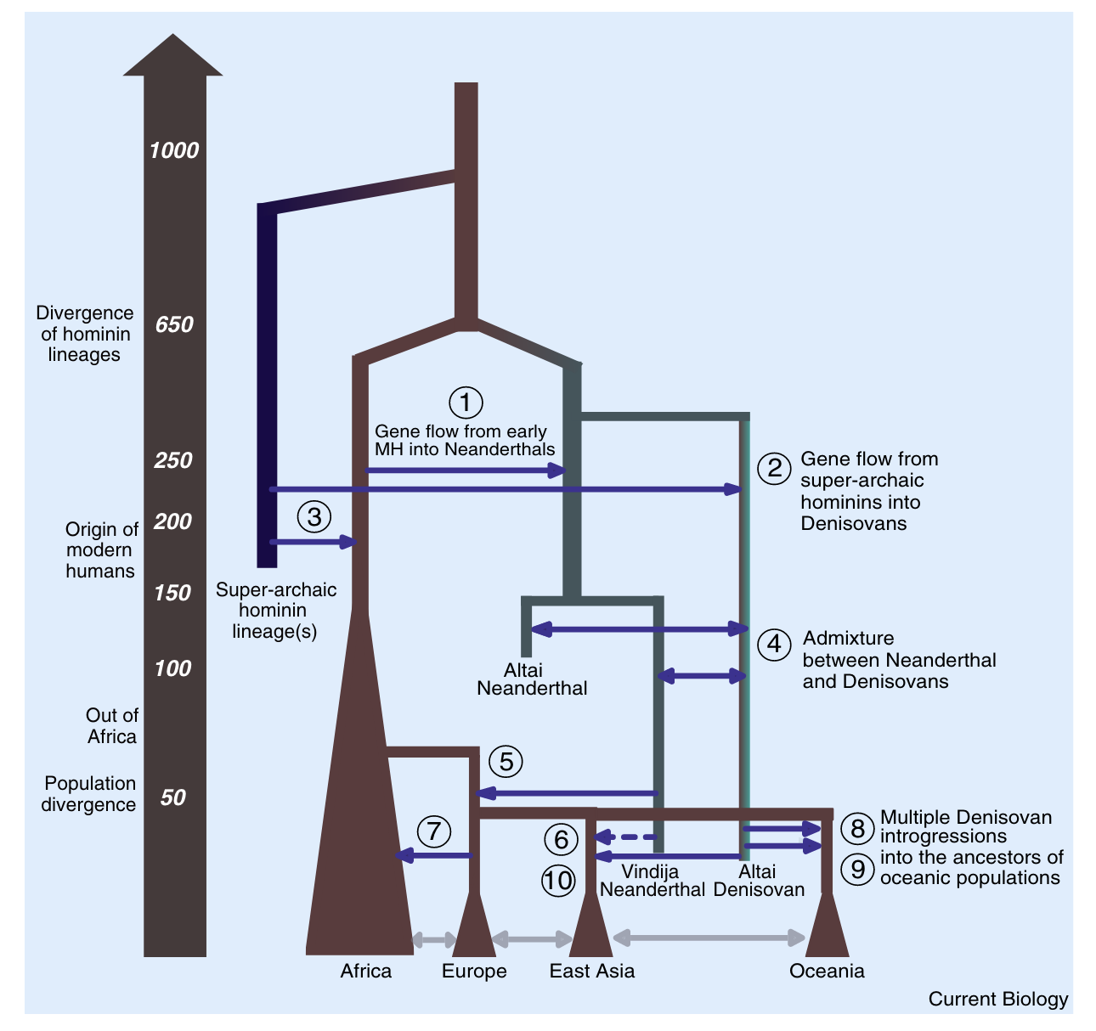
Summary of archaic introgression in hominins
What we know so far…
Gene flow to & from extinct hominins & AMH
Rapidly changing field!
Reilly et al. 2022
Notes:
Here is a summary of what we know so far about archaic introgression events in hominins & there should also be a ghost with gene flow into Africans. Highlighting that this is a rapidly changing field.
# hope these slides have given you an idea of the advances in ancient dna sequencing & bioinformatic methods to analyse this data over the past decade

Slide 60
Gene flow is not unique to humans

Slide 61
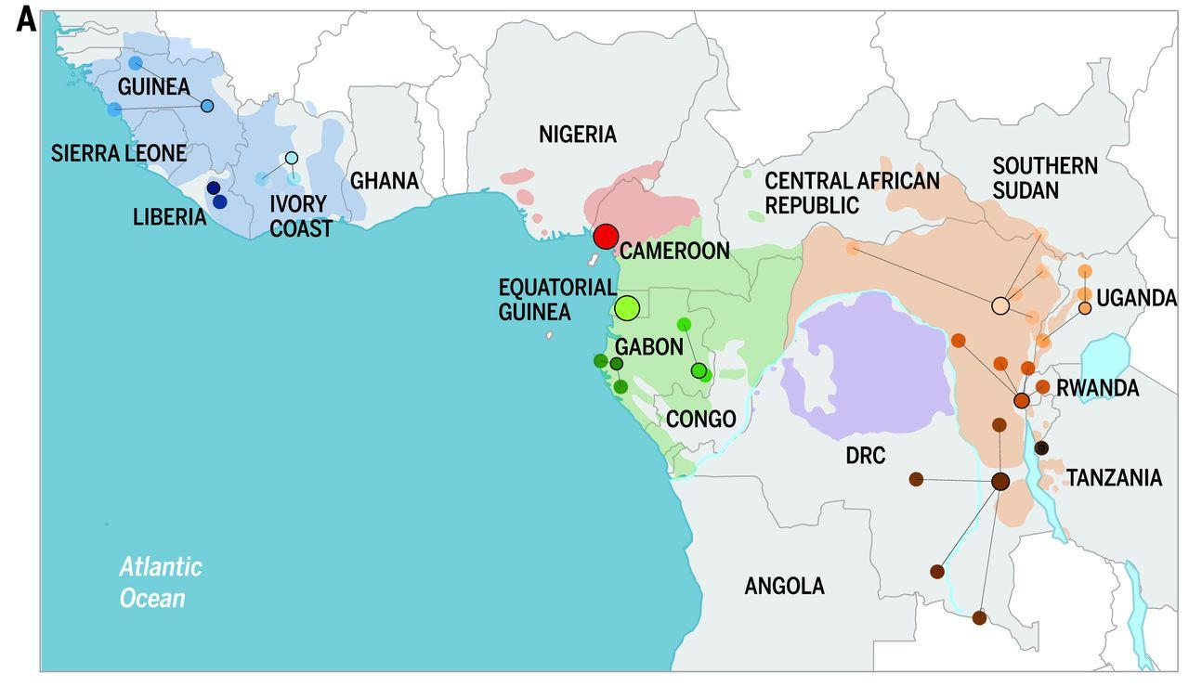
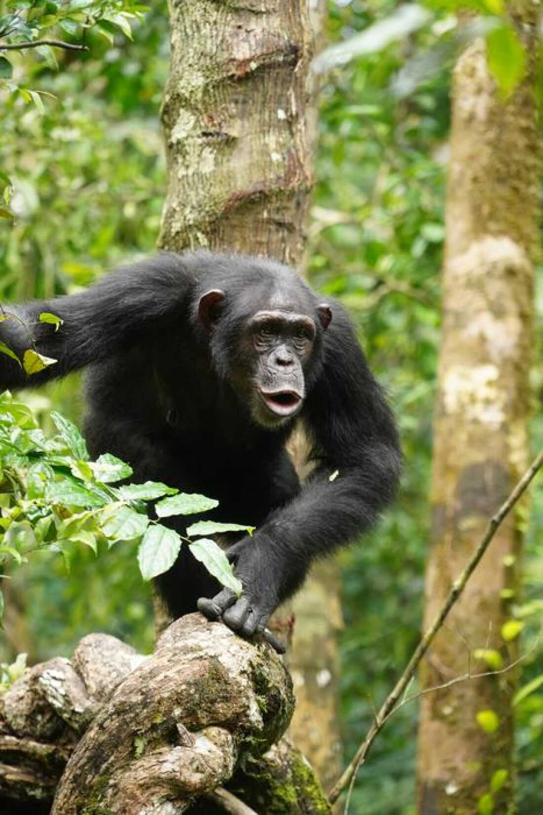
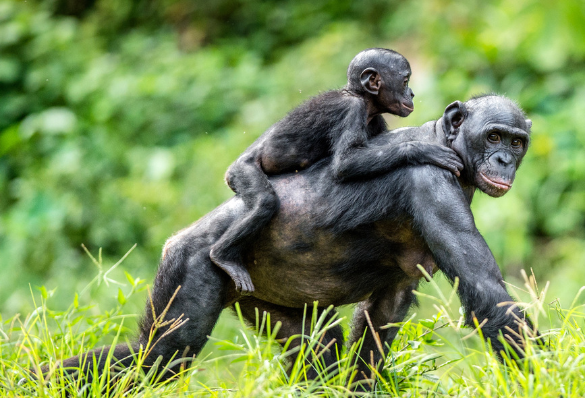
Gene flow between chimpanzees and bonobos
de Manuel et al. 2016

Slide 62
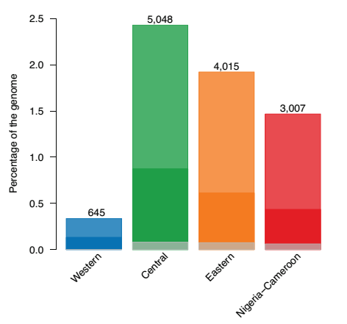
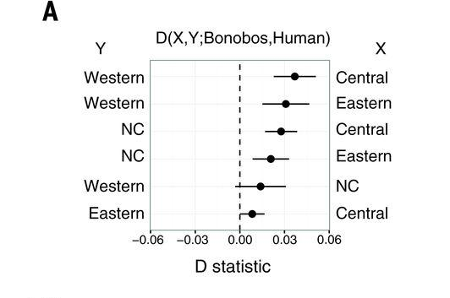
Gene flow between chimpanzees and bonobos
P1
P2
P3
O
C
W
Bon
Human
D-statistics: High allele sharing between C, E, NC chimpanzees with bonobos
de Manuel et al. 2016

Slide 63
Gene flow between chimpanzees and bonobos
P1
P2
P3
O
C/E/NC
W
Bon
Human
D-statistics: High allele sharing between C, E, NC chimpanzees with bonobos
de Manuel et al. 2016

Slide 64
Gene flow between chimpanzees and bonobos
D-statistics: High allele sharing between C, E, NC chimpanzees with bonobos
Chunks of bonobo segments ~ 2.5%
Similar genomic features to hominin introgression events
de Manuel et al. 2016

Slide 65
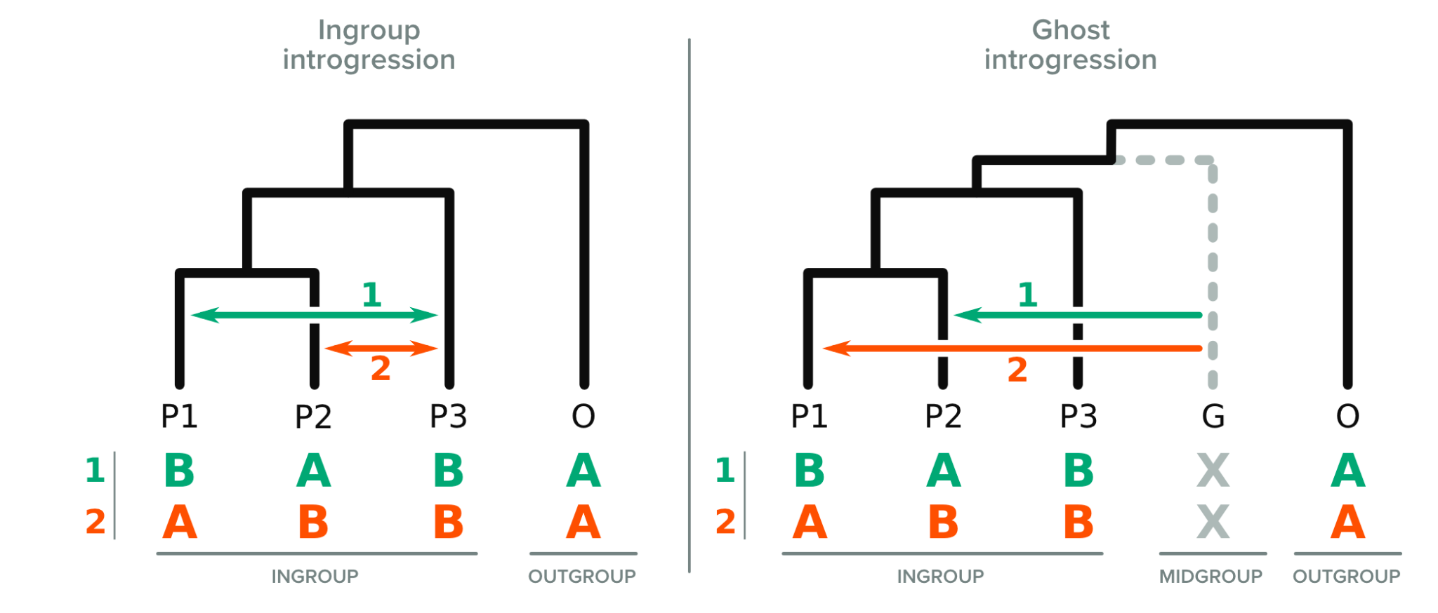
Further scenario to consider
Tricou et al. 2021
Notes:
# another extra slide: further scenario to consider: ghost introgression -> unsampled ghost in the phylogeny can lead to misidentified donor & recipient lineages. By ghost we mean an unsampled population, which may or may not be extinct.
Extra slide -
Introgression events that can result in a significant excess of ABBA or BABA patterns according to the D-statistic. The usual interpretation of this excess is the hypothesis of “ingroup” introgression (left panel). However, “ghost” (or “midgroup”) introgression (right panel) from ghost lineages (G) can produce similar patterns.
Potential misidentification of donor & recipient lineages - from having an unsampled ghost in the phylogeny
From tricou 2021 https://watermark.silverchair.com/syac011.pdf?token=AQECAHi208BE49Ooan9kkhW_Ercy7Dm3ZL_9Cf3qfKAc485ysgAAAt4wggLaBgkqhkiG9w0BBwagggLLMIICxwIBADCCAsAGCSqGSIb3DQEHATAeBglghkgBZQMEAS4wEQQMWqNgJ15BB1coRIXBAgEQgIICkcTu4LMc5NmV4-VKsDU_M2hfbYCc2jT3n2jzXs4FgPkgLgvweStgWgQ2fYfcX0zABp54KkJh3fF-0q-7klaOW5ZIH92FlPEl2unL_76ucabJe2Jy0ykbz7eOrnAExBw3TSuYz9zf_v6sKQ6ful-_iISCpYBZmygwkfeHG__aJIfLNZp2oRn6uD9Xs8AlSBWGRrem9JaU9sobZeAJV2U9weLlSpaCG3seillqRM3sraPbgurIRLZ9ux4bRIz7IS5N4L_3pnCuvfySDJf3pvDOggvlDCpjPl7zFKwofCC0SKbi-XjRrK6BjbwSRU_uVGGqT20e-CzdRVoCVCyx8lRqucieXGj128fUUYJ4_Y_DRfeWtBBEFBkqwX9ewBBYb7csV5evQY8211AdZ0nrlo_xc8Pb5TVisZsnc6rIl-dnh_A4MH4k3rEhVPG7s-bkRe1qbnw8tylKVtkAe_rllT4evUVF4BoZYh1wFKUDs5qxcRs38S-AVd5LGz6EXdjddLngfkY4kCo6-rTkn_oejnHYXziV6GDYvFZV5Av_fL78x4wKM7eNtital5iSD1eyYZS87g8xj5oViovGxWPAz16uG46fivKAL2ppIQI1KjopVAvKYJ-Mc8mAuENGqa1C4RvZCQzugu15rhf-y1H5tPS8zAgJERJgl-tx-DbhXO3fgquPBe3rJNNkop_fxMYcG7ks83u2nFPkd7F-_huKe0meWCCxk9mcK24BDZrmUjNfyj59lbX2dvvZzshUKgjpdkbzDK0KhZ0rgCMWy_Pz0RVvggbXsasDXCZ9aUhfJbSPfk1XG3TEsFL31P8GLtqJeQ1FeUnnzEFIjB0NYQW888mNAGhob4CtJA_9hi0zO8yRv_wOMQ

Slide 66
Further scenario to consider
Ghost gene flow
Needs statistical methods beyond D-statistics to infer
Tricou et al. 2021
Notes:
# another extra slide: further scenario to consider: ghost introgression -> unsampled ghost in the phylogeny can lead to misidentified donor & recipient lineages. By ghost we mean an unsampled population, which may or may not be extinct.
Extra slide -
Introgression events that can result in a significant excess of ABBA or BABA patterns according to the D-statistic. The usual interpretation of this excess is the hypothesis of “ingroup” introgression (left panel). However, “ghost” (or “midgroup”) introgression (right panel) from ghost lineages (G) can produce similar patterns.
Potential misidentification of donor & recipient lineages - from having an unsampled ghost in the phylogeny
From tricou 2021 https://watermark.silverchair.com/syac011.pdf?token=AQECAHi208BE49Ooan9kkhW_Ercy7Dm3ZL_9Cf3qfKAc485ysgAAAt4wggLaBgkqhkiG9w0BBwagggLLMIICxwIBADCCAsAGCSqGSIb3DQEHATAeBglghkgBZQMEAS4wEQQMWqNgJ15BB1coRIXBAgEQgIICkcTu4LMc5NmV4-VKsDU_M2hfbYCc2jT3n2jzXs4FgPkgLgvweStgWgQ2fYfcX0zABp54KkJh3fF-0q-7klaOW5ZIH92FlPEl2unL_76ucabJe2Jy0ykbz7eOrnAExBw3TSuYz9zf_v6sKQ6ful-_iISCpYBZmygwkfeHG__aJIfLNZp2oRn6uD9Xs8AlSBWGRrem9JaU9sobZeAJV2U9weLlSpaCG3seillqRM3sraPbgurIRLZ9ux4bRIz7IS5N4L_3pnCuvfySDJf3pvDOggvlDCpjPl7zFKwofCC0SKbi-XjRrK6BjbwSRU_uVGGqT20e-CzdRVoCVCyx8lRqucieXGj128fUUYJ4_Y_DRfeWtBBEFBkqwX9ewBBYb7csV5evQY8211AdZ0nrlo_xc8Pb5TVisZsnc6rIl-dnh_A4MH4k3rEhVPG7s-bkRe1qbnw8tylKVtkAe_rllT4evUVF4BoZYh1wFKUDs5qxcRs38S-AVd5LGz6EXdjddLngfkY4kCo6-rTkn_oejnHYXziV6GDYvFZV5Av_fL78x4wKM7eNtital5iSD1eyYZS87g8xj5oViovGxWPAz16uG46fivKAL2ppIQI1KjopVAvKYJ-Mc8mAuENGqa1C4RvZCQzugu15rhf-y1H5tPS8zAgJERJgl-tx-DbhXO3fgquPBe3rJNNkop_fxMYcG7ks83u2nFPkd7F-_huKe0meWCCxk9mcK24BDZrmUjNfyj59lbX2dvvZzshUKgjpdkbzDK0KhZ0rgCMWy_Pz0RVvggbXsasDXCZ9aUhfJbSPfk1XG3TEsFL31P8GLtqJeQ1FeUnnzEFIjB0NYQW888mNAGhob4CtJA_9hi0zO8yRv_wOMQ

Slide 67
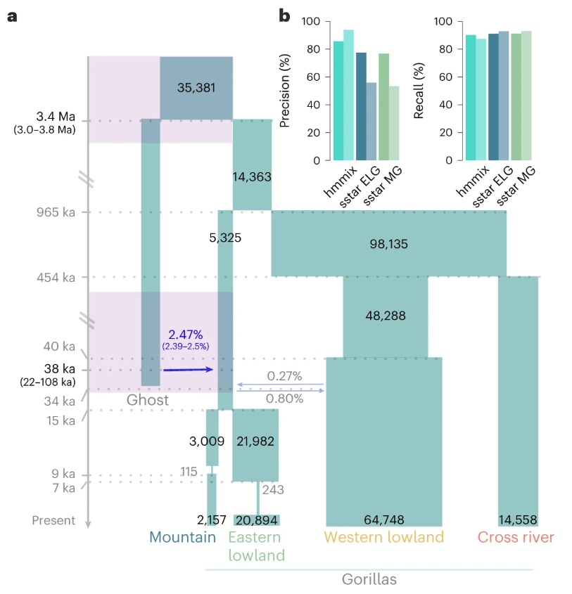
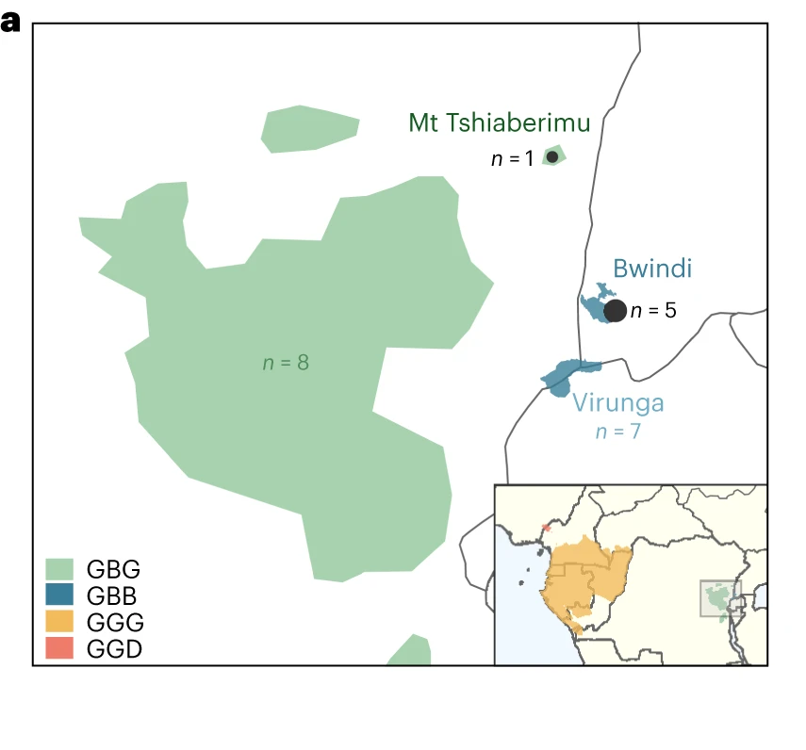
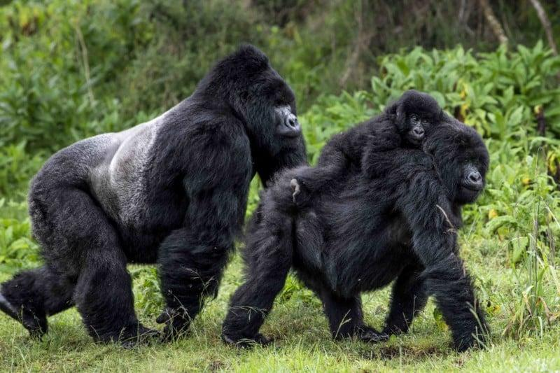
Gene flow in eastern gorillas
Pawar et al. 2023

Slide 68
Ghost gene flow in eastern gorillas
ABC-based demographic modelling
Statistical methods: hmmix, S*
Functional impact for bitter taste perception - adaptive introgression
Pawar et al. 2023

Slide 69
Impact of gene flow on the genome

Slide 70
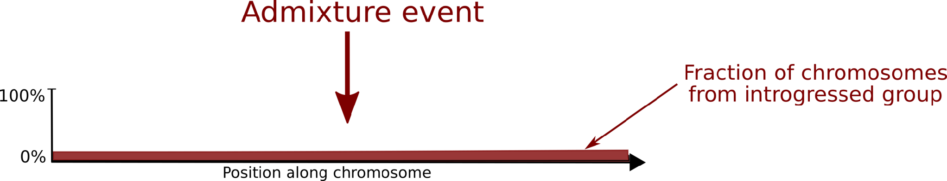
First generation after admixture
Notes:
In the first generation after admixture, whole introgressed chromosomes enter the population.

Slide 71
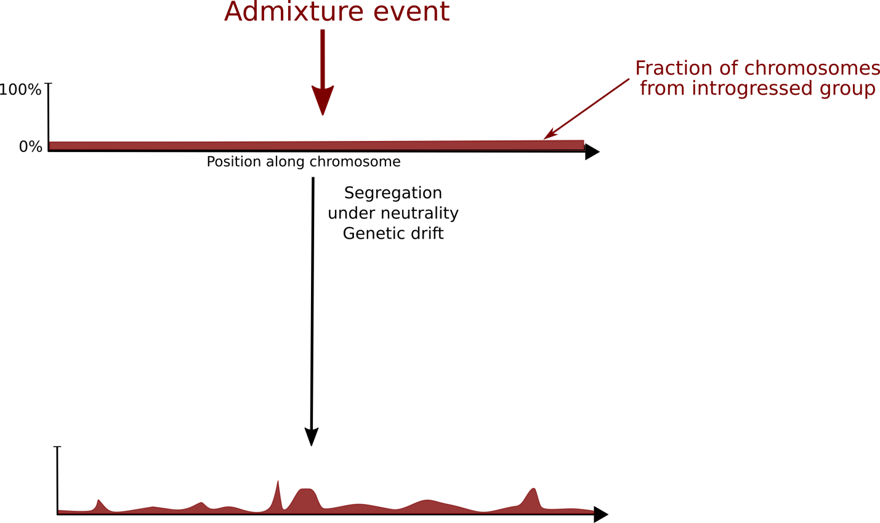
Impact of recombination + drift
Notes:
Over many generations & if segregating under neutrality genetic drift will act to change introgressed allele frequency at random. While recombination will act to break down the length of the introgressed fragments. As with all variation much of the introgressed material is likely to be functionally neutral.

Slide 72
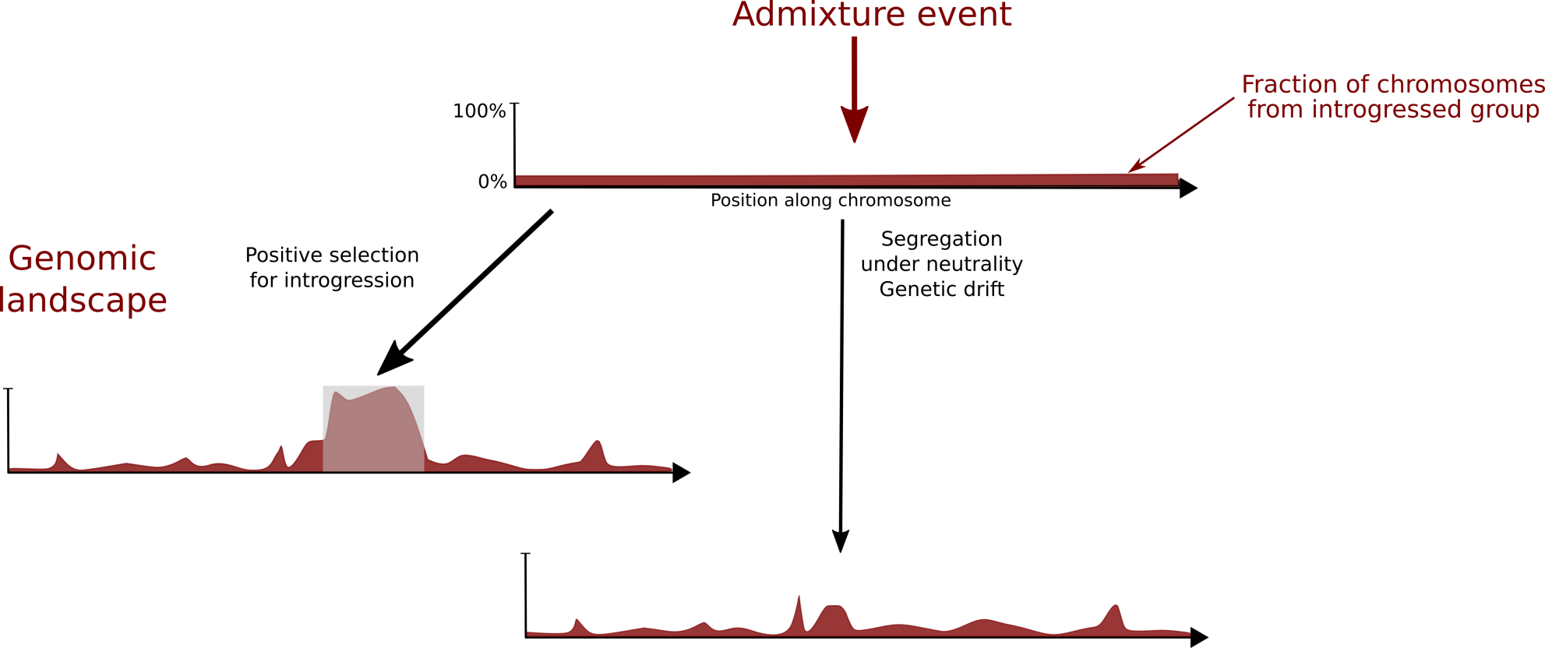
Notes:
But some introgressed variants may be targets of positive selection & increase to high frequency, this is termed ‘adaptive introgression’.

Slide 73
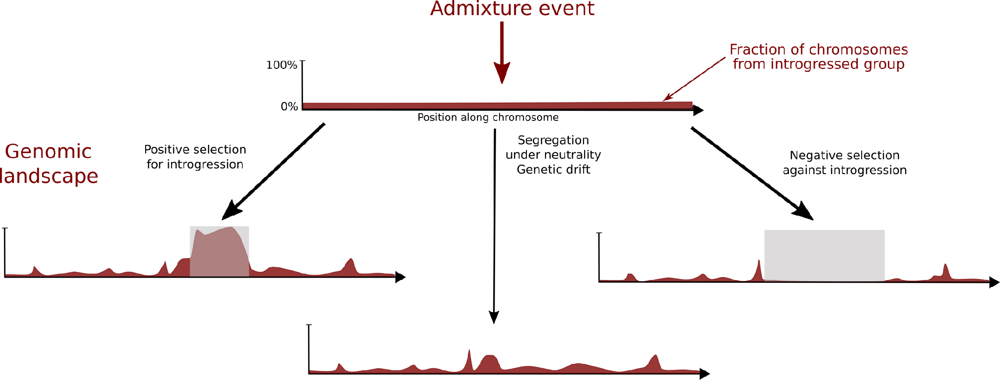
Notes:
While other variants will be purged by negative selection against introgressed material, resulting in introgression deserts.

Slide 74
Adaptive introgression
Candidate loci
Genetic variation
Introgression deserts
Candidate loci
Notes:
The functional consequences of adaptive introgression & introgression deserts can be explored further & assessed for candidate loci. To give an idea of why these regions may have been targeted by selection.

Slide 75
Functionally relevant
Adaptive introgression
Candidate loci
Genetic variation
Introgression deserts
Candidate loci
Notes:
The functional consequences of adaptive introgression & introgression deserts can be explored further & assessed for candidate loci. To give an idea of why these regions may have been targeted by selection.

Slide 76
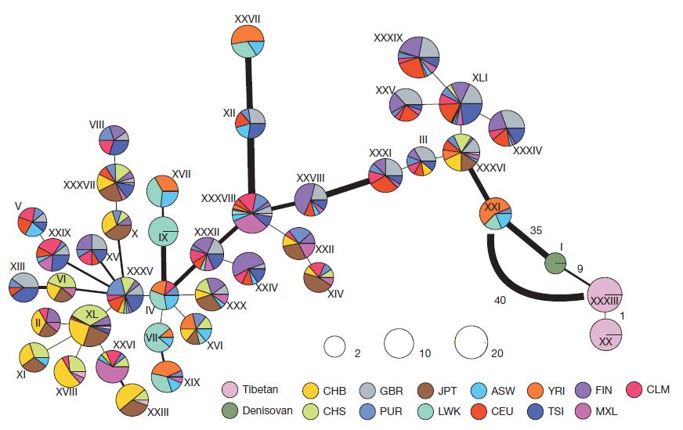
Adaptive introgression in humans
Haplotype networks from pairwise differences at EPAS1
Tibetan haplotype more similar to Denisovan
Divergent to haplotypes of other modern humans
Huerta-Sanchez et al. 2014
Notes:
Let’s look at the archetypal example of adaptive introgression - EPAS1 in Tibetans.
It had previously been shown that the gene EPAS1 had strong signatures of positive selection in the Tibetan population. EPAS1 encodes a transcription factor, which is induced in hypoxic conditions, such as at high altitude.
Huerta-Sanchez et al. built haplotype networks from the pairwise differences in the EPAS1 gene for all populations in the 1000 Genomes dataset - which we see here.

Slide 77
Adaptive introgression in humans
Haplotype networks from pairwise differences at EPAS1
Pink = Tibetan haplotype is more similar to Denisovan (green) & divergent to haplotypes of other modern humans
Altitude Adaptation
Huerta-Sanchez et al. 2014
Notes:
Let’s look at the archetypal example of adaptive introgression - EPAS1 in Tibetans.
It had previously been shown that the gene EPAS1 had strong signatures of positive selection in the Tibetan population. EPAS1 encodes a transcription factor, which is induced in hypoxic conditions, such as at high altitude.
Huerta-Sanchez et al. built haplotype networks from the pairwise differences in the EPAS1 gene for all populations in the 1000 Genomes dataset - which we see here.

Slide 78
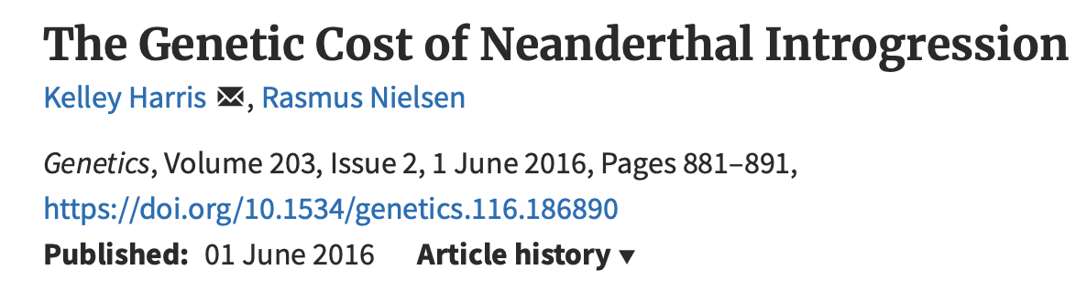
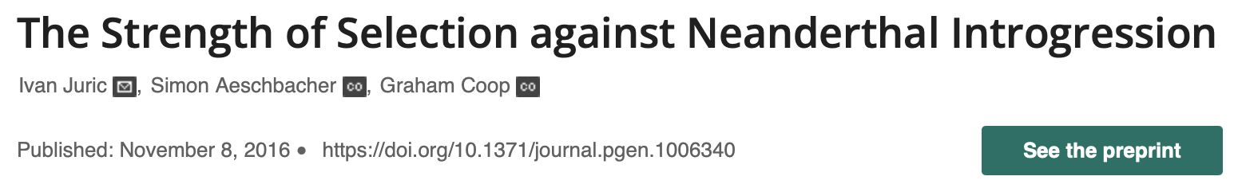
But archaic introgression may have been largely deleterious
Reduced Neandertal ancestry in regions with strong background selection & evolutionary conservation
Reduced in genes & gene regulatory elements
Notes:
The opposite scenario to adaptive introgression, is the emergence of introgression deserts. These are defined as regions longer than 10Mb with depleted archaic ancestry.
Sankararaman et al. & others have localised introgression deserts to chromosome X & to genes expressed in the test, as well as to the region surrounding foxp2.

Slide 79
Introgression deserts
Regions > 10Mb with depleted archaic ancestry
In chromosome X
Genes expressed in testes
Male hybrid sterility?
Archaic alleles deleterious on human background
Sankararaman et al. 2014, 2016
Notes:
Why would these regions be under negative selection?
Deserts in chromosome X & in testes genes support the hypothesis of reduced fertility of male hybrids. & indicate that for these genes the archaic alleles were deleterious on the human background. …idea of regulatory epistasis, that archaic alleles adapted to function in an archaic genetic background, encounter incompatibilities outside of this

Slide 80
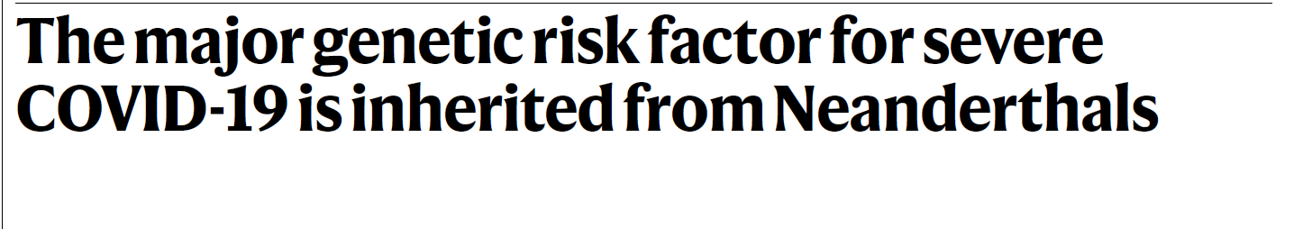
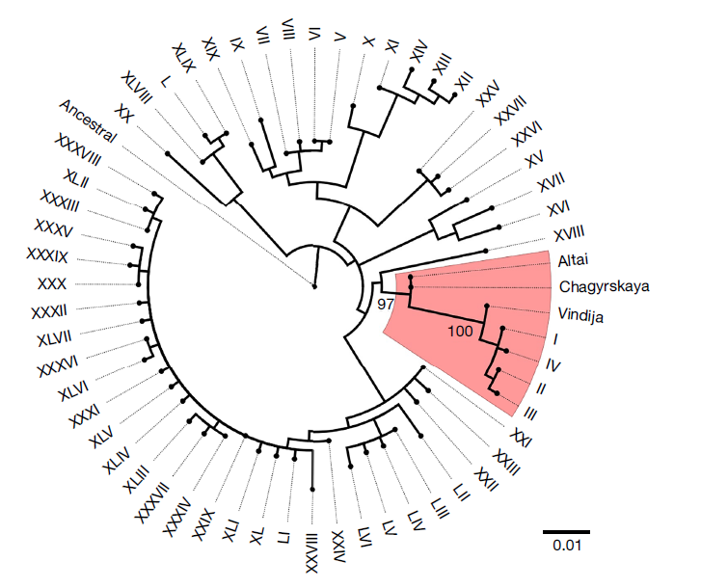
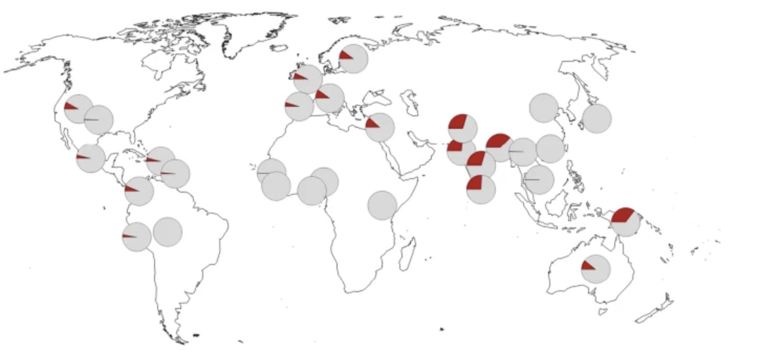
Impact of introgressed variants
All risk haplotypes associated with severe COVID19 cluster with Neandertal sequence
High frequency of risk haplotype in Asia
2X risk of death vs general UK population
Zeberg & Paabo 2020
Notes:
Another timely example of the impact of introgressed variants on health outcomes was provided by the pandemic. Previously a GWAS found this region of chromosome 3 was significantly associated with severe COVID19 at the genome-wide level. Zeberg & Paabo demonstrate that the variants at this GWAS hit are in high linkage disequilibrium. & that all risk haplotypes associated with severe COVID19 cluster with the available Neandertal genomes. So the risk haplotype introgressed from Neandertals

Slide 81
Impact of introgressed variants
All risk haplotypes associated with severe COVID19 cluster with Neandertal sequence
High frequency of risk haplotype in South Asia
2X risk of death vs general UK population
Zeberg & Paabo 2020
Notes:
Another timely example of the impact of introgressed variants on health outcomes was provided by the pandemic. Previously a GWAS found this region of chromosome 3 was significantly associated with severe COVID19 at the genome-wide level. Zeberg & Paabo demonstrate that the variants at this GWAS hit are in high linkage disequilibrium. & that all risk haplotypes associated with severe COVID19 cluster with the available Neandertal genomes. So the risk haplotype introgressed from Neandertals

Slide 82
Exercise

