Slide 1
Demography, coalescence & the SFS
Harvi Pawar, PhD
Postdoctoral Researcher
University of Copenhagen
Conservation Genomics Workshop 2026, Mpala

Slide 2
Objectives
What do we mean by demography?
Effective population size
What is the coalescent?
Species tree vs gene trees
What is the SFS?
What methods can we use for demographic inference?

Slide 3
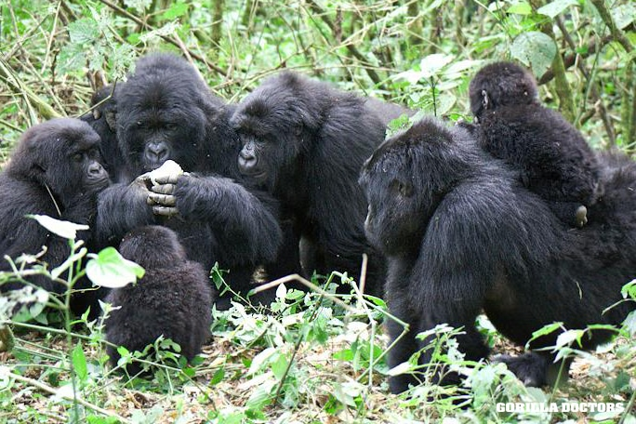
Population of interest
How can we understand their evolutionary past?
Notes:
We have our population of interest & we want to understand their evolutionary past

Slide 4

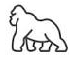
Population of interest
How can we understand their evolutionary past?
Reconstruct past demography
Present day genetic variation
Notes:
..reconstruct

Slide 5
Population of interest
How can we understand their evolutionary past?
Reconstruct past demography
Present day genetic variation
Changes in effective population size
bottlenecks, expansions
Population splits
Migration events
Temporal changes in these demographic events

Slide 6
Why does demography matter?
Impacts
Past demography
Changes in effective population size
bottlenecks, expansions
Population splits
Migration events
Temporal changes in these demographic events
Efficiency of natural selection
Levels of genetic diversity
Mutational load
Genetic resilience of populations
Extinction risk

Slide 7
Why does demography matter?
Impacts
Past demography
Changes in effective population size
bottlenecks, expansions
Population splits
Migration events
Temporal changes in these demographic events
Efficiency of natural selection
Levels of genetic diversity
Mutational load
Genetic resilience of populations
Extinction risk

Slide 8
Effective population size (Ne)

Slide 9
Effective population size (Ne)
The number of individuals of a theoretical, idealised Wright-Fisher population that would experience the same rate of genetic drift as the observed population.

Slide 10
Effective population size (Ne)
The number of individuals of a theoretical, idealised Wright-Fisher population that would experience the same rate of genetic drift as the observed population.
=> measure of the expected efficacy of drift and selection

Slide 11
Effective population size (Ne)
The number of individuals of a theoretical, idealised Wright-Fisher population that would experience the same rate of genetic drift as the observed population.
=> measure of the expected efficacy of drift and selection
Ne != census population size (Nc)
Number of individuals in population

Slide 12
Effective population size (Ne)
The number of individuals of a theoretical, idealised Wright-Fisher population that would experience the same rate of genetic drift as the observed population.
=> measure of the expected efficacy of drift and selection
Ne != census population size (Nc)
Most wild populations Ne << Nc

Slide 13
Genetic drift
Stochastic process
Leading to random change in allele frequencies

Slide 14
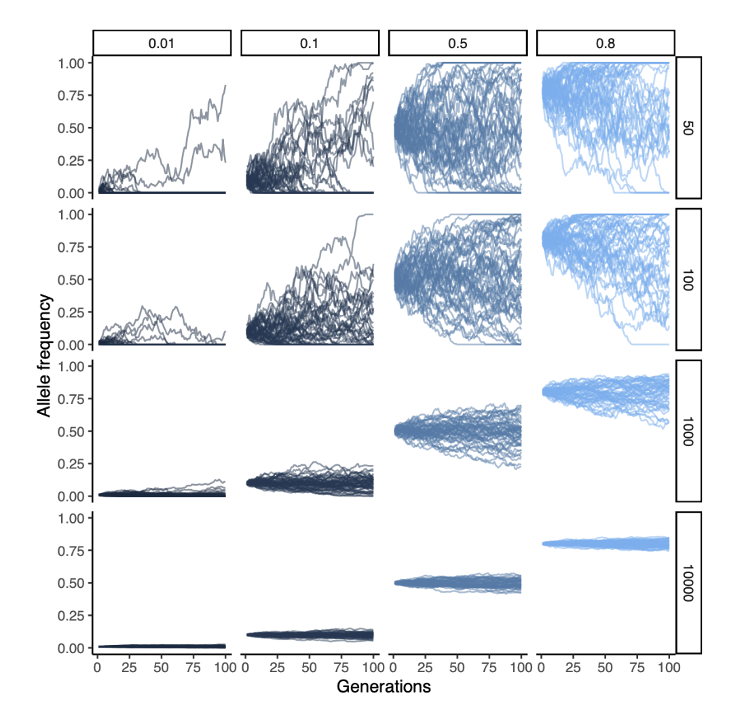
Impact of genetic drift at different Ne
Starting allele frequencies
Small Ne
Different effective population sizes
Large Ne
Notes:
what do we expect to see re time to fixation & probability of fixation
Define genetic drift
Impact of different population sizes

Slide 15
Impact of genetic drift at different Ne
Low Ne high impact of drift, alleles randomly drift to loss or fixation
Notes:
add explanation re smaller ne & higher impact of drift

Slide 16
Impact of genetic drift at different Ne
Low Ne high impact of drift, alleles randomly drift to loss or fixation
Notes:
Define genetic drift
Impact of different population sizes

Slide 17
Impact of genetic drift at different Ne
Low Ne high impact of drift, alleles randomly drift to loss or fixation
High Ne, low impact of drift, stable allele frequencies
Notes:
Random loss or fixation of allele

Slide 18
Lost genetic diversity is lost
Smaller Ne => purifying selection is less efficient => deleterious mutation accumulation

Slide 19
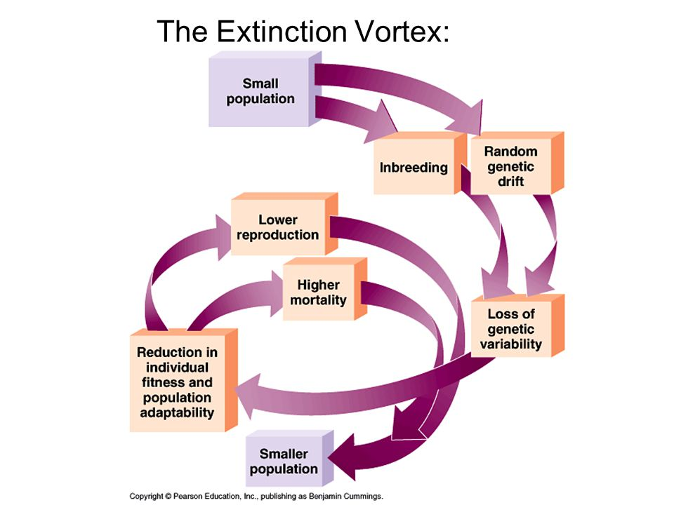
Lost genetic diversity is lost
Smaller Ne => purifying selection is less efficient => deleterious mutation accumulation
Extinction vortex

Slide 20
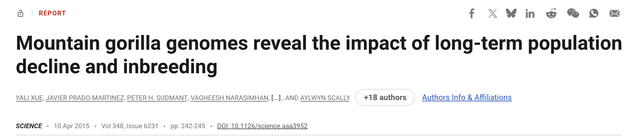
Lost genetic diversity is lost
Smaller Ne => purifying selection is less efficient => deleterious mutation accumulation
Extinction vortex
But genetic purging can occur of deleterious mutations

Slide 21
Coalescence
Stochastic process concerning the genealogy of sampled gene sequences
Notes:
..briefly introduce the concept of coalescence, which will be important for what we will discuss today

Slide 22
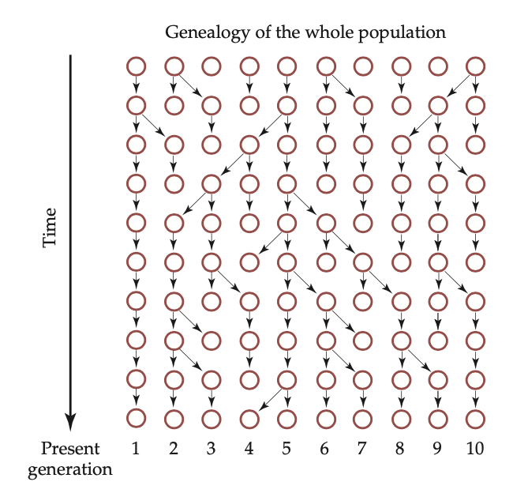
Past
Under a Wright-Fisher model
Constant sized population (2N)
No mutation
No migration
No selection
No recombination
No population structure
Non-overlapping generations
Present
Notes:
Here we have a representation of a population, of constant population size through time, where each row represents a different generation & here in the present we sample 10 haploid individuals. The relationships of the samples to each other is what we call a genealogy.

Slide 23
Past
Under a Wright-Fisher model
Constant sized population (2N)
No mutation
No migration
No selection
No recombination
No population structure
Non-overlapping generations
Present
Notes:
Here we have a representation of a population, of constant population size through time, where each row represents a different generation & here in the present we sample 10 haploid individuals. The relationships of the samples to each other is what we call a genealogy.

Slide 24
Past
Relationship of samples to each other
Each row = 1 generation
Haploid samples in the present
Present
Notes:
Here we have a representation of a population, of constant population size through time, where each row represents a different generation & here in the present we sample 10 haploid individuals. The relationships of the samples to each other is what we call a genealogy.

Slide 25
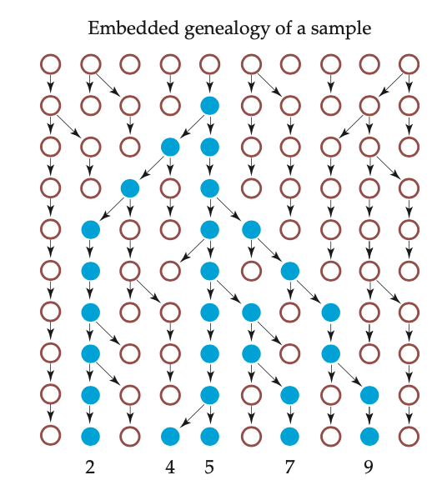
Trace back the ancestry of samples 2,4,5,7,9
Where do they share a common ancestor?
5 samples
Notes:
If we start from the present, using coalescence, we can trace back the ancestry of these samples, to determine where they share a common ancestor.

Slide 26
Trace back the ancestry of samples 2,4,5,7,9
Where do they share a common ancestor?
4 & 5 share common ancestor in previous generation
they coalesce here to one lineage
4 ancestors
5 samples
Notes:
If we start from the present, using coalescence, we can trace back the ancestry of these samples, to determine where they share a common ancestor.

Slide 27
Trace back the ancestry of samples 2,4,5,7,9
Where do they share a common ancestor?
7 & ancestor of (4 & 5) coalesce here
3 ancestors
4 ancestors
5 samples
Notes:
If we start from the present, using coalescence, we can trace back the ancestry of these samples, to determine where they share a common ancestor.

Slide 28
Trace back the ancestry of samples 2,4,5,7,9
1 anc
2 anc
2 anc
3 anc
Eventually all lineages coalesce into one
This is where they share the most recent common ancestor (MRCA)
3 anc
4 anc
4 anc
4 anc
5 samples
Notes:
If we start from the present, using coalescence, we can trace back the ancestry of these samples, to determine where they share a common ancestor.

Slide 29
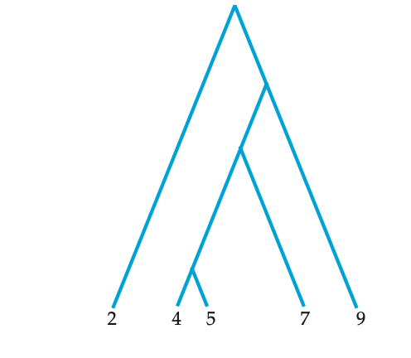
Probability of coalescence of 2 alleles in previous generation (t-1) = 1 / 2Ne
1 anc
2 anc
2 anc
3 anc
3 anc
4 anc
4 anc
4 anc
5 samples
Notes:
first coalescence usually happens quickly, then waiting time increases

Slide 30
Probability of coalescence of 2 alleles in previous generation (t-1) = 1 / 2Ne
1 anc
2 anc
First coalescence usually happens fast, then waiting times increase
2 anc
3 anc
3 anc
4 anc
4 anc
4 anc
5 samples
Notes:
first coalescence usually happens quickly, then waiting time increases

Slide 31
Probability of coalescence of 2 alleles in previous generation (t-1) = 1 / 2Ne
Coalescence rate ∝ population size
Direct relation between time and Ne
1 anc
2 anc
2 anc
3 anc
3 anc
4 anc
4 anc
4 anc
5 samples
Notes:
Long internal branches - when there is only 2 lineages left, we expect
them to take 2Ne generations to coalesce

Slide 32
Gene trees + species trees

Slide 33
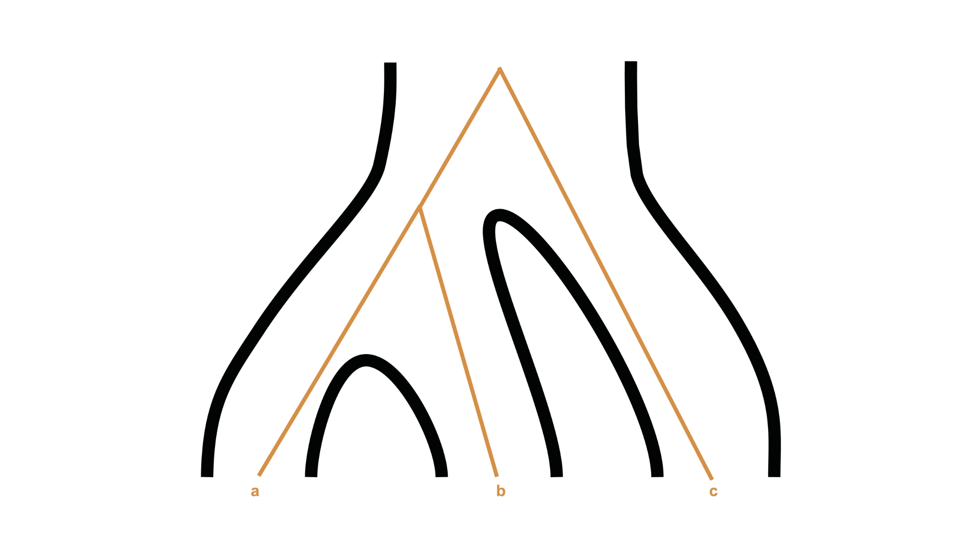
Past
Species tree
Present

Slide 34
Past
Species tree
Gene tree
Present

Slide 35
C & anc(A,B) coalesce
A & B coalesce
Species tree
Gene tree

Slide 36
Molecular divergence
Species tree
Gene tree
Species divergence
Notes:
molecular divergence coming before species divergence

Slide 37
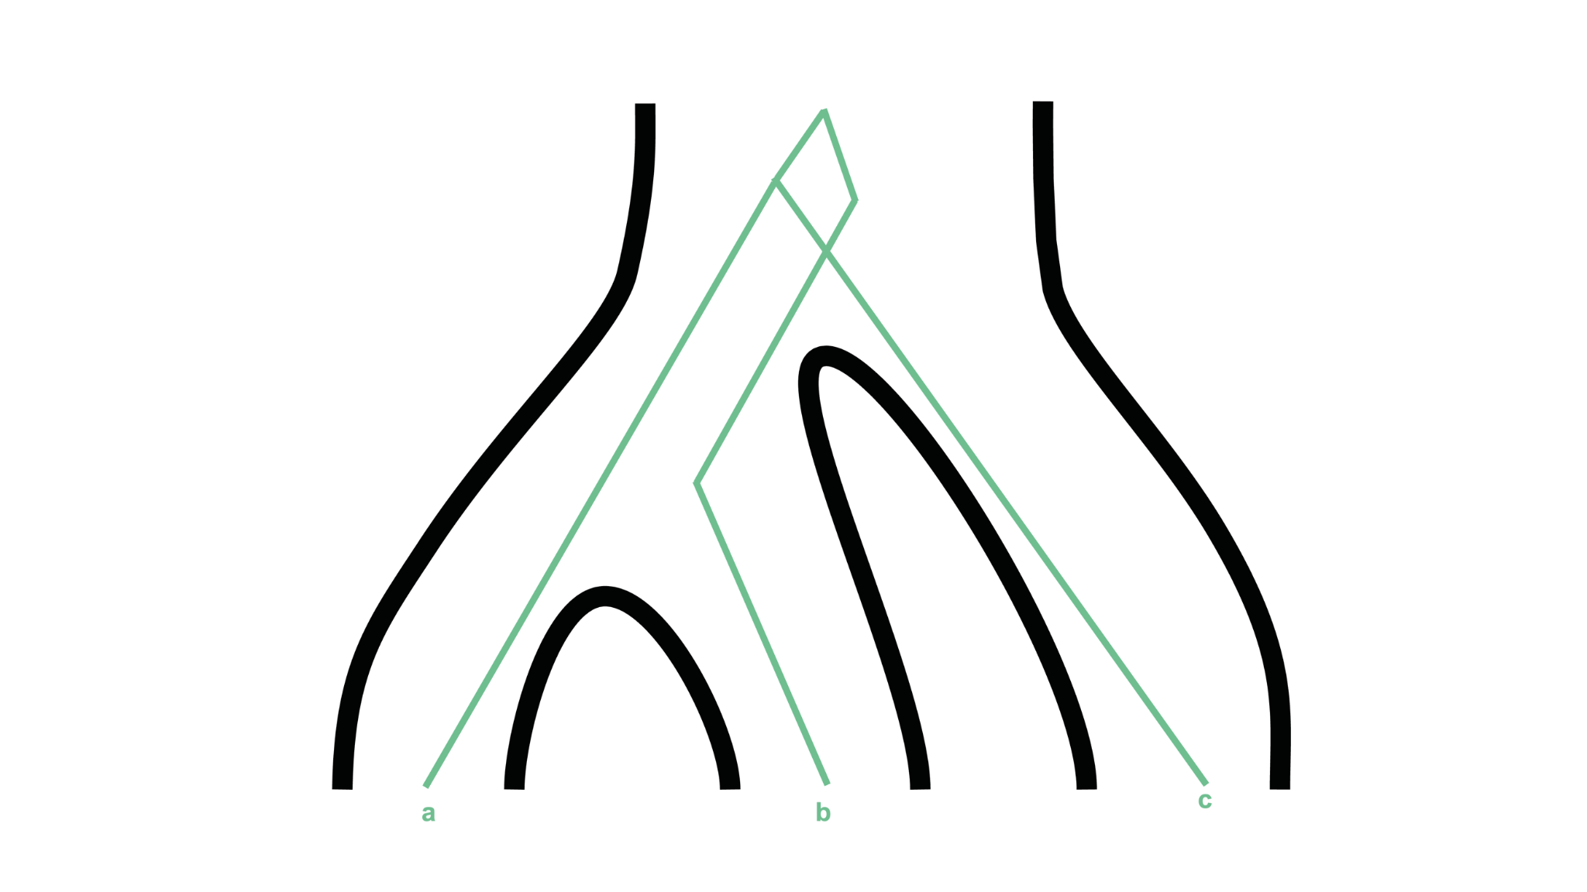
What is happening in this gene tree?

Slide 38
B & anc(A,C) coalesce
What is happening in this gene tree?
A & C coalesce

Slide 39
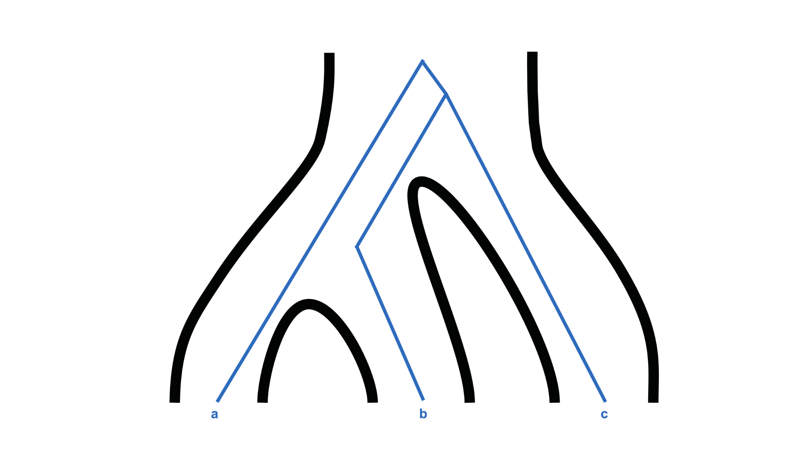
& this gene tree?

Slide 40
A & anc(B,C) coalesce
& this gene tree?
B & C coalesce

Slide 41
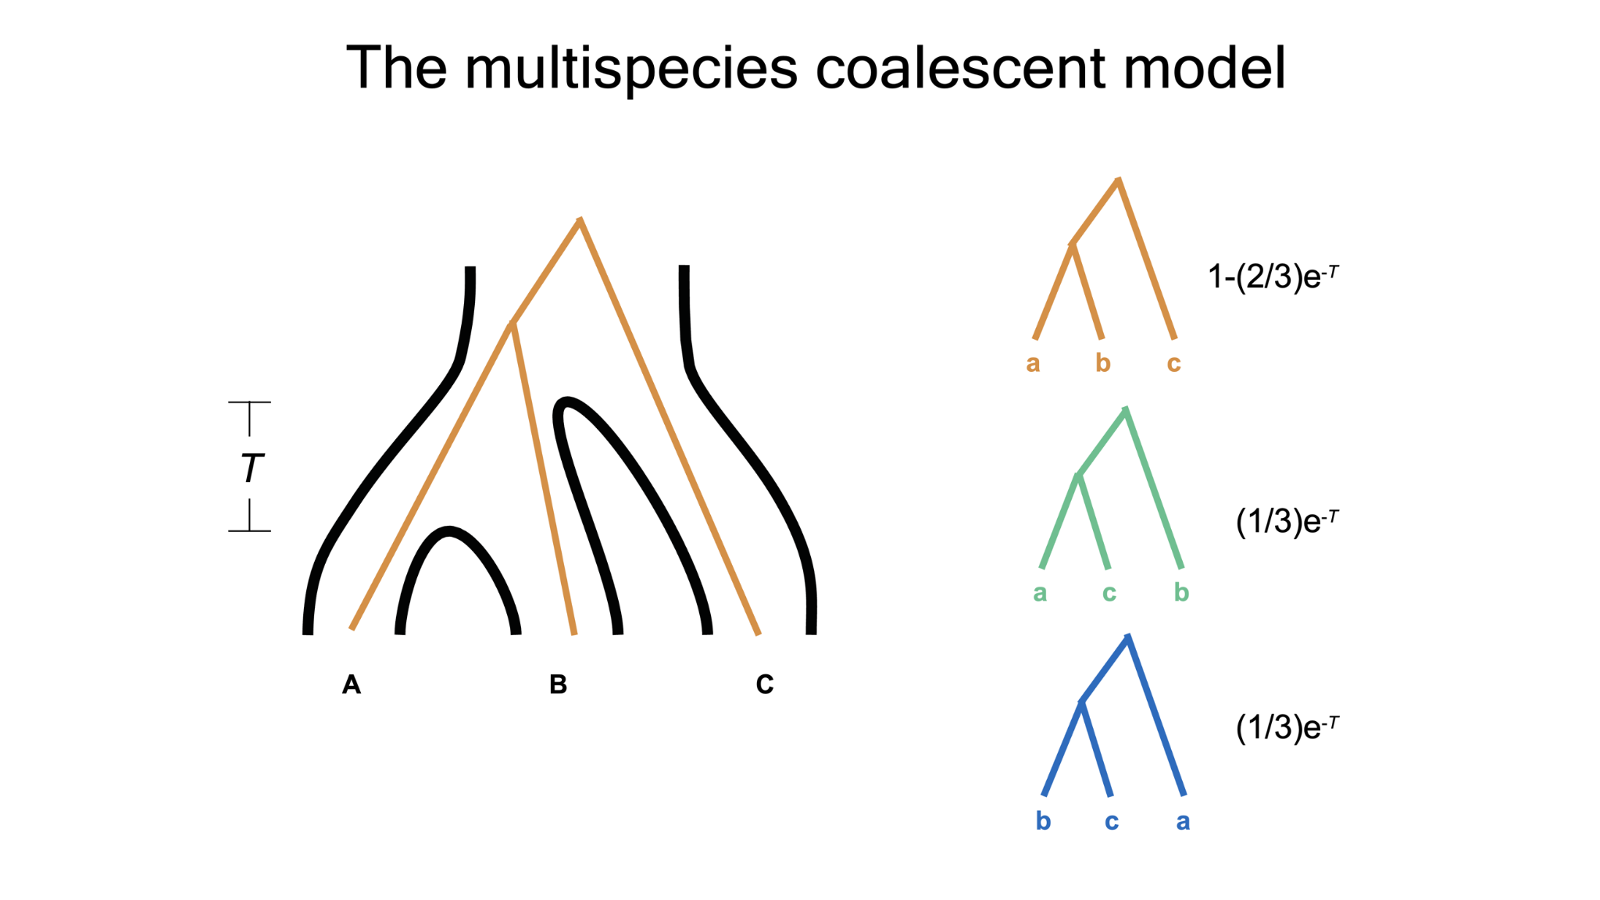
Multispecies coalescent model
((A,B),C)
((A,C),B)
3 populations
1 species tree
3 possible gene tree topologies
((B,C),A)

Slide 42
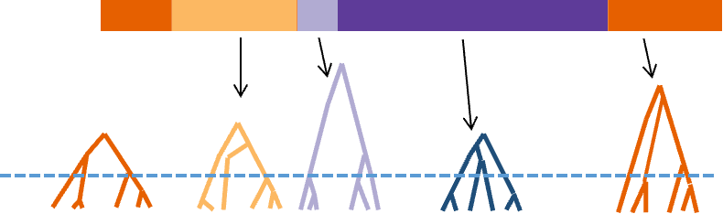
Recombination allows different genomic regions to have different gene trees

Slide 43
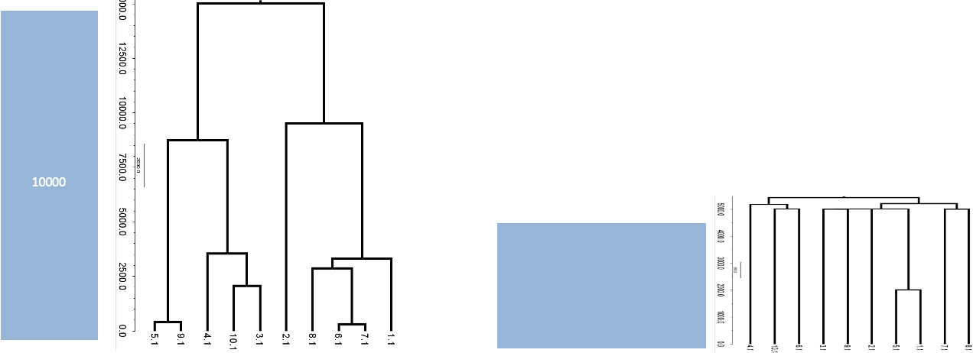

Gene trees under different population sizes
Constant Ne
Population expansion
Past
Present

Slide 44
Gene trees under different population sizes
Constant Ne
Population expansion
Past
Small Ne in ancestor => higher coalescence rate
lineages coalesce quickly before the population expansion
Present
short internal branches

Slide 45
Gene trees under different population sizes
Constant Ne
Population expansion
Past
After expansion, high Ne & low coalescence rate
=> lineages persist for longer time without coalescing
Present
Long external branches

Slide 46
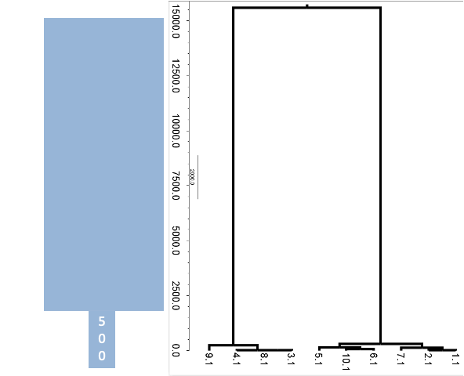
Gene trees under different population sizes
Constant Ne
Population expansion
Population decline
Past
Lower number of lineages => lower rate of coalescence and increased waiting time
Present

Slide 47
Gene trees under different population sizes
Long internal branches
Constant Ne
Population expansion
Population decline
Past
Lower number of lineages => lower rate of coalescence and increased waiting time
Present

Slide 48
Gene trees under different population sizes
Constant Ne
Population expansion
Population decline
Past
Lower number of lineages => lower rate of coalescence and increased waiting time
Short external branches
Lots of coalescence events in recent time (when population size is small)
Present

Slide 49
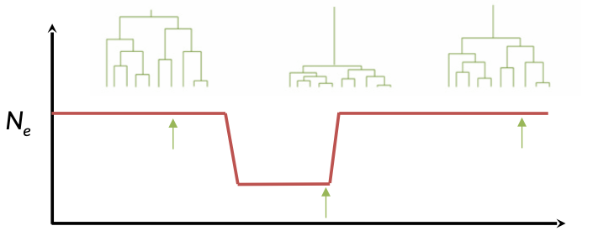
Coalescence summary 1
Coalescence events are more likely to occur when the population size is small
Population decline: shorter coalescence times in recent past
Population expansion: longer coalescence times in recent past
Notes:
question to ask here - what demog is shown in red
- bottleneck
large pop -> pop decline -> pop expansion

Slide 50
Coalescence with mutation
Topology of neutral coalescent trees depends on demography, but is independent of mutation process.
We can add neutral mutations to the genealogical tree, according to a Poisson distribution.
Mutations accumulate along the branches
Long branches carry more mutations than short branches.
Expected number of mutations between a pair of sequences
= 2 * E[TMRCA]* 𝜇 = 4N𝜇

Slide 51
Let’s add neutral mutations
Topology of neutral coalescent trees depends on demography, but is independent of mutation process.
We can add neutral mutations to the genealogical tree, according to a Poisson distribution.
Mutations accumulate along the branches
Long branches carry more mutations than short branches.
Expected number of mutations between a pair of sequences
= 2 * E[TMRCA]* 𝜇 = 4N𝜇
𝜃 neutral parameter

Slide 52
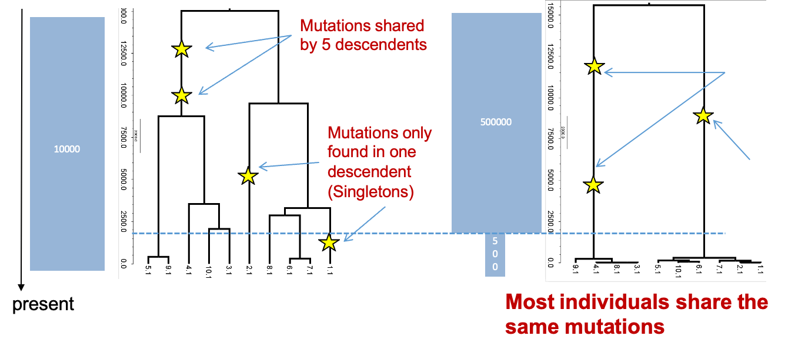
Add neutral mutations to constant Ne population

Slide 53
Add neutral mutations to constant Ne population
These 5 samples share these 2 mutations from the ancestor

Slide 54
Add neutral mutations to constant Ne population
These 5 samples share these 2 mutations from the ancestor
mutations in one descendant = singletons

Slide 55
Add neutral mutations to declining population

Slide 56
Add neutral mutations to declining population
2 mutations shared by 4 descendants
1 mutation shared by 6 descendants

Slide 57
Add neutral mutations to declining population
Longer branch = more likely mutation occurred
Declining population - most individuals share the same mutations
2 mutations shared by 4 descendants
1 mutation shared by 6 descendants

Slide 58
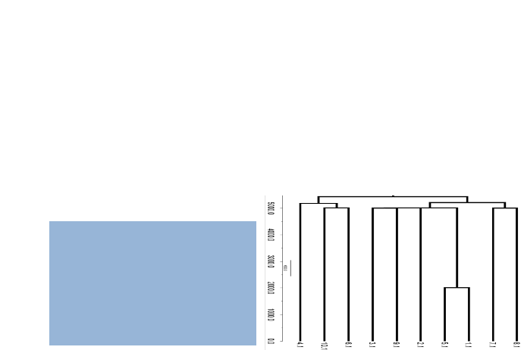

Add neutral mutations to expanding population

Slide 59
Add neutral mutations to expanding population
Most mutations only in one descendant = singletons
Excess rare variants

Slide 60
Coalescence summary 2
Topology of neutral coalescent trees depends on demography, but is independent of mutation process.
We can add neutral mutations to the genealogical tree, according to a Poisson distribution.
Mutations accumulate along the branches
Long branches carry more mutations than short branches.
Notes:
Ask question here - what demography type has the most rare variants?

Slide 61
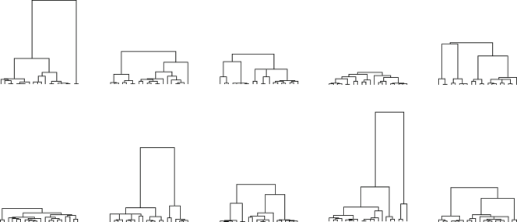
Coalescence summary 3
Probabilistic nature of timing of coalescence events also generates variation

Slide 62
Exercise

Slide 63
Site Frequency Spectrum

Slide 64
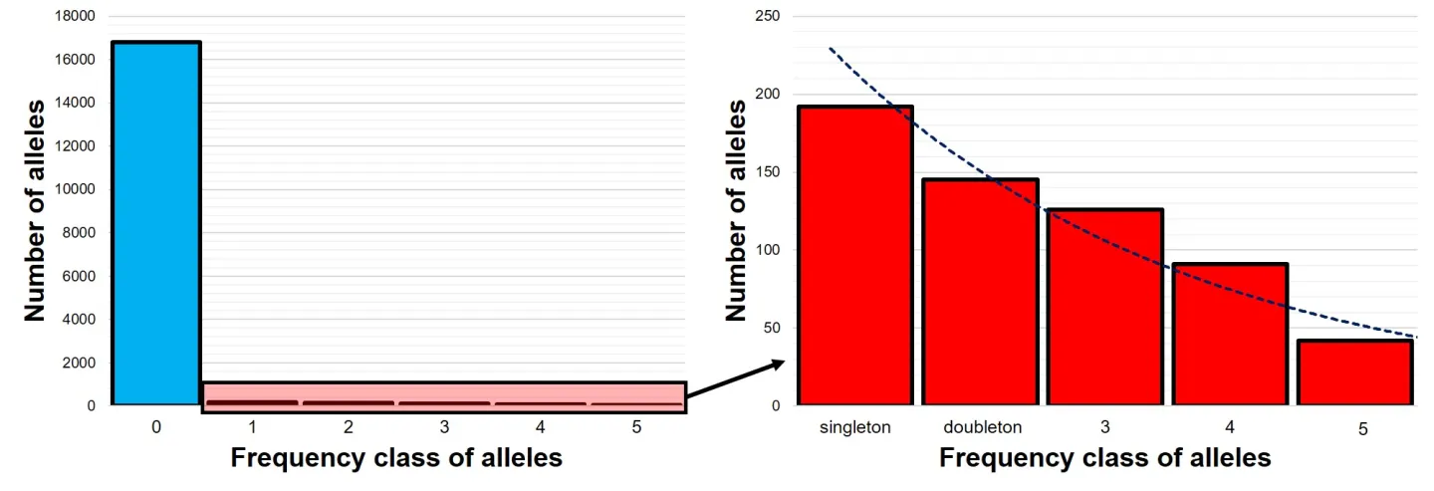
SFS = allele frequency spectrum
Histogram of allele counts

Slide 65
SFS
How frequent are certain classes of alleles?
Frequency distribution of alleles in data

Slide 66
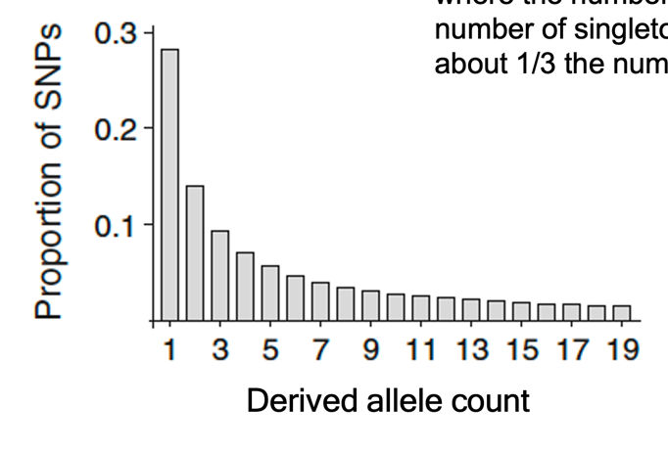
Neutral unfolded SFS
Exponential shape
Many more rare alleles than common alleles
Doubletons ~ ½ number of singletons
Tripletons ~ ⅓ number of singletons
Proportion of SNPs
Derived allele count

Slide 67
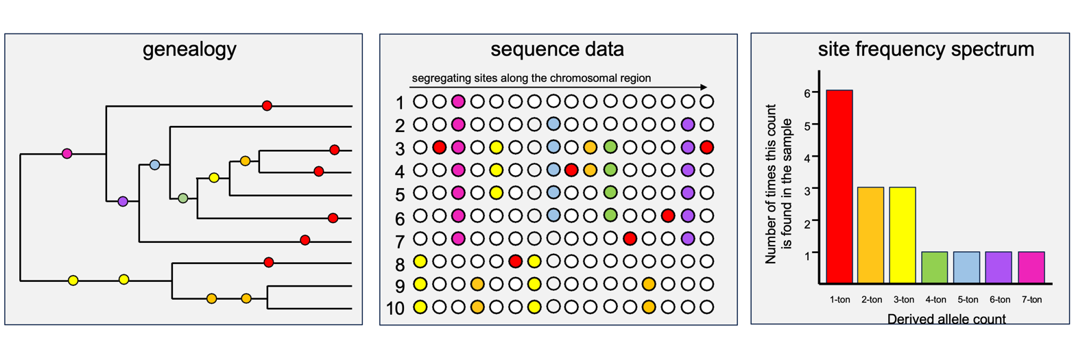
What would be the SFS for this data?

Slide 68
Genealogy -> sequence data -> SFS

Slide 69
Genealogy -> sequence data -> SFS

Slide 70
Genealogy -> sequence data -> SFS

Slide 71
Genealogy -> sequence data -> SFS

Slide 72
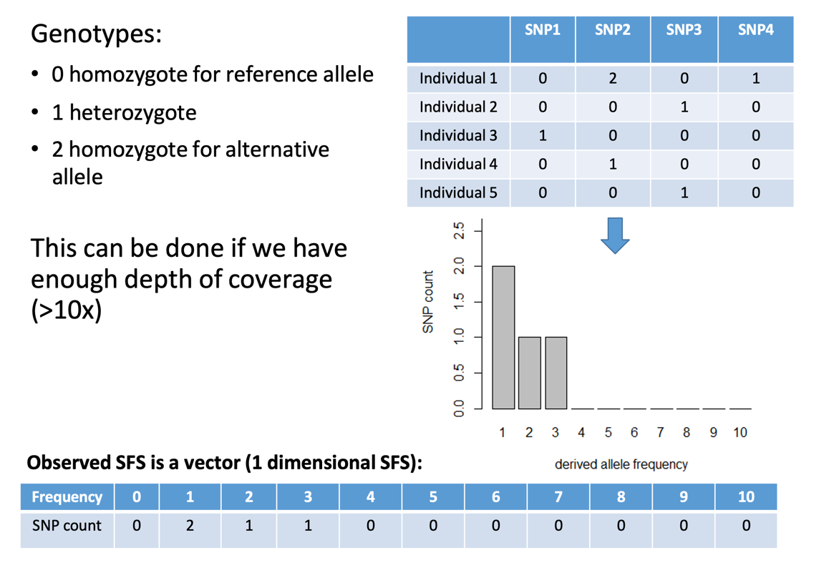
SFS from real data
Genotypes
0 = ref/ref
1 = ref/alt
2 = alt/alt
Size of SFS depends on number of samples
Efficient summary of genomic data

Slide 73
SFS from real data
Genotypes
0 = ref/ref
1 = ref/alt
2 = alt/alt
Size of SFS depends on number of samples
Efficient summary of genomic data
diploids

Slide 74
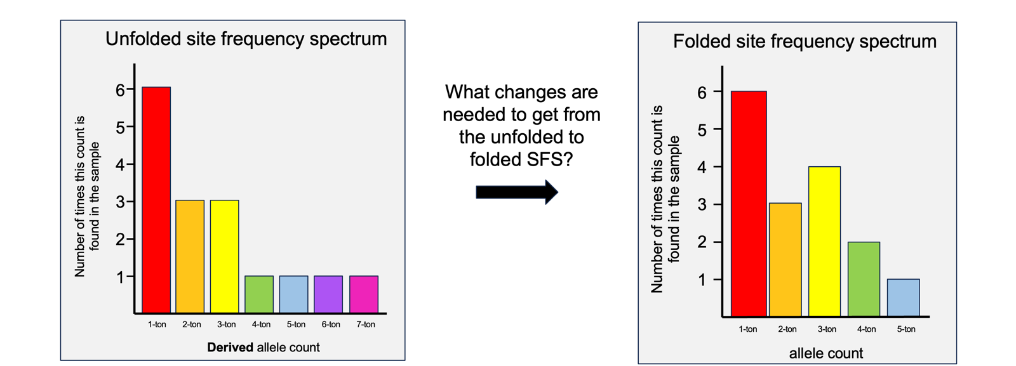
Unfolded SFS to Folded SFS
Ancestral/derived

Slide 75
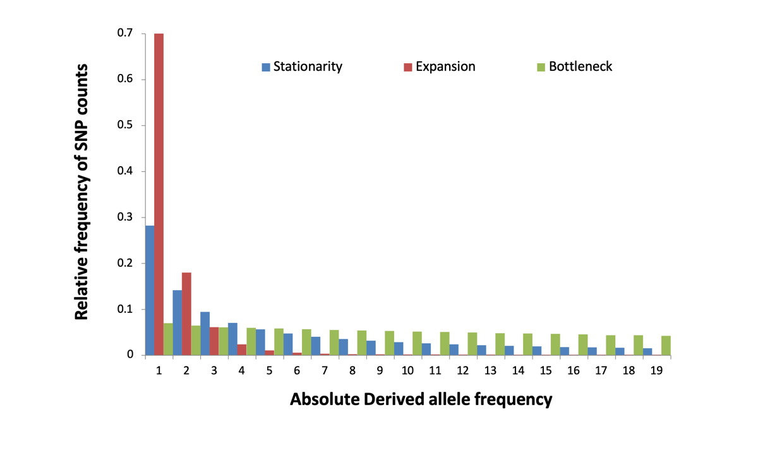
Impact of demography on SFS
Population expansion
Constant
Population decline

Slide 76
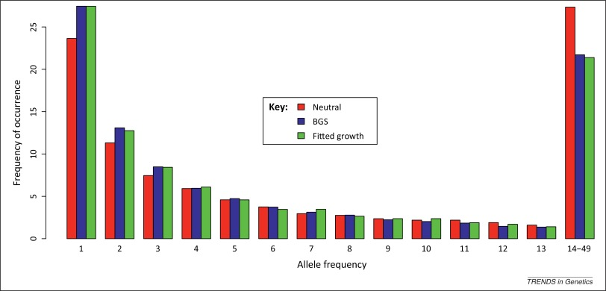
Impact of natural selection on SFS
Background selection SFS has similar shape to population expansion
Notes:
https://www.cell.com/trends/genetics/fulltext/S0168-9525%2814%2900158-9#fig0005

Slide 77
Exercise

Slide 78
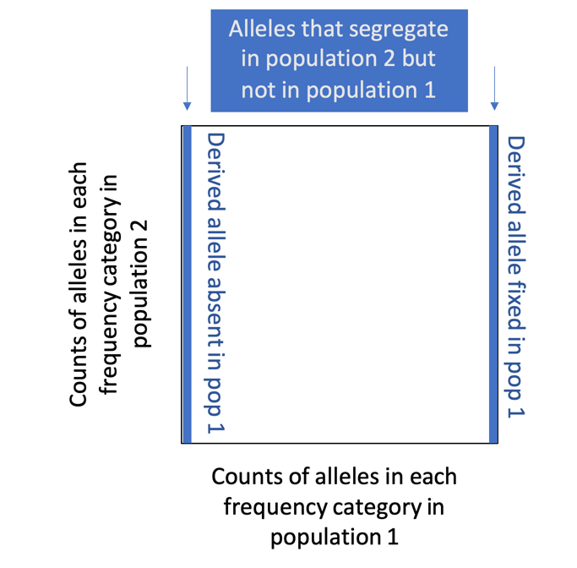
2D-SFS
Joint site frequency spectrum
Sharing of alleles and their frequencies between the 2 populations

Slide 79
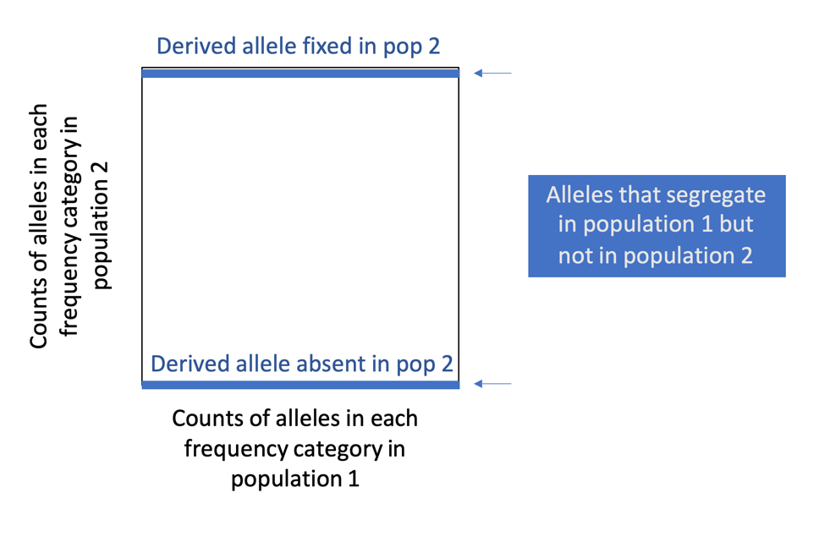
2D-SFS

Slide 80
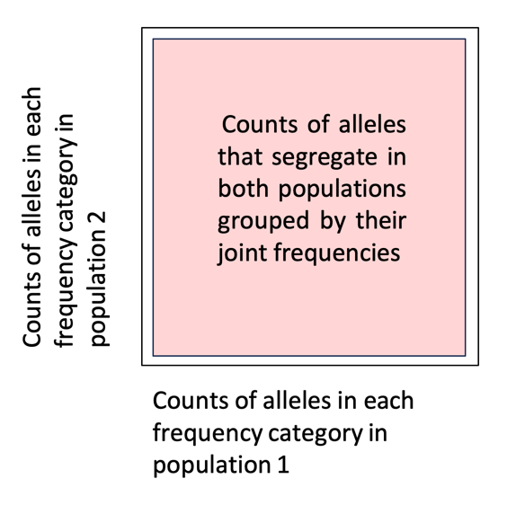
2D-SFS

Slide 81
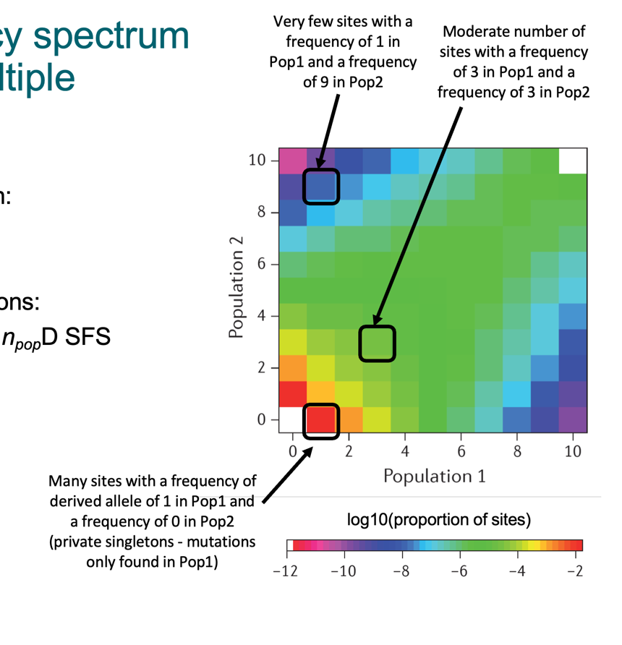
2D-SFS

Slide 82
SFS summary
Allele frequency spectrum
Mutation rate affects the number of SNPs
Shape of the SFS is impacted by demography + natural selection
Summary of genome-wide data at a snapshot in time

Slide 83
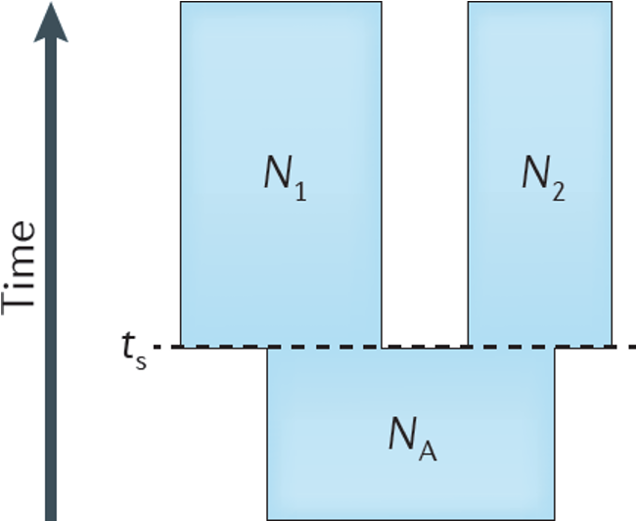
Demographic model of 2 populations
Present
Changes
Past
Notes:
..reconstruct

Slide 84
How to infer demography?

Slide 85
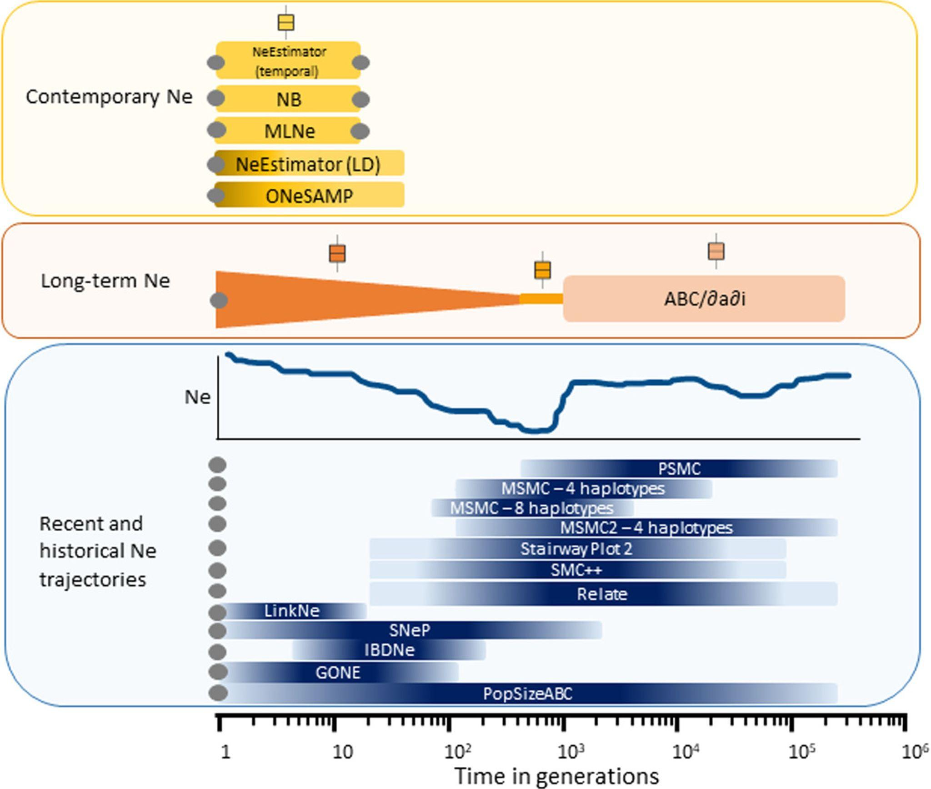
Methods to infer demography
Demographic modelling
(ABC, SFS)
2) Inference methods
Notes:
methods that infer recent or historical Ne trajectories provide information about a specific part of the Ne trajectory
Note that the spans of the timeframes are approximate since they depend on the data used and the true demographic history; this applies particularly for SFS‐based methods and recent times

Slide 86
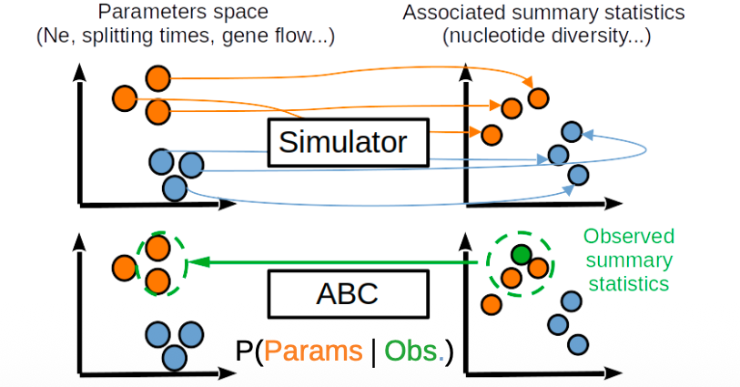
Demographic modelling
Inference methods

Slide 87
Methods to infer demography
Inference methods: capture different aspects of the genetic data
LD-based
SFS-based
Coalescent-based

Slide 88

Methods to infer demography
Inference methods: capture different aspects of the genetic data
LD-based
SFS-based
Coalescent-based

Slide 89
Linkage disequilibrium
Non-random association of alleles at different loci
Genetic drift can create LD between closely linked loci
Strength of LD depends on recombination + genetic drift

Slide 90
Linkage disequilibrium & demography
Non-random association of alleles at different loci
Genetic drift can create LD between closely linked loci
Strength of LD depends on recombination + genetic drift
Changes in Ne can impact LD
eg population bottleneck -> smaller Ne, higher impact of drift -> increase LD

Slide 91
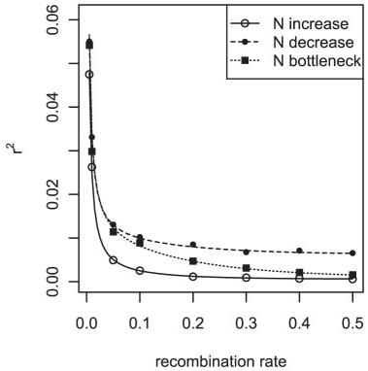
Linkage disequilibrium & demography
Measure of LD between loci
Park 2012

Slide 92
Linkage disequilibrium & demography
Measure of LD between loci
High Ne fast LD decay
Park 2012

Slide 93
Linkage disequilibrium & demography
Small Ne slow LD decay
Measure of LD between loci
High Ne fast LD decay
Park 2012

Slide 94
Linkage disequilibrium & demography
Small Ne slow LD decay
Measure of LD between loci
Residual LD
High Ne fast LD decay
Park 2012
Notes:
https://pmc.ncbi.nlm.nih.gov/articles/PMC3462787

Slide 95
Methods to infer demography
Methods have power to reconstruct past Ne at specific part of the trajectory/time in the past
Timespan for detection depends on data used & the true demographic history (unknown)

Slide 96
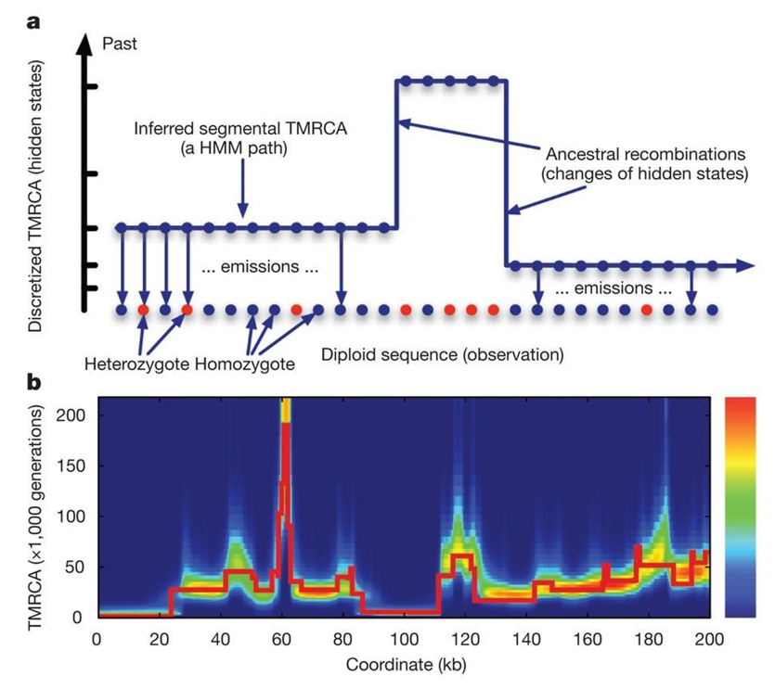
SMC
Basis of several coalescent-based methods

Slide 97
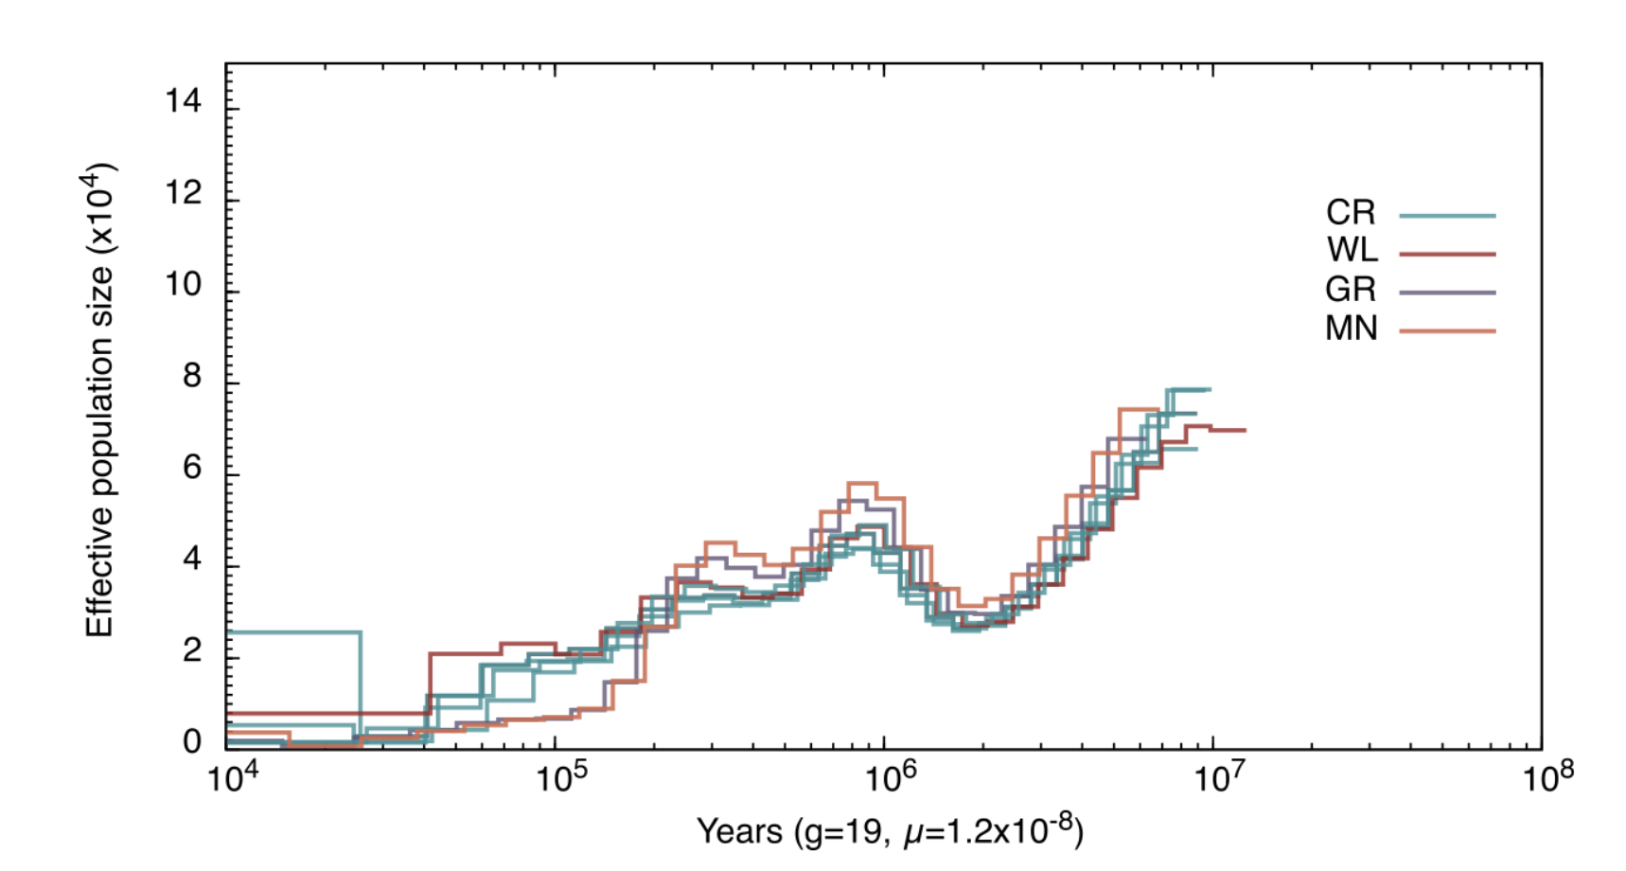
PSMC
Alvarez-Estape et al. 2023

Slide 98
PSMC
Alvarez-Estape et al. 2023

Slide 99
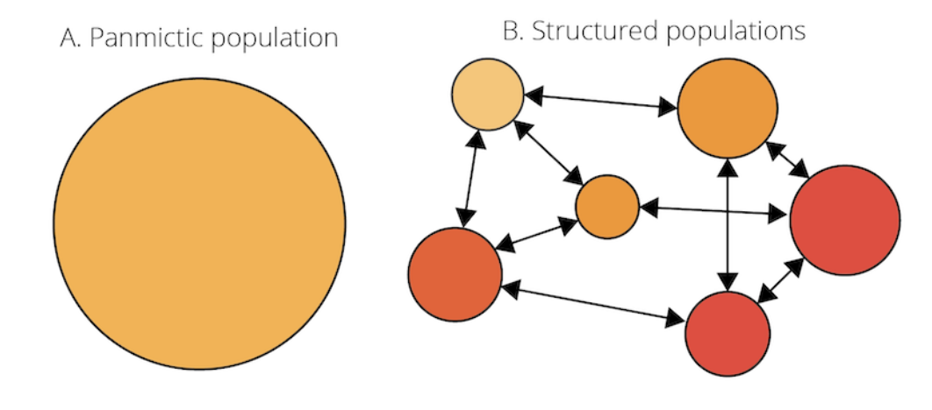
PSMC - Limitations
Assumes panmictic population
Change in Ne can be caused by other factors, eg population structure
Low accuracy in recent time periods
Sensitive to data quality

Slide 100
Exercise

Slide 101
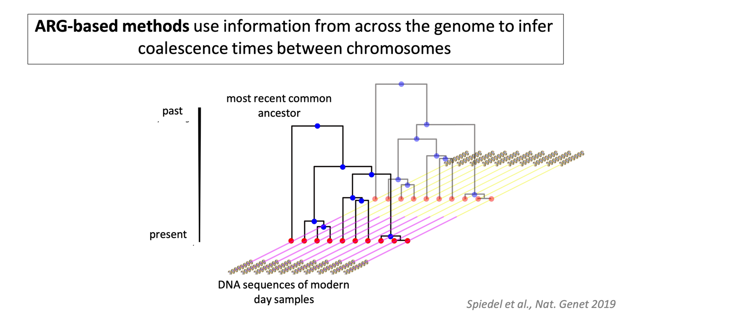
New class of methods to infer demography

Slide 102
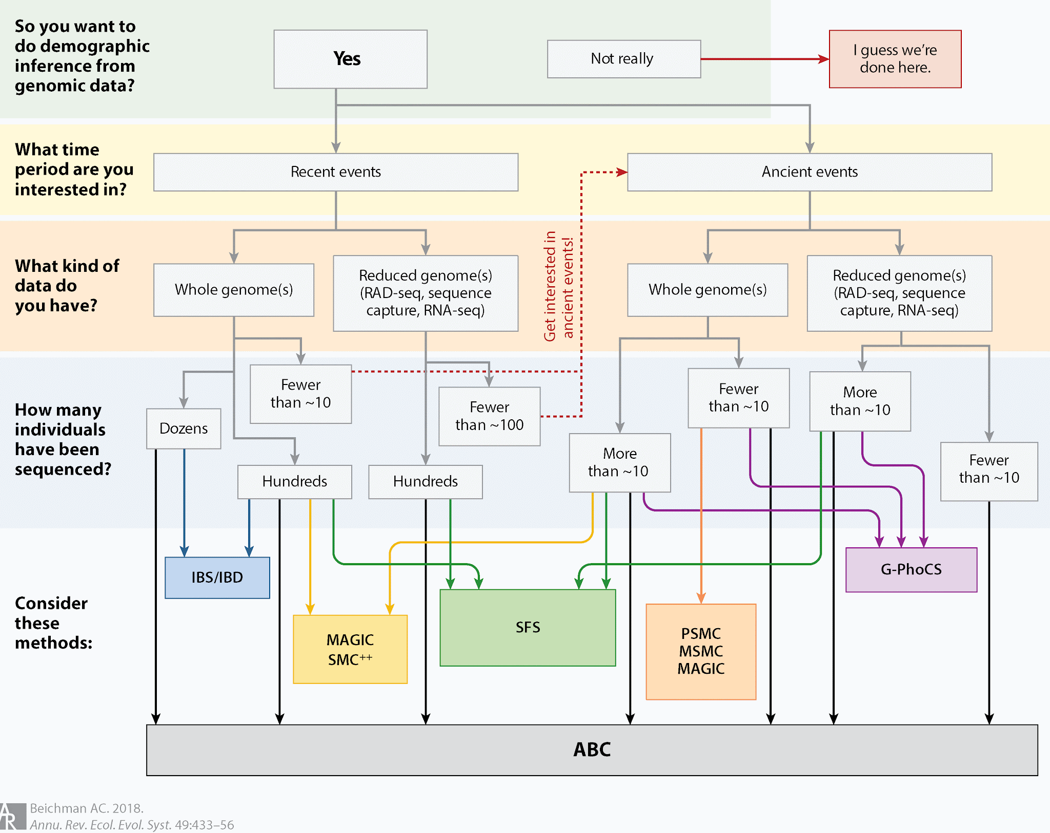
Methods to infer demography - Summary
Beichman et al. 2018

