Slide 1
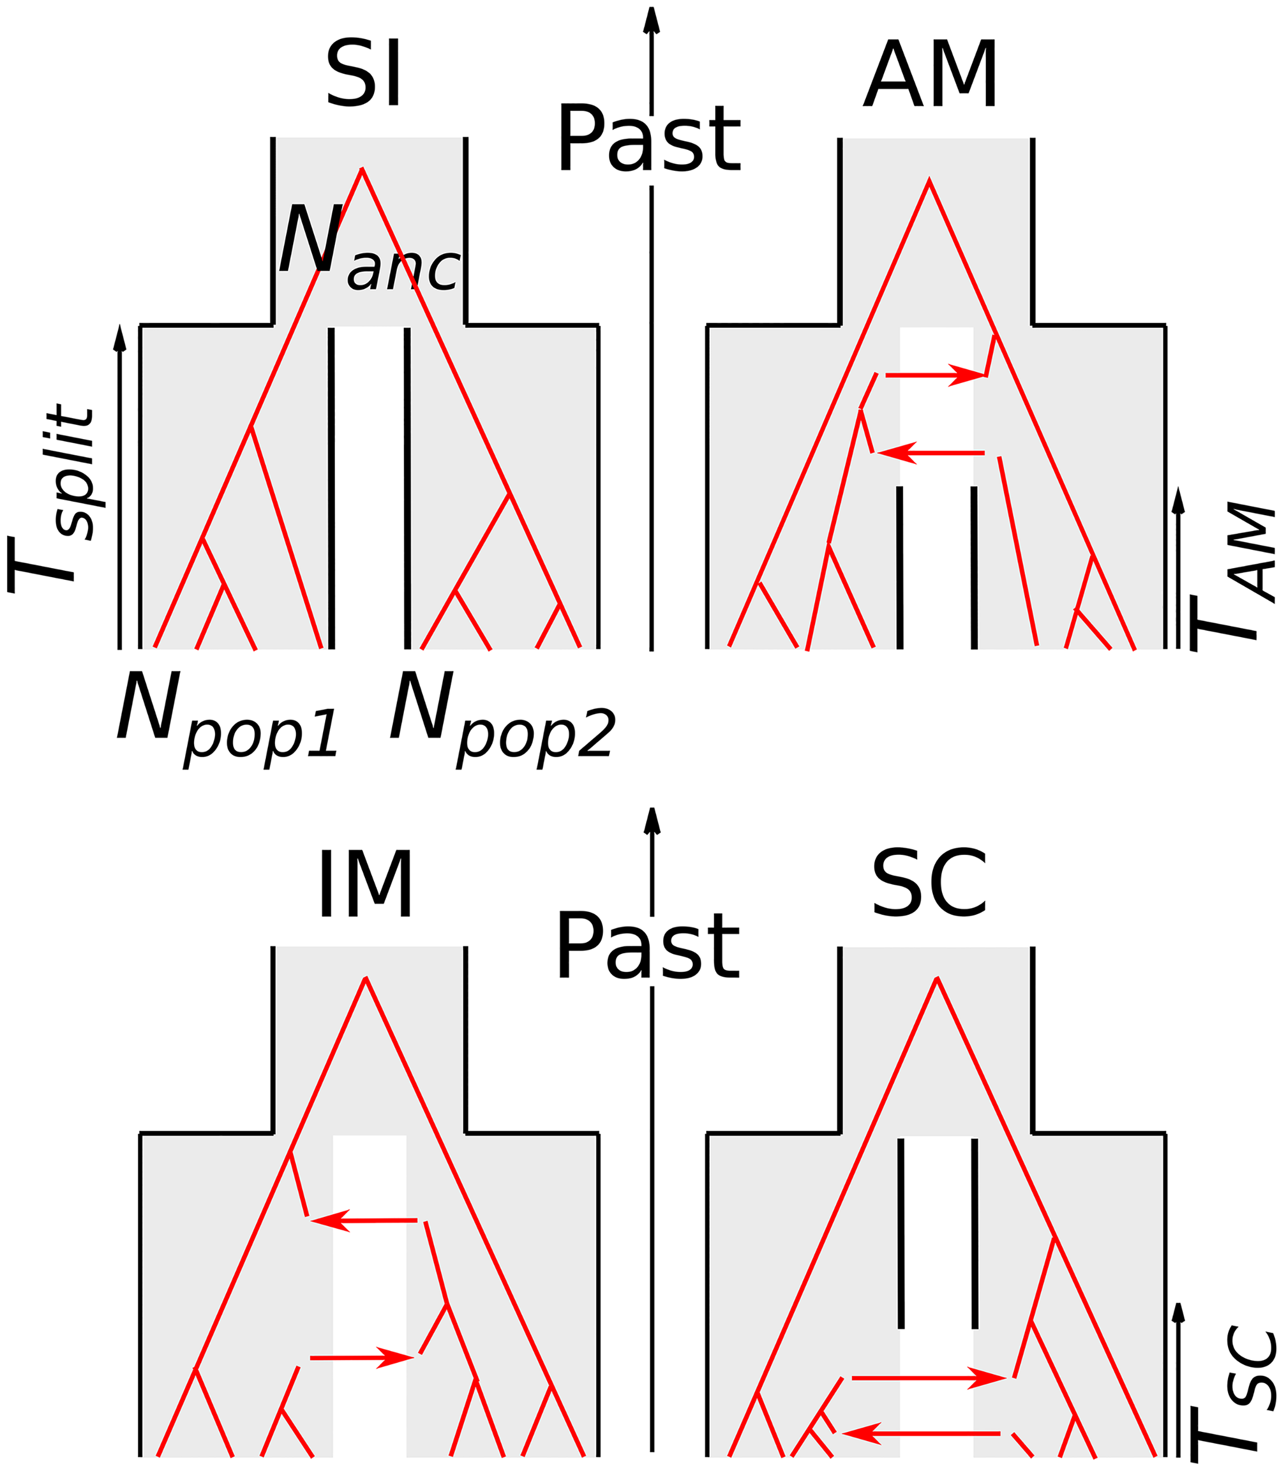
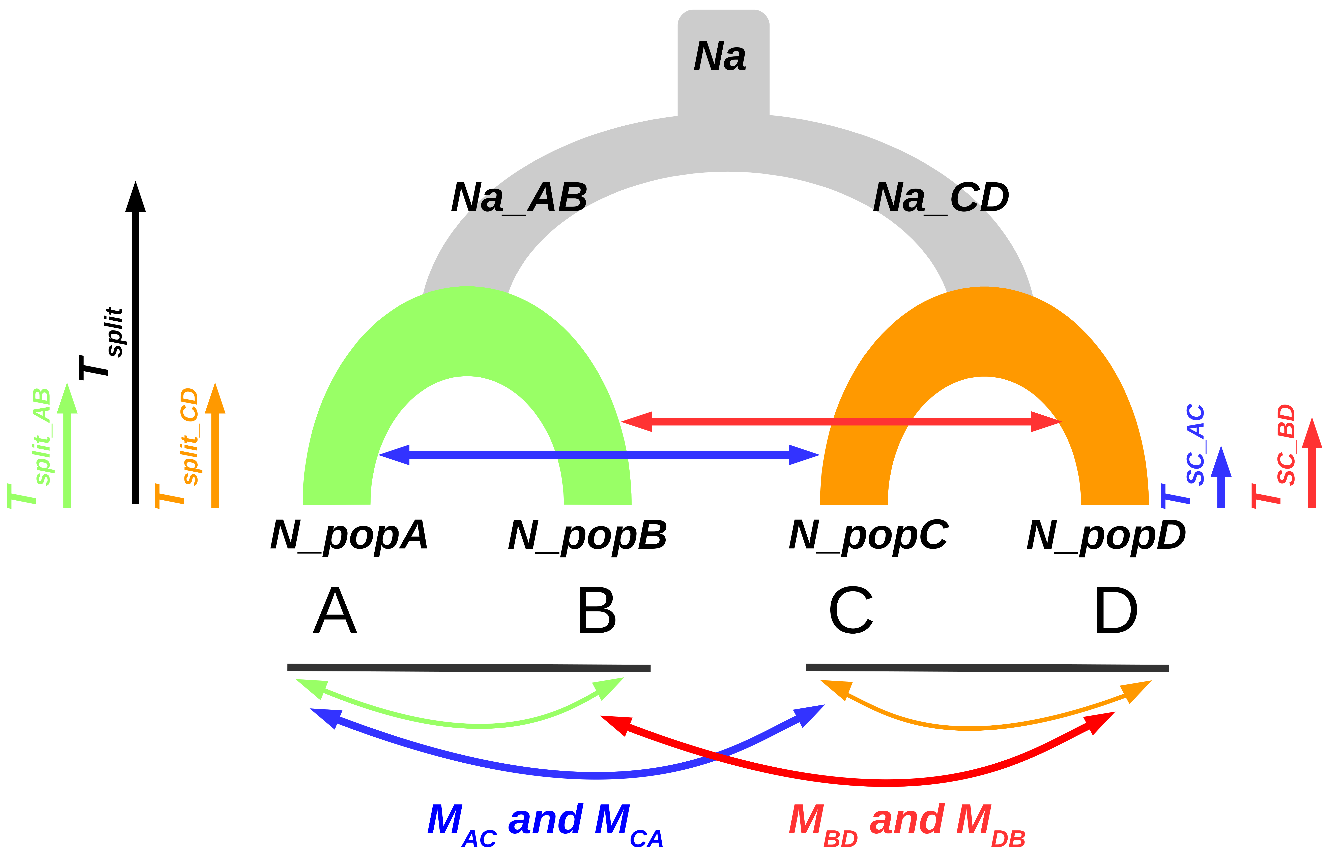
2 populations/species
4 populations/species

Slide 2
4 populations/species

