Slide 1
Can we detect a selective sweep within a genomic region using ABC ?
Alignment :
n sampled individuals
Pos 0
Pos 1
L = 100kb

Slide 2
Can we detect a selective sweep within a genomic region using ABC ?
S segregating sites
n sampled individuals
Pos 0
Pos 1
L = 100kb

Slide 3
Can we detect a selective sweep within a genomic region using ABC ?
S segregating sites
n sampled individuals
Pos 0
Pos 1
L = 100kb
Scanning the surveyed region using a sliding window :
Overlapping windows :
Width = 0.1 (10kb)
Step = 0.05 (5kb)
*
*values are not fixed
Can be setted by users.

Slide 4
Can we detect a selective sweep within a genomic region using ABC ?
S segregating sites
n sampled individuals
Pos 0
Pos 1
L = 100kb
7 computed statistics in different windows :
Average π over SNPs
Variation for π over SNPs
Watterson’s θ
Tajima’s D
Achaz’s Y*
Pearson’s r (position ~ pi)
P-value of Pearson’s r

Slide 5
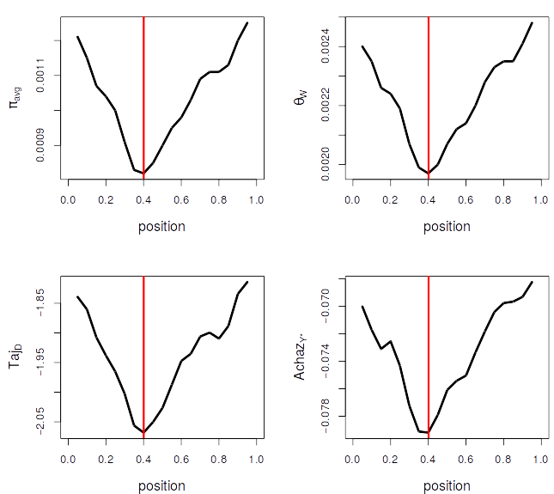
Simple visualisation of some statistics across a surveyed region of 100kb
Example :
.Position Sp = 0.4
.Coefficient S_{AA} = 3.5 %
.Fixation time SF = 30,000 gen
.L = 100kb
.Recomb rate = 2e⁻⁸/bp

Slide 6
Can we use [ABC + random forests] to estimate Sp, SF and S_{AA} ?
Sp, SF and S_{AA} are estimated for 10,000 simulated datasets with random
combinations of {Sp ; SF; S_{AA}}
n = 30 sampled individuals
Pos 0
Pos 1
Sp : randomly sampled from uniform U(0, 1)
SF : randomly sampled from uniform U(0, 400,000) generations
S_{AA} : randomly sampled from uniform U(0.002, 0.5)

Slide 7
Schematic representation + interpretation
Accurately estimated
values
Parameter value
estimated by ABC
Real simulated parameter value
to estimate

Slide 8
Schematic representation + interpretation
Overestimated values
Accurately estimated
values
Parameter value
estimated by ABC
Real simulated parameter value
to estimate

Slide 9
Schematic representation + interpretation
Overestimated values
Accurately estimated
values
Parameter value
estimated by ABC
Underestimated values
Real simulated parameter value
to estimate

Slide 10
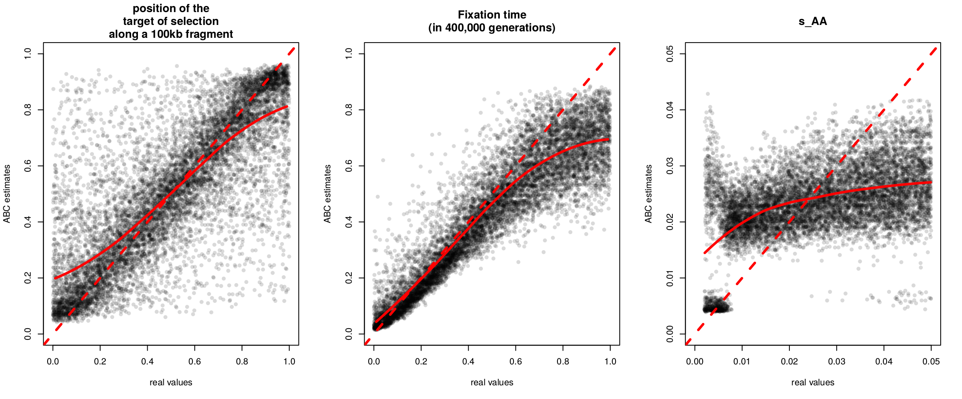
Results : ABC analyses of 10,000 of simulated datasets
1. Plot of 10,000 points (real values, estimated values)
Visual interpretation :
Estimating the position : not bad, except in the proximity of extremities (general problem with ABC).
Not a big issue if genomes are scanned using a sliding window.
Fixation time : looks efficient, except for ancient fixation.
Selective coefficient : cannot be estimated for now. It’s normal according to Pennings and Hermisson
when using patterns of diversity.

Slide 11
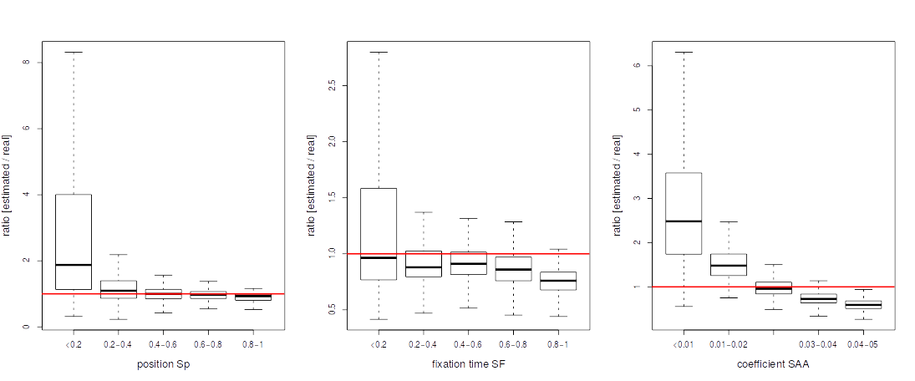
Results : ABC analyses of 10,000 of simulated datasets
2. Distributions of the ratio estimates/real values within bins of parameters
Visual interpretation :
Estimating the position : not bad, except in the proximity of extremities (general problem with ABC).
Not a big issue if genomes are scanned using a sliding window.
Fixation time : looks efficient, except for ancient fixation.
Selective coefficient : cannot be estimated for now. It’s normal according to Pennings and Hermisson
when using patterns of diversity.

Slide 12
Results of explicit model comparisons:
Since selective coefficients cannot be estimated using the current version, an explicit test of
sweep can be an option :
Number of simulations: 9598 (4841 ‘neutral’ + 4757 ‘with sweep’)
(not exactly 10,000 after removing simulations with at least one ‘NA’ statistic)
Confusion matrix:
Neutral selection class.error
Neutral 4796 45 0.0092956001
Selection 3 4754 0.0006306496
Classified as
Simulated
models
Mean error rate : 0.004963125
Very low error rate (~0.05%) when discriminating among «neutral» and «sweeped» datasets

Slide 13
Next step :
1) trying to add statistics taking informations from LD (i.e : H12 stat from
http://journals.plos.org/ploscompbiol/article?id=10.1371/journal.pcbi.1004845)
2) exploring genomes :
For instance, it can be done by first :
i) comparing « neutral » versus « selective » scenarios in overlapping 100kb regions
of genomes (divided themselves in windows like in slide 3)
ii) estimating the position Sp and the time SF for regions supporting the selective
Scenarios
3) To do before : fitting a demographic scenario to avoid bias because of recent
expansion/contraction of populations
4) all codes will be uploaded here : https://github.com/popgenomics/ABCsweep

