Slide 1

Population genomics
camille.roux@univ-lille.fr

Slide 2



Evaluation on the module :
Each student will present an article at the beginning of each session
7 days of preparation
The aim of this student: make the message of the article clear to the audience.

Slide 3
Evaluation on the module :
Each student will present an article at the beginning of each session
7 days of preparation
The aim of this student: make the message of the article clear to the audience.
20 minutes of presentation …
… followed by questions
?

Slide 4
Evaluation on the module :
Each student will present an article at the beginning of each session
Clarity :
Making clear the context (why o this study?): 4 points
What is the scientific question ? 2 points
In concrete terms, what do the authors do to answer the question? 4 points
What are the results ? 4 points
Interpretation of the results : 4 points
Take home message from the paper : 2 points

Slide 5
Population genomics
camille.roux@univ-lille.fr
Today : an introduction to pop. geno.

Slide 6
Genetic diversity

Slide 7
Genetic diversity
How to quantify diversity?

Slide 8
Genetic diversity
How to quantify diversity?
How to interpret this diversity?

Slide 9
Genetic diversity
Past

Slide 10
The product Ne.µ : important determinant of genetic diversity
mutation

Slide 11
The product Ne.µ : important determinant of genetic diversity
fixation
mutation
loss

Slide 12
The product Ne.µ : important determinant of genetic diversity
Large population
(large Ne)
Small population
(small Ne)
fixation
fixation
mutation
mutation
loss
loss

Slide 13
Wright and Fisher model
Past

Slide 14
Structured populations

Slide 15
Structured populations
Past

Slide 16
Structured populations
Past

Slide 17
Structured populations
Past

Slide 18
Migration

Slide 19
Migration
Past

Slide 20
Migration
Past

Slide 21
?
?
?
?
?
?
Etc...

Slide 22
1. How to compare alternative demographic scenarios?
Past

Slide 23
1. How to compare alternative demographic scenarios?
Past
2. What evolutionary forces act on a given locus?

Slide 24
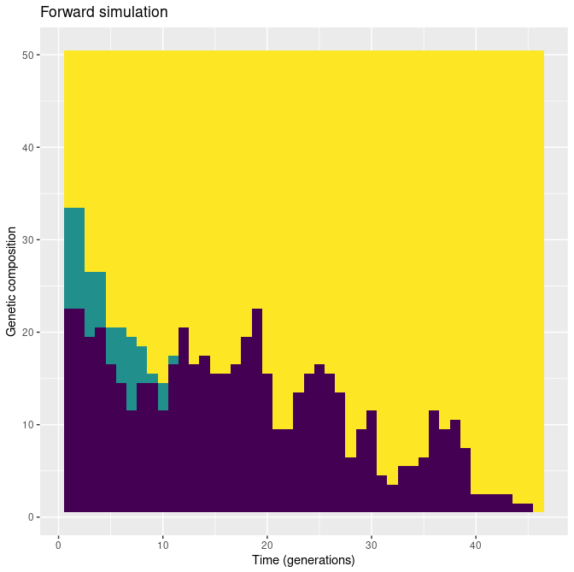
Genetic drift
Ne = 50 (individuals)

Slide 25
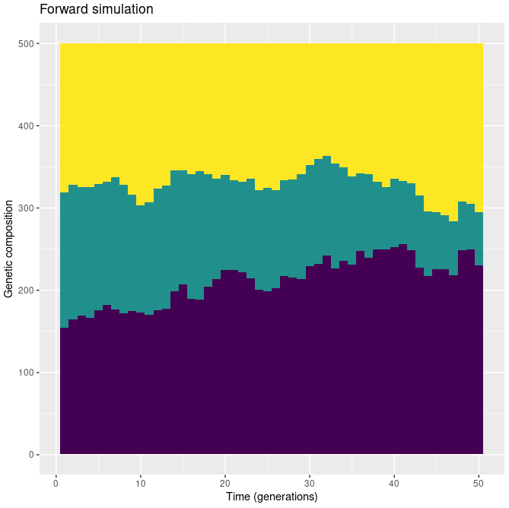
Genetic drift
Ne = 50 (individuals)
Ne = 500

Slide 26
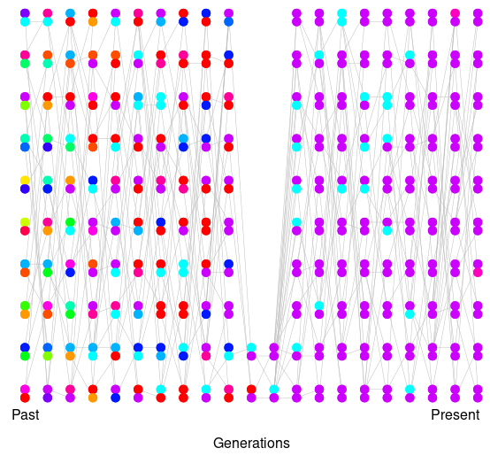
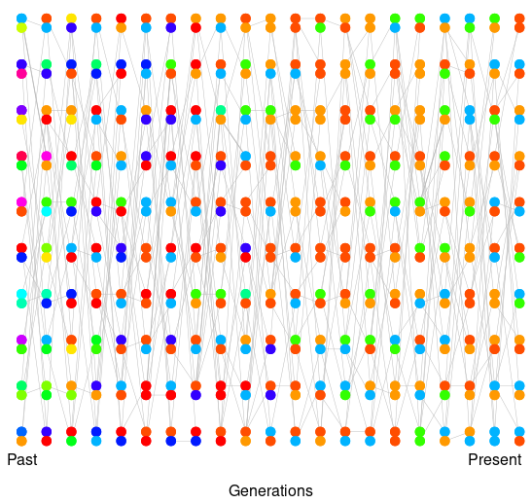
Genetic drift
Bottleneck
Constant size

Slide 27
Natural selection
Directional selection
fitness
trait
Ancestral allele
Derived allele

Slide 28
Natural selection
Purifying selection
x
fitness
trait
Ancestral allele
Derived allele

Slide 29
Natural selection
Balancing selection
fitness
trait

Slide 30
1. How to compare alternative demographic scenarios?
2. What evolutionary forces act at a given locus?

Slide 31
1. How to compare alternative demographic scenarios?
2. What evolutionary forces act at a given locus?
Model
of
evolution
Quantifying
genomic patterns
Observation

Slide 32
How can we measure that ?!?

Slide 33
How can we measure that ?!?
1. Sampling individuals from natural population(s)

Slide 34
How can we measure that ?!?
1. Sampling individuals from natural population(s)
2. Sequencing them

Slide 35
How can we measure that ?!?
1. Sampling individuals from natural population(s)
2. Sequencing them
3. Analyse the sequences

Slide 36
1. Sampling individuals from natural population(s)
Samples must be a set of unrelated individuals
MRCA

Slide 37


1. Sampling individuals from natural population(s)
Samples must be a set of unrelated individuals
MRCA

Slide 38
1. Sampling individuals from natural population(s)
Samples must be a set of unrelated individuals
MRCA

Slide 39
1. Sampling individuals from natural population(s)
Samples must be a set of unrelated individuals

Slide 40

1. Sampling individuals from natural population(s)
Samples must be a set of unrelated individuals

Slide 41
1. Sampling individuals from natural population(s)
Samples must be a set of unrelated individuals

Slide 42
1. Sampling individuals from natural population(s)
Samples must be a set of unrelated individuals

Slide 43
1. Sampling individuals from natural population(s)
Samples must be a set of unrelated individuals
Generally : use between 10 and 50 individual chromosomes (5 to 25 diploid individuals)

Slide 44
1. Sampling individuals from natural population(s)
Samples must be a set of unrelated individuals
Generally : use between 10 and 50 individual chromosomes (5 to 25 diploid individuals)
Inference requires a set of seuqnces sampled from a single population
population = group of randomly mating individuals

Slide 45
1. Sampling individuals from natural population(s)
Samples must be a set of unrelated individuals
Generally : use between 10 and 50 individual chromosomes (5 to 25 diploid individuals)
Inference requires a set of seuqnces sampled from a single population
population = group of randomly mating individuals
For some methods : a sequenced outgroup is required
outgroup
focal group
or
ingroup

Slide 46
How can we measure that ?!?
1. Sampling individuals from natural population(s)
2. Sequencing them

Slide 47
How can we measure that ?!?
1. Sampling individuals from natural population(s)
2. Sequencing them
How ?

Slide 48
How can we measure that ?!?
1. Sampling individuals from natural population(s)
2. Sequencing them
3. Analyse the sequences

Slide 49
1 2 3 4 5 6 7 8 9 10 11 12 13 14 15
i₁ : T T A C A A T C C G A T C G T
i₂ : T T A C G A T G C G C T C G T
i₃ : T C A C A A T G C G A T G G A
i₄ : T T A C G A T G C G C T C G T

Slide 50
1 2 3 4 5 6 7 8 9 10 11 12 13 14 15
i₁ : T T A C A A T C C G A T C G T
i₂ : T T A C G A T G C G C T C G T
i₃ : T C A C A A T G C G A T G G A
i₄ : T T A C G A T G C G C T C G T

Slide 51
With missing data ?
1 2 3 4 5 6 7 8 9 10 11 12 13 14 15
i₁ : T T A C A A T C C G A T C G T
i₂ : - - A C G A T G C G C T C G T
i₃ : T C A C A A T G C G A T G G A
i₄ : T T A C G A T G - - C T C G T

Slide 52
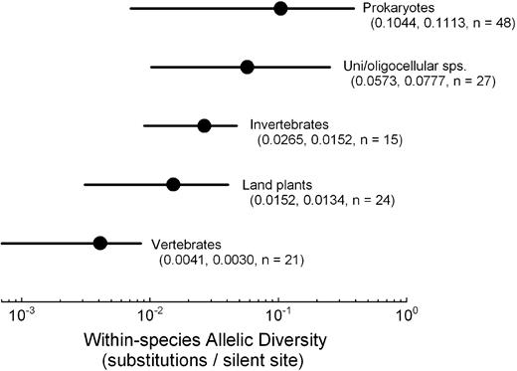
Lynch M. The origins of eukaryotic gene structure. Molecular biology and evolution. 2006 Feb 1;23(2):450-68.

Slide 53
Population structure
Population 1
Population 2
How do we measure differences among populations ?
How do we define populations in practice?

Slide 54
Population structure
How do we measure differences among populations ?
How do we define populations in practice?

Slide 55
The Wahlund effect
Population 1
Population 2
How differente are genotypic frequencies (assuming HW) ?

Slide 56
The Wahlund effect
If pop.1 and pop.2 are part from the same panmictic population → we expect similar genotypic frequencies
Population 1
A
A
A
a
A
A
A
a
A
A
Population 2
a
A
a
a
a
a
a
A
a
a
Total population

Slide 57
The Wahlund effect
If pop.1 and pop.2 are part from the same panmictic population → we expect similar genotypic frequencies
Population 1
A
A
A
 | f(AA) | f(Aa) | f(aa)
Pop. 1
Pop. 2
Tot. Pop.
a
A
A
A
a
A
A
Population 2
a
A
a
a
a
a
a
A
a
a
Total population

Slide 58
The Wahlund effect
If pop.1 and pop.2 are part from the same panmictic population → we expect similar genotypic frequencies
Population 1
A
A
A
 | f(AA) | f(Aa) | f(aa)
Pop. 1 | 0.64 | 0.32 | 0.04
Pop. 2 | 0.04 | 0.32 | 0.64
Tot. Pop. | 0.25 | 0.5 | 0.25
a
A
A
A
a
A
A
Population 2
a
A
a
a
a
a
a
A
a
a
Total population

Slide 59
The Wahlund effect
If pop.1 and pop.2 are part from the same panmictic population → we expect similar genotypic frequencies
Population 1
A
A
A
 | f(AA) | f(Aa) | f(aa)
Pop. 1 | 0.64 | 0.32 | 0.04
Pop. 2 | 0.04 | 0.32 | 0.64
Tot. Pop. | 0.25 | 0.5 | 0.25
a
A
A
A
a
A
A
Population 2
a
A
a
a
a
a
A
50 % of individuals are expected to be heterozygous.
a
a
a
Total population

Slide 60
The Wahlund effect
If pop.1 and pop.2 are part from the same panmictic population → we expect similar genotypic frequencies
Population 1
A
A
A
 | f(AA) | f(Aa) | f(aa)
Pop. 1 | 0.64 | 0.32 | 0.04
Pop. 2 | 0.04 | 0.32 | 0.64
Tot. Pop. | 0.25 | 0.5 | 0.25
a
A
A
A
a
A
A
Population 2
a
A
a
a
a
a
50 % of individuals are expected to be heterozygous.
However, we observe 32 %.
mean(pop₁ ; pop₂) = f(Aa)_{Tot} - 0.18
a
A
a
a
Total population

Slide 61
The Wahlund effect
If pop.1 and pop.2 are part from the same panmictic population → we expect similar genotypic frequencies
Population 1
A
A
A
 | f(AA) | f(Aa) | f(aa)
Pop. 1
Pop. 2
Tot. Pop.
A
A
A
A
A
A
A
Population 2
a
a
a
a
a
a
a
a
a
a
Total population

Slide 62
The Wahlund effect
If pop.1 and pop.2 are part from the same panmictic population → we expect similar genotypic frequencies
Population 1
A
A
A
 | f(AA) | f(Aa) | f(aa)
Pop. 1 | 1 | 0 | 0
Pop. 2 | 0 | 0 | 1
Tot. Pop. | 0.25 | 0.5 | 0.25
A
A
A
A
A
A
A
Population 2
a
a
a
a
a
a
50 % of individuals are expected to be heterozygous.
However, we observe 0%.
mean(pop₁ ; pop₂) = f(Aa)_{Tot} - 0.5
a
a
a
a
Total population

Slide 63
The Wahlund effect
If pop.1 and pop.2 are part from the same panmictic population → we expect similar genotypic frequencies
Population 1
A
A
A
 | f(AA) | f(Aa) | f(aa)
Pop. 1
Pop. 2
Tot. Pop.
a
A
a
A
A
a
A
Population 2
A
a
a
a
A
A
A
A
A
A
Total population

Slide 64
The Wahlund effect
If pop.1 and pop.2 are part from the same panmictic population → we expect similar genotypic frequencies
Population 1
A
A
A
 | f(AA) | f(Aa) | f(aa)
Pop. 1 | 0.49 | 0.42 | 0.09
Pop. 2 | 0.49 | 0.42 | 0.09
Tot. Pop. | 0.49 | 0.42 | 0.09
a
A
a
A
A
a
A
Population 2
A
a
a
a
A
A
42% of individuals are expected to be heterozygous.
We effectively observe 42%.
mean(pop₁ ; pop₂) = f(Aa)_{Tot} - 0
A
A
A
A
Total population

Slide 65
The Wahlund effect
A
A
A
A
a
a
a
a
A
A
A
a
A
A
A
A
a
A
A
A
Populations with similar allele frequencies → show very small deviations from HWE.

Slide 66
The Wahlund effect
A
A
A
A
a
a
a
a
A
A
A
a
A
A
A
A
a
A
A
A
Populations with similar allele frequencies → show very small deviations from HWE.
A
a
A
A
a
A
a
a
a
a
A
A
A
a
a
A
A
A
a
a
Populations with different allele frequencies → show strong deviations from HWE.

Slide 67
The Wahlund effect
A
a
A
A
A
a
a
a
a
a
A
a
A
A
a
a
A
A
a
A
Useful measure of allele frequency differences among populations

Slide 68
The Wahlund effect
A
a
A
A
A
a
a
a
a
a
A
a
A
A
a
a
A
A
a
A
Useful measure of allele frequency differences among populations → variance in frequencies σ²

Slide 69
The Wahlund effect
A
a
A
A
A
a
a
a
a
a
A
a
A
A
a
a
A
A
a
A
Useful measure of allele frequency differences among populations → variance in frequencies σ²
Where :
n is the number of populations
p_{i} is the frequency of allele A (or a) in population i.
p is the frequency of allele A (or a) in the whole metapopulation.

Slide 70
The Wahlund effect
A
a
A
A
A
a
a
a
a
a
A
a
A
A
a
a
A
A
a
A
Useful measure of allele frequency differences among populations → variance in frequencies σ²
Where :
n is the number of populations
p_{i} is the frequency of allele A (or a) in population i.
p is the frequency of allele A (or a) in the whole metapopulation.
σ² = (1/2) * [(0.8-0.5)² + (0.2-0.5)²] = 0.09

Slide 71
The Wahlund effect
Population 1
A
A
A
 | f(AA) | f(Aa) | f(aa)
Pop. 1 | 0.64 | 0.32 | 0.04
Pop. 2 | 0.04 | 0.32 | 0.64
Tot. Pop. | 0.25 | 0.5 | 0.25
a
A
A
A
a
A
A
Population 2
a
A
a
a
a
a
a
A
E[f(AA)] = p² + σ²
E[f(Aa)] = 2pq – 2σ²
E[f(aa)] = q² + σ²
a
a
Total population

Slide 72
The Wahlund effect
Population 1
A
A
A
 | f(AA) | f(Aa) | f(aa)
Pop. 1 | 0.64 | 0.32 | 0.04
Pop. 2 | 0.04 | 0.32 | 0.64
Tot. Pop. | 0.25 | 0.5 | 0.25
a
A
A
A
a
A
A
Population 2
a
A
a
a
a
a
a
A
E[f(AA)] = p² + σ²
E[f(Aa)] = 2pq – 2σ²
E[f(aa)] = q² + σ²
a
a
Total population
Expected genotypic frequencies within populations

Slide 73
The Wahlund effect
Population 1
A
A
A
 | f(AA) | f(Aa) | f(aa)
Pop. 1 | 0.64 | 0.32 | 0.04
Pop. 2 | 0.04 | 0.32 | 0.64
Tot. Pop. | 0.25 | 0.5 | 0.25
a
A
A
A
a
A
A
Population 2
a
A
a
a
a
a
a
A
E[f(AA)] = p² + σ²
E[f(Aa)] = 2pq – 2σ²
E[f(aa)] = q² + σ²
a
a
Total population
Expected genotypic frequencies in total

Slide 74
The Wahlund effect
Population 1
A
A
A
 | f(AA) | f(Aa) | f(aa)
Pop. 1 | 0.64 | 0.32 | 0.04
Pop. 2 | 0.04 | 0.32 | 0.64
Tot. Pop. | 0.25 | 0.5 | 0.25
a
A
A
A
a
A
A
Population 2
a
A
a
a
a
a
a
A
E[f(AA)] = p² + σ²
E[f(Aa)] = 2pq – 2σ²
E[f(aa)] = q² + σ²
a
a
Total population
Variance in allele frequencies

Slide 75
Variance in allelic frequencies (σ²) measures the genetic differentiation
Population 1
A
A
A
A
A
A
A
A
A
A
Population 2
a
a
a
a
a
a
a
a
a
a

Slide 76
Variance in allelic frequencies (σ²) measures the genetic differentiation
Population 1
Population 1
A
A
A
A
A
A
A
a
A
A
A
A
a
A
A
A
σ²
>>>
A
a
A
A
Population 2
Population 2
a
A
a
a
a
a
a
a
a
A
A
a
a
a
A
A
a
a
A
A

Slide 77
We can measure the variance in allelic frequencies (σ²) to quantify the genetic differentiation
What are the limits of σ² ?
(the min. and max. values for σ²)

Slide 78
We can measure the variance in allelic frequencies (σ²) to quantify the genetic differentiation
What are the limits of σ² ?
(the min. and max. values for σ²)
...
f(A)₁ = p₁
f(A)₂ = p₂
f(A)_{n} = p_{n}
Pop. 1
Pop. 2
Pop. n

Slide 79
We can measure the variance in allelic frequencies (σ²) to quantify the genetic differentiation
What are the limits of σ² ?
(the min. and max. values for σ²)
...
f(A)₁ = p₁
f(A)₂ = p₂
f(A)_{n} = p_{n}
Pop. 1
Pop. 2
Pop. n
Lowest variance
...
p₁ = p
p₂ = p
p₃ = p
Pop. 1
Pop. 2
Pop. n

Slide 80
We can measure the variance in allelic frequencies (σ²) to quantify the genetic differentiation
What are the limits of σ² ?
(the min. and max. values for σ²)
...
f(A)₁ = p₁
f(A)₂ = p₂
f(A)_{n} = p_{n}
Pop. 1
Pop. 2
Pop. n
Lowest variance → when p_{i} = p
...
p₁ = p
p₂ = p
p₃ = p
Pop. 1
Pop. 2
Pop. n

Slide 81
We can measure the variance in allelic frequencies (σ²) to quantify the genetic differentiation
What are the limits of σ² ?
(the min. and max. values for σ²)
...
f(A)₁ = p₁
f(A)₂ = p₂
f(A)_{n} = p_{n}
Pop. 1
Pop. 2
Pop. n
Lowest variance → when p_{i} = p
...
p₁ = p
p₂ = p
p₃ = p
Pop. 1
Pop. 2
Pop. n

Slide 82
We can measure the variance in allelic frequencies (σ²) to quantify the genetic differentiation
What are the limits of σ² ?
(the min. and max. values for σ²)
...
f(A)₁ = p₁
f(A)₂ = p₂
f(A)_{n} = p_{n}
Pop. 1
Pop. 2
Pop. n
Highest variance
...
Pop. 1
Pop. 2
Pop. n

Slide 83
We can measure the variance in allelic frequencies (σ²) to quantify the genetic differentiation
What are the limits of σ² ?
(the min. and max. values for σ²)
...
f(A)₁ = p₁
f(A)₂ = p₂
f(A)_{n} = p_{n}
Pop. 1
Pop. 2
Pop. n
Highest variance → when p_{i} = 0 or 1
...
p₁ = 1
p₂ = 1
p₃ = 0
Pop. 1
Pop. 2
Pop. n
Proportion p with p_{i}=1 and proportion q with p_{i}=0

Slide 84
We can measure the variance in allelic frequencies (σ²) to quantify the genetic differentiation
What are the limits of σ² ?
(the min. and max. values for σ²)
...
f(A)₁ = p₁
f(A)₂ = p₂
f(A)_{n} = p_{n}
Pop. 1
Pop. 2
Pop. n
Highest variance → when p_{i} = 0 or 1
...
p₁ = 1
p₂ = 1
p₃ = 0
Pop. 1
Pop. 2
Pop. n
Proportion p with p_{i}=1 and proportion q with p_{i}=0

Slide 85
We can measure the variance in allelic frequencies (σ²) to quantify the genetic differentiation
What are the limits of σ² ?
(the min. and max. values for σ²)
...
f(A)₁ = p₁
f(A)₂ = p₂
f(A)_{n} = p_{n}
Pop. 1
Pop. 2
Pop. n
Highest variance → when p_{i} = 0 or 1
...
p₁ = 1
p₂ = 1
p₃ = 0
Pop. 1
Pop. 2
Pop. n
Proportion p with p_{i}=1 and proportion q with p_{i}=0

Slide 86
We can measure the variance in allelic frequencies (σ²) to quantify the genetic differentiation
Values for σ² are lying from 0 (min) to pq (max)

Slide 87
We can measure the variance in allelic frequencies (σ²) to quantify the genetic differentiation
Values for σ² are lying from 0 (min) to pq (max)
Depend on allele frequencies

Slide 88
We can measure the variance in allelic frequencies (σ²) to quantify the genetic differentiation
Values for σ² are lying from 0 (min) to pq (max)
Depend on allele frequencies
Makes comparisons between loci complicated
Locus 1 : σ²= 0.09
Locus 2 : σ²= 0.12
Differentiation at locus 2 appears higher than locus 1

Slide 89
We can measure the variance in allelic frequencies (σ²) to quantify the genetic differentiation
Values for σ² are lying from 0 (min) to pq (max)
Depend on allele frequencies
Makes comparisons between loci complicated
Locus 1 : σ²= 0.09
Locus 2 : σ²= 0.12
If p = 0.1
Then σ² in [0 ; 0.09]
Differentiation at locus 2 appears higher than locus 1

Slide 90
We can measure the variance in allelic frequencies (σ²) to quantify the genetic differentiation
Values for σ² are lying from 0 (min) to pq (max)
Depend on allele frequencies
Makes comparisons between loci complicated
Locus 1 : σ²= 0.09
Locus 2 : σ²= 0.12
If p = 0.1
If p = 0.5
Then σ² in [0 ; 0.09]
Then σ² in [0 ; 0.25]
Differentiation at locus 2 appears higher than locus 1

Slide 91
We can measure the variance in allelic frequencies (σ²) to quantify the genetic differentiation
Values for σ² are lying from 0 (min) to pq (max)
Depend on allele frequencies
Makes comparisons between loci complicated
Locus 1 : σ²= 0.09
Locus 2 : σ²= 0.12
If p = 0.1
If p = 0.5
Then σ² in [0 ; 0.09]
Then σ² in [0 ; 0.25]
Differentiation at locus 2 appears higher than locus 1
We standardize σ² by the maximum variance possible

Slide 92
We can measure the variance in allelic frequencies (σ²) to quantify the genetic differentiation
Values for σ² are lying from 0 (min) to pq (max)
Depend on allele frequencies
Makes comparisons between loci complicated
Locus 1 : σ²= 0.09
Locus 2 : σ²= 0.12
If p = 0.1
If p = 0.5
Then σ² in [0 ; 0.09]
Then σ² in [0 ; 0.25]
Differentiation at locus 2 appears higher than locus 1
We standardize σ² by the maximum variance possible

Slide 93
We can measure the variance in allelic frequencies (σ²) to quantify the genetic differentiation
Values for σ² are lying from 0 (min) to pq (max)
Depend on allele frequencies
Makes comparisons between loci complicated
Locus 1 : σ²= 0.09
Locus 2 : σ²= 0.12
If p = 0.1
If p = 0.5
Then σ² in [0 ; 0.09]
Then σ² in [0 ; 0.25]
Differentiation at locus 2 appears higher than locus 1
We standardize σ² by the maximum variance possible
Locus 1 : F_{ST}= 1
Locus 2 : F_{ST}= 0.48
Locus 1 actually more differentiated than 2

Slide 94
Measuring F_{st} with DNA sequences

Slide 95
Measuring F_{st} with DNA sequences

Slide 96
Measuring F_{st} with DNA sequences

Slide 97
Measuring F_{st} with DNA sequences

Slide 98
Measuring F_{st} with DNA sequences

Slide 99
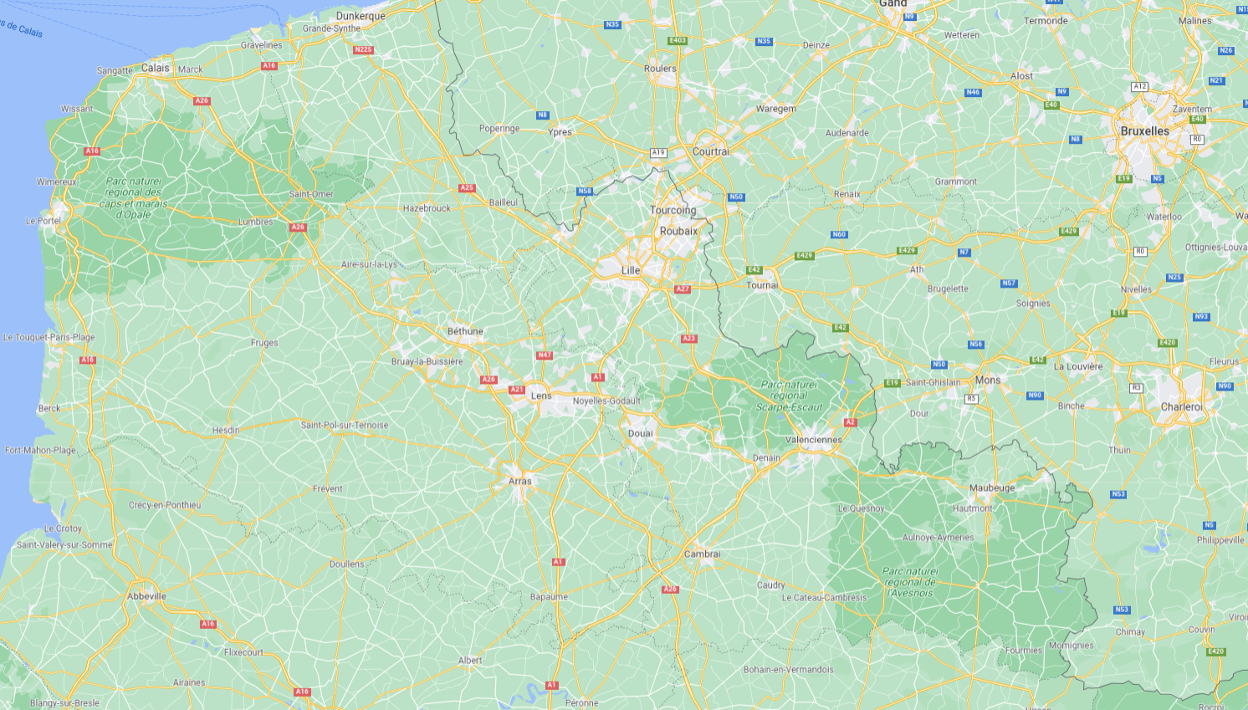
Measuring F_{st} with DNA sequences

Slide 100
Measuring F_{st} with DNA sequences

Slide 101
Measuring F_{st} with DNA sequences

Slide 102
Measuring F_{st} with DNA sequences
3
5
1
4
2
6
10
7
9
8
Sampling

Slide 103
Measuring F_{st} with DNA sequences
3
5
1
4
2
6
10
7
9
8
length = L nucleotides
Sampling
1
Sequencing
2
3
10 sequenced copies of one gene
4
5
6
7
8
9
10

Slide 104
Measuring F_{st} with DNA sequences
Real (unknown)
coalescent tree
Sequenced dataset
1
2
3
4
5
6
7
8
9
1
2
3
4
5
6
7
8
9
10
10

Slide 105
Measuring F_{st} with DNA sequences
Real (unknown)
coalescent tree
Sequenced dataset
1
2
a → A
3
4
5
6
7
8
9
1
2
3
4
5
6
7
8
9
10
10

Slide 106
Measuring F_{st} with DNA sequences
Real (unknown)
coalescent tree
Sequenced dataset
1
A
2
A
3
A
a → A
4
A
5
A
6
a
7
a
8
a
9
a
1
2
3
4
5
6
7
8
9
10
10
a

Slide 107
Measuring F_{st} with DNA sequences
Real (unknown)
coalescent tree
Sequenced dataset
1
A
a
2
A
a
3
A
a
a → A
4
A
a
5
A
a
6
a
A
7
a
A
8
a
A
9
a
a
1
2
3
4
5
6
7
8
9
10
10
a
a

Slide 108
Measuring F_{st} with DNA sequences
Real (unknown)
coalescent tree
Sequenced dataset
1
A
a
2
A
a
3
A
a
a → A
4
A
a
5
A
a
6
a
A
7
a
A
8
a
A
9
a
a
1
2
3
4
5
6
7
8
9
10
10
a
a

Slide 109
Measuring F_{st} with DNA sequences
Real (unknown)
coalescent tree
Sequenced dataset
1
A
a
a
2
A
a
a
3
A
a
a
a → A
4
A
a
A
5
A
a
A
6
a
A
a
7
a
A
a
8
a
A
a
9
a
a
a
1
2
3
4
5
6
7
8
9
10
10
a
a
a

Slide 110
Measuring F_{st} with DNA sequences
Real (unknown)
coalescent tree
Sequenced dataset
1
A
a
a
a
a
2
A
a
a
a
a
3
A
a
a
a
a
a → A
4
A
a
A
a
a
5
A
a
A
a
a
6
a
A
a
a
A
7
a
A
a
a
A
8
a
A
a
a
A
9
a
a
a
A
A
1
2
3
4
5
6
7
8
9
10
10
a
a
a
a
A

Slide 111
Measuring F_{st} with DNA sequences
Real (unknown)
coalescent tree
Sequenced dataset
1
A
a
a
a
a
2
A
a
a
a
a
3
A
a
a
a
a
a → A
4
A
a
A
a
a
5
A
a
A
a
a
6
a
A
a
a
A
7
a
A
a
a
A
8
a
A
a
a
A
9
a
a
a
A
A
1
2
3
4
5
6
7
8
9
10
10
a
a
a
a
A
E[f(Aa)] = average heterozygosity among populations

Slide 112
Measuring F_{st} with DNA sequences
Real (unknown)
coalescent tree
Sequenced dataset
1
A
a
a
a
a
2
A
a
a
a
a
3
A
a
a
a
a
a → A
4
A
a
A
a
a
5
A
a
A
a
a
6
a
A
a
a
A
7
a
A
a
a
A
8
a
A
a
a
A
9
a
a
a
A
A
1
2
3
4
5
6
7
8
9
10
10
a
a
a
a
A
E[f(Aa)] = average heterozygosity among populations

Slide 113
Measuring F_{st} with DNA sequences
Real (unknown)
coalescent tree
Sequenced dataset
1
A
a
a
a
a
2
A
a
a
a
a
3
A
a
a
a
a
a → A
4
A
a
A
a
a
5
A
a
A
a
a
6
a
A
a
a
A
7
a
A
a
a
A
8
a
A
a
a
A
9
a
a
a
A
A
1
2
3
4
5
6
7
8
9
10
10
a
a
a
a
A
E[f(Aa)] = average heterozygosity among populations

Slide 114
Measuring F_{st} with DNA sequences
Real (unknown)
coalescent tree
Sequenced dataset
1
A
a
a
a
a
2
A
a
a
a
a
3
A
a
a
a
a
a → A
4
A
a
A
a
a
5
A
a
A
a
a
6
a
A
a
a
A
7
a
A
a
a
A
8
a
A
a
a
A
9
a
a
a
A
A
1
2
3
4
5
6
7
8
9
10
10
a
a
a
a
A
E[f(Aa)] = average heterozygosity among populations
?
?
?
?
?

Slide 115
Measuring F_{st} with DNA sequences
Real (unknown)
coalescent tree
Sequenced dataset
1
A
a
a
a
a
2
A
a
a
a
a
3
A
a
a
a
a
a → A
4
A
a
A
a
a
5
A
a
A
a
a
6
a
A
a
a
A
7
a
A
a
a
A
8
a
A
a
a
A
9
a
a
a
A
A
1
2
3
4
5
6
7
8
9
10
10
a
a
a
a
A
E[f(Aa)] = average heterozygosity among populations
0
0.24
0.24
0.16
0

Slide 116
Measuring F_{st} with DNA sequences
Real (unknown)
coalescent tree
Sequenced dataset
1
A
a
a
a
a
2
A
a
a
a
a
3
A
a
a
a
a
a → A
4
A
a
A
a
a
5
A
a
A
a
a
6
a
A
a
a
A
7
a
A
a
a
A
8
a
A
a
a
A
9
a
a
a
A
A
1
2
3
4
5
6
7
8
9
10
10
a
a
a
a
A
E[f(Aa)] = average heterozygosity among populations
0
0.24
0.24
0.16
0

Slide 117
Measuring F_{st} with DNA sequences
Real (unknown)
coalescent tree
Sequenced dataset
1
A
a
a
a
a
2
A
a
a
a
a
3
A
a
a
a
a
a → A
4
A
a
A
a
a
5
A
a
A
a
a
6
a
A
a
a
A
7
a
A
a
a
A
8
a
A
a
a
A
9
a
a
a
A
A
1
2
3
4
5
6
7
8
9
10
10
a
a
a
a
A
E[f(Aa)] = average heterozygosity among populations
0
0.24
0.24
0.16
0
0.5
0.42
0.32
0.18
0.5

Slide 118
Measuring F_{st} with DNA sequences
Real (unknown)
coalescent tree
Sequenced dataset
1
A
a
a
a
a
2
A
a
a
a
a
3
A
a
a
a
a
a → A
4
A
a
A
a
a
5
A
a
A
a
a
6
a
A
a
a
A
7
a
A
a
a
A
8
a
A
a
a
A
9
a
a
a
A
A
1
2
3
4
5
6
7
8
9
10
10
a
a
a
a
A
E[f(Aa)] = average heterozygosity among populations
0
0.24
0.24
0.16
0
0.5
0.42
0.32
0.18
0.5

Slide 119
Measuring F_{st} with DNA sequences
Real (unknown)
coalescent tree
Sequenced dataset
1
A
a
a
a
a
2
A
a
a
a
a
3
A
a
a
a
a
a → A
4
A
a
A
a
a
5
A
a
A
a
a
6
a
A
a
a
A
7
a
A
a
a
A
8
a
A
a
a
A
9
a
a
a
A
A
1
2
3
4
5
6
7
8
9
10
10
a
a
a
a
A
E[f(Aa)] = average heterozygosity among populations
0
0.24
0.24
0.16
0
0.5
0.42
0.32
0.18
0.5
1
0.43
0.25
0.11
1

Slide 120
Measuring F_{st} with DNA sequences
Real (unknown)
coalescent tree
Sequenced dataset
1
A
a
a
a
a
2
A
a
a
a
a
3
A
a
a
a
a
a → A
4
A
a
A
a
a
5
A
a
A
a
a
6
a
A
a
a
A
7
a
A
a
a
A
8
a
A
a
a
A
9
a
a
a
A
A
1
2
3
4
5
6
7
8
9
10
10
a
a
a
a
A
E[f(Aa)] = average heterozygosity among populations
0
0.24
0.24
0.16
0
0.5
0.42
0.32
0.18
0.5
1
0.43
0.25
0.11
1
F_{ST} = 0.558

Slide 121
The effect of migration on F_{ST}
1
2
3
4
5
6
7
8
9
10
F_{ST} = 0.558

Slide 122
The effect of migration on F_{ST}
1
2
3
4
5
6
7
8
9
10
1
2
3
4
5
6
7
8
9
10
F_{ST} = 0.558

Slide 123
The effect of migration on F_{ST}
1
2
3
4
5
6
7
8
9
10
1
2
3
4
5
6
7
8
9
10
F_{ST} = 0.558

Slide 124
The effect of migration on F_{ST}
1
2
3
4
5
6
7
8
9
10
1
2
3
4
5
6
7
8
9
10
F_{ST} = 0.558

Slide 125
The effect of migration on F_{ST}
1
2
3
4
5
6
7
8
9
10
1
2
3
4
5
6
7
8
9
10
F_{ST} = 0.558
F_{ST} = ?

Slide 126
The effect of migration on F_{ST}
Fst = 0.43
1
2
3
4
5
6
7
8
9
10
1
2
3
4
5
6
7
8
9
10
F_{ST} = 0.558
F_{ST} = ?

Slide 127
The effect of migration on F_{ST}
Fst = 0.43
0.25
1
2
3
4
5
6
7
8
9
10
1
2
3
4
5
6
7
8
9
10
F_{ST} = 0.558
F_{ST} = ?

Slide 128
The effect of migration on F_{ST}
0.43
Fst = 0.43
0.04
0.25
0.11
1
2
3
4
5
6
7
8
9
10
1
2
3
4
5
6
7
8
9
10
F_{ST} = 0.558
F_{ST} = ?

Slide 129
The effect of migration on F_{ST}
0.43
Fst = 0.43
0.04
0.25
0.11
1
2
3
4
5
6
7
8
9
10
1
2
3
4
5
6
7
8
9
10
F_{ST} = 0.558
F_{ST} = 0.252

Slide 130
The effect of migration on F_{ST}
0.43
Fst = 0.43
0.04
0.25
0.11
1
2
3
4
5
6
7
8
9
10
1
2
3
4
5
6
7
8
9
10
F_{ST} = 0.558
F_{ST} = 0.252
Migration F_{ST}

Slide 131
Migration + recombination + genetic drift
Modern human pop.
Neandertal pop.
~50,000 BP
F_{ST}

Slide 132
Migration + recombination + genetic drift
Modern human pop.
Neandertal pop.
migration
~45,000 BP
migration
F_{ST}

Slide 133
Migration + recombination + genetic drift
Modern human pop.
Neandertal pop.
migration
~45,000 BP
0.05cM
Present
after 2,000 generations

Slide 134
Migration + recombination + genetic drift
Modern human pop.
Neandertal pop.
migration
~45,000 BP
0.05cM
Present
after 2,000 generations
introgression
introgression
F_{ST}

Slide 135
def Fst_sequences(seq_pop1, seq_pop2):
# measures Hs
nA_1 = seq_pop1.count('A')
na_1 = seq_pop1.count('a')
nA_2 = seq_pop2.count('A')
na_2 = seq_pop2.count('a')
p1 = nA_1 / (nA_1 + na_1)
q1 = 1-p1
p2 = nA_2 / (nA_2 + na_2)
q2 = 1-p2
Hs = (1/2) * (2*p1*q1 + 2*p2*q2)
# measures Ht
nA_tot = (seq_pop1+seq_pop2).count("A")
na_tot = (seq_pop1+seq_pop2).count("a")
p_bar = nA_tot / (nA_tot + na_tot)
q_bar = 1-p_bar
Ht = 2*p_bar*q_bar
# final step: Fst
Fst = 1 - Hs/Ht
return(Fst)

Slide 137
The Wahlund effect
q1=1-p1
q2=1-p2
q3=1-p3
p = (p1+p2+p3)/3
q = (q1+q2+q3)/3
fAa_1 = 2*p1*q1
fAa_2 = 2*p2*q2
fAa_3 = 2*p3*q3
fAa = 2 * p * q
sigma_sqr = (1/3) * ( (p1-p)**2 + (p2-p)**2 + (p3-p)**2 )
res = round(c(fAa_1, fAa_2, fAa_3, fAa, sigma_sqr, sigma_sqr/(p*q), (fAa_1+fAa_2+fAa_3)/3 + 2*sigma_sqr), 2)
names(res) = c('fAa (pop 1)', 'fAa (pop 2)', 'fAa (pop 3)', 'fAa (tot. pop)', 'sigma_sqr', 'Fst', 'mean(fAa) + 2 sigma_sqr')
tmp = paste("\n#pop. 1\nAA\tAa\taa\n", p1**2, "\t", 2*p1*q1, "\t", q1**2, "\n", sep="")
cat(tmp)
tmp = paste("\n#pop. 2\nAA\tAa\taa\n", p2**2, "\t", 2*p2*q2, "\t", q2**2, "\n", sep="")
cat(tmp)
tmp = paste("\n#pop. 3\nAA\tAa\taa\n", p3**2, "\t", 2*p3*q3, "\t", q3**2, "\n", sep="")
cat(tmp)
tmp = paste("\n#pop. total\nAA\tAa\taa\n", p**2, "\t", 2*p*q, "\t", q**2, "\n", sep="")
cat(tmp)
return(t(t(res)))

Slide 140
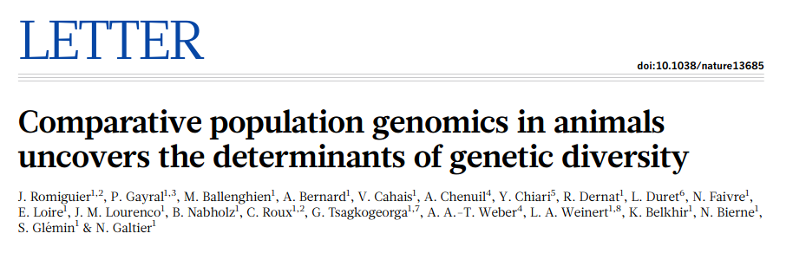

Slide 141
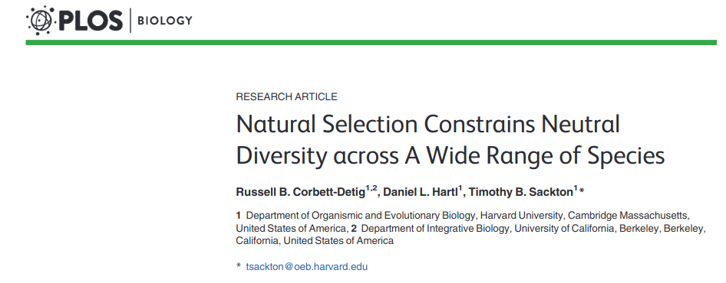

Slide 142
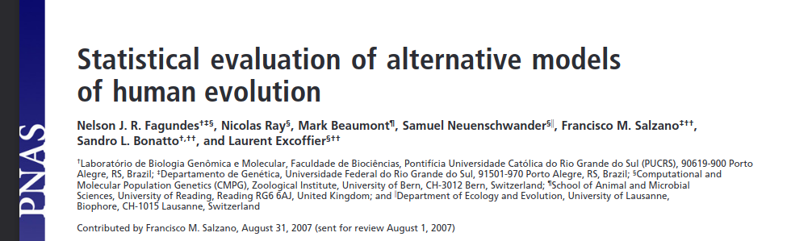

Slide 143


Slide 144
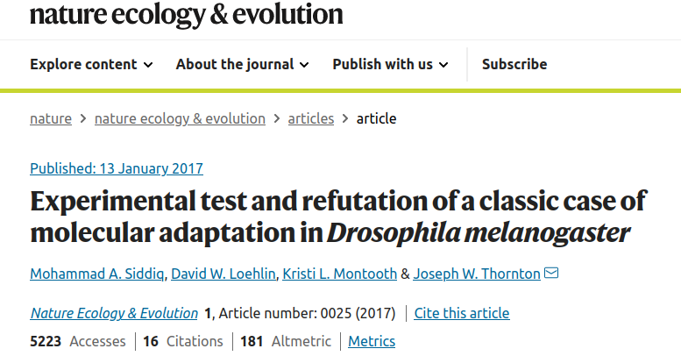

Slide 145
