Slide 1
Why sex-ratios are mostly balanced in nature?
Karl Düsing (1883) → first general mathematical treatment of sex-ratio evolution
Population of z individuals
n.x
x
Assumption:
All males together → will produce z offspring
All females together → will produce z offspring
Each
will produce
offspring
Each
will produce
offspring

Slide 2
Why sex-ratios are mostly balanced in nature?
Karl Düsing (1883) → first general mathematical treatment of sex-ratio evolution
Population of z individuals
n.x
x
Assumption:
All males together → will produce z offspring
All females together → will produce z offspring
Each
will produce
offspring
Each
will produce
offspring

Slide 3
Why sex-ratios are mostly balanced in nature?
Karl Düsing (1883) → first general mathematical treatment of sex-ratio evolution
Population of z individuals
n.x
x
Assumption:
All males together → will produce z offspring
All females together → will produce z offspring
Each
will produce
offspring
Each
will produce
offspring

Slide 4
Why sex-ratios are mostly balanced in nature?
Each
will produce
offspring
Each
will produce
offspring
Suppose 2 strategies among : Fem_1 = more sons; Fem_2 = more daughters
children
grandchildren
1st generation
2nd generation
ba. + a.
1
a. + ba.
2
Karl Düsing (1883)

Slide 5
Why sex-ratios are mostly balanced in nature?
Each
will produce
offspring
Each
will produce
offspring
Suppose 2 strategies among : Fem_1 = more sons; Fem_2 = more daughters
children
grandchildren
1st generation
2nd generation
ba. + a.
1
a. + ba.
2
Karl Düsing (1883)

Slide 6
Why sex-ratios are mostly balanced in nature?
Each
will produce
offspring
Each
will produce
offspring
Suppose 2 strategies among : Fem_1 = more sons; Fem_2 = more daughters
children
grandchildren
1st generation
2nd generation
ba. + a.
1
a. + ba.
2
Karl Düsing (1883)

Slide 7
Suppose 2 strategies among
grandchildren
2 generations
1
2
Number of grandchildren produced by
2
=
Number of grandchildren produced by
1
Karl Düsing (1883)

Slide 8
Suppose 2 strategies among
grandchildren
2 generations
1
2
Number of grandchildren produced by
2
=
Number of grandchildren produced by
1
Karl Düsing (1883)

Slide 9
If sex-ratio is originally balanced:
x males
x females
Ratio of produced grandchildren Fem_2 / Fem_1:
All strategies among females lead to the same number of grandchildren
Karl Düsing (1883)

Slide 10
If sex-ratio is originally unbalanced:
2x males
x females
Ratio of produced grandchildren Fem_2 / Fem_1:
(for all b>1)
Karl Düsing (1883)

Slide 11
If sex-ratio is originally unbalanced:
2x males
x females
Ratio of produced grandchildren Fem_2 / Fem_1:
(for all b>1)
Production of the minority sex is favoured
Karl Düsing (1883)

Slide 12
Why sex-ratios are sometimes unbalanced in nature?
Models explaining balanced sex-ratio always assume: panmixia
+
unlimited mating opportunities
A few number of can fertilize all

Slide 13
Why sex-ratios are sometimes unbalanced in nature?
Models explaining balanced sex-ratio always assume: panmixia
+
unlimited mating opportunities
A few number of can fertilize all

Slide 14
Why sex-ratios are sometimes unbalanced in nature?
Models explaining balanced sex-ratio always assume: panmixia
+
unlimited mating opportunities
A few number of can fertilize all → local mate competition

Slide 15
Sex-ratio adjustment
Male reproductive capacity k = 3
3 mothers
6 mothers
5 mothers
4 mothers

Slide 16
Sex-ratio adjustment
Male reproductive capacity k = 3
3 mothers
6 mothers
5 mothers
4 mothers

Slide 17
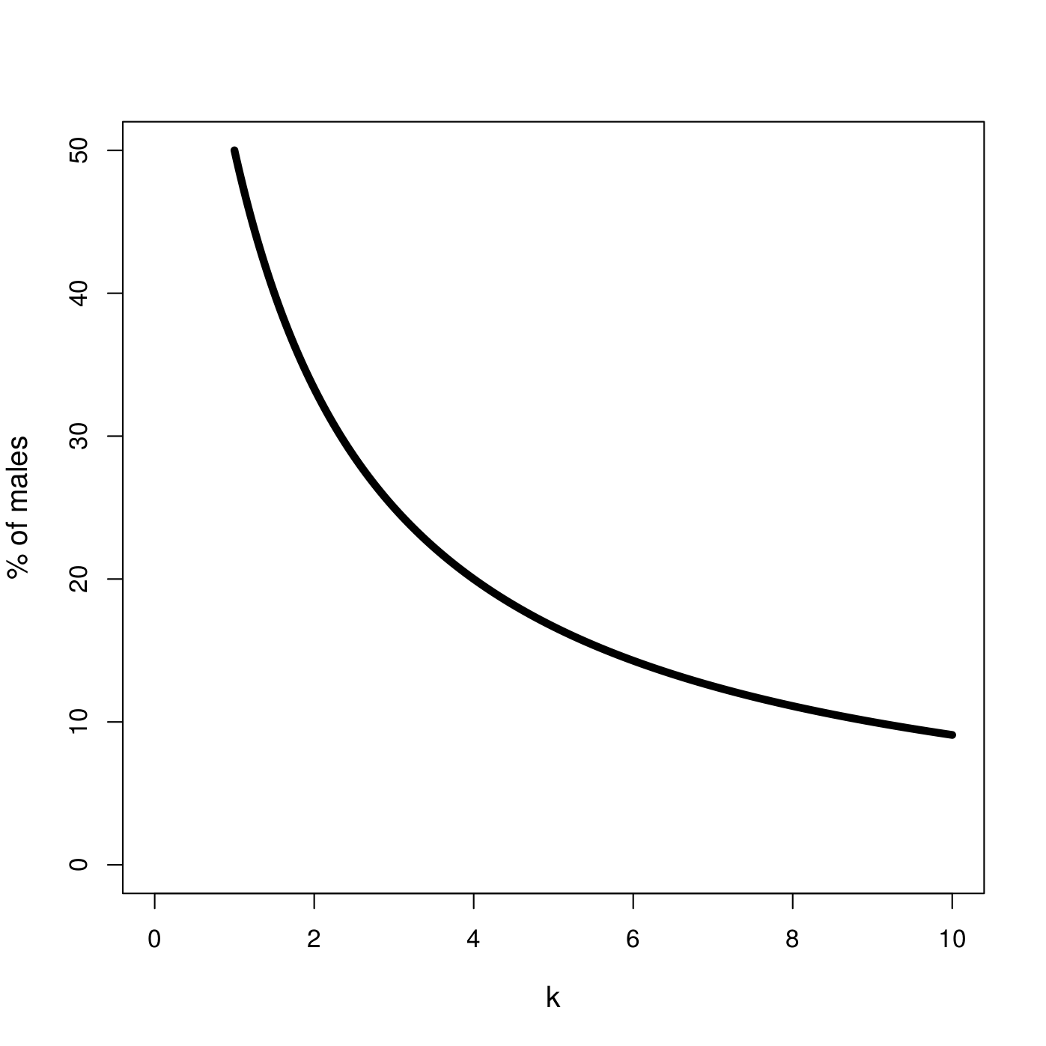
Sex-ratio adjustment

Slide 18
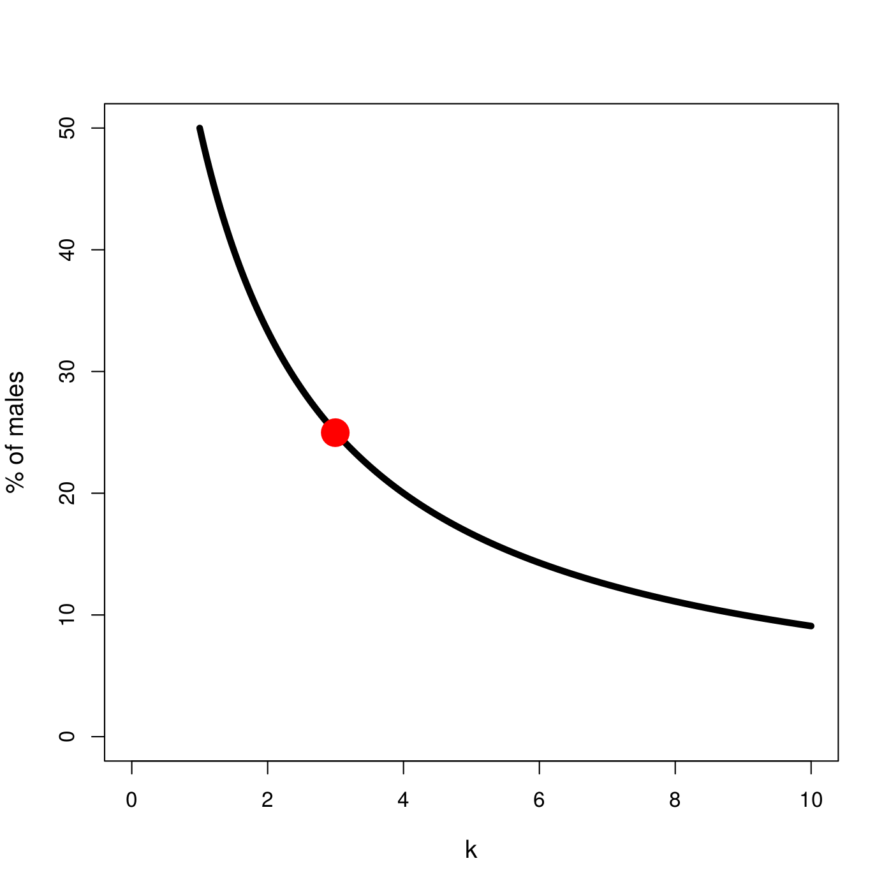
Sex-ratio adjustment
Example: male reproductive capacity k = 3
25%
k=3

Slide 19
Sex-ratio adjustment
The case of fig wasps
oviposition
fig

Slide 20
Sex-ratio adjustment
The case of fig wasps
oviposition
Strong LMC → bias toward daughters

Slide 21
Sex-ratio adjustment
The case of fig wasps
oviposition
oviposition
Strong LMC → bias toward daughters

Slide 22
Sex-ratio adjustment
The case of fig wasps
oviposition
oviposition
Strong LMC → bias toward daughters
Weaker LMC → increased production of sons

Slide 23
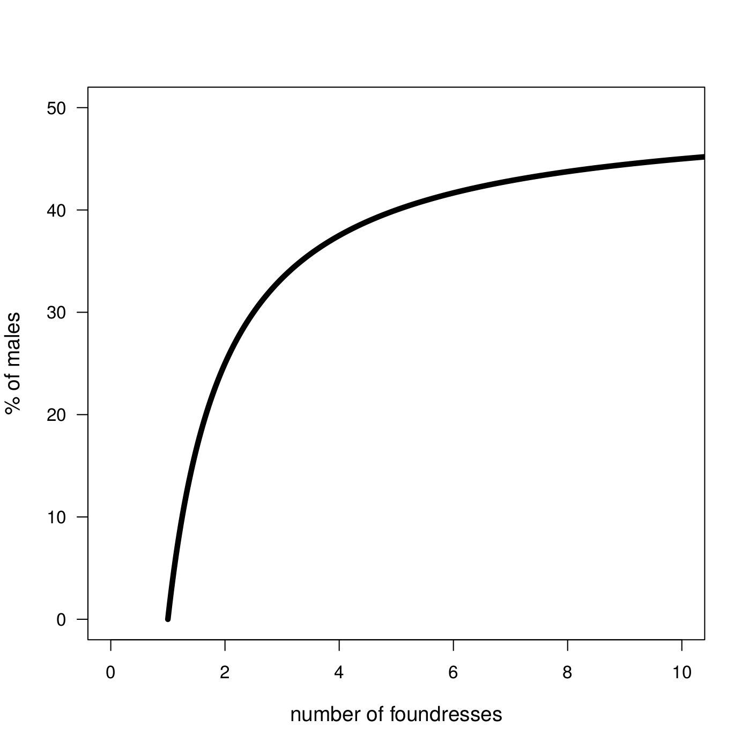
Sex-ratio adjustment
The case of fig wasps
If #foundresses , then LMC

Slide 24
Sex-ratio adjustment
The case of fig wasps
oviposition
oviposition
oviposition
Effect of inbreeding on sex-ratio

Slide 25
Sex-ratio adjustment
The case of fig wasps
oviposition
oviposition
oviposition
Effect of inbreeding on sex-ratio

Slide 26
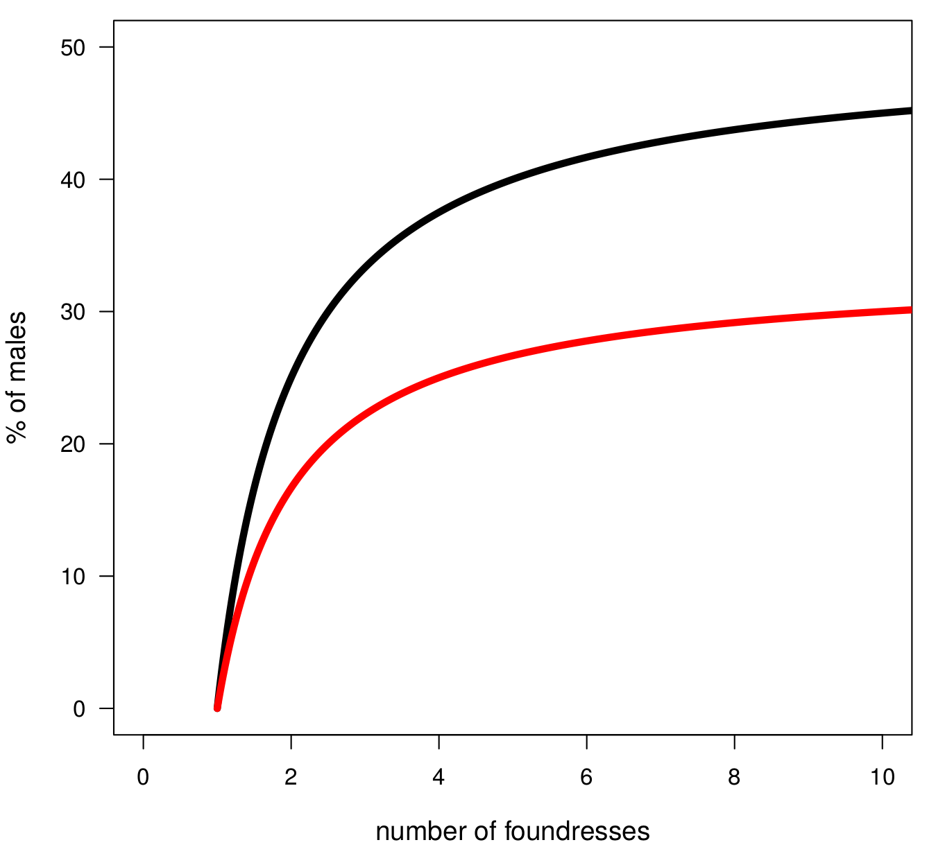
Sex-ratio adjustment
Inbreeding: min
(foundresses are from different figs)
The case of fig wasps
Inbreeding: max
(foundresses are from the same fig)

Slide 27
Sex ratios in gonochoristic species
Balanced for panmictic populations
Female biased if competition between brothers is strong
% of males
Number of foundresses

Slide 28
Sex ratios in gonochoristic species
Balanced for panmictic populations
Female biased if competition between brothers is strong
% of males
Number of foundresses

Slide 29
Cases of hermaphrodites

