Slide 1
PRECISION CONSIDERATION
Higher precision implies higher chances of predicted positives being actually positive
Reduces false positives
Saves human effort in verifying the predictions are actually fraud - once a model predicts accounting fraud, it is reliably accurate in the prediction
RECALL CONSIDERATION
Higher precision implies higher chances of capturing positive classes in the data
Since accounting fraud cases in the data are low, it is important to capture as many of those cases as we can
Problem: Predictive modeling to detect accounting fraud
1
Models
Simple Logistic, Logistic with L1, Random Forests, AdaBoost
Selection criteria: Maximizing & balancing precision and recall for positive class
2
Data Processing
Checking for missing values, identifying severe class imbalance
Undersampling the data - minority class to majority class - 0.2:1 after resampling
Standardized data, checked for multicollinearity and reduced features
Validation: 10-fold cross validation, 70/30 train test split with stratified sampling
3
Results
Final model: Random Forests with all features, using undersampled data
Final accuracy, precision, recall, AUC: 82%, 85%, 45%, 71.07%
Best data: undersampled data with 0.2:1 positive-negative class ratio
Model is superior to other models given highest precision and comparable recall for positive class - two primary metrics of importance for this problem

Slide 2
Model Comparisons
Model | Precision | Recall
Simple Logistic - all features, all data | 0.01% | 58%
Logistic with L1 - significant features, undersampled data | 47% | 58%
Random Forests - all features, undersampled data | 85% | 45%
AdaBoost - reduced features, undersampled data | 69% | 17%
85% precision significantly outperforms the rest of the models
While recall is slightly lower than the best and overall a very low value, it is comparatively still a strong value between other models
While most models failed to capture much of the fraud cases due to data imbalance, the best balance in capturing fraud cases and being accurate at it was observed for the random forests model.

Slide 3
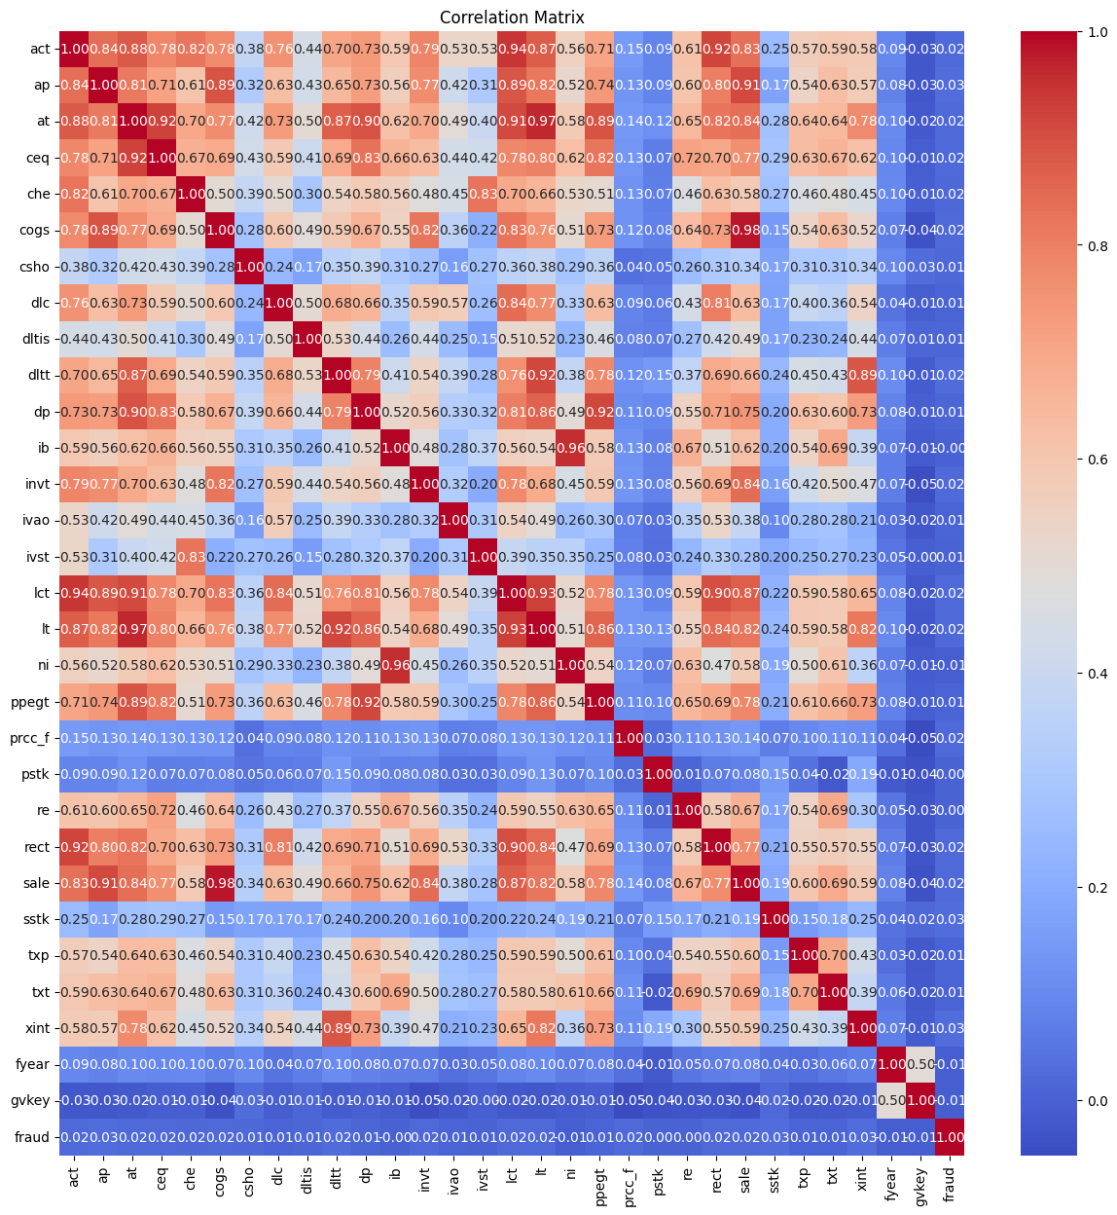
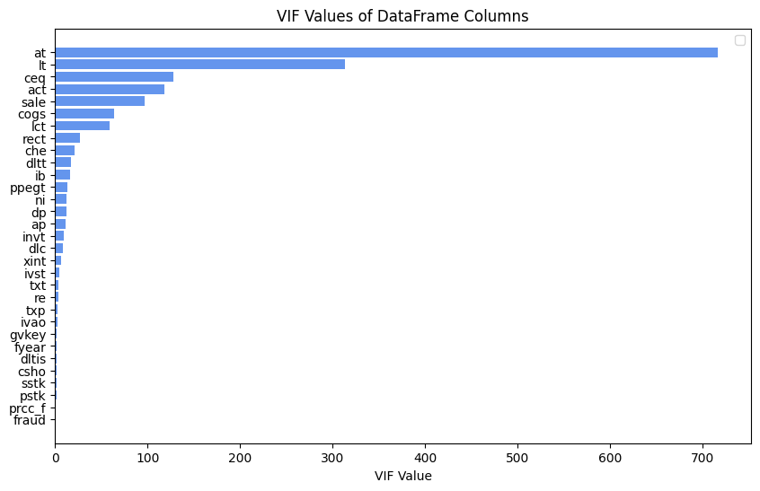
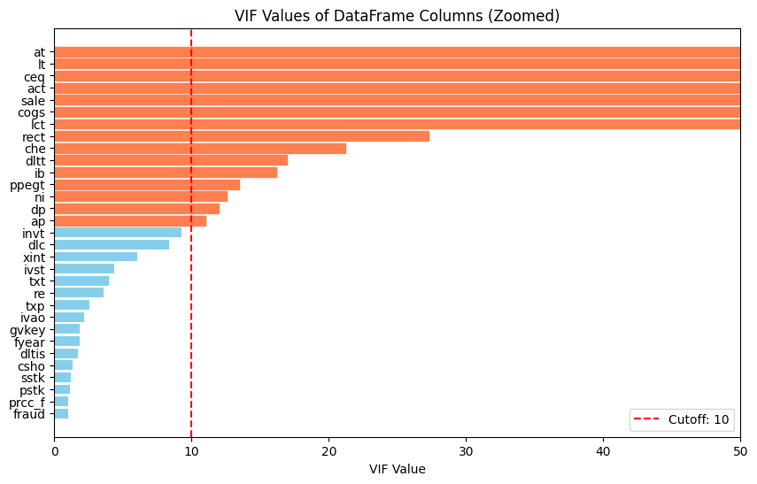
Data Processing and exploration
High correlations - expected in the context of this data
VIF values and cutoff = 10
HIGH imbalance
Positive classes: 964
Total rows: 146045

Slide 4
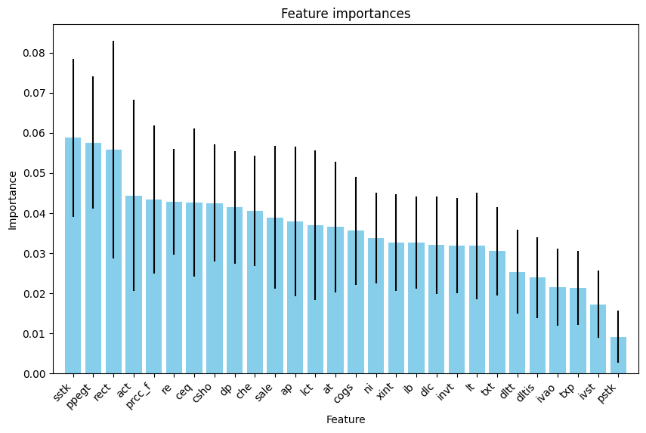
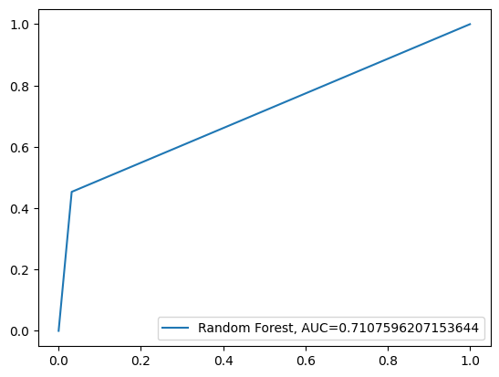
Final model AUC: model can accurately distinguish between classes 71.07% of the time.
Top 5 features: sstk (sale of common and preferred stock), ppegt (PP&E total), rect (receivables, total), act (current assets, total) and prcc_f (price close, annual, total)

Slide 5
Interpretations
Model precision is high - once fraud is suspected, emphasis can be placed on important features of the model
Financial documents contain a lot of information, so important features - sale of common and preferred stock, PP&E total, total receivables, total current assets and annual total price close should be considered first during scrutiny
Major disruptions in average patterns for these features should be noted, and tallied against prior frauds to check if disruptions contribute positively/negatively to fraud
Limitations
Final model was random forests, which has low interpretability - however, precision is high so it can be relied upon to predict suspected cases
Need appropriate methods to manage data imbalance
Data had varied time lengths, making it difficult to leverage time based data effectively and uniformly for different companies
There is high correlation in data, but this is expected given the domain knowledge - features are linked

