Slide 1
FINAL SELECTION TRADE-OFFS
~2% increase in recall not justified by extensive drop in interpretability
However, given the domain of problem, 2% difference is life-saving, change model IF interpretability is unimportant
Both models are powerful, trade-offs must be considered based on the task
Problem: Classifying malignant and benign breast cancer lumps
1
Models
Ridge Classifier, Logistic with L1 penalty, Simple Logistic, SVC/SVM
Selection criteria: Maximizing recall for malignant class
2
Data Processing
Cleaning: KNN-imputed blank values for ‘BARE’
Standardized data, checked for multicollinearity and reduced features
Validation: Leave-One-Out & 10-fold cross validation
3
Results
Final model: Simple Logistic Regression on a subset dataset using important variables
Final accuracy, recall, AUC: 97.60%, 96.29%, 99.29%
Final subset of data: 5 features selected
Model is superior to other models given highest accuracy, only slightly lower recall than the Best SVM model, but significantly greater interpretability
Model | Accuracy | Recall (Malignant Class)
Ridge Classifier | 94.61% | 87.03%
Logistic with L1 | 95.20% | 88.88%
Simple Logistic | 97.60% | 96.29%
Best SVM | 97.01% | 98.14%

Slide 2
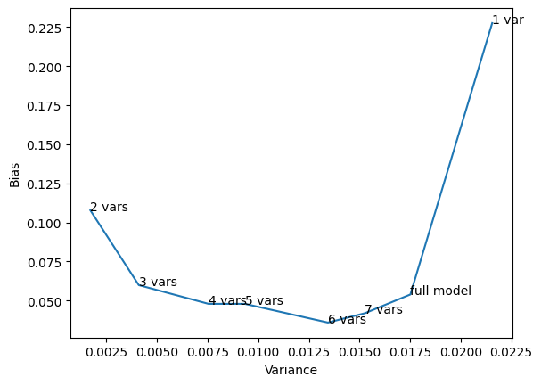
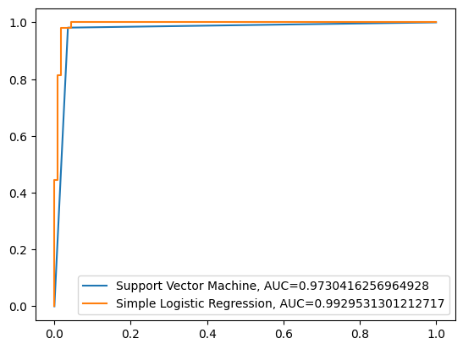
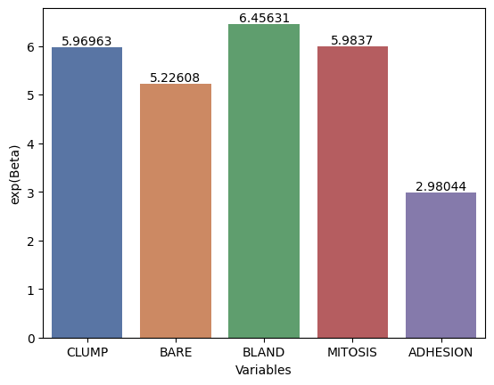
SCENARIO: Interpretability/Physician Use
MODEL: Simple Logistic
Bias-Variance Trade-Off
AUC Comparison of Competitive Models: 99.29% vs 97.30%
All 5 statistically significant variables & minimal tradeoff impact
LIMITATIONS
Small training data, model may not generalize to newer sets of data as more data is available
Final subset does not use cell shape and size, but they could be easier to identify by physicians
Slightly imbalanced data, leading to higher accuracies which can be misleading
TAKEAWAYS & PHYSICIAN USE:
When identifying malignant lumps, emphasis should be placed on these 5 features
Compare 2 cells - if all else remains the same and one has a chromatin texture (‘BLAND’) value higher by 1 standard deviation, the odds of that cell being malignant are 6.45 times higher
Model Use Examples: The odds of a lump being malignant increases by a factor of 5.96 with one standard deviation increase in CLUMP variable representing the clump thickness in cells.
AUC Comparison: The Simple Logistic model can accurately distinguish between malignant and benign lumps 99.29% of the time, holistically considering various thresholds. This is about 2% better performance than the SVM model, adding on to the Simple Logistic model’s advantages.

Slide 3
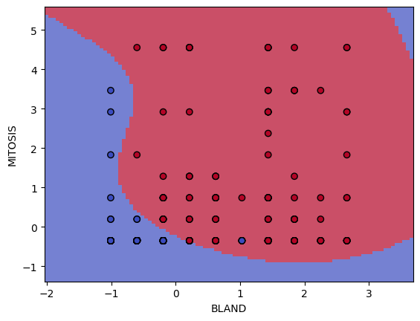
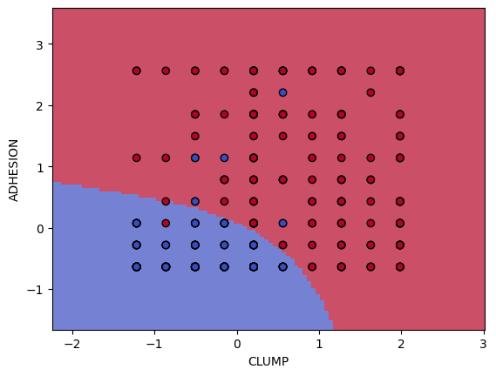
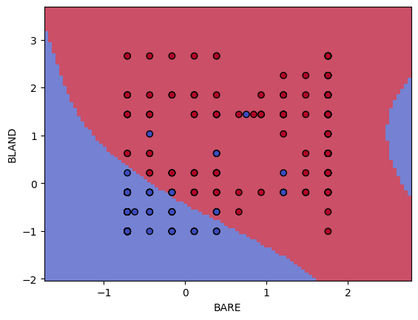
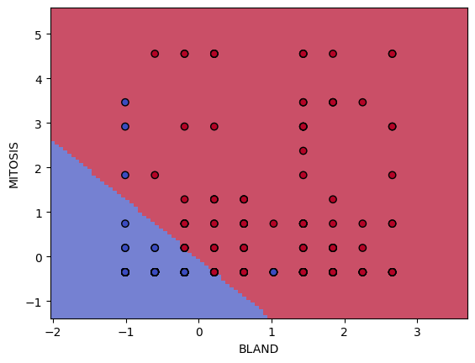
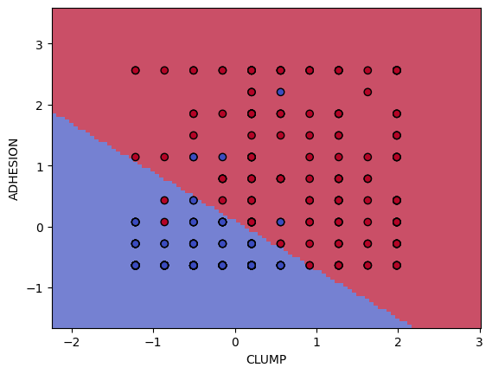
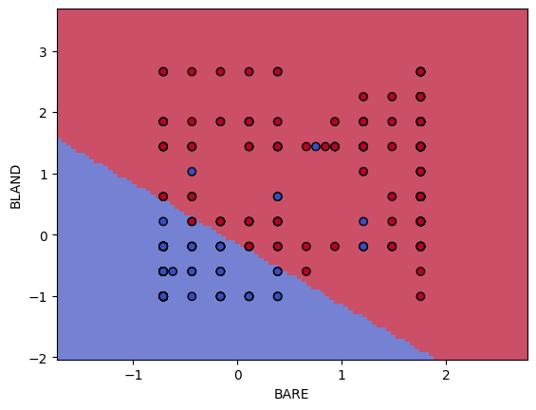
SCENARIO: Interpretability is unimportant, recall (correctly identifying malignant lumps) is the main focus
MODEL: Best SVM (RBF kernel, C=10, Gamma=0.1, class_weight=’balanced’ found through 10-fold cross-validated grid search of various parameters), test accuracy 97.01%, positive class recall 98.14%
Decision Boundaries
RBF Kernel
Linear Kernel

