Slide 1

Computer Networks – 1 Network attack prediction & Network intrusion Prediction
Presented by- Ajinkya Vikas Pophale

Slide 2
Data Description
Description | Network Intrusion Prediction | Network Attack Prediction
Shape | (4998, 32) | (12989, 33)
Information | Data types: int64(32) | Data types: float64(15), int64(14), object(4)
Null Values | No | Yes, Also 11 Null columns
OneHotEncoding | No | Yes
Target Column | Label | Type of Attack

Slide 3
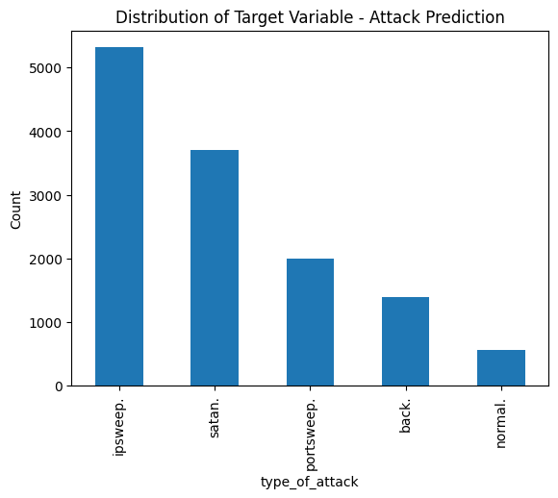
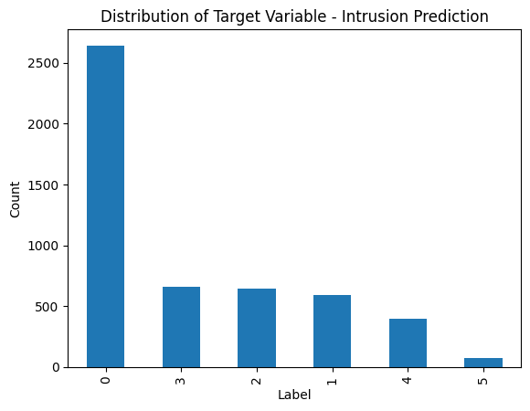
Visualizations – Target columns

Slide 4
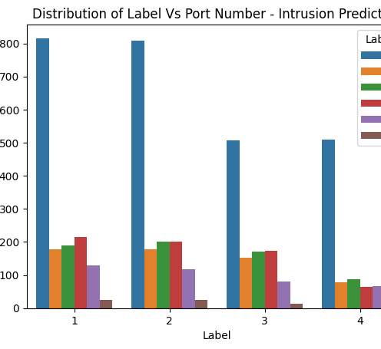
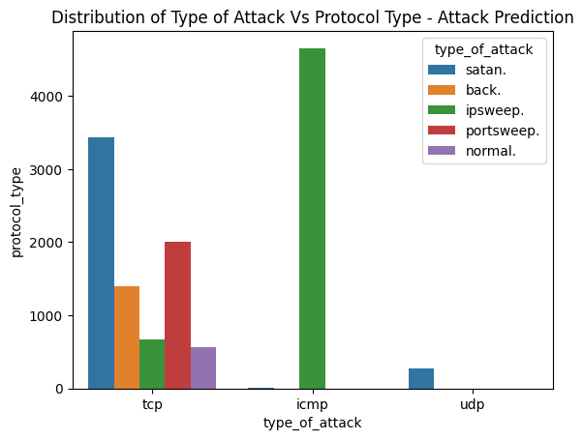
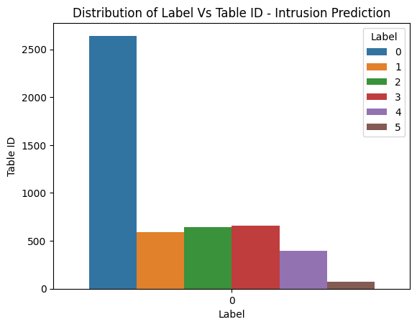
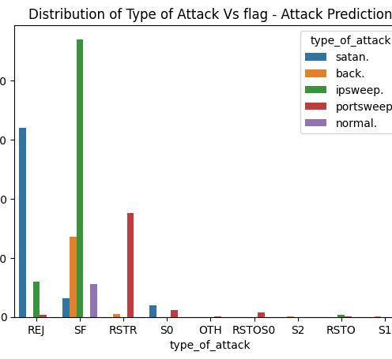
Visualization – Independent feature vs Target column

Slide 5
Train Test Split
Performed Train Test Split of 70-30% with Stratify=y and Random_state=random
Then, performed Standard Scalar on both X_train and X_test

Slide 6
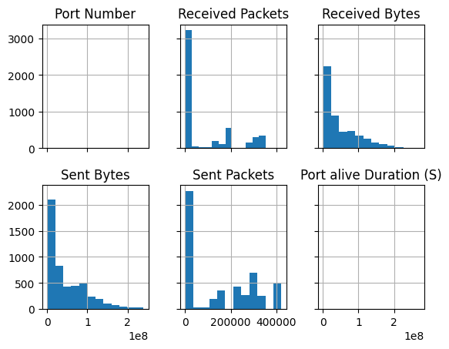
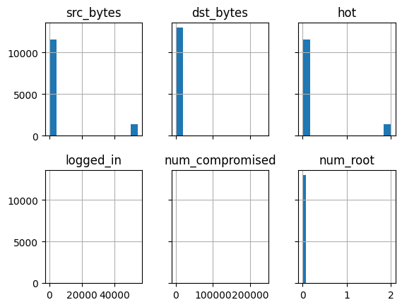
Histogram
Intrusion
Attack

Slide 7
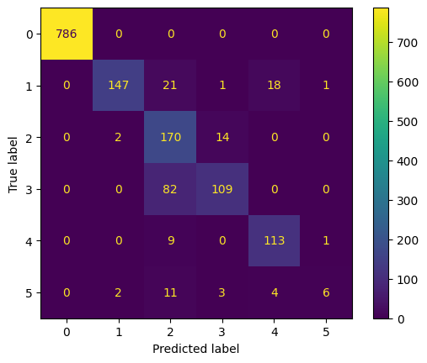

Model Training – Intrusion Prediction
Model | Metric | Score
Logistic Regression | Accuracy, precision, recall, f1 score | 87%
Decision Tree | Accuracy, precision, recall, f1 score | 92%
Confusion Matrix- Logistic Regression
Confusion Matrix- Decision Tree

Slide 8
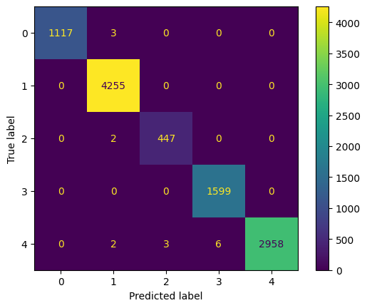
Model Training – Attack Prediction
Model | Metric | Score
Decision Tree | Accuracy F1 score Recall | 99.9%
Logistic Regression | Accuracy Recall F1 score | 99.7%
K-Neighbors | Accuracy Recall F1 score | 99.4%
Ensemble Blending | Accuracy Recall F1 score | 99.7%
Stacking | Accuracy Recall F1 score | 99.8%

Slide 9
Analysis – Attack Prediction
Target Class Imbalance - If one class dominates the data, the model may become biased towards it.
Checked for Multicollinearity - Dropped columns which were highly collinear.
Label Encoding instead of One Hot Encoding (drop=‘first’) on the object data type columns.
Train Test Split 80%-20%, 90%-10%

